Slide 1



Principles of Management & Communication
MCA 1 Semester
Ms. Ankita Sharma
ASSISTANT PROFESSOR
KIET SCHOOL OF MANAGEMENT

Slide 2

DR. A.P.J. ABDUL KALAM TECHNICAL UTTAR PRADESH, UNIVERSITY, LUCKNOW
EVALUATION SCHEME
SEMESTER-I
S.No . | Subject Code | Subject Name | Periods |  |  | Sessional |  |  | ESE | Total | Credit
 |  |  | L | T | P | CT | TA | Total
1. | KCA103 | Principles of Management & Communication | 3 | 0 | 0 | 30 | 20 | 50 | 100 | 150 | 3
CT: Class Test TA: Teacher Assessment L/T/P: Lecture/ Tutorial/ Practical

Slide 3
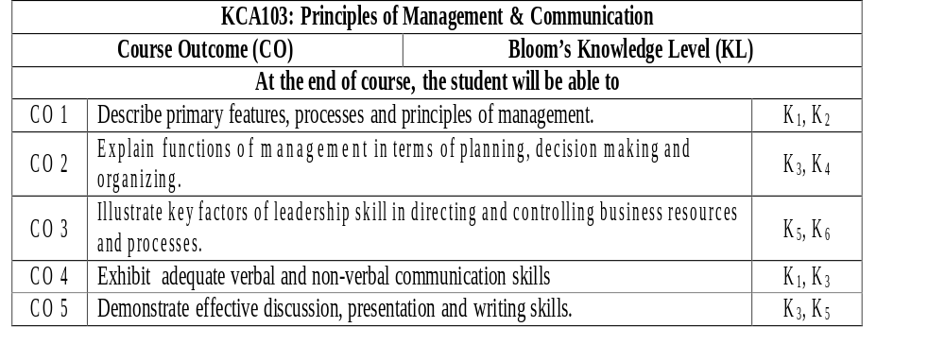
COURSE OBJECTIVES

Slide 4
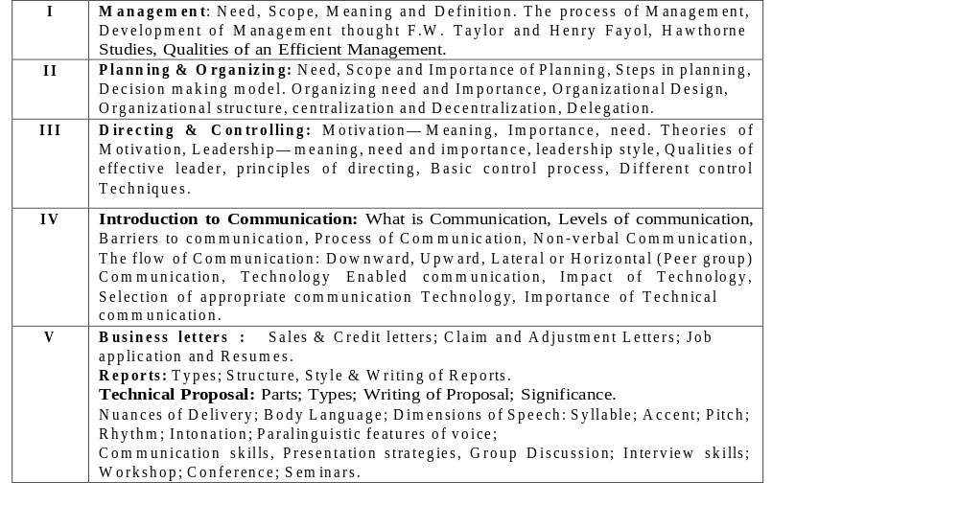
SYLLABUS

Slide 5
UNIT 1
Management: Need, Scope, Meaning and Definition. The process of Management, Development of Management thought F.W. Taylor and Henry Fayol, Hawthorne Studies, Qualities of an Efficient Management.

Slide 6
INTRODUCTION
Management : On expanding : Manage – men – tactfully
At any time of our lives we are members of one organization or another e.g. Church, School, College, Workplace etc. The organizations we belong to are diverse in many aspects for example size, structure, membership and ownership.
However these organizations all have certain things in common. These include:
A goal or purpose
Program or method for achieving the goals.
Plans to ensure effectiveness of the goals.
Leaders/Managers who are responsible for helping the organization to achieve its goals.
So the study of management involves the study of the work and performance of managers i.e. how organizations are managed so that they can achieve their goals.

Slide 7
DEFINING MANAGEMENT
By Mary Parker Follet: "the art of getting things done through people“
Management has also been defined as the process of planning, organizing, leading and controlling the efforts of organizational members and using all other resources to achieve stated organizational goals.
It is a process of grouping together organizational material and human resource activities and directing them to use the scarce resources efficiently and effectively in order to achieve the organizational and individual goals and objectives

Slide 8
NATURE OF MANAGEMENT
UNIVERSAL PROCESS: Applicable in all types of organisations-(govt, business, schools, hospitals, military and at all levels).
PURPOSEFUL: to achieve specific goals / objectives.
CREATIVE: optimum utilisation of resources through efficiency to achieve objectives.
INTEGRATIVE: to unify individuals into teams to achieve individual & organisational goals.
CONTINUOS PROCESS: always on-going.
SOCIAL PROCESS: it is by the people, through the people & for the people.
contd…..

Slide 9
NATURE OF MANAGEMENT (CONTD)
INTANGIBLE: Unseen & invisible force but results & actions can be seen.
GROUP PHENOMENON: Group effort to get things done.
BOTH ART & SCIENCE: Application of knowledge & skills based on sound principles to solve problems.

Slide 10
MANAGEMENT FUNCTIONS
a) Planning
Planning involves determining the organizations goals and the best ways of reaching them. Plans permit the organization to obtain and commit the resources required to reach its objectives.
b) Organizing
it is the process of grouping activities and resources in a logical and appropriate fashion. Basically it is creating the organizational chart for a firm. (Determining the structure of the organization - the jobs to be done, who is to do them, how the jobs are to be grouped, how much authority each manager is to have and how many employees each is to supervise).
c) Staffing: Recruitment and selection of Personnel. Right people, at right time, in right quantity

Slide 11
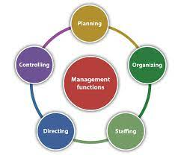
d) Directing:
Giving Directions to all the employees. What, When, Where, and how to perform the task?
e) Controlling
This is the final basic management function and it is the process of monitoring and adjusting organizational activities towards goal attainment. There should not be difference between expected and actual outcome

Slide 12
IMPORTANCE OF MANAGEMENT
Achieving Group Goals:- by arrangement of the factors of production. Integrates, leads and channelises them to desired result.
Optimum Utilisation Of Resources:- of human, physical & financial; eliminating wastage; increasing efficiency;
Reduces Costs:- through better planning & control;
Effective Organisation and Co-ordination:- arranging and integrating the physical and human resources. Coordinates the efforts of employees.
Fulfilling Social Responsibility:- improving standard of living through new products & technologies.

Slide 13
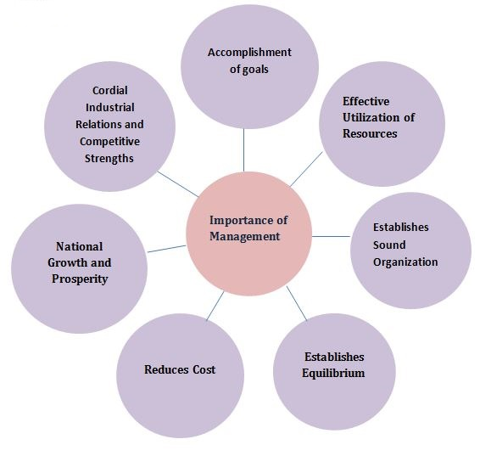

Slide 14


Slide 15
SCOPE OF MANAGEMENT
Financial Management: Financial management includes forecasting, cost control, management accounting, budgetary control, statistical control, financial planning etc.
Human Resource Management: Personnel / Human Resource Management covers the various aspects relating to the employees of the organisation such as recruitment, training, transfers, promotions, retirement, terminations, remuneration, labour welfare and social security, industrial relations etc.
Marketing Management: Marketing management deals with marketing of goods, sales promotion, advertisement and publicity, channels of distribution, market research etc.
Production Management: Production Management includes production planning, quality control and inspection, production techniques etc.

Slide 16
SCOPE OF MANAGEMENT
Material Management: Material management includes purchase of materials, issue of materials, storage of materials, maintenance of records, materials control etc.
Purchasing Management: Purchasing management includes inviting tenders for raw materials, placing orders, entering into contracts etc.
Maintenance Management: Maintenance Management relates to the proper care and maintenance of the buildings, plant and machinery etc.
Office Management: Office management is concerned with office layout, office staffing and equipment of the office.

Slide 17
MANAGEMENT SCIENCE-ART?
SCIENCE IS ORGANISED KNOWLEDGE WITH:-
  CLEAR CONCEPTS,
  THEORY,
  KNOWLEDGE DEVELOPED FROM HYPOTHESIS,
  EXPERIMENTATION,
  ANALYSIS & RESEARCH
ART – IS APPLYING THE ORGANISED KNOWLEDGE TO:-
  CO-ORDINATE EFFORTS OF PEOPLE,
  ACHIEVE RESULTS,
  CONVERT RESOURCES INTO OUTPUT THROUGH CREATIVITY, &
  USING DIFFERENT APPROACHES AS PER SITUATION.
CONTD…

Slide 18
MANAGEMENT IS SCIENCE
BECAUSE:-
Principles of management have been developed through observation experimentation, analysis & research,.
Management principles have universal application,
Principles are available for every function of management,
Principles of management are flexible,
Management as a social science studies human behaviour. (inter-disciplinary).
CONTD…..

Slide 19
MANAGEMENT IS ART
BECAUSE:-
Process of management involves knowledge, skills and their application,
It seeks to achieve practical results, service etc.,
Through creativity moulds behaviour & attitude of people,
It is a personalized process,
It requires judgement, skills & practice.

Slide 20
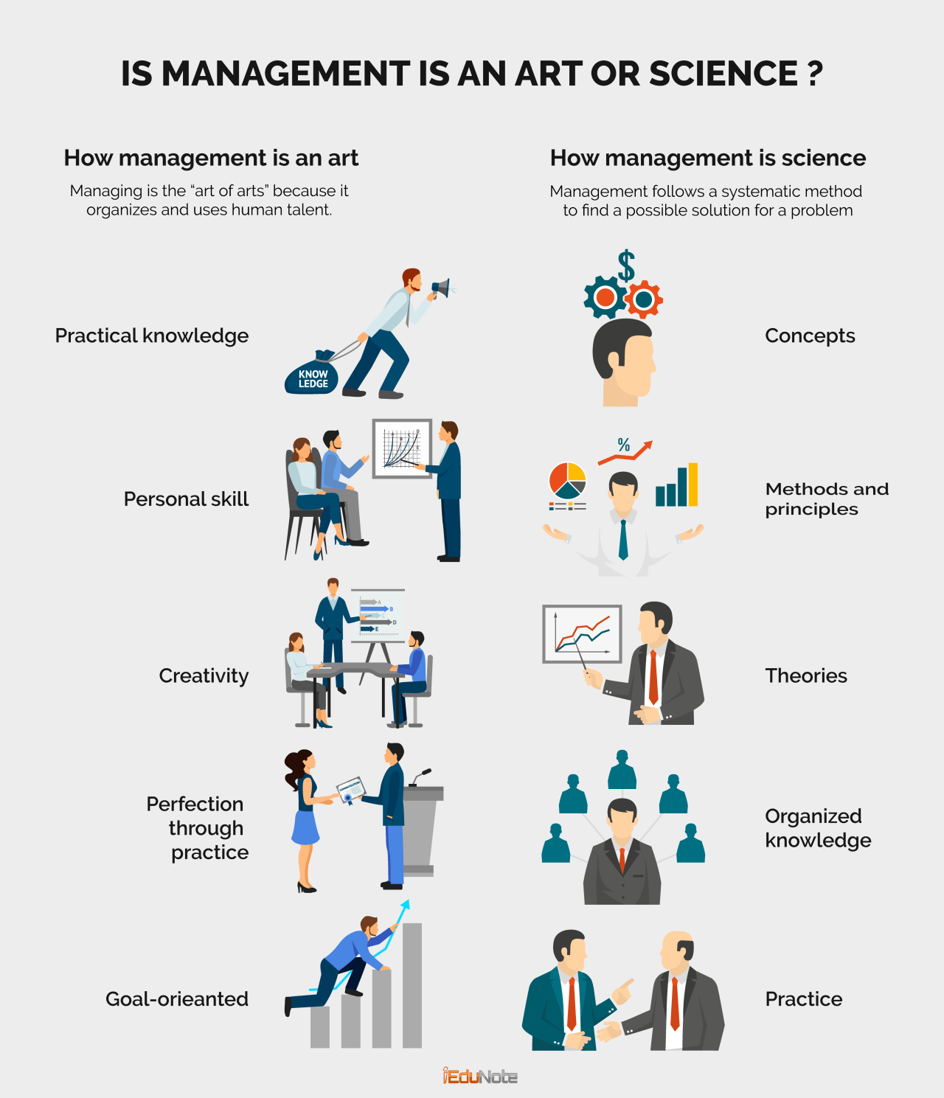

Slide 21
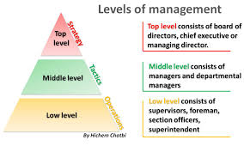

Slide 22
MANAGEMENT LEVELS
a) Low Level Management
Also called first- level or supervisory management. This is the lowest management level in an organization. First line managers only direct operating employees. Examples are Foremen, Office Managers, Supervisors and Department Managers. These managers are the ones in the day-to-day contact with operating employees.
b) Middle Level Management
These make up the largest group of managers in most companies. Their positions extend from top management all the way down to those immediately above first line management. Titles here include Plant Manager, Division Manager and Operations Manager. They are the managers who implement the strategies and policies set by top management and also co-ordinate the work of first-line managers.

Slide 23
c) Top Level Management
Top managers are those at the upper levels of the organization. They comprise of comparatively small groups of executives who are responsible for the overall management of the organization. They set the overall organizational goals and determine strategy and operating policies. Titles here may include President, Chief Executive Officer, Managing Director, General Manager, Chief Secretary etc.

Slide 24

MANAGEMENT SKILLS
Skills is what separates good managers from others. Like a player in any game, the more skilful a manager is, the greater are his chances of success.
Technical Skills
They are the skills needed to perform specialized tasks. They enable one to use the tools, procedures or techniques of a specialized field. These skills are gained through formal training. These skills are specially important for First line managers as they are the ones in the real operations of the firm.

Slide 25
Interpersonal (Human Skills)
These are the skills needed to enable one to work with, understand and motivate others, either as individuals or as groups. They include the ability to understand someone else's position, to present ones own position in a reasonable, amicable manner. The better a manager's human skills are, the more effective he/she is likely to be, since management is basically getting work done through people.

Slide 26
c) Conceptual Skills
These relate to the managers mental ability to coordinate and integrate all the organization's interests and activities i.e. to be able to think in the abstract, to see relationships between forces that others cannot see and to take a global perspective of the organization and its environment. For example if a manager recognizes an opportunity that others have not and then successfully exploits that opportunity he is drawing on conceptual skills. Conceptual skills are most important for top managers who must look for opportunities to be exploited by the organization.
CONCLUSION:
Technical skills deal with jobs; human skills with persons; & conceptual skills with ideas.
These skills are inter-related & are required by managers at all levels.

Slide 27
RELATIVE SKILLS AT DIFFERENT LEVELS
TOP MANAGEMENT | CONCEPTUAL | HUMAN | TECH.
MIDDLE MANAGEMENT | CONCEPTUAL | HUMAN | TECH
FIRST LINE MANAGEMENT | CONCEPTUAL | HUMAN | TECH.

Slide 28
WHO ARE EFFECTIVE MANAGERS
Have vision, think long – term, set direction
Are good communicators and good listeners
Understand operations
Know where to spend time and how to prioritize
Do not resist change
Delegate well
Accept responsibility and admit mistakes

Slide 29
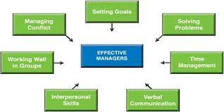

Slide 30


Slide 31
QUALITIES OF A GOOD MANAGER
Education
Training
Leadership
Personality
Ability to do and get work done
Self-confidence
Honesty
Politeness
Technical proficiency
Human touch

Slide 32


Slide 33
EVOLUTION OF MANAGEMENT THOUGHTS
Fayol’s theory of Management
1. Henry Fayol is known as father of General Management/Administrative management. He wrote first book ‘Administration Industrielle General’ which was published in 1916.
He proposed that all operations in a business can be classified into 6 major heads, namely technical (production), commercial (buying and selling), financial (use of capital), security (protection of property), accounting (keeping financial records) and managerial. According to him first five activities are well known, so he concentrated himself on the sixth managerial activity.
Listed planning, organizing, commanding, coordinating and controlling as the main elements of management.
Fayol developed theory of management. He opined that managerial excellence is a technical ability and can be acquired.
4. Proposed 14 principles of management which could be applied universally.

Slide 34
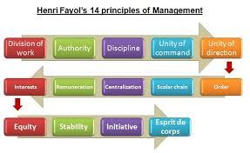

Slide 35
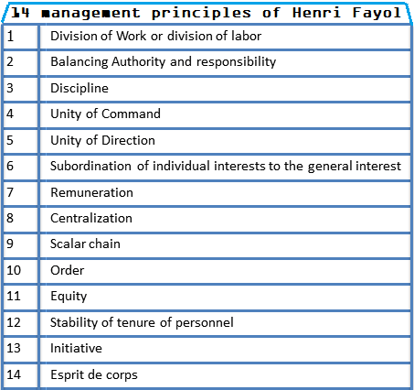

Slide 36
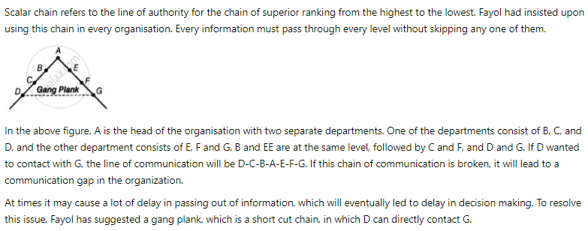
Scalar Chain

Slide 37
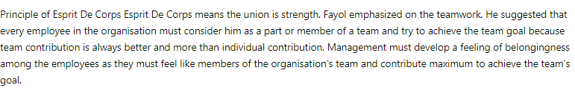
Esprit De crops

Slide 38
Scientific Management Theory
Scientific management is logical approach towards the solution of management problems. The traditional management applied ‘trial and errors method’ in finding correct solution to the management problems. It was an uneconomical approach.
Fedrick W Taylor known as the father of scientific management rested his philosophy on four basic principles.
  The development of a true science of management so that the best method for performing each task could be determined.
  The Scientific selection of workers so that the each workers would be given responsibility for the task for which he or she was best suited.
  The scientific education and development of workers.
  Intimate friendly cooperation between management and labor.

Slide 39
Principles/Assumptions of Scientific Management
Replacing rule of thumb with Science
Harmony in group (co-operation between labour and management)
Division of Responsibility between workers and management
Scientific selection, training and development of workers
Maximum output in place of restricted output
Mental revolution

Slide 40
Technique/Elements of Scientific Management
Work Studies – Methods, motion, time & fatigue
Standardisation – Product, Raw material, Machine, Methods
Functional Foremanship
Differential piece rate system

Slide 41
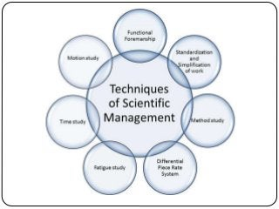

Slide 42
Advantages/Importance of Scientific Management
Reducing cost of production
Effective planning and control
Simplification of productive process
Benefits of standardisation
Increasing profit
Better relation between labour and management

Slide 43
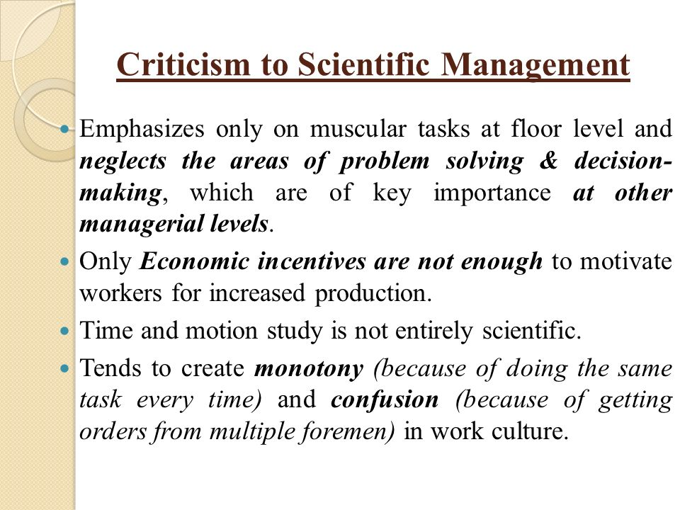

Slide 44
Hawthorne Experiments
The behavioural approach to management was initiated by the famous Hawthorne Experiments.
Conducted at Hawthorne plant of Western Electric Company (USA) having 30000 employees at Chicago.
George Elton Mayo and their team of researchers from the Harvard Business School conducted these experiments.
The Hawthorn Experiments consisted of the following phases:
  Illumination Experiment
  Relay Assembly test Room Experiment
  Bank Wiring Observation Room Study
  Mass Interview Programme

Slide 45
Illumination Experiments:
Illumination experiments were undertaken to find out how varying levels of illumination (amount of light at the workplace, a physical factor) affected the productivity. The hypothesis was that with higher illumination, productivity will increase. In the first series of experiments, a group of workers was chosen and placed in two separate groups. One group was exposed to varying intensities of illumination.
Since this group was subjected to experimental changes, it was termed as experimental group. Another group, called as control group, continued to work under constant intensities of illumination. The researchers found that as they increased the illumination in the experimental group, both groups increased production. When the intensity of illumination decreased, the production continued to increase in both the groups.

Slide 46
Thus, it was concluded that illumination did not have any effect on productivity but something else was interfering with the productivity. At that time, it was concluded that human factor was important in determining productivity but which aspect was affecting, it was not sure. Therefore, another phase of experiments was undertaken.

Slide 47
Relay Assembly Test Room Experiments
Relay assembly test room experiments were designed to determine the effect of changes in various job conditions on group productivity as the illumination experiments could not establish relationship between intensity of illumination and production. For this purpose, the researchers set up a relay assembly test room two girls were chosen.
These girls were asked to choose for more girls as co-workers. The work related to the assembly of telephone relays. Each relay consisted of a number of parts which girls assembled into finished products. Output depended on the speed and continuity with which girls worked. The experiments started with introducing numerous changes in sequence with duration of each change ranging from four to twelve weeks.

Slide 48
An observer was associated with girls to supervise their work. Before each change was introduced, the girls were consulted. They were given opportunity to express their viewpoints and concerns to the supervisor. In some cases, they were allowed to take decisions on matters concerning them.
Following were the changes and resultant outcomes:
The incentive system was changed so that each girl’s extra pay was based on the other five rather than output of larger group, say, 100 workers or so. The productivity increase as compared to before.
Two five- minute rests one in the morning session and other in evening session were introduced which were increased to ten minutes. The productivity increased.
The rest period was reduced to five minutes but frequency was increased. The productivity decreased slightly and the girls complained that frequent rest intervals affected the rhythm of the work.

Slide 49
The number of rest was reduced to two of ten minutes of each, but in the morning, coffee or soup was served along with the sandwich and in the evening, snack was provided. The productivity increased.
Changes in working hours and workday were introduced, such as cutting an hour off the end of the day and eliminating Saturday work. The girls were allowed to leave at 4.30 p.m. instead of usual 5.00 p.m. and later at 4.00 p.m. productivity increased.
As each change was introduced, absenteeism decreased, morale increased, and less supervision was required. It was assumed that these positive factors were there because of the various factors being adjusted and making them more positive. At this time, the researchers decided to revert back to original position, that is, no rest and other benefits. Surprisingly, productivity increased further instead of going down.

Slide 50
This development caused a considerable amount of redirection in thinking and the result implied that productivity increased not because of positive changes in physical factors but because of the change in girls’ attitudes towards work and their work group.
They developed a feeling of stability and a sense of belongings. Since there was more freedom of work, they developed a sense of responsibility and self-discipline. The relationship between supervisor and workers became close and friendly

Slide 51
Mass Interviewing Programme
During the course of experiments, about 20,000 interviews were conducted between 1928 and 1930 to determine employees’ attitudes towards company, supervision, insurance plans, promotion and wages.
It was found that the opportunity to talk freely about things that are important to workers, has a positive effect on their morale and productivity.

Slide 52
Bank Wiring Observation Room Experiment
These experiments were conducted to find out the impact of small groups on the individuals. In this experiment, a group of 14 male workers were formed into a small work group. The men were engaged in the assembly of terminal banks for the use in telephone exchanges.
The work involved attaching wire with switches for certain equipment used in telephone exchanges. Hourly wage for each worker was fixed on the basis of average output of each worker. Bonus as also payable on the basis of group effort.
It was expected that highly efficient workers would bring pressure on less efficient workers to increase output and take advantage of group incentive plan. However, the strategy did not work and workers established their own standard of output and this was enforced vigorously by various methods of social pressure. The workers cited various reasons for this behaviour viz. fear of unemployment, fear of increase in output, desire to protect slow workers etc.

Slide 53
The Hawthorne experiments clearly showed that a man at work is motivated by more than the satisfaction of economic needs. Management should recognize that people are essentially social beings and not merely economic beings. As a social being, they are members of a group and the management should try to understand group attitudes and group psychology.

Slide 54
Findings of Hawthorne studies
Social Unit: A factory is not only a techno-economic unit, but also a social unit. Men are social beings. This social characteristic at work plays an important role in motivating people. The output increased in Relay Room due to effectively functioning of a social group with a warm relationship with its supervisors.
Group Influence: The workers in a group develop a common psychological bond uniting them as a group in the form of informal organisation. Their behaviour is influenced by these groups. Pressure of a group, rather than management demands, frequently has the strongest influence on how productive workers would be.
Motivation: Human and social motivation can play even a greater role than mere monitory incentives in moving or motivating and managing employee group.

Slide 55
Supervision: The style of supervision affects worker’s attitude to work and his productivity. A supervisor who is friendly with his workers and takes interest in their social problems can get co-operation and better results from the subordinates.
Working Conditions: Productivity increases as a result of improved working conditions in the organisation.
Employee Morale: Mayo pointed out that workers were not simply cogs, in the machinery, instead the employee morale (both individual and in groups) can have profound effects on productivity
Communication: Experiments have shown that the output increases when workers are explained the logic behind various decisions and their participation in decision making brings better results.

