Slide 1



Principles of Management & Communication
MCA 1 Semester
Ms. Ankita Sharma
ASSISTANT PROFESSOR
KIET SCHOOL OF MANAGEMENT

Slide 2
Unit 2
Planning & Organizing:
Need, Scope and Importance of Planning, Steps in planning,
Decision making model.
Organizing need and Importance, Organizational Design, Organizational structure, centralization and Decentralization, Delegation.

Slide 3

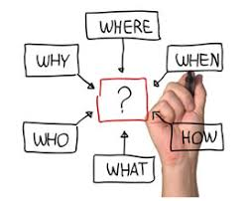

Slide 4
INRODUCTION
Planning is the basic process by which we select our goals and determine how to achieve them.
Planning means looking ahead. It is deciding in advance what is to be done.
Koontz says that planning involves selection from among alternatives future courses of action for the firm as a whole and for every department or section within it.
So when planning managers select organizational objectives and departmental goals and determine ways of achieving them. It thus provides a rational approach to pre-selected objectives.
It will therefore involve:
selecting what objectives are to be achieved
deciding the actions to be taken assigned these activities
deciding who will be responsible for the action to achieve them

Slide 5
Deciding the organizational position to planning can be looked at, therefore, as the process of developing plans.
A plan is a blue print or framework used to describe how the organization expects to achieve its goals.
Planning then is simply the process of determining which path among several the organization wishes to follow. When you plan you map out a course of action in advance.
Any goal might be approached in several different ways. Planning is the process of determining which is the best way to approach a particular goal.
According to Louis A Allen - "Management planning involves the development of forecasts, objectives, policies, programmes, procedures, schedules and budgets".

Slide 6
IMPORTANCE OF PLANNING
  The purpose of every plan and of all derivative plans is to facilitate the accomplishment of enterprise purpose and objectives.
  Gives direction to the activities of the organization. Without plans people would not know what is to be expected of them.
  Facilitates control. The plans act as standards against which performance can be measured and evaluated. Deviations from plans help to point out weaknesses in the organizational process.
  Since managerial operations in organizing, leading and controlling are designed to support the accomplishment of enterprise objectives, planning logically precedes the execution of all other management functions.
To offset uncertainty and change: Future is always full of uncertainties and changes. Planning foresees the future and makes the necessary provisions for it.

Slide 7
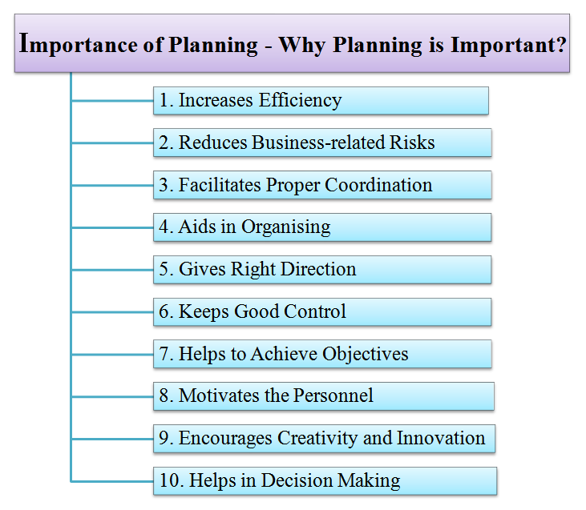

Slide 8
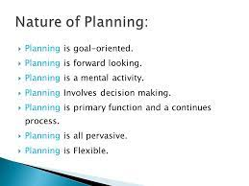

Slide 9
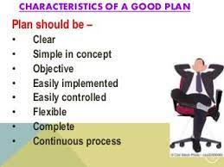

Slide 10
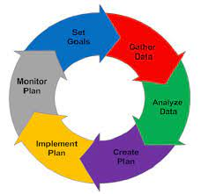
PLANNING PROCESS
Identifications and recognition of the problem
Collection and analysing information
Defining organizational objectives
Determining planning premises
Examining alternative courses of action and selecting the appropriate course
Determining or formulating secondary or derivative plans
Budgeting implementation of plans requires finance
Providing for future evaluation and follow up

Slide 11
TYPES OF PLAN
BASED ON TIME SPAN
  1. LONG RANGE 2. MEDIUM RANGE 3. SHORT RANGE
BASED ON NATURE OF PLANS
1. STRATEGIC 2. TACTICAL 3. OPERATIONAL
LONG RANGE PLAN (5 TO 20 YEARS)
Is Prepared by Top Management, To set Long Term Goals for Guiding Future Efforts;
Is Needed because of Growing Competition, Accelerated Obsolescence & Increased Specialisation;&
Involves Changes in Organization's Resources.

Slide 12
MEDIUM RANGE PLAN: (1 TO 5 YEARS)
Prepared by Middle Level Management;
Specific activities required to achieve goals are developed;&
Has Fixed Structure to use Available Resources
SHORT RANGE PLAN :(UPTO 1 YEAR)
Prepared by First Level Management;
Normally Divided into 4 Quarters of The Year with Specific Targets.

Slide 13
On the basis of scope of planning, there can be the following types of planning:
Strategic Plans: Which are the broad plans developed by top managers to guide the general direction of the firm. They follow from the major goals of the firm and indicate what business the firm is in or what business it intends to be. Strategic plans therefore indicate how or where the firm will position itself within its environment
Tactical Plans: These have a moderate scope and intermediate time frame. They are concerned with how to implement the strategic plans that are already developed. They deal with specific resources and time constraints. They mainly focus on people and action. Tactical planning is mainly associated with middle management.
3.Operational Plans: They have the narrowest focus and shortest time frame.
They fall into many types that include:
· Standing Plans: Plans developed to handle recurring and relatively routine situations. They include policies which are general guidelines governing relatively important actions within the organization.
· Single Use Plans: This is the second category of operational plans. These are plans set up to handle events that happen only once. E.g. any one time programs and any project.

Slide 14
DECISION MAKING
The word decision has been derived from the Latin word "decidere" which means "cutting off".
Thus, decision involves cutting off of alternatives between those that are desirable and those that are not desirable. Decision is a kind of choice of a desirable alternative.
In the words of Ray A Killian, "A decision in its simplest form is a selection of alternatives".
Dr. T. G Glover defines decision "as a choice of calculated alternatives based on judgement".
In the words of George R. Terry, "Decision-making is the selection based on some criteria from two or more possible alternatives".

Slide 15
Felix M. Lopez says that "A decision represents a judgement; a final resolution of a conflict of needs, means or goals; and a commitment to action made in face of uncertainty, complexity and even irrationally".
According to Rustom S. Davar, "Decision-making may be defined as the selection based on some criteria of one behaviour alternative from two or more possible alternatives. To decide means to cut off or in practical content to come to a conclusion".
From the above definitions, we can conclude that, Decision Making involves the process of establishing goals, tasks and searching for alternatives for a decision problem.

Slide 16
CHARACTERISTICS OF DECISION MAKING
The decision-maker has freedom to choose an alternative.
Decision-making may not be completely rational but may be judgemental and emotional.
Decision-making is goal-oriented.
Choosing from among the alternative courses of operation implies uncertainty about the final result of each possible course of operation.
Decision making is rational. It is taken only after a thorough analysis and reasoning and weighing the consequences of the various alternatives.

Slide 17
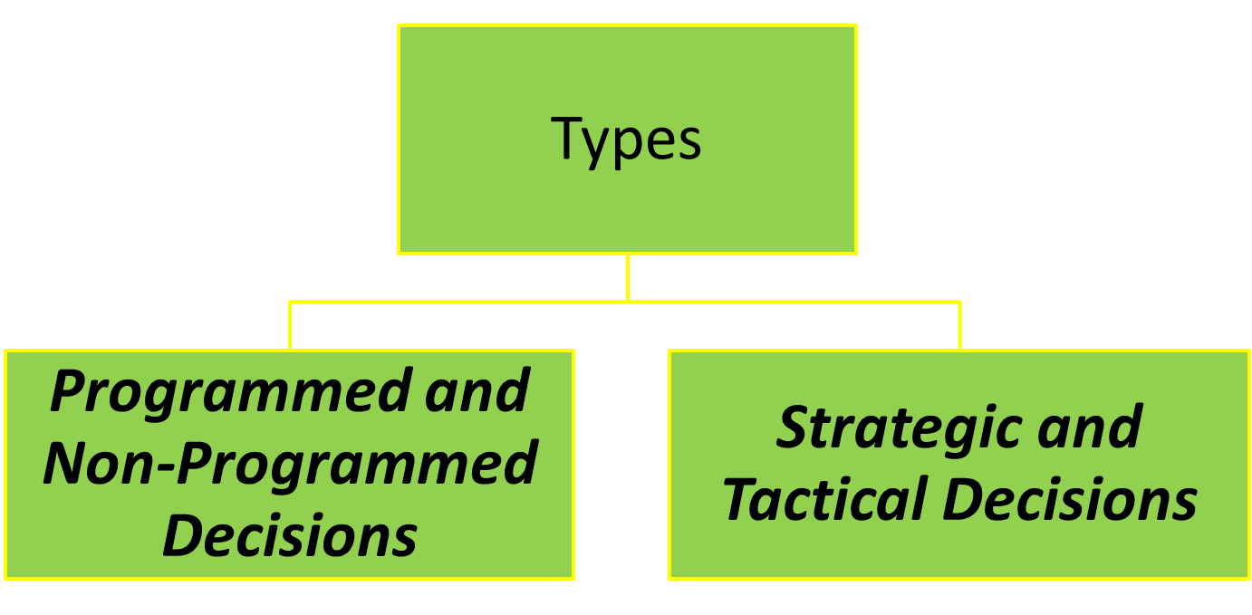
TYPES OF DECISION

Slide 18
1. Programmed and Non-Programmed Decisions
Herbert Simon has grouped organizational decisions into two categories based on the procedure followed. They are:
Programmed decisions: Programmed decisions are routine and repetitive and are made within the framework of organizational policies and rules. These policies and rules are established well in advance to solve recurring problems in the organization. Programmed decisions have short-run impact. They are, generally, taken at the lower level of management.
Non-Programmed Decisions: Non-programmed decisions are decisions taken to meet non-repetitive problems. Non-programmed decisions are relevant for solving unique/ unusual problems in which various alternatives cannot be decided in advance. A common feature of non-programmed decisions is that they are non-recurring and therefore, readymade solutions are not available. Since these decisions are of high importance and have long-term consequences, they are made by top level management.

Slide 19
2. Strategic and Tactical Decisions
Organizational decisions may also be classified as strategic or tactical.
Strategic Decisions: Basic decisions or strategic decisions are decisions which are of crucial importance.
Strategic decisions a major choice of actions concerning allocation of resources and contribution to the achievement of organizational objectives.
Decisions like plant location, product diversification, entering into new markets, selection of channels of distribution, capital expenditure etc are examples of basic or strategic decisions.

Slide 20
b) Tactical Decisions: Routine decisions or tactical decisions are decisions which are routine and repetitive. They are derived out of strategic decisions. The various features of a tactical decision are as follows:
Tactical decision relates to day-to-day operation of the organization and has to be taken very frequently.
The outcome of tactical decision is of short-term nature and affects a narrow part of the organization.
The authority for making tactical decisions can be delegated to lower level managers because, first, the impact of tactical decision is narrow and of short-term nature and Second, by delegating authority for such decisions to lower-level managers, higher level managers are free to devote more time on strategic decisions.

Slide 21
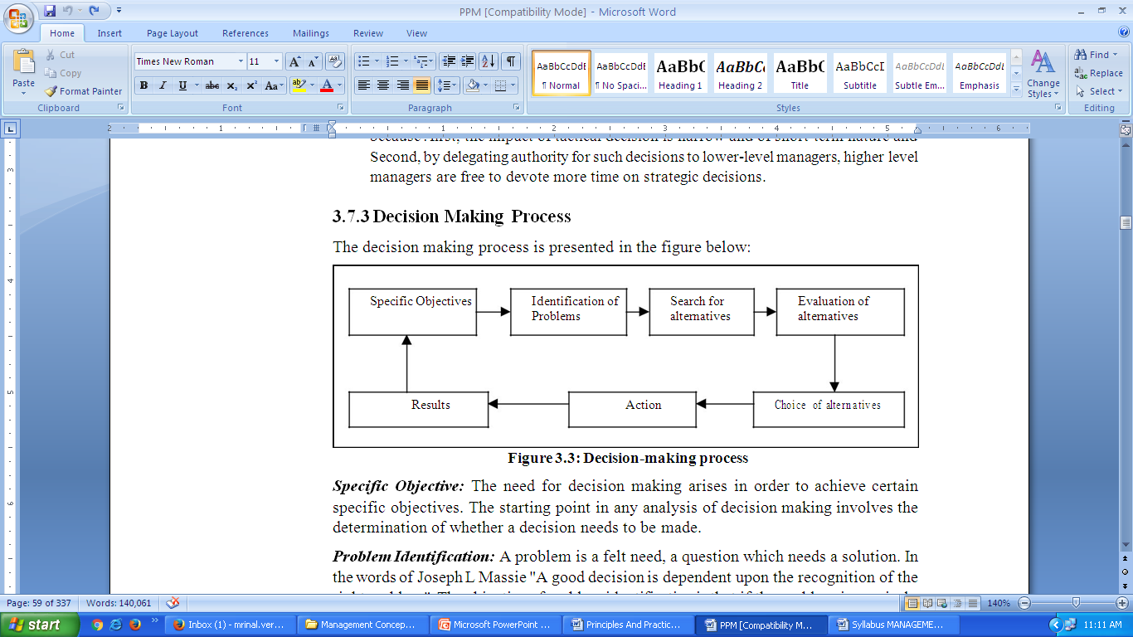
DECISION MAKING PROCESS

Slide 22
DECISION MAKING PROCESS
Specific Objective: The need for decision making arises in order to achieve certain specific objectives. The starting point in any analysis of decision making involves the determination of whether a decision needs to be made.
Problem Identification: A problem is a felt need, a question which needs a solution. In the words of Joseph L Massie "A good decision is dependent upon the recognition of the right problem". The objective of problem identification is that if the problem is precisely and specifically identifies, it will provide a clue in finding a possible solution. A problem can be identified clearly, if managers go through diagnosis and analysis of the problem.

Slide 23
3. Search for Alternatives: A problem can be solved in several ways; however, all the ways cannot be equally satisfying. Therefore, the decision maker must try to find out the various alternatives available in order to get the most satisfactory result of a decision.
A decision maker can use several sources for identifying alternatives:
  His own past experiences
  Practices followed by others and
  Using creative techniques.
  4. Evaluation of Alternatives: The decision maker must check proposed alternatives against limits, and if an alternative does not meet them, he can discard it. Having narrowed down the alternatives which require serious consideration, the decision maker will go for evaluating how each alternative may contribute towards the objective supposed to be achieved by implementing the decision.

Slide 24
5. Choice of Alternative: The evaluation of various alternatives presents a clear picture as to how each one of them contribute to the objectives under question. A comparison is made among the likely outcomes of various alternatives and the best one is chosen.
6. Action: Once the alternative is selected, it is put into action. The actual process of decision making ends with the choice of an alternative through which the objectives can be achieved.
7. Results: When the decision is put into action, it brings certain results. These results must correspond with objectives, the starting point of decision process, if good decision has been made and implemented properly. Thus, results provide indication whether decision making and its implementation is proper.

Slide 25
DECISION MAKING MODELS
1. Rational Model
2. Bounded Rationality Model
3. Intuitive
4. Creative

Slide 26
Rational Model
The rational decision-making model describes a series of steps that decision makers should consider if their goal is to maximize the quality of their outcomes. In other words, if you want to make sure you make the best choice, going through the formal steps of the rational decision-making model may make sense.

Slide 27
Bounded rationality model
The bounded rationality model of decision making recognizes the limitations of our decision-making processes. According to this model, individuals knowingly limit their options to a manageable set and choose the best alternative without conducting an exhaustive search for alternatives. An important part of the bounded rationality approach is the tendency to satisfice, which refers to accepting the first alternative that meets your minimum criteria.
For example, many college graduates do not conduct a national or international search for potential job openings; instead, they focus their search on a limited geographic area and tend to accept the first offer in their chosen area, even if it may not be the ideal job situation.

Slide 28
Intuitive decision-making model
The intuitive decision-making model has emerged as an important decision-making model. It refers to arriving at decisions without conscious reasoning. Eighty-nine percent of managers surveyed admitted to using intuition to make decisions at least sometimes, and 59% said they used intuition often (Burke & Miller, 1999). When we recognize that managers often need to make decisions under challenging circumstances with time pressures, constraints, a great deal of uncertainty, highly visible and high-stakes outcomes, and within changing conditions, it makes sense that they would not have the time to formally work through all the steps of the rational decision-making model.
The intuitive decision-making model argues that, in a given situation, experts making decisions scan the environment for cues to recognize patterns (Breen, 2000; Klein, 2003; Salas & Klein, 2001). Once a pattern is recognized, they can play a potential course of action through to its outcome based on their prior experience.

Slide 29
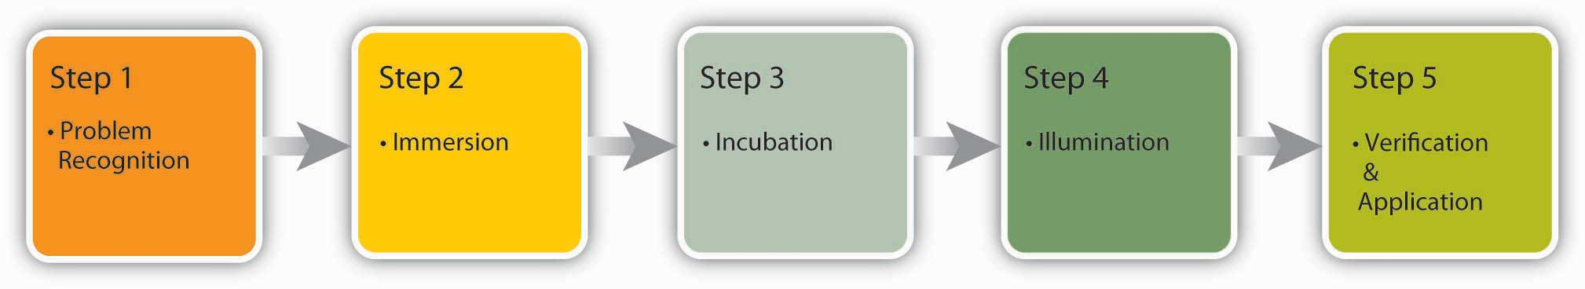
Creative Model
Creativity is the generation of new, imaginative ideas. With the flattening of organizations and intense competition among organizations, individuals and organizations are driven to be creative in decisions ranging from cutting costs to creating new ways of doing business.

Slide 30
The five steps to creative decision making are similar to the previous decision-making models in some keys ways. All of the models include problem identification, which is the step in which the need for problem solving becomes apparent. If you do not recognize that you have a problem, it is impossible to solve it.
Immersion is the step in which the decision maker thinks about the problem consciously and gathers information. A key to success in creative decision making is having or acquiring expertise in the area being studied.
Then, incubation occurs. During incubation, the individual sets the problem aside and does not think about it for a while. At this time, the brain is actually working on the problem unconsciously.
Then comes illumination or the insight moment, when the solution to the problem becomes apparent to the person, usually when it is least expected. This is the “eureka” moment similar to what happened to the ancient Greek inventor Archimedes, who found a solution to the problem he was working on while he was taking a bath.
Finally, the verification and application stage happens when the decision maker consciously verifies the feasibility of the solution and implements the decision.

Slide 31
