Slide 1
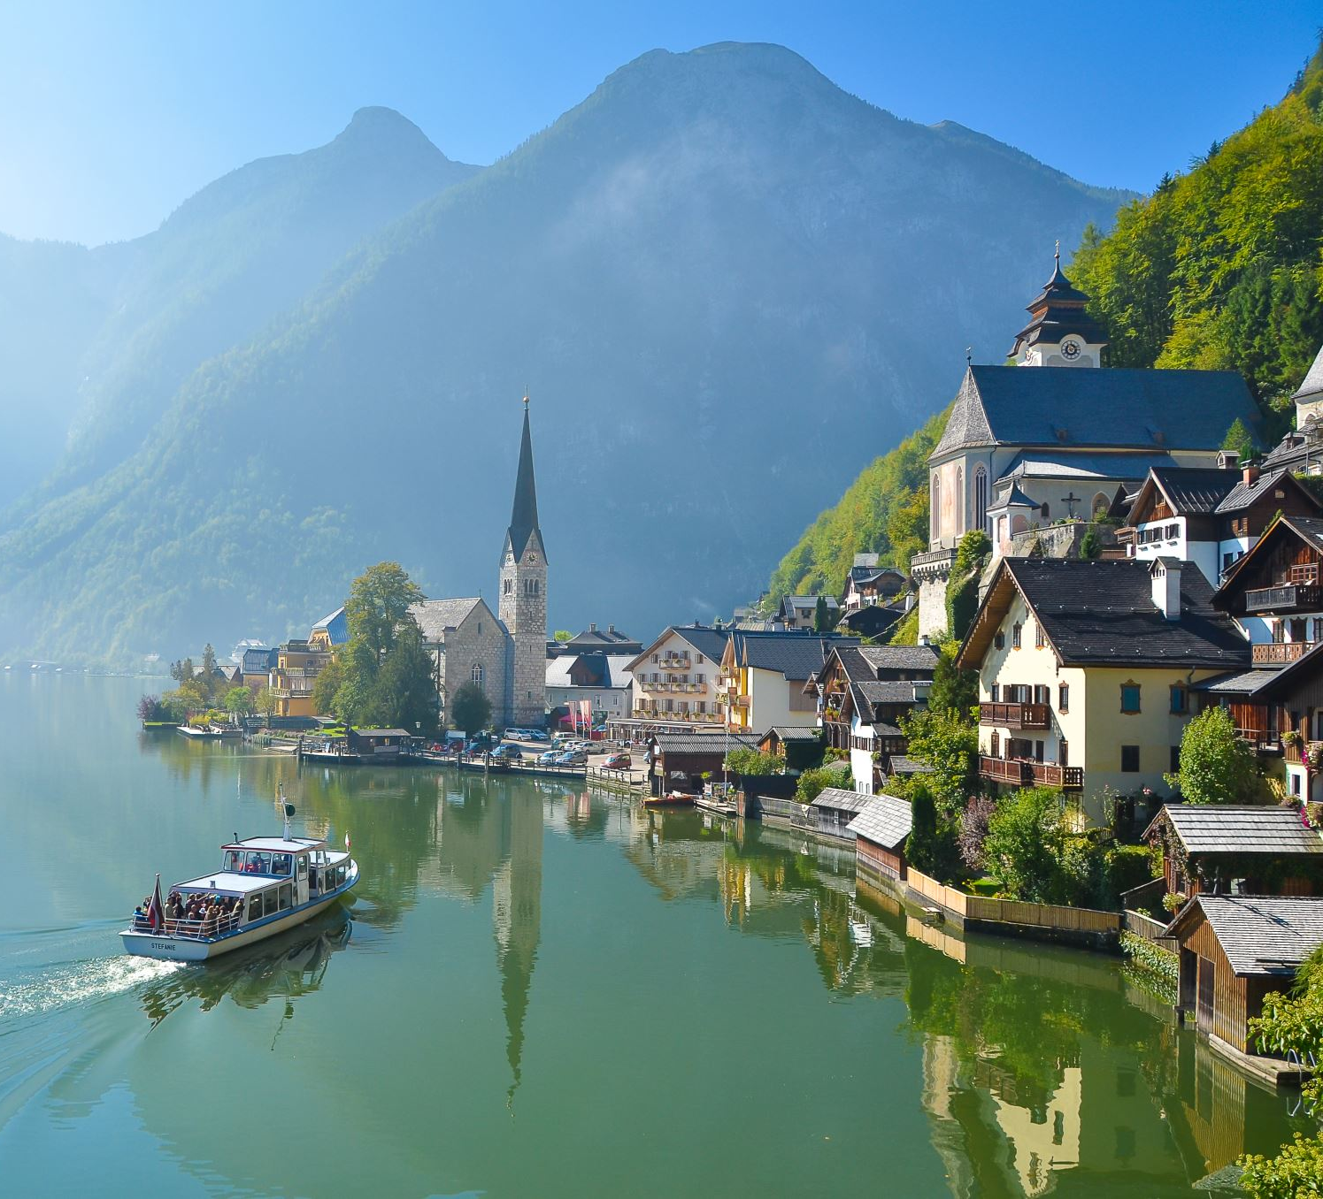
Travel Experts
Cole, John, Mike, Sumit
15 August 2019

