Slide 1
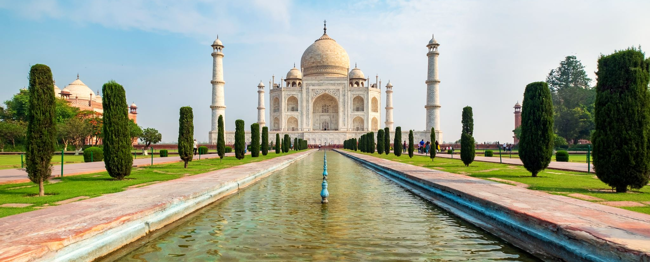
Travel Experts
We are here to get you there.

Slide 2
Overview
Upgrade hardware
Migrate database
Enhance agent and customer experience
This project will increase growth and help expand Travel Expert’s market

Slide 3
Scope
Research existing travel agency products and services
Talk to employees
Developers plan, create and test software and databases
Plan and price hardware purchases
Review and deploy font and back end software

Slide 4
Cost and Timeline
Under $250,000
3 months

Slide 5
Our company has very talented people who have a passion for progress and creativity.

