Slide 1

Developing In Docker
Mark Buckler
September 8, 2017

Slide 3
Motivation
Modern code is heavily dependent on packages/libraries
Installing dependencies can be time consuming, especially if installation instructions are incomplete or wrong
Multiple dependency versions can be cumbersome
Bit rot can break make environments
Summary:
Huge headache for people reproducing research as well as general users and developers

Slide 4
The Solution = Docker
Users/co-developers can run your code without needing to install dependencies on their machine
Users/co-developers can maintain multiple dependency versions on a server without conflicts
Environments can be “pulled” as simply as cloning from a GitHub repository, and therefore can easily be moved between multiple machines

Slide 5
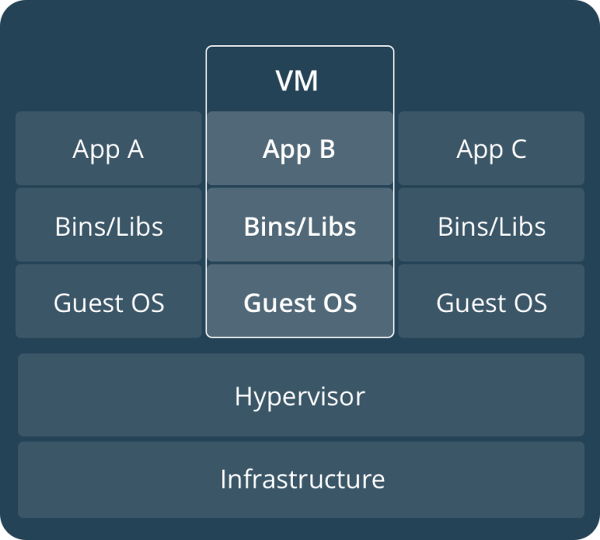
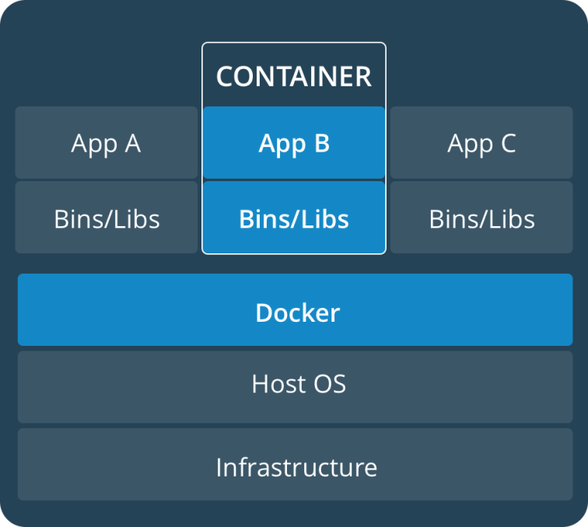
What is Docker?

Slide 6
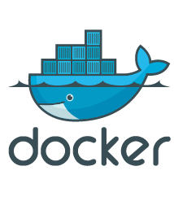

How Do I Use It?
Dockerfile
Docker Hub
Docker Image
pull
build
push
run
Docker Container
Development or Deployment Environment

Slide 7
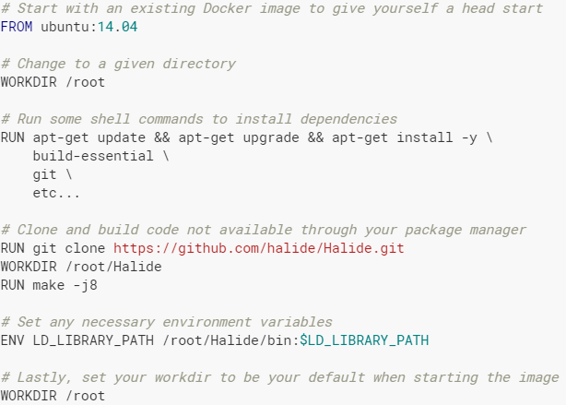
Writing a Dockerfile

Slide 8
Running a Docker Container: Volumes
docker pull mbuckler/approx-vision
docker run \
-v <path to datasets>:/datasets \
-v <path to approx-vision>:/approx-vision \
-it mbuckler/approx-vision \
/bin/bash

Slide 9
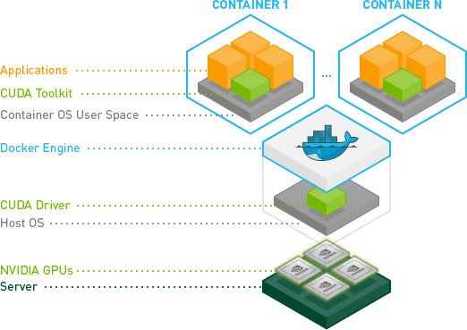
What About GPU Use?
NVIDIA Docker

Slide 10


What About X Windows (GUIs)?
Include the X packages in your Docker image
Set the path to your .Xauthority file (and make if no ssh)
Use host’s networking stack & connect your displace and Xauthority environment file when you run the container

Slide 11
Docker Downsides
Storing many Docker images can fill up disk space
Docker users have sudo privilege on the local machine when running containers. Two options:
Require that docker users run containers by invoking sudo
Use docker group - Users have sudo privileges in container, not out

Slide 12
Conclusion
Docker is very useful!
I use it every day in my research
Highly recommended for people who…
Want their code to be easy to run (Docker for brg/pymtl?)
Need to install many diverse sets of dependencies (deep learning)
These instructions will be on the CSL wiki and my website
www.markbuckler.com/post/docker-use/

