Slide 1

Patenting in Academia and Industry
Mark Buckler
March 4, 2018
Notes:
Criticality to be defined

Slide 3
Why do we do research?
Many possible reasons…
To altruistically expand human knowledge
To support engineering industry
To solve interesting puzzles
As an excuse to travel to exotic conference destinations
Always thought our name would sound cool with “Dr” in front

Slide 4
Why do we do research?
Many possible reasons…
To altruistically expand human knowledge
To support engineering industry $$$
To solve interesting puzzles
As an excuse to travel to exotic conference destinations
Always thought our name would sound cool with “Dr” in front

Slide 5
How to make money from ideas
Useful but intangible ideas are “Intellectual Property” (IP)
Trademark – recognizable sign, design, or expression
Trade secret – secret information which gives economic advantage over competitors or customers
Copywrite – exclusive rights to an “original work of authorship”
Patent – exclusive rights to a solution to a specific technological problem

Slide 6
What is a Patent, and how do we make money?
A patent on a specific invention gives exclusive usage rights of that idea to whoever holds the patent.
Inventor(s): Person or people who conceived of the patented invention
Assignee: Person or company who owns the patent
You can make money by…
Making and selling products or services with the patented invention
Selling the patent to another organization
Licensing out the patent in exchange for a percentage of sales
Suing for the profits made by an organization who used the patented invention without your permission

Slide 7
What can be patented?
A patentable idea must have all of the following properties:
Non-abstract
Man-made
Novel
Non-obvious
Useful

Slide 8
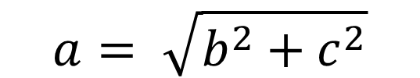
What can be patented?
A patentable idea must have all of the following properties:
Non-abstract
Man-made
Novel
Non-obvious
Useful
$$a= \sqrt{b^{2}+c^{2}}$$

Slide 9

What can be patented?
A patentable idea must have all of the following properties:
Non-abstract
Man-made
Novel
Non-obvious
Useful

Slide 10
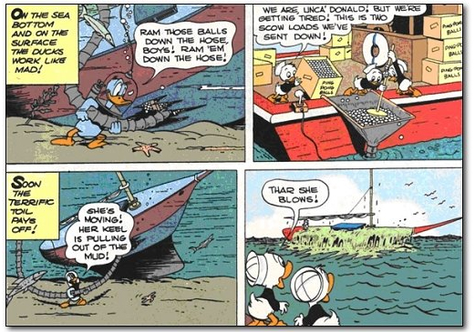
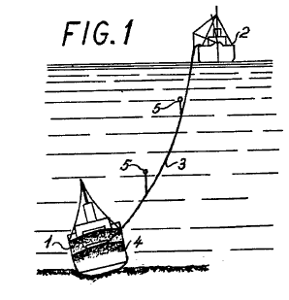
What can be patented?
A patentable idea must have all of the following properties:
Non-abstract
Man-made
Novel
Non-obvious
Useful
Notes:
https://www.greyb.com/4-cases-examiner-found-ridiculously-awesome-prior-art/

Slide 11
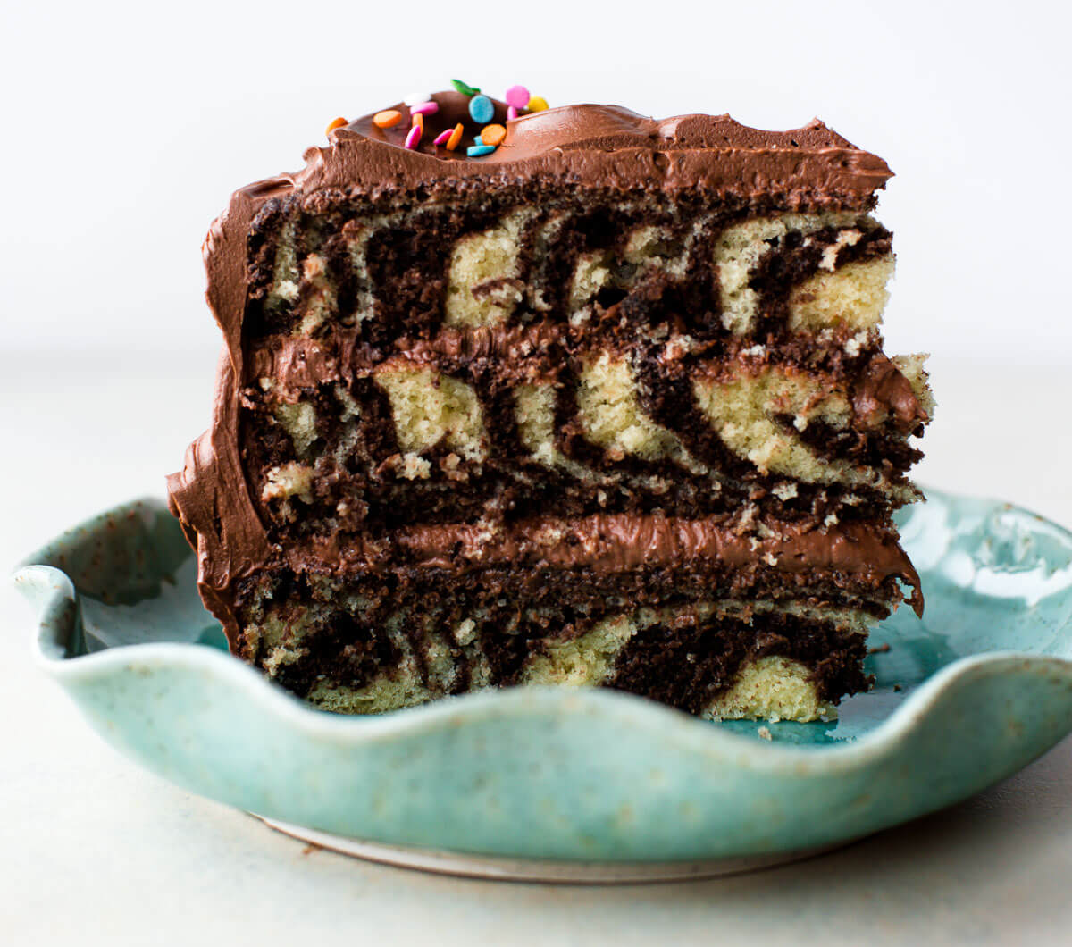
What can be patented?
A patentable idea must have all of the following properties:
Non-abstract
Man-made
Novel
Non-obvious
Useful

Slide 12
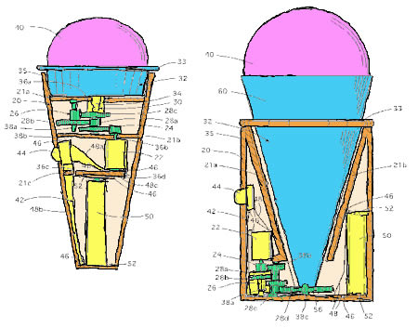
What can be patented?
A patentable idea must have all of the following properties:
Non-abstract
Man-made
Novel
Non-obvious
Useful

Slide 13
If I don’t own the patent, why bother?
In either a company or a university, they NEED you
Industry
Patents can be a replacement for publishing (useful for visa)
Cash bonuses for having an IDF approved and eventual issued patent
Academia
Possible influence over who uses the patent
Personal share of licensing fees
Cornell: 1/3 Inventor(s), 1/3 CTL, 1/3 Department

Slide 14
Should I file a provisional application?
Provisional applications are inexpensive, free-form, and last for a year
Personal:
If you aren’t under a Confidential Information and Inventions Assignment Agreement (CIIAA) then its probably worth it!
In an organization:
Gets the filing date started before making claims

Slide 15
When should I file?
ASAP! A good choice is right after conference submission
The US
A “first-inventor-to-file” country as of 2013
One year grace period after publishing
Other countries
No such thing as an international patent (IPCU)
Some are “first-to-invent” and others “first-to-file”
Most others have no grace period

Slide 16
Ok you want to file. Now what?
The Invention Disclosure Form (IDF)
Who are the inventors?
What problem does the invention solve?
What prior art are you aware of?
What competitors are you aware of?
What are the unique features of the invention?
How does the invention work?
Are there any alternative versions of the invention?
How could the invention be used?
How can the use of this invention be detected?
Who might want to purchase or license the potential patent?

Slide 17
Who are the inventors?
Author: Person who made important contributions (building prototypes, testing, writing)
Inventor: Person who conceives of an original, useful, and non-obvious idea
Use best judgement to consider if any of your collaborators co-conceived the idea with you
Be careful! Patents have been invalidated before for incorrect inventor lists.

Slide 18
What problem does the invention solve?
Think about this like the Motivation + Background sections of a paper
Background: Set the stage. What is the state of your field like?
Motivation: Why was the invention created? Why are people worse off without your invention?

Slide 19
What prior art are you aware of?
Think about this like the Related Work section of a paper
Prior art includes any patents, papers, documentation, or other published information

Slide 20
What competitors are you aware of?
Who else (people, research groups, companies, universities) is working on the same problems that you are?
What competing inventions or full products are you aware of?
What flaws do these competitors have that necessitate a better solution?

Slide 21
What are the unique features of the invention?
Think about this like the Contributions section of a paper
This is where you put the big sales pitch for your invention. Stress why your differences represent a competitive advantage

Slide 22
What are the unique features of the invention?
Think about this like the Contributions section of a paper
This is where you put the big sales pitch for your invention. Stress why your differences represent a competitive advantage

Slide 23
How does the invention work?
The most complex section of the IDF… Try to focus on clarity for a non-expert reader
Use pictures whenever possible
Consider adding in a jargon glossary

Slide 24
Are there any alternative versions?
Your prototype represents only one possible choice for each design decision
Explain the entire design space to ensure broad claims
Include versions which you consider inferior!

Slide 25
How can the use of this invention be detected?
Part of a patent’s value is how easy the invention can be detected
Consider general forensic methods in your field
If its too hard to detect use, your organization may prefer to protect your invention as a Trade Secret

Slide 26
Who might want to license the patent?
If you are in a company, this likely won’t even be asked since it is assumed the company will use the patent
Otherwise, consider:
Large companies
Startup companies
Non-practicing entities
If you want to use the patent in a startup of your own, be very clear about this!

Slide 27

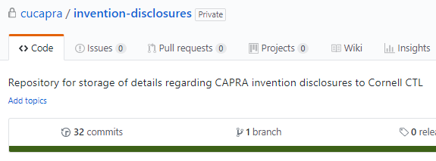
Final Words
CTL hosts workshops pretty frequently, have been helpful
CAPRA has filed 5 IDFs so far, repo with template available!

