Slide 1
Sacrificing myself on the alter
Confession of my sins

Slide 2
God is looking for more….
When I first came to God, back to Lord Jesus Christ as my Savior – He told me something distinctly and I didn’t obey.
God asked me to tell my now ex-wife about my past, to confess to her all my sins and to tell her that I now serve Jesus Christ. I feared losing my earthly relationship, more than I feared losing my relationship with Jesus. God be thanked, He is far more merciful than any of us!

Slide 3
Let us not fill God with regret!
[1Sa 15:11 CSB] "I regret that I made Saul king, for he has turned away from following me and has not carried out my instructions." So Samuel became angry and cried out to the LORD all night.
What did God want? For Saul to trust and obey – but Saul didn’t love God first and foremost. He didn’t fear God. For years, I have been only giving God a small piece of my heart, and trying to lock him out from the recesses.
I had an evil heart of unbelief still – I refused to turn and love him with all of myself. I worshipped the Lord with my mouth – but not in my heart, not completely. I let other spirits reign over me.

Slide 4
Root of sin
I’ve already told part of my testimony here – how Christ delivered me from pornography, but I held on to the parts Satan made me fear telling. That spirit of fear, controlled me. I gave that unclean spirit legal rights over my mind, my heart and my soul. That’s why even though I had freedom from objectifying women, I struggled to break free of the physical desire for sex. It was a recent physical stumble, that led me to fast for days, and pray and seek God’s voice. I finally grew sick of letting that unclean spirit have control of me, and wanted to seek the face of God.

Slide 5
Spoken again...
God again told me I had to confess my sins, immediately I again let that spirit of fear rise up and God showed me a dream of what was happening. I was in a crowded theater, and then the spirit of fear came in and instead of confronting it, I ran from it. I ran to the upper exit, and pulled the fire alarm and jumped out the window. I prayed for wisdom and knew what God was telling me. I had to start confessing the sins I’ve kept bottled up inside of me. If I am in Christ I have no reason to fear. If I am in Christ, I should only fear God – not other spirits, or men.

Slide 6
Pulling out sin by the root
[Luk 13:6-9 CSB] And he told this parable: "A man had a fig tree that was planted in his vineyard. He came looking for fruit on it and found none. "He told the vineyard worker, 'Listen, for three years I have come looking for fruit on this fig tree and haven't found any. Cut it down! Why should it even waste the soil? ' "But he replied to him, 'Sir, leave it this year also, until I dig around it and fertilize it. "Perhaps it will produce fruit next year, but if not, you can cut it down.' "

Slide 7
Here I am opening my heart
All of my major sins were connected to sexual abuse. I was personally abused when I was eight, by a cousin (who was no doubt abused herself.) for a long time, I feared even being around her. But that abuse at such a young age, shattered me and allowed a multitude of unclean spirits into me. What further shattered me was what happened next, Satan working to kill steal and destroy.

Slide 8
God is near the broken hearted
It’s important to remember, that God is near the broken hearted, and the reason why is because He is broken hearted over our sins. That we choose to sin, over obeying Him. “obedience is better than sacrifice”
Do we believe it? Do we live it?
God’s heart is broken, and Jesus wept.

Slide 9
The shattering
My mom after this, was taken over by a multitude of demons. She has clinical schizophrenia and a Christian should understand this is legion. I believe she herself was sexually abused, and Satan was trying to destroy my family for generations. She let those demons drive her to witchcraft, and she had us stand in a circle performing chants, calling out unclean spirits into the world. This went on for months, and then she decided we wouldn’t be going to school anymore, she would homeschool us. But that entailed her standing in a circle chanting to the demons and unclean spirits.

Slide 10
Confess your sins...
[Jas 5:15-16 CSB] The prayer of faith will save the sick person, and the Lord will raise him up; if he has committed sins, he will be forgiven. Therefore, confess your sins to one another and pray for one another, so that you may be healed. The prayer of a righteous person is very powerful in its effect.
We often wonder why our prayers aren’t being answered. The answer is right there in scripture if you believe in your heart! Confess and forsake your sins, then you become the righteousness of Christ, he covers our transgressions and is faithful and just to cleanse us from all unrighteousness.

Slide 11
The seismic shift
Two months into the “seventh grade” as it were, my mom convinced my dad to pick up everything and leave and drive to Washington. I found out later what my mom did, when she left the house. She placed a curse on her children. She tied a noose around our toys, and hung them up. When we ended up in Seattle we were in a shelter for a week, and then CPS showed up to take us away from my Parents. I found out the reason for this later, is that my Mom had been running from a court order in St. Helens. In the foster home, I faced extreme bullying. In both the homes in Seattle my life was threatened, and the foster parents had to place me in a separate locked room. Later on, I was in a home where they would accuse me of lying, even when I was telling the truth. It completely broke me.

Slide 12
Jesus can save me
[Jhn 4:29 CSB] "Come, see a man who told me everything I ever did. Could this be the Messiah? "
Jesus knows everything we’ve ever done and even knows what we will do. He wants us to use that to bear more fruit for the kingdom of God. God weeps for the lost souls that end up in hell, and he weeps when His children do not obey Him. If we love Him, we will keep His commandments – including ripping out our heart of stone, throwing it on the floor and letting the world see what Jesus saved us from.

Slide 13
The infestation
When we got back home, my Mom started doing her chanting again and this time a demon fully entered me. It called itself “Rash”. It caused me to sexually abuse myself and one of my Sisters. I sodomized myself, I was always masturbating, I couldn’t control myself. Then my Mom convinced my Dad to drive around Bellevue looking for the three immortal Mormons. On the way home He was pulled over for having a brake light out. She started screaming that He was abusing us, and then the officer pulled my Dad out of the car. She jumped into the driver seat (supernaturally, seriously) and started the car so fast, and floored it. I don’t personally remember much beyond that. I was knocked out, my jaw broken in five places. It was after this, that I met a friend that started getting involved in the occult, using Ouija boards, trying to transcendtally meditate and even trying to cast demons out of the abyss. I had let the generational curse of witchcraft take me over. At a certain point, I woke up and was unable to move. I felt the demon over me, but was unable to move. I felt He wanted to kill me, but I could do nothing against it. In the back of my mind, God called me to call on Jesus. I did – they left.

Slide 14
Not a complete confession
This was not an extensive nor complete confession of my life. I also had a spirit of suicide, a spirit of fantasizing about bestiality, I was demonized for years, even after I came back to Christ in August of 2015. While the closer I drew near to Him, the more grace He poured out, He cannot reside in an unclean vessel. God already knows everything you’ve done – find a brother or sister and confess your sins, so Jesus can pluck that unclean spirit out.

Slide 15
The clean vessel explained
[2Ti 2:20-22 CSB] Now in a large house there are not only gold and silver vessels, but also those of wood and clay; some for honorable use and some for dishonorable. So if anyone purifies himself from anything dishonorable, he will be a special instrument, set apart, useful to the Master, prepared for every good work. Flee from youthful passions, and pursue righteousness, faith, love, and peace, along with those who call on the Lord from a pure heart.
God wants us to become a clean vessel of gold and silver, not of wood and clay. Those are for dishonor and I believe the vessels of dishonor will not enter the Kingdom of God.

Slide 16
Which is what Paul meant here
[1Co 3:11-15 CSB] For no one can lay any other foundation than what has been laid down. That foundation is Jesus Christ. If anyone builds on the foundation with gold, silver, costly stones, wood, hay, or straw, each one's work will become obvious. For the day will disclose it, because it will be revealed by fire; the fire will test the quality of each one's work. If anyone's work that he has built survives, he will receive a reward. If anyone's work is burned up, he will experience loss, but he himself will be saved ​-- ​but only as through fire.
This passage is often incorrectly interpreted as a post death refining fire that cleans saints up, removing their wood, hay and straw. This is supposed to happen in our life as we let God’s refining fire purify us from wood, hay and stubble into gold, silver and costly stones. That can only happen if we are pursuing God with our whole heart, our whole soul and our whole mind. That we self sacrificially love Jesus and love others, even the lost that despise you.

Slide 17
Further explained
[Pro 27:18 CSB] Whoever tends a fig tree will eat its fruit, and whoever looks after his master will be honored.
The fig tree is us, planted in the vine (Jesus) we can only produce fruit if we are abiding in Christ (love) and that fruit should be holy and not rotten. God revealed this to me, that when I confessed my sins, He plucked off rotten fruit from me. It fell to the ground, the rotten flesh fell away, leaving a seed. The seed from our rotten fruit, from sharing our testimony is able to produce more fruit.
We have to find out where our heart is. I’ve spent the past week in prayer and fasting, and as I opened up with – the Lord revealed that my whole heart was not yet bent toward His will. I knew it, but ignored it. I had let a pharisee spirit in, the pride of my life, and I was falling from grace.
”This people worship me with their lips, but their heart is far from me.” It was reading 1 Samuel about Saul that gave me that realization this morning. I wasn’t completely honest with God or myself. I wasn’t sharing my whole heart with God, or the brothers and sisters of the body, that can benefit from how God saved me. I wasn’t listening to God’s plan for my life, but following my plans for my life.

Slide 18
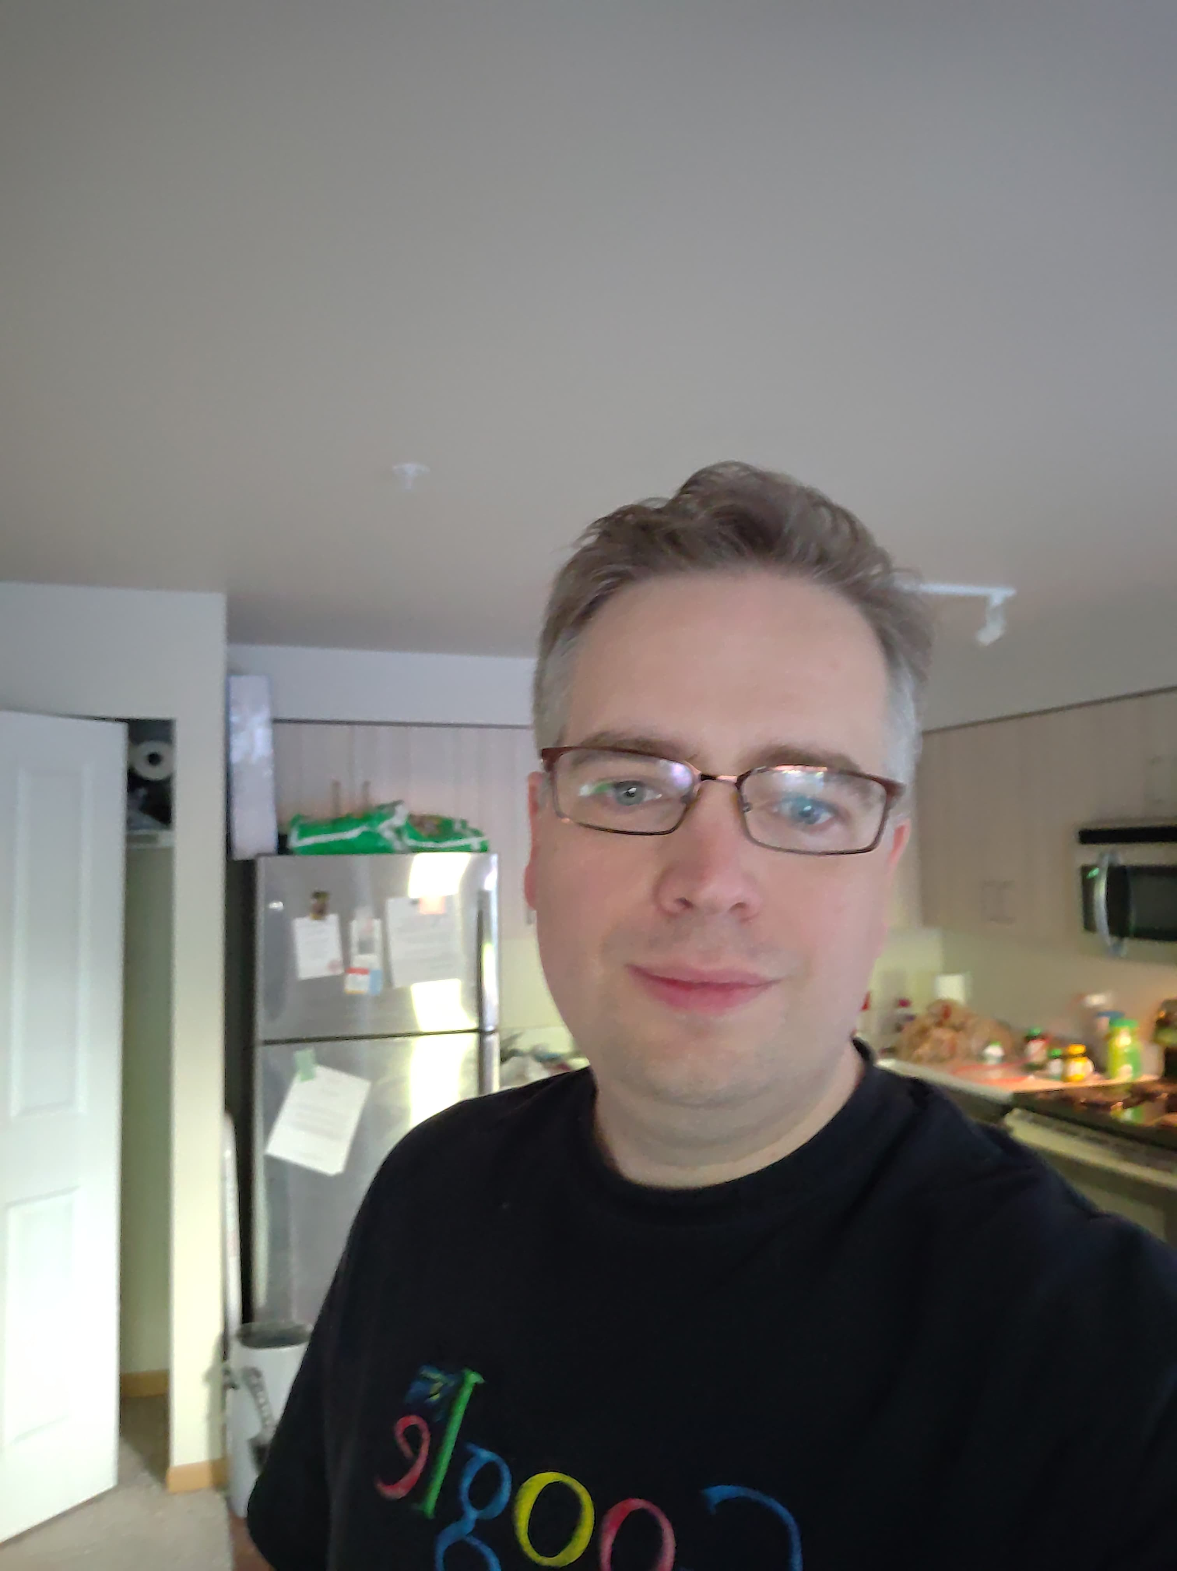
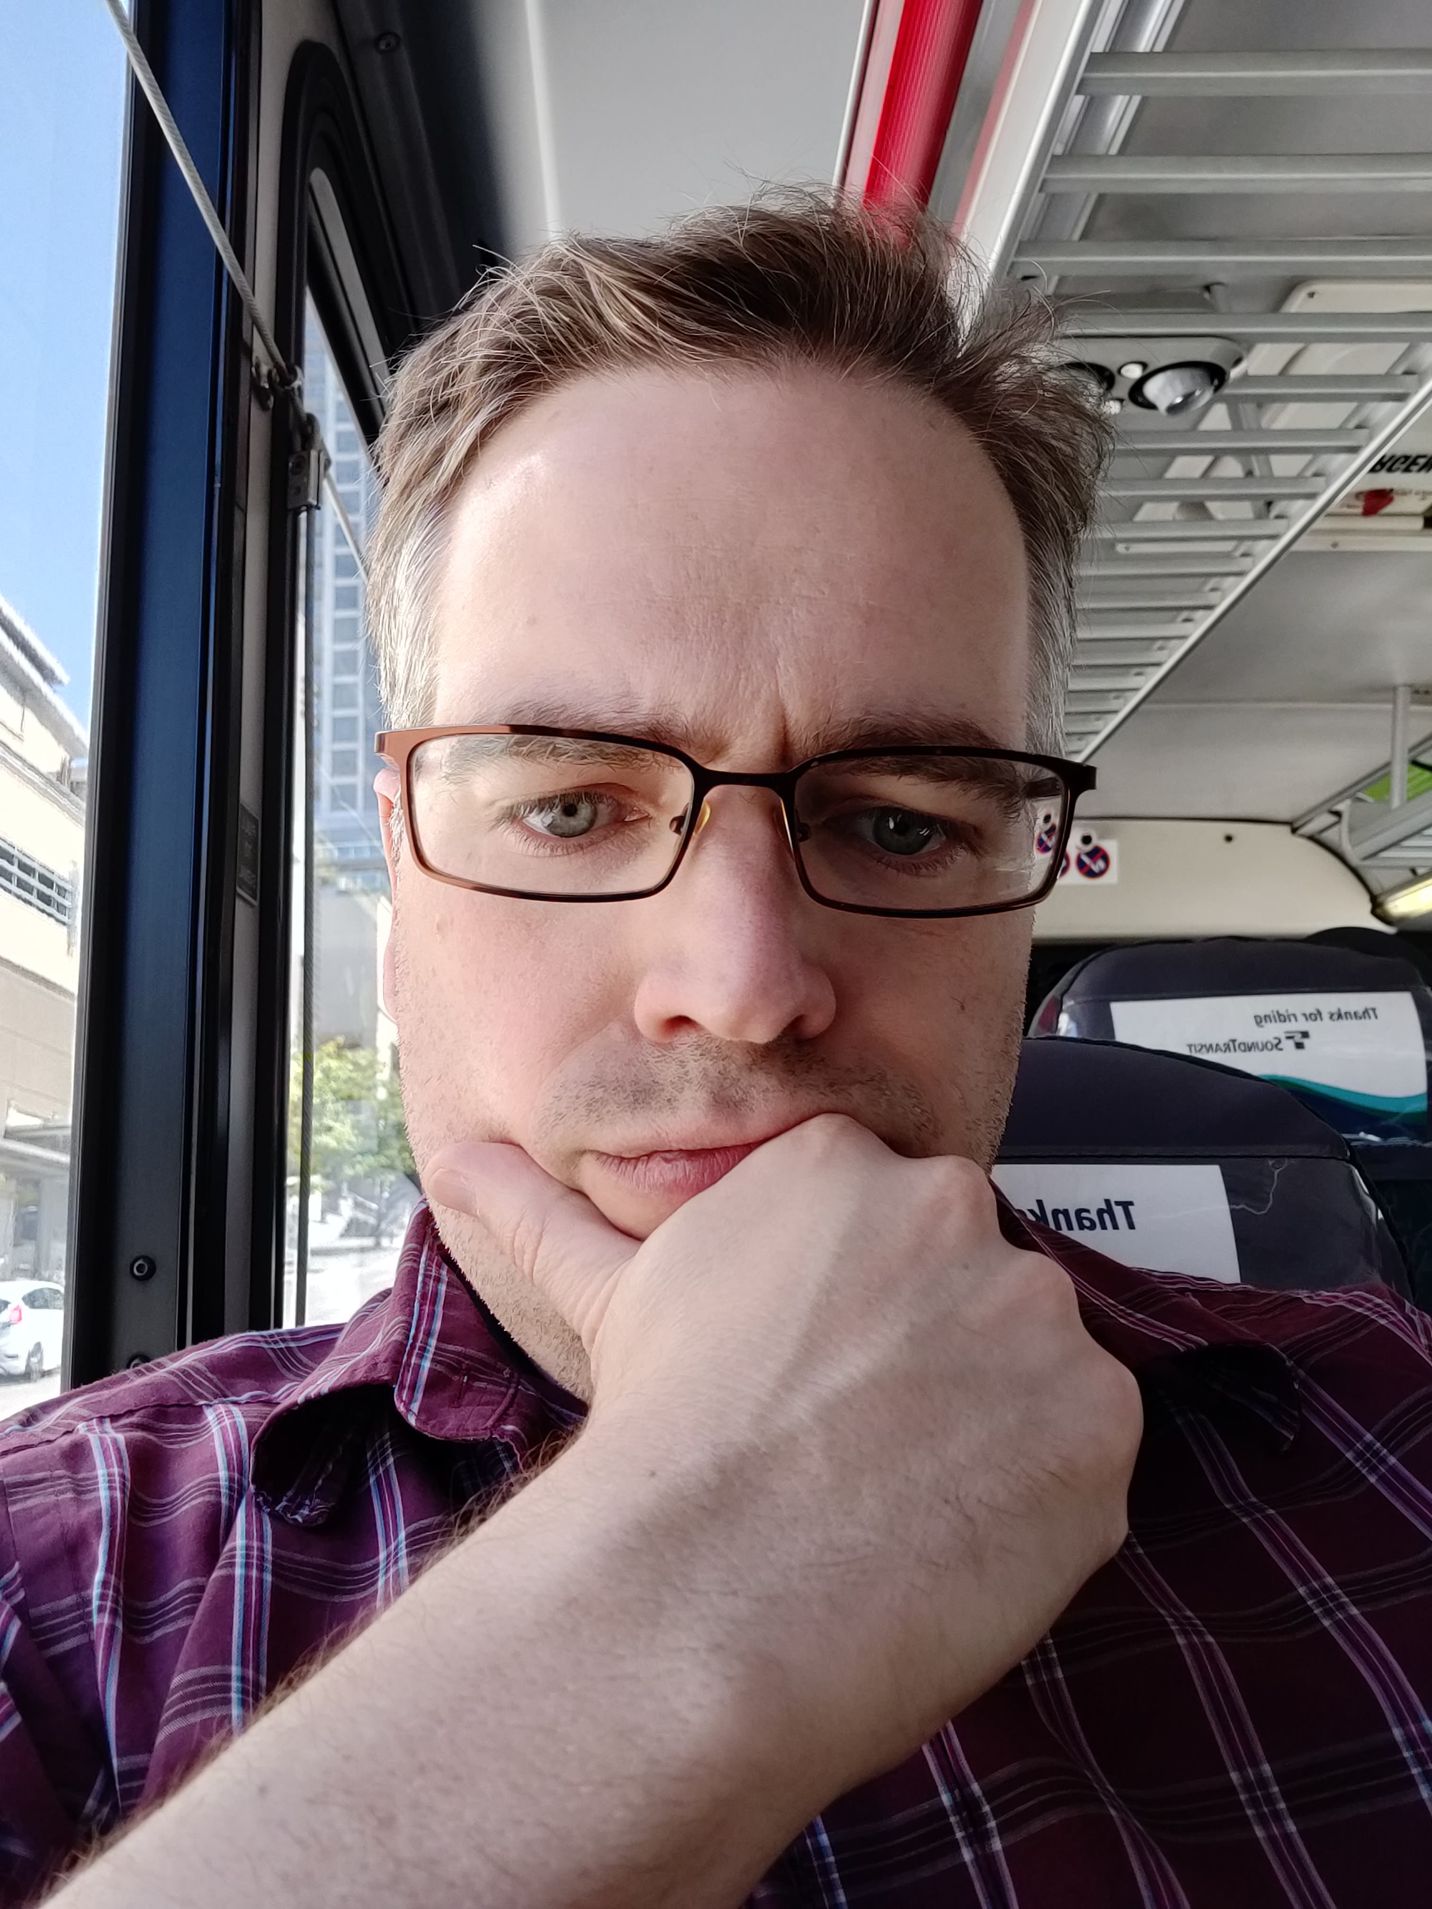
New deliverance
What really spurred this was seeking deliverance, wanting a closer relationship to God and realizing last Sunday my heart was still further from Him than I wanted. I talked with a friend and asked for help to be delivered from these unclean spirits over me. I believe the pictures speak for themselves. God removed a greater burden from me, because I confessed my sins one to another, and because I humbly sought to obey Him. I opened more of myself to Him and He opened more of himself to me.

Slide 19
Closing
Following the Savior is not easy – nothing worth possessing here is easy to obtain, why would an eternal inheritance be any different. When Jesus asked Matthew to follow Him, he had to forsake all of his possessions and follow Jesus, trusting in Him, loving Him.
The same is true for us, He’s calling us to follow Him, but we first have to trust Him and love Him. We have to let the vessel of our heart be crushed, the straw surrounding it, be consumed by the fire of the Holy Spirit. When we humble ourselves, purifying ourselves, God will pick up the dry bones, the pieces of broken vessel and use the living water to mold us into a new creation. He will breath the breath of life, the Holy Spirit onto our dry bones, quickening us to be able to perform what He desires.
We cannot do that without loving Him, and trusting Him. Open yourself up to God, by opening your heart to others.
Thank you Jesus

