Slide 1
Doctrine matters – Where we start when unsaved
Biblical Truth
Idolatry of our beliefs

Slide 2
Where we are today. (including myself)
Biblical Truth
Idolatry of our beliefs
The goal of Bible study and sound doctrine should be to purge all
idolatry from our hearts

Slide 3
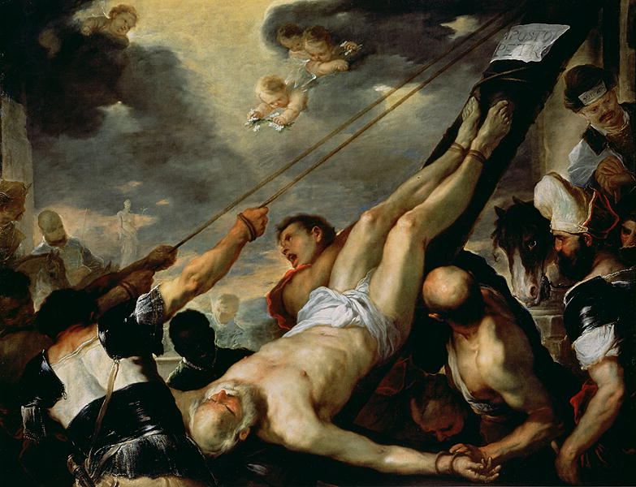
An Autopsy of Morris’
[Gal 2:19-20 NASB] 19 "For through the Law I died to the Law, so that I might live to God. 20 "I have been crucified with Christ; and it is no longer I who live, but Christ lives in me; and the life which I now live in the flesh I live by faith in the Son of God, who loved me and gave Himself up for me.

Slide 4

Week 1 – Building the foundation of our faith
The foundation of our faith is the Bible.
Jesus Christ is the word of God.
The Bible is the word of God.
Therefore, Jesus Christ is your Bible. If we can’t trust it, then we can’t trust Jesus.

Slide 5
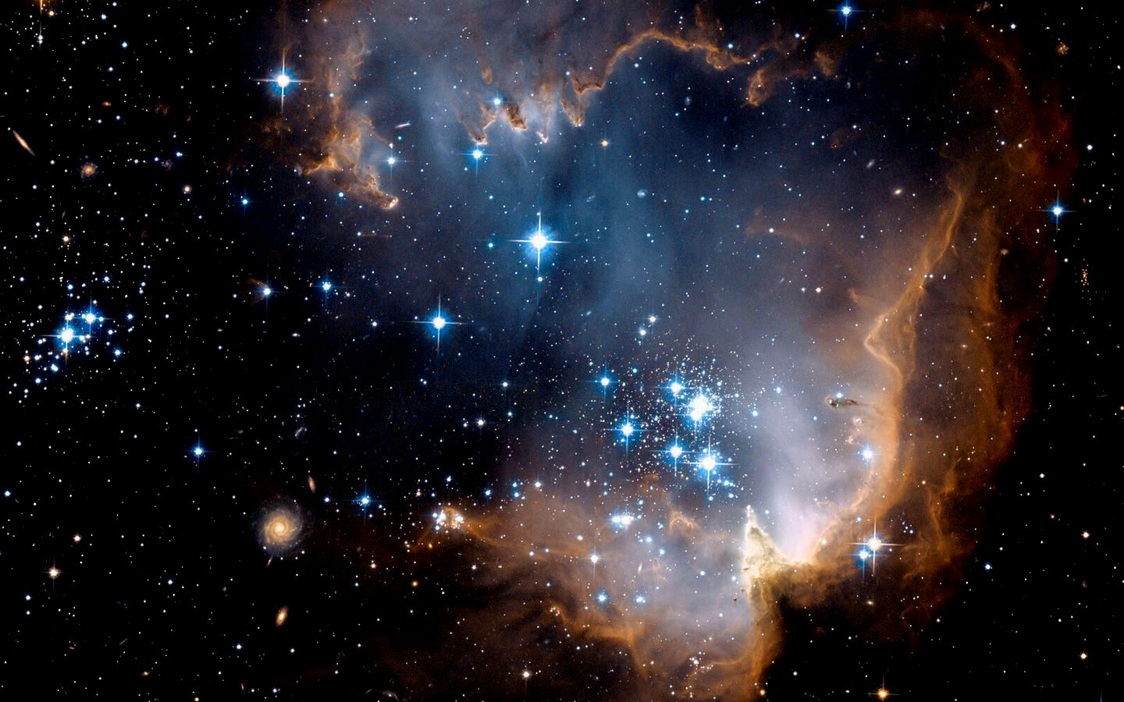
Start at the beginning
[Gen 1:1-3 NASB] 1 In the beginning God created the heavens and the earth. 2 The earth was formless and void, and darkness was over the surface of the deep, and the Spirit of God was moving over the surface of the waters. 3 Then God said, "Let there be light"; and there was light.
[Exo 3:2-3 NKJV] 2 And the Angel of the LORD appeared to him in a flame of fire from the midst of a bush. So he looked, and behold, the bush was burning with fire, but the bush [was] not consumed. 3 Then Moses said, "I will now turn aside and see this great sight, why the bush does not burn."
e them utterance.

Slide 6
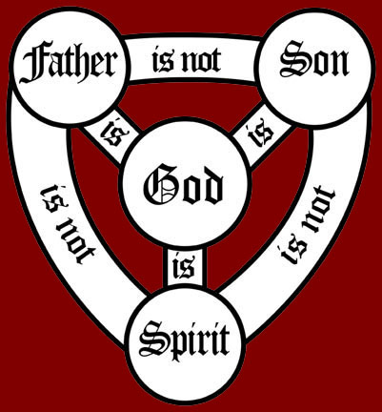
The triune Godhead exists throughout scripture
The very first book of the Bible and within the first three verses, we see an image of the Godhead. The Father, the Son and the Holy Spirit. If we throw out the truth of Genesis, we may as well throw out the truth of the Godhead.

Slide 7

Revealed light and word
[Jhn 1:1-5 NASB] 1 In the beginning was the Word, and the Word was with God, and the Word was God. 2 He was in the beginning with God. 3 All things came into being through Him, and apart from Him nothing came into being that has come into being. 4 In Him was life, and the life was the Light of men. 5 The Light shines in the darkness, and the darkness did not comprehend it.

Slide 8
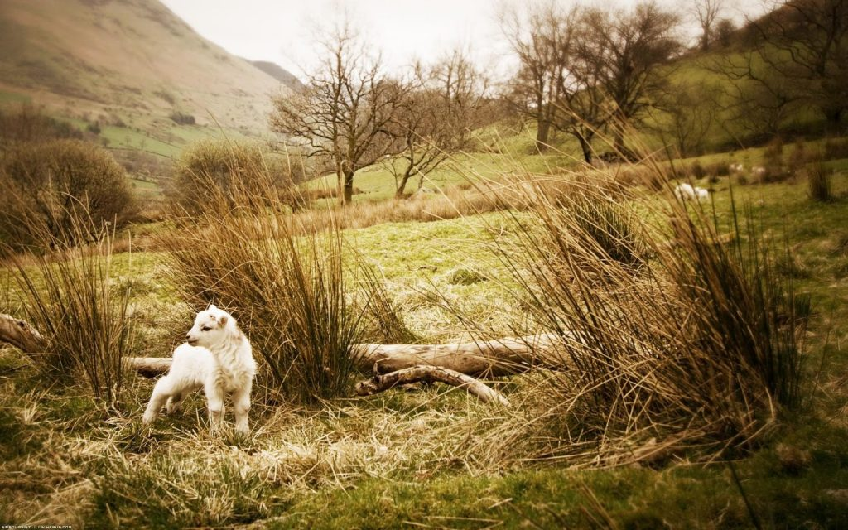
The lost (unchurched)
Those who are perishing, unsaved and unchurched do not grasp Scripture.
If we tell them they don’t have to believe certain things, they are placing their foundation on Sand and not on Jesus Christ. (The Bible is our cornerstone – It is an image of the Word of God)
[Mat 7:26 NKJV] 26 "But everyone who hears these sayings of Mine, and does not do them, will be like a foolish man who built his house on the sand:
If one doubts Genesis they will doubt the entire Bible. If you doubt the virgin birth, the flood of Noah, the six day creation – why would you believe God resurrected His only begotten son? Why even believe Jesus is the son of God? The same book that tells us Jesus is God, and rose from the dead, is the same book that tells us an ass talked, God destroyed the world in a flood and God used Moses to divide the red sea.

Slide 9
Why not compromise the Bible to bring people into Church?
[Jhn 3:19-20 NKJV] 19 "And this is the condemnation, that the light has come into the world, and men loved darkness rather than light, because their deeds were evil. 20 "For everyone practicing evil hates the light and does not come to the light, lest his deeds should be exposed.
[1Co 1:18 NKJV] 18 For the message of the cross is foolishness to those who are perishing, but to us who are being saved it is the power of God.
[2Co 3:16 NKJV] 16 Nevertheless when one turns to the Lord, the veil is taken away.
The Bible is foolish to the unsaved, therefore it is foolish to compromise the word to try and church the unchurched, or save the unsaved.
[Jhn 3:12 NKJV] 12 "If I have told you earthly things and you do not believe, how will you believe if I tell you heavenly things?
Jesus tells us these Earthly things happened. Creation, a young Earth and Adam and Eve being literal. That Noah really had an ark that saved eight people and all the animals from a global flood. That Jonah was really swallowed by a whale, and that an ass actually spoke. If we don’t believe Him in these little things, how can we believe Him in the big things?

Slide 10
What is the light?
[Psa 119:105 NASB] 105 Your word is a lamp to my feet And a light to my path.
The Holy Spirit of God is our light. The Word (Jesus) is our Bible.
[Mat 4:4 NKJV] 4 But He answered and said, "It is written, 'Man shall not live by bread alone, but by every word that proceeds from the mouth of God.' "
[Deu 8:3 NKJV] 3 "So He humbled you, allowed you to hunger, and fed you with manna which you did not know nor did your fathers know, that He might make you know that man shall not live by bread alone; but man lives by every [word] that proceeds from the mouth of the LORD.
[Jhn 6:49-53 NKJV] 49 "Your fathers ate the manna in the wilderness, and are dead. 50 "This is the bread which comes down from heaven, that one may eat of it and not die. 51 "I am the living bread which came down from heaven. If anyone eats of this bread, he will live forever; and the bread that I shall give is My flesh, which I shall give for the life of the world." 52 The Jews therefore quarreled among themselves, saying, "How can this Man give us [His] flesh to eat?" 53 Then Jesus said to them, "Most assuredly, I say to you, unless you eat the flesh of the Son of Man and drink His blood, you have no life in you.
[Jhn 1:14 NKJV] 14 And the Word became flesh and dwelt among us, and we beheld His glory, the glory as of the only begotten of the Father, full of grace and truth.
To consume the word, we read the Bible. To drink His blood, we are baptized unto His death.
[Rom 6:4 NKJV] 4 Therefore we were buried with Him through baptism into death, that just as Christ was raised from the dead by the glory of the Father, even so we also should walk in newness of life.

Slide 11
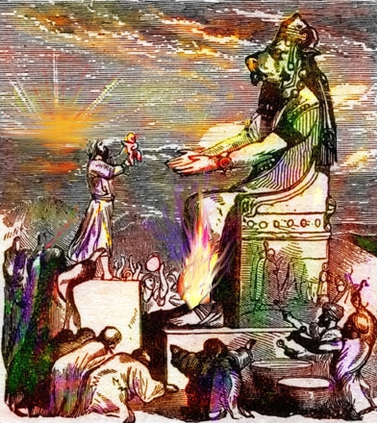
We live in a pagan world today.
We cannot win souls for God by taking away or adding to His word. (The Bible)
We cannot win souls, unless we address them as the lost Pagan souls that they are.
This requires an Acts 17 approach, not an Acts 2 approach. Furthermore – some of them just need to be answered by their foolishness.
[Pro 26:4-5 NKJV] 4 Do not answer a fool according to his folly, Lest you also be like him. 5 Answer a fool according to his folly, Lest he be wise in his own eyes.
What this means is, if we attempt to show them the wisdom of Scripture they won’t see it unless you sacrifice whole portions of God’s word. We are to answer them according to their folly. How do they know what they believe is true without the Bible? Remember, the word of God is a lamp unto our feet.

Slide 12
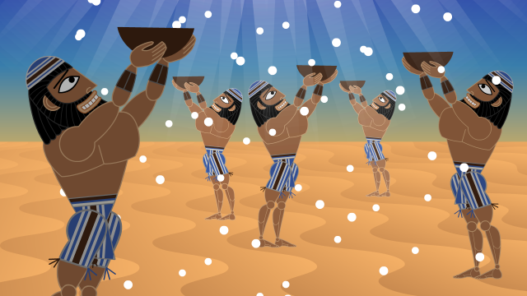
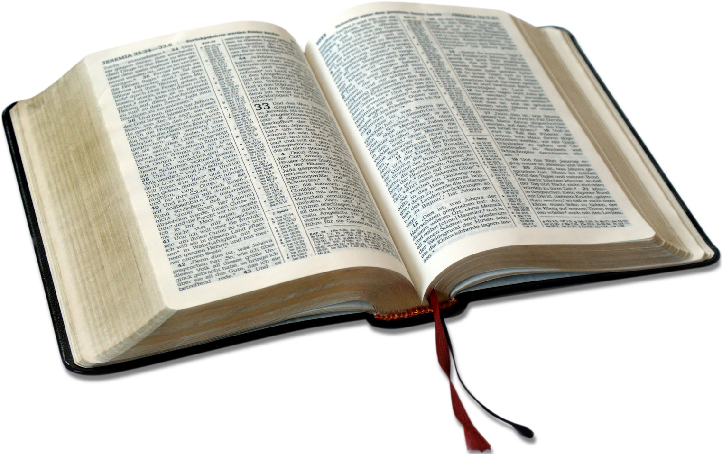
Our Daily Bread
During the Lord’s prayer, Jesus tells us we should have God, “give us today our daily bread.” this is not talking about actual food, it’s talking about the word of God.
“Seek ye first the Kingdom of God – and these things (food, clothing, shelter) will be granted to you.”

Slide 13
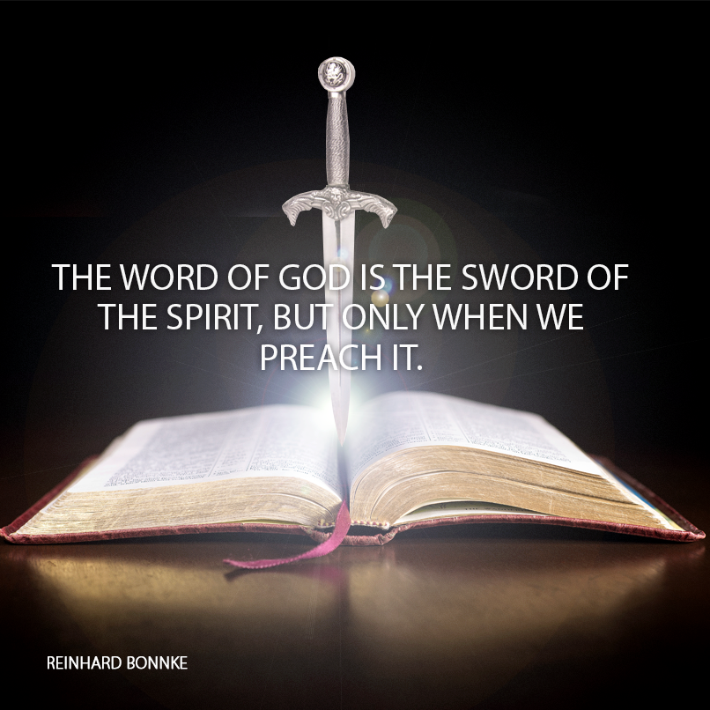
Our Bible is the Sword Paul talks about in Ephesians 6
[Eph 6:17 NKJV] 17 And take the helmet of salvation, and the sword of the Spirit, which is the word of God;
[Heb 4:12-13 NKJV] 12 For the word of God [is] living and powerful, and sharper than any two-edged sword, piercing even to the division of soul and spirit, and of joints and marrow, and is a discerner of the thoughts and intents of the heart. 13 And there is no creature hidden from His sight, but all things [are] naked and open to the eyes of Him to whom we [must give] account.
[Rev 2:12, 16 NKJV] 12 "And to the angel of the church in Pergamos write, 'These things says He who has the sharp two-edged sword: ... 16 "Repent, or else I will come to you quickly and will fight against them with the sword of My mouth.
[Rev 19:15 NKJV] 15 Now out of His mouth goes a sharp sword, that with it He should strike the nations. And He Himself will rule them with a rod of iron. He Himself treads the winepress of the fierceness and wrath of Almighty God.

Slide 14

The problem with not trusting the Bible
When we place trust in a man to discern God’s word, over the Holy Spirit within us – or when we take His word that we can’t trust the word of God, we are effectively allowing the enemy to break our sword.
[Act 17:11 NKJV] 11 These were more fair-minded than those in Thessalonica, in that they received the word with all readiness, and searched the Scriptures daily [to find out] whether these things were so.

Slide 15
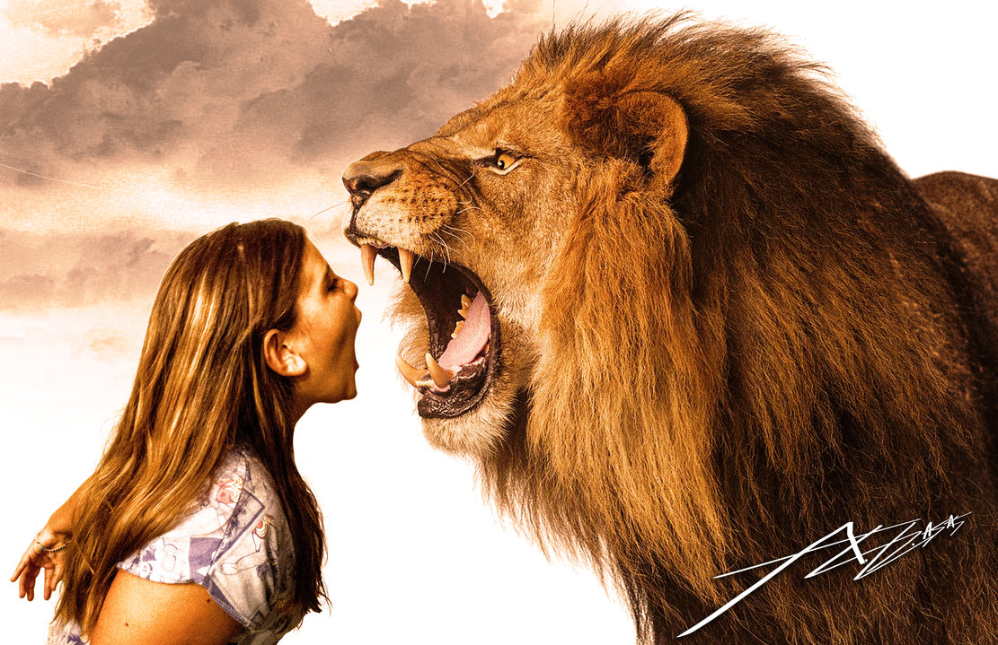
Why would we go to battle against the forces of the Devil with a broken sword?
[1Pe 5:8-9 NKJV] 8 Be sober, be vigilant; because your adversary the devil walks about like a roaring lion, seeking whom he may devour. 9 Resist him, steadfast in the faith, knowing that the same sufferings are experienced by your brotherhood in the world.
[Jas 4:7 NKJV] 7 Therefore submit to God. Resist the devil and he will flee from you.

Slide 16
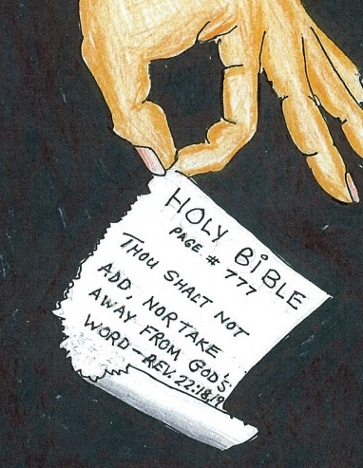
There is a stern warning regarding, taking from or adding to His word
[Deu 4:2 NKJV] 2 "You shall not add to the word which I command you, nor take from it, that you may keep the commandments of the LORD your God which I command you.
[Rev 22:18 NKJV] 18 For I testify to everyone who hears the words of the prophecy of this book: If anyone adds to these things, God will add to him the plagues that are written in this book; 19 and if anyone takes away from the words of the book of this prophecy, God shall take away his part from the Book of Life, from the holy city, and [from] the things which are written in this book.

Slide 17
Why I trust the KJV over the modern translations
[Act 8:36-38 KJV] 36 And as they went on [their] way, they came unto a certain water: and the eunuch said, See, [here is] water; what doth hinder me to be baptized? 37 And Philip said, If thou believest with all thine heart, thou mayest. And he answered and said, I believe that Jesus Christ is the Son of God. 38 And he commanded the chariot to stand still: and they went down both into the water, both Philip and the eunuch; and he baptized him.
[Act 8:36-38 NIV] 36 As they traveled along the road, they came to some water and the eunuch said, "Look, here is water. What can stand in the way of my being baptized?" 37 38 And he gave orders to stop the chariot. Then both Philip and the eunuch went down into the water and Philip baptized him.
It’s not a coincidence that the modern translations attack the Son of God.

Slide 18
Why I trust the KJV over the modern translations
[1Jo 5:6-8 KJV] 6 This is he that came by water and blood, [even] Jesus Christ; not by water only, but by water and blood. And it is the Spirit that beareth witness, because the Spirit is truth. 7 For there are three that bear record in heaven, the Father, the Word, and the Holy Ghost: and these three are one. 8 And there are three that bear witness in earth, the Spirit, and the water, and the blood: and these three agree in one.
[1Jo 5:6-8 NIV] 6 This is the one who came by water and blood--Jesus Christ. He did not come by water only, but by water and blood. And it is the Spirit who testifies, because the Spirit is the truth. 7 For there are three that testify: 8 the Spirit, the water and the blood; and the three are in agreement.
The strongest support for the Godhead removed from the Bible? Who would do that?

Slide 19
Why I trust the KJV over the modern translations
[Luk 4:4 KJV] 4 And Jesus answered him, saying, It is written, That man shall not live by bread alone, but by every word of God.
[Luk 4:4 NIV] 4 Jesus answered, "It is written: 'Man shall not live on bread alone.'"
Remember two things:
1) Jesus Christ is the word being spoken of here.
2) the word is your Bible.
Jesus the word of God, was quoting what He told the Jews in Deut 8:3. Would He suddenly forget how this thought was finished?
[Deu 8:3 KJV] 3 And he humbled thee, and suffered thee to hunger, and fed thee with manna, which thou knewest not, neither did thy fathers know; that he might make thee know that man doth not live by bread only, but by every [word] that proceedeth out of the mouth of the LORD doth man live.

Slide 20
The deity of Christ is under attack
[Gal 4:7 KJV] 7 Wherefore thou art no more a servant, but a son; and if a son, then an heir of God through Christ.
[Gal 4:7 NIV] 7 So you are no longer a slave, but God's child; and since you are his child, God has made you also an heir.
What happened to Christ?

Slide 21
The deity of Christ is under attack
[Eph 3:9 KJV] 9 And to make all [men] see what [is] the fellowship of the mystery, which from the beginning of the world hath been hid in God, who created all things by Jesus Christ:
[Eph 3:9 NIV] 9 and to make plain to everyone the administration of this mystery, which for ages past was kept hidden in God, who created all things.
Again the deity of Christ is attacked. God created all things through Him. Do you think this is a coincidence?

Slide 22
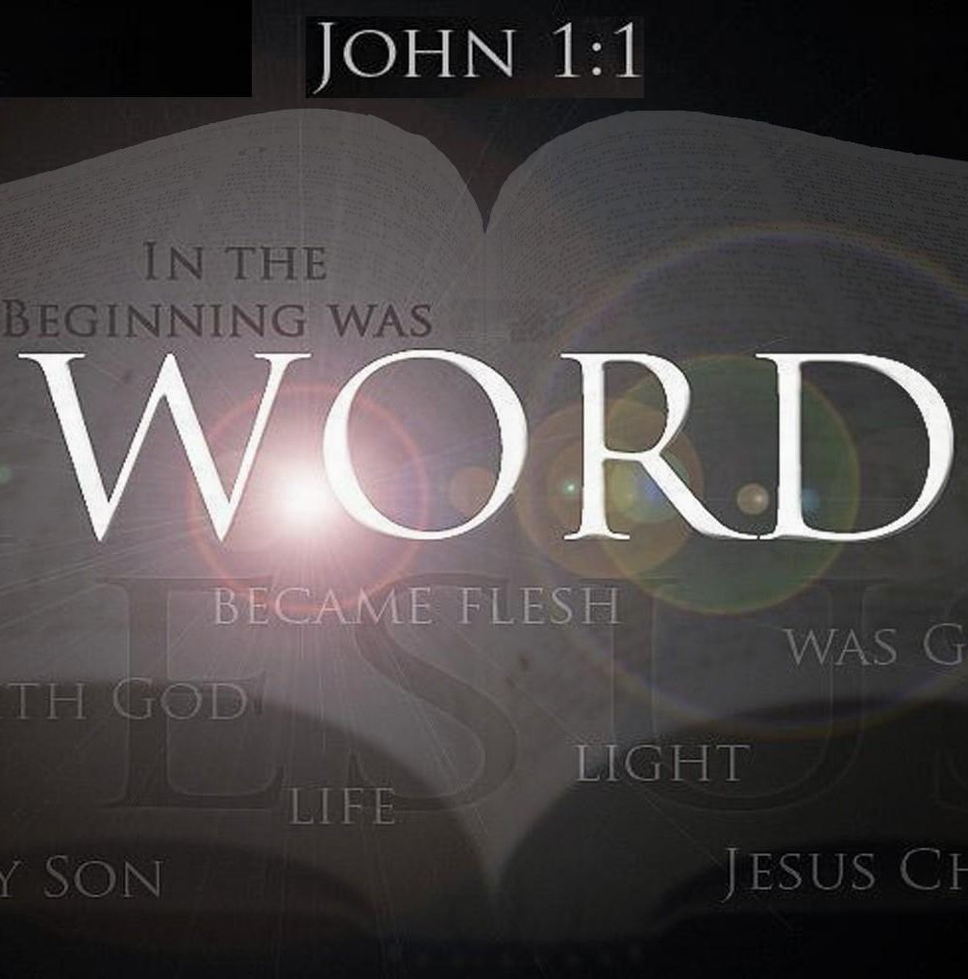
It is imperative that we trust His word – That Jesus Christ, the Holy Spirit and the Father were all involved in preserving the word of God.
[2Ti 3:16 NKJV] 16 All Scripture [is] given by inspiration of God, and [is] profitable for doctrine, for reproof, for correction, for instruction in righteousness,

Slide 23
Week 2 – Refining fire of Biblical doctrine
The Bible must be like our straight edge for what is true and false. Of all the warnings in the New Testament, none is repeated more often than the warnings to be wary of false prophets, and wolves in sheeps clothing.
The strongest admonition of this is in the KJV, as I went over last week, I do trust this over modern translations.
[1Ti 6:5 KJV] 5 Perverse disputings of men of corrupt minds, and destitute of the truth, supposing that gain is godliness: from such withdraw thyself.
[1Ti 6:5 NIV] 5 and constant friction between people of corrupt mind, who have been robbed of the truth and who think that godliness is a means to financial gain.
[Tit 3:10 NIV] 10 Warn a divisive person once, and then warn them a second time. After that, have nothing to do with them.
[Tit 3:10 KJV] 10 A man that is an heretick after the first and second admonition reject;

Slide 24
The Bible itself is like our filter (kidneys)
[Tit 1:15-16 KJV] 15 Unto the pure all things [are] pure: but unto them that are defiled and unbelieving [is] nothing pure; but even their mind and conscience is defiled. 16 They profess that they know God; but in works they deny [him], being abominable, and disobedient, and unto every good work reprobate.
Our works betray our reins and heart. Our works show who reigns our heart.
[Gal 2:20 NKJV] 20 "I have been crucified with Christ; it is no longer I who live, but Christ lives in me; and the [life] which I now live in the flesh I live by faith in the Son of God, who loved me and gave Himself for me.
When we are born again, we crucify our flesh and are given a new heart and new reins. It allows us to not sin, and allows Christ in us to do what the Father layed out for Him.
[Eph 2:10 NKJV] 10 For we are His workmanship, created in Christ Jesus for good works, which God prepared beforehand that we should walk in them.

Slide 25
God wants to reign our reins
[Jer 17:10 KJV] 10 I the LORD search the heart, [I] try the reins, even to give every man according to his ways, [and] according to the fruit of his doings.
Modern translations, translate this incorrectly. This is about sacrifice to God. The heart pumps the new blood (born again Christian) through our regenerated body. The new reins (Kidney and liver) filter and purify what is in the blood.
[Rev 2:23 KJV] 23 And I will kill her children with death; and all the churches shall know that I am he which searcheth the reins and hearts: and I will give unto every one of you according to your works.

Slide 26
Paul, James and John as the filter
[1Co 6:18-20 KJV] 18 Flee fornication. Every sin that a man doeth is without the body; but he that committeth fornication sinneth against his own body. 19 What? know ye not that your body is the temple of the Holy Ghost [which is] in you, which ye have of God, and ye are not your own? 20 For ye are bought with a price: therefore glorify God in your body, and in your spirit, which are God's..
[1Th 4:1-8 NKJV] 1 Finally then, brethren, we urge and exhort in the Lord Jesus that you should abound more and more, just as you received from us how you ought to walk and to please God; 2 for you know what commandments we gave you through the Lord Jesus. 3 For this is the will of God, your sanctification: that you should abstain from sexual immorality; 4 that each of you should know how to possess his own vessel in sanctification and honor, 5 not in passion of lust, like the Gentiles who do not know God; 6 that no one should take advantage of and defraud his brother in this matter, because the Lord [is] the avenger of all such, as we also forewarned you and testified. 7 For God did not call us to uncleanness, but in holiness. 8 Therefore he who rejects [this] does not reject man, but God, who has also given us His Holy Spirit.
The reins clean our hearts from our rotten fleshly desires, but we must submit to God, so we can resist the Devil. Like the white blood cells the Kidneys help the body produce to fight disease, the reins of God are supposed to produce within us a hatred of sin. This is why even in the corporate body, Paul tells us to give sinners over to the Devil so their flesh is destroyed, and they may yet be saved.

Slide 27
God’s reign over our reins and hearts
[Tit 2:11-15 NKJV] 11 For the grace of God that brings salvation has appeared to all men, 12 teaching us that, denying ungodliness and worldly lusts, we should live soberly, righteously, and godly in the present age, 13 looking for the blessed hope and glorious appearing of our great God and Savior Jesus Christ, 14 who gave Himself for us, that He might redeem us from every lawless deed and purify for Himself [His] own special people, zealous for good works. 15 Speak these things, exhort, and rebuke with all authority. Let no one despise you.
They cannot despise us, because Christ in us has become a pattern that others see from us.
[Tit 2:7-8 NKJV] 7 in all things showing yourself [to be] a pattern of good works; in doctrine [showing] integrity, reverence, incorruptibility, 8 sound speech that cannot be condemned, that one who is an opponent may be ashamed, having nothing evil to say of you.
This does not mean you are saved by these works – it means when you are saved, the process of sanctification should lead us to perform these works, as Christ is living through us. We become image bearers of Christ.
[Tit 3:4-5 NKJV] 4 But when the kindness and the love of God our Savior toward man appeared, 5 not by works of righteousness which we have done, but according to His mercy He saved us, through the washing of regeneration and renewing of the Holy Spirit,
This washing leads to our progressive sanctification. It will bear the fruit of the holy spirit, and we should no longer be bearing the fruit of our perishing flesh.

Slide 28
The fruits
[Gal 5:16-18 NKJV] 16 I say then: Walk in the Spirit, and you shall not fulfill the lust of the flesh. 17 For the flesh lusts against the Spirit, and the Spirit against the flesh; and these are contrary to one another, so that you do not do the things that you wish. 18 But if you are led by the Spirit, you are not under the law.

Slide 29
Fruits of death
[Gal 5:19-21 NKJV] 19 Now the works of the flesh are evident, which are: adultery, fornication, uncleanness, lewdness, 20 idolatry, sorcery, hatred, contentions, jealousies, outbursts of wrath, selfish ambitions, dissensions, heresies, 21 envy, murders, drunkenness, revelries, and the like; of which I tell you beforehand, just as I also told [you] in time past, that those who practice such things will not inherit the kingdom of God.
[Rom 6:15-21 NKJV] 15 What then? Shall we sin because we are not under law but under grace? Certainly not! 16 Do you not know that to whom you present yourselves slaves to obey, you are that one's slaves whom you obey, whether of sin [leading] to death, or of obedience [leading] to righteousness? 17 But God be thanked that [though] you were slaves of sin, yet you obeyed from the heart that form of doctrine to which you were delivered. 18 And having been set free from sin, you became slaves of righteousness. 19 I speak in human [terms] because of the weakness of your flesh. For just as you presented your members [as] slaves of uncleanness, and of lawlessness [leading] to [more] lawlessness, so now present your members [as] slaves [of] righteousness for holiness. 20 For when you were slaves of sin, you were free in regard to righteousness. 21 What fruit did you have then in the things of which you are now ashamed? For the end of those things [is] death.

