Slide 1
An Autopsy of Morris’
[Gal 2:19-20 NASB] 19 "For through the Law I died to the Law, so that I might live to God. 20 "I have been crucified with Christ; and it is no longer I who live, but Christ lives in me; and the life which I now live in the flesh I live by faith in the Son of God, who loved me and gave Himself up for me.

Slide 2

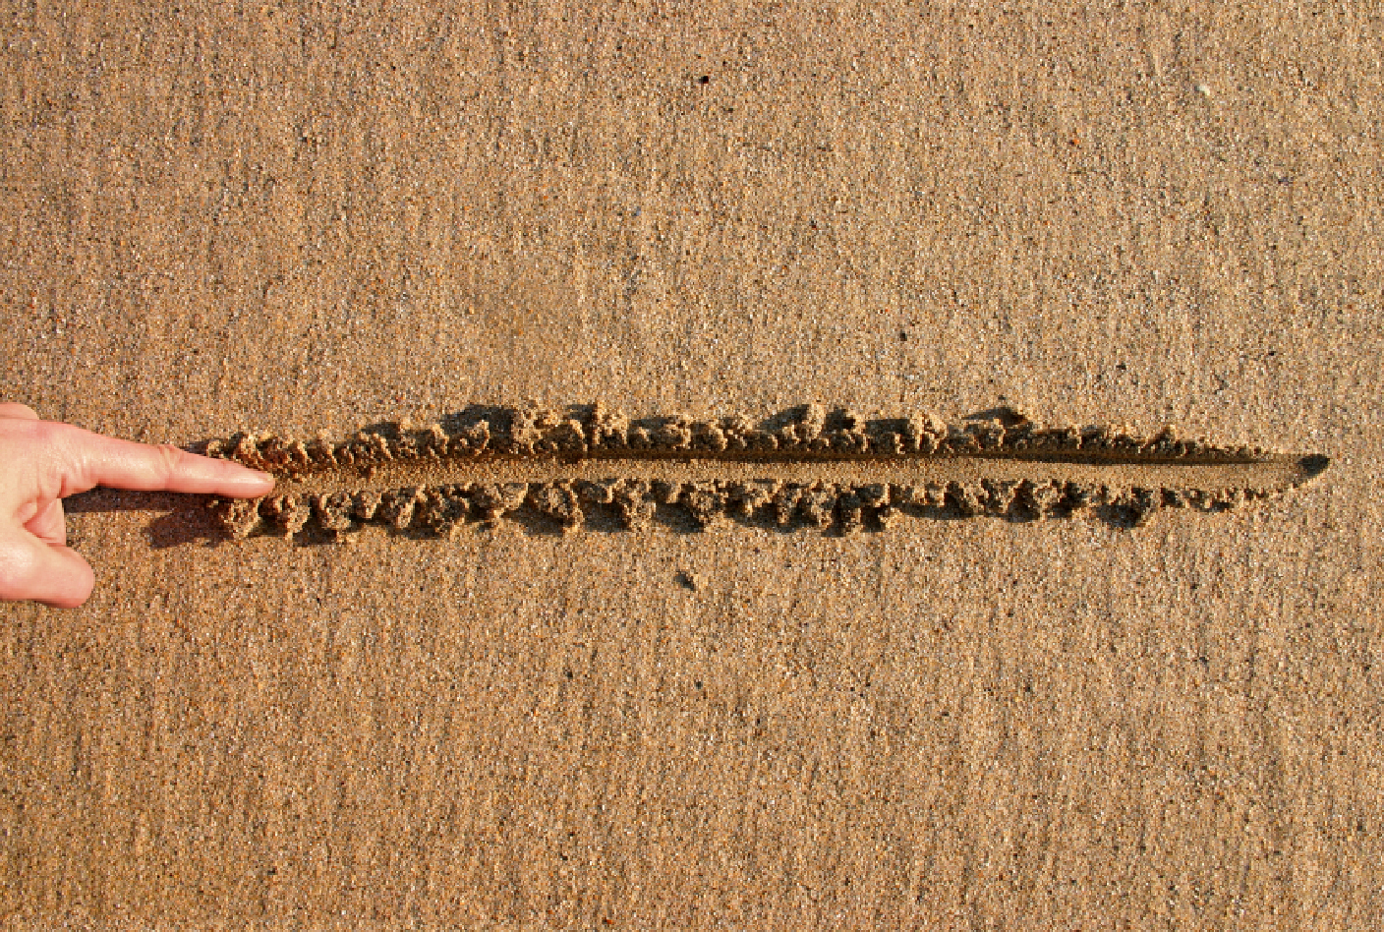
The question
Why are you speaking against these leaders and churches so much?
The answer is, lines in the cornerstone. And this study will talk about that compared to lines in the sand.

Slide 3
Start with the right material
[Mat 7:24 NASB] 24 "Therefore everyone who hears these words of Mine and acts on them, may be compared to a wise man who built his house on the rock.
What is the rock? Jesus Christ. What else is Jesus Christ?
[Jhn 1:1-2 NASB] 1 In the beginning was the Word, and the Word was with God, and the Word was God. 2 He was in the beginning with God.
What is the word? Jesus Christ. What else is the word? Your Bible.
Your Bible is Jesus Christ, when He tells us to consume our daily bread – He is telling us to read Him daily. When He challenged the Jews in John 6 to consume His flesh, He was telling them to read the Bible everyday.
Without reading the Bible, we cannot know Jesus Christ as the words within are from Him.

Slide 4
The first and most important line
When someone speaks against the authority of God’s word, they speak against Jesus Christ.
When someone says, “As the Bible goes, so goes our faith.” They are right – our faith is intimately tied to the authority of the Bible. The Bible is Jesus Christ. If someone preaches a Jesus without the authority of the Bible, they are preaching a different Jesus.
[2Co 11:4 NASB] 4 For if one comes and preaches another Jesus whom we have not preached, or you receive a different spirit which you have not received, or a different gospel which you have not accepted, you bear this beautifully.
This is why California is going after the Bible. They believe this sentiment. They want to destroy Biblical Christianity. They have made it illegal to preach from or sell the Bible.

Slide 5

Biblical Authority example
Biblical authority challenged to win the lost to come to church more. Like calling the garden of eden a myth.
Should we cross this line to win people to the Church? What type of foundation will they have if they don’t trust God’s word? Is the goal to save some for Church or to save them from hell?
[2Ti 4:2-4 NASB] 2 preach the word; be ready in season and out of season; reprove, rebuke, exhort, with great patience and instruction. 3 For the time will come when they will not endure sound doctrine; but wanting to have their ears tickled, they will accumulate for themselves teachers in accordance to their own desires, 4 and will turn away their ears from the truth and will turn aside to myths.

Slide 6
Who’s authority are we under?
“If the Bible is the foundation of our faith, it is all or nothing. Christianity becomes a fragile house of cards religion.”
This statement removes God as arbiter and judge of all truth. It places man as the center of truth, that man’s judgment is greater than God’s judgment. If you reject the authority of the Bible – using arguments from atheists, and scoffers of God, you destroy – logically, any arguments for Jesus Christ and the resurrection.
[1Co 15:4 NASB] 4 and that He was buried, and that He was raised on the third day according to the Scriptures,
He was raised on the third day according to Scriptures. The scripture that is being undermined with that statement. If your foundation isn’t built on trusting scripture, you are trusting the man who brought you to the Church.
The other reason this particular doctrine is important to me, is because Mormons have a deep distrust of God’s word, the Holy Bible. They believe what is being said here, that it’s just written by fallible men, edited by fallible men and that we can’t really trust it. Without trust in the Bible, Jesus Christ is a myth.
[1Co 15:31-32 NASB] 31 I affirm, brethren, by the boasting in you which I have in Christ Jesus our Lord, I die daily. 32 If from human motives I fought with wild beasts at Ephesus, what does it profit me? If the dead are not raised, LET US EAT AND DRINK, FOR TOMORROW WE DIE.
Mormons reject the Bible and place the judgment of one man above Scripture (Jesus Christ); Joseph Smith.

Slide 7
The walls – God’s love
God desires us to desire Him. But, we are naturally separated from God. We are naturally rebellious from God. We must die daily to our flesh, so that it is not we who live, but Christ who lives through us. Any true mentor, teacher, preacher should teach and or preach that we must repent of sin, and mean it.
[2Co 7:9-10 NASB] 9 I now rejoice, not that you were made sorrowful, but that you were made sorrowful to the point of repentance; for you were made sorrowful according to the will of God, so that you might not suffer loss in anything through us. 10 For the sorrow that is according to the will of God produces a repentance without regret, leading to salvation, but the sorrow of the world produces death.
Godly sorrow is what God wants from us, to know that we hate our sin as much as He does. He knows it will not be possible for us to live sinless perfect lives, but He does expect us to sin less. This is a mark of being of Christ and not of the Devil any longer. If there is no preaching of the narrow gate, bearing our cross, repenting of our sins, then there is a Gospel that does not build on the cornerstone of the Bible.
[Luk 13:3, 5, 23-24 NASB] 3 "I tell you, no, but unless you repent, you will all likewise perish. ... 5 "I tell you, no, but unless you repent, you will all likewise perish." ... 23 And someone said to Him, "Lord, are there just a few who are being saved?" And He said to them, 24 "Strive to enter through the narrow door; for many, I tell you, will seek to enter and will not be able.
This doesn’t mean we work for Salvation – we cannot. It’s impossible. But we must put forth effort in the battle of sin, as Jesus Christ has empowered us to overcome sin and death. Paul called this disciplining His body daily, lest He himself become disqualified. That’s what it means to run the good race. That when you are slipping in to sin, you recognize it, call to Jesus to help deliver you from that temptation and He will. (1 Co 10:13). It’s also important, that if you do stumble in to sin, you recognize that and call on Jesus for mercy. (1 John 2:1) His mercy and grace are freely available. If we approach Him with a humble heart, He will give us more grace. (James 4:6-10)
What makes up the walls of this house of God? Our humility and sacrifice to Him.
[Luk 14:27 NASB] 27 "Whoever does not carry his own cross and come after Me cannot be My disciple.

Slide 8
Built on shaky ground
There is a gospel being preached that focuses on what God can do for us here. This Gospel tears down the fact that we are sinners not even worth being trampled on.
[Luk 14:34-35 NASB] 34 "Therefore, salt is good; but if even salt has become tasteless, with what will it be seasoned? 35 "It is useless either for the soil or for the manure pile; it is thrown out. He who has ears to hear, let him hear."
If we are not willing to
[Luk 14:33 NASB] "So then, none of you can be My disciple who does not give up all his own possessions. (I’m not saying we must do this now, I’m saying it’s a heart issue. We must be willing to lose everything here for Jesus. “What does it profit a man to gain the whole world and lose His soul.”) are we truly His disciple? This passage is about our salvation – every passage surrounding it is about the resurrection to come, and our salvation. This passage has challenged me, especially from some of the teachings I heard.

Slide 9
God doesn’t want us to be rich
[Jas 5:1-5 NASB] 1 Come now, you rich, weep and howl for your miseries which are coming upon you. 2 Your riches have rotted and your garments have become moth-eaten. 3 Your gold and your silver have rusted; and their rust will be a witness against you and will consume your flesh like fire. It is in the last days that you have stored up your treasure! 4 Behold, the pay of the laborers who mowed your fields, and which has been withheld by you, cries out against you; and the outcry of those who did the harvesting has reached the ears of the Lord of Sabaoth. 5 You have lived luxuriously on the earth and led a life of wanton pleasure; you have fattened your hearts in a day of slaughter.

Slide 10
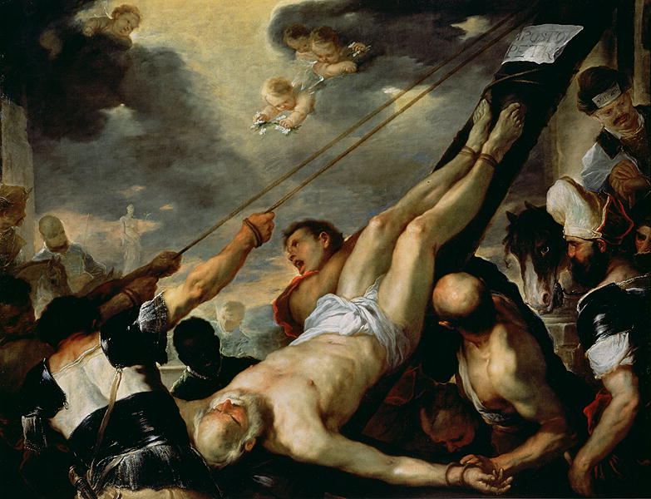
The second line
Health, Wealth and Prosperity - “If God is for us who can be against us.”
1) What is the context of this passage? Rom 8:31 – About How God will help us through trials. It has nothing to do with health, wealth and prosperity.
2) What does it mean, that “also with Him give us freely all things”?
3) Eternal life. It is not talking about transitory wealth.
[1Ti 6:7 NASB] 7 For we have brought nothing into the world, so we cannot take anything out of it either.
4) What was Peter doing wrong to not gain Earthly prosperity?

Slide 11
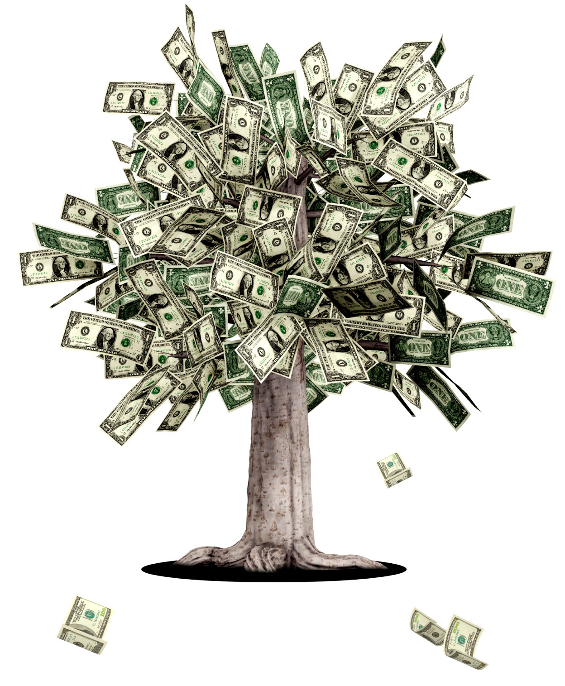
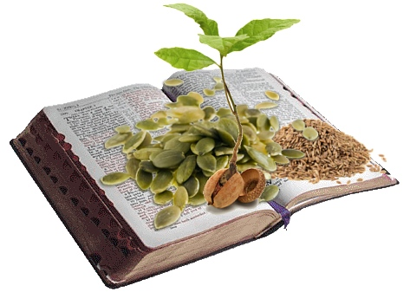
The second line expanded
[Mar 4:3 NASB] 3 "Listen to this! Behold, the sower went out to sow;

Slide 12
Jesus explains this parable
Is this parable about gaining money? Is it about you having your best life now? This parable is telling us to spread the word of God, in season and out of season. It’s by the power of God that a heart grows with the word.
[1Co 3:6 NASB] 6 I planted, Apollos watered, but God was causing the growth.
God is the one that grows our faith. God is sovereign and preserved the word until this age. God is sovereign over the life we will lead through Jesus.
[Eph 2:10 NASB] 10 For we are His workmanship, created in Christ Jesus for good works, which God prepared beforehand so that we would walk in them.

Slide 13
Third line – the responsibility of believers in season and out of season
[Eph 4:1-14 NASB] 1 Therefore I, the prisoner of the Lord, implore you to walk in a manner worthy of the calling with which you have been called, 2 with all humility and gentleness, with patience, showing tolerance for one another in love, 3 being diligent to preserve the unity of the Spirit in the bond of peace. 4 There is one body and one Spirit, just as also you were called in one hope of your calling; 5 one Lord, one faith, one baptism, 6 one God and Father of all who is over all and through all and in all. 7 But to each one of us grace was given according to the measure of Christ's gift. 8 Therefore it says, "WHEN HE ASCENDED ON HIGH, HE LED CAPTIVE A HOST OF CAPTIVES, AND HE GAVE GIFTS TO MEN." 9 (Now this expression, "He ascended," what does it mean except that He also had descended into the lower parts of the earth? 10 He who descended is Himself also He who ascended far above all the heavens, so that He might fill all things.) 11 And He gave some as apostles, and some as prophets, and some as evangelists, and some as pastors and teachers, 12 for the equipping of the saints for the work of service, to the building up of the body of Christ; 13 until we all attain to the unity of the faith, and of the knowledge of the Son of God, to a mature man, to the measure of the stature which belongs to the fullness of Christ. 14 As a result, we are no longer to be children, tossed here and there by waves and carried about by every wind of doctrine, by the trickery of men, by craftiness in deceitful scheming;

Slide 14
The job of a Church is not to reach the “unchurched”
The job of the Church is to raise up disciples, just as Jesus did with the 12 Apostles. The job of the Church is not to bring the world to it, but that we go out to our world to reach the lost to save them from eternal hell.
[Rom 14:19 NASB] 19 So then we pursue the things which make for peace and the building up of one another.
Church should be training us to be disciples of Christ. That we are ready in season and out of season to share the good news.
[Mar 16:15 NASB] 15 And He said to them, "Go into all the world and preach the gospel to all creation.
[1Pe 3:15 NASB] 15 but sanctify Christ as Lord in your hearts, always being ready to make a defense to everyone who asks you to give an account for the hope that is in you, yet with gentleness and reverence;

Slide 15
The lost will not like this Church
When we try to reach the lost in Church where we are to edify believers, we are not teaching the Gospel according to Paul.
[1Co 1:18 NASB] 18 For the word of the cross is foolishness to those who are perishing, but to us who are being saved it is the power of God.
A lost person, an “unchurched” person should gain nothing from a sermon that is edifying the body of Christ.
[Jhn 3:19-21 NASB] 19 "This is the judgment, that the Light has come into the world, and men loved the darkness rather than the Light, for their deeds were evil. 20 "For everyone who does evil hates the Light, and does not come to the Light for fear that his deeds will be exposed. 21 "But he who practices the truth comes to the Light, so that his deeds may be manifested as having been wrought in God."

Slide 16
The lost will not like us
Anyone who follows Christ will likely receive persecution.
[2Ti 3:12 NASB] 12 Indeed, all who desire to live godly in Christ Jesus will be persecuted.
[Jhn 15:17-19 NASB] 17 "This I command you, that you love one another. 18 "If the world hates you, you know that it has hated Me before it hated you. 19 "If you were of the world, the world would love its own; but because you are not of the world, but I chose you out of the world, because of this the world hates you.

Slide 17
Last line for the night?
The roof is the most important part. Preaching on contendeness.
[1Ti 6:6 NASB] 6 But godliness actually is a means of great gain when accompanied by contentment.
God will grant us the things we need, if we seek Him first. This is the “prosperity” of a follower in Christ.
[1Ti 6:8 NASB] 8 If we have food and covering, with these we shall be content.
What shall we want, if we have food and covering? Remember what Paul said?
[1Ti 6:7 NASB] 7 For we have brought nothing into the world, so we cannot take anything out of it either.
We cannot take anything here into the next world. In fact, the things of this world have a gravity that can hold us back from a whole-hearted relationship with God.
Are we focused on the right things for our spiritual eternal life?
[Mat 6:19-21 NASB] 19 "Do not store up for yourselves treasures on earth, where moth and rust destroy, and where thieves break in and steal. 20 "But store up for yourselves treasures in heaven, where neither moth nor rust destroys, and where thieves do not break in or steal; 21 for where your treasure is, there your heart will be also.

Slide 18
The lines that I see being crossed
Approval of Homosexuality (Gal 5:19-21)
No rebukes for adultery and or divorce within the body of Christ (See 1 Corinthians)
Greed, and avarice for the things of this world (Rev 21:8)
Judgment against God’s word. (Rev 19:13)
Unity that sacrifices doctrine. (Tit 1:9) (A little leaven leavens the whole lump)
No focus on evangelism – it is the responsibility of every believer.
No focus on sanctification – We will not be sinless, but we should be sinning less. We should be winning battles against the flesh.
Where is the fear of God? The fear of God is the beginning of wisdom – do we desire to know how to apply His word? Fear God.
Why is there so little talk of Hell? Hell is eternal, those who do not believe will spend an eternity in hell where the worm does not die, and the fire is not quenched. All of our neighbors around us that do not believe in Christ, will spend an eternity in Hell for their unbelief. This is an area that has convicted my heart. If we really believe in hell, why aren’t we doing more than helping the poor. We should be preaching the gospel to the lost outside of Church, in season and out of season. We don’t know how long your neighbor’s life is. Will they live past this week, or will they meet God tonight? If our neighbor died tonight, and didn’t hear the word, would they say, “Why didn’t Morris tell me this truth?” Do we fear God and believe that eternal torment is real for unbelievers?

Slide 19
Conclusion
I hope that this doesn’t feel like an attack on someone that you listen to, or where you go to Church. My hope is that this builds you up from the ground up. It’s why I believe what I believe. Why I have said what I have said.
I should have started with doctrine, and not attacking people. It was wrong of me to attack the Church and to attack the people you listen to. Doctrine is more important than people and denominations.
Don’t take my word for any of this.
[Act 17:11 NASB] 11 Now these were more noble-minded than those in Thessalonica, for they received the word with great eagerness, examining the Scriptures daily to see whether these things were so.

