Slide 1
I’ve decided to no longer fellowship at Eastridge

Slide 2
Following the Holy Spirit is not easy
I have been praying about this for along time. Teachings have not aligned with scripture.
The night before they announced Jesus Culture I prayed to God to show me a sign on what He wanted me to do. It was also that sermon that P. Steve said, “I am not ashamed of the prosperity Gospel.”

Slide 3
My reasons
Steve is focused on a prosperity gospel more and more – This is against scripture.
He is hyper focused on tithing, trying to yoke his congregation back to the law.
He is focused on the wrong building. The body of Christ is flesh and blood not brick and mortar.

Slide 4
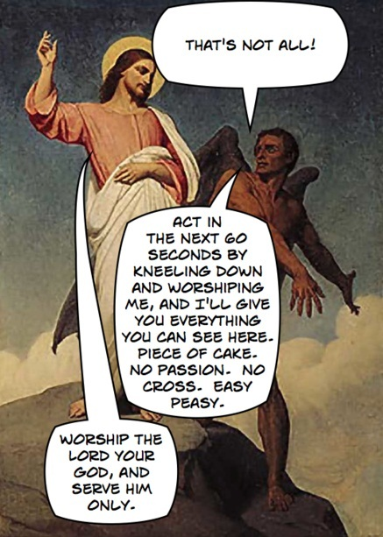
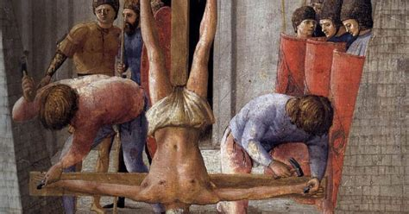
The problem with the Prosperity Gospel
Was Peter not faithful enough to God? Why wasn’t He made to prosper here on Earth?

Slide 5

Discernment is important.
It’s easy to tell what’s right and what’s wrong. What requires discernment is distinguishing what’s right from what’s slightly wrong. This is why our Bible is so important. We must test all things.
[1Jo 4:1 NIV] 1 Dear friends, do not believe every spirit, but test the spirits to see whether they are from God, because many false prophets have gone out into the world.

Slide 6
The verse that made me know I have to leave.
[1Ti 6:5 NIV] 5 and constant friction between people of corrupt mind, who have been robbed of the truth and who think that godliness is a means to financial gain.
This verse tells us exactly what is going on at Eastridge. I listened to the last sermon and heard more of this push for Earthly prosperity. He is continuing to confuse spiritual gain with financial gain. This is also known as the Doctrine of Balaam.
[Rev 2:14-16 NIV] 14 Nevertheless, I have a few things against you: There are some among you who hold to the teaching of Balaam, who taught Balak to entice the Israelites to sin so that they ate food sacrificed to idols and committed sexual immorality. 15 Likewise, you also have those who hold to the teaching of the Nicolaitans. 16 Repent therefore! Otherwise, I will soon come to you and will fight against them with the sword of my mouth.
[1Ti 6:5 NKJV] 5 useless wranglings of men of corrupt minds and destitute of the truth, who suppose that godliness is a [means of] gain. From such withdraw yourself.

Slide 7
More on the doctrine of Balaam
[2Pe 2:15 NIV] 15 They have left the straight way and wandered off to follow the way of Balaam son of Bezer, who loved the wages of wickedness.
[Mat 6:19-21 NIV] 19 "Do not store up for yourselves treasures on earth, where moths and vermin destroy, and where thieves break in and steal. 20 But store up for yourselves treasures in heaven, where moths and vermin do not destroy, and where thieves do not break in and steal. 21 For where your treasure is, there your heart will be also.

Slide 8
What prosperity did God promise?
[Mat 6:25-34 NIV] 25 "Therefore I tell you, do not worry about your life, what you will eat or drink; or about your body, what you will wear. Is not life more than food, and the body more than clothes? 26 Look at the birds of the air; they do not sow or reap or store away in barns, and yet your heavenly Father feeds them. Are you not much more valuable than they? 27 Can any one of you by worrying add a single hour to your life? 28 "And why do you worry about clothes? See how the flowers of the field grow. They do not labor or spin. 29 Yet I tell you that not even Solomon in all his splendor was dressed like one of these. 30 If that is how God clothes the grass of the field, which is here today and tomorrow is thrown into the fire, will he not much more clothe you--you of little faith? 31 So do not worry, saying, 'What shall we eat?' or 'What shall we drink?' or 'What shall we wear?' 32 For the pagans run after all these things, and your heavenly Father knows that you need them. 33 But seek first his kingdom and his righteousness, and all these things will be given to you as well. 34 Therefore do not worry about tomorrow, for tomorrow will worry about itself. Each day has enough trouble of its own.

Slide 9
Which is the same thing Paul exhorts
[1Ti 6:6-11 NIV] 6 But godliness with contentment is great gain. 7 For we brought nothing into the world, and we can take nothing out of it. 8 But if we have food and clothing, we will be content with that. 9 Those who want to get rich fall into temptation and a trap and into many foolish and harmful desires that plunge people into ruin and destruction. 10 For the love of money is a root of all kinds of evil. Some people, eager for money, have wandered from the faith and pierced themselves with many griefs. 11 But you, man of God, flee from all this, and pursue righteousness, godliness, faith, love, endurance and gentleness.

Slide 10
Now to this last Sunday.
Matt 25:14 “For it is just like a man about to go on a journey, who called his own slaves and entrusted his possessions to them. 15 To one he gave five [fn]talents, to another, two, and to another, one, each according to his own ability; and he went on his journey. 16 Immediately the one who had received the five talents went and traded with them, and gained five more talents. 17 In the same manner the one who had received the two talents gained two more. 18 But he who received the one talent went away, and dug a hole in the ground and hid his [fn]master’s money.19 “Now after a long time the master of those slaves *came and *settled accounts with them. 20 The one who had received the five talents came up and brought five more talents, saying, ‘Master, you entrusted five talents to me. See, I have gained five more talents.’ 21 His master said to him, ‘Well done, good and faithful slave. You were faithful with a few things, I will put you in charge of many things; enter into the joy of your master.’22 “Also the one who had received the two talents came up and said, ‘Master, you entrusted two talents to me. See, I have gained two more talents.’ 23 His master said to him, ‘Well done, good and faithful slave. You were faithful with a few things, I will put you in charge of many things; enter into the joy of your master.’24 “And the one also who had received the one talent came up and said, ‘Master, I knew you to be a hard man, reaping where you did not sow and gathering where you scattered no seed. 25 And I was afraid, and went away and hid your talent in the ground. See, you have what is yours.’26 “But his master answered and said to him, ‘You wicked, lazy slave, you knew that I reap where I did not sow and gather where I scattered no seed. 27 Then you ought to have put my money [fn]in the bank, and on my arrival I would have received my money back with interest. 28 Therefore take away the talent from him, and give it to the one who has the ten talents.’29 “For to everyone who has, more shall be given, and he will have an abundance; but from the one who does not have, even what he does have shall be taken away. 30 Throw out the worthless slave into the outer darkness; in that place there will be weeping and gnashing of teeth.

Slide 11
Is God really going to throw this man into Hell for not making money?
[Mat 25:30 NASB] 30 "Throw out the worthless slave into the outer darkness; in that place there will be weeping and gnashing of teeth.
The punishment that Jesus describes here is the final judgment, Hell. It’s the same judgment He describes in Luke.
[Luk 13:23-28 NASB] 23 And someone said to Him, "Lord, are there just a few who are being saved?" And He said to them, 24 "Strive to enter through the narrow door; for many, I tell you, will seek to enter and will not be able. 25 "Once the head of the house gets up and shuts the door, and you begin to stand outside and knock on the door, saying, 'Lord, open up to us!' then He will answer and say to you, 'I do not know where you are from.' 26 "Then you will begin to say, 'We ate and drank in Your presence, and You taught in our streets'; 27 and He will say, 'I tell you, I do not know where you are from; DEPART FROM ME, ALL YOU EVILDOERS.' 28 "In that place there will be weeping and gnashing of teeth when you see Abraham and Isaac and Jacob and all the prophets in the kingdom of God, but yourselves being thrown out.

Slide 12
The parable of talents is about evangelism
Each of us has different spiritual gifts as Paul says in 1 Co 12. Those gifts are meant to be used to exhort the existing body and to add to the body.
That is why that unfaithful servant was cast out, He was not faithful to His spiritual gift. Like the man who refused to forgive others. (Matt 18:21-35) After He refused to forgive, God gave Him over to the tormentors.

Slide 13
This has nothing to do with money
P. Steve several times talked about building a legacy here on Earth. What does that scripture I quoted earlier say?
”Seek first the kingdom of God.”
God did not tell us to build a kingdom on Earth before His second coming. This is what “legacy” means – He wants to build His legacy by making Eastridge larger.
[Mat 28:19-20 NASB] 19 "Go therefore and make disciples of all the nations, baptizing them in the name of the Father and the Son and the Holy Spirit, 20 teaching them to observe all that I commanded you; and lo, I am with you always, even to the end of the age."
P. Steve believes that making disciples, means growing Eastridge. That is not the body of Christ, it’s a building. It has no soul.
God does not dwell in a building of brick and mortar, He dwells in a build of flesh and blood. Living stone – that is the building that P. Steve should be focused on building up, not the building of brick and mortar.

Slide 14
Rethinking Church

Slide 15
Chan’s view on this aligns with the Bible
We are the Temple, we are the Church
[1Pe 2:4-9 NKJV] 4 Coming to Him [as to] a living stone, rejected indeed by men, but chosen by God [and] precious, 5 you also, as living stones, are being built up a spiritual house, a holy priesthood, to offer up spiritual sacrifices acceptable to God through Jesus Christ. 6 Therefore it is also contained in the Scripture, "Behold, I lay in Zion A chief cornerstone, elect, precious, And he who believes on Him will by no means be put to shame." 7 Therefore, to you who believe, [He is] precious; but to those who are disobedient, "The stone which the builders rejected Has become the chief cornerstone," 8 and "A stone of stumbling And a rock of offense." They stumble, being disobedient to the word, to which they also were appointed. 9 But you [are] a chosen generation, a royal priesthood, a holy nation, His own special people, that you may proclaim the praises of Him who called you out of darkness into His marvelous light;

Slide 16
[Gal 5:9 NIV] 9 "A little yeast works through the whole batch of dough."
It’s important for us to be like the Bereans to challenge our Pastors or if necessary leave them, for their false teachings put us in danger.
[Act 17:11 NIV] 11 Now the Berean Jews were of more noble character than those in Thessalonica, for they received the message with great eagerness and examined the Scriptures every day to see if what Paul said was true.

Slide 17
Who spoke with this Yeast?
“Jesus loves me this I know, for the Bible tells me so. “This is where our trouble began”
A lot of People don’t believe it. And I understand that. Maybe the thought is, ‘Hey, maybe they had to come up with some myth about Jesus to give Him street cred, you know, later on.’ Maybe that’s where that came from.

Slide 18
Should a Christians care what the world thinks about the Bible or Jesus’ supernatural origin?
[Jas 4:4 NIV] 4 You adulterous people, don't you know that friendship with the world means enmity against God? Therefore, anyone who chooses to be a friend of the world becomes an enemy of God.
[1Jo 4:5 NIV] 5 They are from the world and therefore speak from the viewpoint of the world, and the world listens to them.

