Slide 1
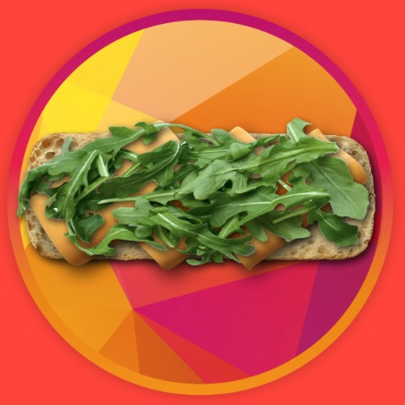
Sandwicheck v2.0
Moshe Bukhman
MERN fullstack project with Debian custom server

Slide 2

What’s new already the front
Toast error messages
More dynamic sandwich creation
Choise of portion size
Adding comment
Ingredients sorted by interest
Role selection on signup
Each sandwich gets a generated flattened image
Dietary options of a sandwich (auto generated by ingredients)
Adding a child to a parent’s account via a link or manually
Copy one’s sandwith and edit
Constants and ENV variables, almost no hardcoded variables

Slide 3
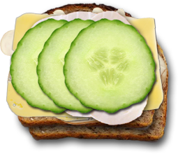
How strong is the back-end?
A lot of optimizations before data goes to and from DB
Security: secured cookies 100% ruled by the server, request limiter, input sanitazation (xpp) and parameters protection (hpp)
Authorization: admin acces, parents can access their children

Slide 4
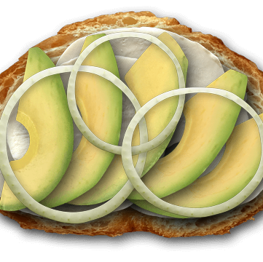
What’s next and already supported by server?
Reset, forgot password w/email confirmation
Admin: add, edit, soft remove ingredients with proper images checking
Create a child without an email or a password
Login as any child and go back to a parent account
Sandwich editing in first 20 minutes after creation
Seach by ingredients
Seach by dietary options
Weekly and daily menus
Parents have full access to children’s data without log-in as a child
Profile images
Detaching parents and children (with special treatment of email-less children)

Slide 5

What will be in the future?
Parents must confirm email to be able to add a child
Weekly menus of all family with ingredients-to-buy option
Time limit for updation child menu
Include / not all parents’ menus to the family menu (divorse…)
Each sandwich has it’s own social media image and description
Server to send constants and settings to the client
Words filtering with JS module / AI

Slide 6

Technologies
Debian server, DNS management
JWT, bcrypt.js, multer, nodemailer
MERN STACK
Sharp module

Slide 7


https://sandwicheck.app

