Slide 1
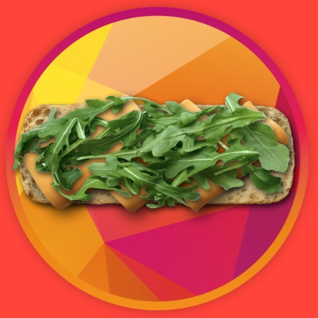
Sandwicheck v2.0
Moshe Bukhman
MERN fullstack project with Debian custom server

Slide 2

What’s new already the front
Toast error messages
More dynamic sandwich creation
Choise of portion size
Adding comment
Ingredients sorted by interest
Role selection on signup
Each sandwich gets a generated flattened image
Dietary options of a sandwich (auto generated by ingredients)
Adding a child to a parent’s account via a link or manually
Copy one’s sandwith and edit
Constants and ENV variables, almost no hardcoded variables

Slide 3
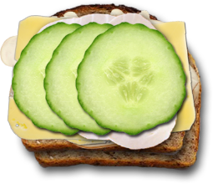
How strong is the back-end?
A lot of optimizations before data goes to and from DB
Security: secured cookies 100% ruled by the server, request limiter, input sanitazation (xpp) and parameters protection (hpp)
Authorization: admin acces, parents can access their children

Slide 4
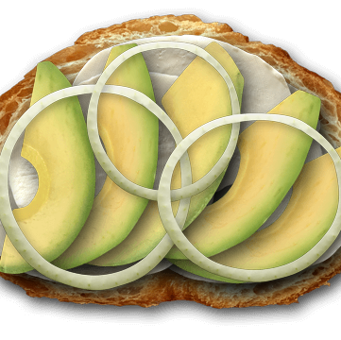
What’s next and already supported by server?
Reset, forgot password w/email confirmation
Admin: add, edit, soft remove ingredients with proper images checking
Create a child without an email or a password
Login as any child and go back to a parent account
Sandwich editing in first 20 minutes after creation
Seach by ingredients
Seach by dietary options
Weekly and daily menus
Parents have full access to children’s data without log-in as a child
Profile images
Detaching parents and children (with special treatment of email-less children)

Slide 5

What will be in the future?
Parents must confirm email to be able to add a child
Weekly menus of all family with ingredients-to-buy option
Time limit for updation child menu
Include / not all parents’ menus to the family menu (divorse…)
Each sandwich has it’s own social media image and description
Server to send constants and settings to the client

Slide 6

Technologies
Debian server, DNS management
JWT, bcrypt.js, multer, nodemailer
MERN STACK
Sharp module

Slide 7


https://sandwicheck.app

