Slide 1


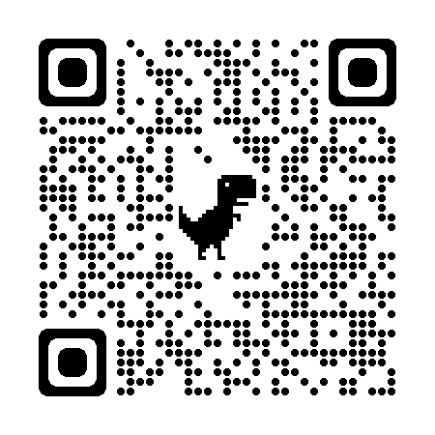
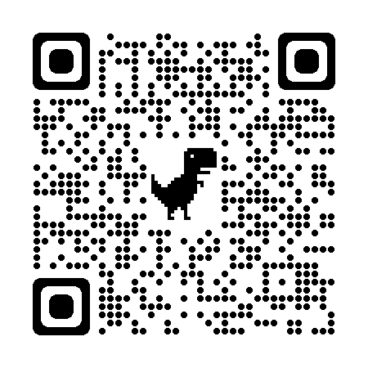


USAID Feed the Future Global Poverty and Malnutrition Estimation Project
Medha Bulumulla
In conjunction with International Food and Policy Research and United States Agency for International Development
Introduction
Data | Description
ARENA | DHS cluster level prevalence of child stunting, wasting, and healthy; DHS cluster level prevalence of households falling below asset poverty line; geotagged travel time to nearest city with population of 500000 or more; geotagged percent tree cover; geotagged pasture coverage; geotagged altitude; and geotagged slope. The non-DHS, geotagged data were linked to the DHS data by IFPRI from third party data sources as documented in the manuscript.
DHS | Women's underweight BMI prevalence at the cluster level.
CHRPS | Monthly precipitation data at 0.05 degree resolution.
UCDP | The number of violent events, or incidents wherein "armed force was used by an organized actor against another organized actor, or against civilians, resulting in at least 1 direct death at a specific location and a specific date" and the number of deaths that occurred during each event
LST | Monthly composites of daily LST observations, at 1km resolution.
SIF | Time series SIF data recorded at monthly, 0.05 degree resolution.
FAO | Monthly market-level data for major food commodities.
Results
Challenges
Estimating food insecurity using surveys can be expensive due to travel and personnel costs.
This project aims to use easily accessible data to predict where food insecurity will strike using data from Bangladesh, Ethiopia, Ghana, Guatemala, Honduras, Kenya, Mali, Nepal, Nigeria, Senegal, and Uganda 2004-2016
Chris Browne, a math PhD student, developed Python scripts to perform contemporaneous forecasting and sequential nowcasting.
Using the machine learning technique of Multivariate Joint Random Forest Method on malnutrition and poverty indicators, sequential nowcasting’s prediction improved but was not as effective in contemporaneous prediction.
I annotated the python scripts, created a project website, developed presentations and learning modules. My work aimed to help others with less machine learning experience to recreate the code for their needs.
Please see the below QR codes to look at my websites.
This project features data from numerous departments and organizations, coordinating with everyone was often difficult.
Understanding and annotating someone else’s proved to be more difficult than I originally expected because not everyone has the same writing styles.
Acknowledgements
Methodology
We thank the United States Agency for International Development for financial support under cooperative agreement #7200 AA18 CA00 014, “Innovations in Feed the Future Monitoring and Evaluation – Harnessing Big Data and Machine Learning to Feed the Future” All data and written products are solely the authors’ responsibility and do not necessarily reflect the views of USAID or the United States Government.
Thank you to my faculty mentor, Chris Barrett for his guidance, Chris Browne for his code, Linden McBride for her advice, the Laidlaw Foundation and Cornell University for making this happen.
Joint Random Forest Method?
A supervised machine learning technique where many decision trees are created. Then majority voting is utilized to decide on a final tree.
Whitening
Transforming a vector of random variables to remove correlation to train the model
Sequential Nowcasting:
Using current observations to make predictions. This can be used in early warning systems or give a baseline when deciding on interventions
Contemporaneous Forecasting:
Using past observations to make predictions. This can be used to inform geographic targeting in poverty, malnutrition interventions, or to monitor and evaluate.
Annotated Code & Project Website

