Slide 1

THY Datathon

Slide 2





AI of the Tiger
Fatih Kubilay Yavuz
Hakkı Besim Bardakçı
Melik Burak Bozbey
Boğaziçi Üniversitesi
Endüstri Mühendisliği
4.Sınıf
İTÜ
Bilgisayar Mühendisliği
3.Sınıf
Boğaziçi Üniversitesi
Elektrik-Elektronik Mühendisliği
4.Sınıf

Slide 3
Case 1

Slide 4



Procedure
UI
Thresholding
Query Selection
Parse Data

Slide 5
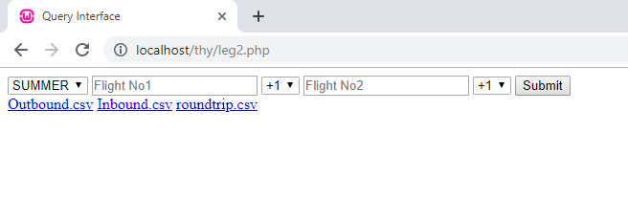

Slide 6
Case 2

Slide 7
Procedure
ML
Preprocessing
Exploratory Data Analysis
Data Scaling

Slide 8


Data Scaling
Handling Large Data with «Pandas»
Set specific data types for each column.
«Feather» Format to Read & Write Data
It uses Apache Arrow columnar memory specification to represent binary data on disk.
«Swifter» to Efficient Data Manipulation
A package which efficiently applies any function to a pandas dataframe or series in the fastest available
manner.
Encoding Categorical Labels
LabelEncoder is used instead of OneHotEncoder.

Slide 9
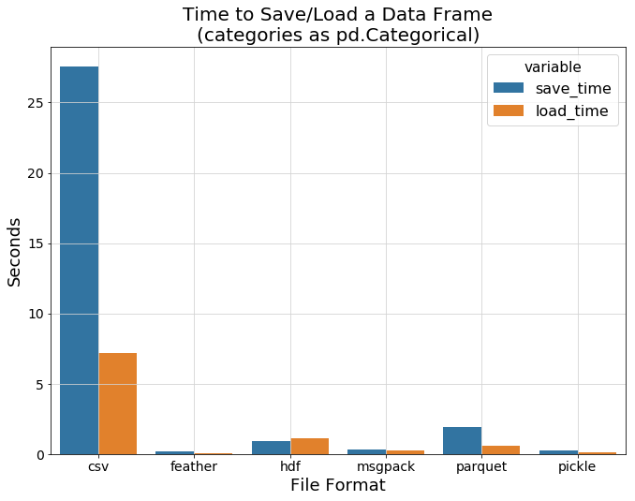
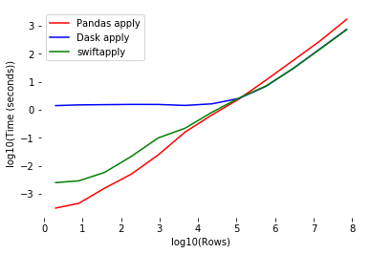


Slide 10

Exploratory Data Analysis
Missing Values
These values need imputation or replication with any other value rather than NaN.
Highly Correlated Features
A simpler model is preferable, and, in similiar sense, a model with fewer features is simpler.
Feature Importance & Dimension Reduction
The importance of a feature is measured by calculating the increase in the model’s prediction error after permuting the feature.
Feature Extraction
Time series features are converted to Pandas datetime format and features extracted w.r.t to datetime.

Slide 11

Data Preprocessing
Missing Values
Dropping entire NaN values & replication with unknown label and most_frequent instances for FLIGHT_NO & AIRCRAFT_TYPE
0.1% for FLIGHT_NO & 0.4% for AIRCRAFT.
Feature Importance
Meaningful features were used due to improve model’s performance.
Outlier Detection
Discrepancy on CONNECTION_TIME and relation of CABIN CLASS and SELL_CLASS etc.
No manipulation is made because these type of data are also in the submission file.

Slide 12
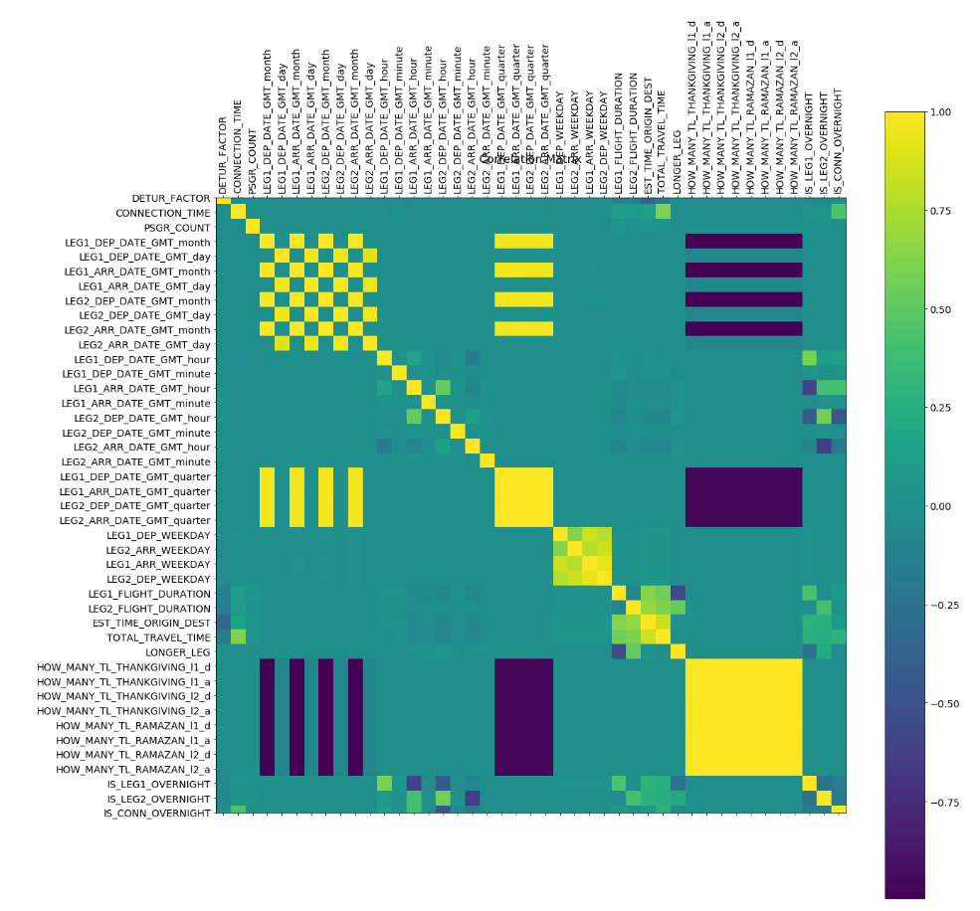

Slide 13

Machine Learning
Neural Networks
CatBoost
Linear Regression

Slide 14
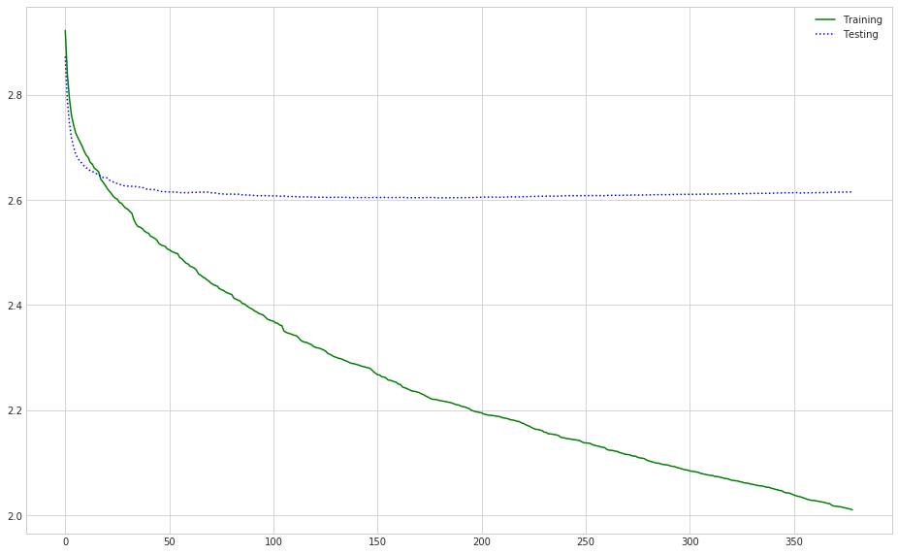

Slide 15

Future Improvements
Time Series Generator with Keras
Without scale 0.09% RMSE validation loss.
Data Cleaning
Outliers in data are also in submission file.
SparkSQL
In case of no giant VMs, structured data manipulation & machine learning models usually faster with SparkSQL.
Domain Knowledge
More features can be extracted with domain knowledge.

Slide 16
Teşekkürler
AI of the Tiger

