Slide 1

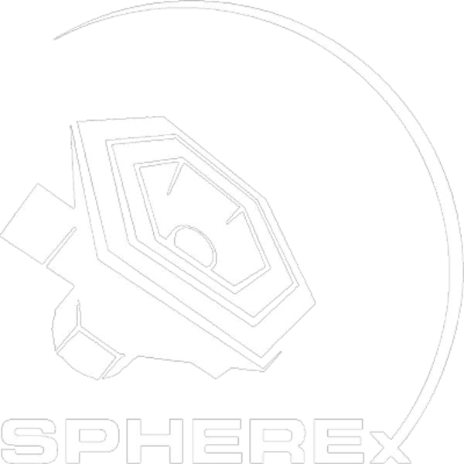
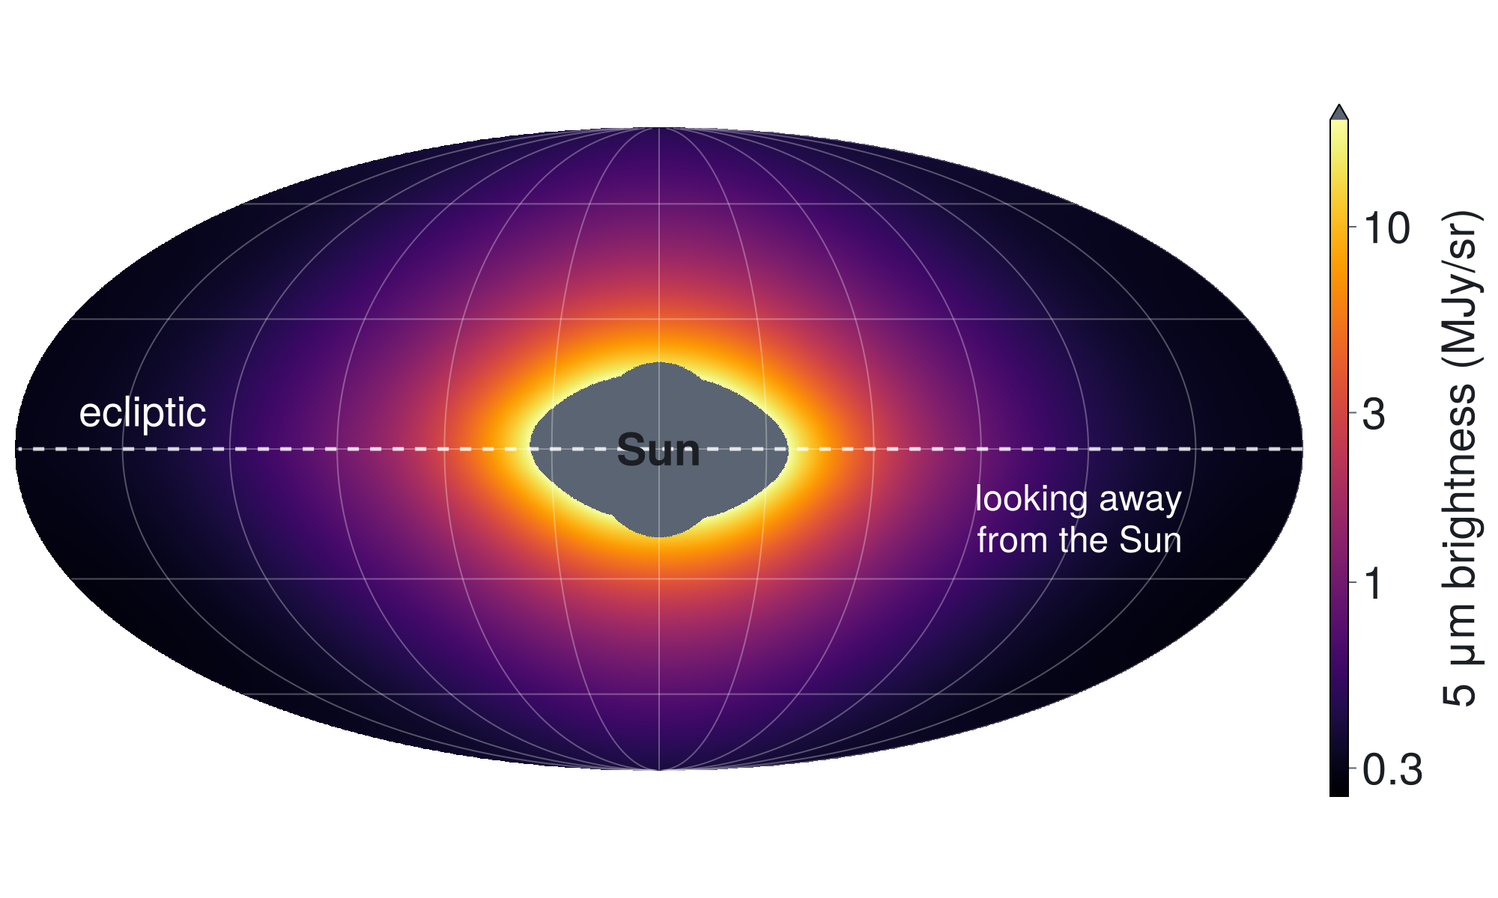
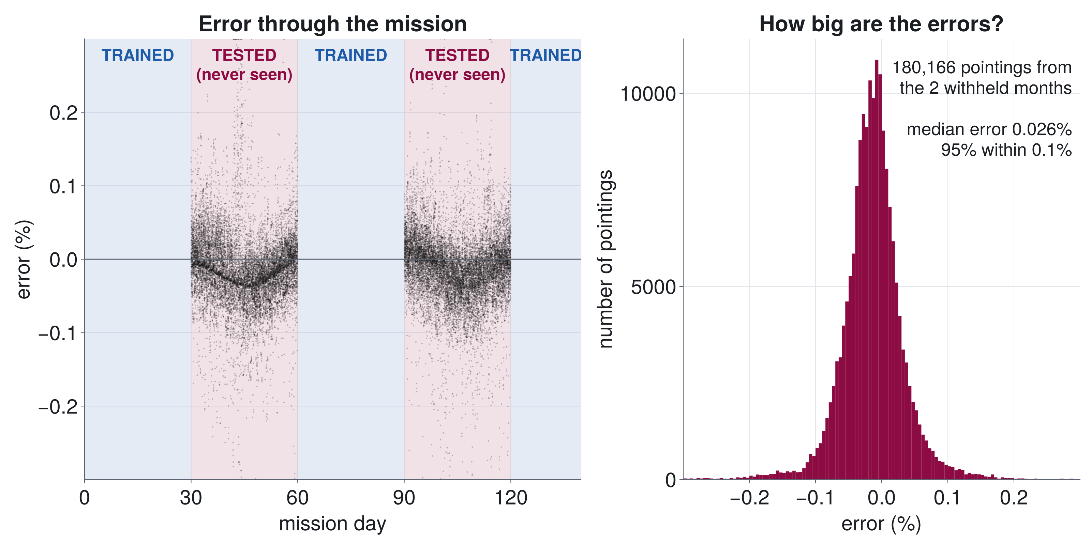
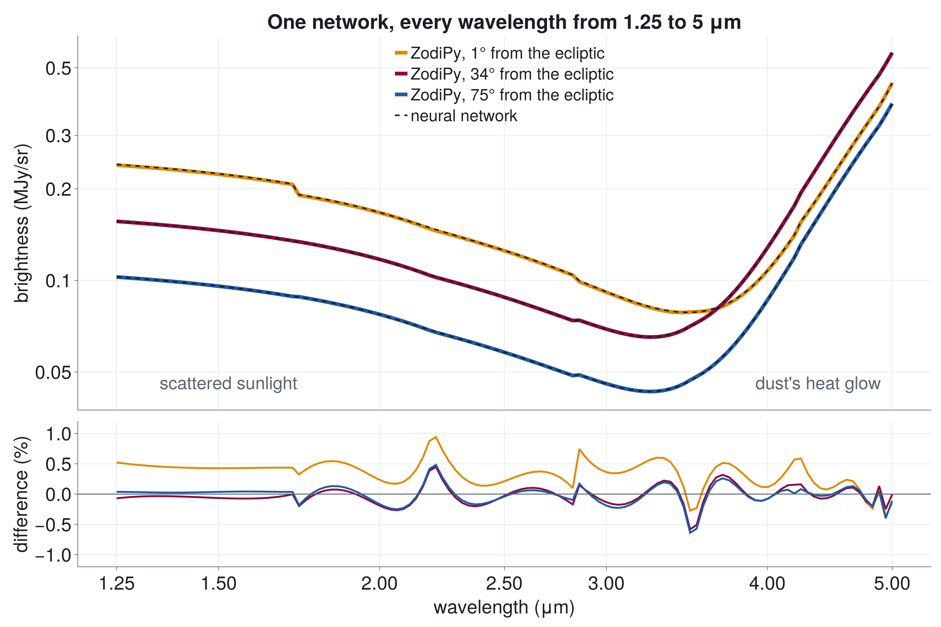
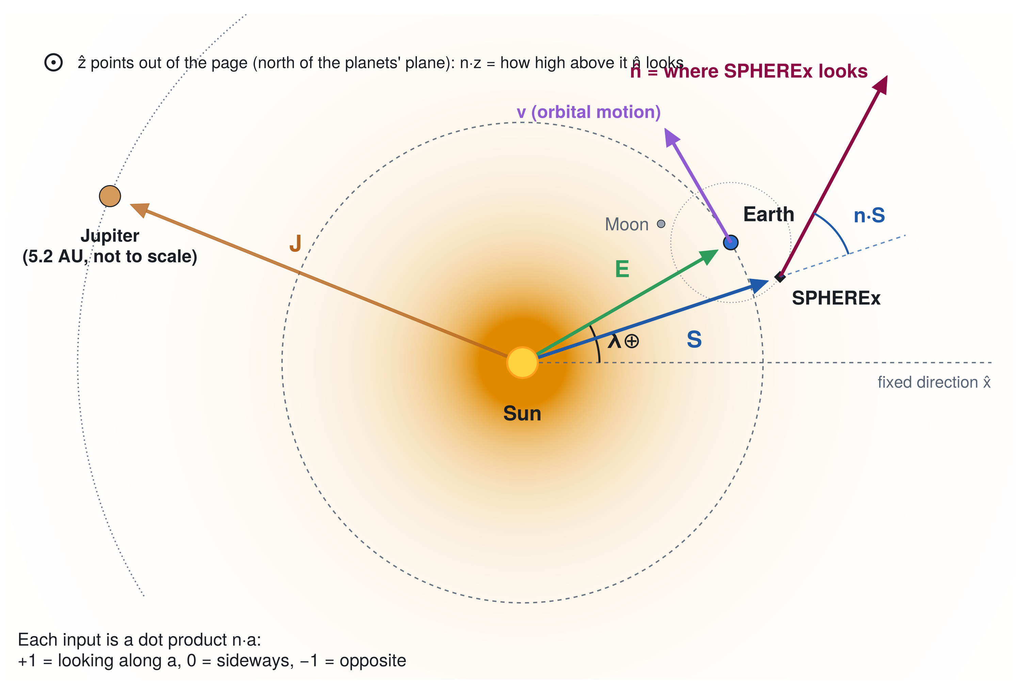

Teaching a Neural Network the Glow of the Solar System
A geometrically constrained model of zodiacal light for NASA's SPHEREx mission
Mark A. Burch and Dr. Andrew Saydjari
Astronomy Department, New Mexico State University, Las Cruces, NM
A geometrically constrained neural network learns the zodiacal light from viewing geometry alone, reaching ~0.03% median error on months it never saw.
Background
Results
SPHEREx is a NASA space telescope, launched in March 2025, that maps the entire sky across a range of infrared wavelengths (0.75–5 μm). Its maps will help explain how the universe began, how galaxies formed, and where water and other ingredients for life are found.
0.026%
95%
64
Zodiacal light. The Solar System is filled with a thin cloud of dust from comets and asteroids. Sunlight scattered by this dust, plus the dust's own heat glow, adds a smooth glow across every SPHEREx image (Fig. 1). It is bright enough to be confused with the faint background light from distant galaxies, and it changes with where the telescope looks and where Earth is in its orbit, so it must be carefully modeled and removed.
The Kelsall model. Kelsall et al. (1998) built the standard model of this dust from NASA's COBE satellite: a smooth cloud, three dust bands, a ring around the Sun and a clump trailing Earth. The software ZodiPy computes what a telescope would see from it; we use it to simulate SPHEREx data.
median error on months
withheld from training
of pointings within
0.1% of ZodiPy
wavelengths in
one network
Figure 1. The whole sky at 5 μm as seen from SPHEREx (ZodiPy). The glow is brightest toward the Sun and along the plane of the planets. Grey: too close to the Sun to observe.
The problem: zodiacal light must be removed from every SPHEREx image, but physics models such as Kelsall's were fit to older data and leave errors behind.
Research objective: build a geometrically constrained neural network that learns the zodiacal light directly from SPHEREx data and outperforms the Kelsall model. First step (this poster): show that it can learn ZodiPy's simulated sky from geometry alone.
Figure 3. Neural network vs. ZodiPy. The network was trained on mission days 0–30, 60–90 and 120–140, then tested on the two 30-day blocks it never saw (days 30–60 and 90–120; 180,166 pointings). Half of the errors are below 0.026% and 95% are below 0.1%. (With a random 10% of pointings withheld instead, the median is 0.015%.)
Looking forward: every SPHEREx wavelength. Real SPHEREx images cover many wavelengths, so wavelength becomes one more input. A first version covering 1.25–5 μm already reaches ~0.1% median error on the same withheld months.
Methods
A geometrically constrained model. The network never sees a date or a position on a sky map. Its only inputs are 9 numbers describing the viewing geometry (Fig. 2): dot products of SPHEREx's look direction n with the directions that shape the zodiacal light, plus Earth's place in its orbit. It must learn how the brightness depends on geometry, just as the physics does, instead of memorizing when and where SPHEREx looked.
Figure 4. Brightness vs. wavelength for three pointings: ZodiPy (solid) and the network (dashed). Below 3 μm we see scattered sunlight; above, the dust's heat. Bottom: the differences stay under 1%.
Next Steps
Figure 2. The geometry the network sees (top view, not to scale). n is where SPHEREx looks; S and E point from the Sun to SPHEREx and Earth; v is the orbital motion; λ⊕ is Earth's angle around its orbit. Jupiter and the Moon are shown for context: the final model uses only the Sun–Earth–SPHEREx geometry and the time of year.
✓ DONE
Validate
Learn ZodiPy's simulated sky from geometry alone; test on unseen months and sky regions
The 9 inputs
IN PROGRESS
Refine
Longer training; all SPHEREx wavelengths (0.75–5 μm)
n·S, n·E
toward or away from the Sun (seen from SPHEREx and from Earth)
n·z
how far above or below the plane of the planets
n·vS, n·vE
ahead of or behind the orbital motion (SPHEREx, Earth)
n·x⊕, n·y⊕
look direction in a frame that turns with Earth (x⊕ = Sun → Earth)
NEXT
Scale up
Move training to a computing cluster
sin λ⊕, cos λ⊕
Earth's position in its orbit: the time of year
Training and testing. ZodiPy simulates 423,607 SPHEREx pointings (140 days, 5 μm). Five small networks (4 hidden layers, 64 → 16 neurons; Flux.jl in Julia) learn brightness from the 9 inputs and are averaged, then tested on whole months and sky regions they never saw.
Lesson: adding the time of year (sin λ⊕, cos λ⊕) cut the errors about 40–65×.
NEXT
Real data
Train on real SPHEREx images and compare with the Kelsall model
All results so far are preliminary and use simulated data.
Acknowledgements
References
This research is supported by a URS grant at New Mexico State University, funded by the National Science Foundation (NSF). Thank you to Dr. Andrew Saydjari for mentorship, and to the developers of ZodiPy and Flux.jl.
Kelsall, T., et al. 1998, ApJ, 508, 44 (COBE/DIRBE zodiacal-light model)
San, M., et al. 2022, JOSS, 7, 4602 (ZodiPy)
Doré, O., et al. 2014, arXiv:1412.4872 (SPHEREx)
Innes, M. 2018, JOSS, 3, 602 (Flux.jl)
Notes:
[CHECK with mentor]
- Problem statement: 'physics models such as Kelsall's were fit to older data and leave errors behind' -- right framing?
- Acknowledgment: exact name of the URS grant/program and the NSF award number (if one should be listed).
- Author line: middle initial / 'Dr.' style for the mentor.
- Fig. 2: Jupiter and the Moon are drawn for context; the poster's model inputs are n.S n.z n.E n.vS n.vE n.x_E n.y_E sin/cos(lambda_E) (no Jupiter, no Moon).
Numbers (poster/data_accuracy.jl, data_blocks.jl): 5-network ensemble, 64-64-32-16 gelu.
Trained on days 0-30, 60-90, 120-140; tested on days 30-60, 90-120 (180,166 pointings, 43%): median 0.026%, p95 0.10%, 94.8% within 0.1%, RMS 0.058%.
Random 10% withheld: median 0.015%. Last 20% of the mission (days 111-140, older season inputs): median 0.10%, p95 0.67%.
Errors are relative to ZodiPy (the Kelsall model), not the real sky.
- Multi-wavelength: round-15 'ep300' ensemble, 30-day blocks, 1.25-5.0 um (poster/data_spectra.jl).

