Slide 1

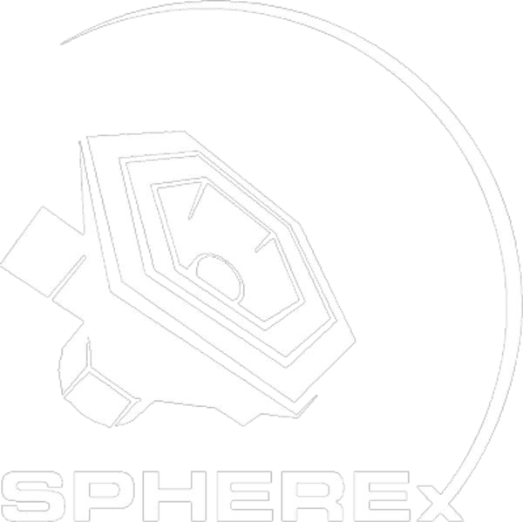
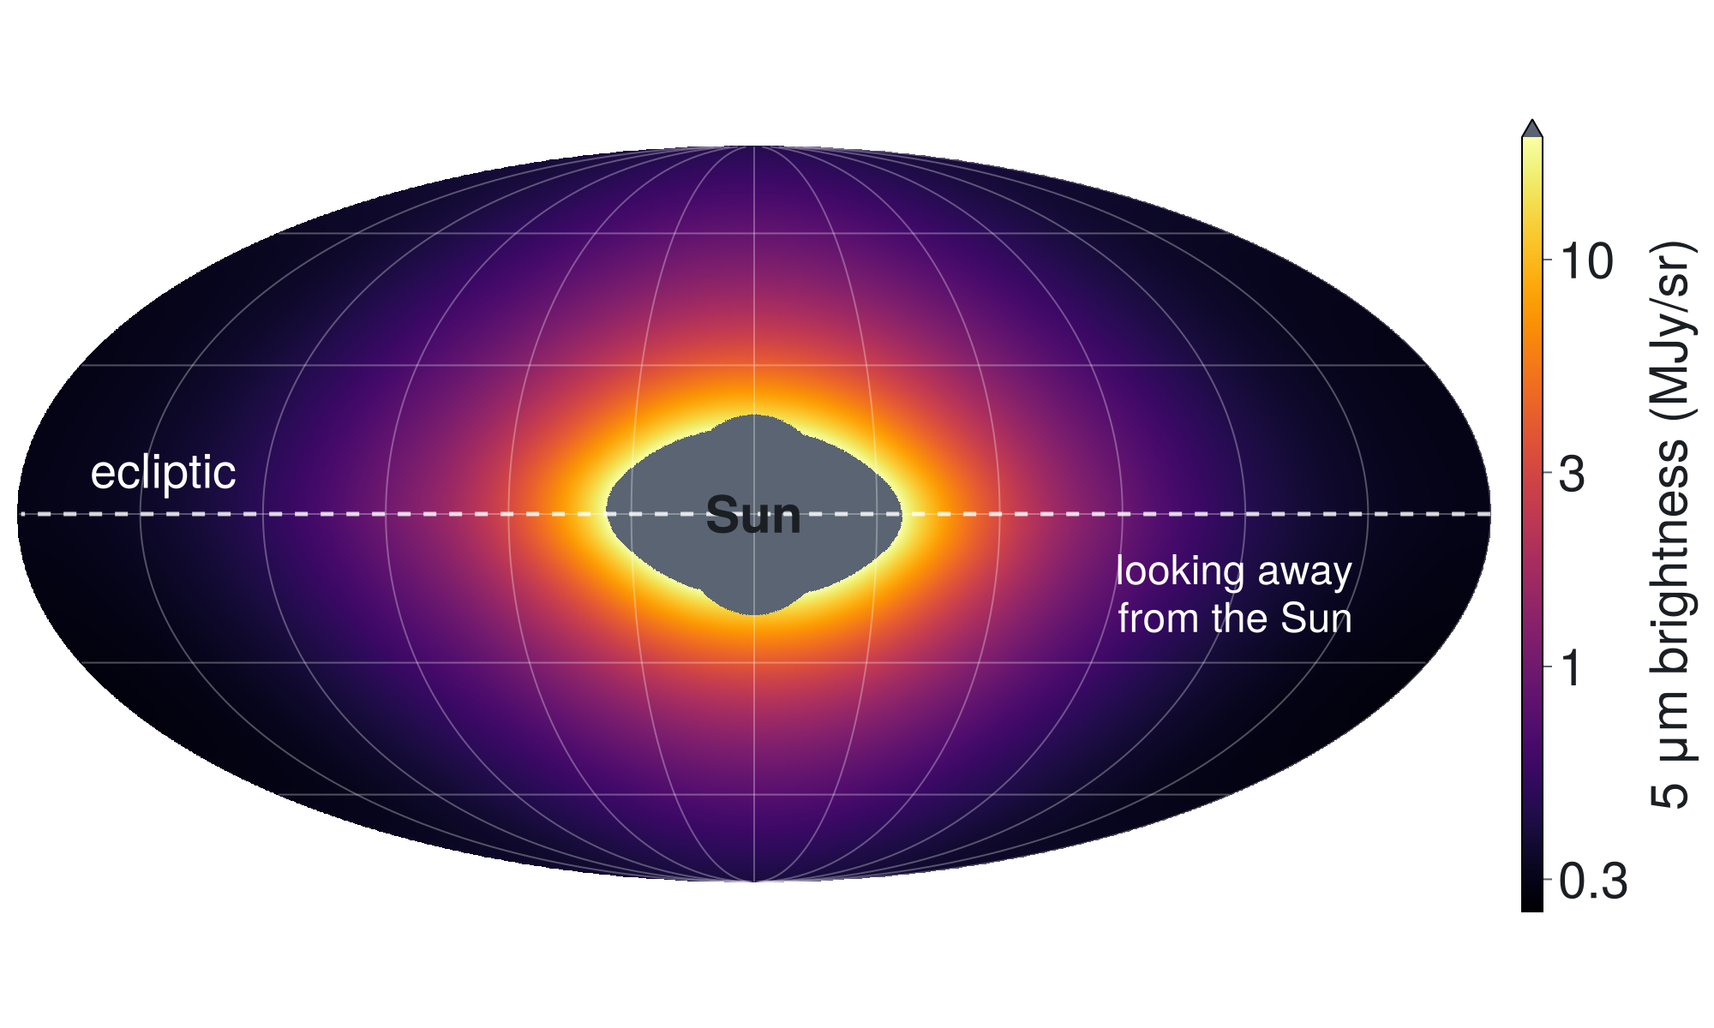
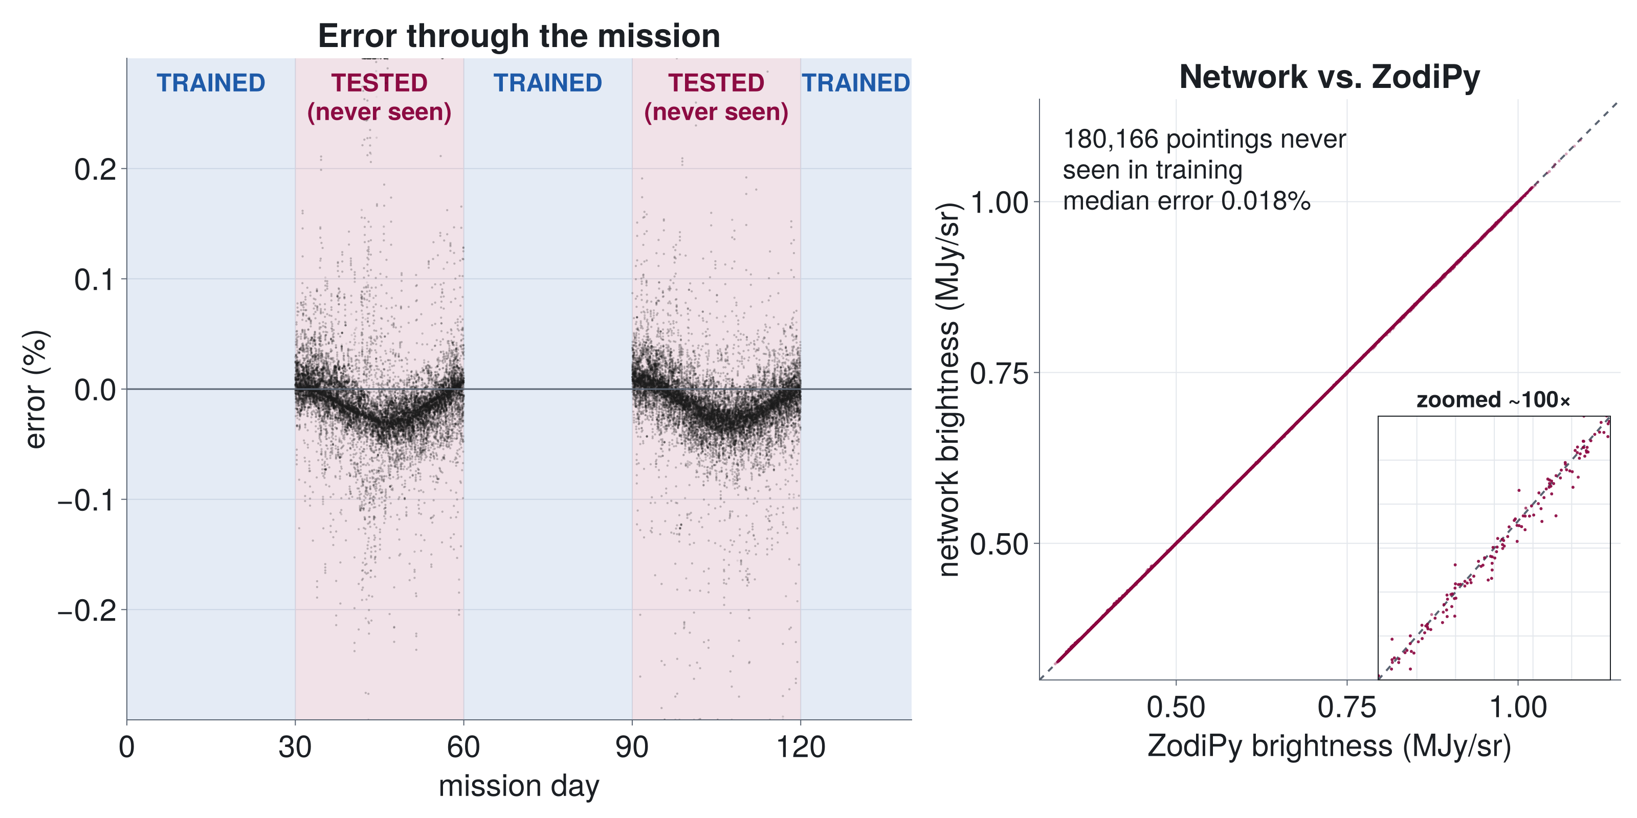
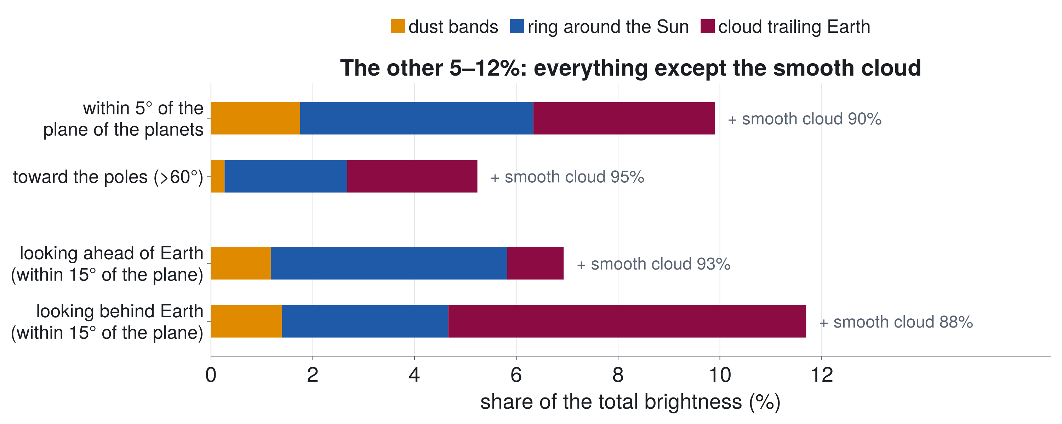
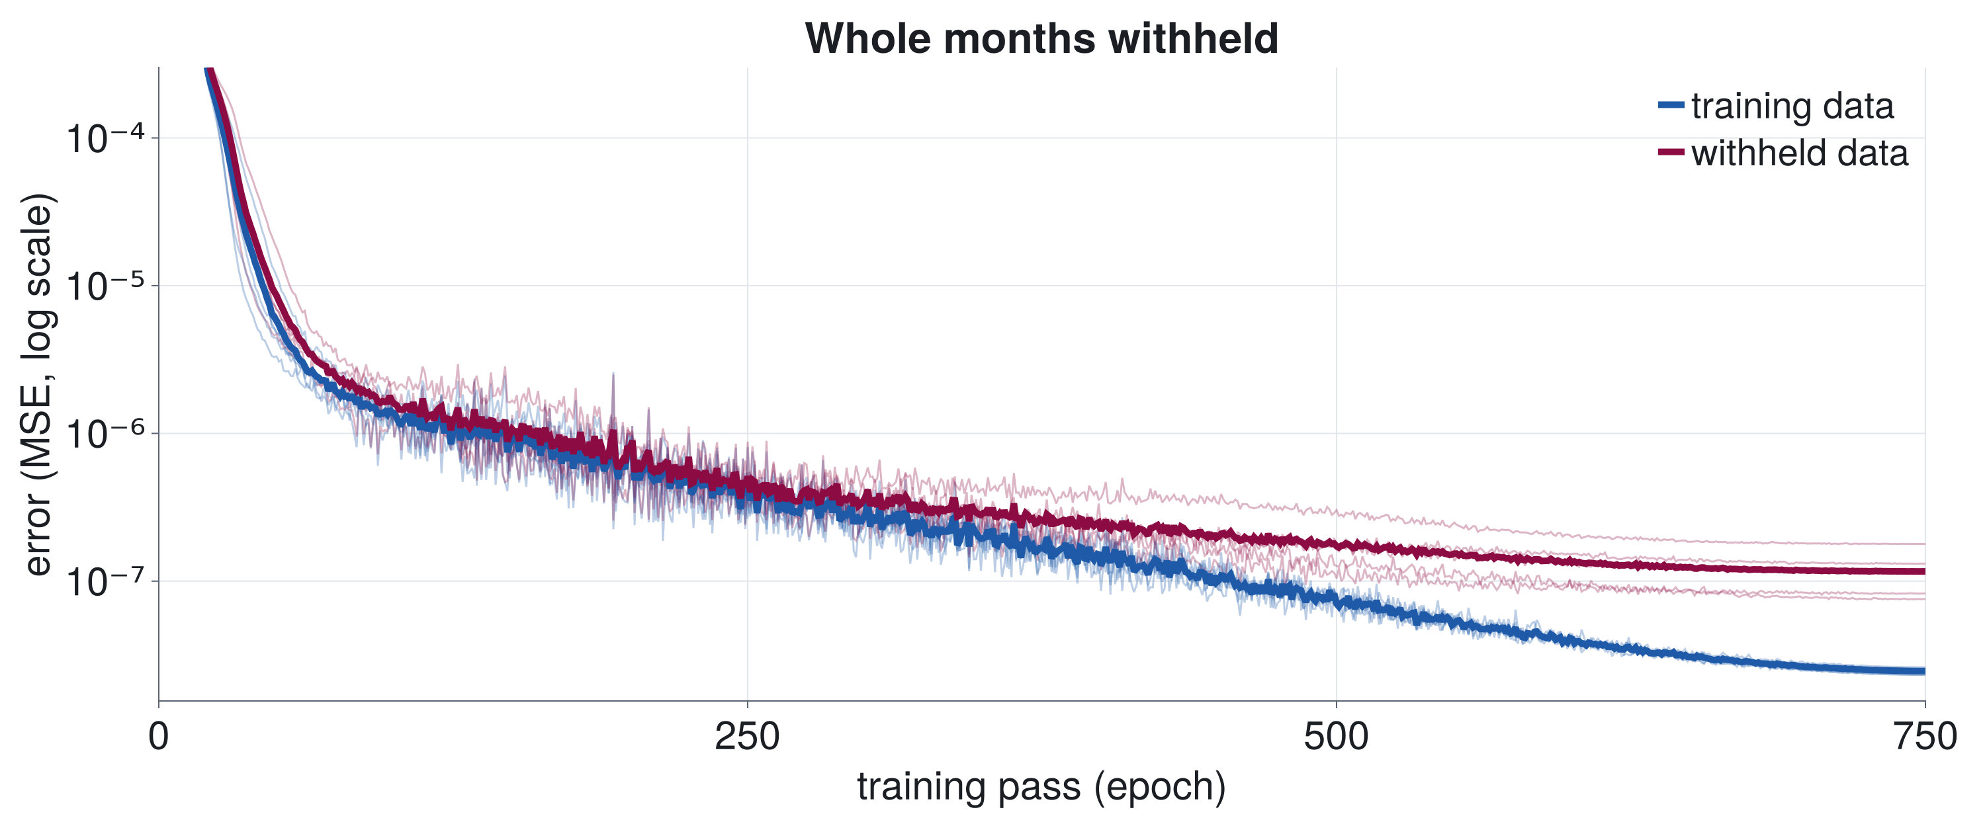
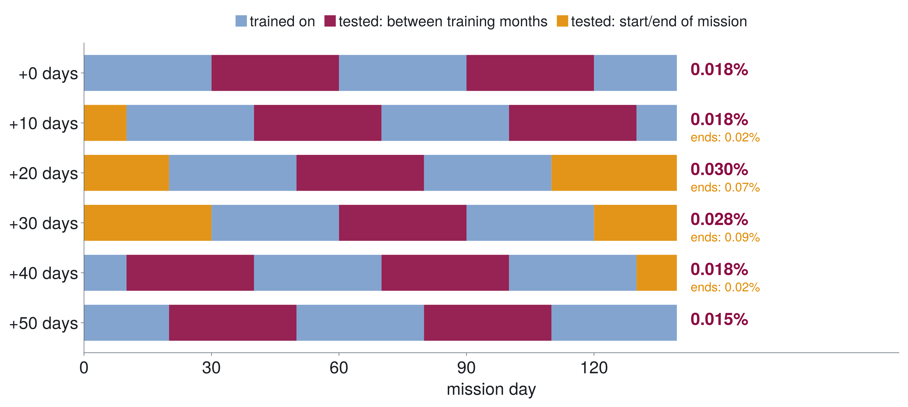
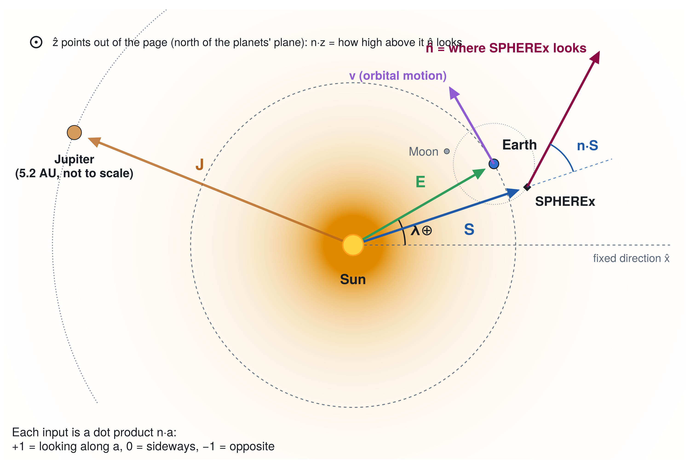
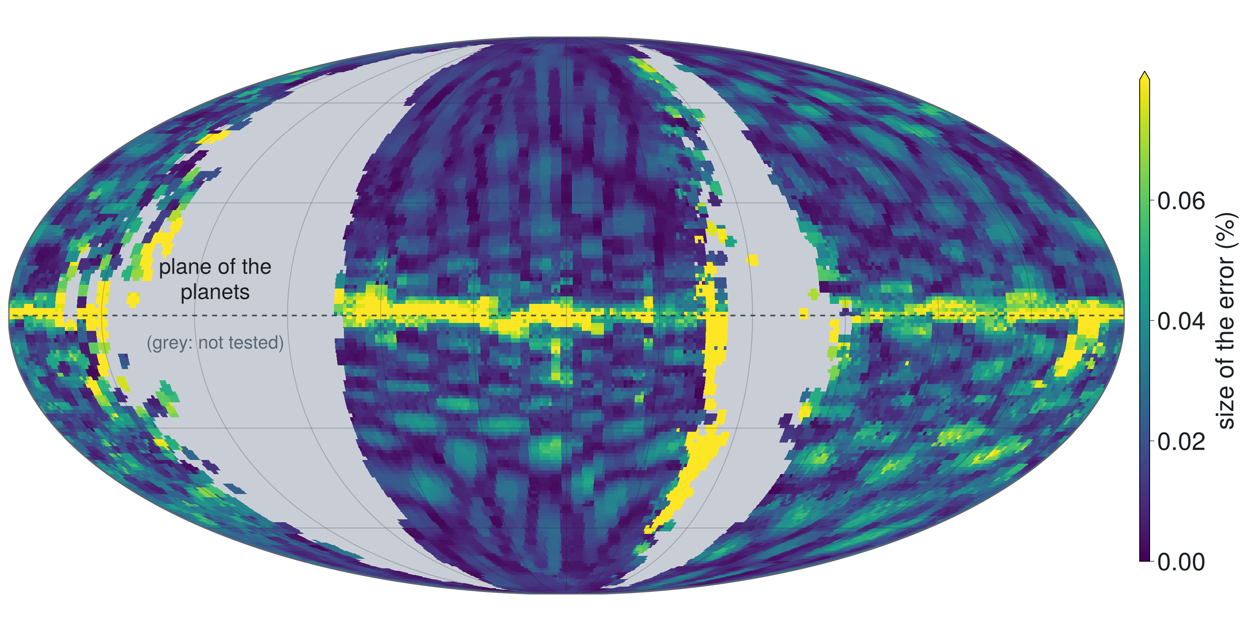

Teaching a Neural Network the Glow of the Solar System
A geometrically constrained model of zodiacal light for NASA's SPHEREx mission
Mark Burch and Andrew Saydjari
Astronomy Department, New Mexico State University, Las Cruces, NM
A geometrically constrained neural network learns the zodiacal light from viewing geometry alone, reaching ~0.02% median error on months it never saw.
Background
Results
SPHEREx: NASA space telescope (launched March 2025) mapping the entire sky in infrared (0.75–5 μm)
Science: how the universe began, how galaxies formed, where water and other ingredients for life are found
0.018%
97.5%
≤0.03%
Zodiacal light
Sunlight scattered by dust from comets and asteroids, plus the dust's heat glow (Fig. 1)
Bright enough to be confused with faint light from distant galaxies
Changes with look direction and Earth's place in orbit → must be modeled and removed
The Kelsall model
Standard dust model from NASA's COBE (Fig. 2); ZodiPy computes what SPHEREx would see from it
median error on months
withheld from training
of pointings within
0.1% of ZodiPy
median error for every
choice of withheld months
Figure 1. The whole sky at 5 μm from SPHEREx (ZodiPy): brightest toward the Sun and along the plane of the planets. Grey: too close to the Sun to observe.
Figure 4. Network vs. ZodiPy on the two 30-day blocks never used in training (days 30–60, 90–120; 180,166 pointings). Left: error through the mission; right: every pointing falls on the 1:1 line.
Figure 5. Error during training: 5 networks (thin), average (thick). The error on withheld months levels off and never rises: no overfitting.
Figure 2. What makes up the zodiacal light SPHEREx sees (Kelsall model): a smooth cloud (88–95%) plus dust bands, a ring around the Sun, and a cloud trailing Earth, strongest when looking behind Earth.
The problem
Zodiacal light must be removed from every SPHEREx image, but models like Kelsall's were fit to older data and leave errors behind
Research objective
A geometrically constrained neural network that learns zodiacal light from SPHEREx data and outperforms the Kelsall model. First step: ZodiPy's simulated sky
Methods
Figure 6. Six versions of the test, sliding the withheld months 10 days at a time: all reach 0.015–0.03% (red). Predicting past the start/end of the data (orange) is harder: fine for ~10 days, then errors grow.
Largest errors along the plane of the planets, where the dust bands are (0.08%); smallest toward the poles (0.013%; Fig. 7)
A geometrically constrained model
No dates or sky-map positions: only 9 numbers describing the viewing geometry (Fig. 3)
It must learn how brightness depends on geometry, as the physics does, not memorize when and where SPHEREx looked
Figure 3. The geometry the network sees (top view, not to scale): n = where SPHEREx looks; S, E = Sun → SPHEREx, Earth; v = orbital motion; λ⊕ = Earth's angle around its orbit. Jupiter and the Moon: context only.
Figure 7. Error on pointings the network never saw, across the whole sky. Each pointing is drawn 3.5° wide, about SPHEREx's view. Grey: not tested.
The 9 inputs
Next Steps
n·S, n·E
toward or away from the Sun (seen from SPHEREx and from Earth)
✓ DONE
Validate
Learn ZodiPy's simulated sky from geometry alone; test on unseen months and sky regions
n·z
how far above or below the plane of the planets
n·vS, n·vE
ahead of or behind the orbital motion (SPHEREx, Earth)
n·x⊕, n·y⊕
look direction in a frame that turns with Earth (x⊕ = Sun → Earth)
IN PROGRESS
Refine
Longer training; all SPHEREx wavelengths (a first 1.25–5 μm version: ~0.1% error)
sin λ⊕, cos λ⊕
Earth's position in its orbit: the time of year
Training and testing
423,607 simulated pointings (140 days, 5 μm); five small networks (Flux.jl), averaged
Tested on whole months and sky regions they never saw
Lesson: adding the time of year (sin λ⊕, cos λ⊕) cut the errors ~40–65×
NEXT
Scale up
Move training to a computing cluster
NEXT
Real data
Train on real SPHEREx images and compare with the Kelsall model
Acknowledgements
All results so far are preliminary and use simulated data.
References
This research is supported by a URS grant at New Mexico State University, funded by the National Science Foundation (NSF). Thank you to Dr. Andrew Saydjari for mentorship, and to the developers of ZodiPy and Flux.jl.
Kelsall, T., et al. 1998, ApJ, 508, 44 (COBE/DIRBE zodiacal-light model)
San, M., et al. 2022, JOSS, 7, 4602 (ZodiPy)
Doré, O., et al. 2014, arXiv:1412.4872 (SPHEREx)
Innes, M. 2018, JOSS, 3, 602 (Flux.jl)
Notes:
[CHECK with mentor]
- Problem statement: 'physics models such as Kelsall's were fit to older data and leave errors behind' -- right framing?
- Acknowledgment: exact name of the URS grant/program and the NSF award number (if one should be listed).
- Fig. 3: Jupiter and the Moon are drawn for context; the poster's model inputs are n.S n.z n.E n.vS n.vE n.x_E n.y_E sin/cos(lambda_E) (no Jupiter, no Moon).
Numbers (poster v6): 5-network ensemble, 64-64-32-16 gelu (4 hidden layers), 750 epochs (round 21, z115_m750_shift*).
- Fig. 2 (poster/data_components.jl): ZodiPy components per pointing as % of the total. Smooth cloud 90.1% (|b|<5) to
94.8% (>60 deg); behind Earth (n.vE<-0.5, |b|<15) the trailing cloud is 7.0% vs 1.1% ahead.
- Fig. 4 (poster/data_accuracy.jl): trained on days 0-30, 60-90, 120-140; tested on days 30-60, 90-120 (180,166 pointings,
43%): median 0.018%, p95 0.069%, 97.5% within 0.1%. (100 epochs: 0.026%, 0.10%, 94.8%.)
Errors are relative to ZodiPy (the Kelsall model), not the real sky.
- Fig. 5 (poster/data_training.jl): epoch-averaged MSE (mean of 10 in-epoch evaluations) on the training data and the
withheld months; final mean train/test MSE 2.5e-8 / 1.2e-7 (MJy/sr)^2.
- Fig. 6: the 30-day split slid by 0, 10, ..., 50 days, 5 seeds each, 750 epochs. Red = withheld windows with training
data before and after (interpolation): 0.015-0.030%. Orange = windows at the mission's start/end (extrapolation in
time): 10 days 0.016-0.023%, 20-30 days 0.07-0.09% median.
- Fig. 7 (poster/data_skyerror.jl): red (interior) windows only, 364,797 pointings (86%), each averaged over the versions
that withheld it: median 0.016%, p95 0.063%; within 2 deg of the ecliptic 0.083%, above 60 deg 0.0125%. Map: each
boresight spread over a disc on a 1-deg grid (radius 1.75 deg = 3.5-deg patches, or 3.5 deg = the 7-deg blend);
boresights lie on scan circles a few degrees apart, so without spreading thin pole-to-pole gaps appear.
- Earth-trailing cloud (mentor's test, 10182026 notebook): stacking residuals along the ahead/behind-Earth angle and the
angle to the cloud's centre shows no leftover cloud signal; fitted missing fraction 0.06 +/- 0.09% (|b|<15, 750 ep).
- Multi-wavelength (Refine step): round-15 'ep300' ensemble, 30-day blocks, 1.25-5.0 um, ~0.1% median (poster/data_spectra.jl).

