Slide 1

Introduction to
Probability

Slide 2
Probability is the mathematical way of quantifying uncertainty.

Slide 3
Put another way: probability is the study of theoretical possibilities and their likelihood of occuring.

Slide 4

Sample Spaces and Events
Sample space (S): the set of all possible outcomes of our model or experiment
Elements: the points in the sample space
Event: a subset of the sample space

Slide 5
Sample Spaces and Events
Sample space (S): the set of all possible outcomes of our model or experiment
Elements: the points in the sample space
Event: a subset of the sample space
Example: toss a coin twice
Sample space: {HH, TT, HT, TH}
Elements: {H, T}
Event that both tosses are the same: {HH, TT}

Slide 6
Sample Spaces and Events
Complement (A^{C}): Everything not in set A; for any event A, P(A^{C}) = 1 – P(A)
Union (A ⋃ B): add up all events in A and B
Intersection (A ∩ B): all events that fall in both A and B

Slide 7
Sample Spaces and Events
Complement (A^{C}): Everything not in set A; for any event A, P(A^{C}) = 1 – P(A)
Union (A ⋃ B): add up all events in A and B
Intersection (A ∩ B): all events that fall in both A and B
Disjoint events: the sets don’t share any common events
P(A or B) = P(A) + P(B)
Joint events: P(A ⋃ B) = P(A) + P(B) - P(A ∩ B)
A
B
A
B

Slide 8
Probability
Every event A gets a probability P(A), which is a real number. Probabilities have some rules:
P(A) ≥ 0 for every A
P(Set) = 1
If A₁, A₂,…,A_{i} are disjoint, then P(⋃ A₁,A₂,...,A_{i}) = ∑ P(A_{i})

Slide 9
Two Ways of Interpreting Probabilities
Frequencies: if we repeat enough trials, P(A) is the proportion of times we’ll see A being true
E.g. If we say a fair coin has P(tossing heads) = .5, then tossing a coin lots (and lots and lots!) of times will get us 50% heads in the long term
Degrees of belief (Bayesian inference): P(A) is our degree of belief that A is true (no repeated experiments necessary)
E.g. if we have a fair coin, we believe P(tossing heads) = .5
The difference starts to matter once we get to inference in a few days.

Slide 10
Independence
When events are independent (i.e. the occurrence of one event does not influence the occurrence of another event), the probabilities can be multiplied:
P(A,B) = P(A) x P(B)

Slide 11
Independence
When events are independent (i.e. the occurrence of one event does not influence the occurrence of another event), the probabilities can be multiplied:
P(A,B) = P(A) x P(B)
Independence can be:
Assumed: We assume tosses of a fair coin are independent
Verified: We derive then verify that P(A,B) = P(A) x P(B)

Slide 12
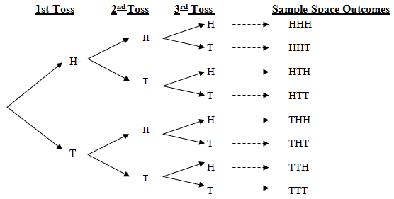
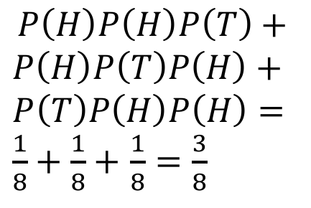
Independence: Example
What’s the probability of flipping three (fair) coins and getting (exactly) two heads?

Slide 13
Dependence
When two events are dependent, the probability of one event occurring influences the likelihood of the other event.

Slide 14
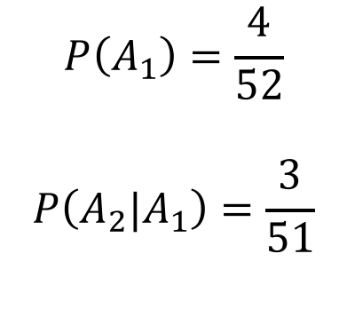
Dependence
When two events are dependent, the probability of one event occurring influences the likelihood of the other event.
What’s the probability of drawing an ace from a deck of 52 cards?
If we don’t replace the drawn card, what’s the probability of drawing a second ace?

Slide 15
Unions and Intersections of Events
What’s the intersection of two events?
If they’re independent: P(A and B) = P(A) x P(B)
If they’re dependent: P(A and B) = P(A) x P(B|A)

Slide 16
Unions and Intersections of Events
What’s the intersection of two events?
If they’re independent: P(A and B) = P(A) x P(B)
If they’re dependent: P(A and B) = P(A) x P(B|A)
What’s the union of two events?
If they’re independent: P(A or B) = P(A) + P(B)
If they’re dependent: P(A or B) = P(A) + P(B) - P(A and B)

Slide 17
Unions and Intersections of Events
What’s the intersection of two events?
If they’re independent: P(A and B) = P(A) x P(B)
If they’re dependent: P(A and B) = P(A) x P(B|A)
What’s the union of two events?
If they’re independent: P(A or B) = P(A) + P(B)
If they’re dependent: P(A or B) = P(A) + P(B) - P(A and B)
Draw some Venn diagrams!

Slide 18
Conditional Probability
Conditional probability is the probability of event A happening, given that event B has already happened. Define:
P(A|B) = P(A,B) / P(B)

Slide 19
Conditional Probability
Conditional probability is the probability of event A happening, given that event B has already happened. Define:
P(A|B) = P(A,B) / P(B)
Conditional probability example
Test for a disease (D⁺,D_) and get test results that are positive/negative (T⁺, T⁻)
P(T⁺|D⁺) = P(T⁺ ∩ D⁺) / P(D)

Slide 20
Random Variables
Random variables are rules that assign a real number value to each element.

Slide 21
Random Variables
Random variables are rules that assign a real number value to each element.
Toss a coin twice and let the random variable X be the number of heads.
 | Probability | X
HH | 1/4 | 2
TT | 1/4 | 0
TH | 1/4 | 1
HT | 1/4 | 1
X | P(X = x)
0 | 1/4
1 | 1/2
2 | 1/4

Slide 22
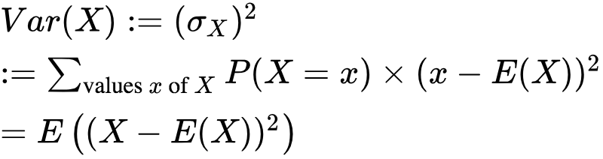
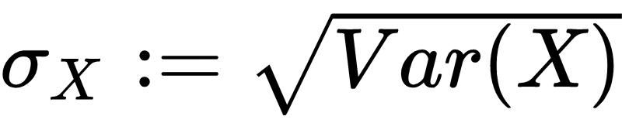
Random Variables: Important Quantities
Discrete random variable: there are only finitely many values attained by the variable. (These are always thought of as functions on a fixed probability space!)
For these we can compute the following important quantities:
Expected value:
Variance:
Standard deviation:

Slide 23
Random Variables: Important Quantities
For two discrete random variables on the same probability space, we can talk about their covariance:

Slide 24

Law of Large Numbers
Often when we’re working with probabilities, we’re interested in what happens asymptotically (in the limit). We have some laws about this.
Law of Large Numbers:
Informal: The average value of a large number of independent samples of a random variable X gets arbitrarily close to its expected value E(X).
Formal: Suppose that X₁, ..., X_{n} are independent random variables with the same probability densities as the random variable X, then:

Slide 25
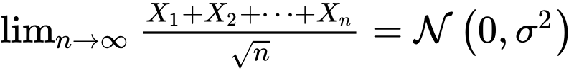
Central Limit Theorem
Whereas the LLN was about samples from a distribution, the Central Limit Theorem is about the value of sample means from any distribution.
Informal: Suppose X is a random variable with mean zero and finite variance. Then the sum of n trials of X divided by sqrt{n} approaches the normal distribution with mean zero and the same variance as X.
Formal: Suppose X is a random variable with E(X) = 0 and variance less than infinity, and X₁, ..., X_{n} are independent random variables with the same probability distribution as X. Then the limit
in probability.

Slide 26
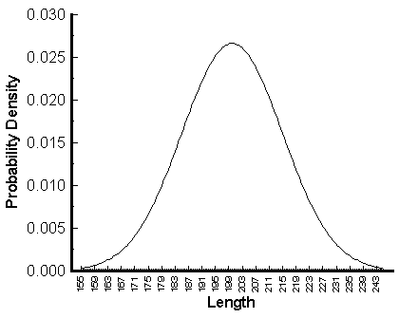
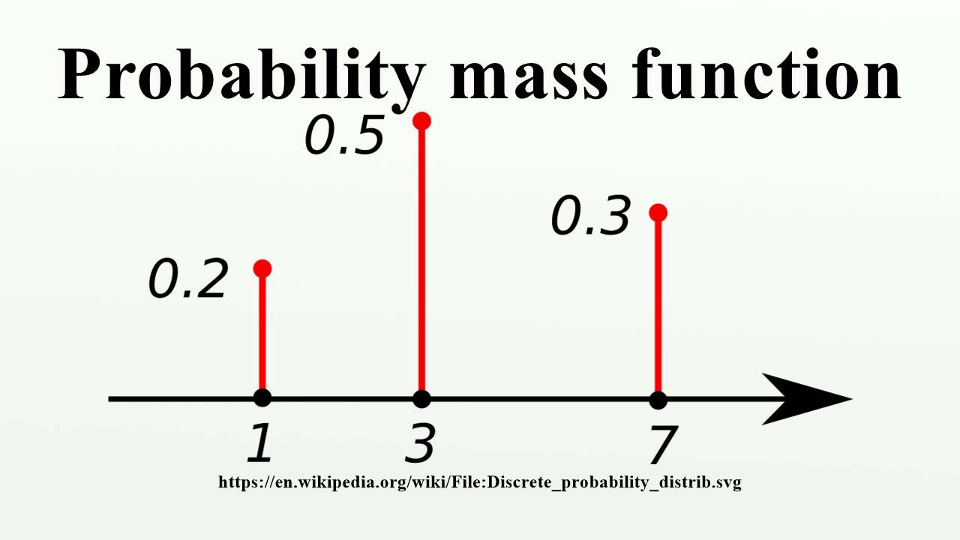
Probability Functions of Random Variables
Probability Density Function (PDF): For continuous random variables, a function whose value at any given sample can be interpreted as a relative likelihood that the value of the random value would equal that sample
Probability Mass Function (PMF): For discrete random variables, a function that gives the probability the the random variable X is exactly equal to some value.

Slide 27
Dependence and Conditional Probabilities
I am allergic to dogs. They make me sneeze. Sometimes dogs greet me. What is the probability that I sneeze?
P(Dog greets me) = P(G) = 1/4
P(Dog does not greet me) = P(NG) = 3/4

Slide 28
Visualize
P(G) = 1/4
P(NG) = 3/4
P(NG) = 3/4
DOG GREETS ME
p = 1/4
P(G) = 1/4

Slide 29
Dependence and Conditional Probabilities
Sometimes we know the conditional probabilities that depend on whether dogs say hello:
P(Sneeze | Dog greets me) = P(S|G) = 9/10
P(No Sneeze | Dog greets me) = P(NS|G) = 1/10
P(Sneeze | Dog doesn’t greet me) = P(S|NG) = 2/10
P(No Sneeze | Dog doesn’t greet me) = P(NS|NG) = 8/10

Slide 30
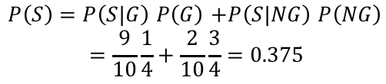
Visualize
P(G) = 1/4
P(NG) = 3/4
P(NG) = 3/4
P(NS|NG) = 8/10
P(S|NG) = 2/10
P(S|G) = 9/10
P(NS|G) = 1/10
P(S|NG) = 2/10
P(NS|NG) = 8/10
DOG GREETS ME
p = 1/4
P(NS|G) = 1/10
P(S|G) = 9/10
P(G) = 1/4

Slide 31
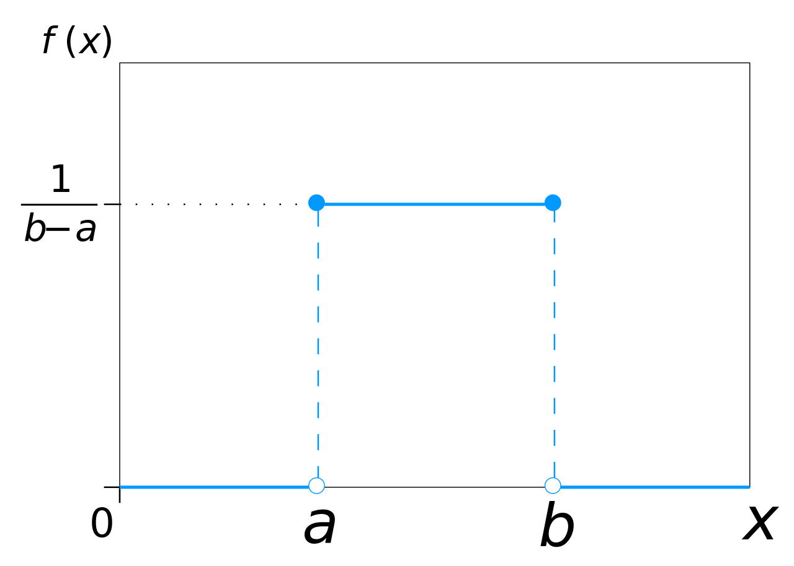
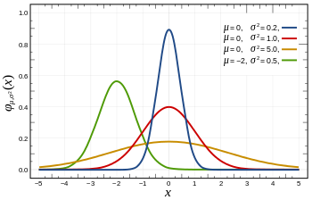
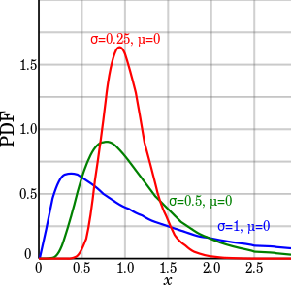
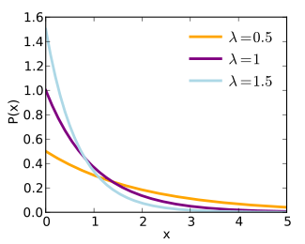
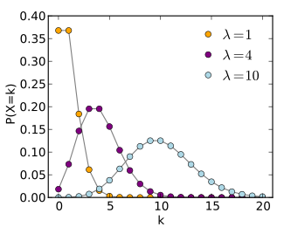
Commonly Used Distributions
Uniform
Gaussian/Normal
Log - Normal
Exponential
Poisson

