Slide 1
Structuring satellite embeddings for multi-class landscape change attribution
Mina Burns
M.S. defense, 7 August 2026
eMapR Lab, Oregon State University
Committee: Robert Kennedy (advisor), Jamon Van Den Hoek, Mark Raleigh, Hamed Alemohammad
Notes:
You are replacing this slide. Committee names carried over from the previous draft, verify spelling and roles.

Slide 2
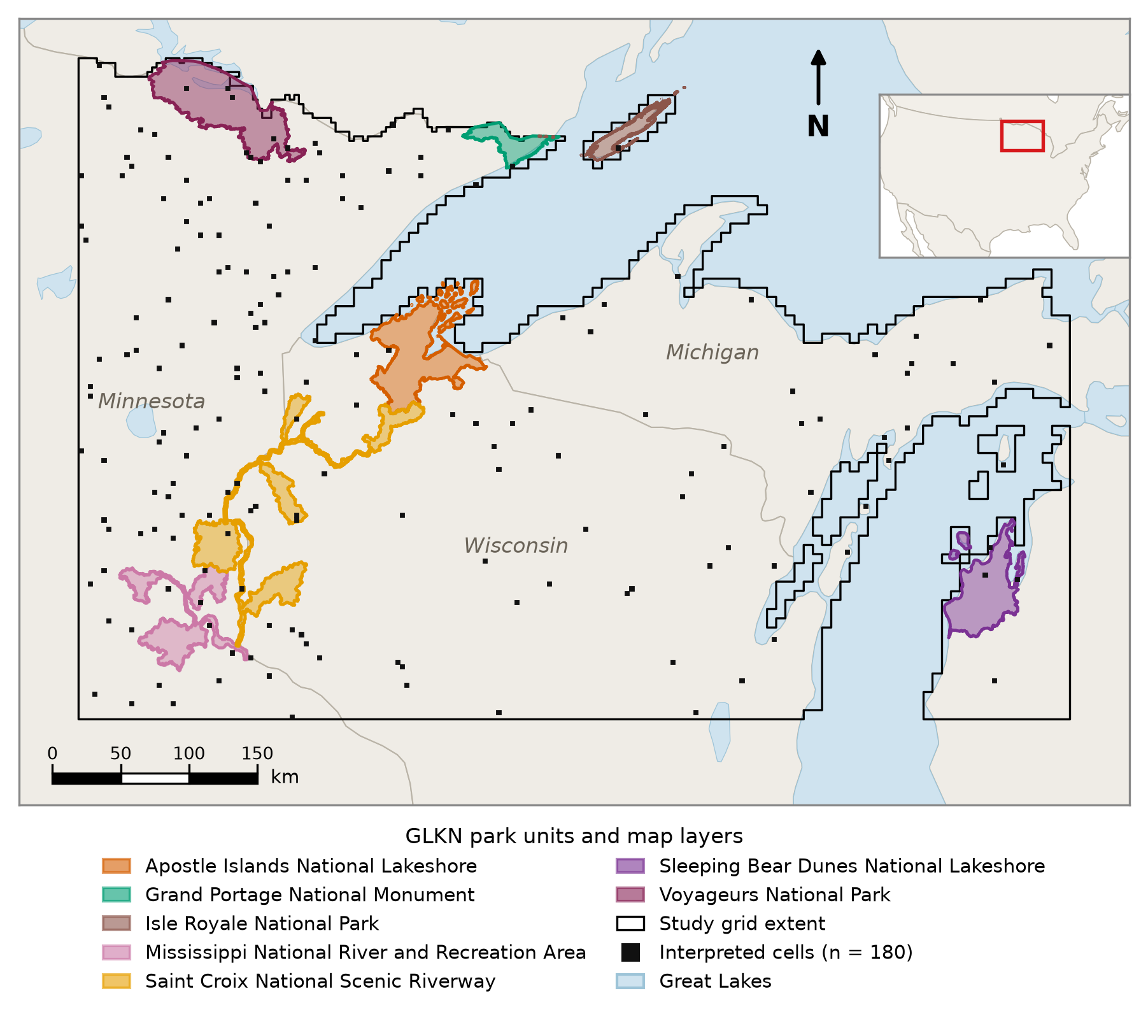
The western Great Lakes
Mixed northern hardwood and conifer forest, wetland, and agriculture
Timber harvest is an economic mainstay
Beaver reshape hydrology across whole watersheds
Insect and disease mortality and exurban development are both expanding
Notes:
Landscape character: heterogeneous forest, extensive wetland, agriculture, low-density development. Why change here matters: harvest drives regional forest economy; beaver flowage alters hydrology and habitat; insect and disease mortality threatens species composition, including black ash. Grid: continuous fishnet over terrestrial MN, WI, and Michigan UP, US only, Great Lakes water excluded, roughly 21,561 cells. Black boxes are the 180 interpreted cells, spread across the whole grid. Seven of nine GLKN park units fall inside the grid, and they supply the change training polygons only.

Slide 3
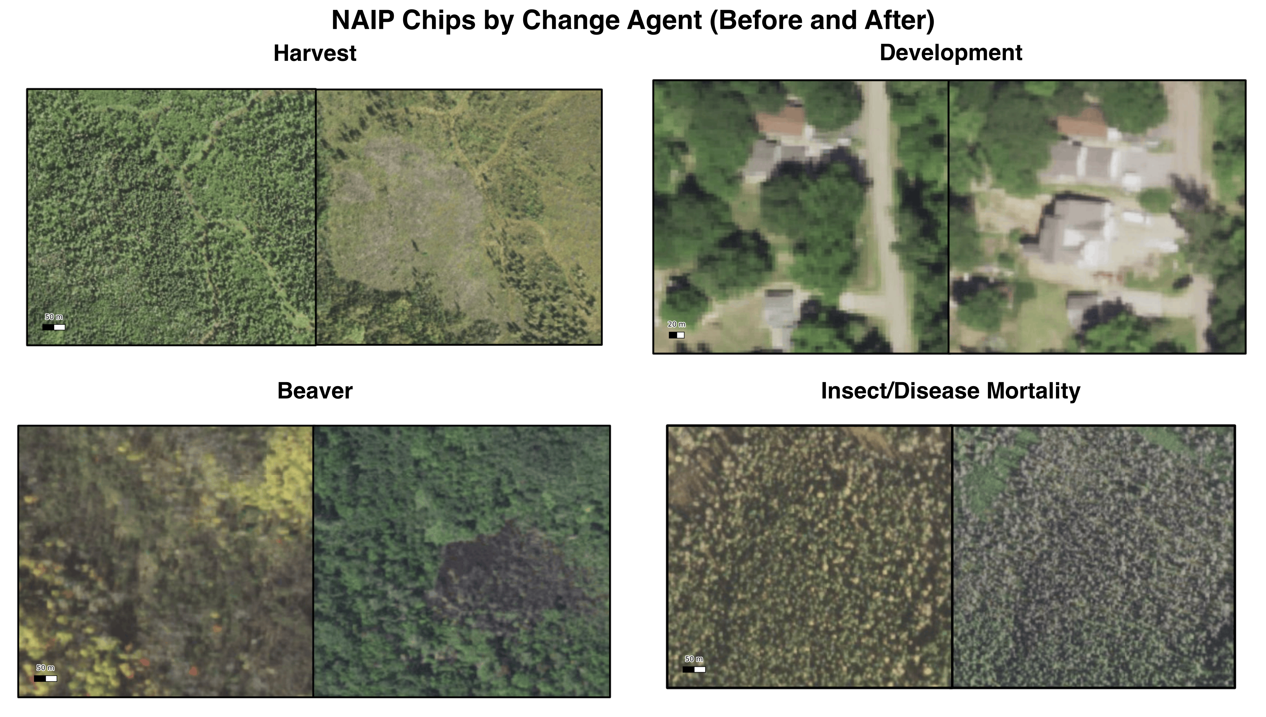
Four agents of change
Harvest
Development
Beaver
Insect / disease
Abrupt, geometric, economically central
Gradual conversion at the exurban fringe
Flooding, diffuse edges, spectrally subtle
Partial canopy loss, no clear boundary
Notes:
Harvest: clear boundaries, high contrast, the easiest case. Regionally the dominant disturbance by area. Development: slow, small, often below the patch size that change detection is tuned for. Beaver: ecologically interesting and spectrally hard. Flooded forest can look like wetland, water, or dead canopy depending on stage. Insect and disease: mortality without removal, so canopy structure changes and the spectral signal is weak. A human interpreter can usually name the agent from NAIP. That is what makes this attribution, not just detection.

Slide 4
How change is mapped now
Detect change first
Label the cause second
Errors from step one carry into step two
[ pres_12_olofsson_standard.png ]
Notes:
Standard practice: detect-then-attribute. Olofsson et al. 2014 is the reference for good practice on accuracy and area estimation. The two-stage structure means a missed detection can never be attributed, and a false detection gets a cause assigned to it. Attribution errors are therefore not independent of detection errors, they compound. Our alternative: attribute directly from a single classification, no detection step.

Slide 5
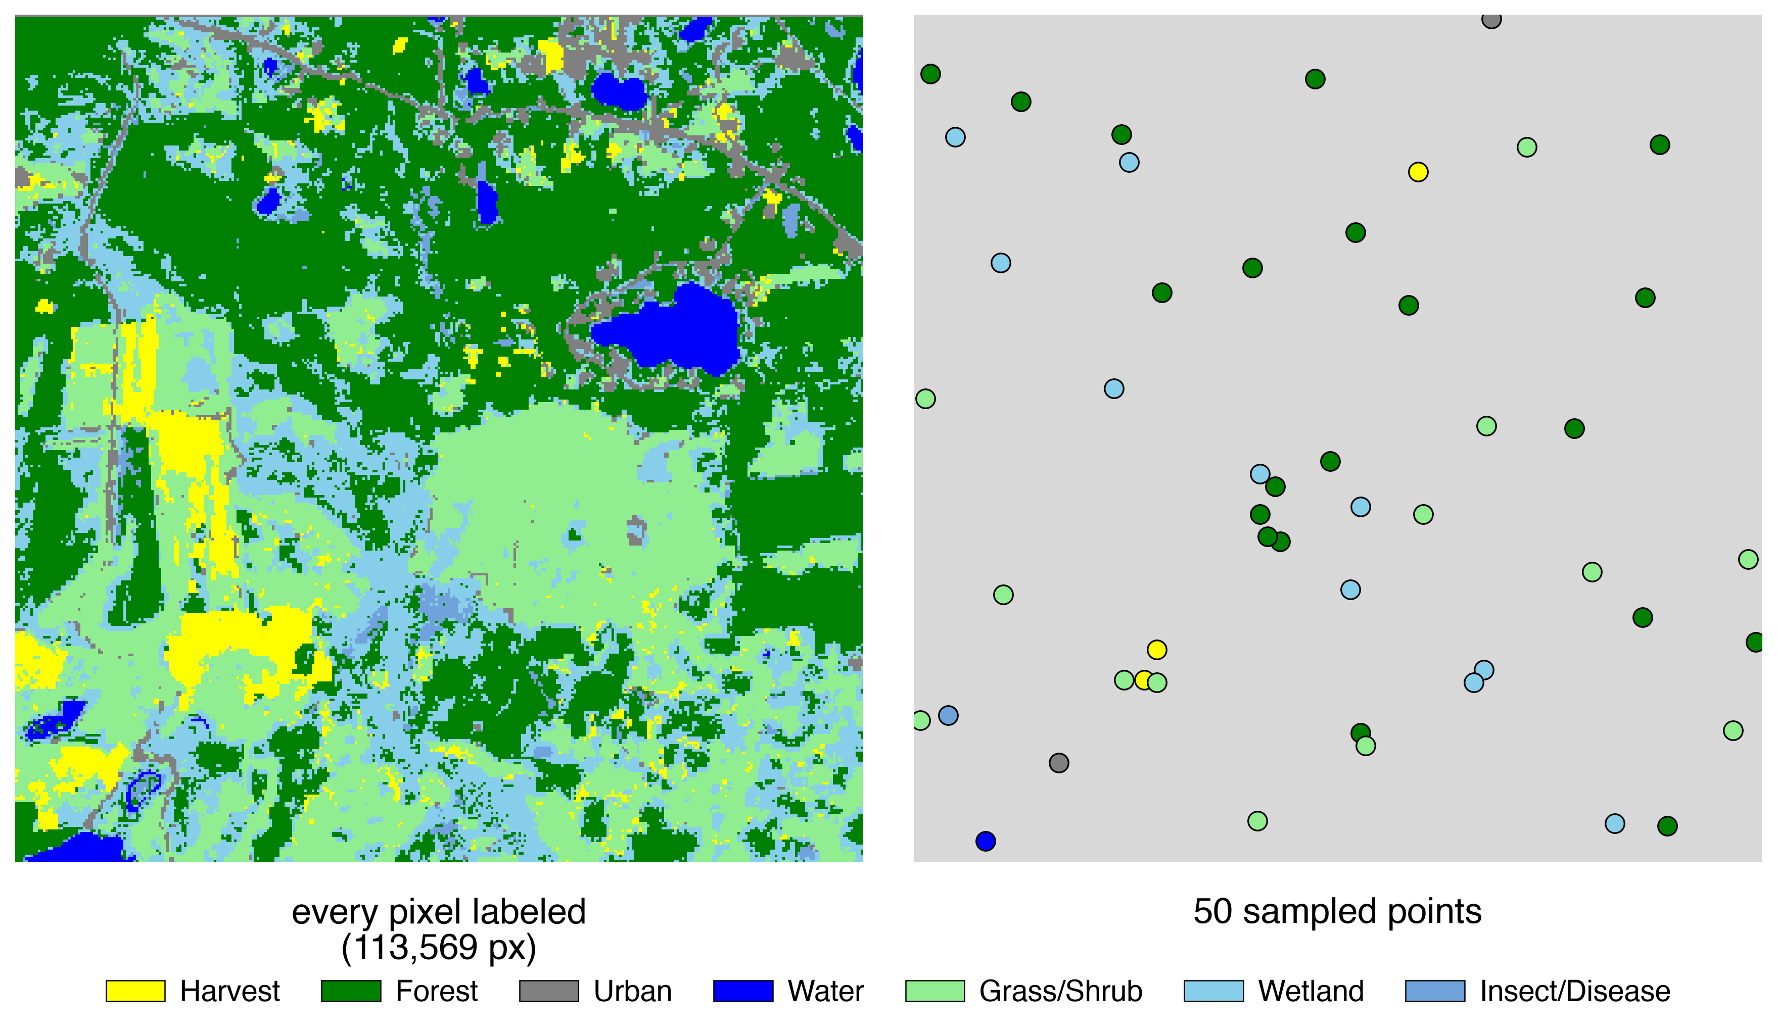
And how do we know a map is good?
The standard is a sample of points
Cheap, unbiased, and well understood
But can it tell two similar maps apart?
Notes:
Design-based accuracy assessment from a probability sample is the accepted standard, Olofsson et al. 2014, Stehman 2014. It supports unbiased estimates of accuracy and area with quantified uncertainty. Our question is different: not how accurate is this map, but which of these two maps is better. That is the comparison anyone selecting a sensor, feature set, or algorithm actually has to make.

Slide 6
We tested that with simulated landscapes
Truth known by construction
Four maps, from near-perfect to badly degraded
Full-map F1 separates them cleanly
Sampled F1 does not
[ pres_09_simulation_f1.png ]
Notes:
Joint work with Rob Kennedy. Simulated 6 by 6 km landscapes, patch structure from real imagery, stochastic disturbance at a target rate. Four renditions of truth with increasing omission, commission, spatial misalignment, and edge effects. Sample is stratified random, n = 50, corrected following Olofsson et al. 2014, so this is the recommended estimator, not a naive one. Two findings: the sampled estimate scatters widely, and for the degraded maps it sits above the one-to-one line, so the sample paints a rosier picture than the map deserves. Binary two-class problem, the easiest case. Ten classes should be worse. Consequence: to compare maps we need reference labels everywhere, not at scattered points.

Slide 7
Foundation models learn a general representation of a place, once, that many tasks can reuse.
The question is whether that representation carries change.
Notes:
Trained on large unlabeled archives, then applied to downstream tasks with little labeled data. In remote sensing this matters because labels are scarce and expensive, which is exactly our situation. Instead of hand-designing indices for each task, you get a learned feature vector per pixel. The promise is that sparse labels go further. The open question is what the representation actually encodes.

Slide 8
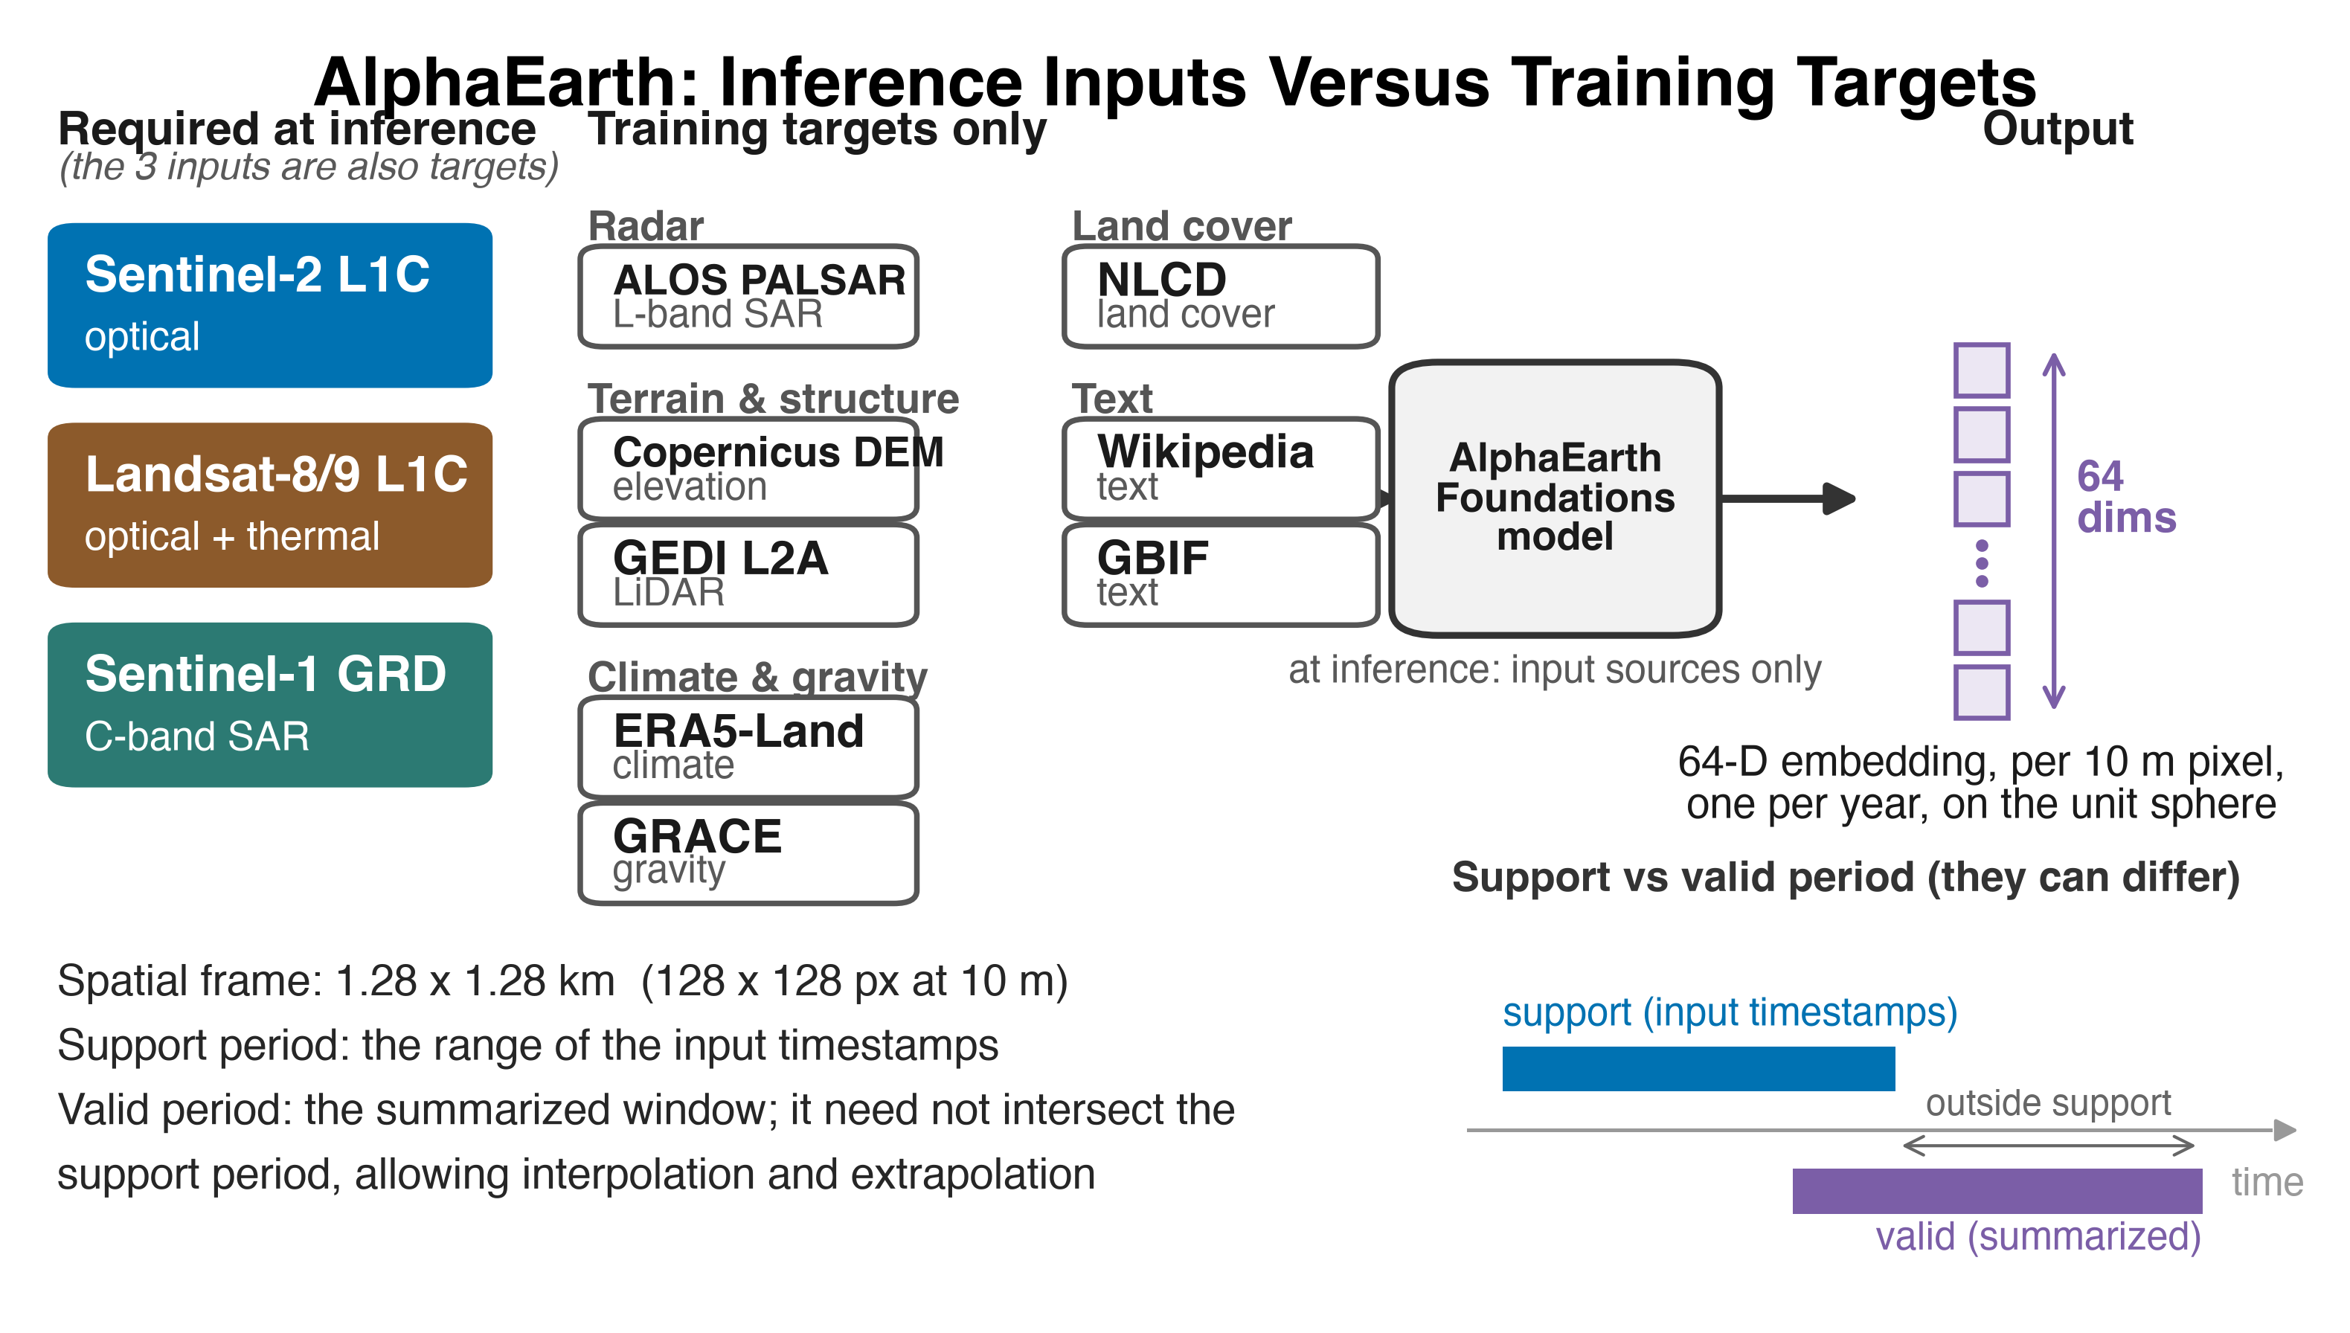
AlphaEarth Foundations
64 numbers per 10 m pixel, per year
Only three sensors needed at inference
Eleven sources used as training targets
1.28 km of spatial context per pixel
Notes:
Inputs at inference: Sentinel-2, Landsat 8 and 9, Sentinel-1. Everything else is training-time only. Training targets also include ALOS PALSAR, Copernicus DEM, GEDI, ERA5-Land, GRACE, NLCD, and text embeddings from Wikipedia and GBIF. Spatial context is 1.28 km, 128 by 128 pixels at 10 m, so each pixel's embedding is informed by its neighborhood. Support period is the window input imagery is drawn from; valid period is the window summarized. They need not coincide. NLCD was a training target. Our stable classes map closely onto NLCD classes, which may help stable-class performance and does nothing for change.

Slide 9
AlphaEarth was designed to describe what is there.
We need to know what changed. Those are not the same task.
Notes:
Each embedding summarizes a year, so change is not represented natively, it has to be constructed from two years. The AEF authors suggest the dot product between two years as a similarity measure, which gives a magnitude of change. A magnitude says how much changed, not what happened. Attribution needs the latter. That gap is the opening for this thesis.

Slide 10
Do AlphaEarth embeddings work for change attribution?
Notes:
State it plainly and let it sit. This is the question the whole talk answers, and the answer is qualified rather than yes or no.

Slide 11
Two questions
1. How do we structure them?
2. How do we tell the maps apart?
An embedding describes one year. Change has to be built from two. Which construction preserves what we need?
If several configurations score about the same, how do we decide which one is actually better?
Notes:
Question one is a representation problem, question two is a measurement problem. Colors return in the results section so the audience can track which question each result answers. The two turn out to be linked, which is the closing argument.

Slide 12
Testing it
What the test requires

Slide 13
To answer this we need a lot of labeled change.
The National Park Service Great Lakes Network has been mapping it for over a decade.
Notes:
GLKN change polygons: attributed by agent, 2010 to 2020, across seven park units inside the grid. Hundreds of thousands of labeled change pixels, already attributed to cause. This is what makes a ten-class attribution scheme trainable at all. We add our own wall-to-wall interpreted cells on top, for validation.

Slide 14
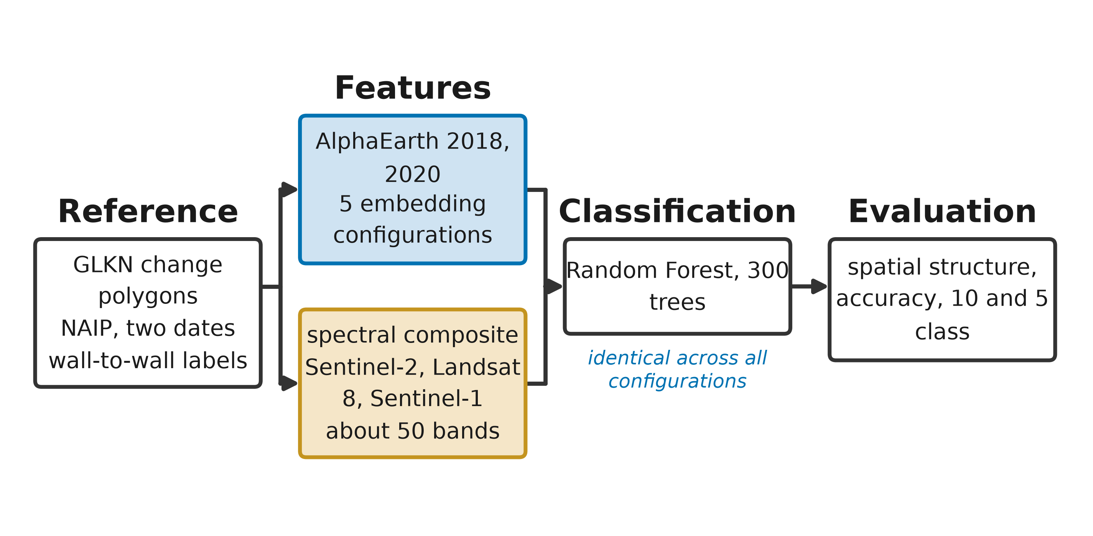
Workflow
Notes:
Reference: GLKN polygons plus NAIP at two dates, interpreted wall to wall. Features: two parallel tracks, AlphaEarth embeddings and spectral composites, from the same three sensors. Classifier: Random Forest, 300 trees, identical across every configuration. That is the control that makes the comparison valid. Evaluation: accuracy plus spatial structure.

Slide 15
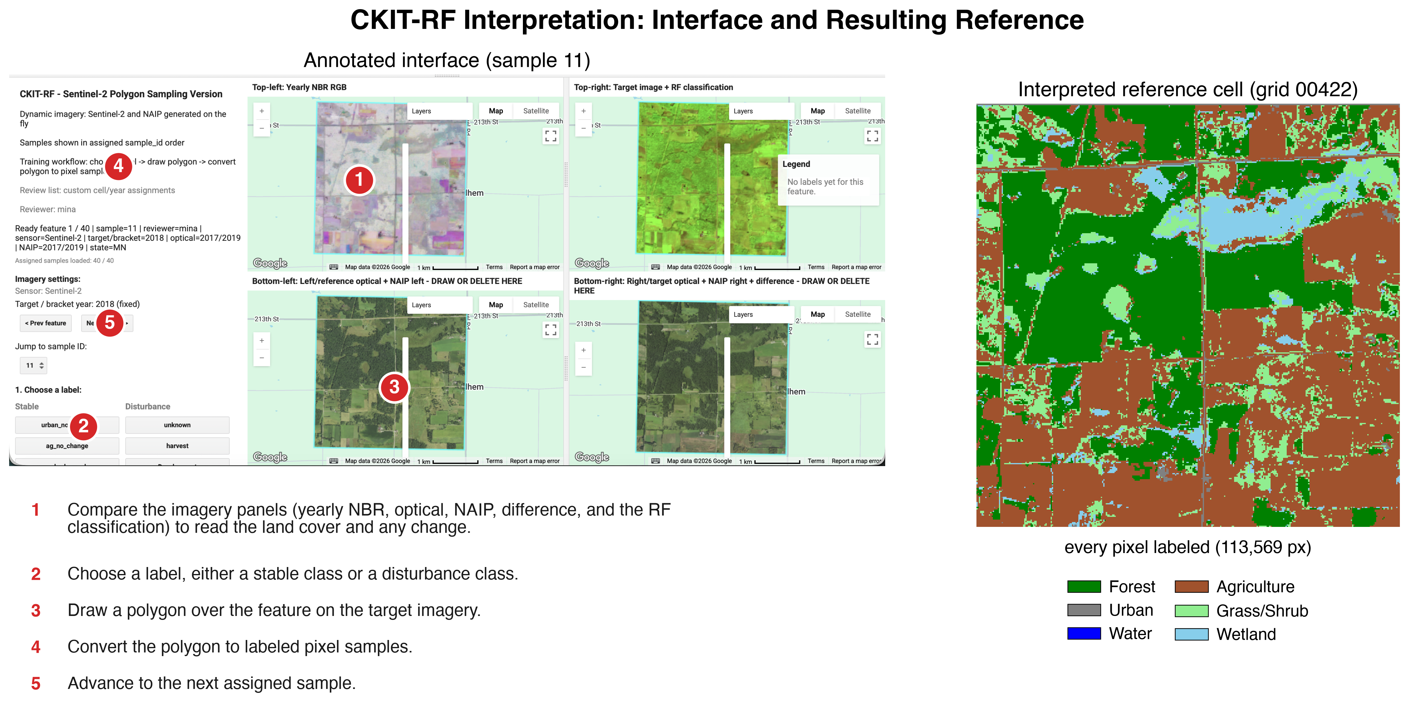
How we built the reference
Interpreter views NAIP at both dates
Places labeled points inside the cell
A within-cell model labels every pixel
180 cells, 72 done twice
Notes:
CKIT-RF, built for this project. Interpreter-driven Random Forest inside a single cell. Output is a fully labeled cell, not a set of points, which is what lets us compare maps rather than just score them. Five interpreters. Cells drawn randomly across the grid, stratified by NAIP acquisition bracket. 72 cells interpreted independently by two people. That overlap is what makes the reliability analysis possible. If asked about cell distribution: brackets follow state NAIP acquisition cadence, so spatial spread partly tracks acquisition years.

Slide 16
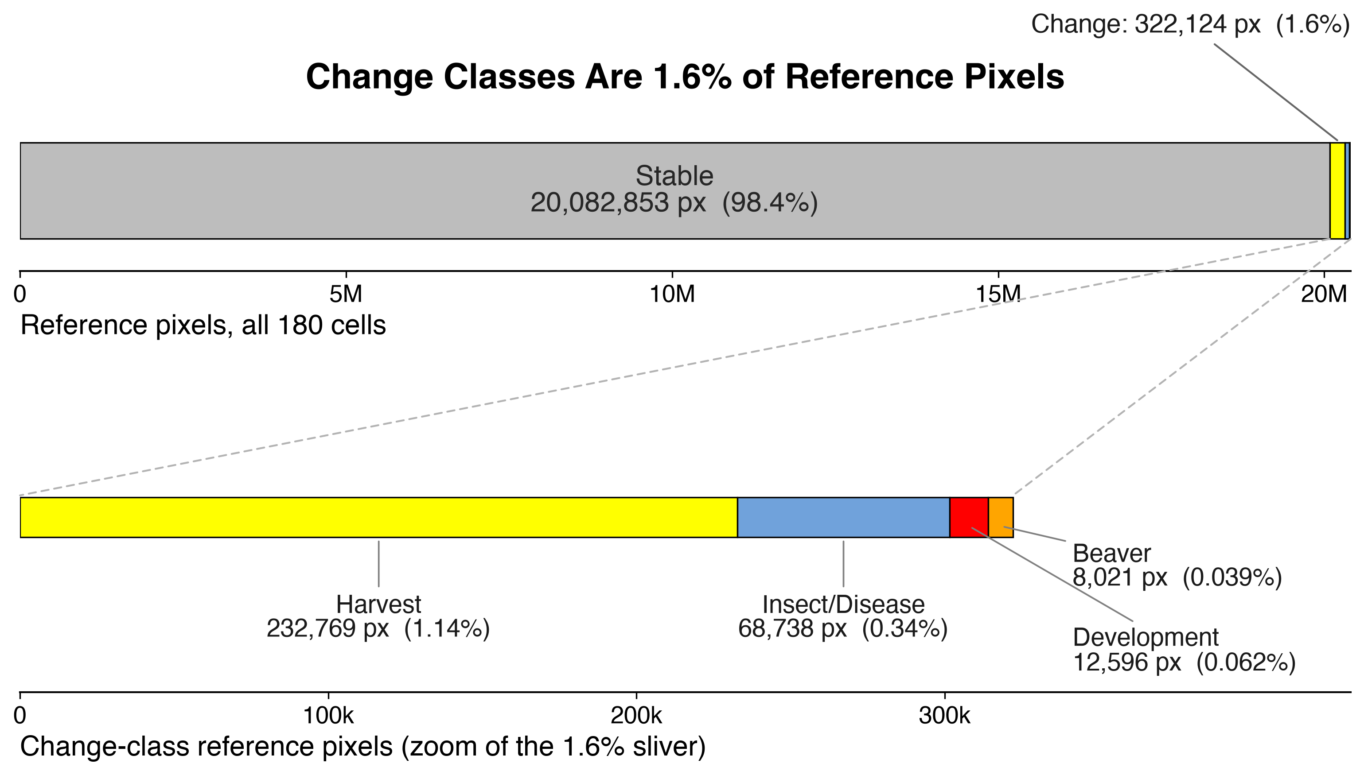
Change is rare
Change is about 1.6% of interpreted pixels
Harvest dominates what change there is
Beaver and insect or disease are a rounding error
Notes:
Now that the audience knows what the reference is, this figure means something. About 1.6 percent of reference pixels are change. That number returns later as the trivial-baseline problem. The four agents differ from each other by orders of magnitude, not just from stable classes. Rarity constrains three separate things: what the classifier can learn, whether a sample sees the class at all, and how well interpreters agree.

Slide 17
Why this is hard
Rare
Spatially clustered
Conceptually ambiguous
1.6% of pixels, and the agents differ by orders of magnitude
Change happens in patches, so nearby pixels repeat information
Trained interpreters looking at the same ground disagree
Notes:
Three properties, each of which produces a separate result later. Rare drives class absence in samples and thin training pools. Clustered drives the design effect, meaning fewer independent observations than pixel counts suggest. Ambiguous drives the reference ceiling, which is the reason the change classes cannot be fixed by a better classifier alone.

Slide 18
Building change from two years
[ pres_15_embedding_ops.png ]
Notes:
Two embeddings, 2018 and 2020, 64 dimensions each. Delta: element-wise difference, direction of change in embedding space. Dot product: similarity between the two years, collapses to a single magnitude. These are the two operations available. The design question is what to combine them with. On year choice: 2018 and 2020 bracket the interpretation dates; happy to say more if asked.

Slide 19
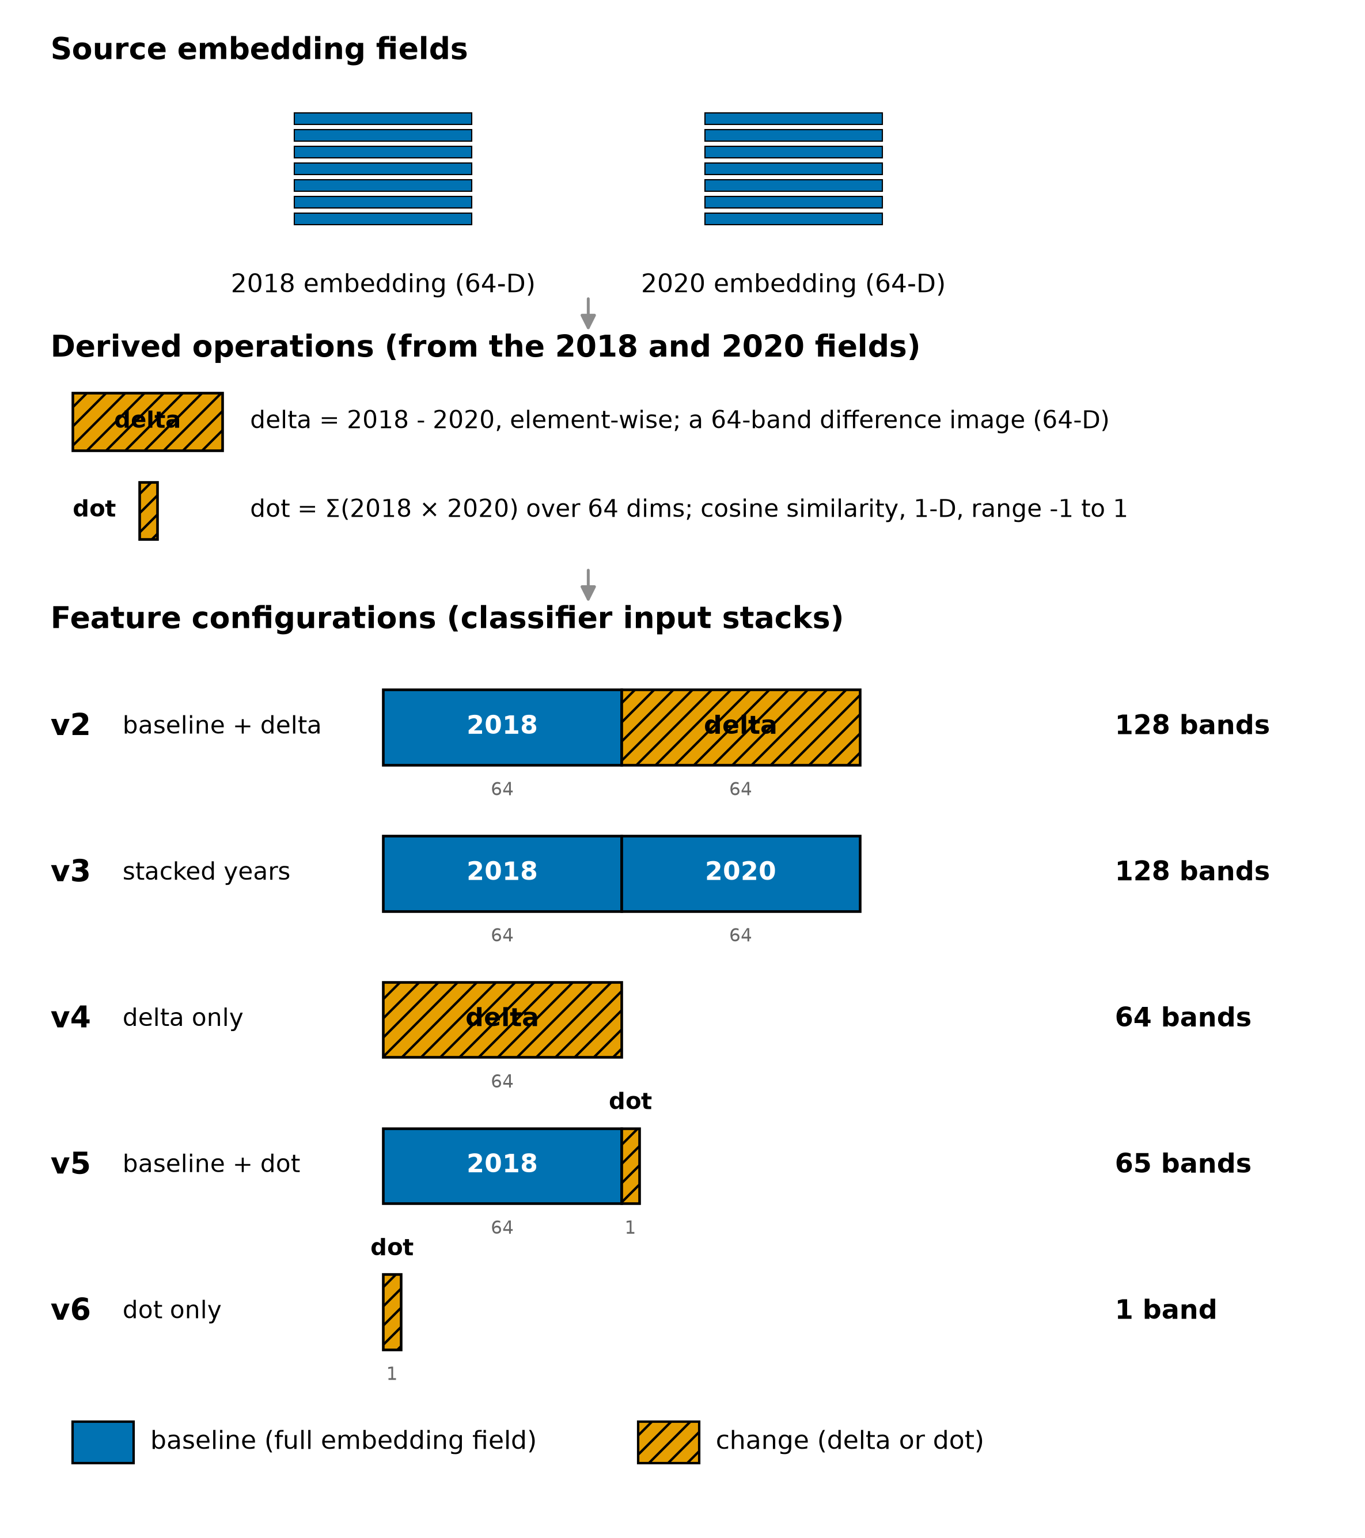
Five configurations
Notes:
v2 and v3 keep a full baseline embedding alongside change. v4 is delta only, no baseline. v5 is baseline plus dot product. v6 is dot product only, the AEF authors' suggested similarity measure on its own. The design variable is whether a baseline embedding survives into the feature vector.

Slide 20
The benchmark: spectral composites
Sentinel-2, Landsat 8, Sentinel-1
Roughly 50 bands
Exactly the sensors AlphaEarth uses at inference
Same information, different representation
[ pres_16_spectral_baseline.png ]
Notes:
This is the null hypothesis. Without it, a good embedding score means nothing. Critically, these are the same three sensors AEF requires at inference, so the comparison holds input information constant and varies only representation. That is a cleaner control than most embedding versus spectral comparisons, which use whatever baseline was convenient. If embeddings do not beat this, the representation is not adding anything for this task.

Slide 21
Reporting on five classes
We care which agent caused the change, not which stable class was confused for another.
Stable
Harvest
Development
Beaver
Insect / disease
All six stable classes collapsed into one
Notes:
Ten classes were used for training. Reporting collapses the six stable classes into one. Rationale: forest confused with wetland is not the error we care about. Missing a harvest is. Collapse is defined once and applied identically to every configuration. Ten-class results exist and are in the supplement.

Slide 22
Results
1. How do we structure them?
2. How do we tell the maps apart?
Which construction of change from two embeddings works?
Which configuration actually produces a better map?
Notes:
Restate before results so the audience knows what each number is for. First three result slides answer question one, the rest answer question two.

Slide 23
Change-class F1
[ pres_14_changeclass_f1_5class.png ]
Notes:
Five-class collapse, four change classes, every configuration plus the spectral baseline. Higher is better. F1 balances missing real change against calling change where there is none. Harvest is the only class any configuration handles at all. Development, beaver, and insect or disease are near zero everywhere, including spectral. The uniformity is the informative part: if representation were the binding constraint, configurations would differ.

Slide 24
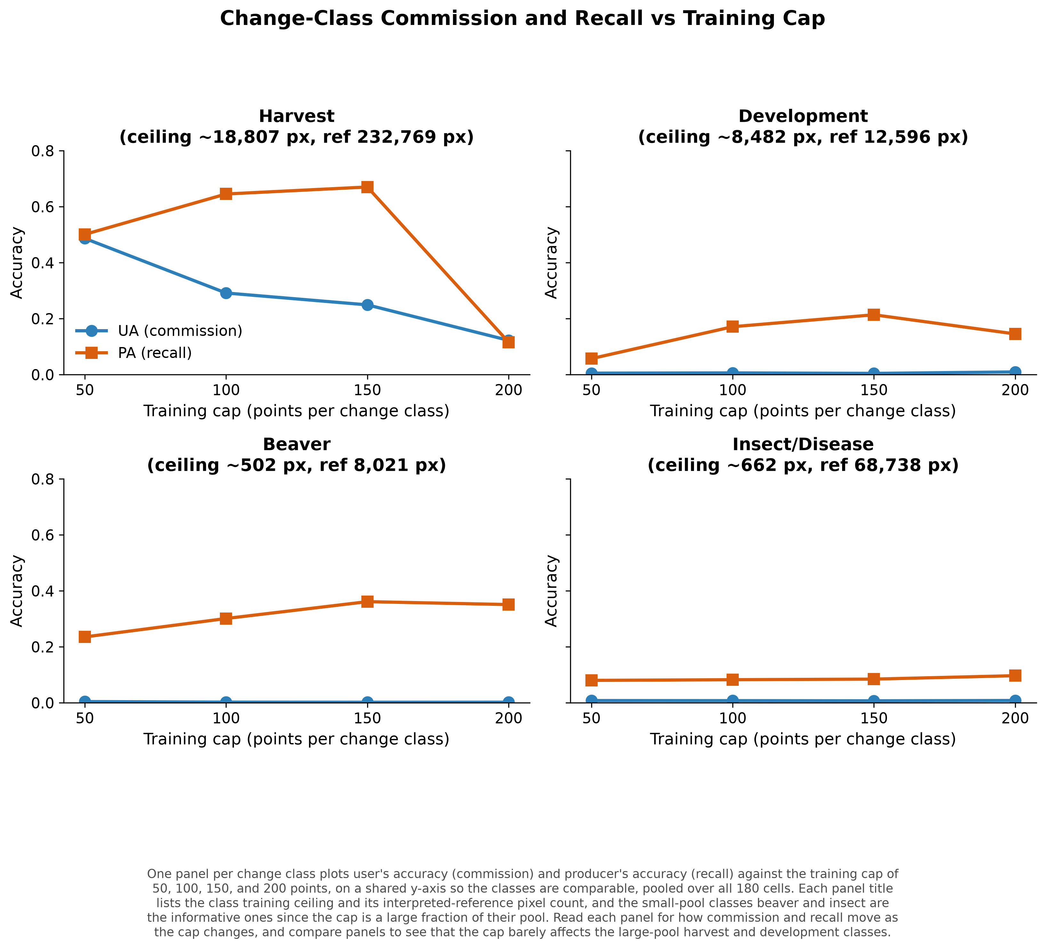
Is it just the training data?
Vary change-class training points: 50, 100, 150, 200
Producer's accuracy moves
User's accuracy stays near zero
More training points is not the fix
Notes:
The obvious first objection, so answer it directly. Beaver has a training pool of only about 502 pixels, so the cap is a large share of what exists. Pushing the classifier to find more beaver only makes it predict beaver far more often than beaver occurs. That is a precision problem, and a training budget cannot solve it.

Slide 25
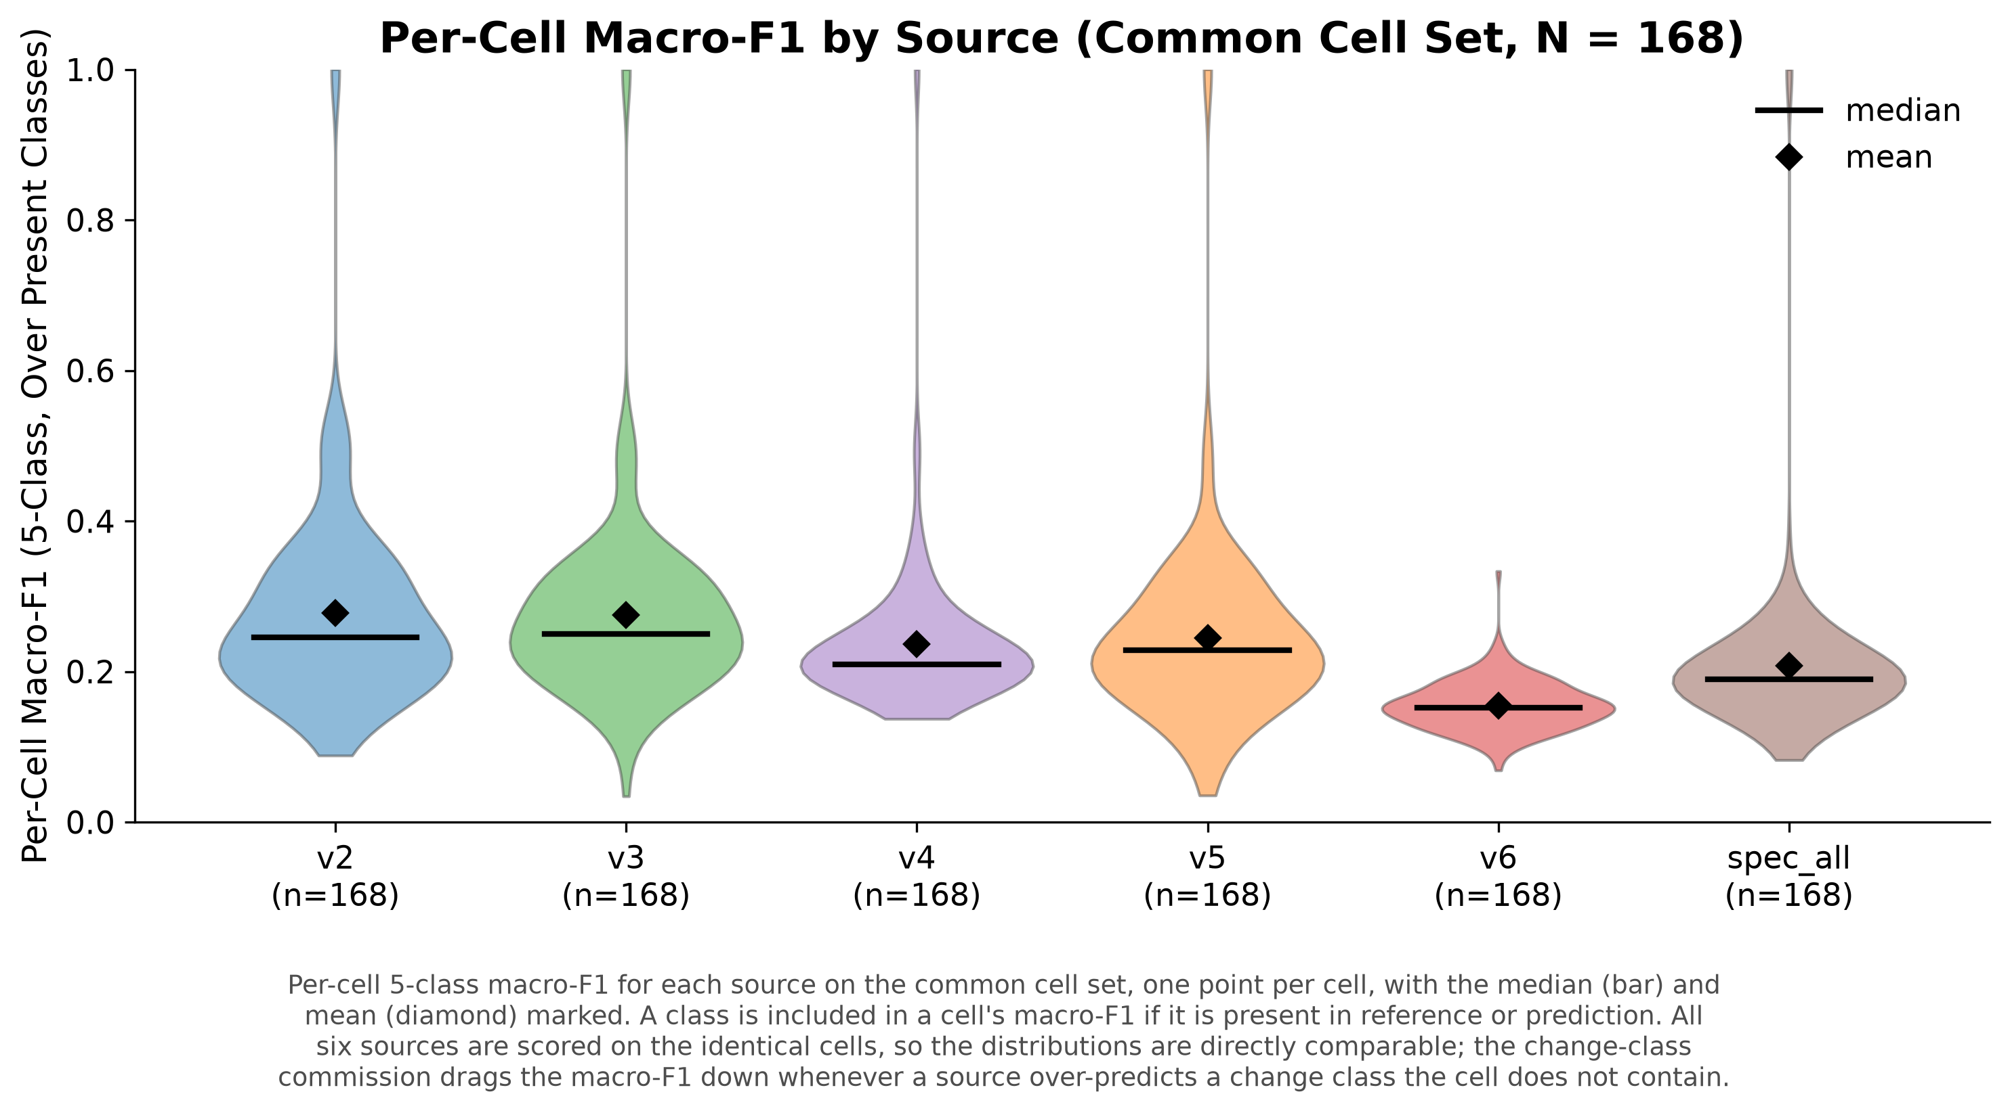
Embeddings perform like spectral
One point per cell, identical footprints
Distributions overlap heavily
No configuration is clearly ahead
Notes:
Per-cell macro-F1 on the common 168-cell set, so this is a like-for-like comparison. The baseline-preserving configurations and the spectral composite land in the same range. Answer to question one, part one: keeping a baseline embedding matters, and embeddings do not beat a matched spectral composite on accuracy. So the interesting difference between them is not statistical. Set up the next section.

Slide 26
Why are the change classes so bad?
Every configuration fails on them, including the spectral baseline. That points somewhere other than the features.
Notes:
Transition slide. The uniformity of the failure is the clue. If features were the constraint, configurations would separate. They do not. What every configuration shares is the reference.

Slide 27
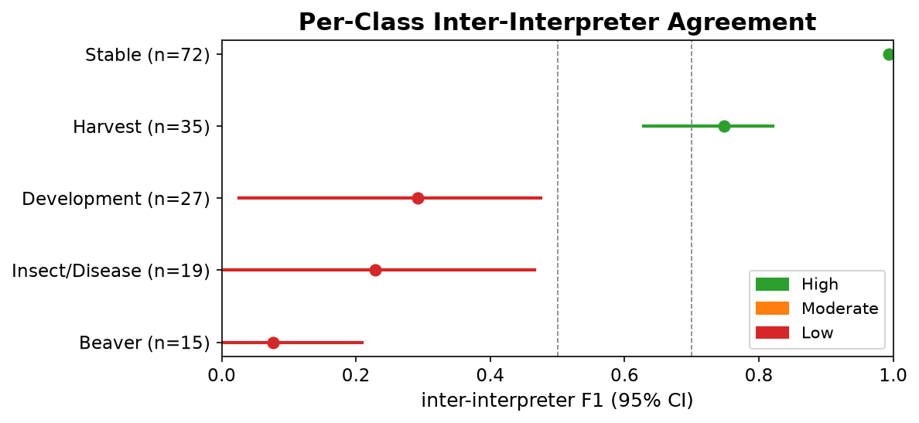
Interpreters disagree, and not at random
Stable 0.99, Harvest 0.75
Development 0.29
Insect / disease 0.23
Beaver 0.08
Notes:
72 double-interpreted cells, five interpreters, cluster bootstrap by pair. The classes interpreters agree on least are the classes the classifiers fail on most. Beaver agreement is 0.077 with a confidence interval reaching zero. Two trained people essentially do not agree on beaver. Inter-interpreter reliability is an established concern in reference data, see Stehman and Czaplewski 1998, Foody 2010, Pengra et al. 2020. Evidence that this is conceptual rather than geometric: contested zones are large and interior, both interpreters placed training points in them and assigned different classes, and relaxing spatial tolerance does not recover agreement for the transitional classes.

Slide 28
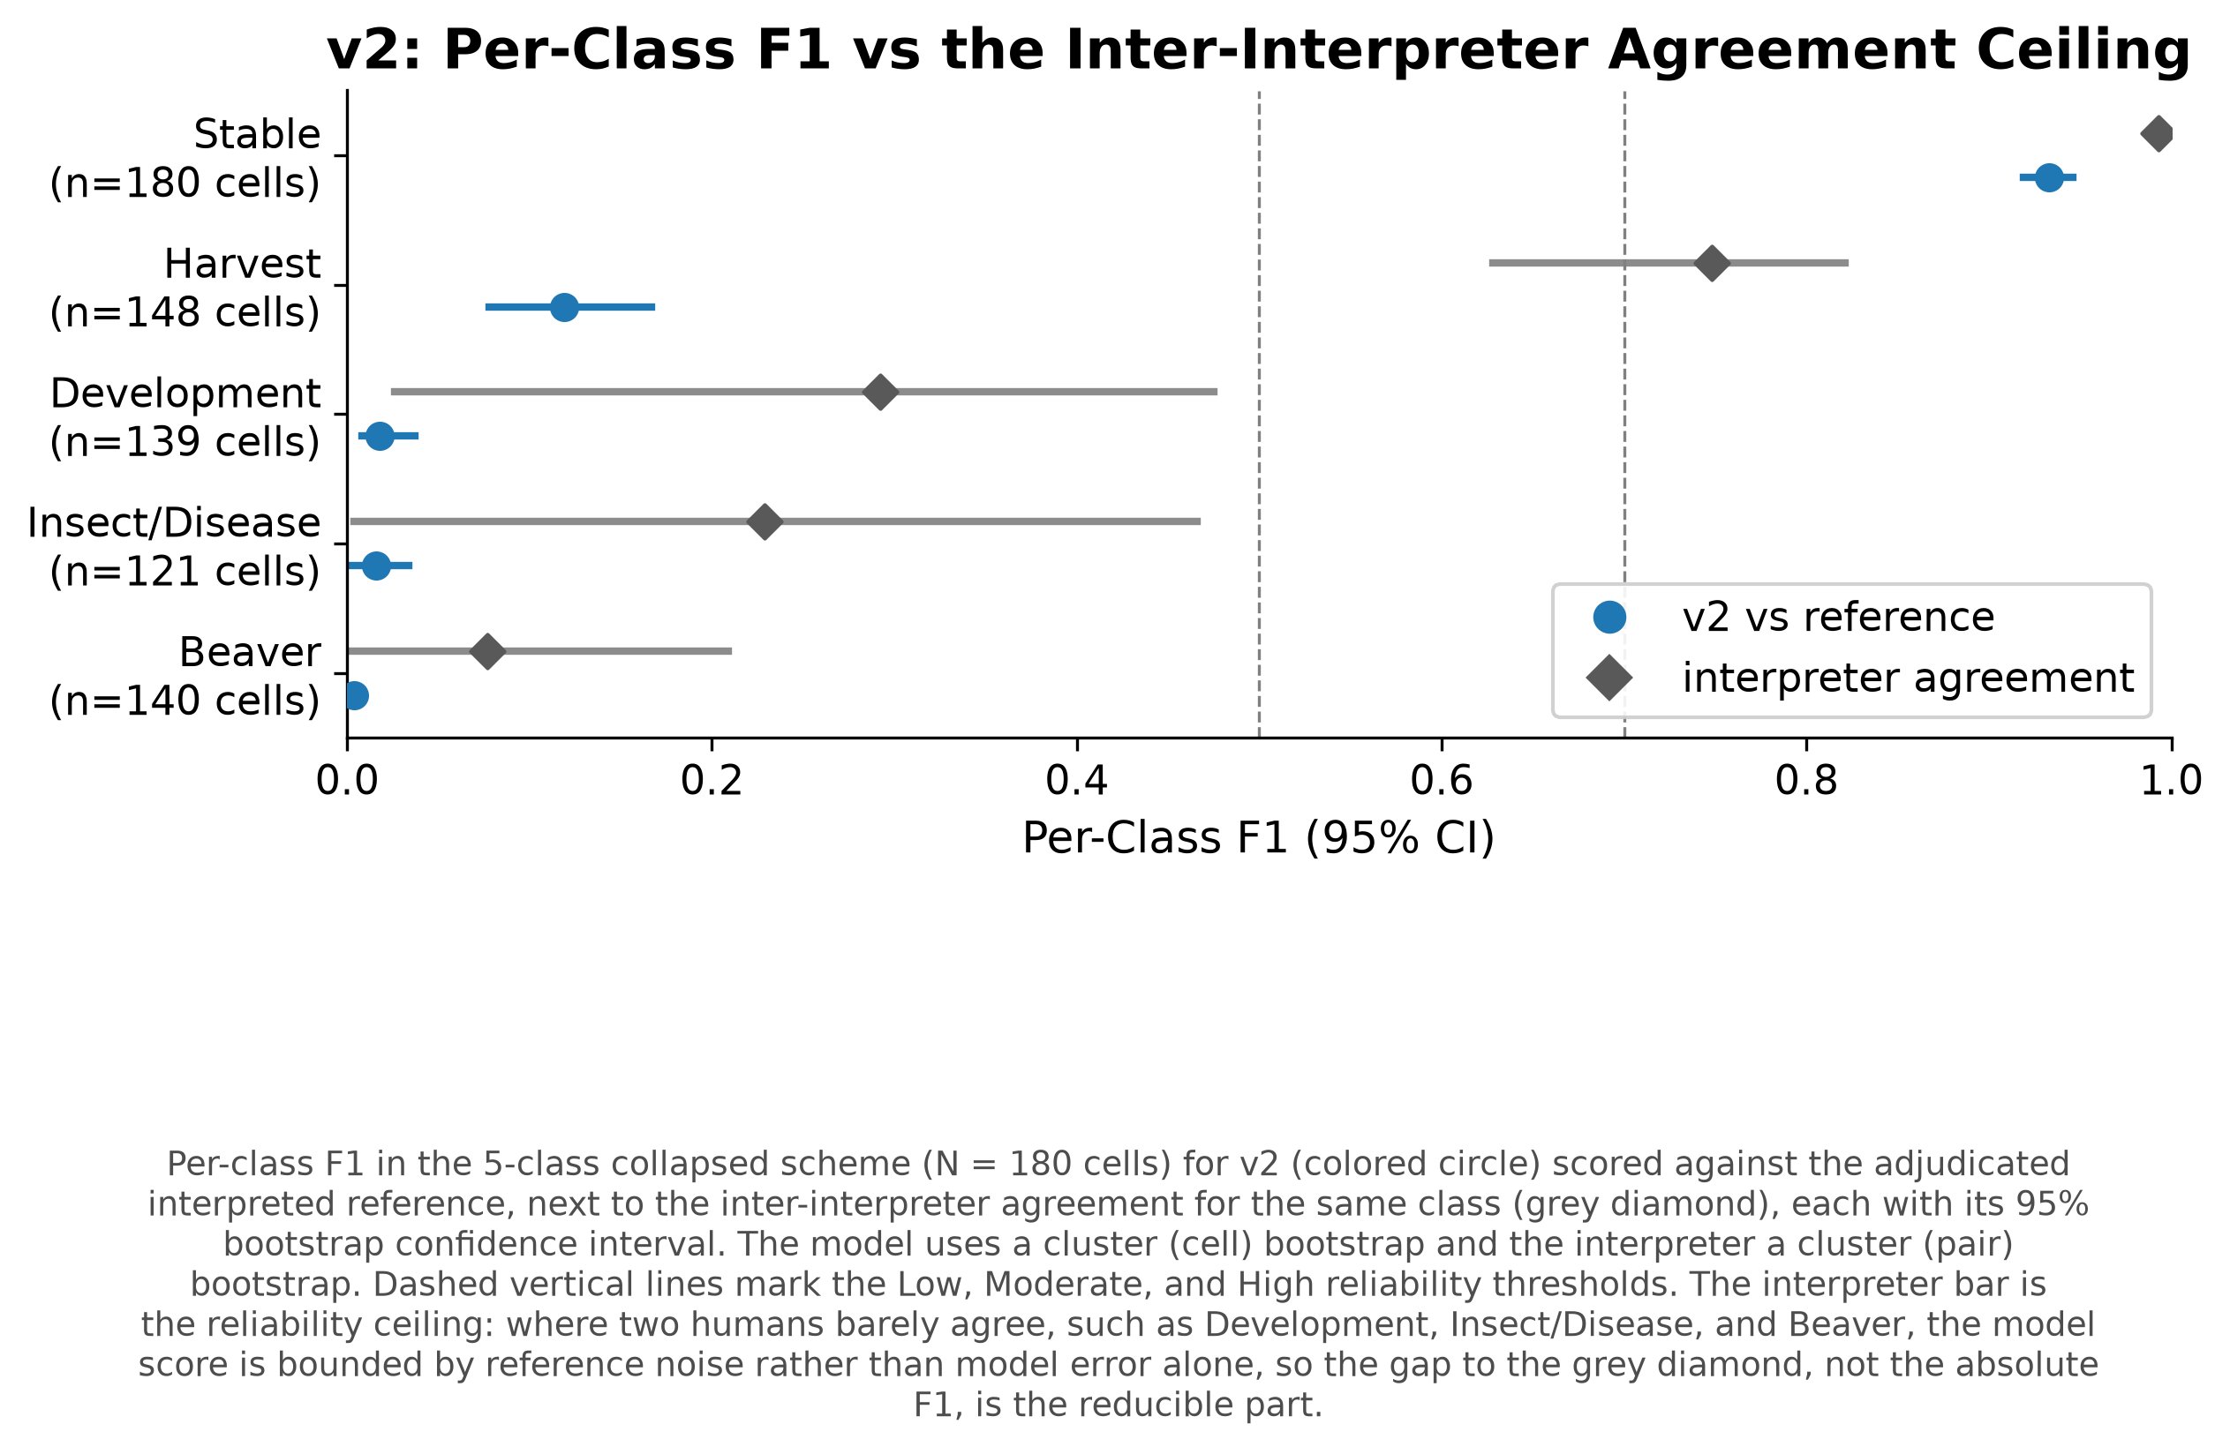
Against the interpreter ceiling
Grey diamonds: how well two humans agree
Stable classes reach it
Harvest does not
Change classes sit below an already low ceiling
Notes:
The ceiling is what the reference can support, not what the classifier can do. Stable classes approach it, so those are model-limited: better features should help. Harvest has a high ceiling, 0.75, and the model does not reach it. That gap is a genuine model shortfall. Beaver model F1 0.004 against a ceiling of 0.077; insect and disease 0.016 against 0.229. The ceiling explains why they are hard and does not close the gap. Defensible claim: a better classifier alone cannot fix these classes. Not that the classifier is already at the limit.

Slide 29
So every configuration scores about the same. Which one gives a better map?
Notes:
This is question two, and the point where aggregate metrics stop helping. Accuracy has told us what it can. The rest is spatial.

Slide 30
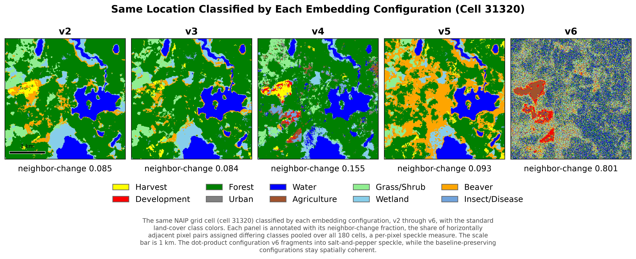
The same ground
Notes:
Reference panel first, then each configuration on identical ground. Same classifier, same training data, same reference. Only the feature representation differs. Baseline-preserving configurations give contiguous patches. Delta-only is grainy. Dot-product-only is salt and pepper. Ask the audience which map they would give a park manager.

Slide 31
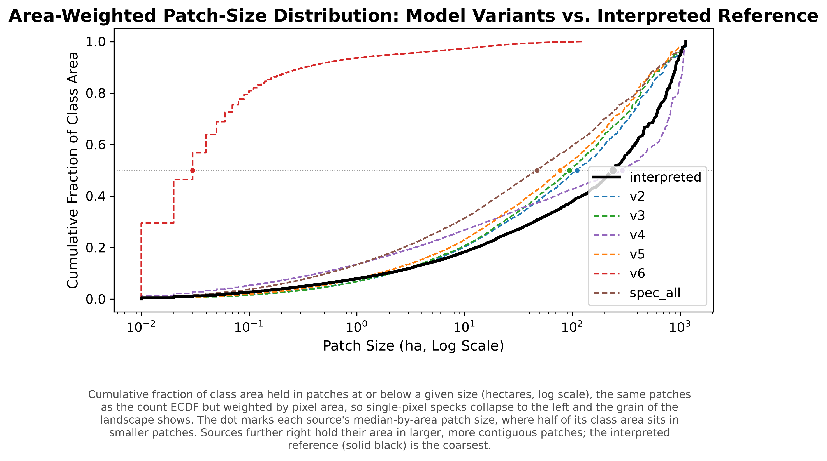
Measuring it
Area-weighted patch size
Reference 239 ha, v2 110 ha, v6 near zero
Moran's I and neighbor-change tell the same story
Notes:
One metric shown; we computed three and they agree, so the choice is not doing any work. Reference median-by-area about 239 ha. v2 about 110, spec_all about 47, v6 essentially zero. Note the direction honestly: coherent configurations are smoother than the reference on Moran's I, 0.82 against 0.75, so the failure mode is over-smoothing rather than fragmentation. Spectral composite is more fragmented than the coherent embedding configurations.

Slide 32
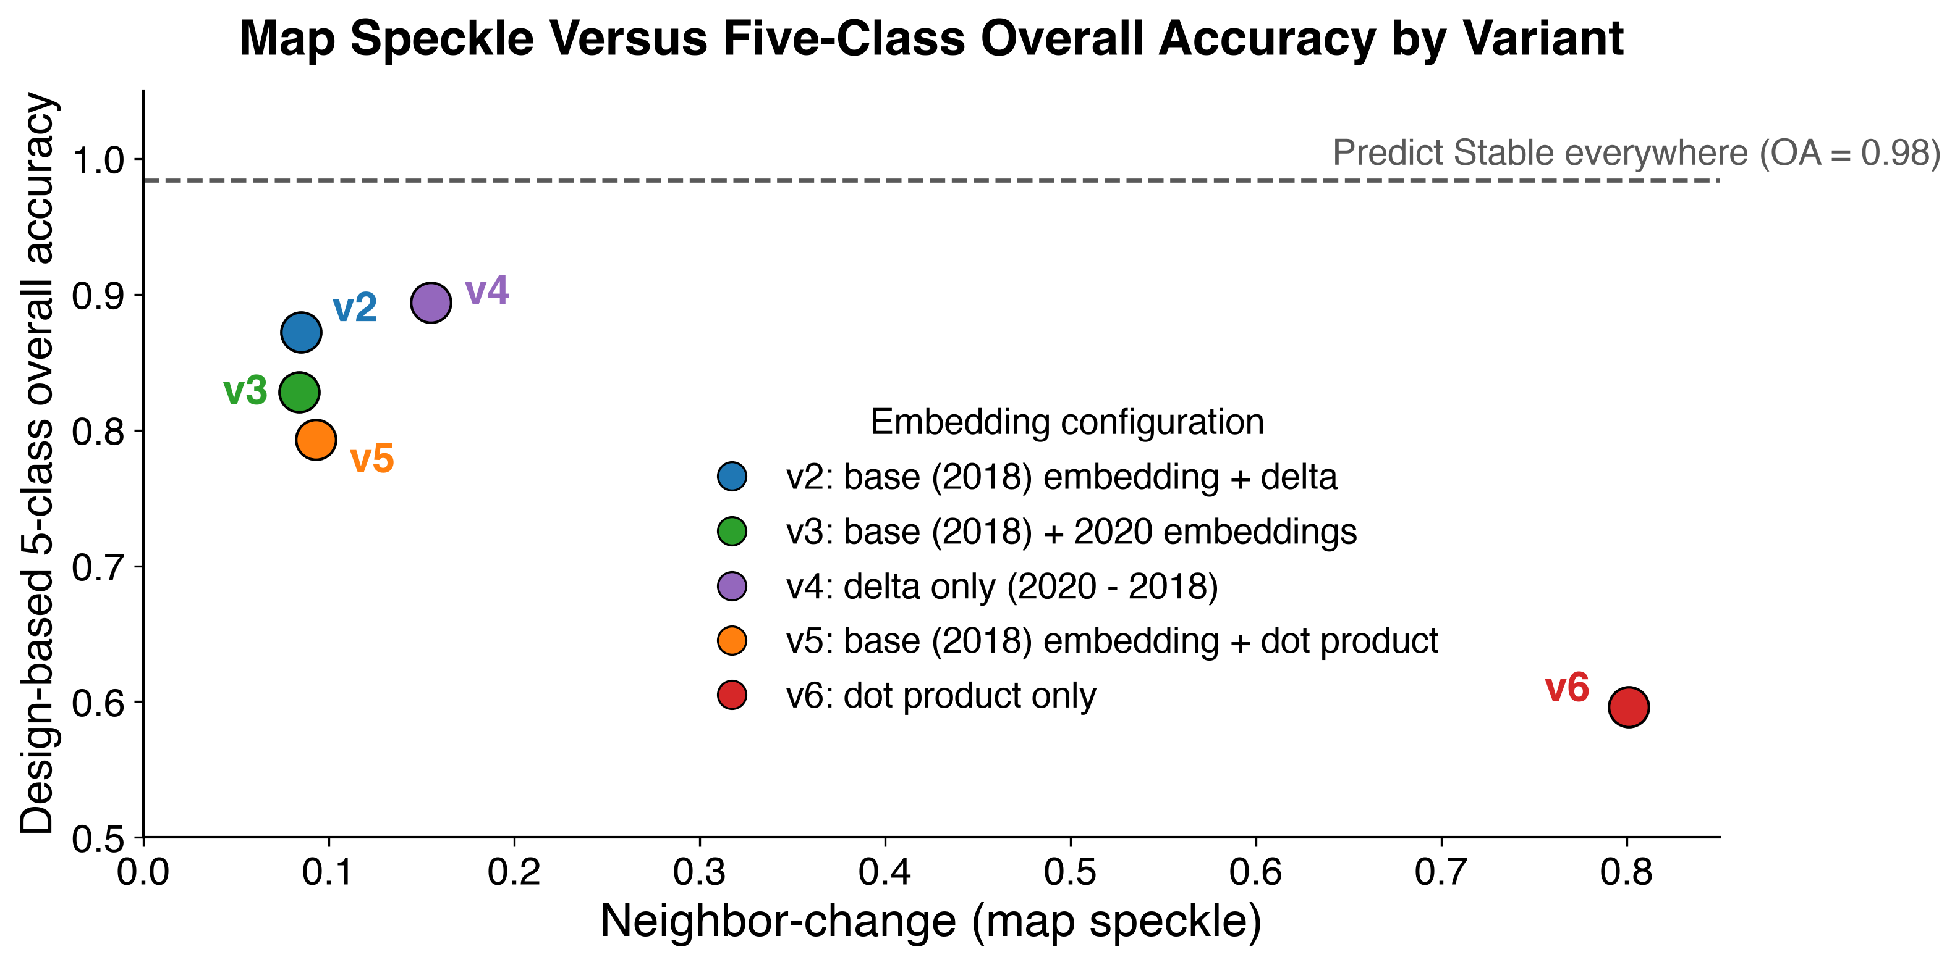
The best-scoring configuration is one of the worst maps
v4 tops five-class accuracy
v4 is among the most fragmented
Every configuration loses to predicting Stable everywhere
Notes:
This is the one thing to remember. v4 is delta-only: highest five-class overall accuracy at 0.894, among the most fragmented maps, and fourth of five on ten-class accuracy. The dashed line is predicting Stable everywhere, 0.984, which beats every configuration. With change at 1.6 percent of the landscape, overall accuracy is uninformative. A conventional assessment, aggregate accuracy from a point sample, would have picked v4 or called them equivalent. On rank correlation: five points describe five points, the informative feature is where v4 sits.

Slide 33
Back to the questions
1. How do we structure them?
2. How do we tell the maps apart?
Keep a full baseline embedding. Reducing change to a magnitude alone destroys the map, even when accuracy looks fine.
Not from accuracy, and not from a point sample. Spatial structure separates them, and it takes wall-to-wall reference to see it.
Notes:
Close the loop opened before the methods. Question one has a clean answer. Question two has a method answer rather than a number. The link between them is the thesis: the property that distinguishes representations is the property conventional assessment cannot see.

Slide 34
What we found
Embeddings match a matched spectral baseline. They do not beat it
Keeping a baseline embedding is what matters most
Aggregate accuracy is blind to spatial structure
The change classes are limited by the reference, not the features
Notes:
Four claims, in the order the talk established them. First two answer question one, second two answer question two. The fourth is the one that generalizes furthest: any rare, conceptually ambiguous class inherits it.

Slide 35
Limitations
Change polygons come from park watersheds, a small part of the grid
One region, one scheme, one classifier
Reliability rests on 72 cells
The reference is a consensus, not a truth
Notes:
First is the one most likely to be pressed: polygon frequencies describe surveyed watersheds, and classifiers extrapolate to a broader landscape. 72 cells is enough for the transitional-class result and thin for the rarest agents. Next step: latent class models on the double-interpreted cells estimate interpreter sensitivity and specificity without a gold standard, turning the reliability bound into a correction.

Slide 36
Thank you
Robert Kennedy
Jamon Van Den Hoek, Mark Raleigh, Hamed Alemohammad
Bekka, Peter, and Ash
NPS Great Lakes Inventory and Monitoring Network
eMapR Lab
Notes:
Verify committee names and roles against the title slide.

Slide 37
Backup
Supplemental slides

Slide 38
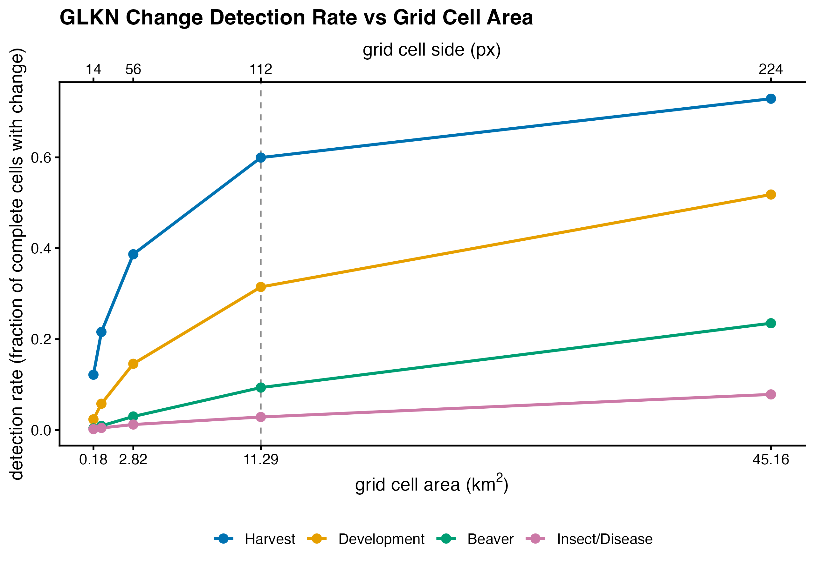
Choosing the assessment unit
Notes:
Detection rate against cell size by agent. At 112 px (3,360 m) harvest appears in about 60% of complete cells, development 31%, beaver 9%, insect and disease 3%. Cell size trades detection of rare agents against interpretation effort.

Slide 39
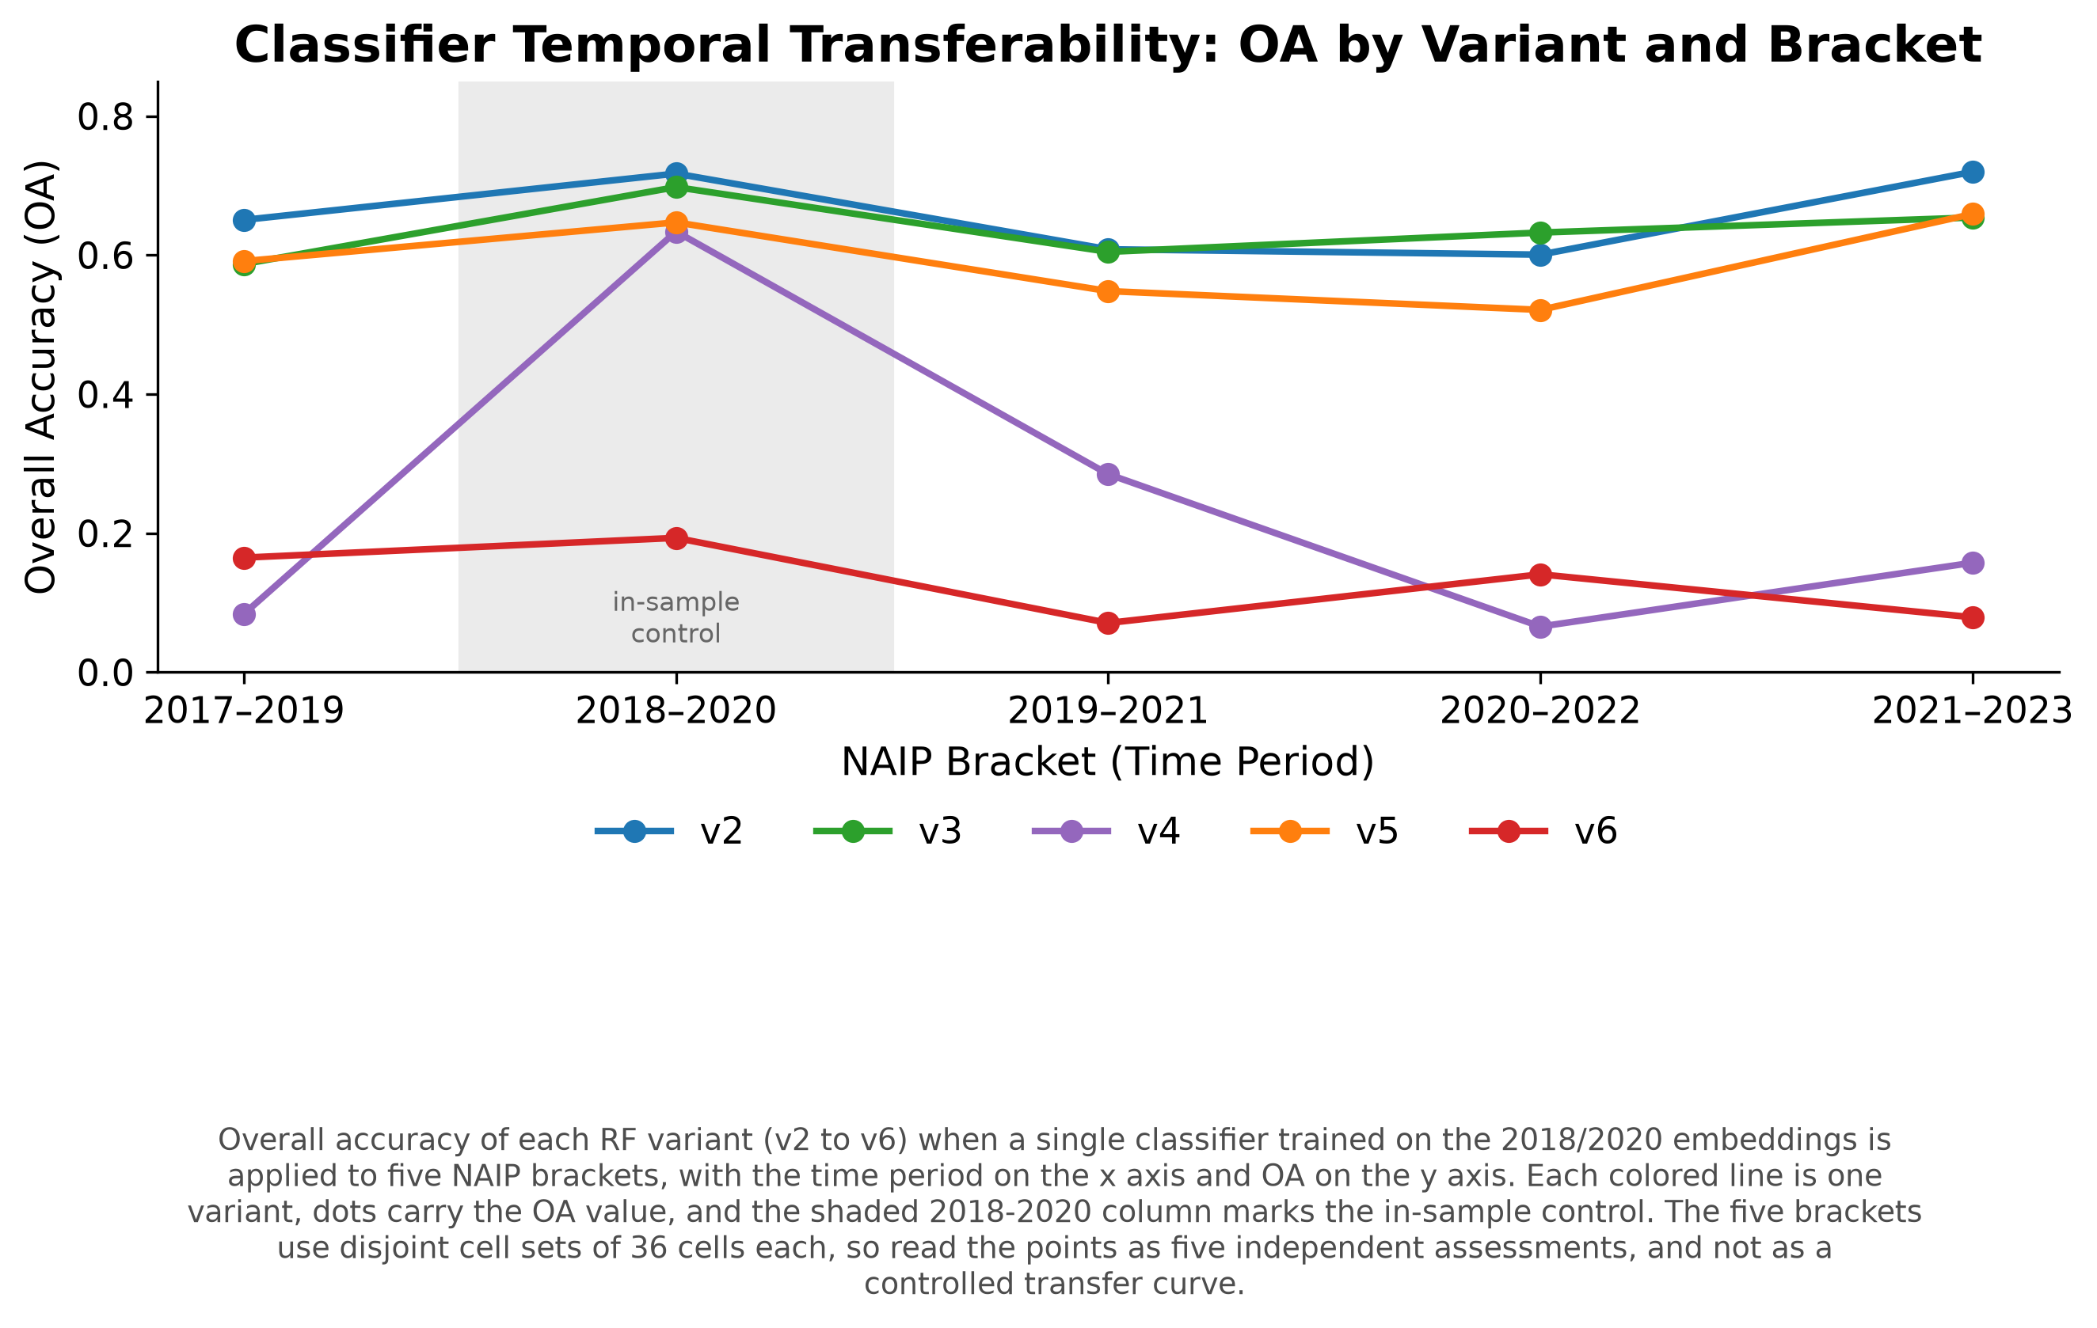
Aggregate accuracy, ten-class
Notes:
Per-bracket overall accuracy. Brackets use disjoint cell sets, so these are independent assessments rather than a transfer curve.

Slide 40
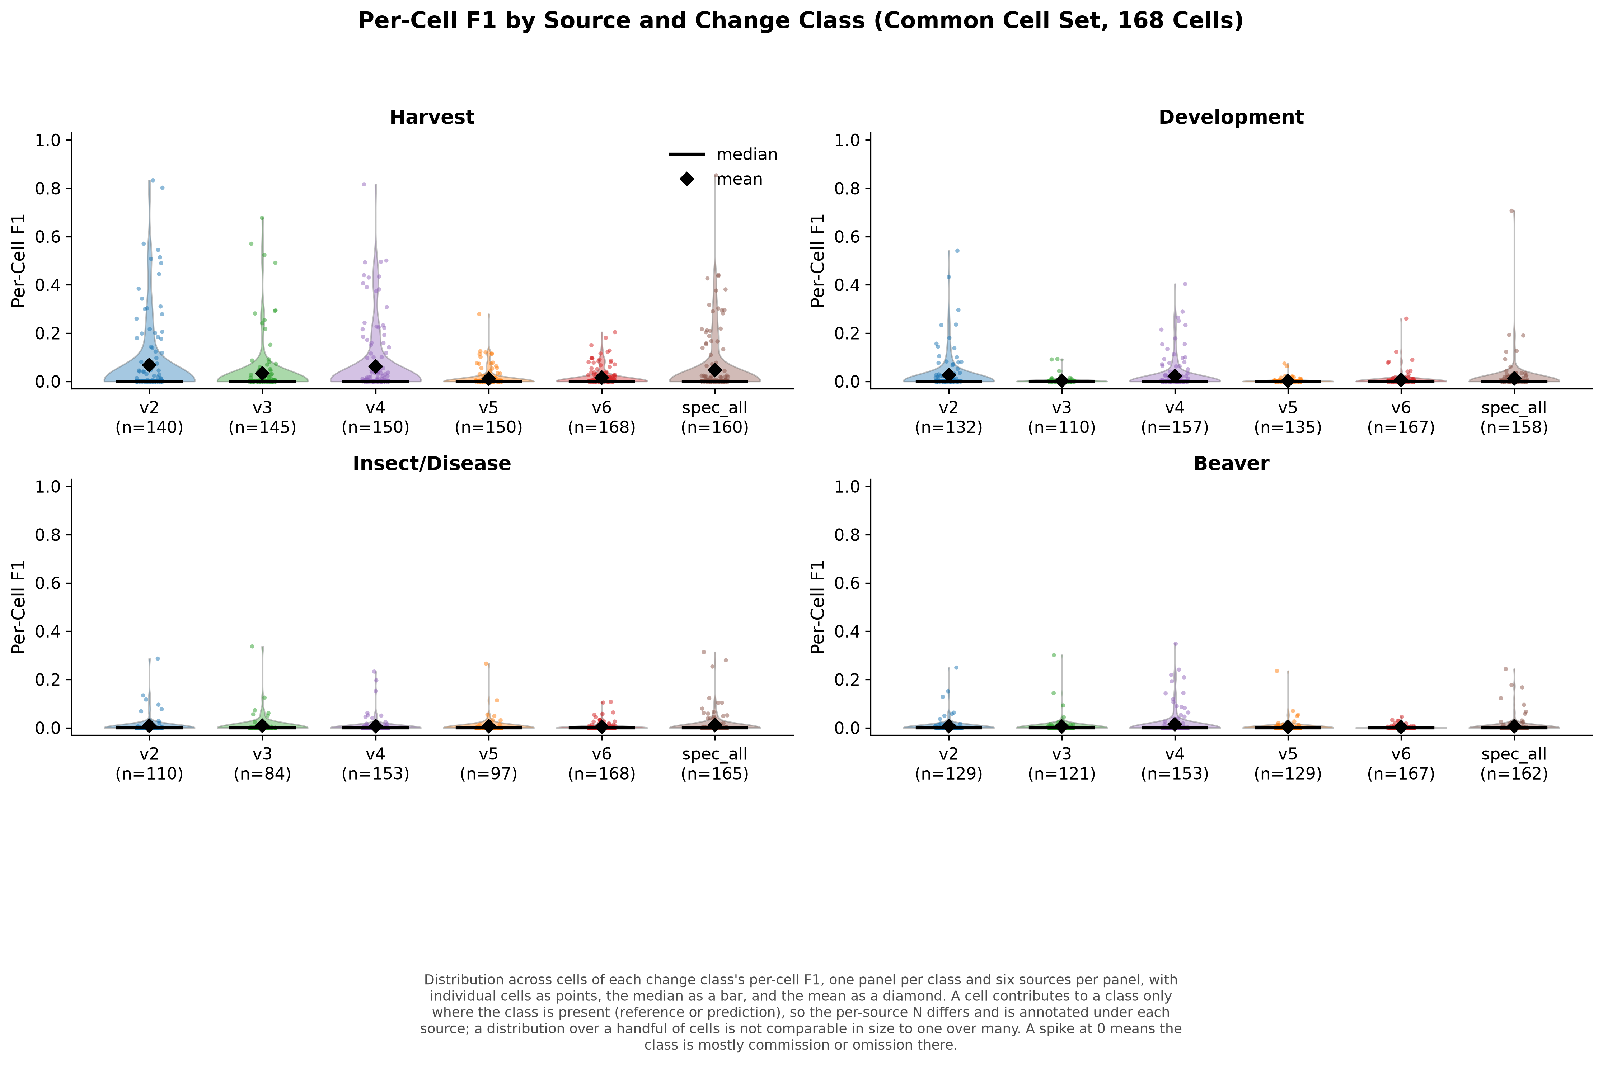
Per-cell change-class F1
Notes:
One point per contributing cell. Contributing cell counts differ across sources.

Slide 41
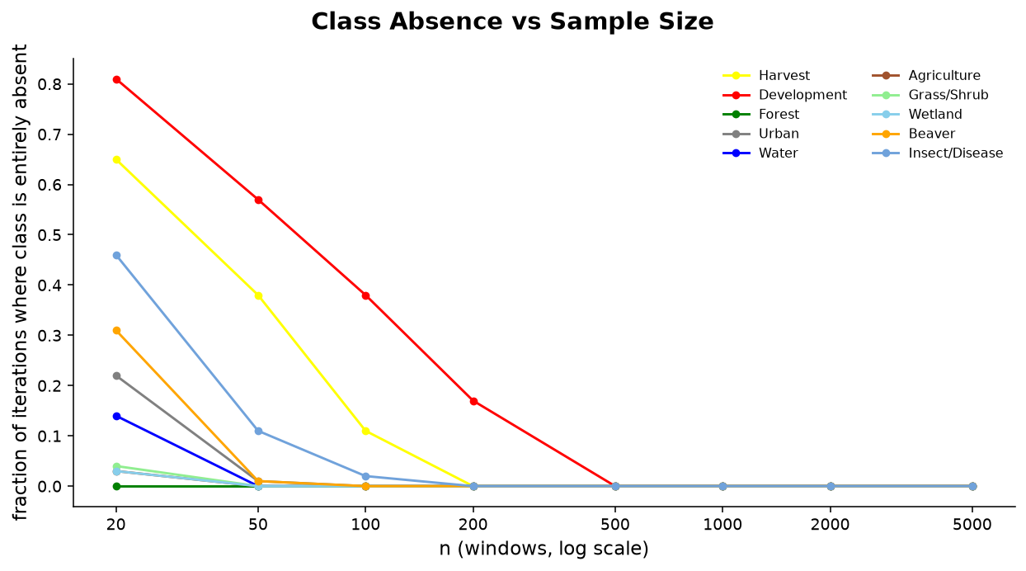
Rare classes vanish from small samples
Notes:
Fraction of Monte Carlo iterations in which a class is entirely absent from a simple random sample. For the rare change classes an accuracy estimate is undefined, not merely imprecise. A window is the block of contiguous pixels drawn at each sample location.

Slide 42
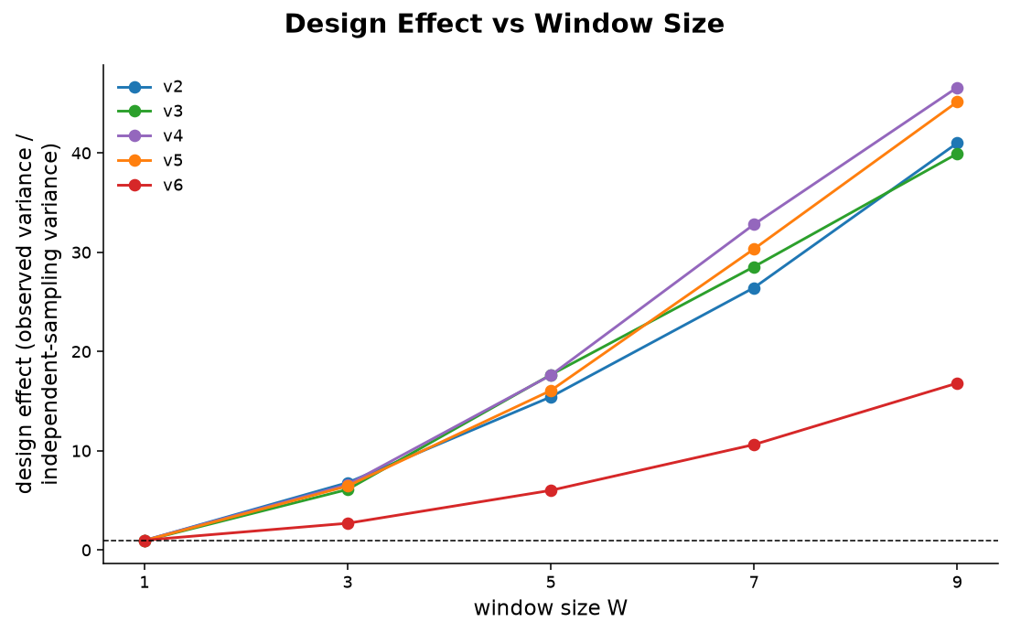
Coherent maps cost more to validate
Notes:
Design effect, observed variance over binomial variance. Large for the coherent configurations, near one for the fragmented one. Spatial coherence inflates the variance of any estimate drawn from clustered units.

Slide 43
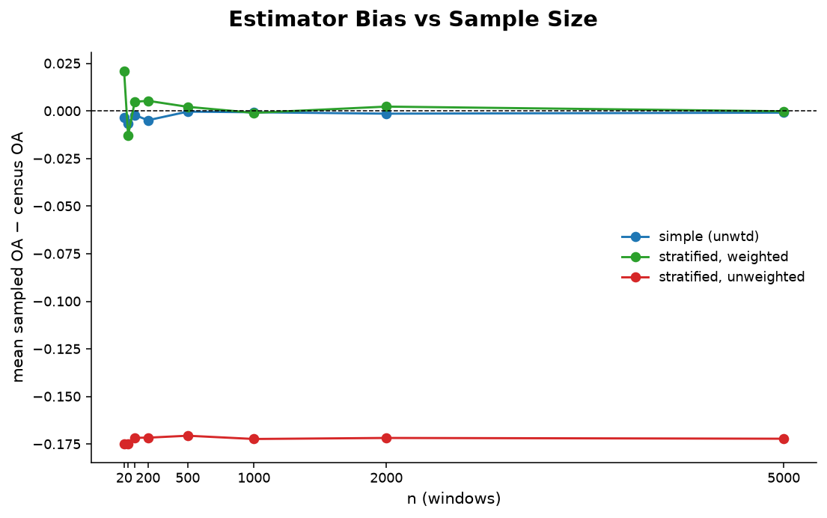
Stratify toward rare classes, then weight
Notes:
Simple random misses the change classes, stratified unweighted is biased, stratified with inclusion-probability weights recovers the census.

Slide 44
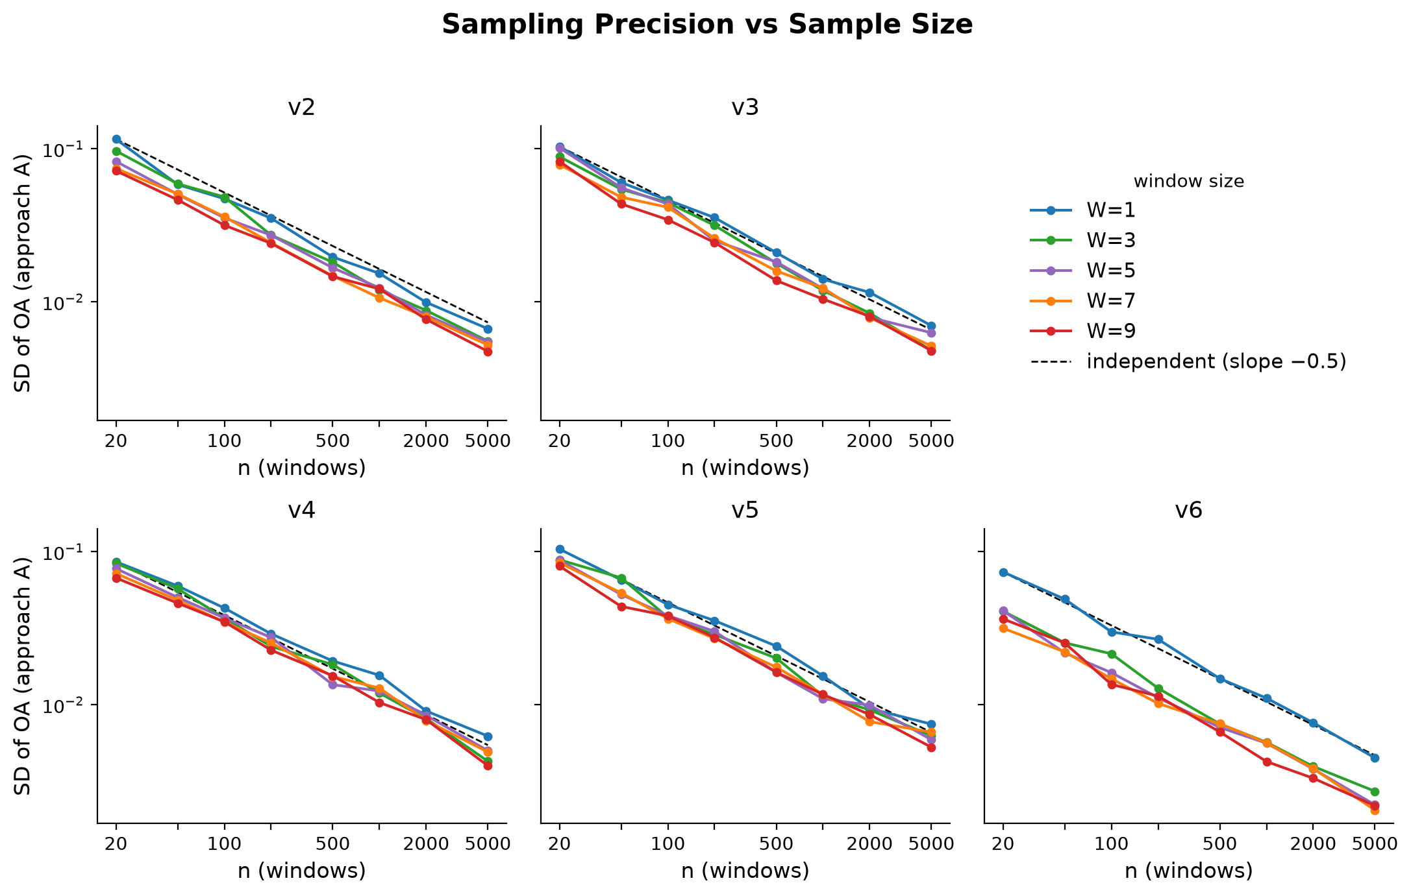
Sampling precision against sample size
Notes:
Precision improves as one over root n. Each spatial window contributes less than its pixel count owing to within-window autocorrelation.

Slide 45
Simulated landscapes and their renditions
[ pres_10_simulation_landscapes.png ]
Notes:
Truth plus four renditions with increasing omission, commission, spatial misalignment, and edge effects.

Slide 46
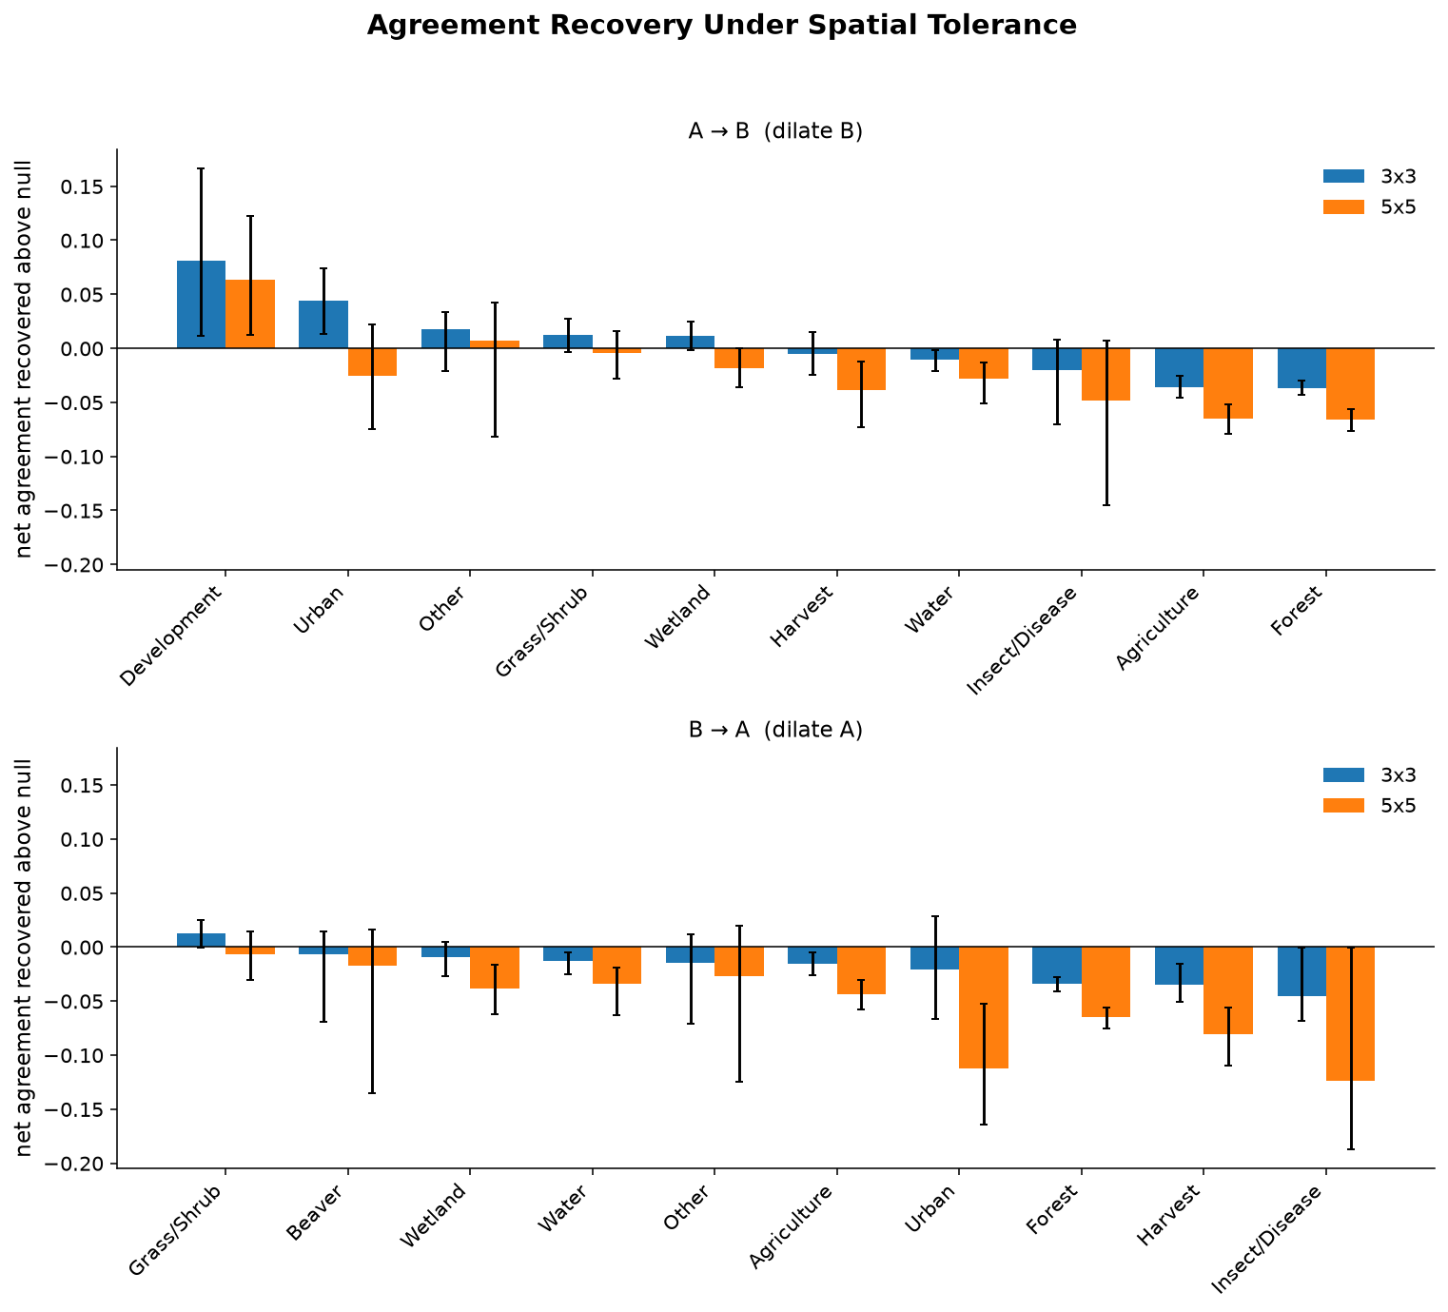
Agreement under spatial tolerance
Notes:
Allowing a match within 3 or 5 pixels recovers boundary-driven disagreement. Grass/shrub and wetland recover little, which is evidence the disagreement is conceptual.

Slide 47
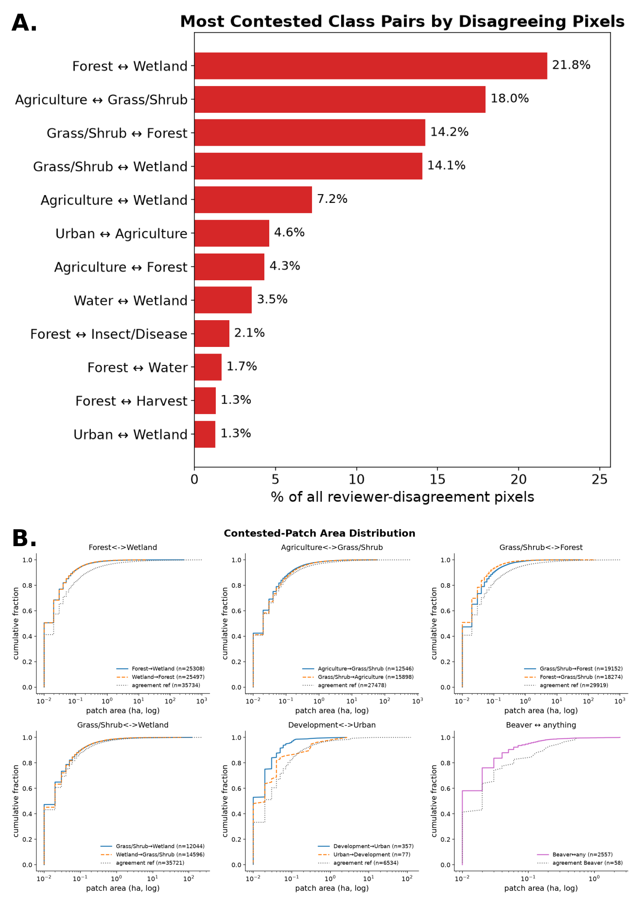
Where interpreters disagree
Notes:
Contested area is in large interior zones, not thin boundary strips. Dominant contested pairs are forest with wetland and grass/shrub with wetland.

Slide 48
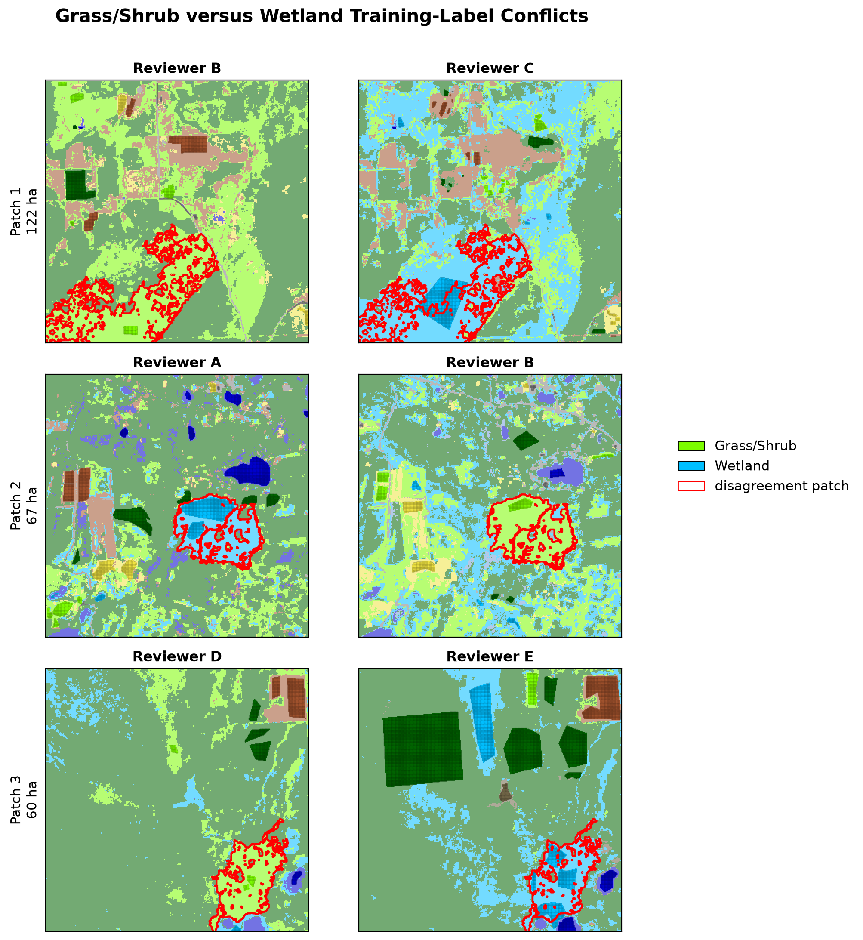
Opposing labels on the same ground
Notes:
Both interpreters placed training points in the same contested zone and assigned different classes. Direct evidence of conceptual rather than geometric disagreement.

Slide 49
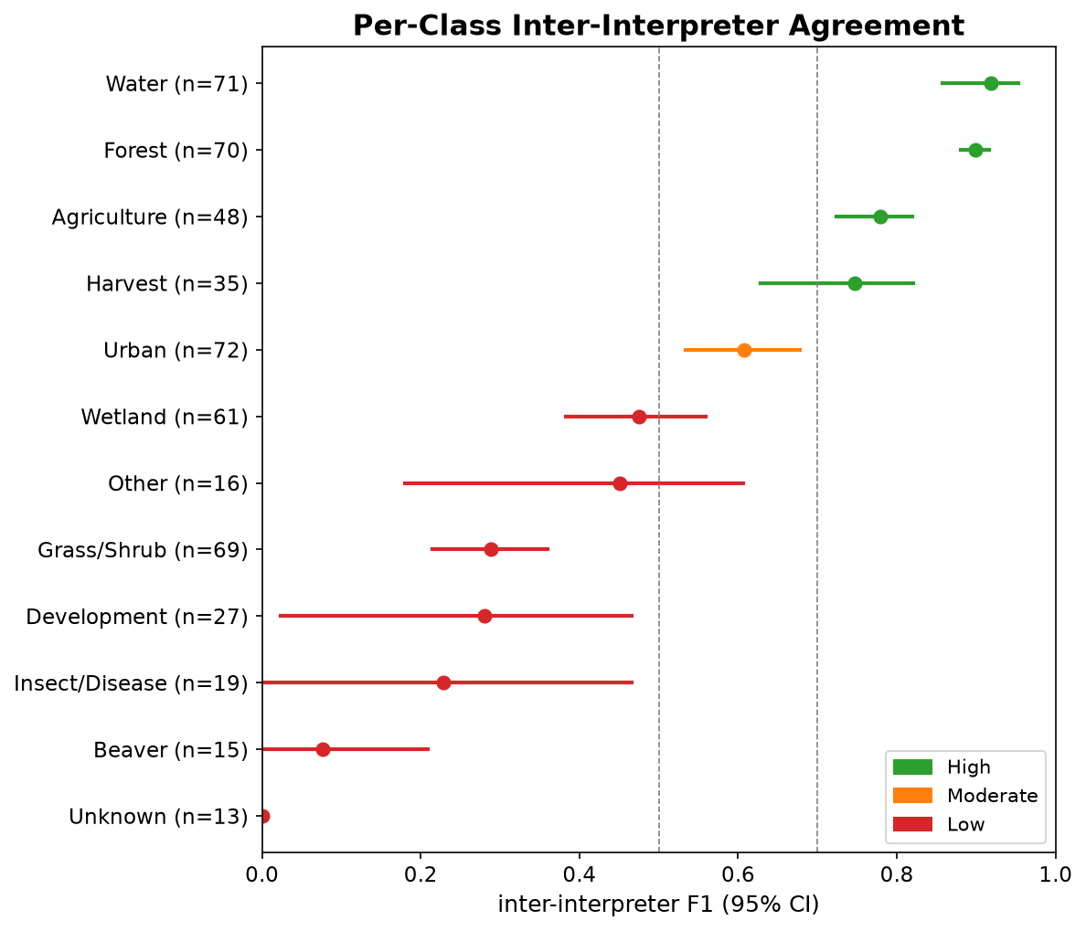
Ten-class interpreter agreement
Notes:
Wetland 0.475, grass/shrub 0.289. The transitional stable classes.

Slide 50
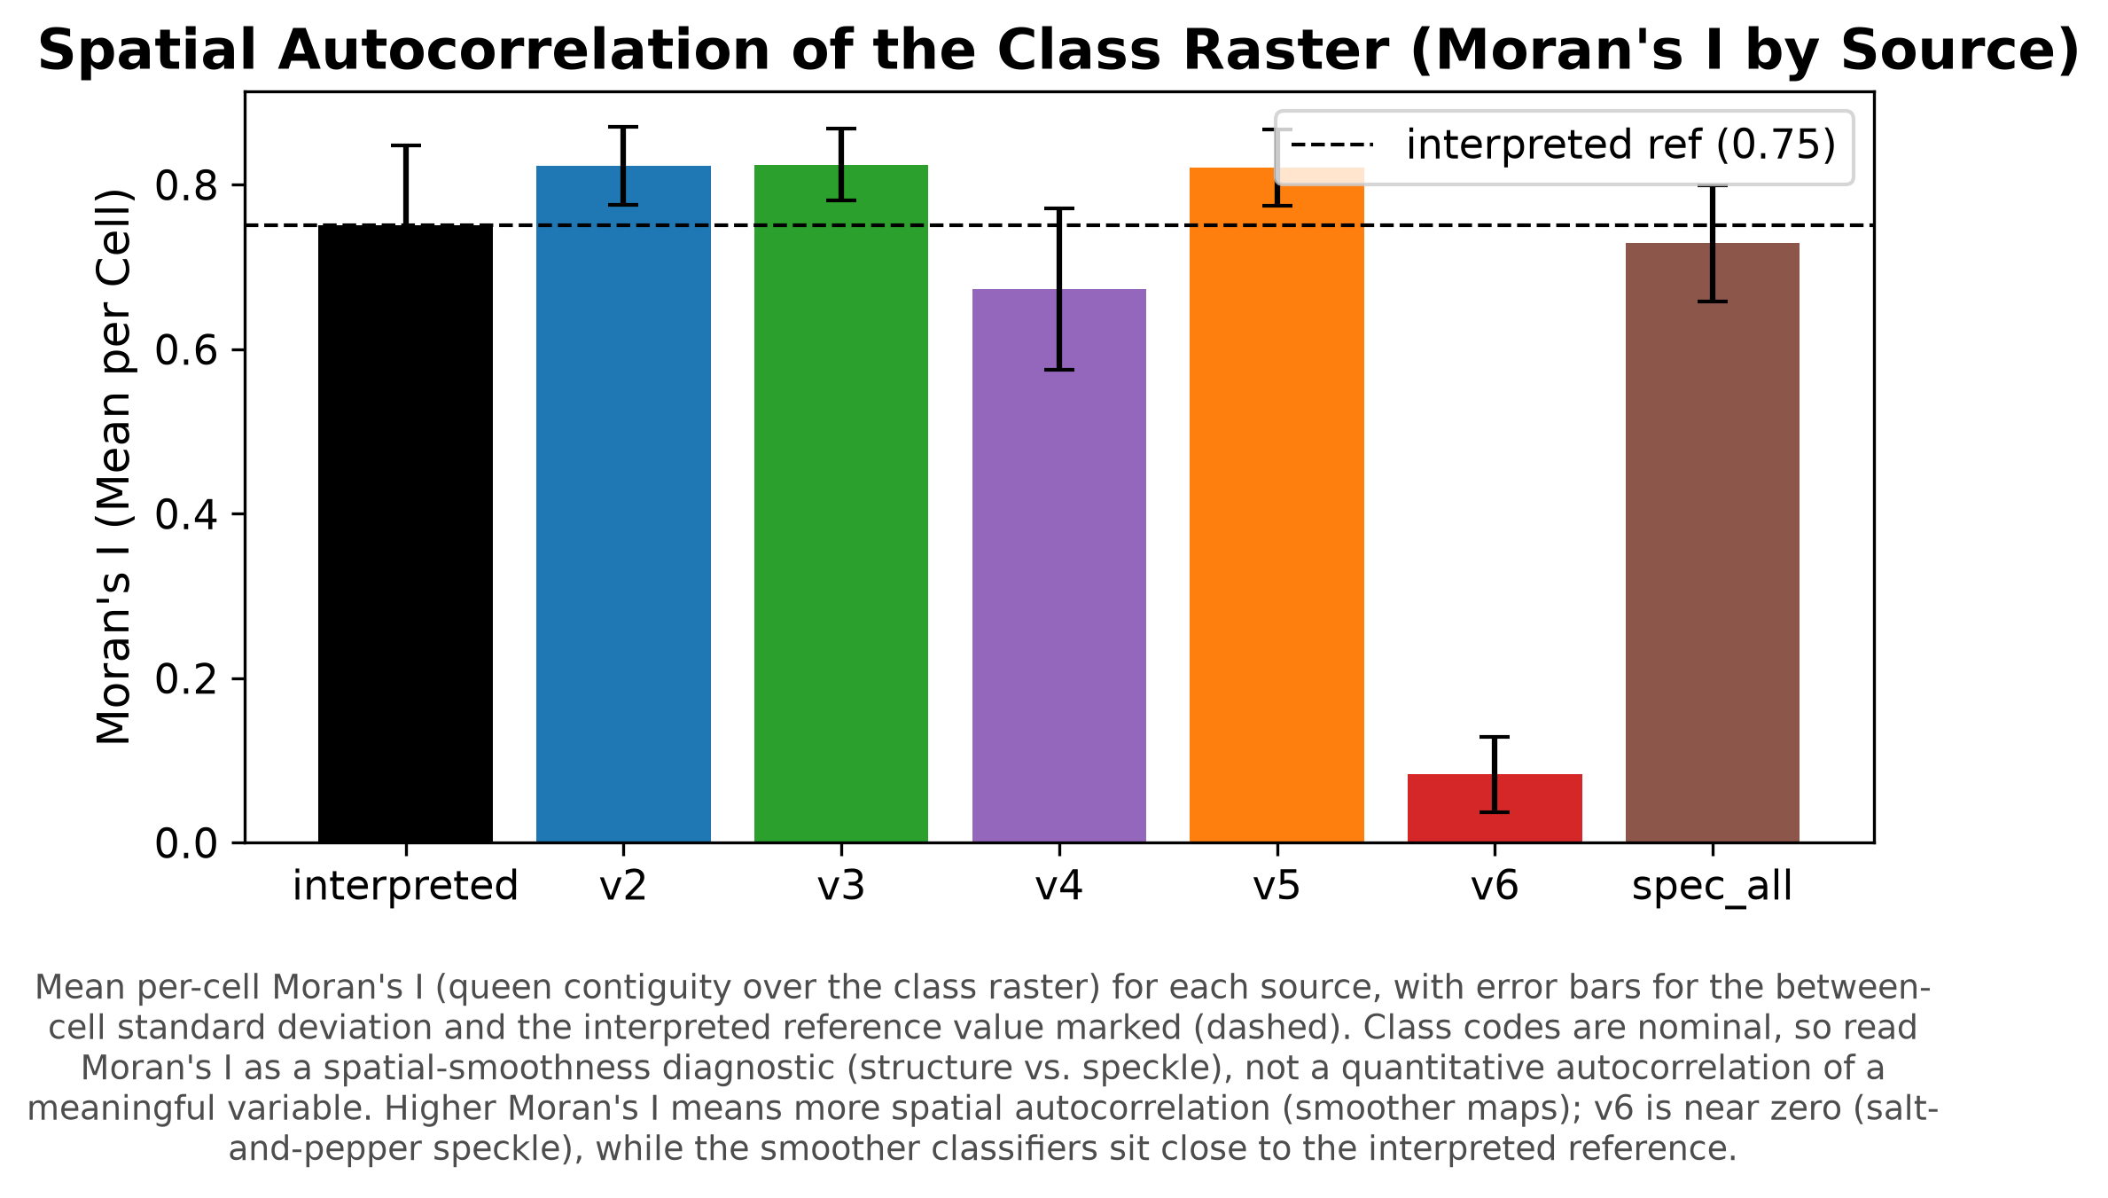
Moran's I by configuration
Notes:
Reference 0.75, coherent configurations 0.82, v6 0.08. The coherent configurations are smoother than the reference.

Slide 51
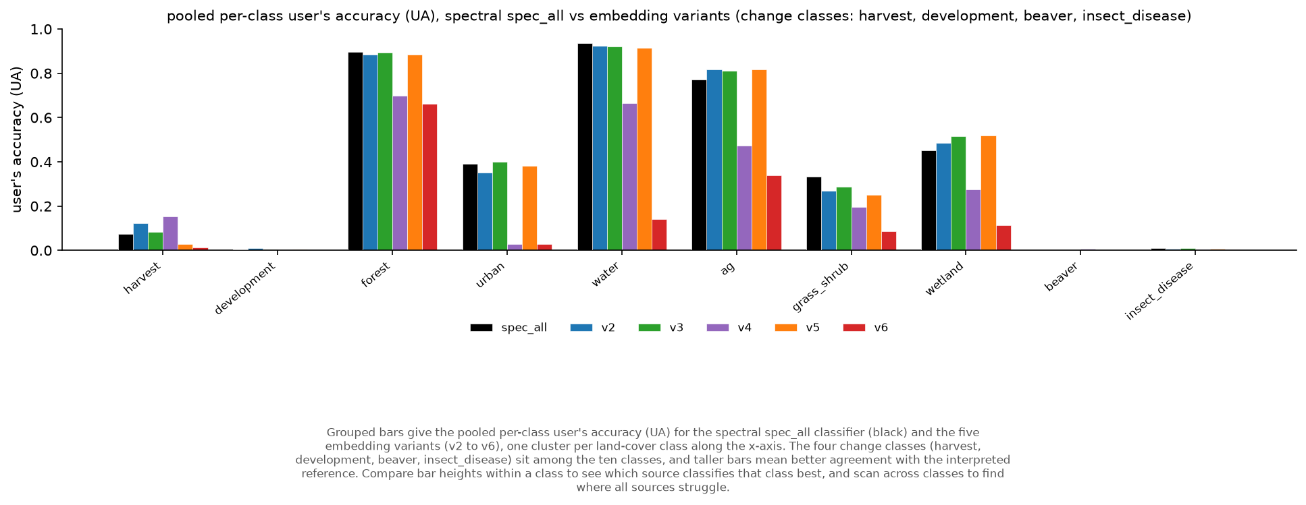
Embeddings against spectral, by class
Notes:
Class-level comparison of the two feature families.

Slide 52
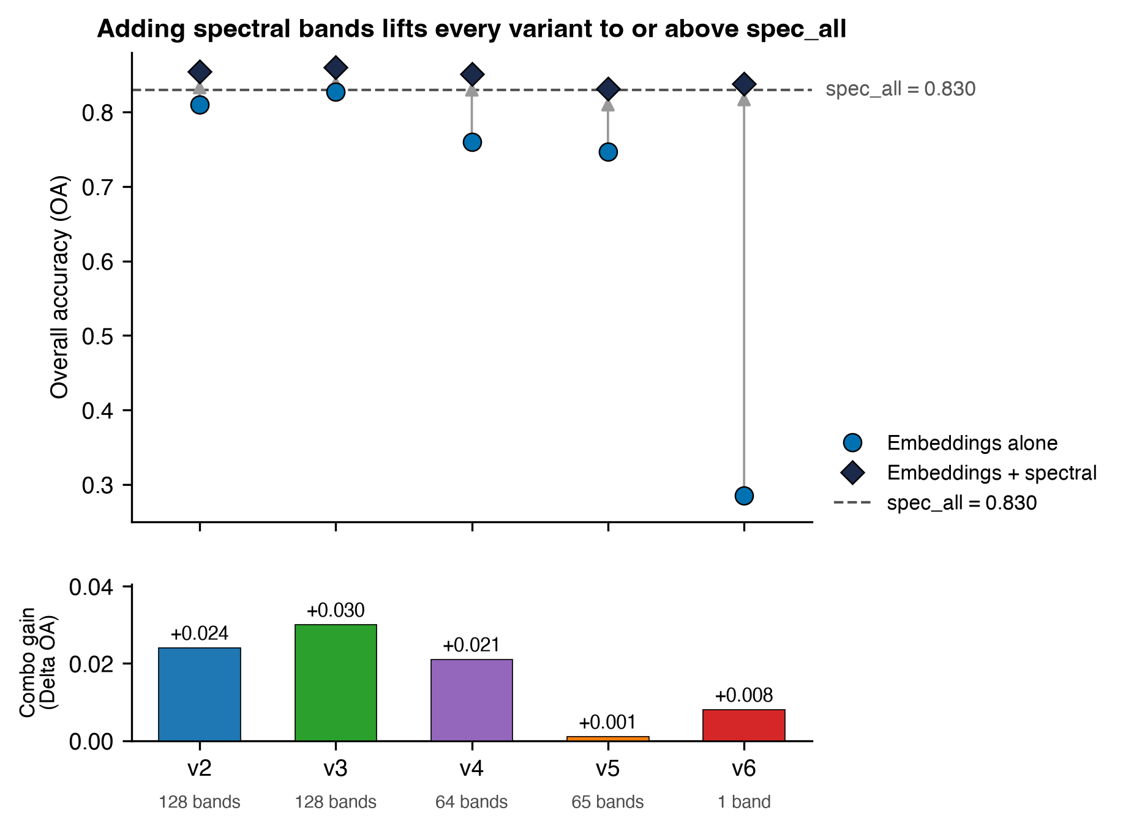
Combined embeddings and spectral
Notes:
Combining families gives at most a three-point gain over the better single family, not significant, with wider out-of-bag to validation gaps suggesting feature dilution.

Slide 53
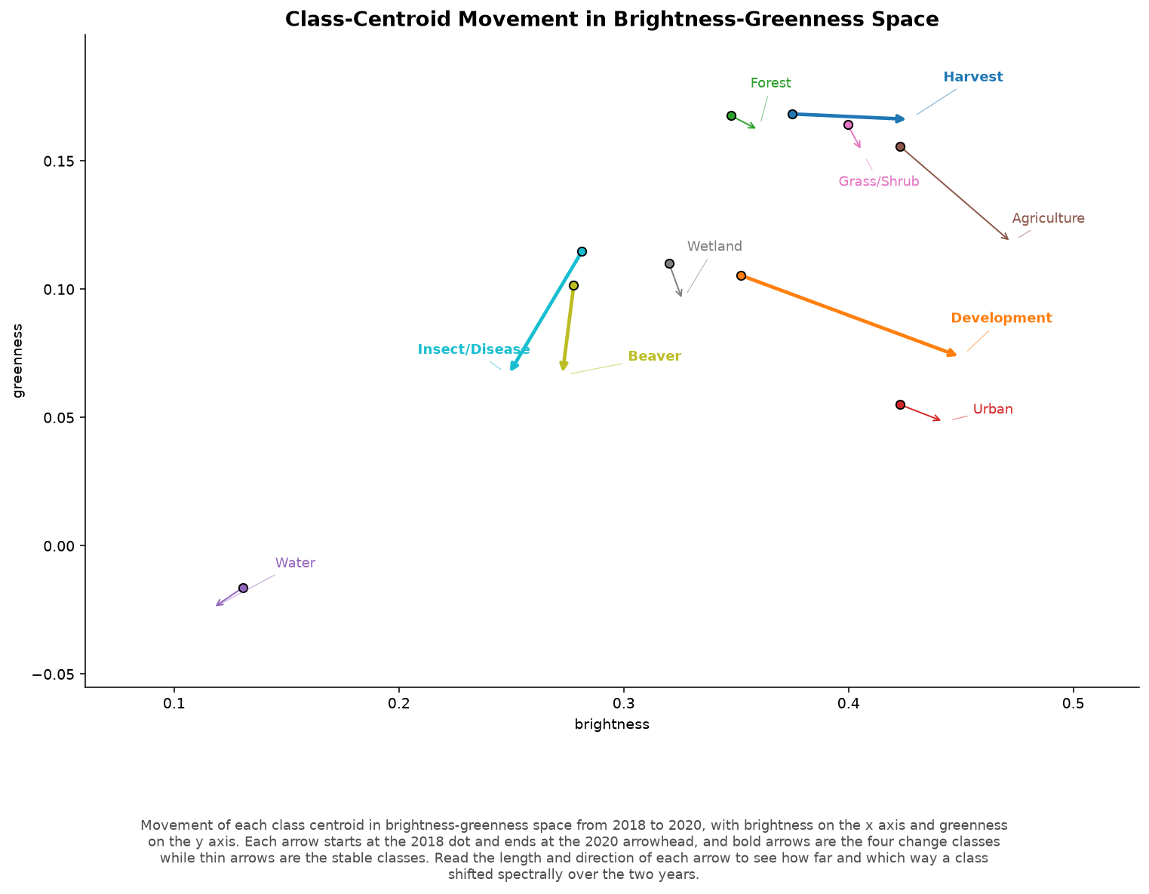
Tasseled Cap class trajectories
Notes:
Training points in Tasseled Cap change space. Use if asked whether the change classes are separable in a conventional spectral change space.

Slide 54
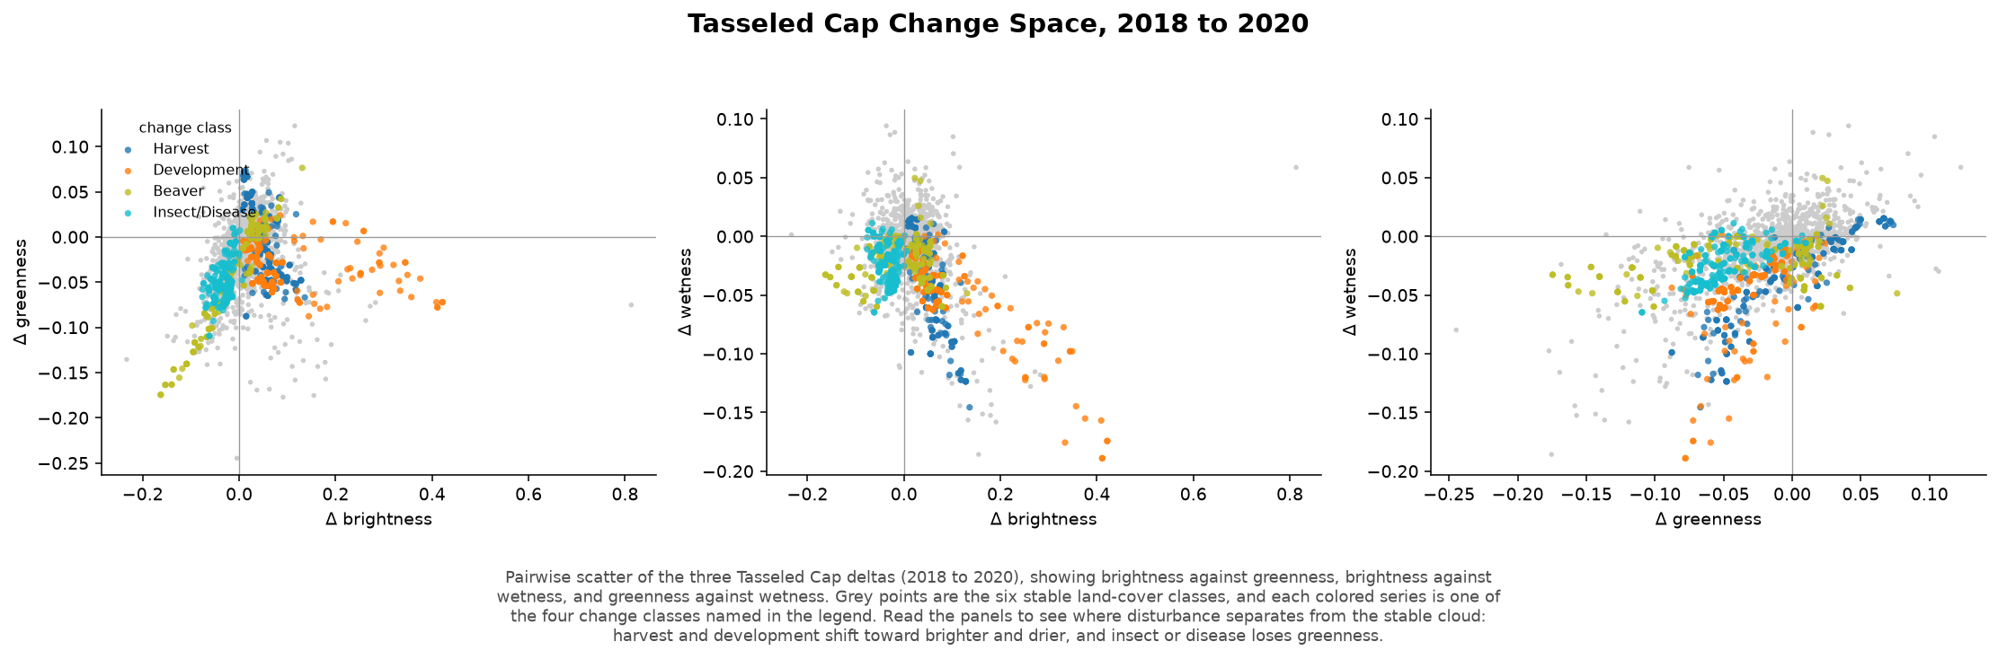
Tasseled Cap diagnostics
Notes:
Delta scatter, mean-delta signature, and linear discriminant projection.

Slide 55
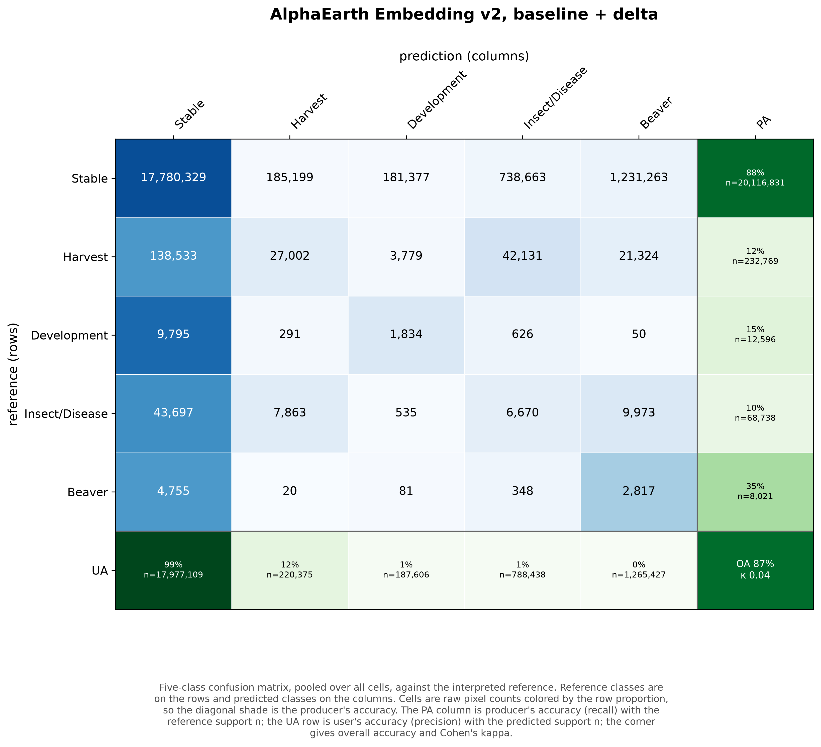
Confusion matrix, v2
Notes:
Five-class collapse, counts colored by row proportion. Shows which classes absorb the change pixels.

Slide 56
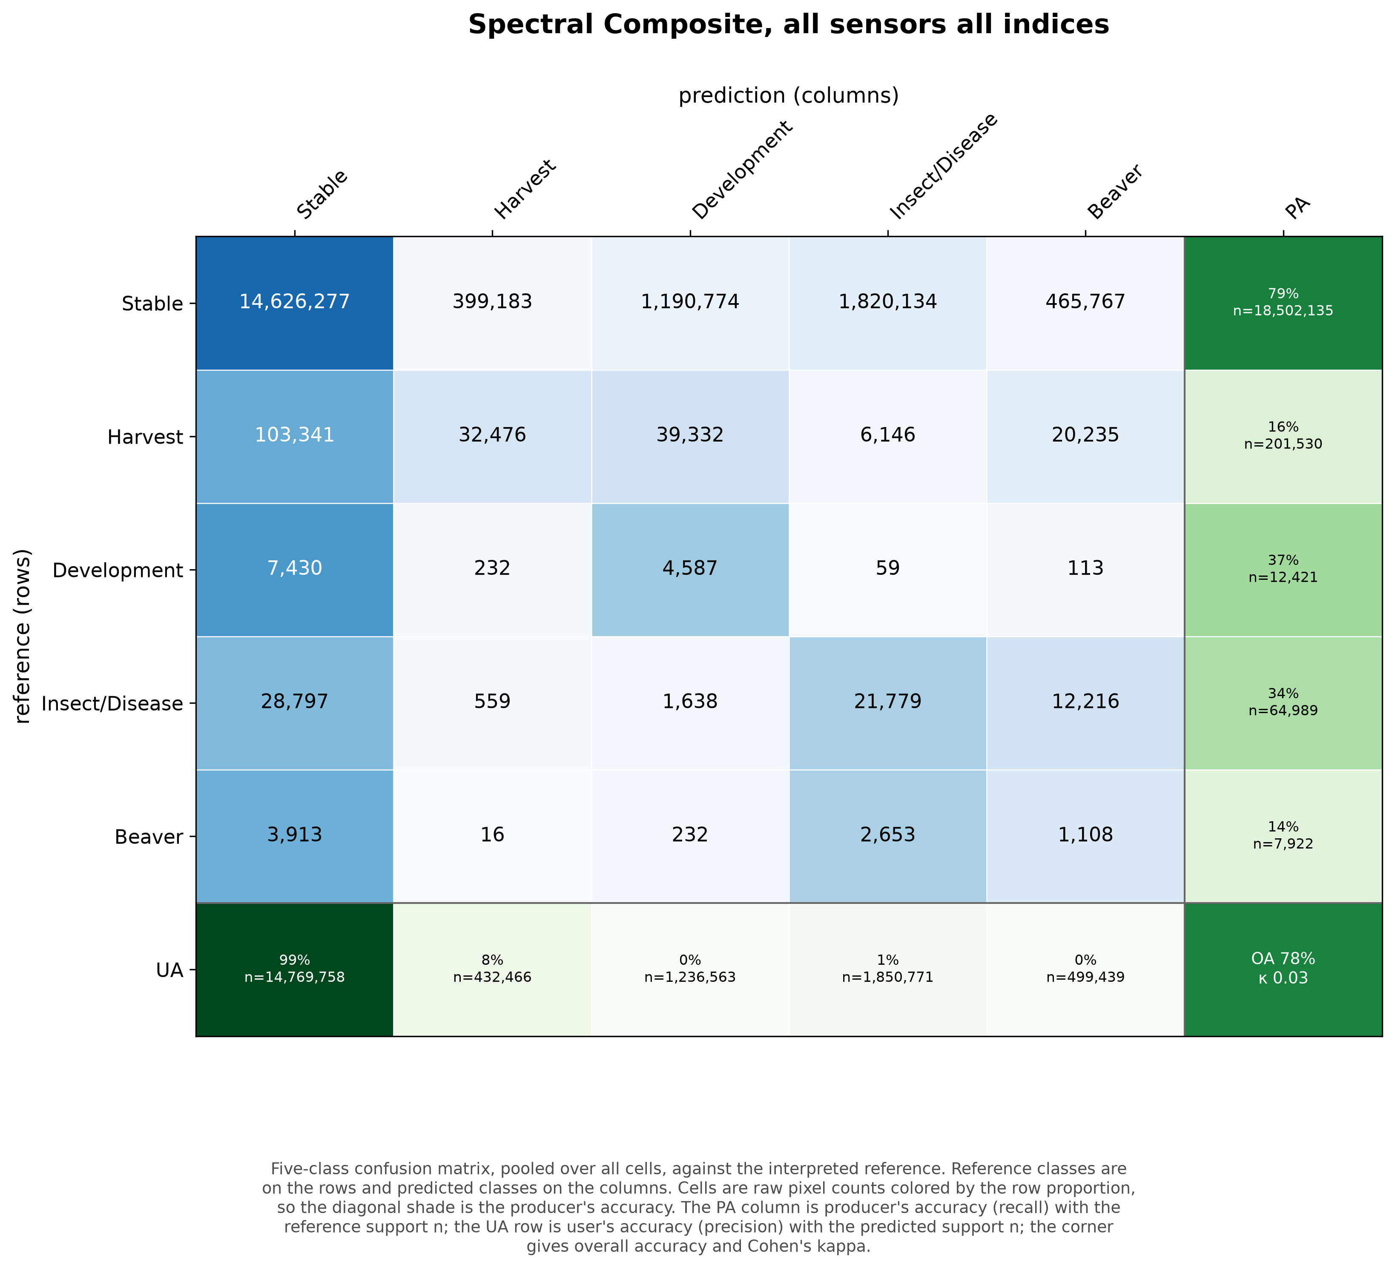
Confusion matrix, spec_all
Notes:
The spectral baseline on 168 cells.

Slide 57
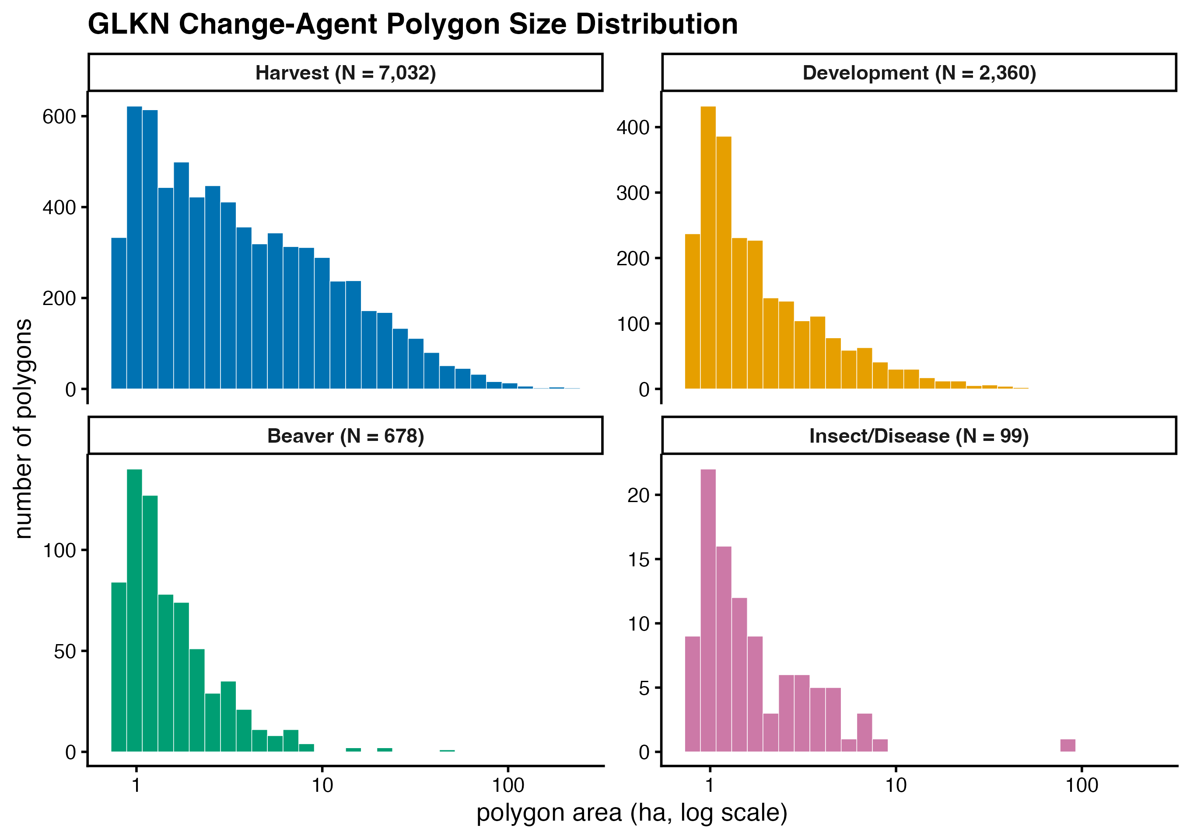
Change-polygon size by agent
Notes:
GLKN polygon area by agent, log hectares, 2010 to 2020. Median areas are similar; counts differ by orders of magnitude.

Slide 58
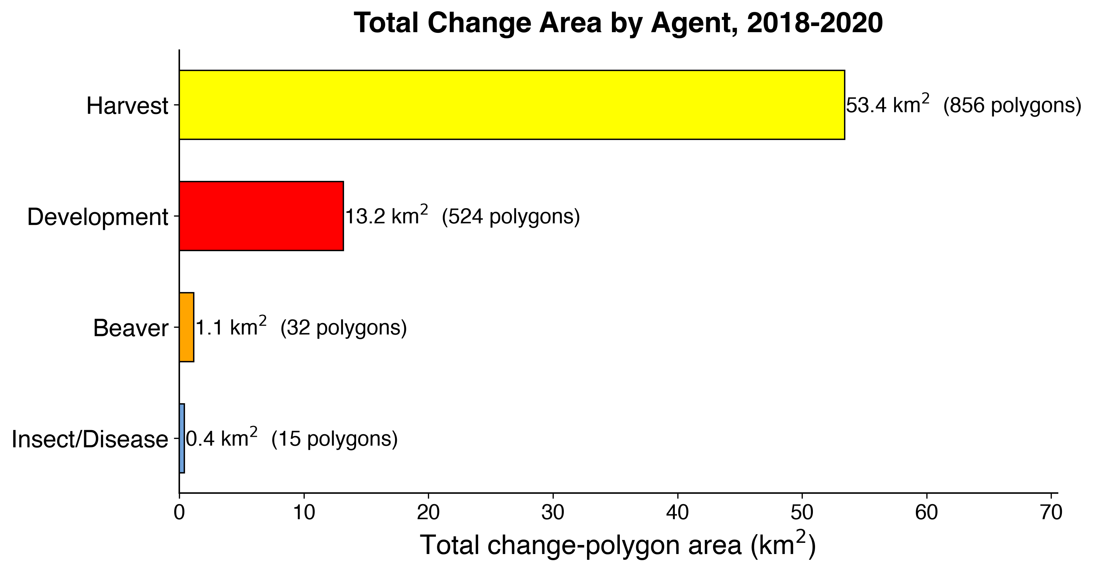
Total polygon area by agent
Notes:
Restricted to the 2018 to 2020 classification window.

Slide 59
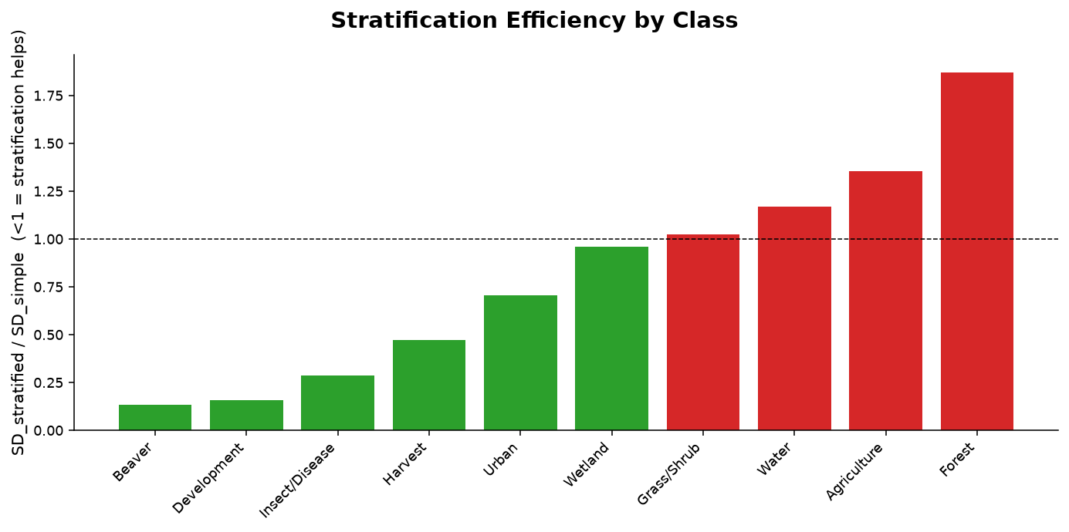
Stratification efficiency
Notes:
Ratio of stratified to simple-random standard deviation. Below one means stratification helps.

Slide 60
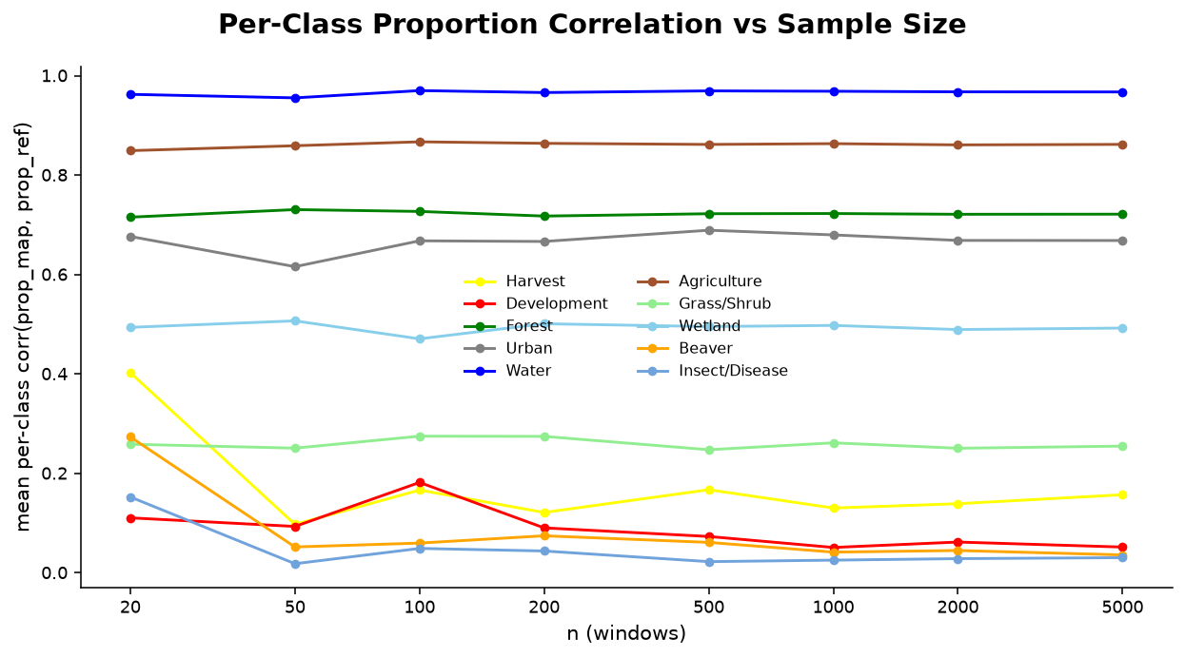
Approach D proportion correlation
Notes:
Per-class correlation of map against reference area proportions with sample size.

Slide 61
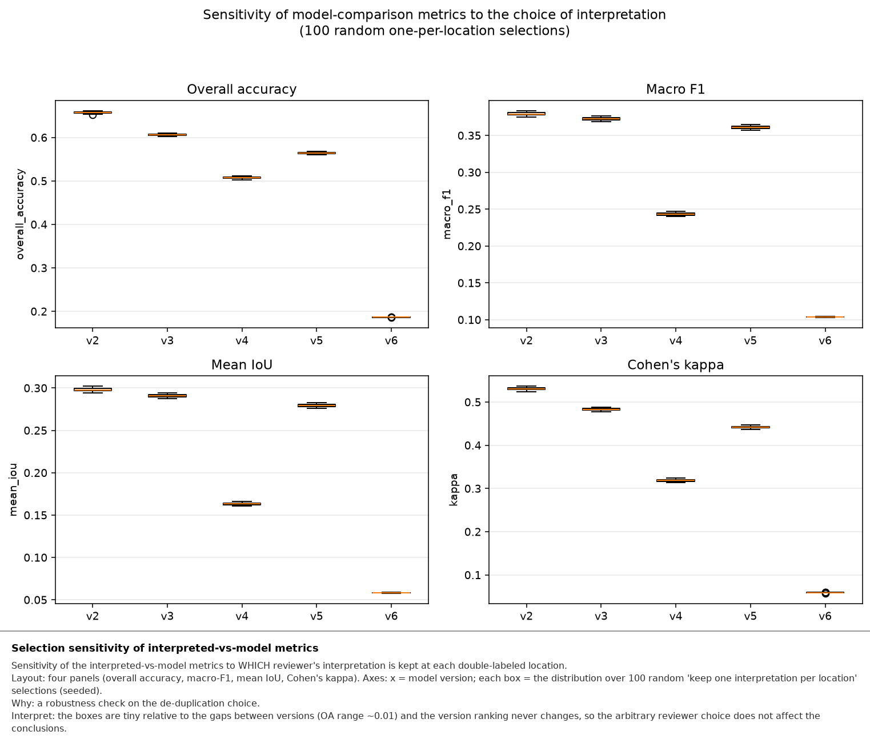
Dedup-selection sensitivity
Notes:
Overall accuracy across 100 random pick-one-interpretation draws. Spread under one accuracy point.

Slide 62
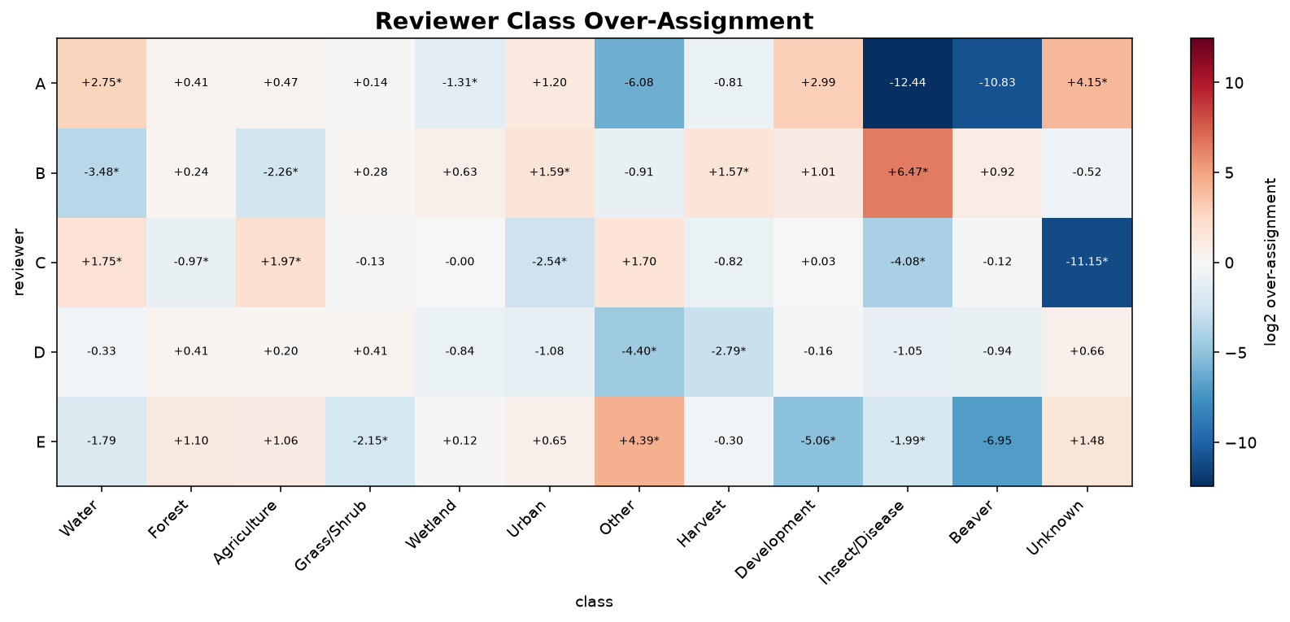
Reviewer over-assignment
Notes:
Log ratio of pixels a reviewer claims that the partner does not, against the reverse. Use if asked whether one interpreter drives the disagreement.

