Slide 1
Structuring satellite embeddings for multi-class landscape change attribution
Mina Burns
PhD defense, 7 August 2026
eMapR Lab, Oregon State University
Advisor: Robert Kennedy
Notes:
Thank the committee. One sentence of orientation: this thesis is about two things that turn out to be the same thing, how you represent satellite data for change attribution, and how you find out whether the resulting map is any good. Keep this to about 30 seconds.

Slide 2
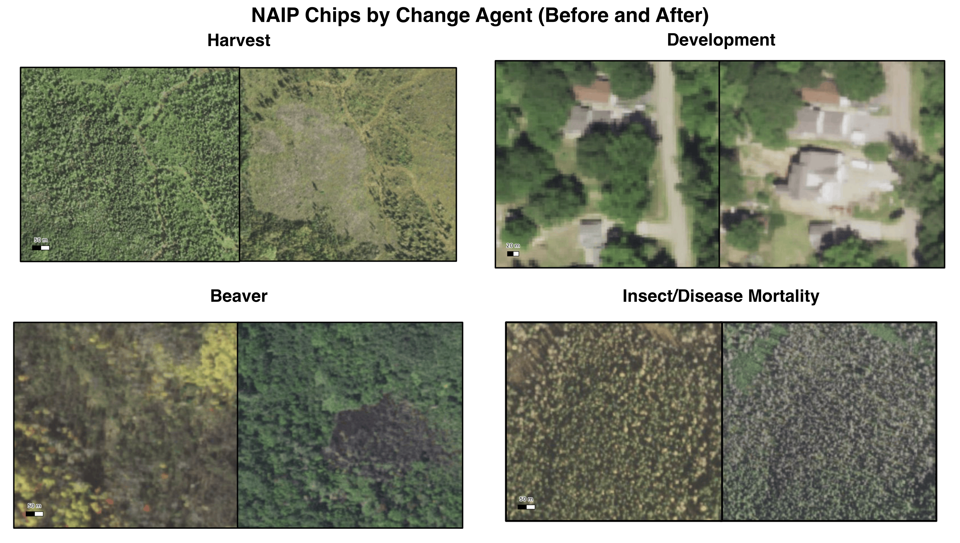
Four agents of change in the western Great Lakes
Notes:
Set up the problem physically before any methods. Harvest and development are abrupt and geometric. Beaver flowage and insect and disease mortality are diffuse, irregular, and often partial canopy loss rather than removal. Point out that a human looking at NAIP can usually name the agent, which is what makes this an attribution problem rather than a detection problem. Do not linger, about 45 seconds.

Slide 3
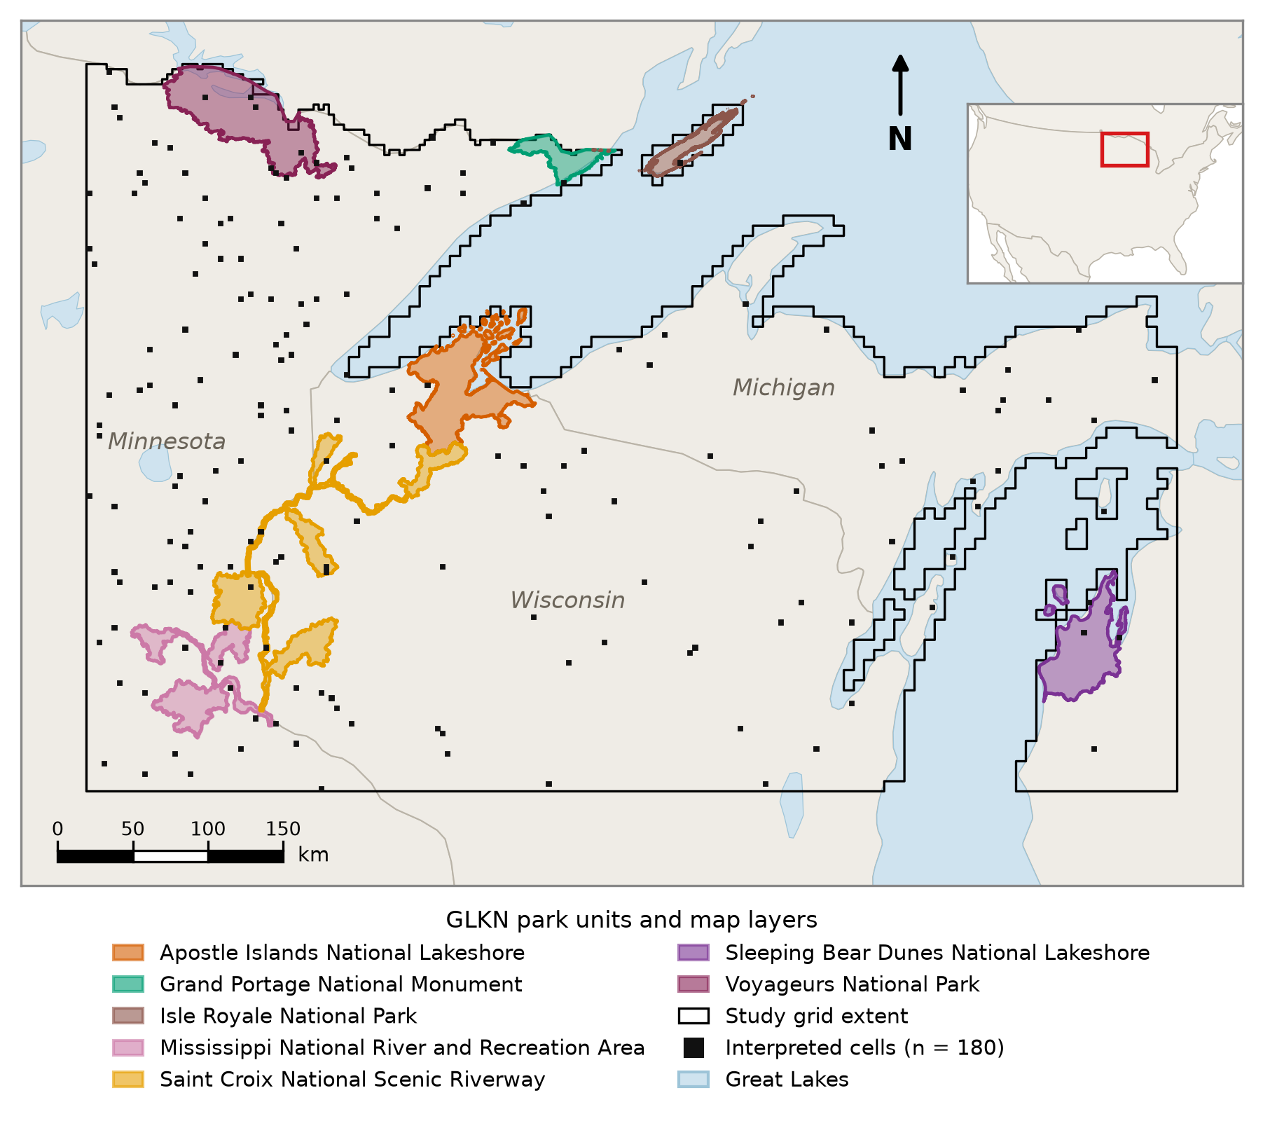
Study area and reference watersheds
Notes:
Three states, Minnesota, Wisconsin, and the Michigan Upper Peninsula, terrestrial only, Great Lakes excluded. The study grid is a continuous frame of roughly 21,561 cells at 112 pixels, EPSG:5070. The seven GLKN park units shown are the source of the attributed change training polygons, and they occupy a small fraction of the grid. The 180 black squares are the interpreted validation cells, distributed across the full grid rather than confined to the parks. Be explicit about that distinction, since it is the single most common misreading of this design.

Slide 4
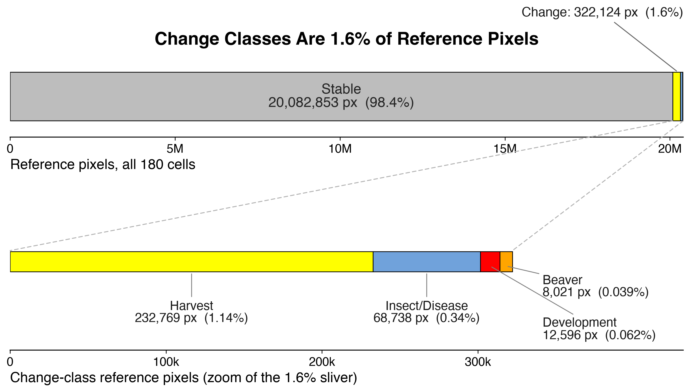
Change is rare
Notes:
The four change classes together are about 1.6 percent of interpreted reference pixels. That number is the complement of the all-Stable baseline accuracy that appears later, so plant it here and call back. Rarity is not a nuisance to be handled, it is the defining property of the problem and it drives three separate results in this talk: what the classifiers can learn, how many samples you need to see a class at all, and how much interpreters agree.

Slide 5
Why change attribution is hard
Rare. Change is a small fraction of the landscape, and the agents differ in abundance by orders of magnitude
Spatially clustered. Change occurs in patches, so nearby pixels carry redundant information
Conceptually ambiguous. For some classes, trained interpreters looking at the same ground disagree on the label
Notes:
This is the thesis in one slide. Each adjective maps to one act of the talk. Rare drives the sampling results, clustered drives the design effect and the spatial coherence results, ambiguous drives the reference reliability results. Tell the audience that explicitly so they have a scaffold for the next 35 minutes.

Slide 6
Two questions
How should satellite embeddings be structured to represent both baseline condition and interannual change?
How should the resulting maps be validated, given a reference that is itself produced by human interpretation?
The two turn out to be linked. The property that distinguishes representations is the property conventional assessment is least able to see.
Notes:
Chapter 2 answers the first, Chapter 3 the second. Flag the third bullet as the punchline and say you will come back to it. Do not explain it yet.

Slide 7
Ten-class scheme
Code | Class | Type
1 | Harvest | Change
2 | Development | Change
3 | Forest | Stable
4 | Urban | Stable
5 | Water | Stable
6 | Agriculture | Stable
7 | Grass/Shrub | Stable
8 | Wetland | Stable
9 | Beaver | Change
10 | Insect/Disease Mortality | Change
Five-class collapse: the six stable classes become Stable, the four change classes are retained, Unknown excluded.
Notes:
Six stable classes, four change classes. Mention the five-class collapse now, since most results are reported both ways, and say that the collapse is defined once and applied identically everywhere. Roughly 40 seconds.

Slide 8
Part one
How the data are represented
Notes:
Brief pause. This is Chapter 2 territory.

Slide 9
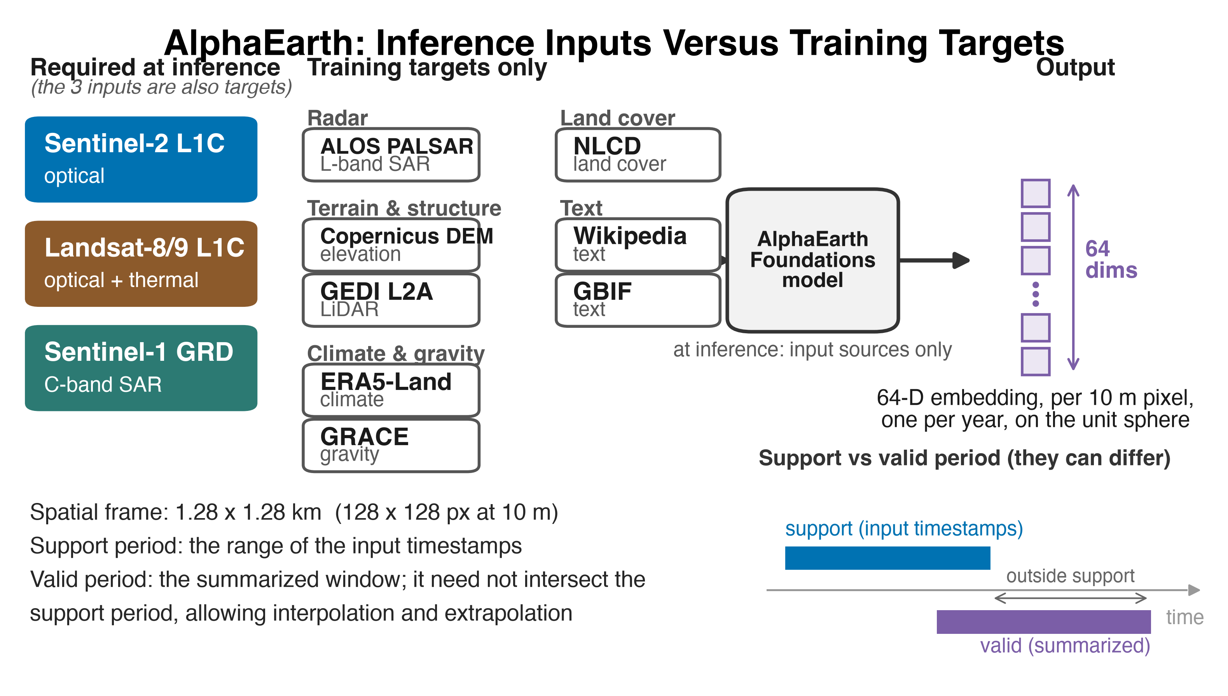
AlphaEarth Foundations
Notes:
Three points. First, only three sources are required at inference, Sentinel-2, Landsat 8 and 9, and Sentinel-1, while eleven sources were used as training targets, including GEDI, ERA5-Land, GRACE, and NLCD. Second, the spatial context is 1.28 km frames, 128 by 128 pixels at 10 m. Third, the support period is the range of input timestamps and the valid period is the window summarized, and they need not coincide. Flag NLCD as a training target yourself. Your stable classes map closely onto NLCD classes, which plausibly contributes to strong stable-class performance and explains nothing about the change classes. Raising it first is much better than answering it cold.

Slide 10
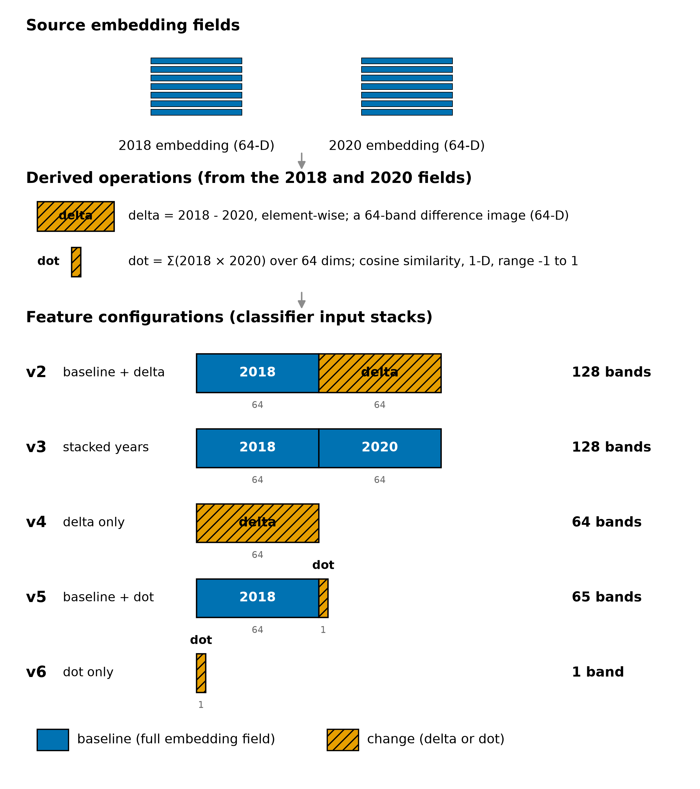
Five embedding configurations
Notes:
The design variable is whether the representation retains a full baseline embedding or reduces change to a magnitude. v2 and v3 preserve the baseline, v5 adds the dot product to the baseline, v4 is delta only, v6 is dot product only. Everything downstream is held constant, same classifier, same training points, same reference. That control is what lets you attribute differences to representation.

Slide 11
Spectral baseline
spec_all: Sentinel-2, Landsat 8, and Sentinel-1 composites, roughly 50 bands
Those are exactly the three sources AlphaEarth requires at inference time
So the comparison holds the input information constant and varies only the representation
Notes:
This is a stronger control than most embedding versus spectral comparisons in the literature, which compare against whatever baseline was convenient. Say so plainly. If asked, the AlphaEarth paper Table S1 lists these three as the only sources marked input, everything else is a training target only.

Slide 12
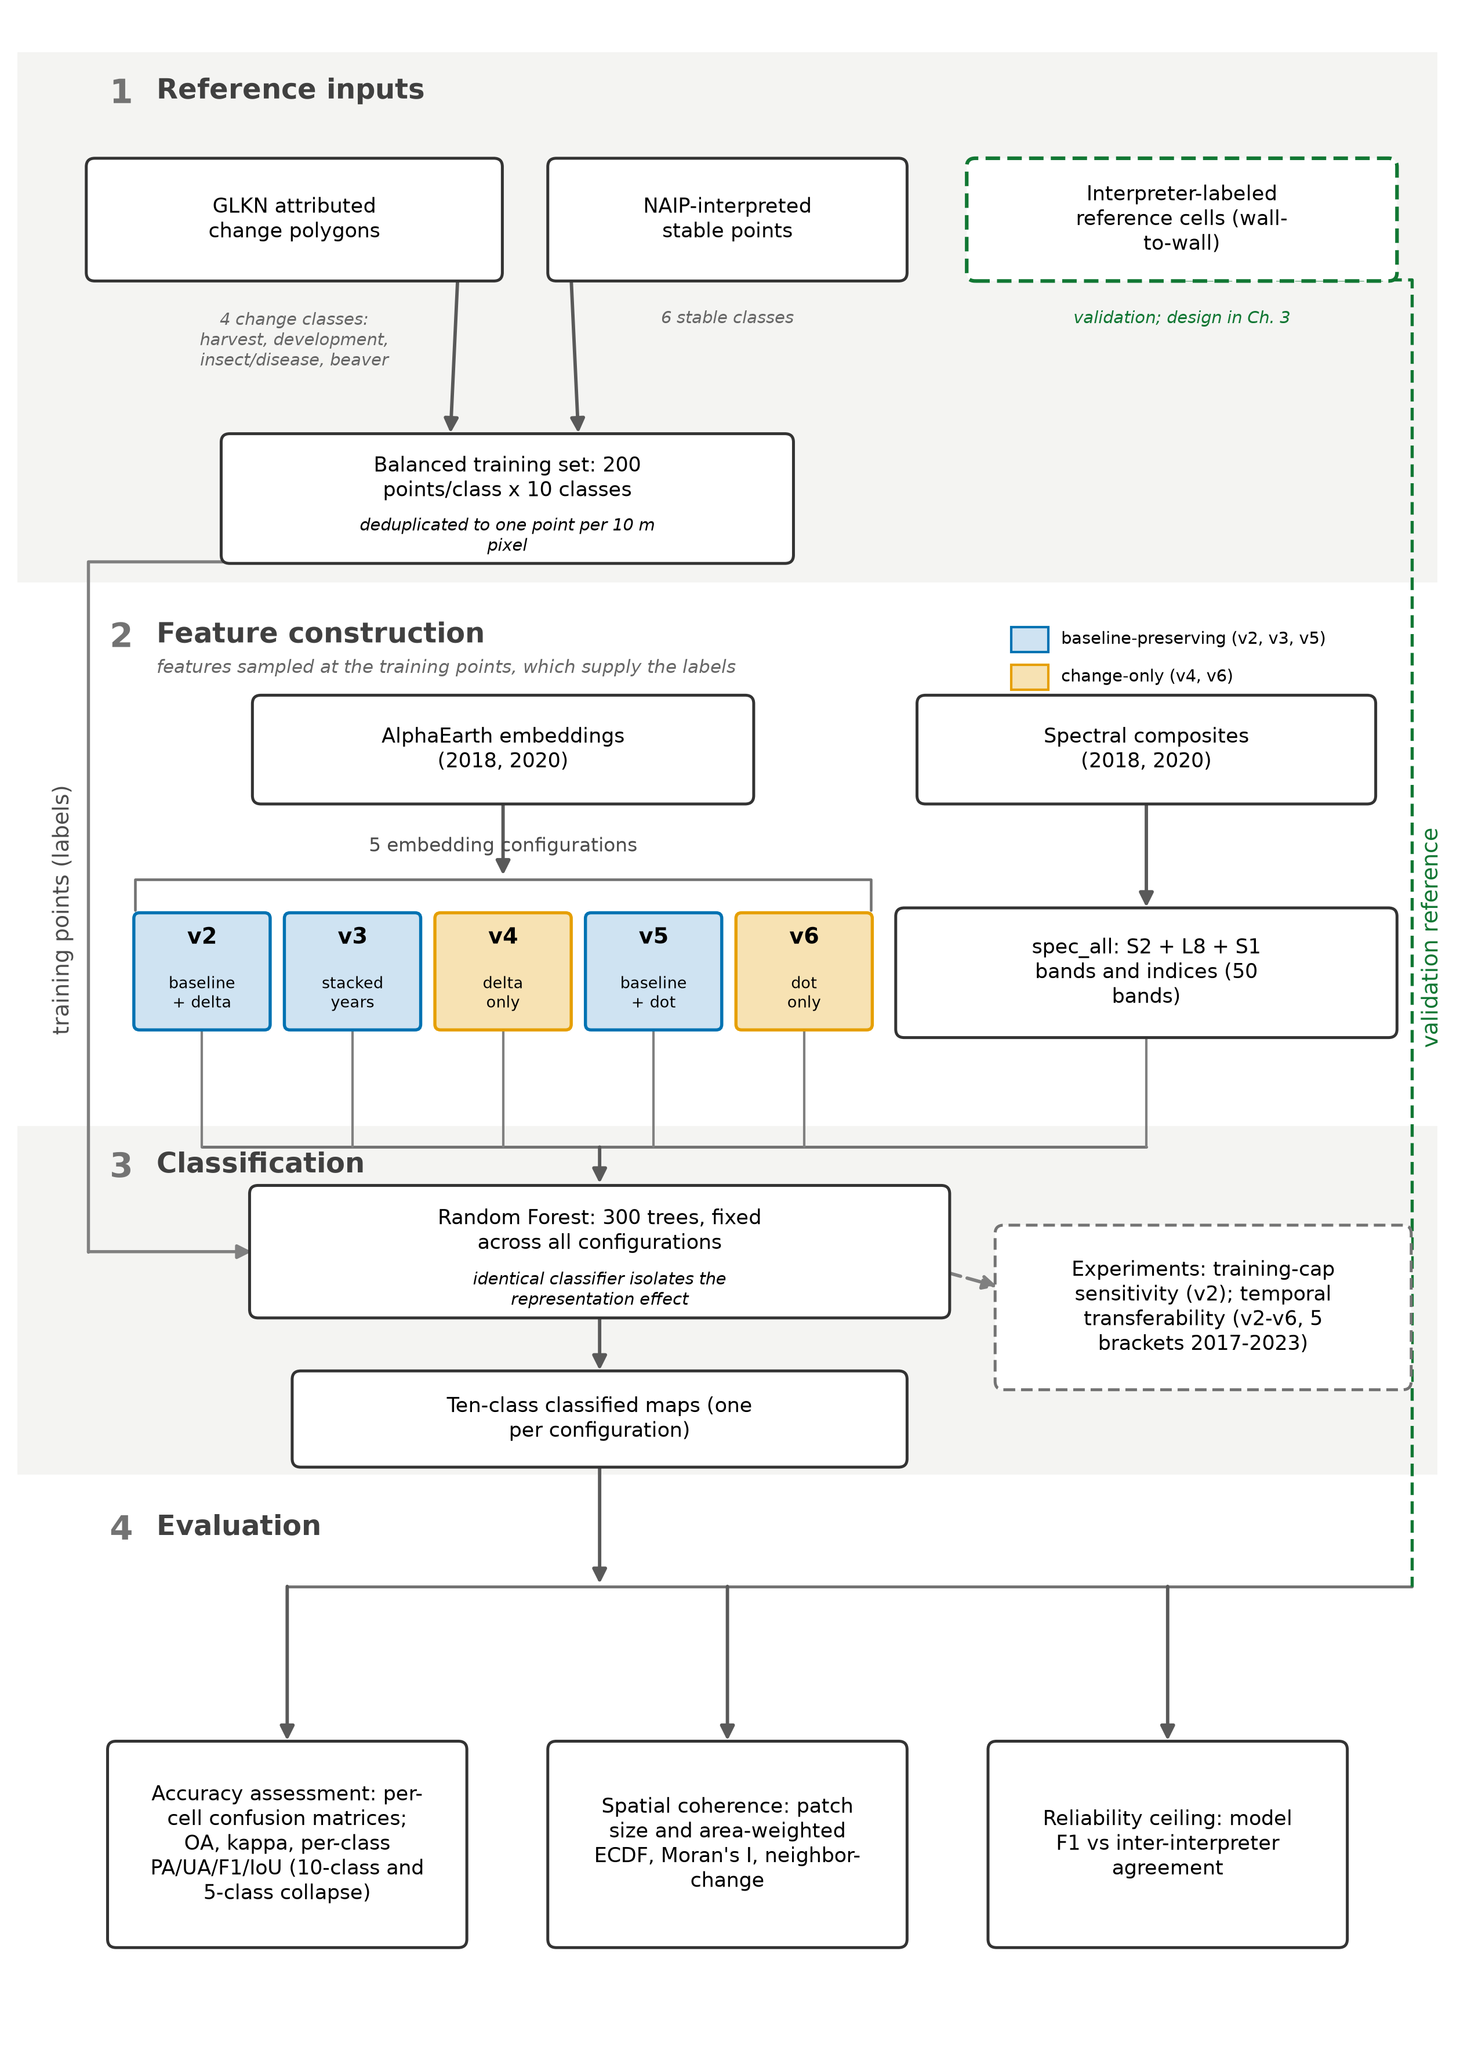
Workflow
Notes:
Move quickly. One line on the classifier: Random Forest, 300 trees, identical across every configuration. Do not explain Random Forest, the committee knows it and explaining it invites the question of why you are explaining it.

Slide 13
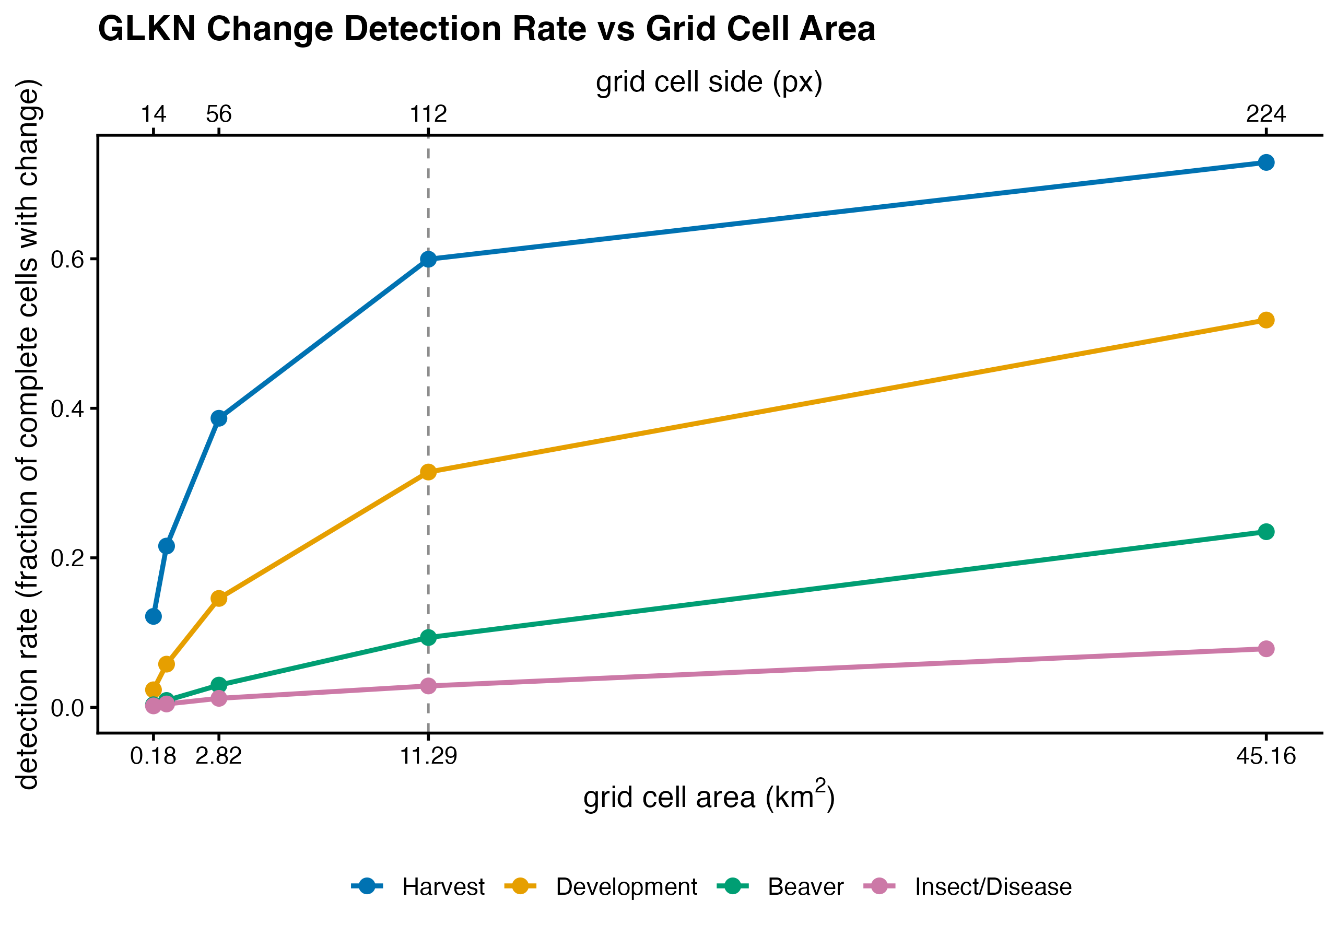
Choosing the assessment unit
Detection rate rises with cell size for every agent
Harvest and development are detected far more often than beaver and insect or disease at every scale
112 px, 3,360 m, 11.29 km2 selected
Notes:
At the selected 112 px cell, harvest appears in about 60 percent of complete cells, development in 31 percent, beaver in 9 percent, and insect and disease in 3 percent. That gradient is the rarity slide again, now expressed as a sampling constraint. The cell size is a compromise between detecting rare agents and keeping interpretation tractable.

Slide 14
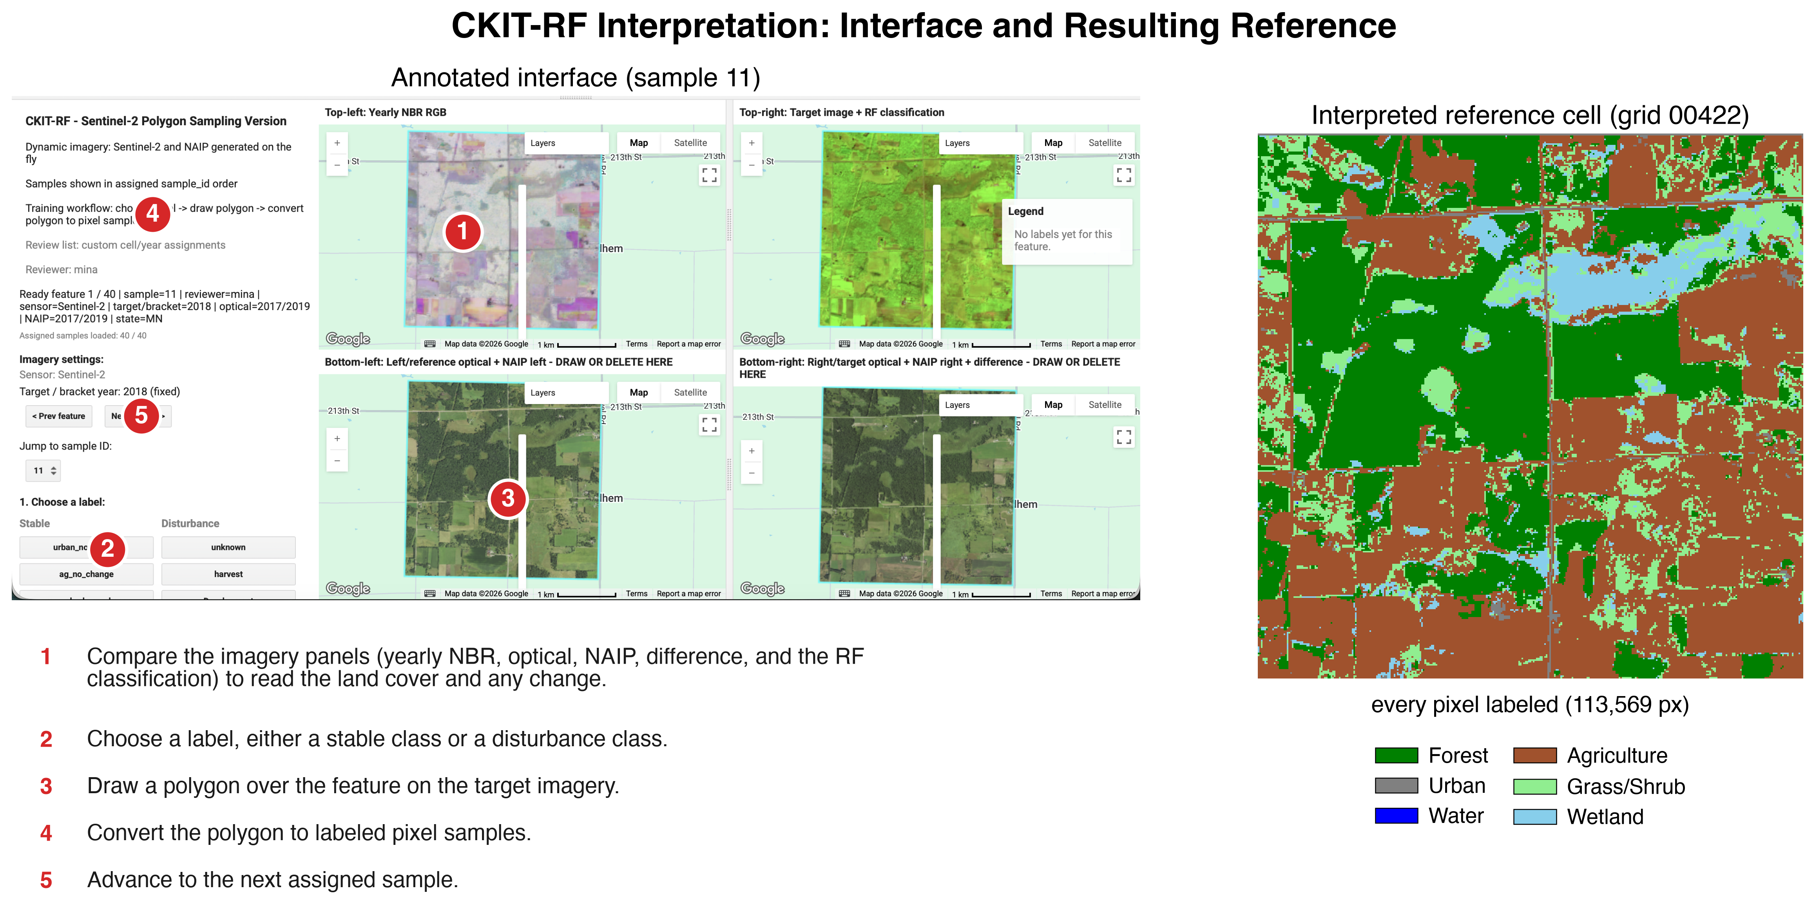
Interpretation interface
Notes:
CKIT-RF. An interpreter views NAIP for both dates, places labeled training points within the cell, and a within-cell Random Forest propagates those labels to every pixel. The output is a wall-to-wall labeled cell, not a set of points. Five interpreters, 180 cells, 72 of them interpreted independently by two people. That 72-cell overlap is what makes Chapter 3 possible.

Slide 15
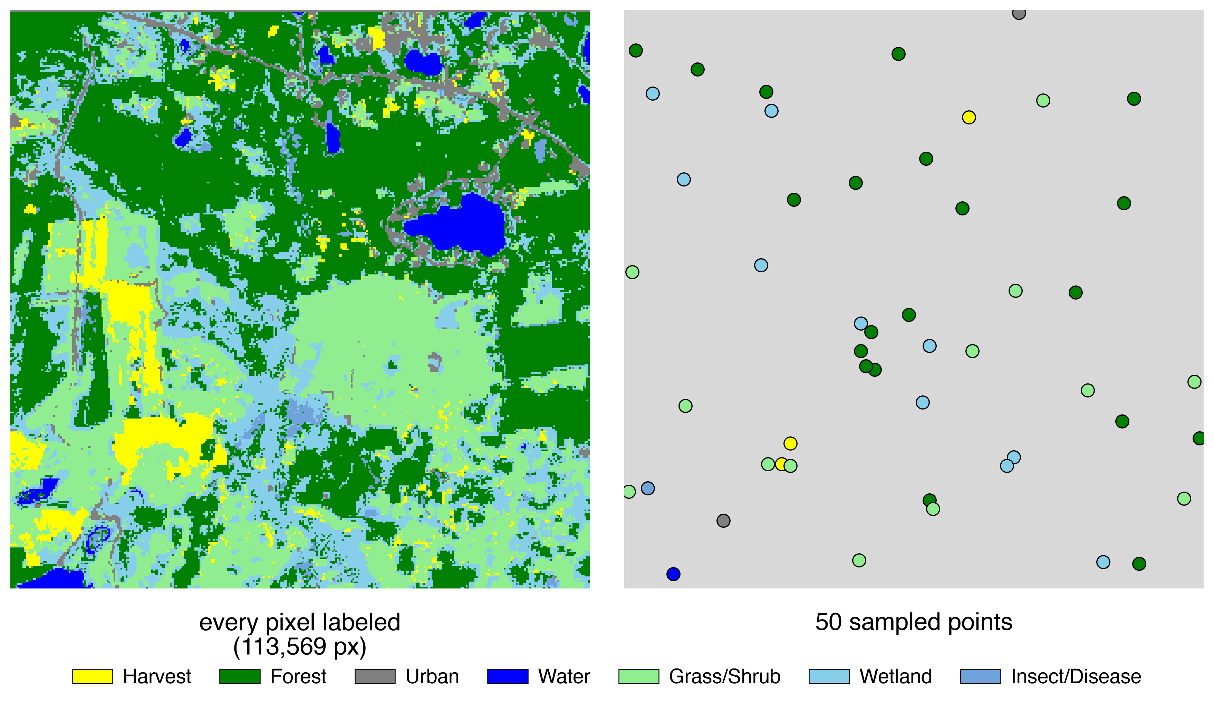
A census within each cell, not scattered points
Every pixel in the cell carries a reference label
A point sample of the same cell supports no statement about spatial structure
This choice is what makes the Chapter 2 comparison possible
Notes:
This is the design decision the whole talk turns on, so slow down here. The left panel is what we have, the right is what a conventional assessment would have. Tell them you will return to this in the final act and show, on simulated landscapes where truth is known, that the right panel cannot rank two maps that the left panel ranks cleanly. About one minute.

Slide 16
Results, part one
Representation determines spatial structure

Slide 17
Aggregate accuracy, ten-class
Source | OA | Kappa | Macro-F1 | Mean IoU | Cells
v2 | 0.659 | 0.536 | 0.383 | 0.301 | 180
v3 | 0.635 | 0.514 | 0.381 | 0.299 | 180
v4 | 0.245 | 0.123 | 0.162 | 0.096 | 180
v5 | 0.593 | 0.472 | 0.365 | 0.285 | 180
v6 | 0.130 | 0.040 | 0.089 | 0.049 | 180
spec_all | 0.588 | 0.461 | 0.362 | 0.275 | 168
Pooled across five NAIP brackets against the adjudicated reference.
Notes:
The baseline-preserving configurations, v2, v3, and v5, sit between 0.59 and 0.66, and the spectral baseline at 0.588 is within that band. v4 and v6, the ones that discard the baseline, collapse. First conclusion: retaining a baseline embedding matters more than anything else in this comparison, and embeddings do not beat a matched spectral composite on aggregate accuracy.

Slide 18
Every configuration loses to a trivial baseline
Source | Five-class OA | Kappa | Macro-F1
Predict Stable everywhere | 0.984 | 0.000 | n/a
v2 | 0.872 | 0.043 | 0.218
v3 | 0.828 | 0.021 | 0.203
v4 | 0.894 | 0.074 | 0.224
v5 | 0.793 | 0.014 | 0.190
v6 | 0.596 | 0.005 | 0.157
Design-based five-class metrics.
Notes:
Raise this yourself, do not wait to be asked. Predicting Stable everywhere gives 98.4 percent overall accuracy and every configuration falls below it. This is not a defect in the maps, it is a demonstration that overall accuracy is uninformative when the class of interest is 1.6 percent of the landscape. It is the strongest possible motivation for everything in Chapter 3. Note also that v4 is best on this metric and fourth of five on ten-class accuracy, which is the inversion the next slides explain.

Slide 19
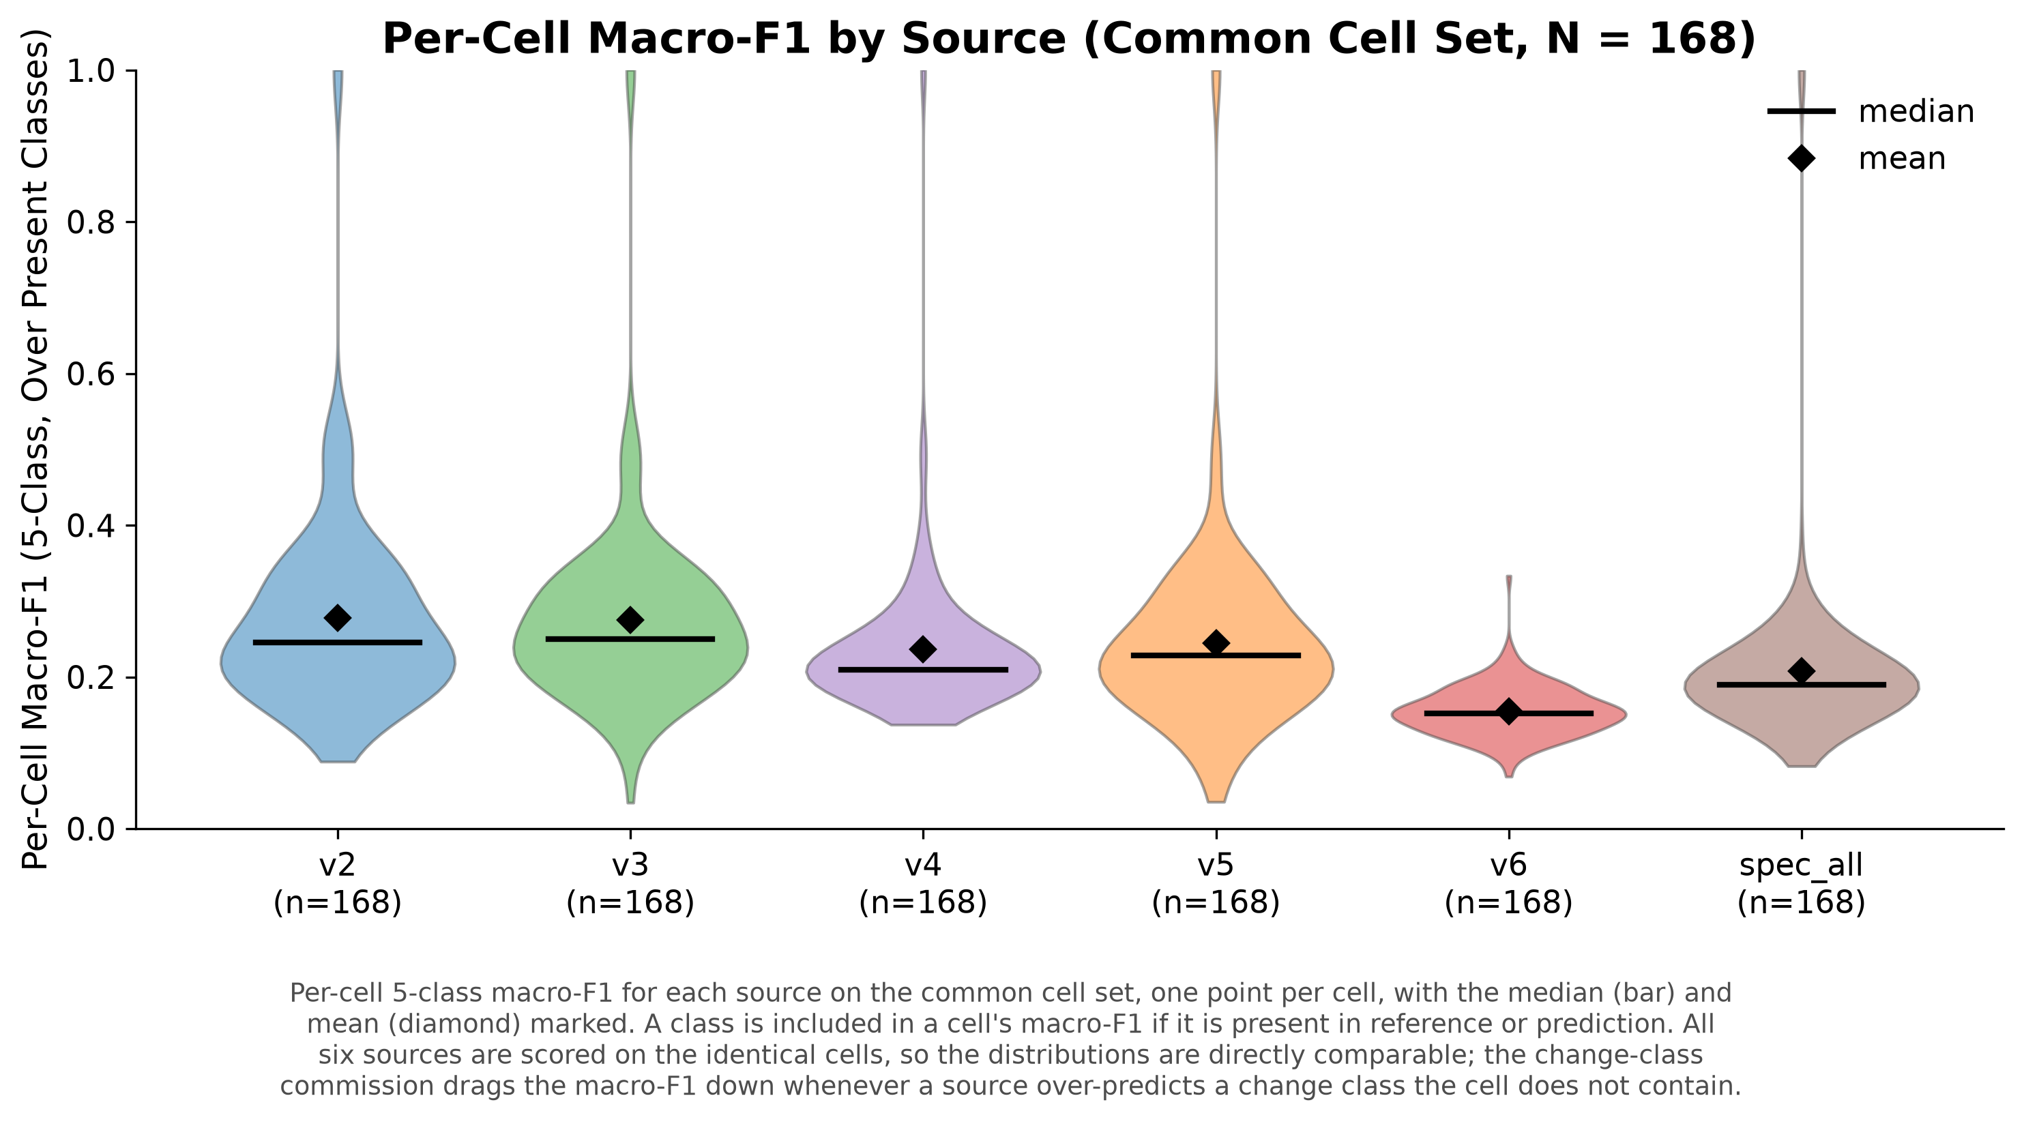
Per-cell macro-F1
Notes:
One point per cell on the common 168-cell set, so the comparison is on identical footprints. The distributions overlap heavily for v2, v3, v5, and spec_all. Aggregate ranking is not stable across cells, which is a first hint that a single number is hiding structure.

Slide 20
Per-class F1, ten-class
Class | v2 | v3 | v4 | v5 | v6 | spec_all
Water | 0.938 | 0.938 | 0.300 | 0.933 | 0.150 | 0.940
Agriculture | 0.800 | 0.806 | 0.477 | 0.797 | 0.265 | 0.620
Forest | 0.793 | 0.767 | 0.351 | 0.718 | 0.188 | 0.770
Urban | 0.466 | 0.497 | 0.052 | 0.481 | 0.041 | 0.453
Wetland | 0.431 | 0.409 | 0.097 | 0.405 | 0.109 | 0.373
Grass/Shrub | 0.246 | 0.280 | 0.168 | 0.256 | 0.099 | 0.332
Harvest | 0.119 | 0.083 | 0.146 | 0.041 | 0.023 | 0.102
Development | 0.018 | 0.007 | 0.005 | 0.006 | 0.004 | 0.007
Insect/Disease | 0.016 | 0.017 | 0.008 | 0.012 | 0.006 | 0.023
Beaver | 0.004 | 0.003 | 0.012 | 0.003 | 0.001 | 0.004
Sorted by v2 F1. The four change classes are at the bottom.
Notes:
Do not soften this. The stable classes are respectable and the change classes are close to failures, uniformly across every configuration including the spectral baseline. Uniformity is the informative part: if representation were the binding constraint, the configurations would differ. They do not. That points at something the classifiers share, which is the reference, and that is Chapter 3. Expect the committee to press here, so state the honest position now and again at the ceiling slide.

Slide 21
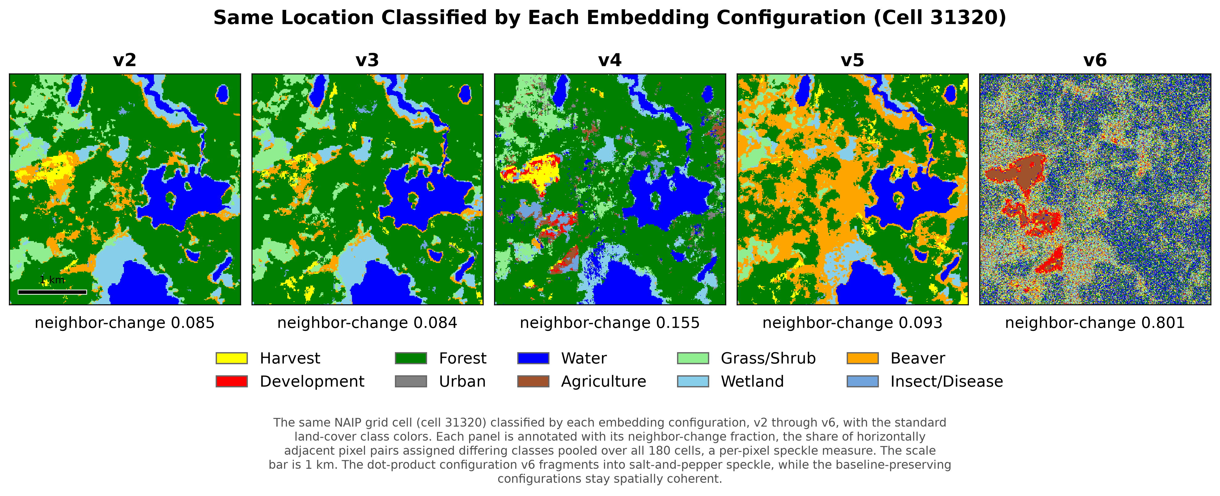
The same ground, five configurations
Notes:
This is the central slide of Chapter 2. Same cell, same classifier, same training data, only the feature representation differs. v2, v3, and v5 give contiguous patches, v4 is grainy, v6 is salt and pepper with a neighbor-change value of 0.80. Let the audience look at it for a few seconds before you say anything. Then ask them which map they would hand to a park manager.

Slide 22
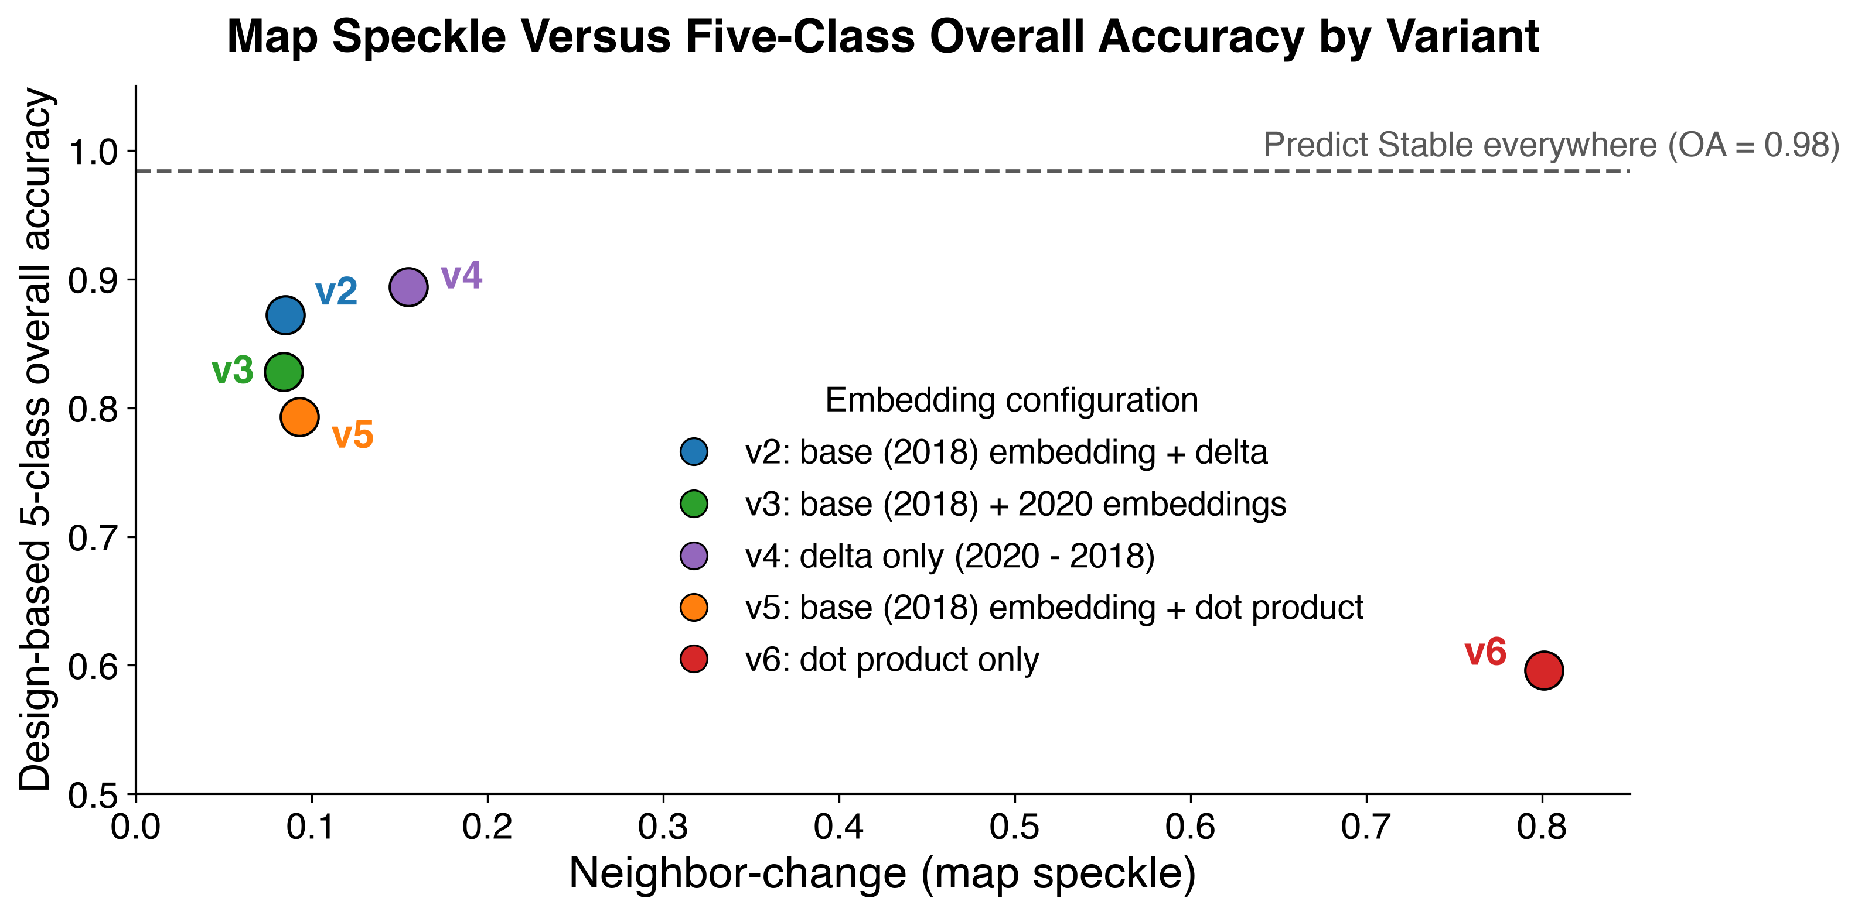
Accuracy and coherence come apart
v4 has the highest five-class accuracy and is among the most fragmented
The same configuration ranks fourth of five on ten-class accuracy
Every configuration falls below the all-Stable baseline
Notes:
The dissociation stated quantitatively. A configuration can top an aggregate metric while producing a map nobody would use. If asked about rank correlation, say that with five points a correlation coefficient describes those five points rather than supporting inference, and that the informative feature is the position of v4 rather than any trend.

Slide 23
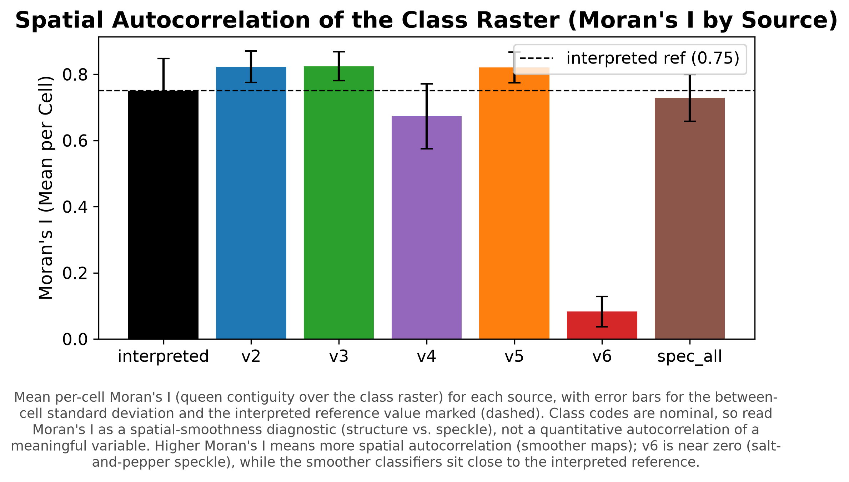
Spatial structure, quantified
Reference Moran's I 0.75, coherent variants 0.82
The maps are smoother than the reference, not just different
v6 at 0.08 confirms the visual read
Notes:
Be honest about the direction here. The coherent variants are more spatially autocorrelated than the interpreted reference, and their median-by-area patch size is smaller. So the failure mode is over-smoothing rather than fragmentation, and more coherent than truth is not automatically better. Expect a question on this and welcome it, since it is a genuinely interesting result.

Slide 24
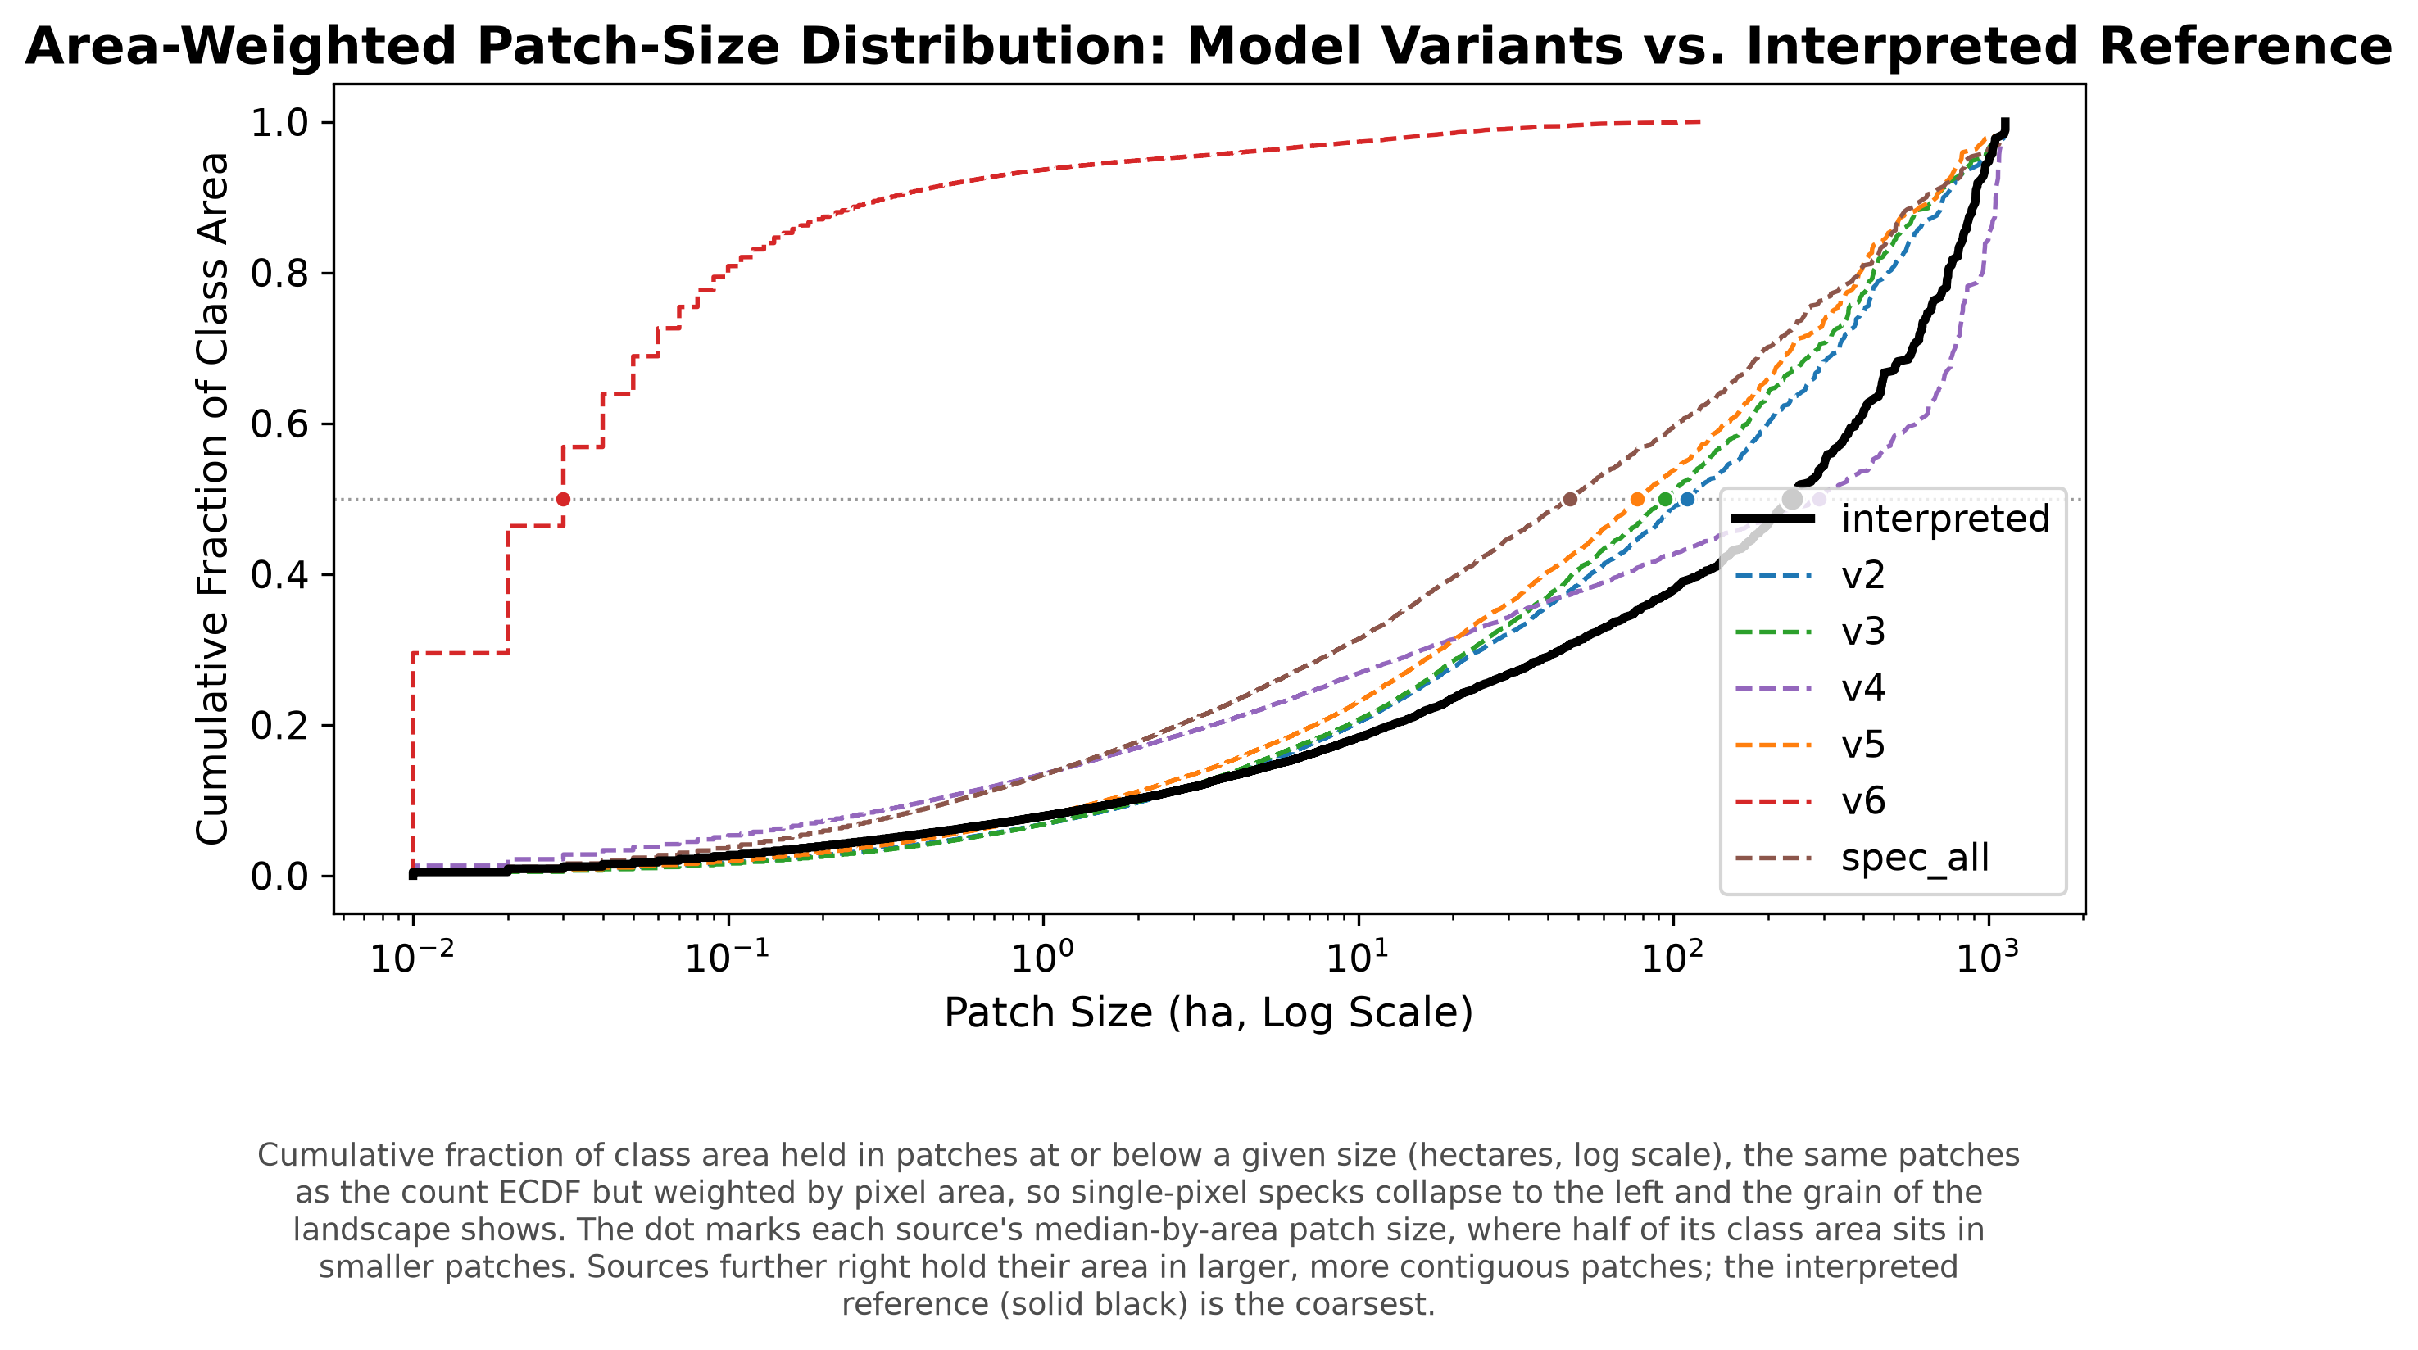
Patch size distributions
Notes:
Area-weighted cumulative distribution of patch size within the interpreted footprints. The reference has a median-by-area of about 239 hectares, v2 about 110, spec_all about 47, v6 essentially zero. The spectral baseline is more fragmented than the coherent embedding configurations, which is the answer if anyone asks why spec_all is missing from the speckle scatter.

Slide 25
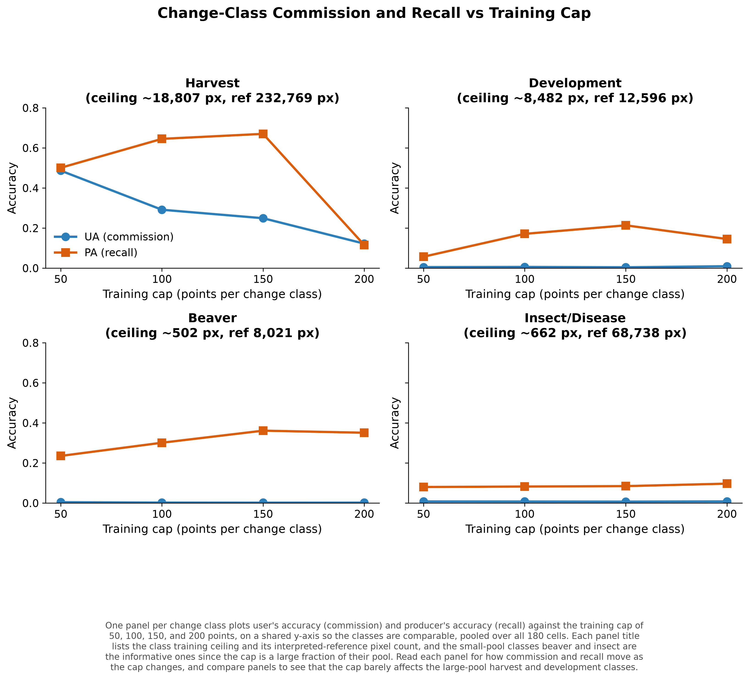
Training-cap sensitivity for the change classes
Notes:
Varying the change-class training cap over 50, 100, 150, and 200 points. Beaver has a training pool of only about 502 pixels, so the cap is a large fraction of what exists. Producer's accuracy moves and user's accuracy stays near zero, meaning the classifier can be pushed to find more beaver only by predicting far more beaver than exists. That is a precision problem the training budget cannot solve.

Slide 26
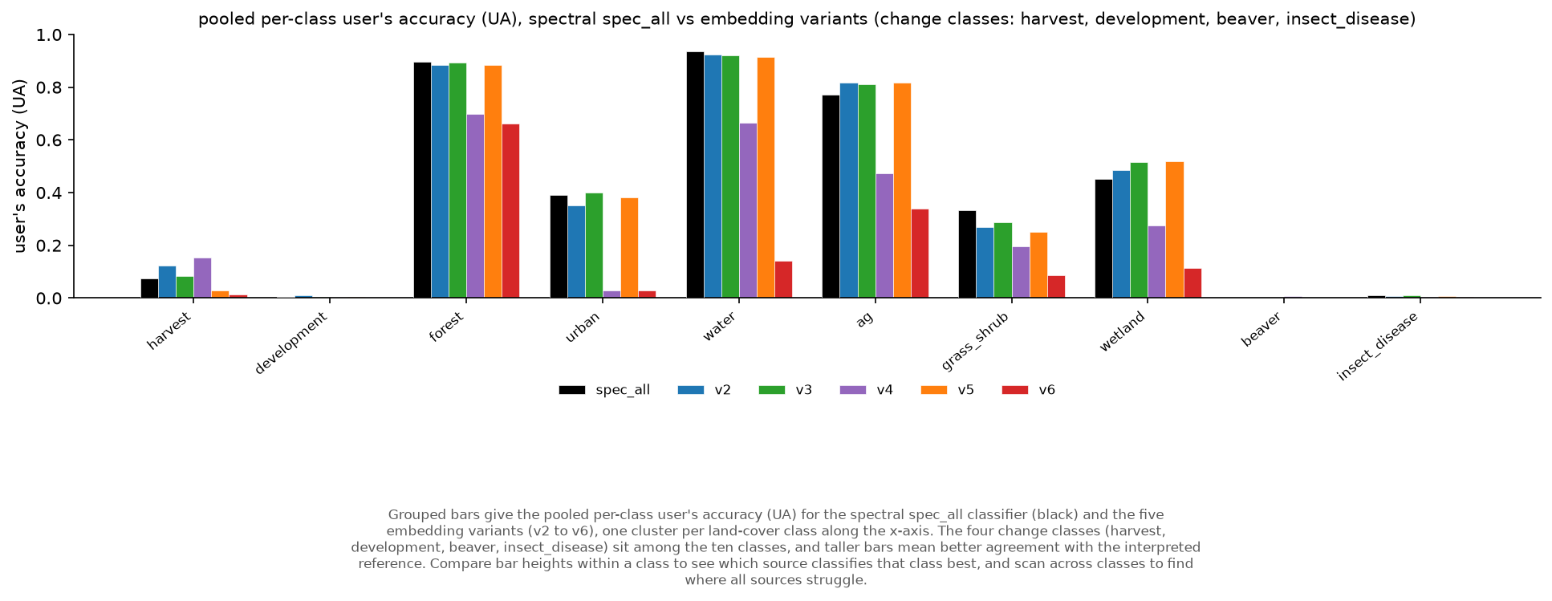
Embeddings against a matched spectral composite
Notes:
Same three sensors, different representation. The change classes are weak for both. Say the conclusion plainly: on this task, embeddings did not outperform a matched spectral composite on aggregate accuracy, and the interesting difference between them is spatial rather than statistical. Resisting the temptation to claim an embedding win is worth doing out loud.

Slide 27
Results, part two
The reference is the binding constraint

Slide 28
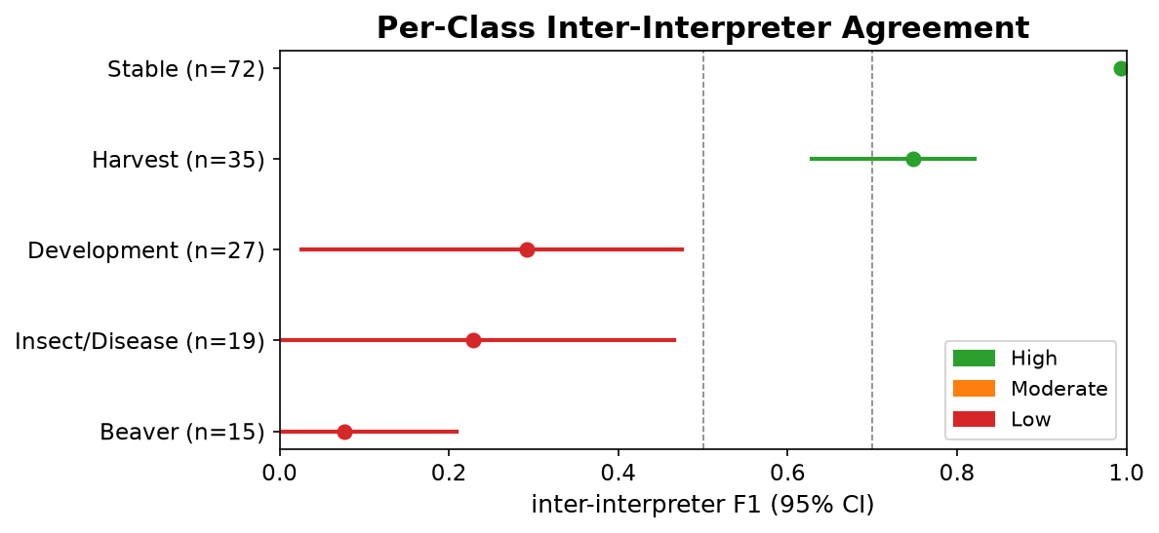
Interpreters disagree, and not at random
Stable 0.99, Harvest 0.75
Development 0.29, Insect/Disease 0.23, Beaver 0.08
Same classes the classifiers fail on
Notes:
Five interpreters, 72 double-interpreted cells, cluster bootstrap by pair. The classes with the lowest interpreter agreement are the same classes with the lowest classifier accuracy. Beaver agreement is 0.077, with a confidence interval reaching zero. Two trained people looking at the same imagery essentially do not agree on beaver.

Slide 29
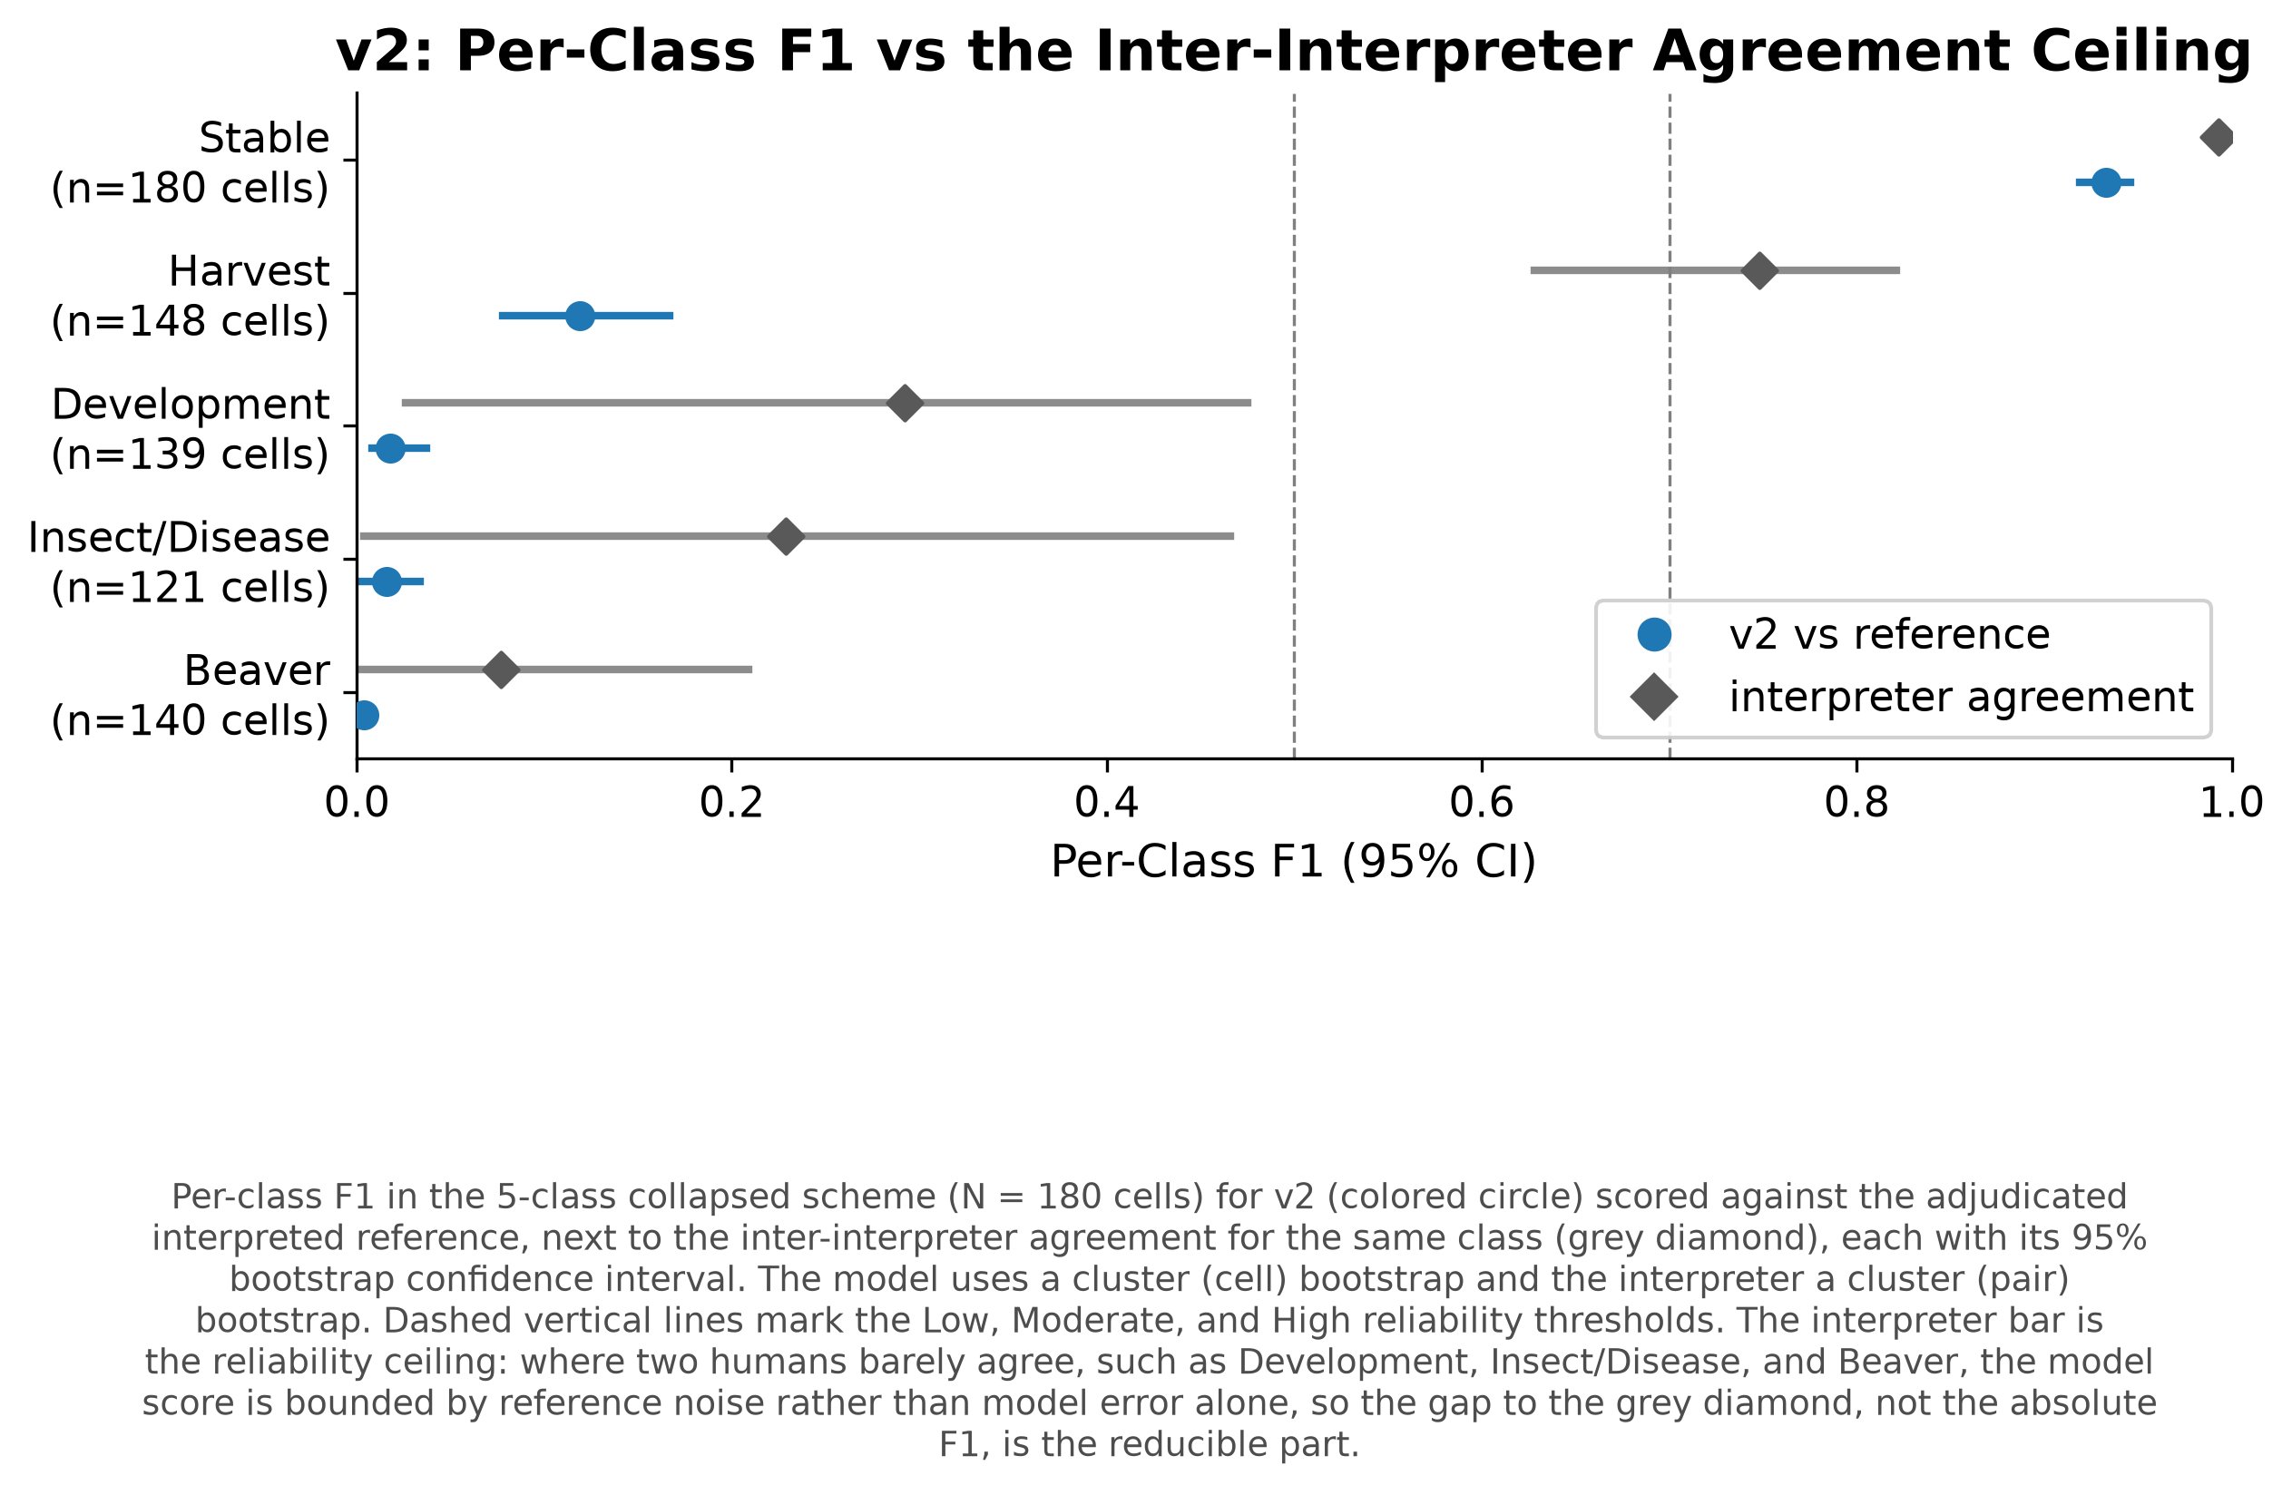
Model accuracy against the interpreter ceiling
Grey diamonds are the agreement ceiling
Stable classes approach it
Change classes fall below an already low ceiling
Notes:
State the honest version. The ceiling explains why these classes are hard and it does not close the gap. Beaver model F1 is 0.004 against a ceiling of 0.077, insect and disease 0.016 against 0.229. So the reference bounds what is achievable and the classifier does not reach that bound. Someone will do this arithmetic, so do it first. The defensible claim is that raising the classifier alone cannot fix these classes, not that the classifier is already at the limit.

Slide 30
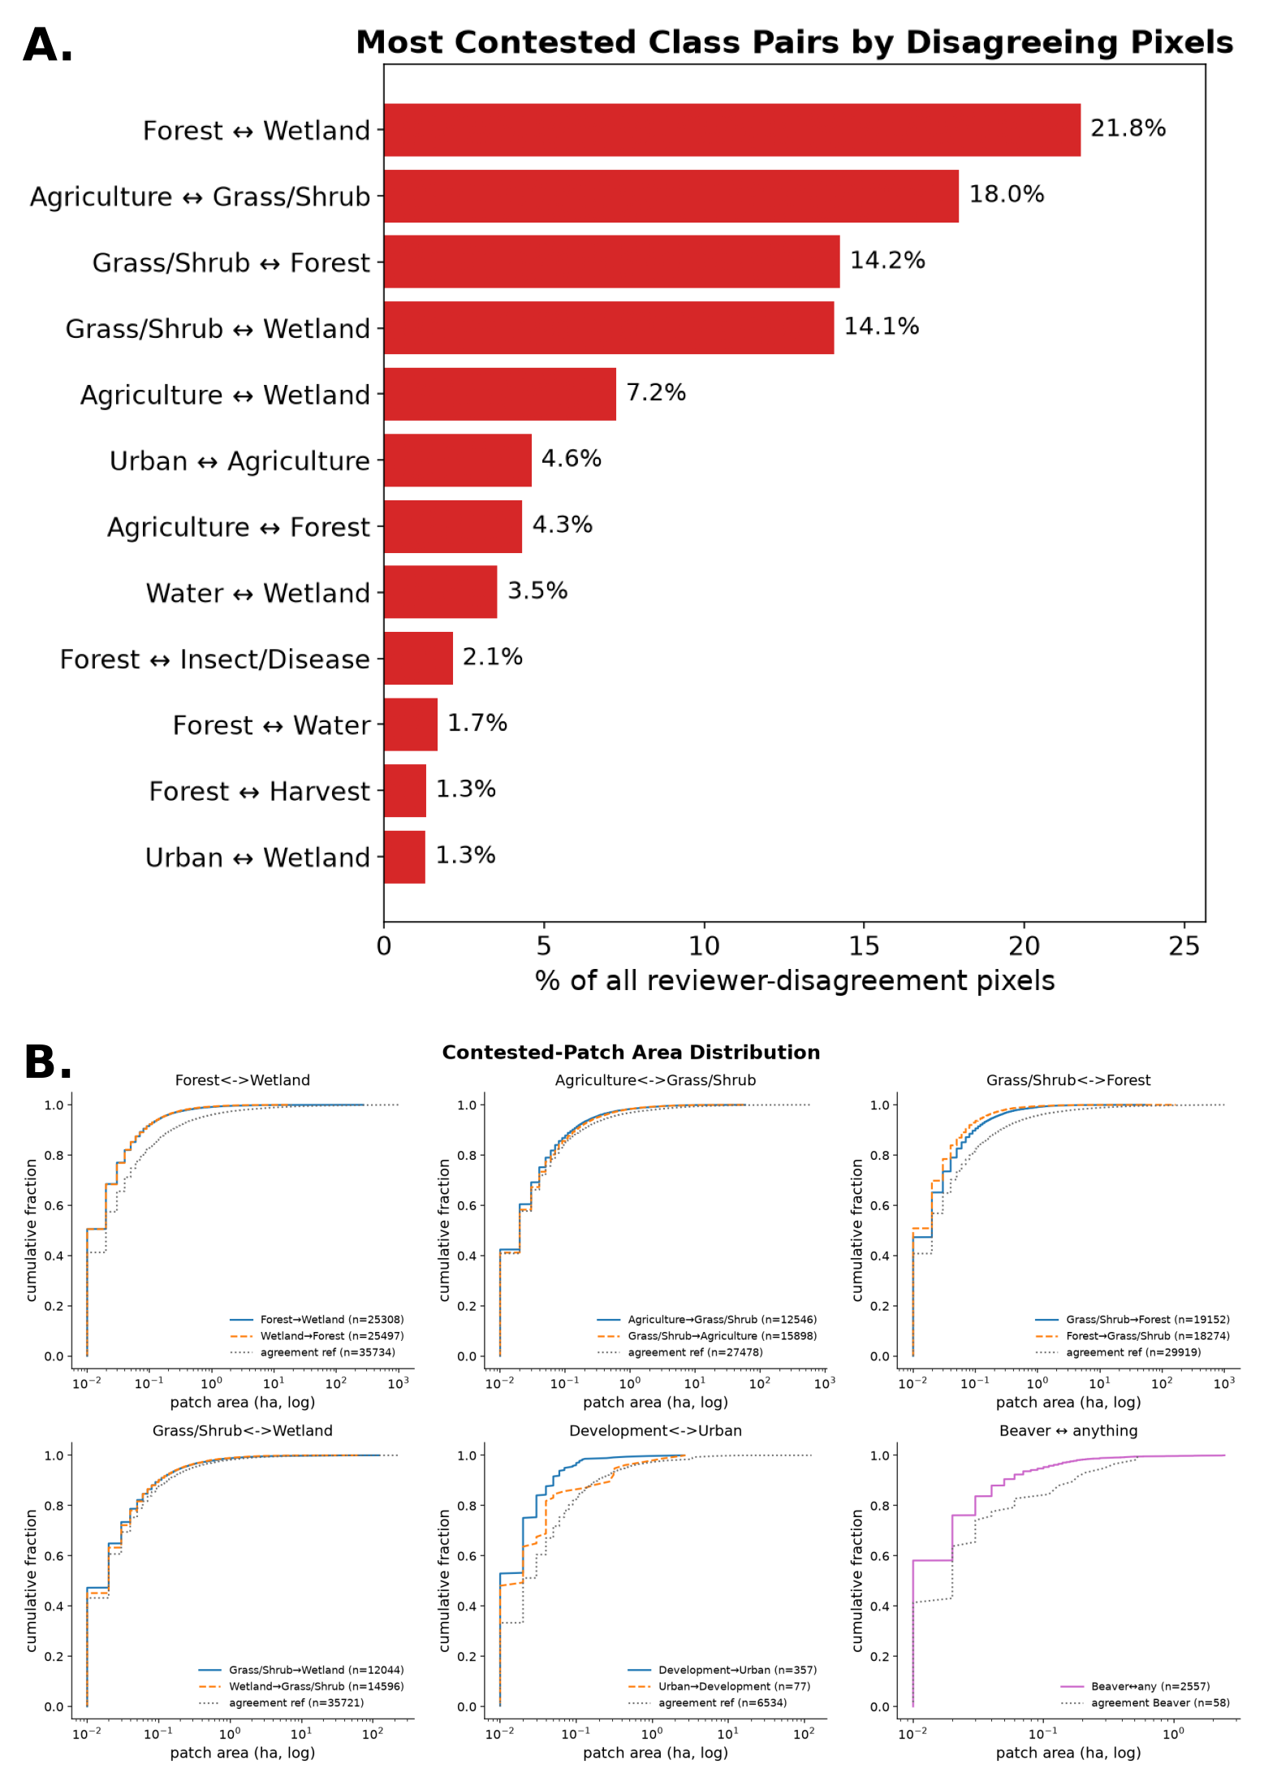
Is the disagreement about drawing or about defining?
Notes:
If interpreters disagreed only on boundary placement, contested area would sit in thin strips along edges. It does not. The contested area is in large, geometrically complex zones, and the dominant contested pairs are forest with wetland and grass or shrub with wetland. That is a clue that the disagreement is about class identity.

Slide 31
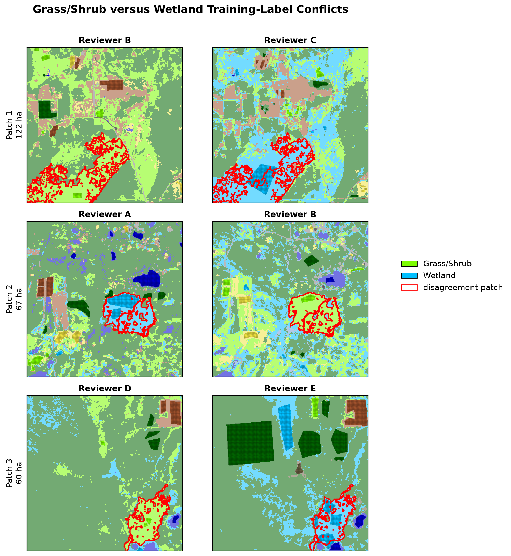
Opposing labels on the same ground
Notes:
The direct evidence. In the largest contested zones both interpreters placed training points, and assigned them to different classes. One called it grass or shrub, the other wetland. This is not imprecision, it is disagreement about what the class means. Reviewers are anonymized.

Slide 32
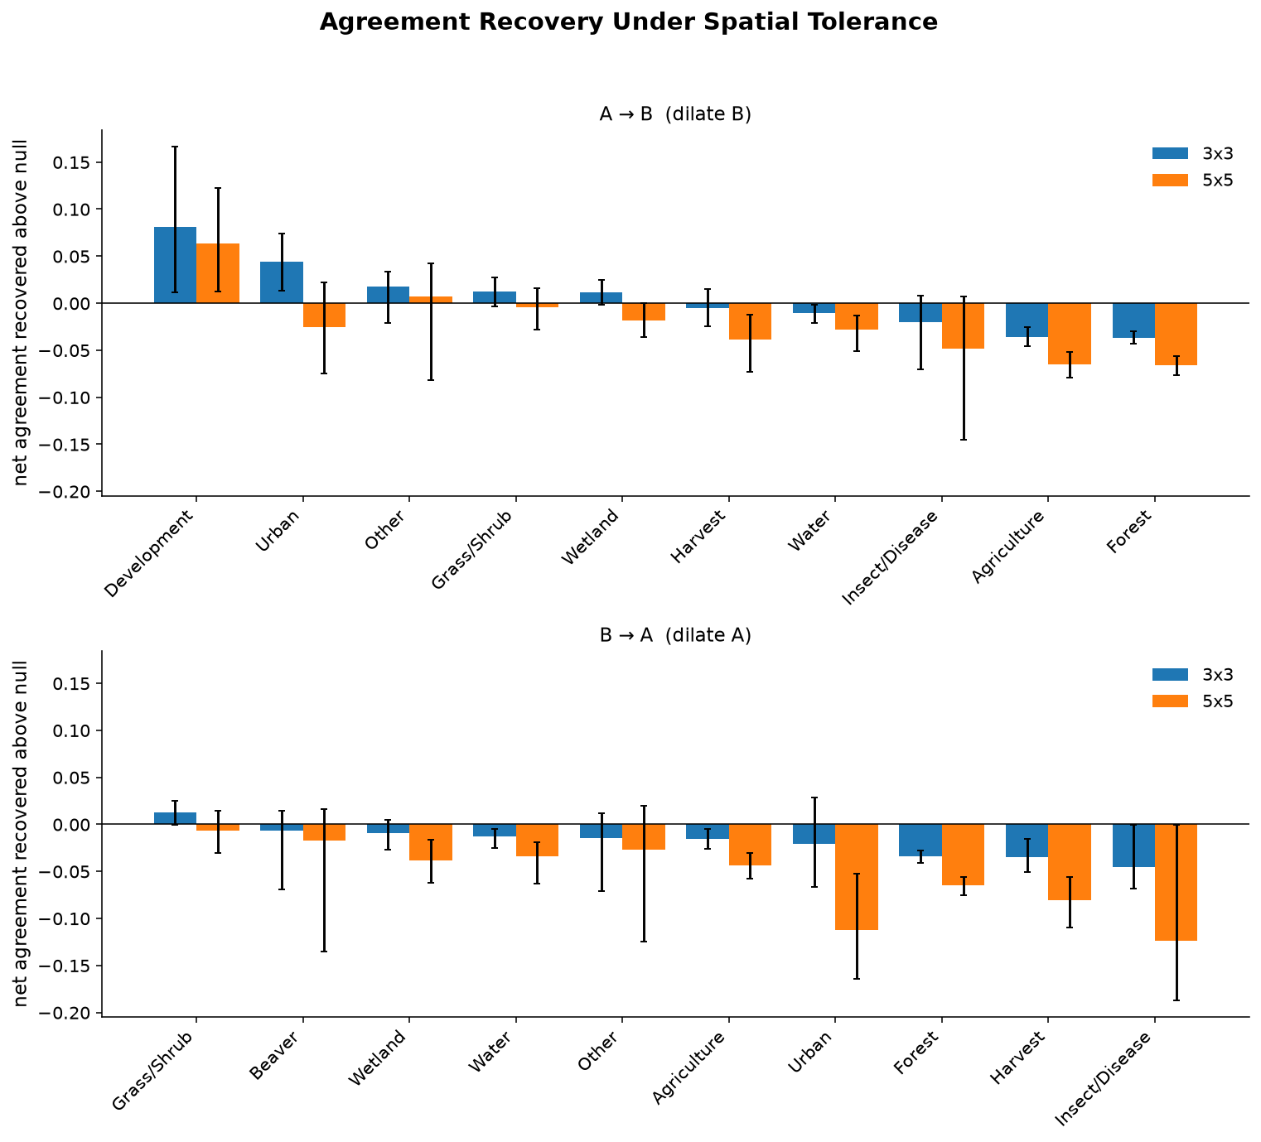
Agreement does not recover under spatial tolerance
Allow a match within 3 or 5 pixels
Boundary-driven disagreement recovers
Grass/shrub and wetland recover little
Notes:
The confirmatory test. If disagreement were about drawing, relaxing spatial precision would recover it. For the transitional classes it does not. Five convergent diagnostics all point the same way, which is why the chapter states the conclusion as strongly as it does.

Slide 33
Hard to define, not hard to draw
For the transitional and rare classes, there is no single correct label for the ground
The achievable accuracy on those classes is bounded by the reference, not by the classifier
A reported accuracy without a companion reliability estimate cannot distinguish the two cases
Notes:
The verdict slide for Chapter 3's first half. Pause on the third bullet, which is the recommendation that follows. If asked what to do about it, the answer is latent class modeling on the double-interpreted cells, which is on the future work slide.

Slide 34
Results, part three
What a sample can and cannot tell you

Slide 35
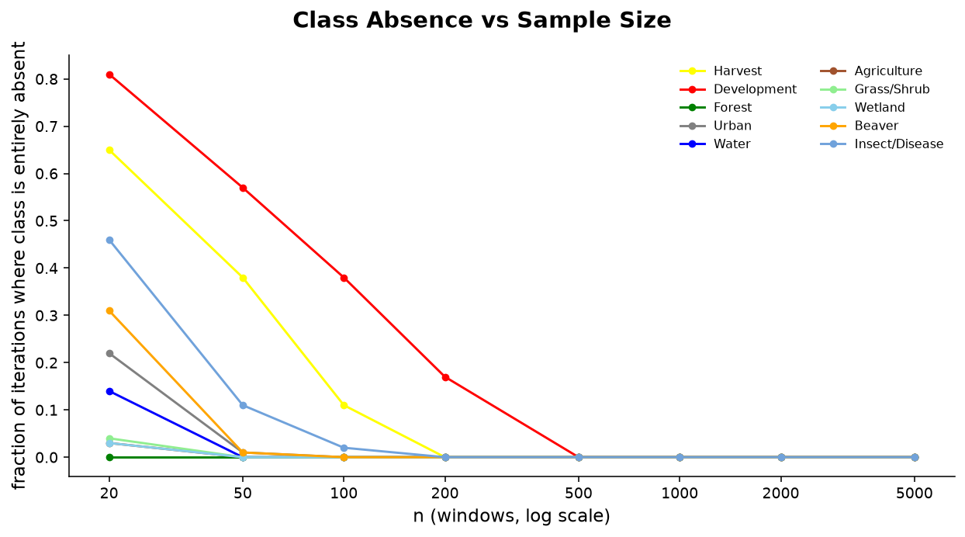
Rare classes vanish from small samples
Fraction of iterations where a class is entirely absent
Common classes always present
Rare change classes missed outright at small n
Notes:
Simple random sampling, Monte Carlo. For the rare change classes, an accuracy estimate is not merely imprecise at small sample size, it is undefined, since the class never appears. That is a qualitatively different failure from a wide confidence interval and it is easy to miss in practice.

Slide 36
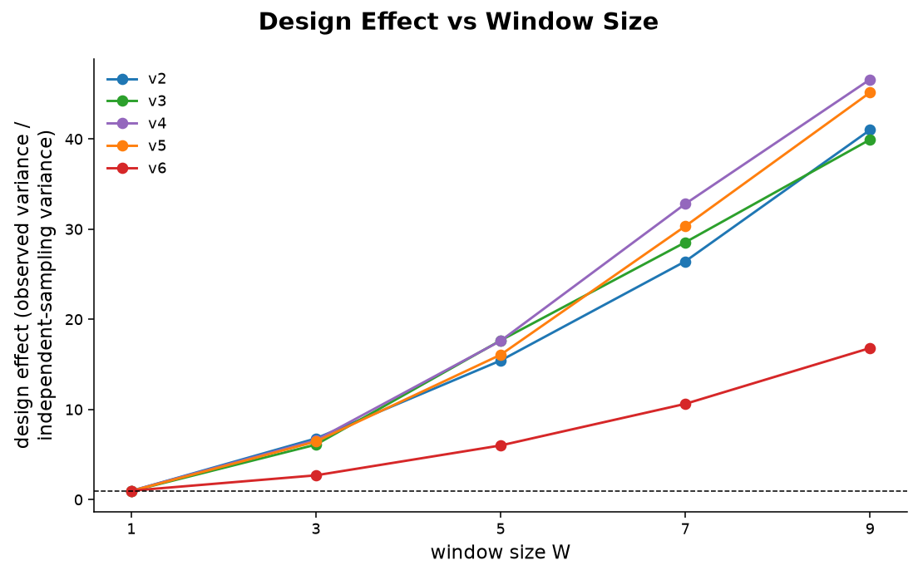
Coherent maps cost more to validate
Design effect is observed variance over binomial variance
Large for coherent variants
Near one for the fragmented variant
Notes:
This is where the two chapters lock together. Spatial coherence, the property that makes a map usable, is the property that inflates the variance of any estimate drawn from spatially clustered units. The fragmented map is cheap to validate and worthless. The good map is expensive to validate. Representation choice and validation design are therefore not separable decisions.

Slide 37
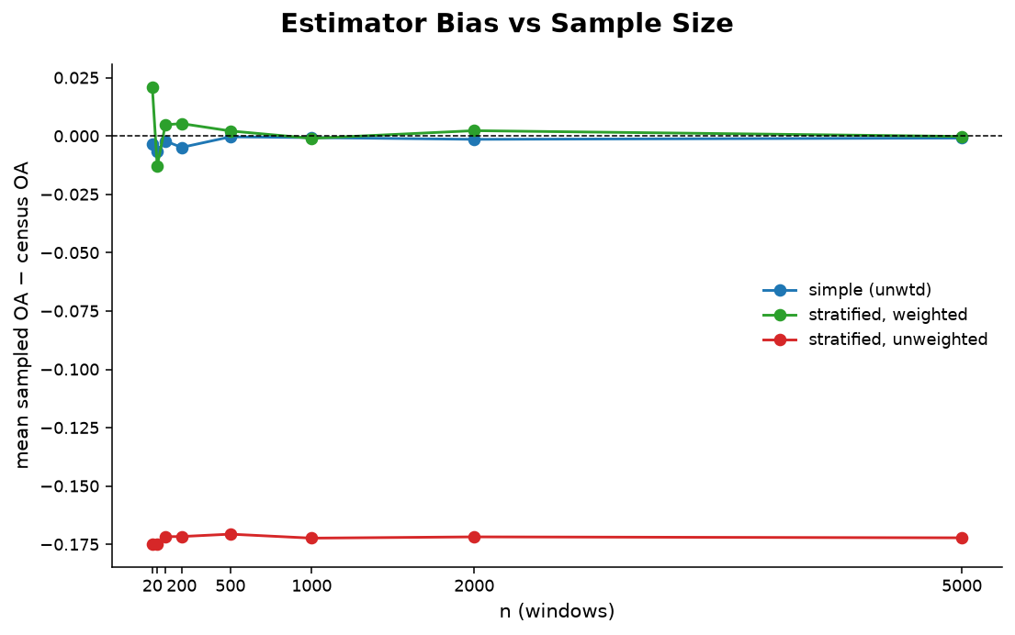
Stratify toward the rare classes, then weight
Simple random misses the change classes
Stratified unweighted is biased
Stratified with inclusion-probability weights recovers the census
Notes:
The practical recommendation. Stratification is necessary to see the rare classes at all, and it introduces bias unless the estimates are weighted by inclusion probability. Both steps are required. Then set up the next slide by asking whether that is sufficient.

Slide 38
Can a point sample tell two maps apart?
Simulated landscapes, truth known by construction
Pixel-level F1 separates the four maps cleanly
Correctly weighted sampled F1 does not
[ pres_09_simulation_f1.png ]
Notes:
The terminal escalation, and joint work with Rob. Four renditions of a known truth landscape, from near-exact to badly degraded. Pixel-level F1 puts them in non-overlapping bands. Sampled F1, stratified and Olofsson-weighted, the exact estimator recommended on the previous slide, overlaps heavily across renditions and sits above the one-to-one line for the degraded maps, so it is optimistic about bad maps. So unbiasedness is necessary and not sufficient. This is a binary two-class problem, the easiest discrimination task available, which means ten classes should be worse rather than better.

Slide 39
Part four
What it means together

Slide 40
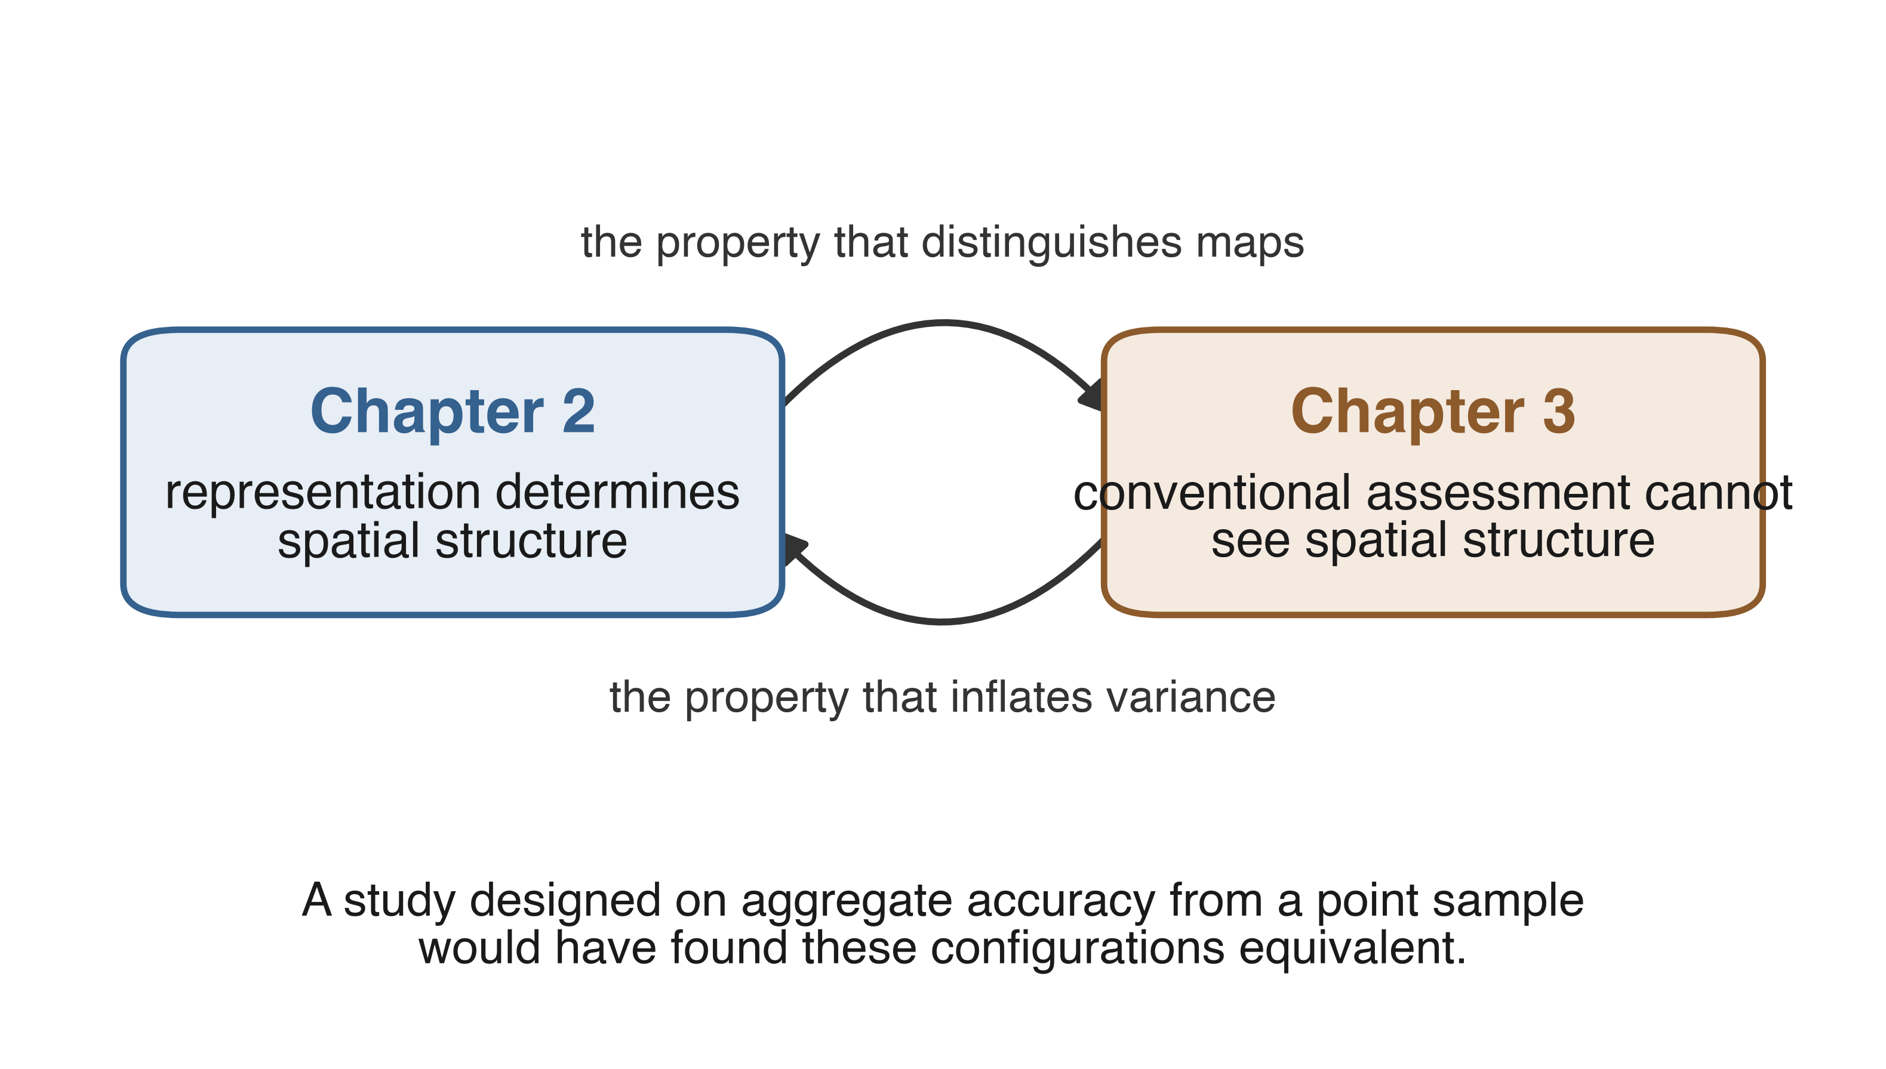
The loop
Notes:
Deliver the punchline promised on slide six. Chapter 2 found that spatial structure is the axis on which representations actually differ. Chapter 3 found that conventional assessment is least able to see that axis. So a study of these same configurations designed the usual way, comparing aggregate accuracy from a point sample, would have concluded that the configurations were equivalent. The wall-to-wall response design is what made the difference visible.

Slide 41
Reference-limited or model-limited
Stable classes are model-limited. Better features and better classifiers should help
Change classes are reference-limited. Every configuration fails on them equally, including the spectral baseline
The two cases call for different responses, and an accuracy figure alone cannot tell them apart
Notes:
This is the claim neither chapter can make alone. Chapter 2 supplies the uniformity of the failure, Chapter 3 supplies the cause. Say explicitly that this is the synthesis, since a committee listens for whether the manuscripts are a thesis or two papers stapled together.

Slide 42
Recommendations
Retain a baseline embedding. Do not reduce interannual change to a magnitude alone
Report a spatial-structure diagnostic alongside accuracy
Report per-class interpreter agreement alongside per-class accuracy
Stratify toward the rare classes and weight the estimates by inclusion probability
To rank maps whose accuracies are close, enumerate within assessment units rather than sampling points
Notes:
Keep this crisp, one sentence each. These five follow directly from the five results just presented, in the same order, and it is worth saying so.

Slide 43
Limitations
Reference change polygons come from the GLKN watersheds, a small and possibly unrepresentative fraction of the grid
One region, one class scheme, one classifier
Reliability rests on 72 double-interpreted cells, thin for the rarest agents
The adjudicated reference is a consensus, not an estimate of an unobserved true label
Simulation perturbations are parameterized rather than calibrated to the observed error structure
Notes:
Own these plainly and do not over-hedge. The first is the one most likely to be pressed, so have the answer ready: the polygon frequencies characterize the surveyed watersheds rather than the region, and the classifiers extrapolate to a landscape whose change characteristics may differ.

Slide 44
Contributions and next steps
A controlled comparison of embedding representations holding classifier, training data, and reference fixed
Evidence that aggregate accuracy is dissociated from spatial coherence, and a diagnostic for the dissociation
A reliability characterization of a multi-interpreter reference, with five convergent diagnostics locating the disagreement
Next: latent class models on the double-interpreted cells, converting the reliability bound into an applied correction
Notes:
The latent class point is the strongest forward-looking answer available, so land it clearly. Those models estimate sensitivity and specificity of several imperfect classifications without a gold standard, and the 72 double-interpreted cells are structurally what such models require.

Slide 45
Thank you
Robert Kennedy, advisor
Committee members
Jamon and the eMapR Lab
Bekka, Peter, and Ash, interpretation
NPS Great Lakes Inventory and Monitoring Network
Notes:
Name the interpreters, they did a large share of the labor. Then stop talking and take questions.

Slide 46
Backup
Supplemental slides

Slide 47
Supplemental contents
Tasseled Cap training-signal diagnostics
Combined embedding and spectral configurations
Overall accuracy by NAIP bracket
Pooled confusion matrices
Per-cell change-class F1
Change-polygon size distributions
Sampling precision against sample size
Stratification efficiency and Approach D correlations
Dedup-selection sensitivity
Reviewer over-assignment
Ten-class interpreter agreement
Notes:
Keep this slide's page number written on your hand. Jumping straight to the right backup slide during questions is worth more than any single result in the deck.

Slide 48
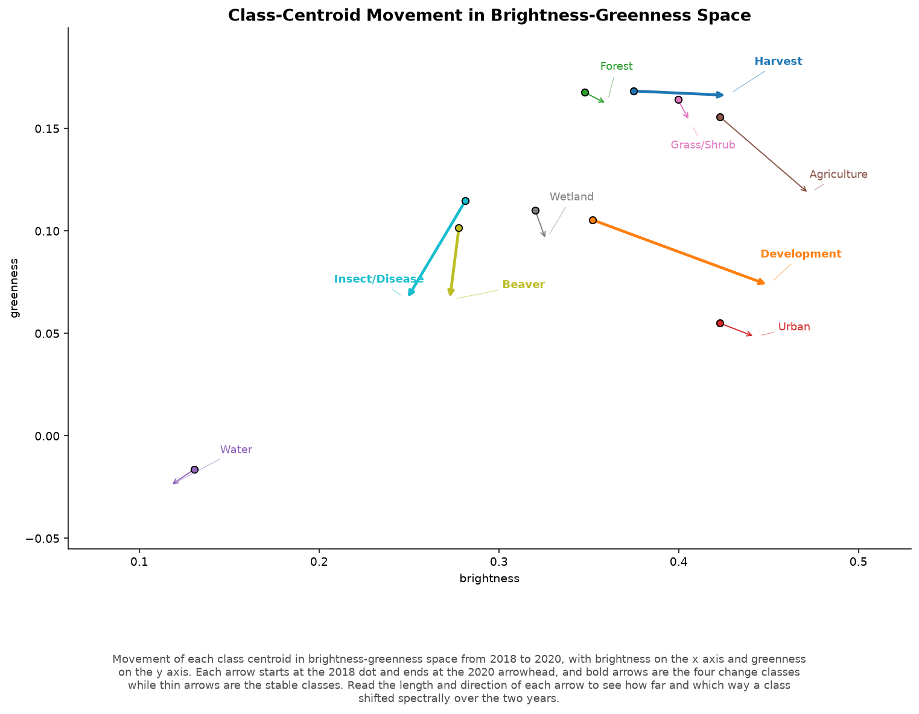
Tasseled Cap class-centroid trajectory
Notes:
Training points in Tasseled Cap change space. Use if asked whether the change classes are separable in a conventional spectral change space at all.

Slide 49
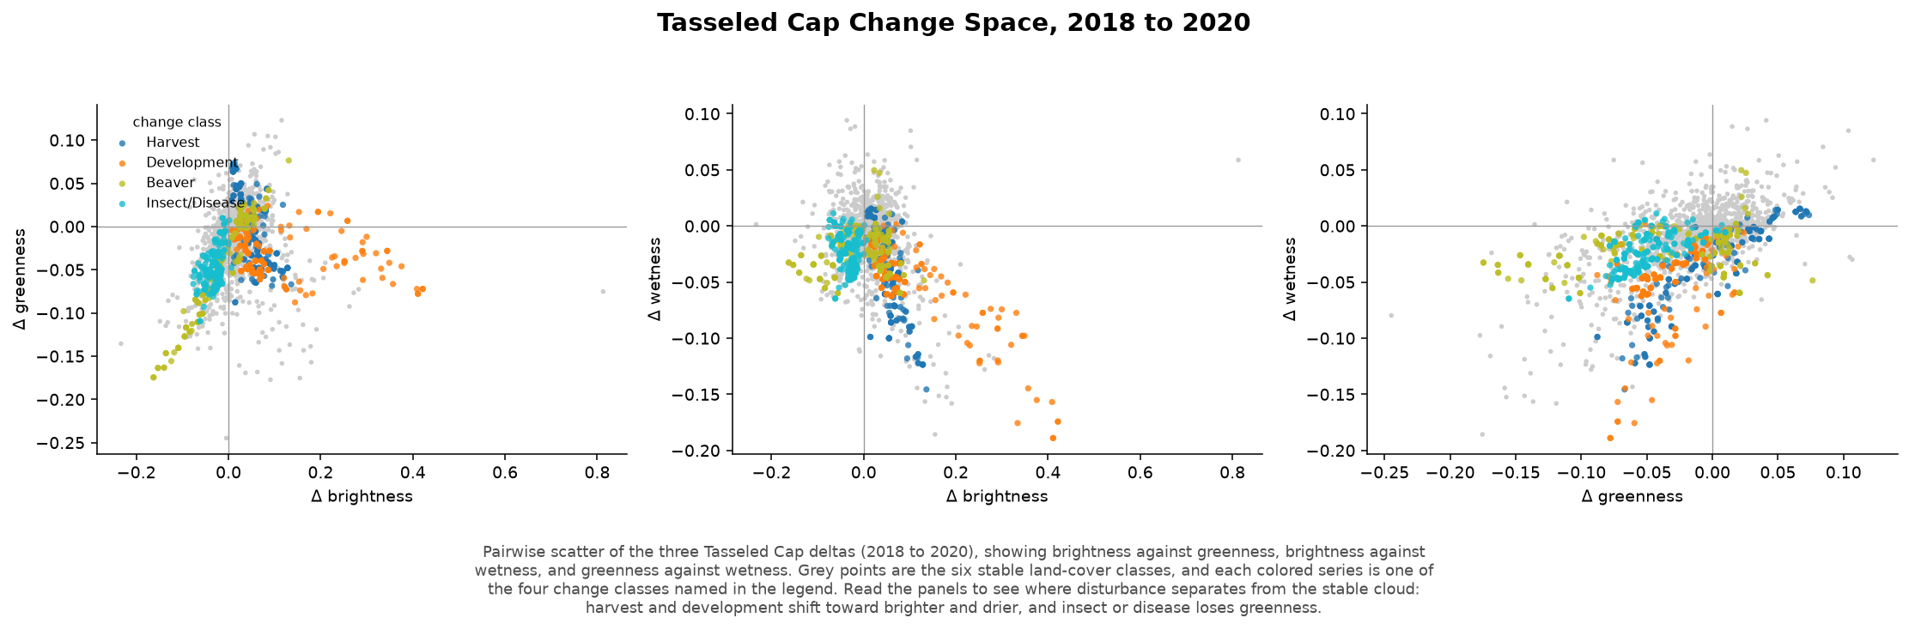
Tasseled Cap diagnostics
Notes:
Delta scatter, mean-delta class signature, and linear discriminant projection of class separability.

Slide 50
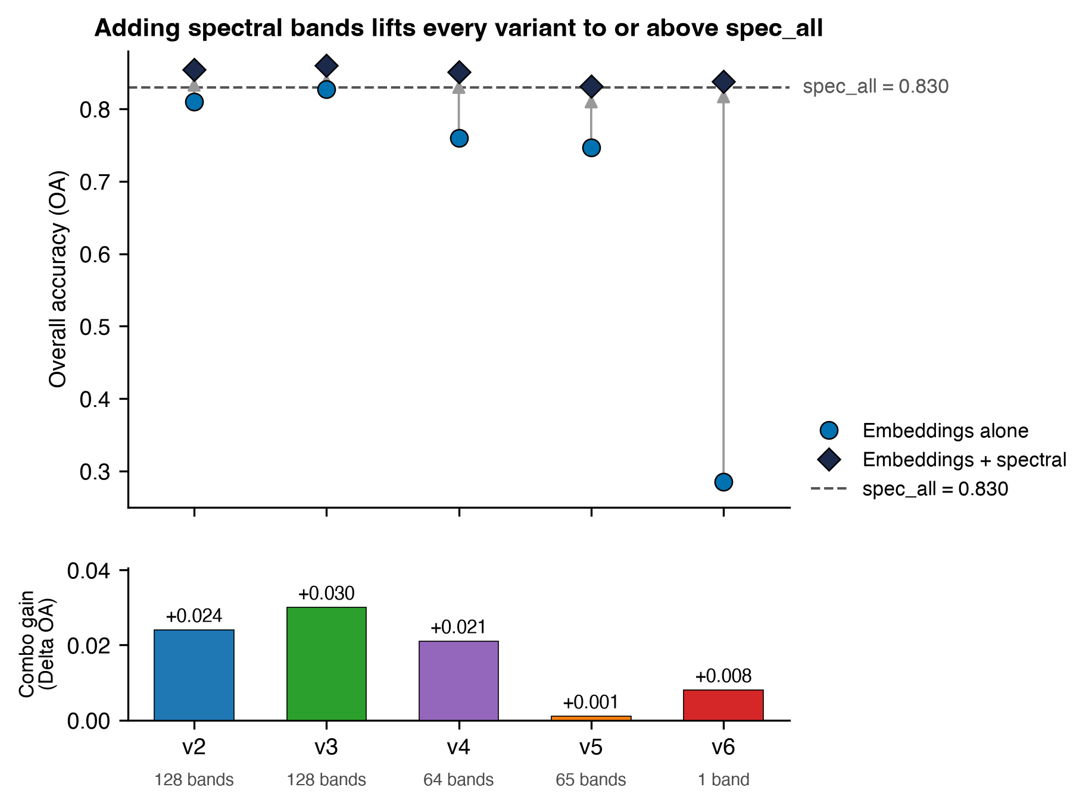
Combined embeddings and spectral features
Notes:
Combining the two families gives at most a three-point gain over the better single family, not significant, with wider out-of-bag to validation gaps suggesting feature dilution.

Slide 51
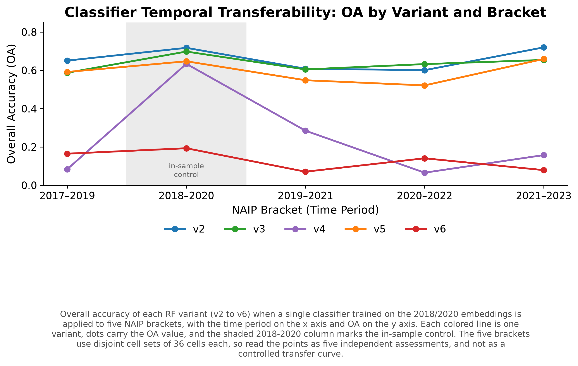
Overall accuracy by NAIP bracket
Notes:
Each bracket uses a disjoint cell set, so these are independent per-bracket assessments rather than a transfer curve. Do not pool across brackets for source comparisons.

Slide 52
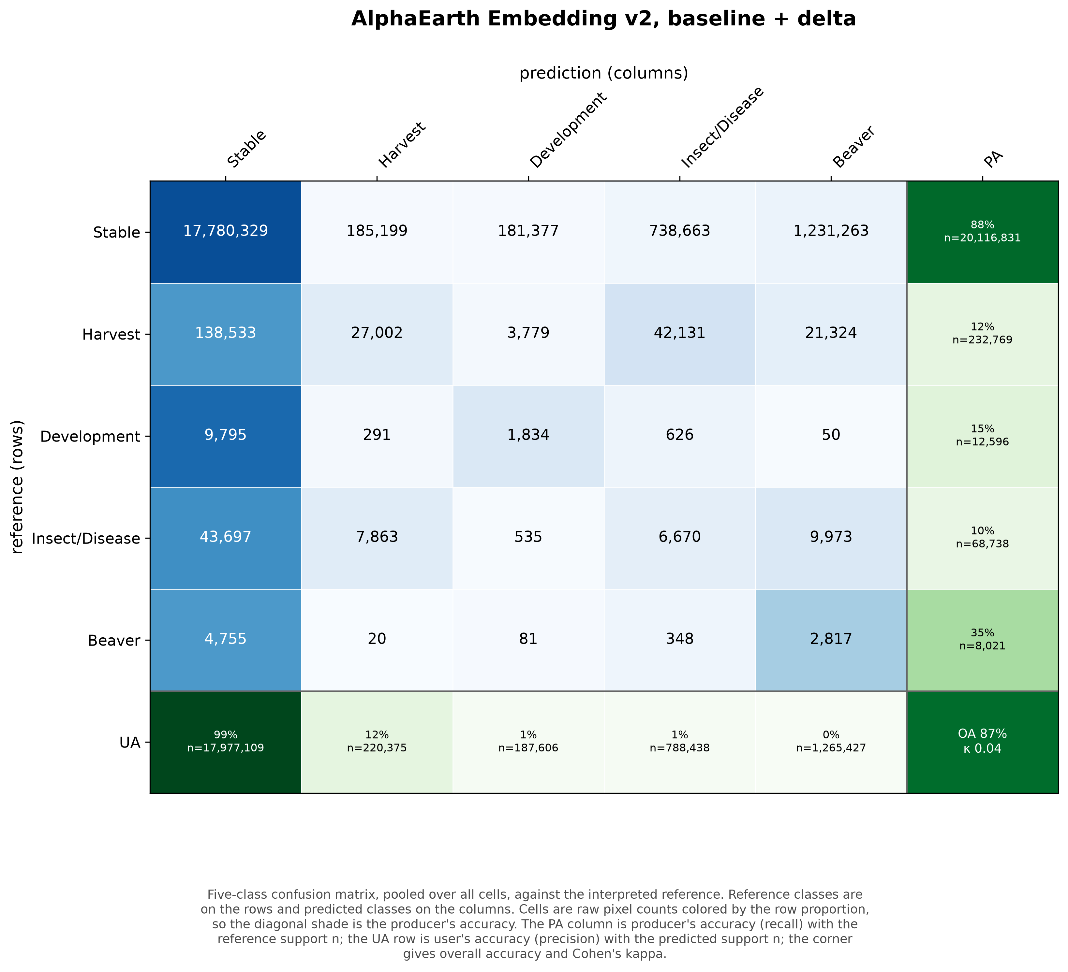
Pooled confusion matrix, v2
Notes:
Five-class collapse, raw pixel counts colored by row proportion. Use for questions about which classes absorb the change pixels.

Slide 53
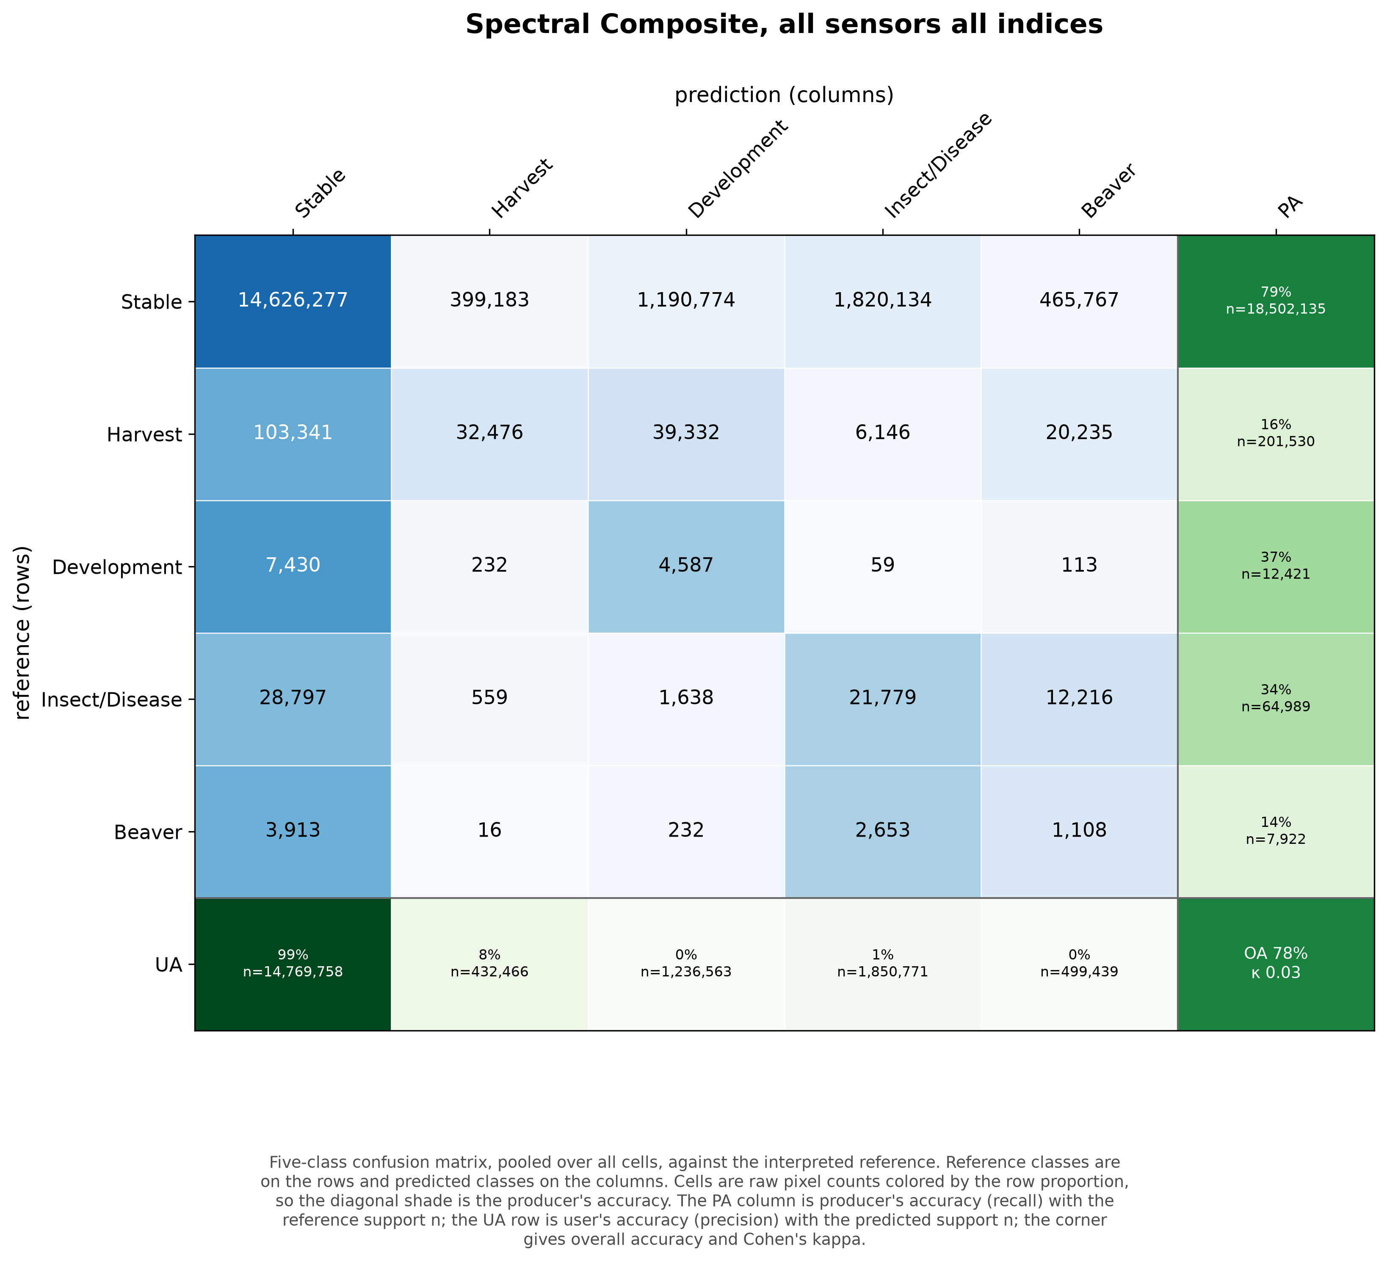
Pooled confusion matrix, spec_all
Notes:
The spectral baseline on 168 cells. Compare the change-class rows against v2.

Slide 54
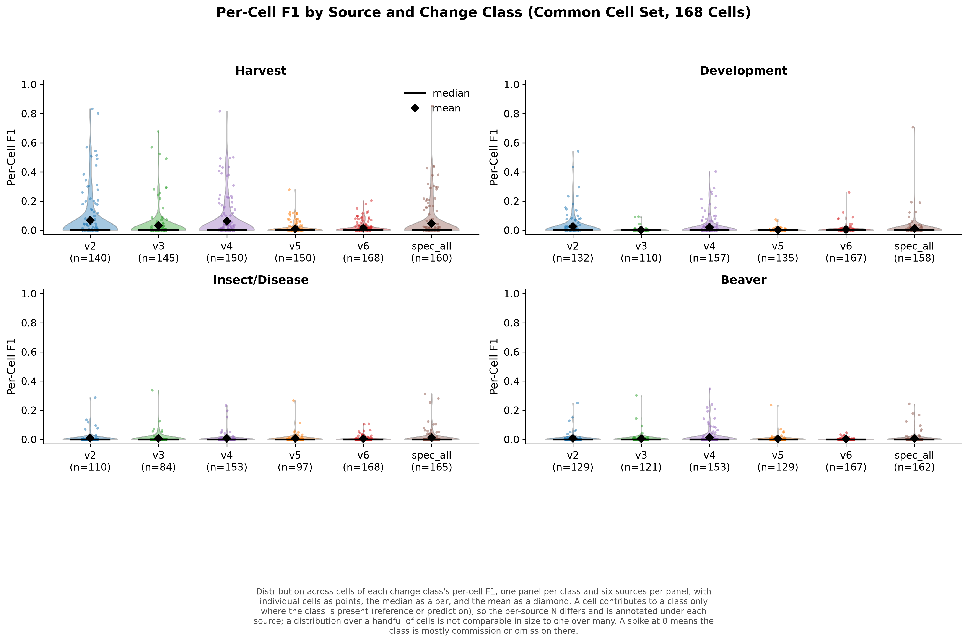
Per-cell change-class F1
Notes:
One point per contributing cell. Contributing cell counts differ across sources and are annotated.

Slide 55
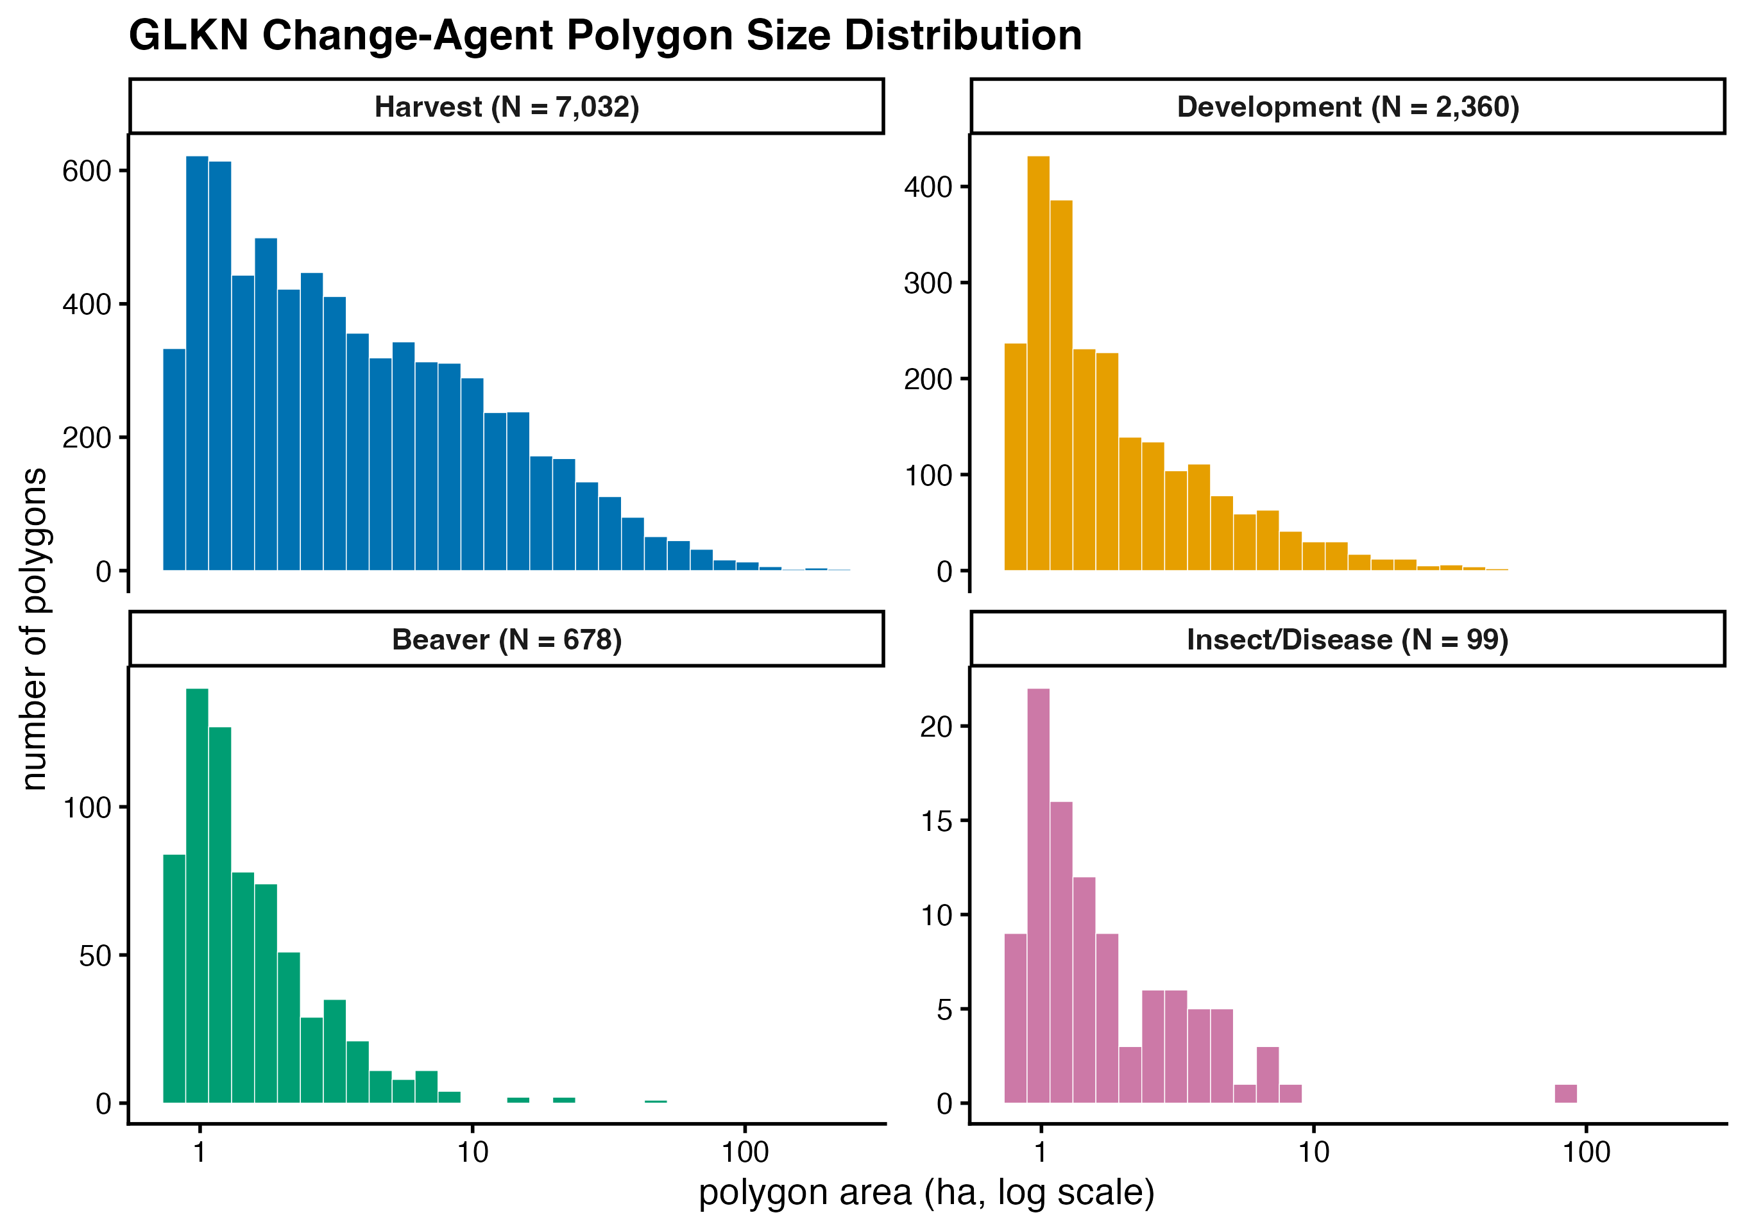
Change-polygon size by agent
Notes:
GLKN polygon area by agent on a log hectare axis, 2010 through 2020. Median areas are similar across agents; the counts differ by orders of magnitude.

Slide 56
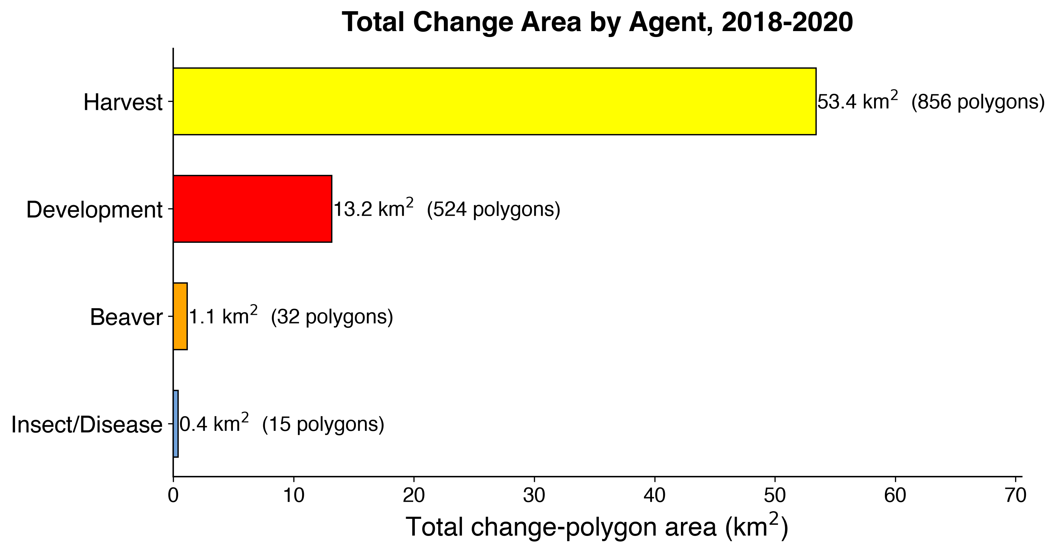
Total polygon area by agent
Notes:
Restricted to the 2018 to 2020 classification window. The full 2010 to 2020 version exists as a separate file.

Slide 57
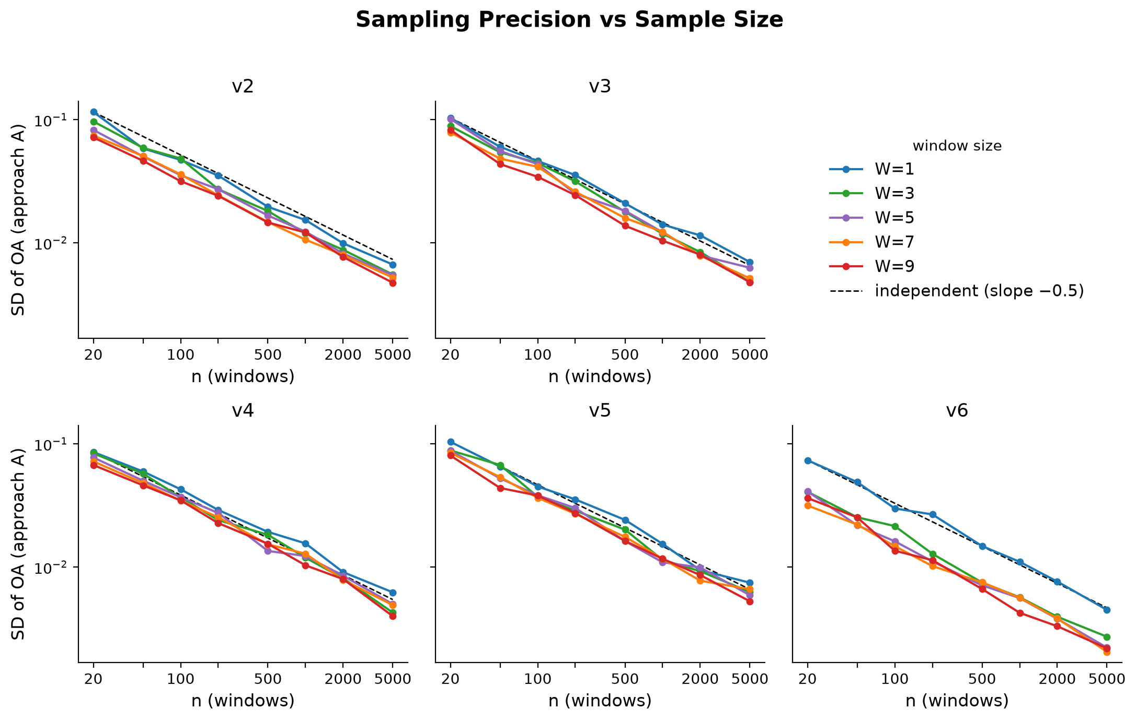
Sampling precision against sample size
Notes:
Precision improves as one over root n, and each spatial window contributes less than its pixel count owing to within-window autocorrelation.

Slide 58
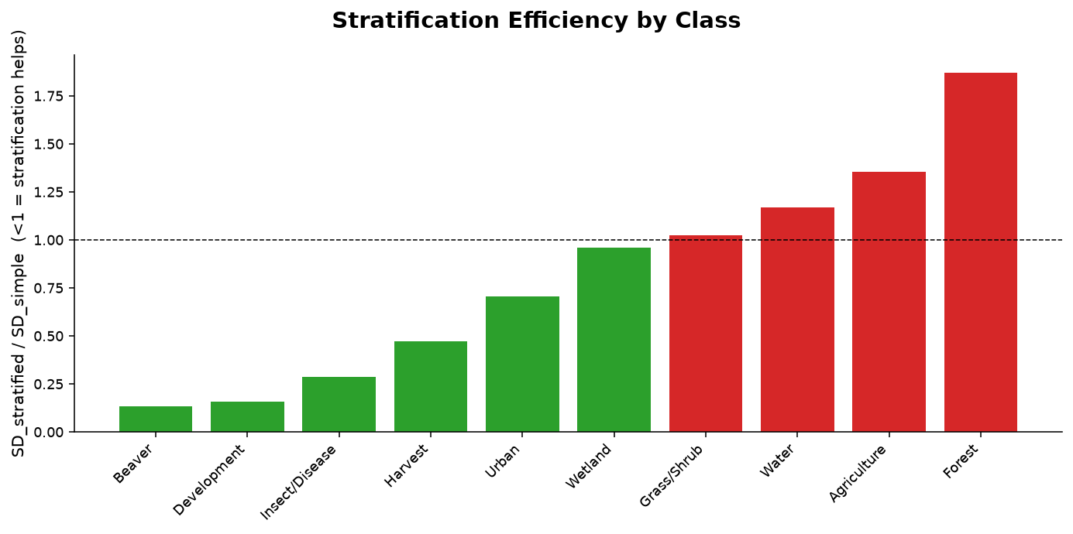
Stratification efficiency by class
Notes:
Ratio of stratified to simple-random standard deviation. Below one means stratification helps for that class.

Slide 59
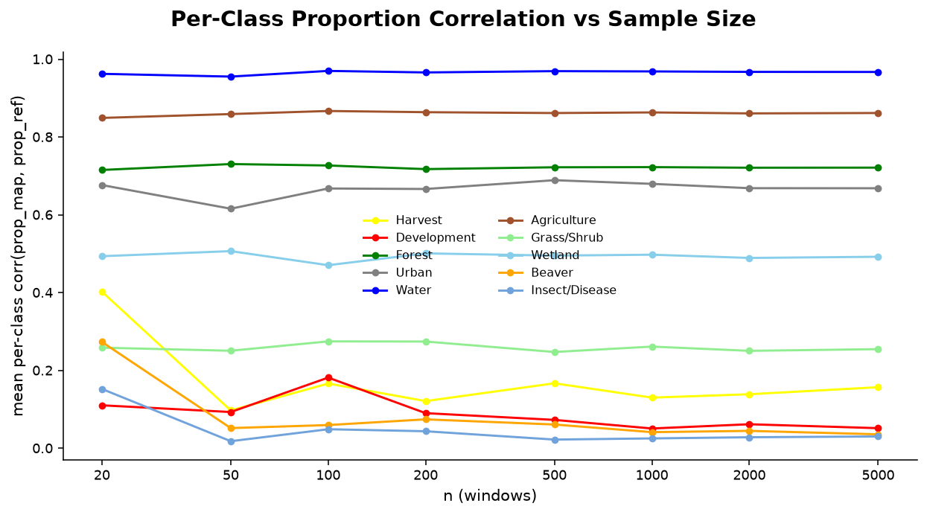
Approach D proportion correlation
Notes:
Per-class correlation of map against reference area proportions with sample size.

Slide 60
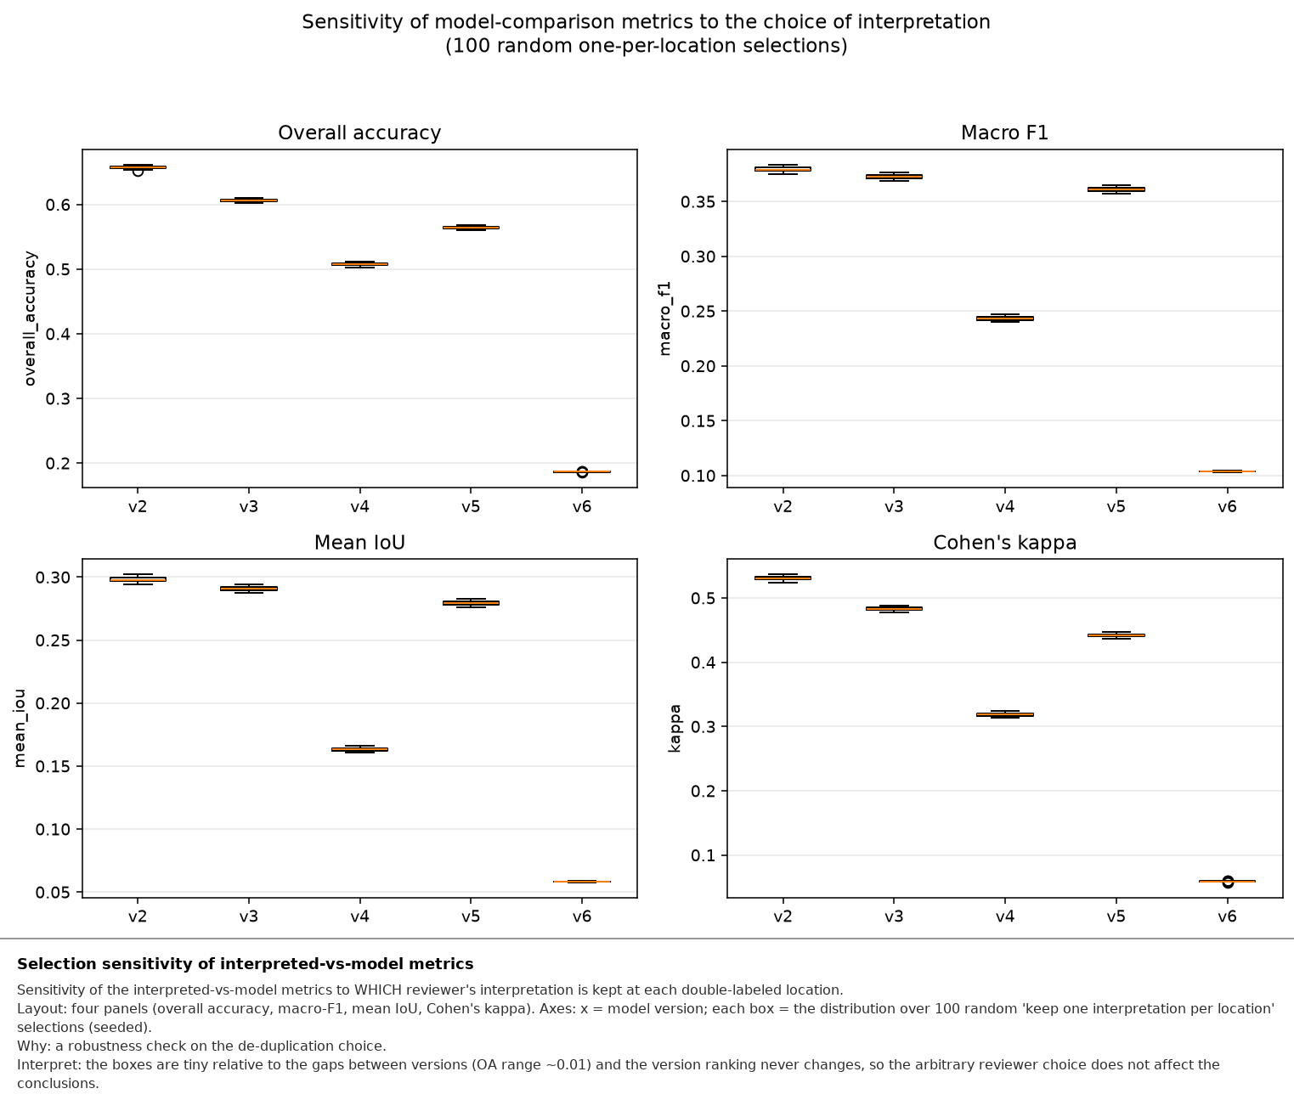
Dedup-selection sensitivity
Notes:
Overall accuracy across 100 random pick-one-interpretation-per-location draws. The spread is under one accuracy point, so the choice of which interpretation to retain does not drive the results.

Slide 61
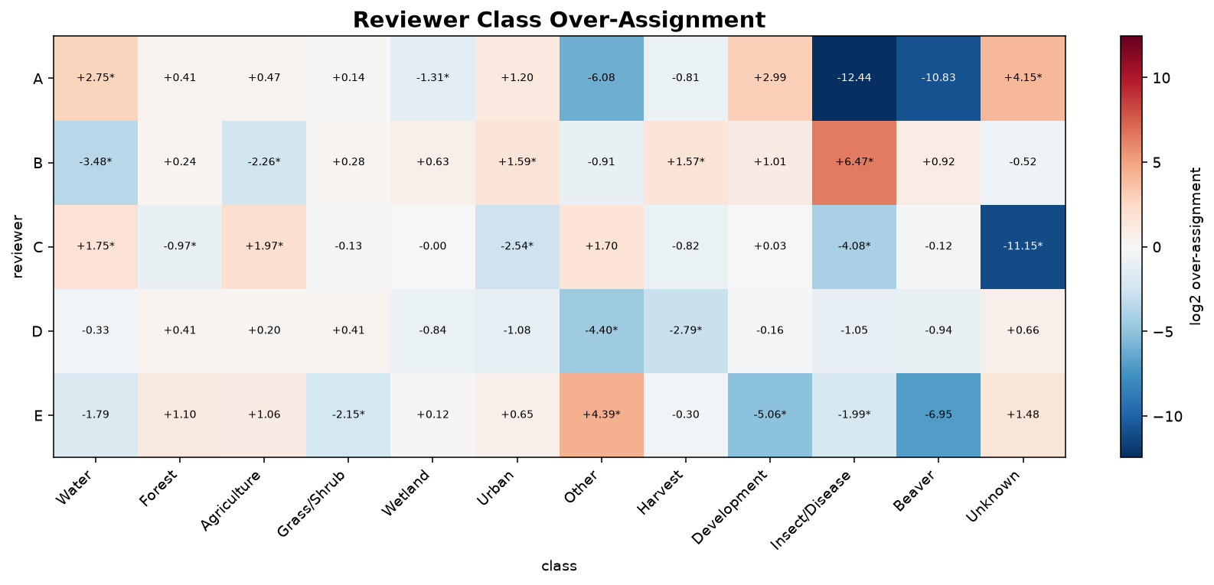
Reviewer over-assignment
Notes:
Log ratio of pixels a reviewer claims for a class that the partner does not, against the reverse. Use if asked whether one interpreter drives the disagreement.

Slide 62
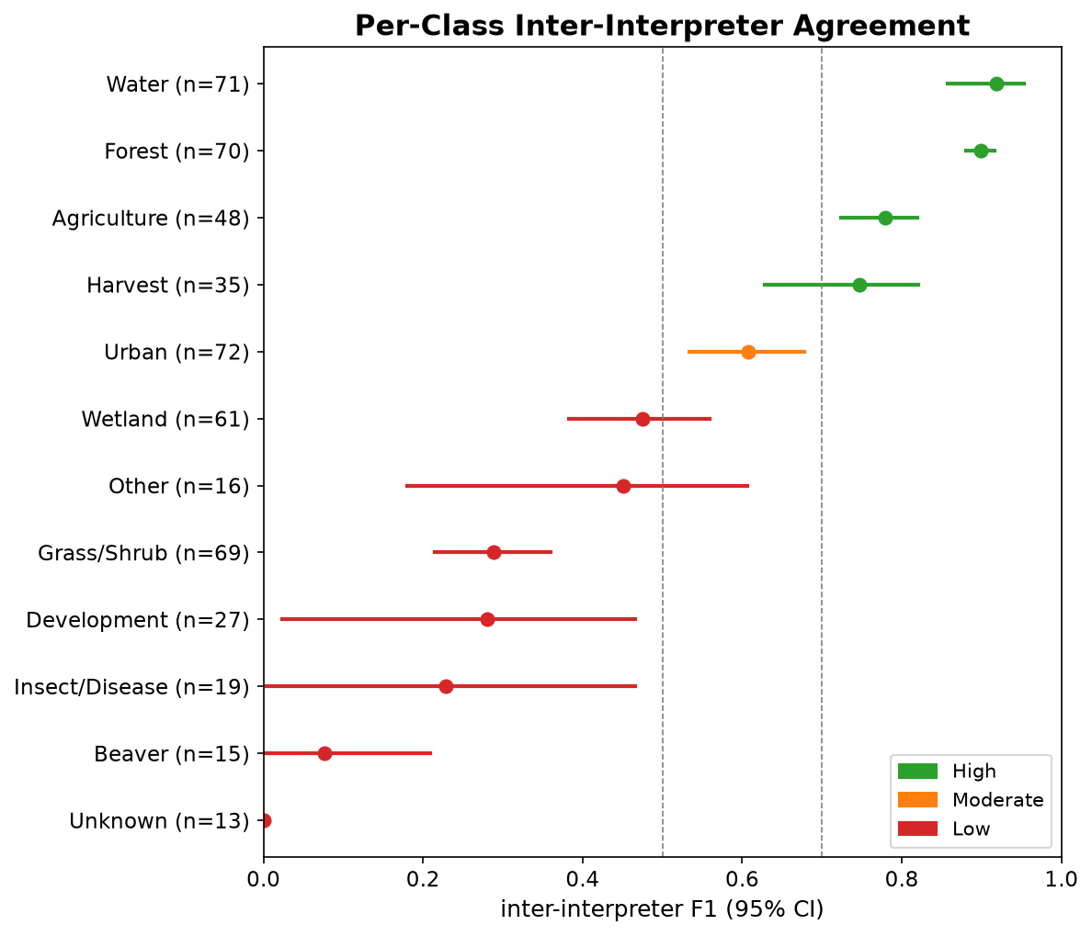
Ten-class interpreter agreement
Notes:
The ten-class version of the agreement figure. Wetland at 0.475 and grass or shrub at 0.289 are the transitional classes referenced in the talk.

Slide 63
Simulated landscape and its four renditions
[ pres_10_simulation_landscapes.png ]
Notes:
Truth plus four renditions with increasing omission, commission, spatial misalignment, and edge effects. Show this if anyone questions whether the simulated maps are visibly different.

