Slide 1



A presentation of ”A Minimal Physiologically Based Pharmacokinetric Model to Characterize CNS Distribution of Metronidazole in Neuro Care ICU Patient” by A. Chauzy et al

Slide 2
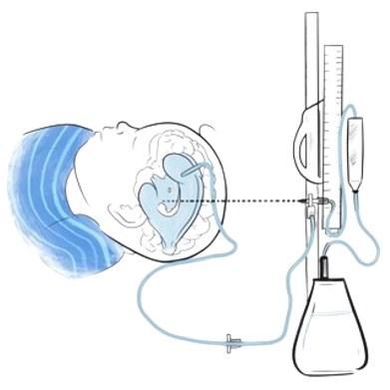
1. Introduction
Objective:
Developp a minimal PBPK mpdel to predict cerebral distrubition of Metronidazole with ICU patients
PK Study:
Based on clinical data of 8 patients
2 groups: 4 patients with a EDV & 4 patients with a microdialysis device
All patients received a 500mg IV over 30min
Samplings performed at steady-state after 2 days of treatment over 8 hours (every 30min for 2-4 first hours and every 1 hours for the remaining dose)

Slide 3
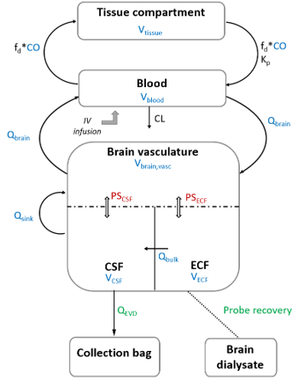
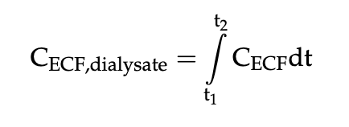
2. PBPK Model
Overview
7 compartments (3 for brain, one central, one peripheral and respectively one for EDV & Microdyalysate)
Metronidazole elimination caracterize a unique total clearance (including renal & hepatic elimination)
Volumes of each compartment coming the literature
As brain dialysate was collected as fractions during various time intervals, the concentrations were describe by :

Slide 4
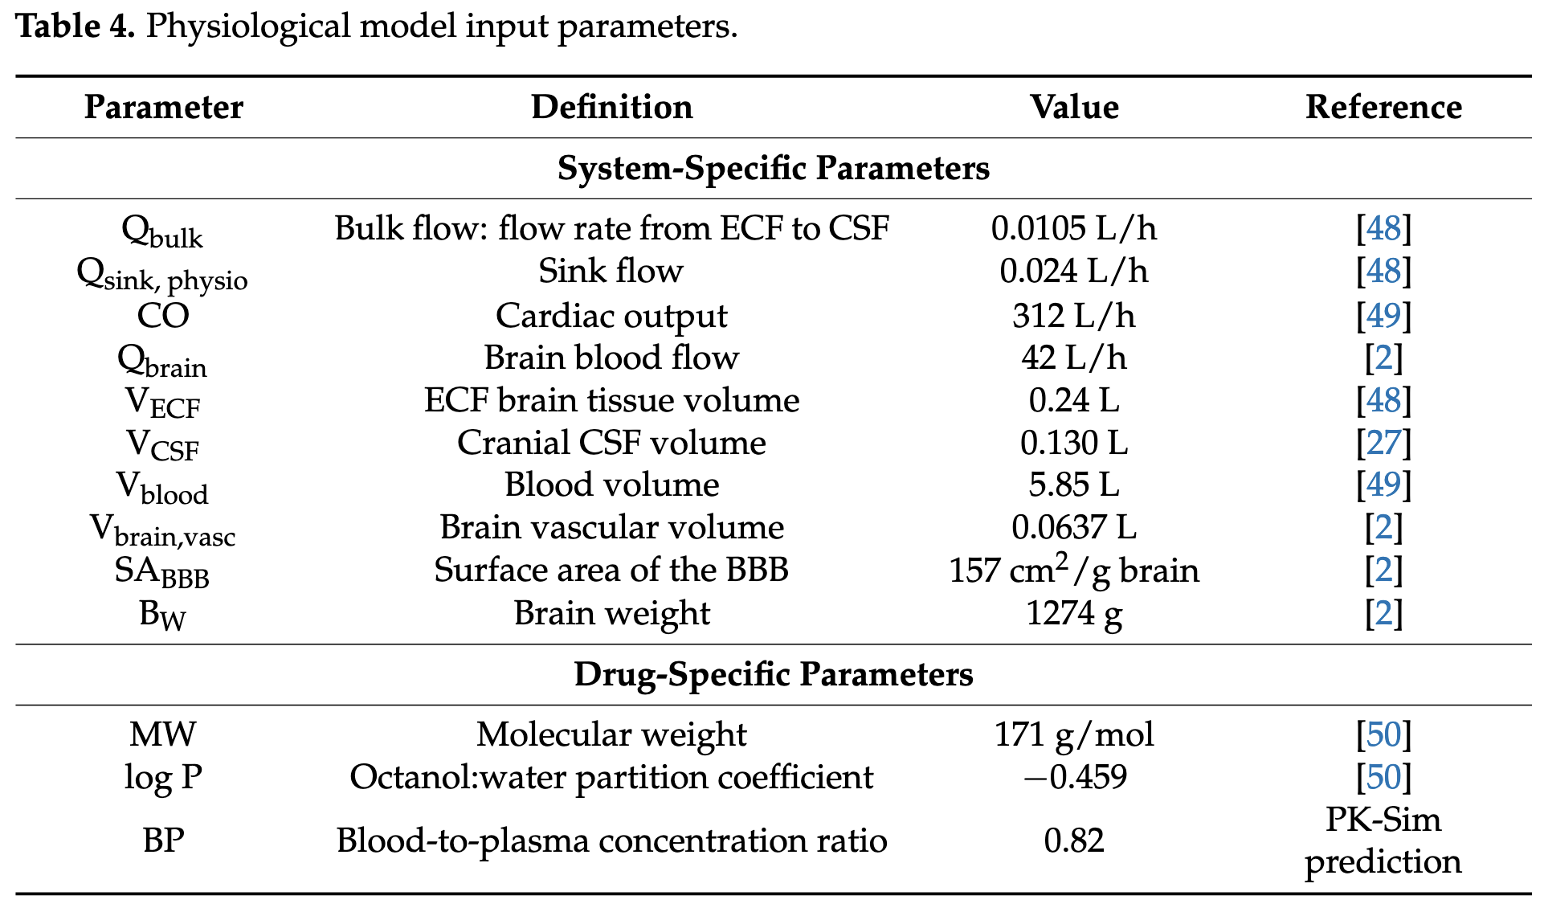
2. PBPK Model
Fixed parameters
References:
2 – Ball K. et al., Development of a PBPK Model for the Rat CNS and Determination of In Vitro-In Vivo Scaling Methodology for the BBB Permeability of Two Transporter, 2012
27 – Gaohua, L et al, Development of a Permeability-Limited Model of the Human Brain and CSF to Integrate Know Physiological and Biological Knowledge, 2016
48 – Westerhout, J. et al, Physiologically Based Pharmacokinetic Modeling to Investigate Regional Brain Distribution Kinetics in Rats., 2012
49 – Brown, R.P et al., Physiological Parameter Values for Physiologically Based Pharmacokinetic Models, 1997
50 – Chemicalize, Available online: https://chemicalize.com (accessed May 2022)

Slide 5
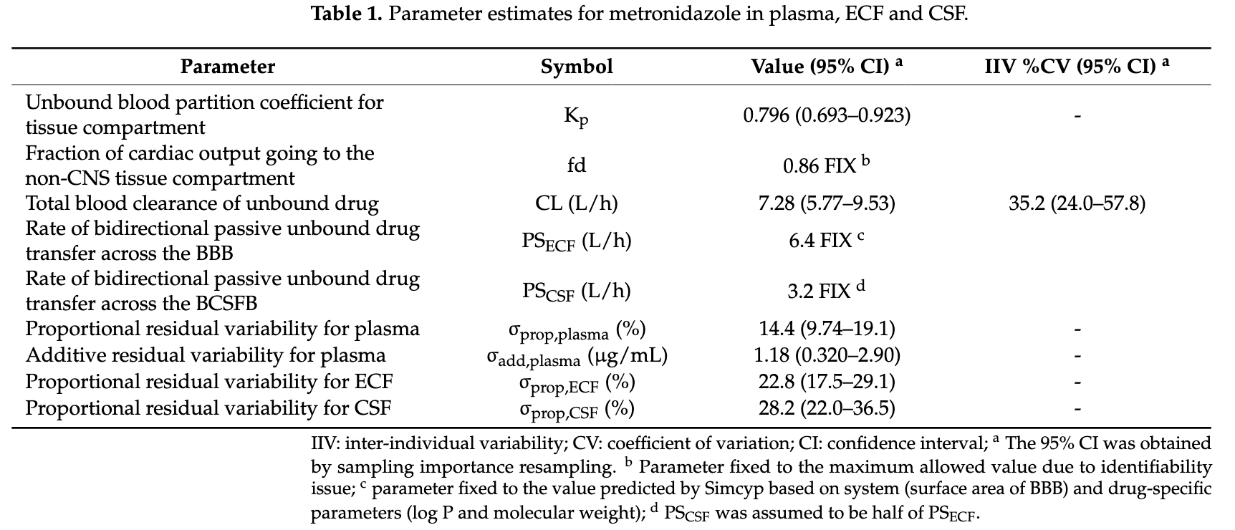
2. PBPK Model
Estimated final parameters
Residual parameters

