Slide 1
Applying a principled approach for ChIP-seq optimization
Michele Busby, PhD
Alon Goren

Slide 2
Outline
Background

Slide 3
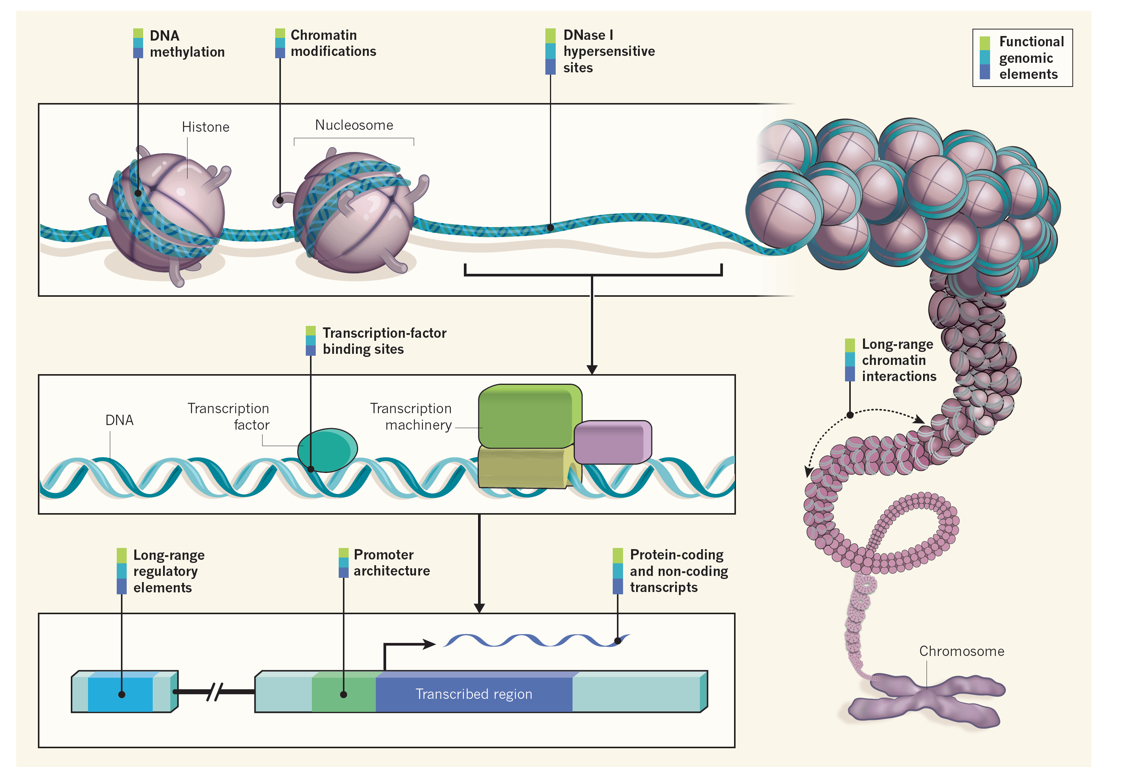
Study of Chromatin Structure & Organization (Things that bind to DNA)
Ecker et al., Nature 2012

Slide 4
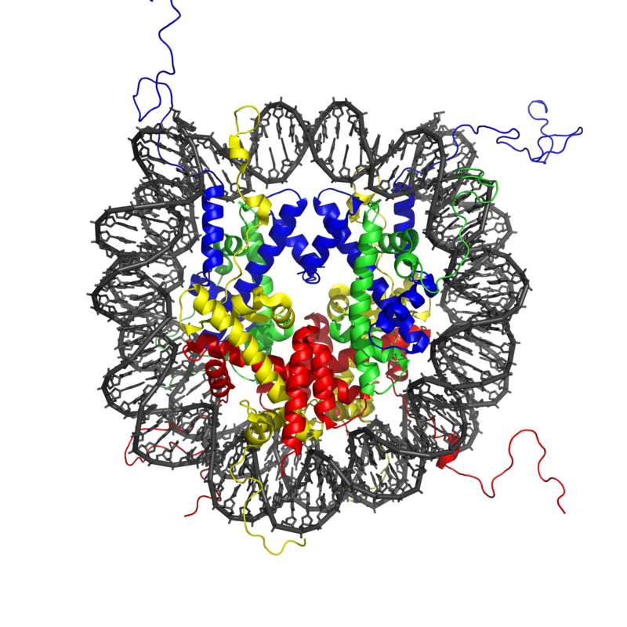
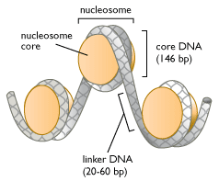
Nucleosomes
Nucleosome cores are made of histones (proteins).
Two each of:
H2A, H2B, H3, H4
From Wikipedia and http://cyberbridge.mcb.harvard.edu/dna_2.html

Slide 5
Histone Methylation: Transfer of –CH3 to an amino acid
H3K4me3 (usually activating)
H3K27me3 (usually repressive)

Slide 6
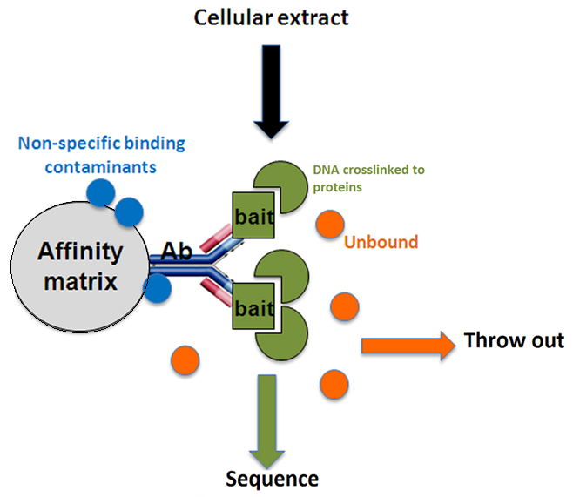
Basic Protocol

Slide 7

Basic Informatics Pipeline
FASTQ
Alignment
Remove Duplicates
Call Peaks

Slide 8
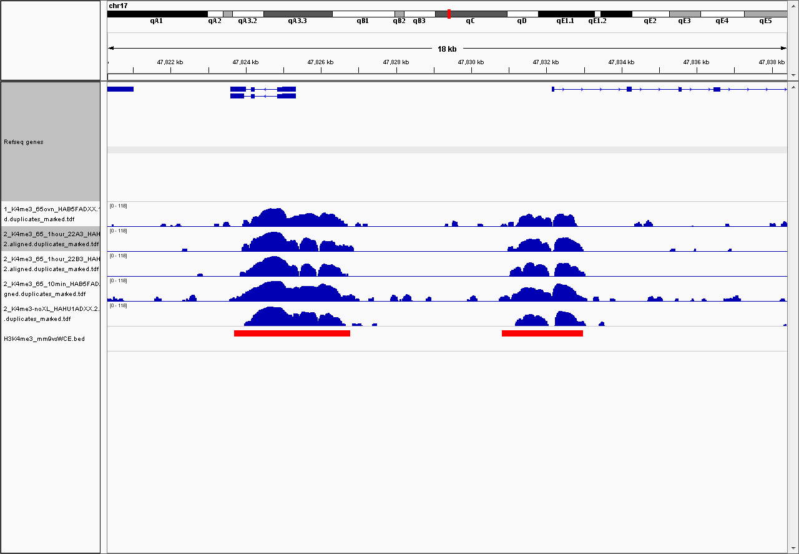
What data looks like

Slide 9
We will not build another peak calling algorithm
Peak
Not Peak

Slide 10
Room for improvement
Challenges in current state
Wild west of antibodies
Inconsistent experimental design
Low standard for whether an experiment “worked”

Slide 11
Antibody variability
Antibodies vary in specificity to target (i.e. may bind to different pieces)
Can also vary by lot
e.g. the current Ezh2 lot rumored to not work
Minimal information to reproduce results often not included in methods section
e.g. concentration of antibody)
Results will not reproduce between labs or between experiments within the same lab

Slide 12
Antibody variability
Example:
Looked at 3 brands of antibodies for H3K27ac
Active Polyclonal
Active Monoclonal
Cell Signaling Monoclonal

Slide 13
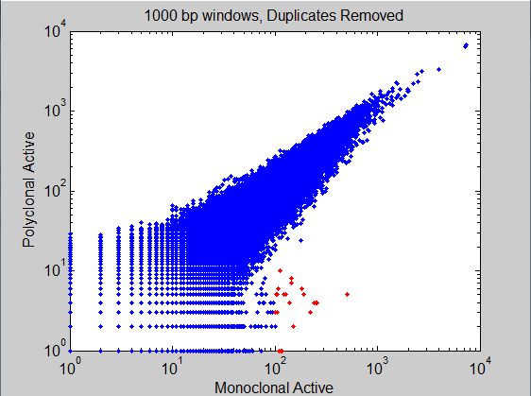
H2K27ac in HeLa Outliers: same brand, different antibodies

Slide 14
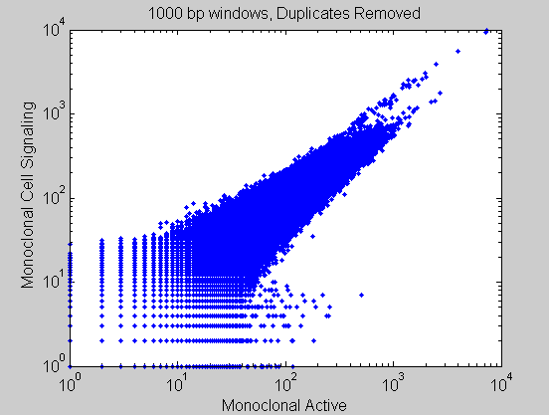
H2K27ac in HeLa Outliers, two populations, different brands

Slide 15
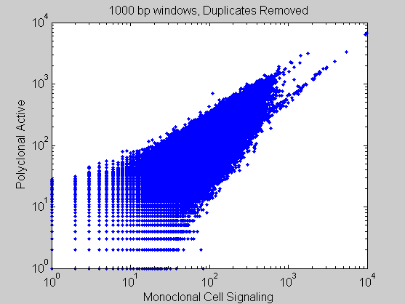
H2K27ac in HeLa Dispersion, two populations, different brands

Slide 16
Inconsistent experimental design
Basic questions not answered
e.g. How many reads do I need?

Slide 17
A principled approach
Take a complex process
List all sources of variability
Rate by variability levels & solving difficulty
Prioritize by ratings
Obviously, attack biggest hit & lowest effort first.

Slide 18
Reasons
Hundreds of CHiP seq datasets have been generated
These basic methods experiments have not been done
BTL will offer:
Cheaper results with optimized methods
Reproducible results

Slide 19
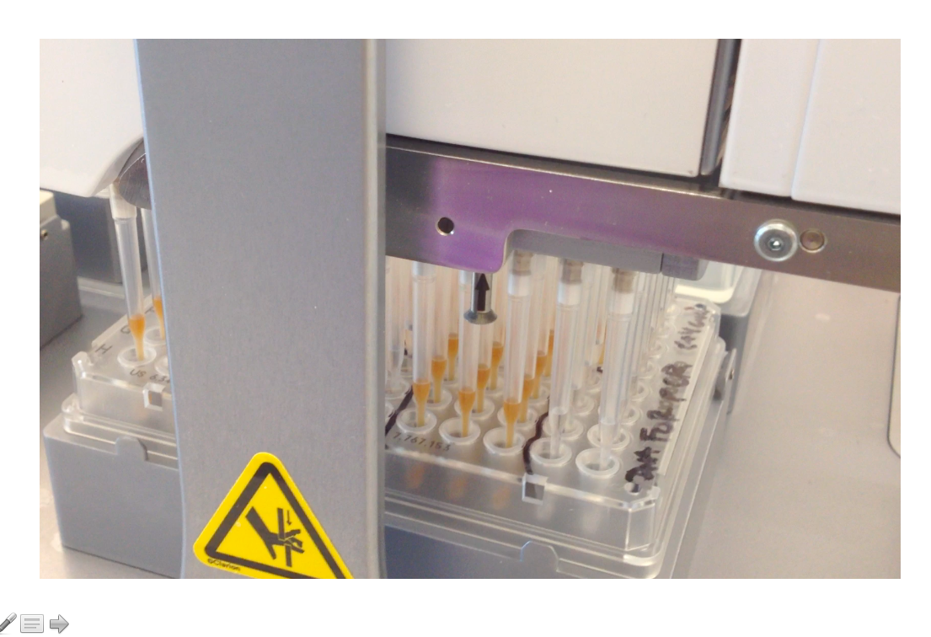
Establishment of robustness by automation

Slide 20
Isolating Sources of Variability
The antibody

Slide 21
Monoclonal vs Polyclonal
Polyclonal Monoclonal
Commonly used Less prevalent
Raised in individual animals Raised from cell line
Each lot requires validation Single validation
Finite resource Same antibody can be reordered
Question:
Can monoclonal antibodies replace polyclonal antibodies?

Slide 22
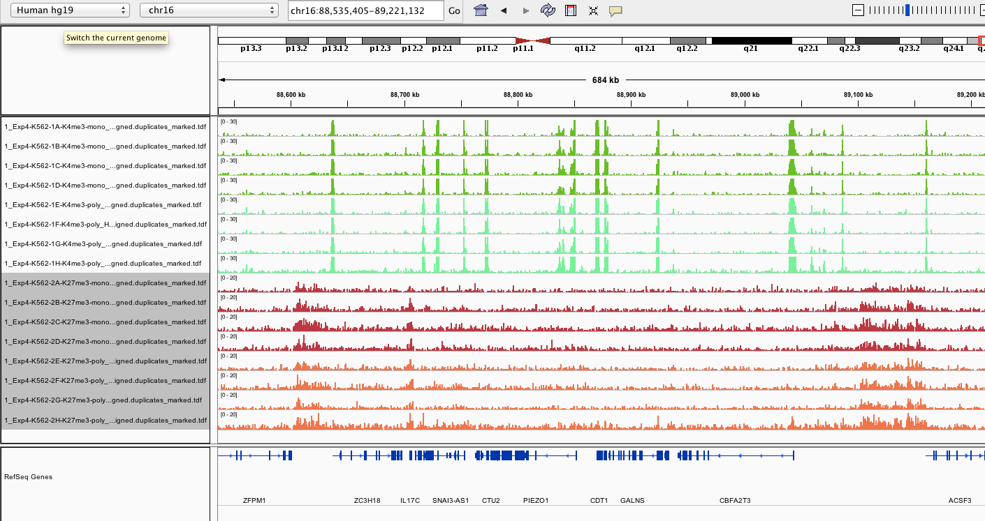
Systematic evaluation of monoclonal antibodies and reproducibility
H3K4me3
monoclonal
H3K4me3
polyclonal
H3K27me3
monoclonal
H3K27me3
polyclonal

Slide 23
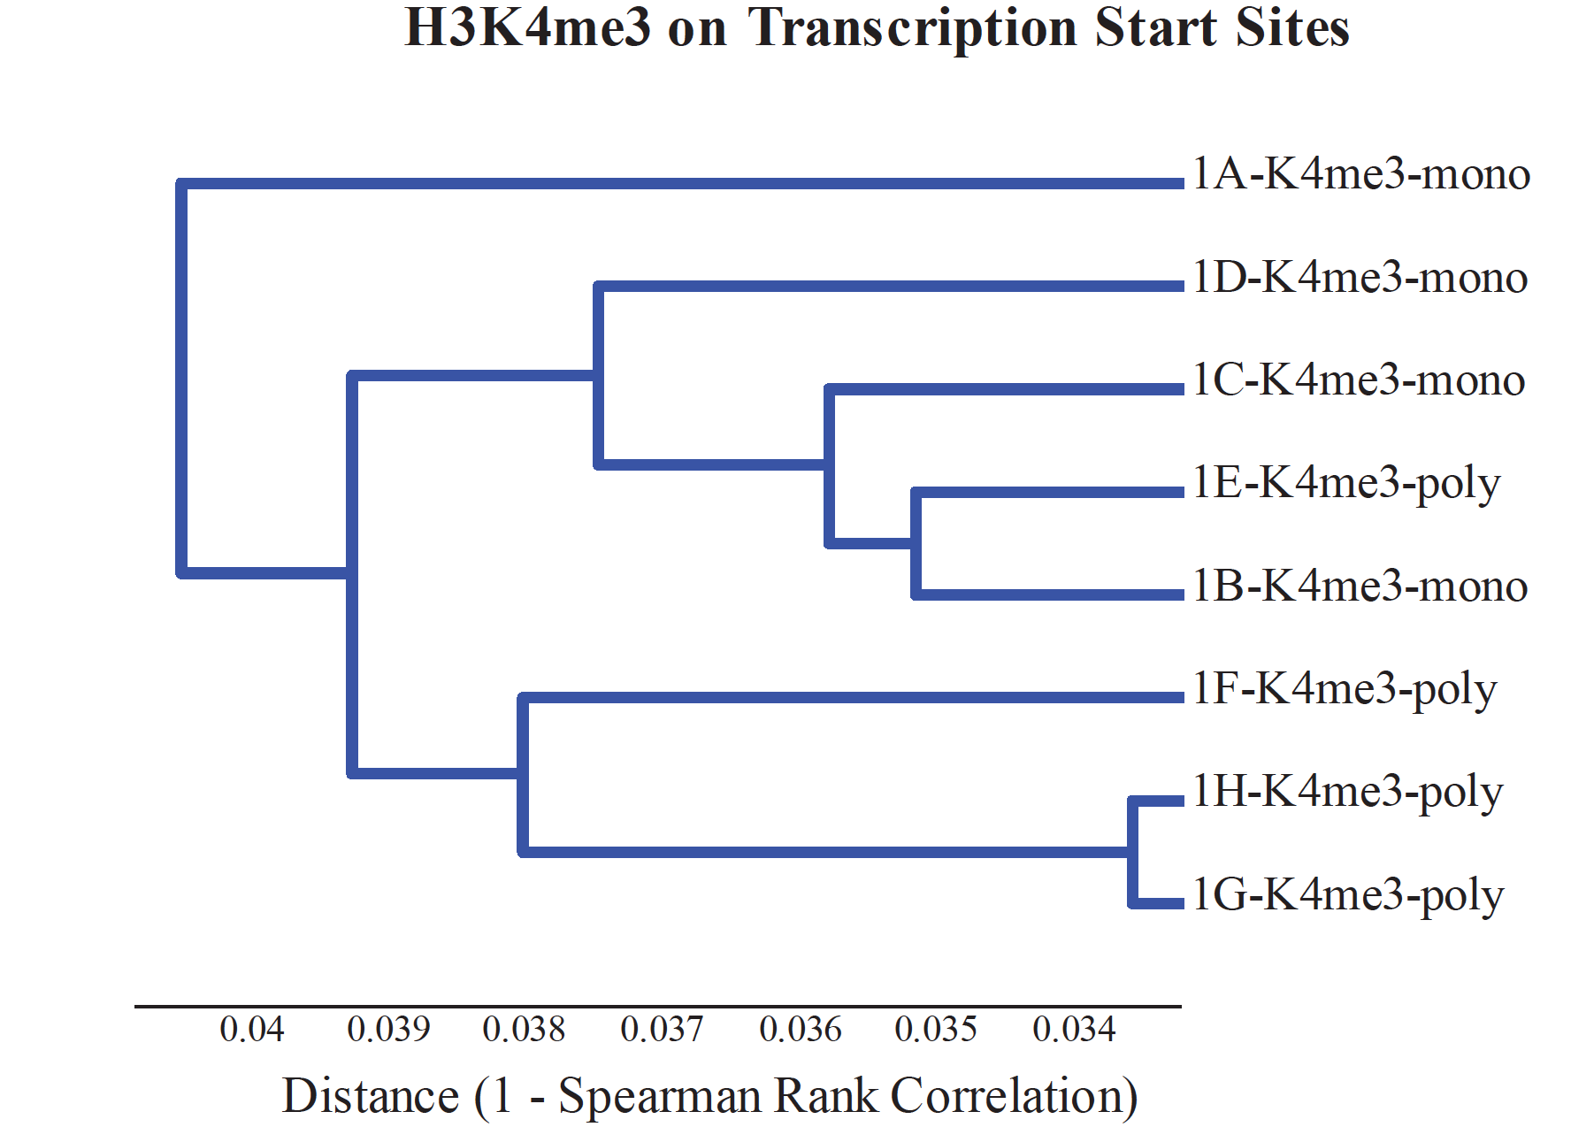
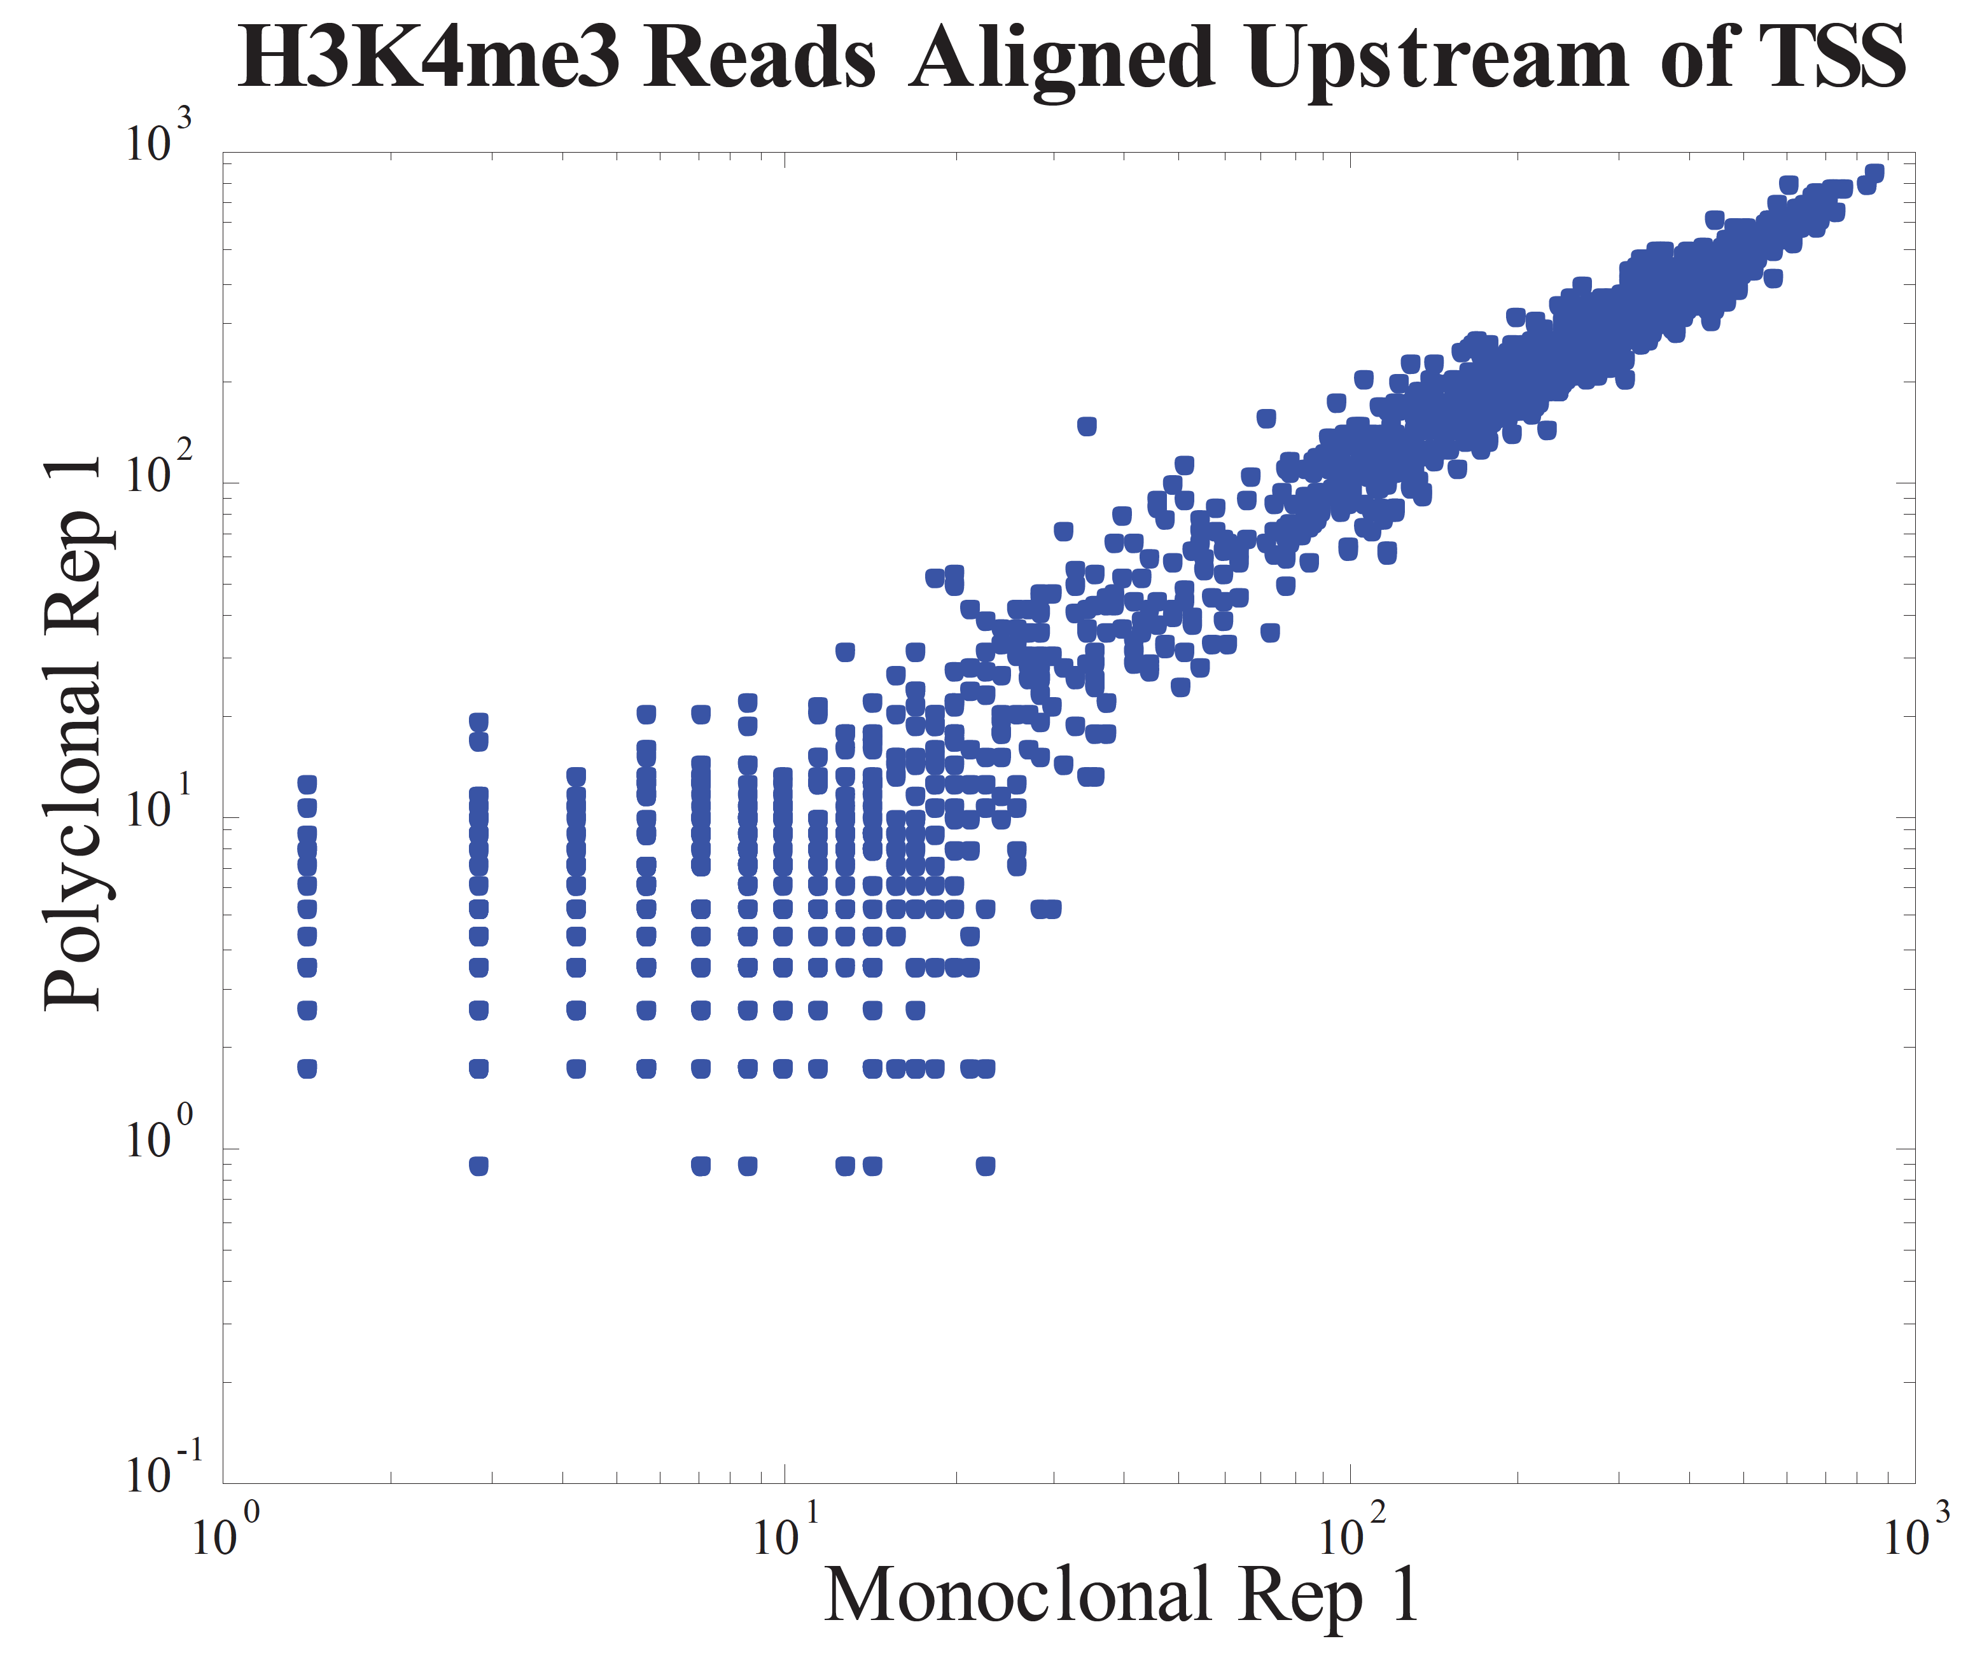
Monoclonal vs Polyclonal : Evaluation of K4me3

Slide 24
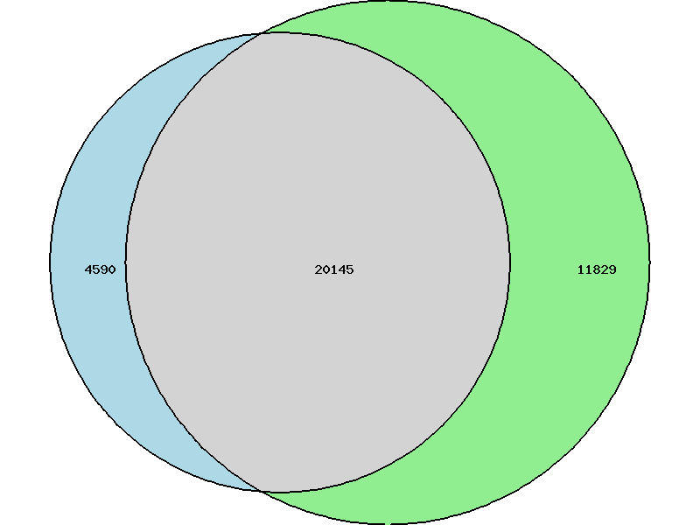
Overlap of peaks H3K4me3
Monoclonal
Polyclonal

Slide 25
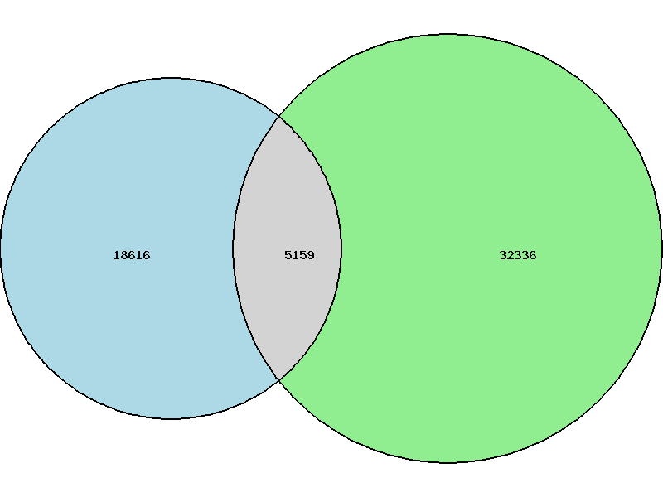
Overlap of peaks H3K27me3
Polyclonal
Monoclonal

Slide 26
Calling peaks is hard if data is noisy
H3K4me3
monoclonal
H3K4me3
polyclonal
H3K27me3
monoclonal
H3K27me3
polyclonal

Slide 27
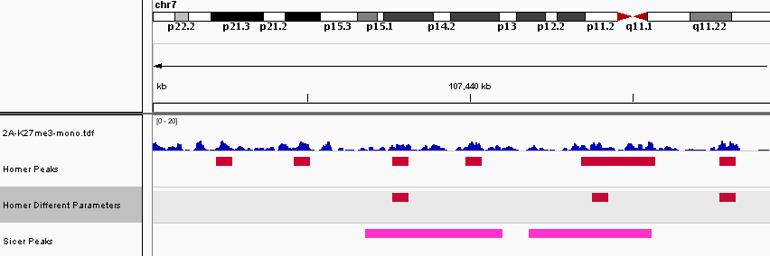
Calling peaks is hard if data is noisy: Peak callers disagree

Slide 28
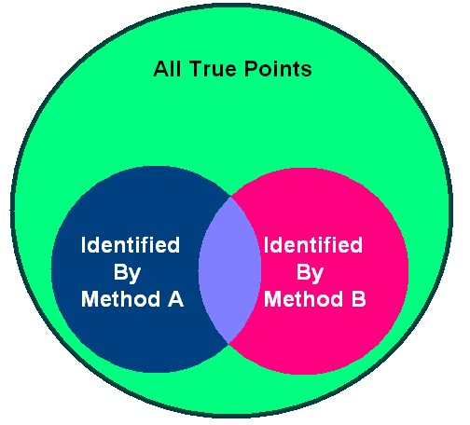
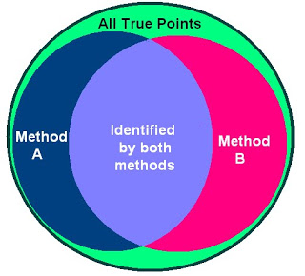
Underpowered data make good methods look bad
Different accurate statistical methods will call different peaks

Slide 29

Options
Typical approach:
Improve algorithms
Expensive (1-2 years labor)
Improvements are likely to be marginal
Difficult to tell if algorithms make the data tell a better biological story or just shift biases around
BTL approach
Improve data
You have better data

Slide 30
Metric to quantify quality of data
Signal to noise ratio:
Create “truth” set of data
e.g. combine many datasets, use public data
Call peaks on truth set
For our data, calculate
% of total reads that fall into “true” peaks

Slide 31
Isolating Sources of Variability
How much antibody to put in

Slide 32
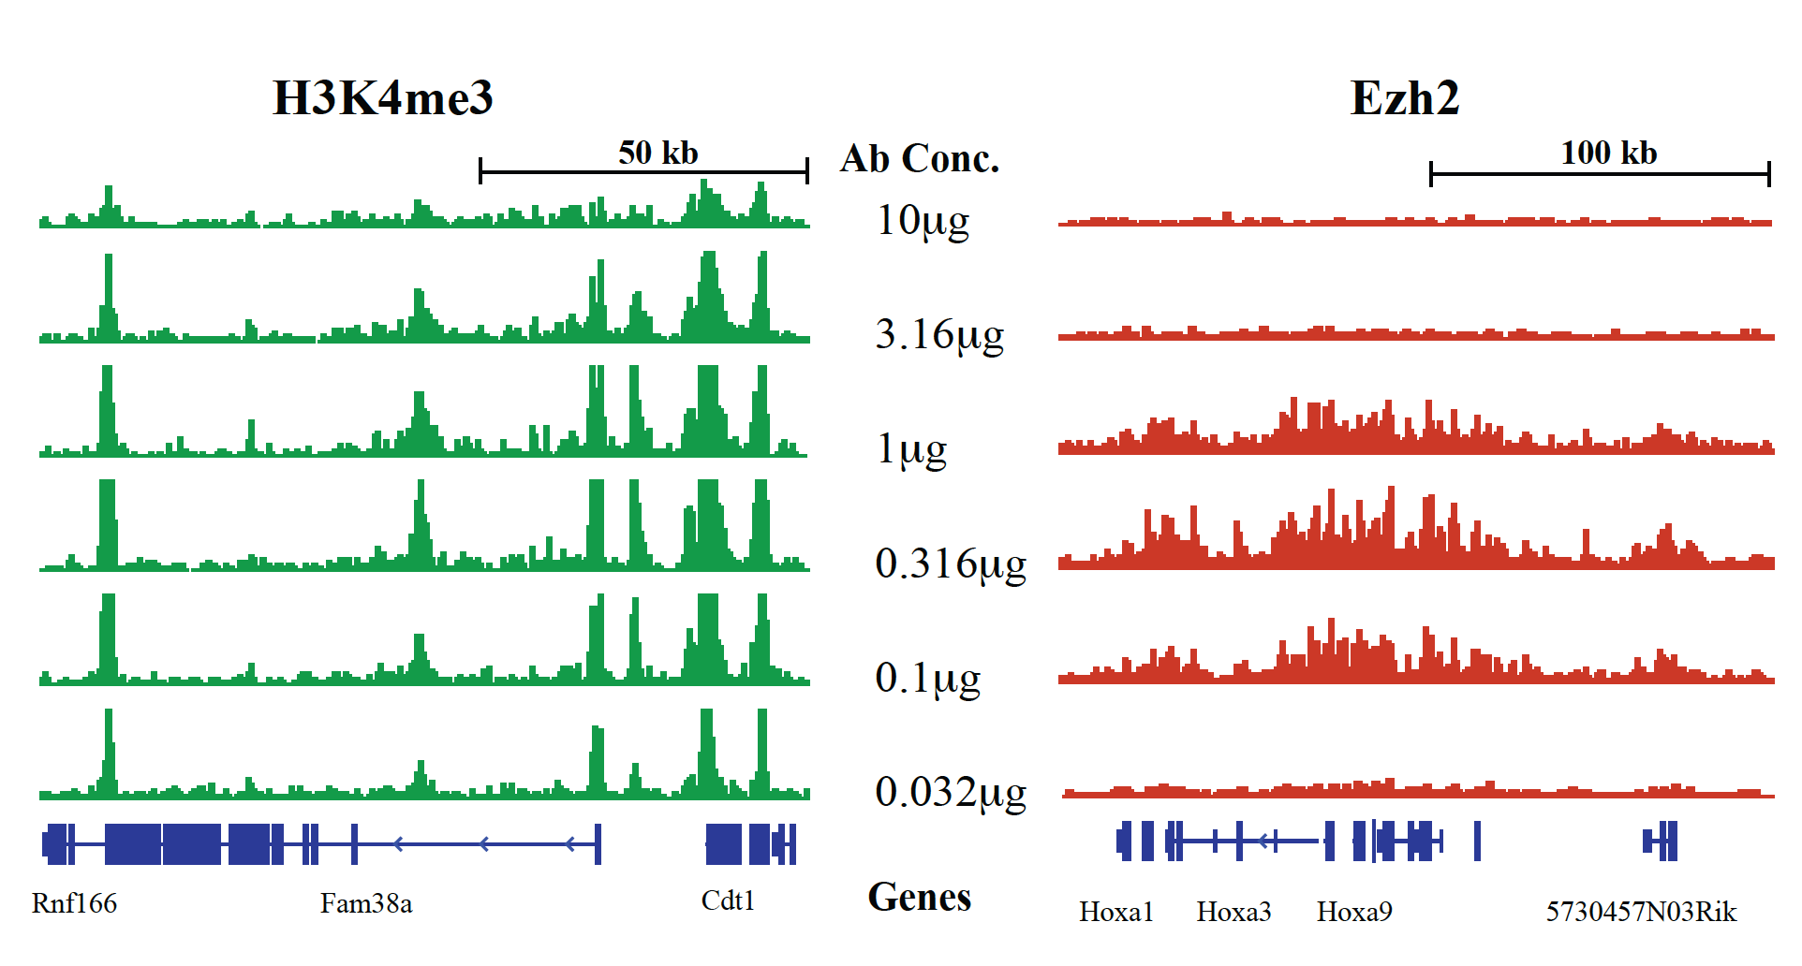
Antibody Concentration
Signal to Noise Measured as the % of Reads Falling in Peaks
Worst Best Change
Ezh2 0.6% (3.16ug) 1.0% (0.316ug) 151%
H3K4me3 14.9% (0.032ug) 31.4% (0.316ug) 211%

Slide 33
Isolating Sources of Variability
Crosslinking

Slide 34
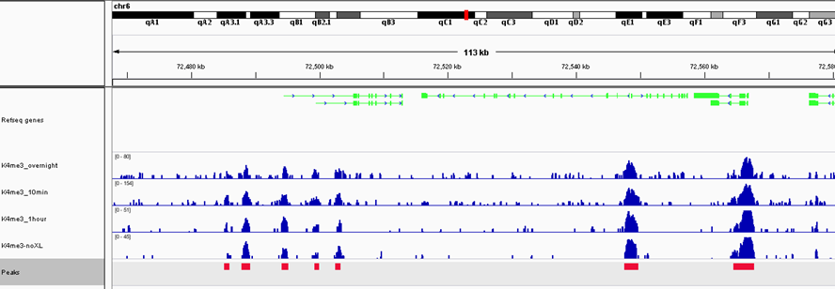
Optimization of cross-linking time
Percentage of Reads in Peaks
 | H3K4me3 | H3K27me3
Overnight | 27% | 2.3%
1 hour | 47% | 1.8%
10 min | 40% | 2.9%
None | 51% | 2.1%

Slide 35
Theory of why this happens
Real bound fragments will be preferentially crosslinked to proteins.
These will be bigger
Have more positive charge
Preferentially pulled out during SPRI cleanup step
With Eli Zhang

Slide 36
But don’t we need to reverse the cross linking so the PCR amplification will work?
It does not appear so.
The PCR amplification heats up the sample several times which appears to be enough to reverse the crosslinking and allow the polymerase to go along the DNA without the cross linked proteins getting in the way.
No crosslinking=cheaper and better

Slide 37
Isolating Sources of Variability
How much to sequence

Slide 38
How deep to sequence?
What are your goals?
Calling peaks in a single sample
(fairly straightforward)
Calling differential peaks
(more complicated)

Slide 39
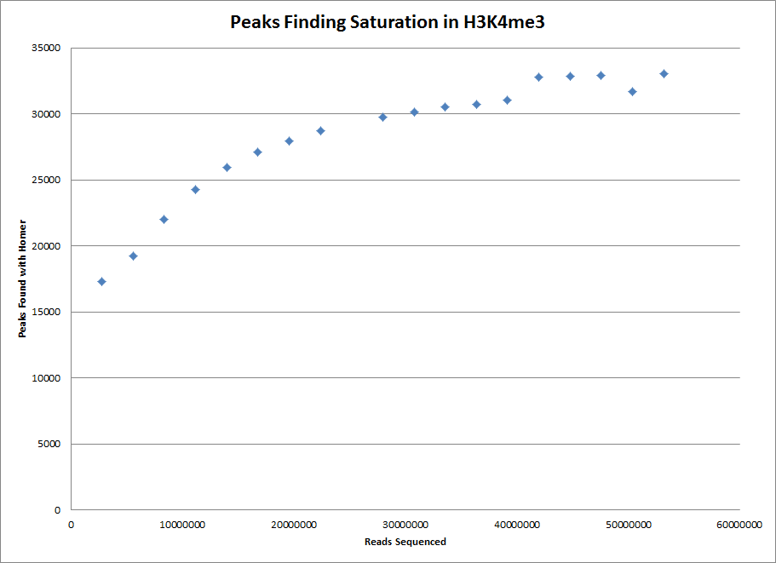
How deep to sequence?

Slide 40
Will vary by epitope e.g. % of the genome covered by histone mark
H3K4me3
monoclonal
H3K4me3
polyclonal
H3K27me3
monoclonal
H3K27me3
polyclonal

Slide 41
Differential peak calling

Slide 42
Existing Approaches
Naïvely calling peaks in both datasets will fail
Peaks may not be called because they are below threshold of the caller
Does not give biological evidence that a peak is not present
One stage approaches:
HMMs etc.
Two stage approaches:
Call peaks in both dataset
Quantify the number of reads within the peaks in each condition
Test for number of reads for statistical differences

Slide 43
Existing Approaches
Problem not solved yet
Focusing on two-stage approaches
Statistics are more tractable
Can repurpose what we know about RNA-Seq (maybe)
Most one-stage approaches do not take replicates into account indicating that the authors fundamentally misunderstood the problem

Slide 44
Statistical analysis to determine if differences in counts represent biological differences in peaks:
Reads in Peaks Measurements
 | Replicate 1 | Replicate 2 | Replicate 3 | Mean
Control | 12 | 14 | 19 | 15
Test | 12 | 41 | 7 | 20
Complications:
Typically a very low number of replicates (or none!)
Read counts can also be low

Slide 45
Increase certainty of measurement with more data

Slide 46
Counting noise a.k.a. shot noise, Poisson noise
1 versus 2
is less certain than
10 versus 20
is less certain than
100 versus 200

Slide 47
Isolating other sources of variance
Library Prep and Sequencing
Technical Rep 1
Library Prep and Sequencing
Technical Rep 2
Library Prep and Sequencing
Biological Rep 1
Library Prep and Sequencing
Biological Rep 2

Slide 48
Problem: We do not know how much sequencing or how many replicates
We do not know what change in binding is biologically significant
Experimental designs may not have enough data
to detect small changes
Biologically important areas may not be
among the low-hanging fruit

Slide 49
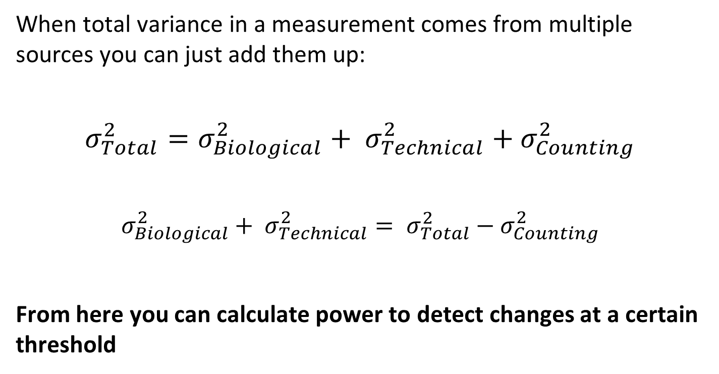
Variance determines how much sequencing you need
When total variance in a measurement comes from multiple sources you can just add them up:
$$σ_{Total}^{2}=σ_{Biological}^{2}+ σ_{Technical}^{2}{+ σ}_{Counting}^{2}$$
$$σ_{Biological}^{2}+ σ_{Technical}^{2}= σ_{Total}^{2}{− σ}_{Counting}^{2}$$
From here you can calculate power to detect changes at a certain threshold

Slide 50
Ways to Increase Certainty: 1) Sequence more reads per sample
Precipitous decrease
in uncertainty

Slide 51
2) Add More Replicates

Slide 52
Add more replicates or sequence existing replicates more deeply?

Slide 53
Add more replicates or sequence existing replicates more deeply?

Slide 54

Why not just have millions of replicates with one read each?
Cost of adding another sample (obtaining sample, library preparation)
Especially in ChIP Seq
Much of the cost is ChIP (antibody, etc.) and library prep
A lot of the noise is counting noise which can be ameliorated with deeper sequencing

Slide 55
We know…
At a fixed cost an
optimal design exists

Slide 56
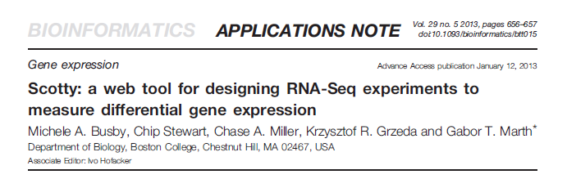
Can’t I just…
Use Scotty?

Slide 57
Will RNA Seq methods work?
We use parametric statistics
Assume that a data fits some distribution
Assumptions are never absolutely true but they need to be close enough not to cause problems in statistics
Main Assumption for Scotty
Repeated measurements of a peak in replicates will form a normal distribution

Slide 58
Will RNA Seq methods work?
Need data:
Option 1:
Ask Chad if we can sequence ~500 replicates of the same exact sample
Option 2:
Encode data
CTCF transcription factor
Has the largest dataset as far as I could tell
Sequenced 29 cell line samples in duplicate (1000 Genome Project samples)
Extrapolate if true for CTCF true for everything

Slide 59
Too small to conclusively test whether a normal distribution
Looks kind of lognormal

Slide 60
T-test results look bad
Looks kind of lognormal

Slide 61
Variability between biological replicates (similar to RNA Seq)
64 16 4 0 4 16 64
Fold change between replicates

Slide 62
Confounders
We did not run the data
Large dataset, probably some batch effects
Single end, outliers could be amplification artifacts (cannot remove duplicates)
Outliers could be caused by SNVs (this we can test for)

Slide 63
Conclusions
Optimize lab protocols
Run paired end data
Plan your experiments with a stat person

Slide 64
Rag on encode
State of the art -
these experiments not done
Lots of data run
Wild west of antibodies
Inconsistency between samples
Look at Encode K27me3
% of reads per peaks (benchmark is low)
More reads per peaks?
Apply model, how little power?

Slide 65
Acknowledgments
Chuck
Yossi
Catherine Yi
Cathy

