Slide 1
Designing RNA-Seq Differential Expression Experiments
Michele Busby, PhD
Computational Biologist

Slide 2
To consult the statistician after an experiment is finished is often merely to ask him to conduct a post mortem examination.
He can perhaps say what the experiment died of.
-R.A. Fisher

Slide 3
Why do replicates?
I did it once.
I did it again.
I got the same
answer!

Slide 4
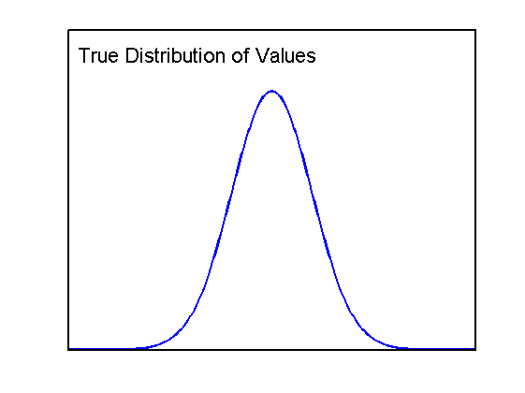



RNA counts change with repeated measurements

Slide 5
Sample from multiple replicates
X
X
X
X
X
X
X
X
X

Slide 6
Replicates reduce uncertainty about the mean
Not certain
Fairly certain

Slide 7
Statistical Analysis
Statistical analysis to determine if differences in counts represent biological differences in expression:
Gene Measurements
 | Replicate 1 | Replicate 2 | Replicate 3 | Mean
Control | 12 | 14 | 19 | 15
Test | 12 | 41 | 7 | 20

Slide 8
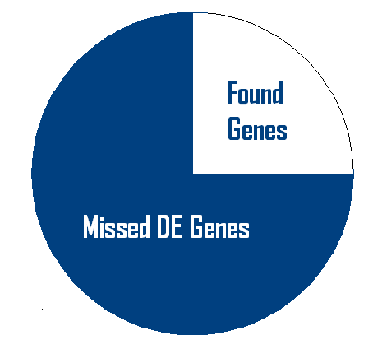
Underpowered studies miss important genes
If you do not have adequate power you can expect to miss the gene you looking for
Example:
Assume that gene expressions of
fold changes of 1.5x can be biologically
Important
If you use 3 replicates of typical samples you will fail to detect >75% of genes which have a true 1.5X fold changes
Calculations of cost should weigh opportunity cost (the cost of missing the gene)

Slide 9
Lower powered studies have higher false discovery rates
Measure expression levels for 30,000 genes
At p<0.01 you will incorrectly call 300 differentially expressed
30000 x 0.01 = 300
Identify 400 DE genes -> FDR = 300/400 = 75%
Identify 3,000 DE genes -> FDR = 300/3000 = 10%
Mostly
Nonsense
Mostly
Science

Slide 10
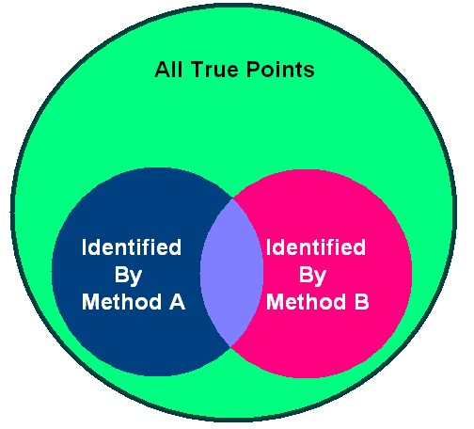
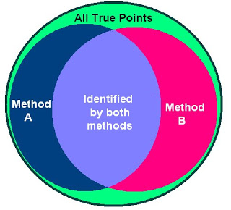
Under powered datasets cost more to analyze
Different accurate statistical methods will call different genes DE
Findings are not robust, adds cost to downstream analysis

Slide 11
Low powered studies are not easily reproduced
Low power studies whose findings are correct are expected to fail to replicate if repeated exactly
Example:
You detected a gene as differentially expressed in an experiment that had a 20% power to detect that difference. If someone repeats your experiment exactly the odds are that they will not detect that gene again

Slide 12
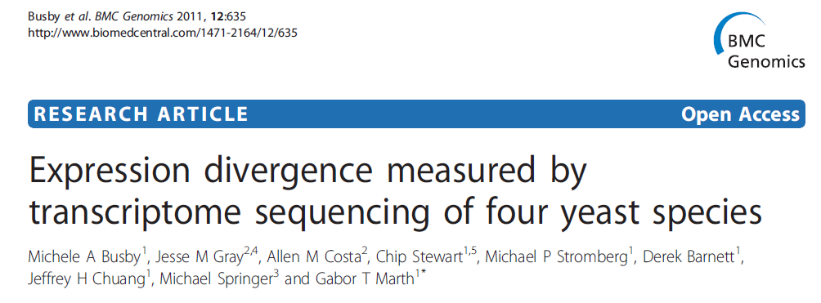
Our Application
Born out of working on a project which had insufficient data

Slide 13


Our Application Boston College, Gabor Marth’s Lab
Answer the user questions:
How many replicates do I need to sequence?
How many reads do I need to sequence for each replicate?
You need more power!
Scotty

Slide 14
Begin with a tractable model
Look at genes, not transcripts
Look at 1 gene across 2 conditions
not 2 different genes in 1 condition (harder)
Ignore reads that cannot be aligned to one position in the genome

Slide 15
Begin with a tractable model
Ignore gene length:
Assume gene length = 100
Same read depths in all samples
Condition 1 Condition 2
Counts 5 10 6 4 15 8
Rates 0.05 0.1 0.06 0.04 0.15 0.08
Rates and counts can be considered equivalent because we are
dividing both sides by a constant.

Slide 16
Statistical model
What are the
sources of
uncertainty
in an RNA Seq
experiment?

Slide 17
Log-log plots of expression counts

Slide 18
Counting noise a.k.a. shot noise, Poisson noise
1 versus 2
is less certain than
10 versus 20
is less certain than
100 versus 200

Slide 19
Log-log plot of counting noise

Slide 20
Isolating other sources of variance
Library Prep and Sequencing
Technical Rep 1
Library Prep and Sequencing
Technical Rep 2
Library Prep and Sequencing
Biological Rep 1
Library Prep and Sequencing
Biological Rep 2

Slide 21
Technical Variance
PCR Amplification, machine error, etc.
Different genes have different degrees of measurement error
PCR Amplification, machine error, etc.
Different genes have different degrees of measurement error

Slide 22
Biological variance
“Real” variance
Genes responding to their environment
(e.g. temperature)
May be genetic differences between subjects
Also gene-specific

Slide 23
Contributions of different types of variance

Slide 24
Contributions of different sorts of variance

Slide 25
Ways to Increase Certainty: 1) Sequence more reads per sample
Precipitous decrease
in uncertainty

Slide 26
Ways to Increase Certainty: 1) Sequence more reads per sample
 | Replicate 1 | Replicate 2 | Replicate 3 | Mean
Control | 12 | 14 | 19 | 15
Test | 12 | 41 | 7 | 20
 | Replicate 1 | Replicate 2 | Replicate 3 | Mean
Control | 22 | 26 | 38 | 30
Test | 23 | 82 | 15 | 41
Theoretical doubling of reads

Slide 27
2) Add More Replicates

Slide 28
Add more replicates or sequence existing replicates more deeply?

Slide 29
Add more replicates or sequence existing replicates more deeply?

Slide 30

Why not just have millions of replicates with one read each?
Cost of adding another sample (obtaining sample, library preparation)
Possibility of introducing more variance into the experiment if you have more replicates than you can control the environment for

Slide 31
Scotty Software
Web-based power analysis for RNA-Seq
Finds the optimal design for an experiment based on user-specified constraints:
Budget
Required Power

Slide 32
Scotty Software
Power to detect differential gene expression is determined by two attributes:
How quickly new transcripts are quantified (Poisson noise)
How much variance is present between replicates (biological and technical variance)
Estimate these parameters based on a pilot dataset
Use this information to predict the power for a number of possible experiments

Slide 33
Why pilot data?

Slide 34
Why pilot data?

Slide 35
Calculate Power for a Matrix of Configurations
Test: does each configuration meet user requirements?
Increasing
Number
Replicates
Increasing Read Depth

Slide 36
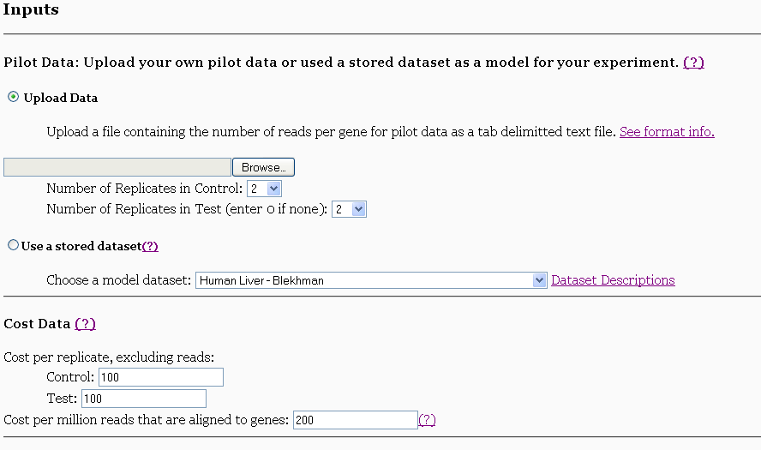
Scotty http://euler.bc.edu/marthlab/scotty/scotty.php

Slide 37
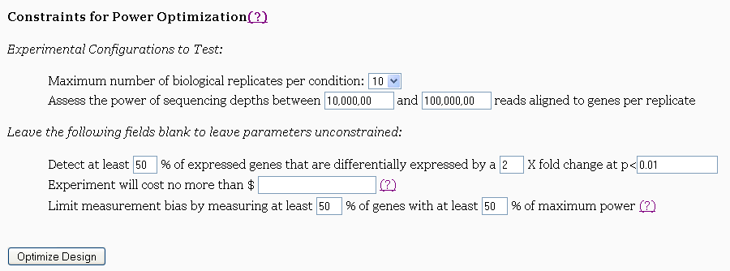
Scotty

Slide 38
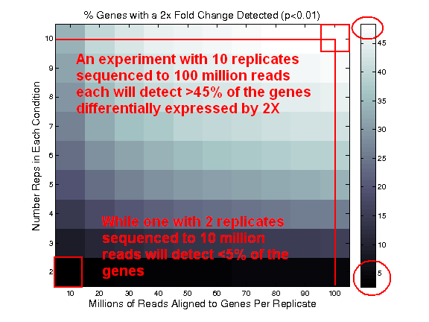
Scotty

Slide 39
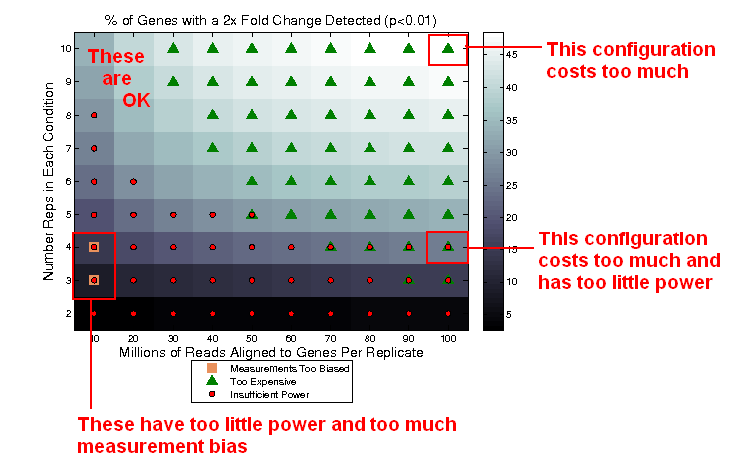
Scotty

Slide 40
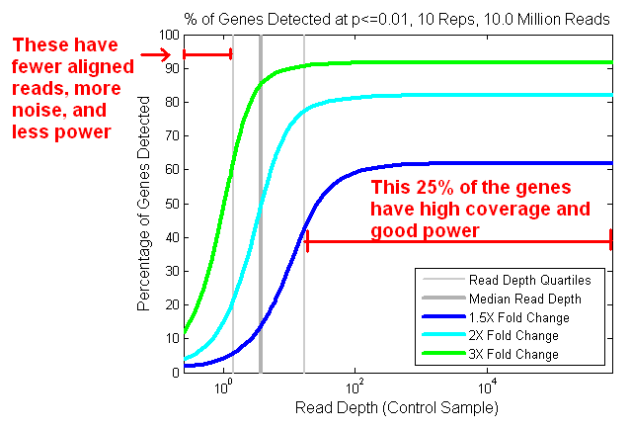
Scotty

Slide 41
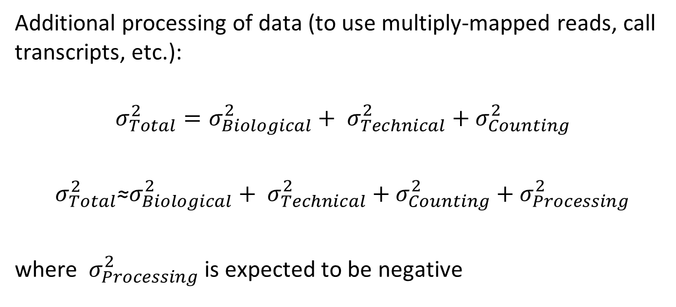
Extending the Model
Additional processing of data (to use multiply-mapped reads, call transcripts, etc.):
$$σ_{Total}^{2}=σ_{Biological}^{2}+ σ_{Technical}^{2}{+ σ}_{Counting}^{2}$$
$σ_{Total}^{2}\text{≈}σ_{Biological}^{2}+ σ_{Technical}^{2}{+ σ}_{Counting}^{2}$ ${+ σ}_{Processing}^{2}$
where ${ σ}_{Processing}^{2}$ is expected to be negative

Slide 42
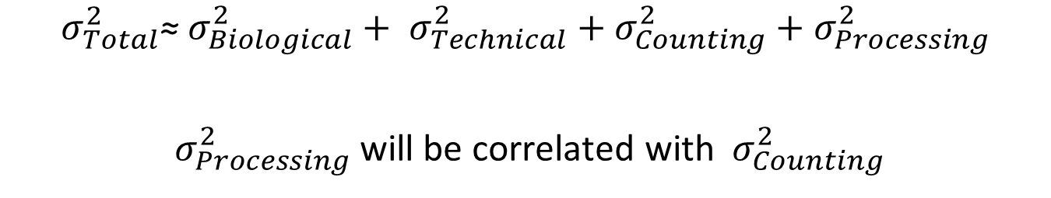
Extending the Model
$σ_{Total}^{2}\text{≈} σ_{Biological}^{2}+ σ_{Technical}^{2}{+ σ}_{Counting}^{2}$ ${+ σ}_{Processing}^{2}$
${ σ}_{Processing}^{2}$ will be correlated with ${ σ}_{Counting}^{2}$
Technique-
specific
Need deep
pilot data
Increasing
Number
Replicates
WORKS
BREAKS
Increasing Read Depth

Slide 43
How many replicates should we have had?
To calculate DE genes in our yeast experiment (p<0.01):
Your results will vary.
 | 50% | 75% | 99%
3X | 4 | 6 | 11
2X | 6 | 8 | 21
1.5X | 13 | 19 | 45

Slide 44
Conclusions
Optimize protocols to maximize quantification, reduce variance between replicates
Perform power analysis before you perform your experiment
Scotty can help and so can we
Consider all the costs of your experiment
Cost of experiment
Cost of analysis
Opportunity cost (often the highest cost)
Report the False Discovery Rate
Report the power of your experiment

Slide 45

Acknowledgments
Boston College
Gabor Marth
Chip Stewart
Krzysztof R. Grzeda
Chase Miller
Derek Barnett
Tony Schreiner
Kourosh Zarringhalam
Broad Institute
Joshua Levin
Xian Adiconis
Christian Matranga
Diego Borges-Rivera
Georgia Giannoukos
Chip Stewart
Aviv Regev

