Slide 1

Scotty: Power Analysis for RNA Seq
Michele Busby, PhD
Computational Biologist

Slide 2
Outline
Background
What is RNA?
What is differential gene expression?
How does RNA-Seq measure differential expression?
Our software for designing RNA-Seq experiments
Our statistical model
Sources of variance in measurements
Statistical model for predicting power

Slide 3
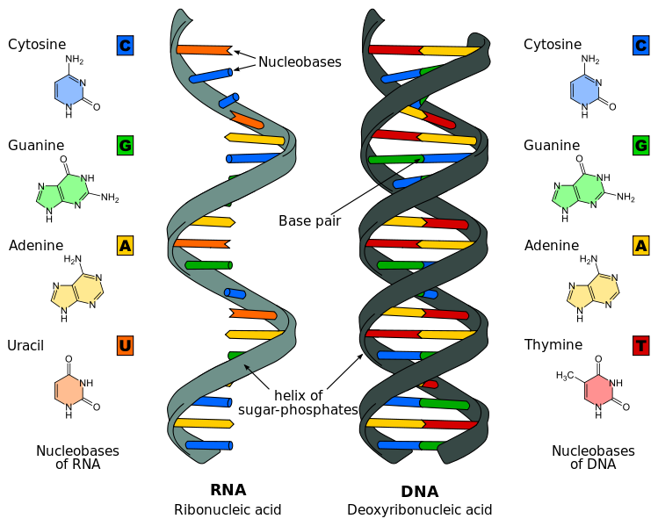
What is RNA?
Image Source: Wikipedia

Slide 4
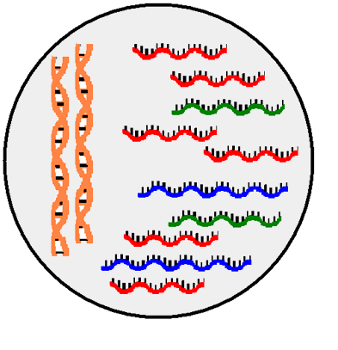
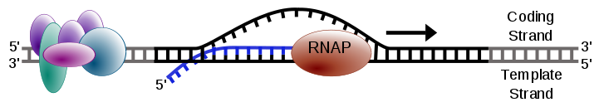
Biology’s Central Dogma
DNA makes RNA

Slide 5
Biology’s Central Dogma
RNA does stuff in the cell
RNA can be translated into a protein
RNAs act on their own, e.g. small RNAs can bind to other RNAs and cause them to be degraded

Slide 6
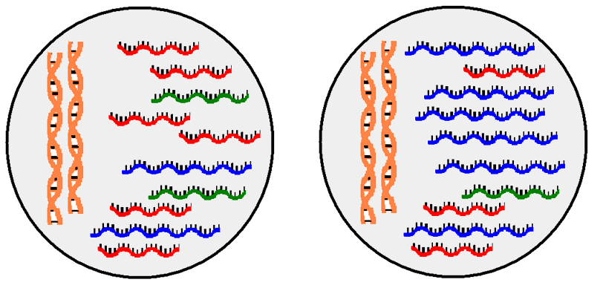
Understanding Biology 20-25K genes in the human genome
Condition One
Condition Two

Slide 7
Examples of experiments
Yeast grown under different conditions
e.g. what genes are on when yeast is fermenting wine versus aerobic growth in bread
What genes are expressed in different tissues
e.g. liver versus kidney
Expression before and after exposure to a chemical
e.g. response to a medication
Gene expression changes in a disease state
e.g. normal versus tumor tissue
Over one million samples of RNA microarray datasets are now available within public databases
Baker, M. (2012) Gene data to hit milestone, Nature, 487, 282-283.

Slide 8
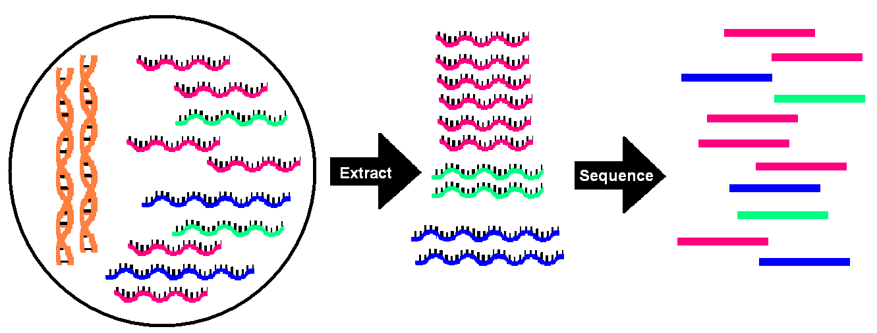
Quantifying RNA through RNA Sequencing
RNA Sequencing:
GTCTCCGGGGGCTGGGGGAACCAGGGTTTCCCACCAACCACCCTCA

Slide 9
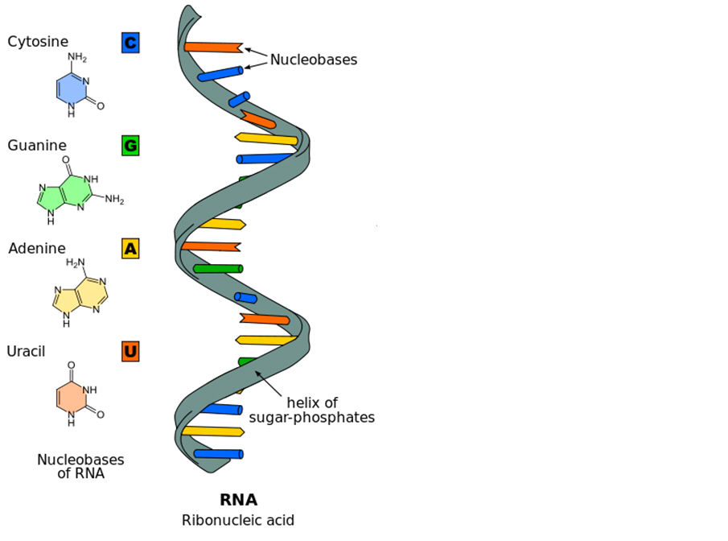
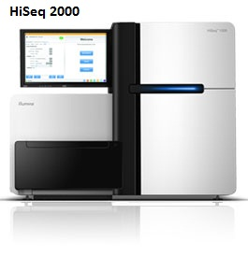

Sequencing RNA
RNA Sequence:
UCCUACGGAUGCUAGU…

Slide 10
Data Produced by Sequencing Machines
FASTQ File (typically 10-100 million records):
@A222C121216:1:2108:28062:13057/1
GTCTCCGGGGGCTGGGGGAACCAGGGTTTCCCACCAACCACCCTCACTCAGCCTTTTCCCTCCAGGCATCTCTGGG
+
A????BABDDBDDDDDFCCEFFIHHHFFEHIIIHHIIHHHIHHIIIIFHHHHFFHHFHFHHHHHHHHFFFDFFFFF
@A222C121216:1:2103:28502:13002/1
AACAAACTACAGCAACACATTTTTCATTTCAGCTTCACTGCTGTGTCTCCCAGTGTAACCCTAGCATCCAGAAGTG
+
????9B?BDDDDDDDDFFCFFFHFHFHHHHHFHHHHHHHHHHHHHHGHHHHFHHGGHGGHHFHFGDHFFHHHHHFH
@A222C121216:1:1104:19681:3061/1
GCTGGAACAGCAGGTCCCAGAGAACTACTTCTATGTGCCAGACCTGGGCCAGGTGCCTGAGATTGATGTTCCATCC
+
?????BBBDDDDDDDDFFFFFFIHIIIFHHIHDHHFGHHIIHHIIB-;DFD,AAEGHIIHIIFIIHHDGGGHGGHF
@A222C121216:1:2104:10550:19343/1
CTTTGTTACAGCACCAGCCAGGGGGTCCAGGAAGACATACTTCTTCTACCTACAGAGGCGACATGGGGGTCAGGCA
+
AAAAABBBDDEDDDDDGGGGGGHDHCFHHFHHFHIHIIIIIIHIIIIHIIIIIIIIIHHHEHHHHIHHDHHHHHGH

Slide 11
Data Produced by Sequencing Machines
FASTQ File:
@A222C121216:1:2108:28062:13057/1
GTCTCCGGGGGCTGGGGGAACCAGGGTTTCCCACCAACCACCCTCACTCAGCCTTTTCCCTCCAGGCATCTCTGGG
+
A????BABDDBDDDDDFCCEFFIHHHFFEHIIIHHIIHHHIHHIIIIFHHHHFFHHFHFHHHHHHHHFFFDFFFFF
@A222C121216:1:2103:28502:13002/1
AACAAACTACAGCAACACATTTTTCATTTCAGCTTCACTGCTGTGTCTCCCAGTGTAACCCTAGCATCCAGAAGTG
+
????9B?BDDDDDDDDFFCFFFHFHFHHHHHFHHHHHHHHHHHHHHGHHHHFHHGGHGGHHFHFGDHFFHHHHHFH
@A222C121216:1:1104:19681:3061/1
GCTGGAACAGCAGGTCCCAGAGAACTACTTCTATGTGCCAGACCTGGGCCAGGTGCCTGAGATTGATGTTCCATCC
+
?????BBBDDDDDDDDFFFFFFIHIIIFHHIHDHHFGHHIIHHIIB-;DFD,AAEGHIIHIIFIIHHDGGGHGGHF
@A222C121216:1:2104:10550:19343/1
CTTTGTTACAGCACCAGCCAGGGGGTCCAGGAAGACATACTTCTTCTACCTACAGAGGCGACATGGGGGTCAGGCA
+
AAAAABBBDDEDDDDDGGGGGGHDHCFHHFHHFHIHIIIIIIHIIIIHIIIIIIIIIHHHEHHHHIHHDHHHHHGH

Slide 12
Data Produced by Sequencing Machines
FASTQ File:
@A222C121216:1:2108:28062:13057/1
GTCTCCGGGGGCTGGGGGAACCAGGGTTTCCCACCAACCACCCTCACTCAGCCTTTTCCCTCCAGGCATCTCTGGG
+
A????BABDDBDDDDDFCCEFFIHHHFFEHIIIHHIIHHHIHHIIIIFHHHHFFHHFHFHHHHHHHHFFFDFFFFF
@A222C121216:1:2103:28502:13002/1
AACAAACTACAGCAACACATTTTTCATTTCAGCTTCACTGCTGTGTCTCCCAGTGTAACCCTAGCATCCAGAAGTG
+
????9B?BDDDDDDDDFFCFFFHFHFHHHHHFHHHHHHHHHHHHHHGHHHHFHHGGHGGHHFHFGDHFFHHHHHFH
@A222C121216:1:1104:19681:3061/1
GCTGGAACAGCAGGTCCCAGAGAACTACTTCTATGTGCCAGACCTGGGCCAGGTGCCTGAGATTGATGTTCCATCC
+
?????BBBDDDDDDDDFFFFFFIHIIIFHHIHDHHFGHHIIHHIIB-;DFD,AAEGHIIHIIFIIHHDGGGHGGHF
@A222C121216:1:2104:10550:19343/1
CTTTGTTACAGCACCAGCCAGGGGGTCCAGGAAGACATACTTCTTCTACCTACAGAGGCGACATGGGGGTCAGGCA
+
AAAAABBBDDEDDDDDGGGGGGHDHCFHHFHHFHIHIIIIIIHIIIIHIIIIIIIIIHHHEHHHHIHHDHHHHHGH

Slide 13
Data Produced by Sequencing Machines
FASTQ File:
@A222C121216:1:2108:28062:13057/1
GTCTCCGGGGGCTGGGGGAACCAGGGTTTCCCACCAACCACCCTCACTCAGCCTTTTCCCTCCAGGCATCTCTGGG
+
A????BABDDBDDDDDFCCEFFIHHHFFEHIIIHHIIHHHIHHIIIIFHHHHFFHHFHFHHHHHHHHFFFDFFFFF
@A222C121216:1:2103:28502:13002/1
AACAAACTACAGCAACACATTTTTCATTTCAGCTTCACTGCTGTGTCTCCCAGTGTAACCCTAGCATCCAGAAGTG
+
????9B?BDDDDDDDDFFCFFFHFHFHHHHHFHHHHHHHHHHHHHHGHHHHFHHGGHGGHHFHFGDHFFHHHHHFH
@A222C121216:1:1104:19681:3061/1
GCTGGAACAGCAGGTCCCAGAGAACTACTTCTATGTGCCAGACCTGGGCCAGGTGCCTGAGATTGATGTTCCATCC
+
?????BBBDDDDDDDDFFFFFFIHIIIFHHIHDHHFGHHIIHHIIB-;DFD,AAEGHIIHIIFIIHHDGGGHGGHF
@A222C121216:1:2104:10550:19343/1
CTTTGTTACAGCACCAGCCAGGGGGTCCAGGAAGACATACTTCTTCTACCTACAGAGGCGACATGGGGGTCAGGCA
+
AAAAABBBDDEDDDDDGGGGGGHDHCFHHFHHFHIHIIIIIIHIIIIHIIIIIIIIIHHHEHHHHIHHDHHHHHGH

Slide 14
Data Produced by Sequencing Machines
FASTQ File:
@A222C121216:1:2108:28062:13057/1
GTCTCCGGGGGCTGGGGGAACCAGGGTTTCCCACCAACCACCCTCACTCAGCCTTTTCCCTCCAGGCATCTCTGGG
+
A????BABDDBDDDDDFCCEFFIHHHFFEHIIIHHIIHHHIHHIIIIFHHHHFFHHFHFHHHHHHHHFFFDFFFFF
@A222C121216:1:2103:28502:13002/1
AACAAACTACAGCAACACATTTTTCATTTCAGCTTCACTGCTGTGTCTCCCAGTGTAACCCTAGCATCCAGAAGTG
+
????9B?BDDDDDDDDFFCFFFHFHFHHHHHFHHHHHHHHHHHHHHGHHHHFHHGGHGGHHFHFGDHFFHHHHHFH
@A222C121216:1:1104:19681:3061/1
GCTGGAACAGCAGGTCCCAGAGAACTACTTCTATGTGCCAGACCTGGGCCAGGTGCCTGAGATTGATGTTCCATCC
+
?????BBBDDDDDDDDFFFFFFIHIIIFHHIHDHHFGHHIIHHIIB-;DFD,AAEGHIIHIIFIIHHDGGGHGGHF
@A222C121216:1:2104:10550:19343/1
CTTTGTTACAGCACCAGCCAGGGGGTCCAGGAAGACATACTTCTTCTACCTACAGAGGCGACATGGGGGTCAGGCA
+
AAAAABBBDDEDDDDDGGGGGGHDHCFHHFHHFHIHIIIIIIHIIIIHIIIIIIIIIHHHEHHHHIHHDHHHHHGH

Slide 15
Sequence Alignment and Quantification
Known RNA Sequence: TCCCGATTTGGGGTTCAAAGCAGTATCGATCTAATAGTAAATCCATTTG
Reads: CCGATTTGGGGTTCAAAGCAGTATCGATCTAATAGTAAATCCA
CGATTTGGGGTTCAAAGCAGTATCGATCTAATAGTAAATCCAT
GATTTGGGGTTCAAAGCAGTATCGATCAAATAGTAAATCCATTTG
TTTGGGGTTCAAAGCAGTATCGATCTAATAGTAAATCCATTTG
GGGTTCAAAGCAGTATCGATCTAATAGTAAATCCATTTG
CGATTTGGGGTTCAAAGCAGTATCGATCTAATAGTAAATCCAT
Basic Quantification:
RNA 1
Reads
7
Counts for thousands of genes at once

Slide 16
Data attributes vary by experiment and sequencing machine
Example of recent experiment at the Broad:
Illumina brand of sequencing machine
17 samples
Two 76 base pair reads per RNA = 154 bases
~20-100 million reads per sample
5-15 GB per sample (as compressed binary file)
RNA
Read

Slide 17
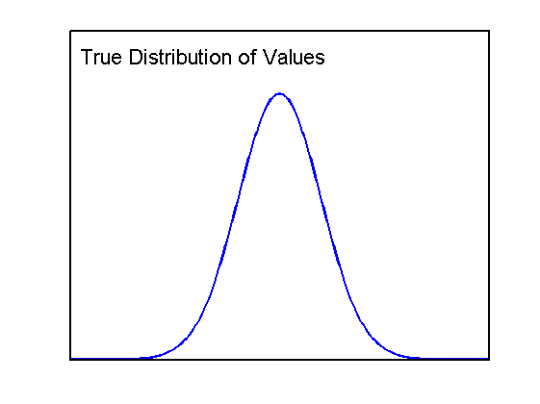



RNA counts change with repeated measurements

Slide 18
Sample from multiple replicates
X
X
X
X
X
X
X
X
X

Slide 19
My Research
Statistical analysis to determine if differences in counts represent biological differences in expression:
Gene Measurements
 | Replicate 1 | Replicate 2 | Replicate 3 | Mean
Control | 12 | 14 | 19 | 15
Test | 12 | 41 | 7 | 20
Complications:
Typically a very low number of replicates (3 is the norm)

Slide 20
Messy lognormal distribution of reads per gene
Most of the reads are take up by a few highly expressed genes

Slide 21
Problem: 3 replicates are not enough
Small changes in gene expression can theoretically have significant impact on the biology
e.g. Canonical models of diseases caused by an extra chromosome
3 chromosomes instead of 2 = 1.5X the expression
Experimental designs do not have enough data
to detect these small changes
Biologically important genes may not be
among the low-hanging fruit

Slide 22
Increase certainty of measurement with more data

Slide 23
Why are small experiments bad?
Miss important genes
Lower power studies have higher false discovery rates:
Type I errors (identifying DE when none exist) are held constant at a given p-values
Fewer truly DE genes are identified
Low power studies whose findings are correct are expected to fail to replicate if repeated exactly
If you only had a 20% chance of finding a gene DE and you repeat the experiment you most likely will not find it again

Slide 24
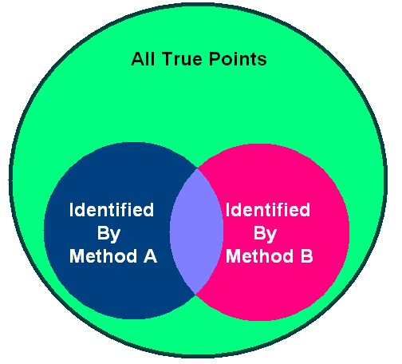
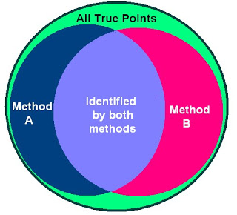
Why are small experiments bad?
Different accurate statistical methods will call different genes DE
Findings are not robust, adds cost to downstream analysis

Slide 25
Why are experiments too small?
Cost
About $650 per replicate for typical sequencing
Additional cost and labor to obtain samples
Culture
Biologists often see replication as a way of confirming a result rather than increasing measurement precision
Cost model of previous technologies was less flexible, made replication more costly. Old experimental designs are still driving the existing model.

Slide 26

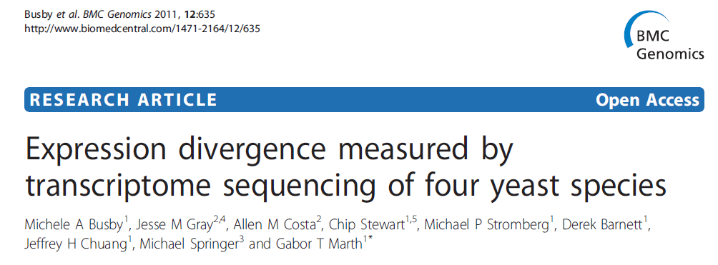
Our Application Boston College, Gabor Marth’s Lab
Born out of working on a project which had insufficient data

Slide 27

Our Application Boston College, Gabor Marth’s Lab
Born out of working on a project which had insufficient data
Answer the user questions:
How many replicates do I need to sequence?
How many reads do I need to sequence for each replicate?
You need more power!
Scotty

Slide 28
Scotty Architecture
PHP
Interface
Compiled
Matlab
Takes Inputs
Processes data
Returns results
Inputs: Pilot data and parameters

Slide 29
Statistical model
What are the
sources of
uncertainty
in an RNA Seq
experiment?

Slide 30
Log-log plots of expression counts

Slide 31
Counting noise a.k.a. shot noise, Poisson noise
1 versus 2
is less certain than
10 versus 20
is less certain than
100 versus 200

Slide 32
Log-log plot of counting noise

Slide 33
Isolating other sources of variance
Library Prep and Sequencing
Technical Rep 1
Library Prep and Sequencing
Technical Rep 2
Library Prep and Sequencing
Biological Rep 1
Library Prep and Sequencing
Biological Rep 2

Slide 34
Technical Variance
PCR Amplification, machine error, etc.
Different genes have different degrees of measurement error
PCR Amplification, machine error, etc.
Different genes have different degrees of measurement error

Slide 35
Biological variance
“Real” variance
Genes responding to their environment
(e.g. temperature)
May be genetic differences between subjects
Also gene-specific

Slide 36
Contributions of Different Types of Variance

Slide 37
Contributions of different sorts of variance

Slide 38
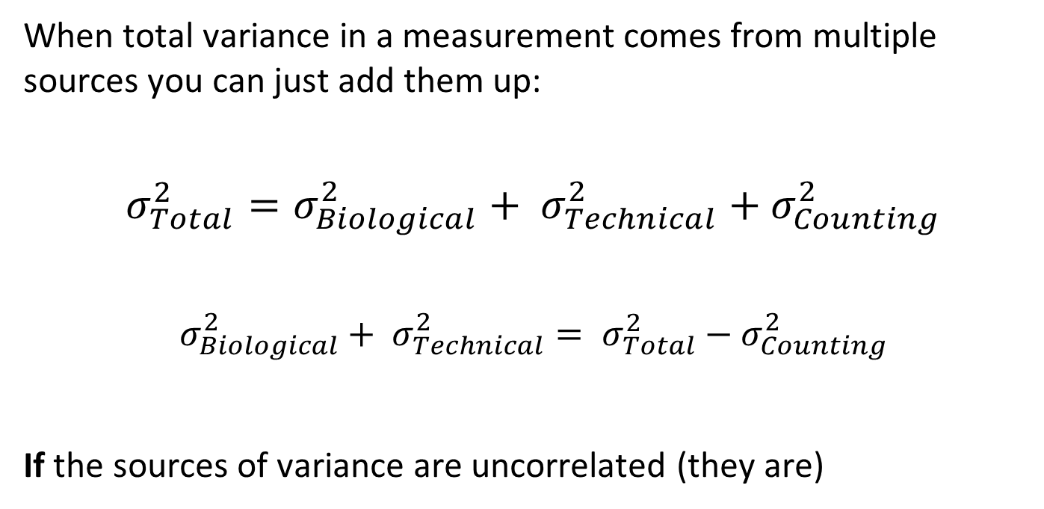
Approach Two statistical tricks: Trick 1
When total variance in a measurement comes from multiple sources you can just add them up:
$$σ_{Total}^{2}=σ_{Biological}^{2}+ σ_{Technical}^{2}{+ σ}_{Counting}^{2}$$
$$σ_{Biological}^{2}+ σ_{Technical}^{2}= σ_{Total}^{2}{− σ}_{Counting}^{2}$$
If the sources of variance are uncorrelated (they are)

Slide 39
Approach Two Statistical Tricks: Trick 2
If you are sampling from a big enough pool count noise can be approximated by a Poisson distribution:
The variance of the Poisson distribution around a count (λ) is λ

Slide 40
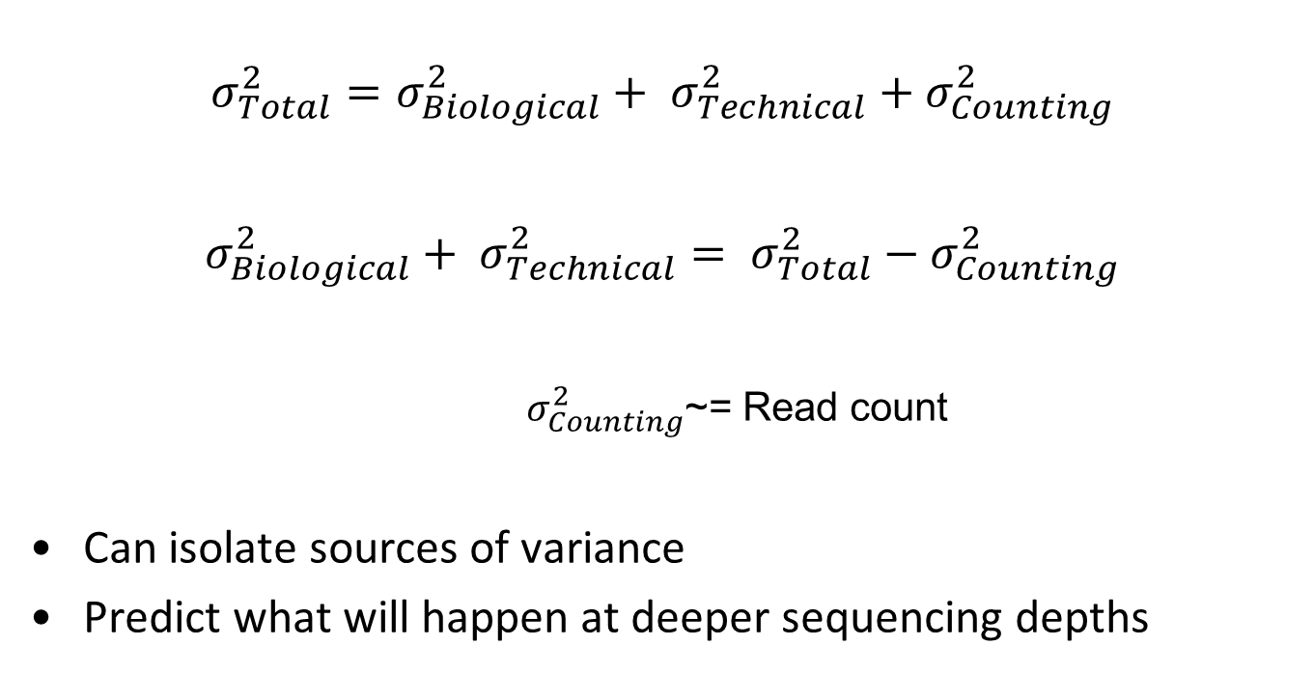
Combining Tricks 1 and 2
$$σ_{Total}^{2}=σ_{Biological}^{2}+ σ_{Technical}^{2}{+ σ}_{Counting}^{2}$$
$$σ_{Biological}^{2}+ σ_{Technical}^{2}= σ_{Total}^{2}{− σ}_{Counting}^{2}$$
${ σ}_{Counting}^{2}$~= Read count
Can isolate sources of variance
Predict what will happen at deeper sequencing depths

Slide 41
Approach Extensive Use of Fake Data
Simulation of RNA-Seq data:
Used Matlab
Modeled counts from different replicates
Simulated biological and technical variance as variables drawn from normal or lognormal distributions (tested both)
Count variance modeled as Poisson
Parameters based on real data

Slide 42
Ways to Increase Certainty: 1) Sequence more reads per sample
Precipitous decrease
in uncertainty

Slide 43
Ways to Increase Certainty: 1) Sequence more reads per sample
 | Replicate 1 | Replicate 2 | Replicate 3 | Mean
Control | 12 | 14 | 19 | 15
Test | 12 | 41 | 7 | 20
 | Replicate 1 | Replicate 2 | Replicate 3 | Mean
Control | 22 | 26 | 38 | 30
Test | 23 | 82 | 15 | 41
Theoretical doubling of reads

Slide 44
2) Add More Replicates

Slide 45
Add more replicates or sequence existing replicates more deeply?

Slide 46
Add more replicates or sequence existing replicates more deeply?

Slide 47

Why not just have millions of replicates with one read each?
Cost of adding another sample (obtaining sample, library preparation)
Possibility of introducing more variance into the experiment if you have more replicates than you can control the environment for

Slide 48
Scotty Software
Web-based power analysis for RNA-Seq
Finds the optimal design for an experiment based on user-specified:
Budget
Experimental goals
Makes a recommendation for the optimal number of reads and number of replicates

Slide 49
Scotty Software
Power to detect differential gene expression is determined by two attributes:
How quickly new transcripts are quantified (Poisson noise)
How much variance is present between replicates (biological and technical variance)
Estimate these parameters based on a pilot dataset
Use this information to predict the power for a number of possible experiments

Slide 50
Why pilot data?

Slide 51
Why pilot data?

Slide 52
Can standard formulas be used to calculate power?
T-test
Derived by William Sealy Gosset in 1908 at the Guiness factory
Accounts for both differences in mean and uncertainty in the estimate of the mean and the variance based on replicate number
Assumes data is distributed as a normal distribution
Could not find large enough datasets to test this definitively but looks normal or lognormal
Formulas are in every textbook to calculate power

Slide 53
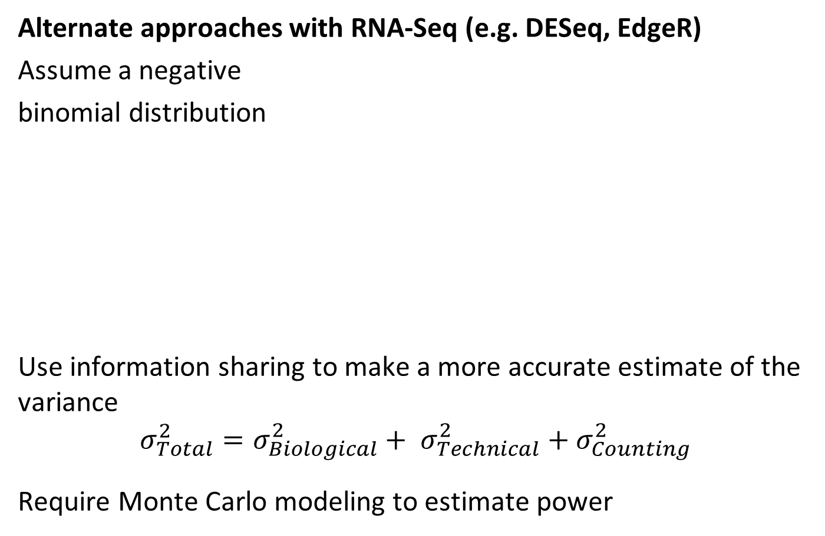
Negative Binomial Tests
Alternate approaches with RNA-Seq (e.g. DESeq, EdgeR)
Assume a negative
binomial distribution
Use information sharing to make a more accurate estimate of the variance
$$σ_{Total}^{2}=σ_{Biological}^{2}+ σ_{Technical}^{2}{+ σ}_{Counting}^{2}$$
Require Monte Carlo modeling to estimate power

Slide 54
Can a t-test be used to call differential expression?

Slide 55
Can a t-test be used to call differential expression?

Slide 56
Conclusions
t-test OK
Simulation experiments showed that the textbook t-test formulas are not very accurate.
Textbooks substitute a normal distribution for a t-distribution
Chokes low number of replicates

Slide 57
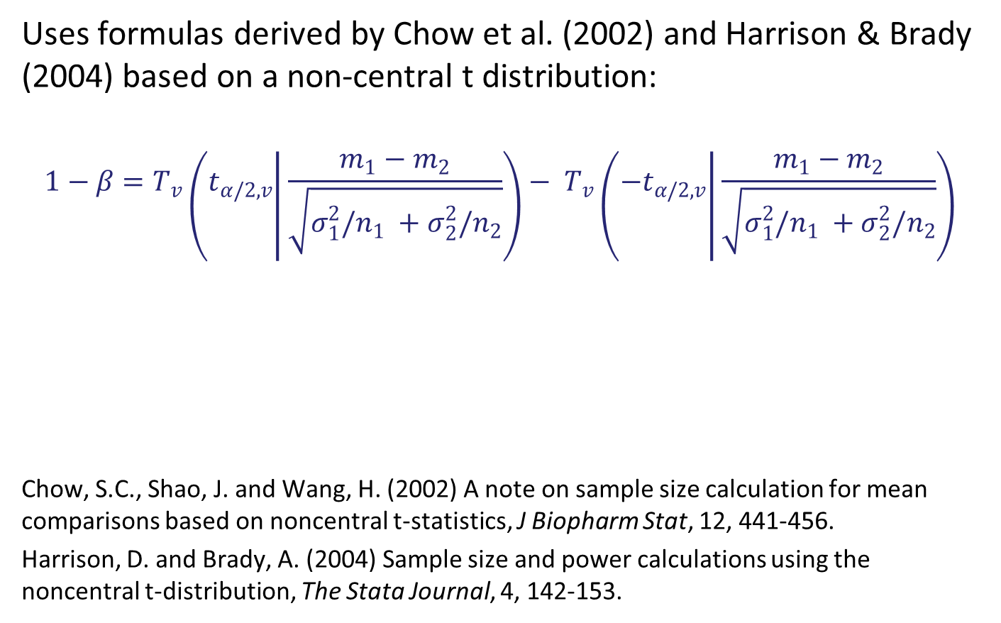
Power Calculation
Uses formulas derived by Chow et al. (2002) and Harrison & Brady (2004) based on a non-central t distribution:
$$1−β=T_{v}\left(t_{α/2,v} | \frac{m_{1}−m_{2}}{\sqrt{σ_{1}^{2}/n_{1} +σ_{2}^{2}/n_{2}}}\right)− T_{v}\left({−t}_{α/2,v} | \frac{m_{1}−m_{2}}{\sqrt{σ_{1}^{2}/n_{1} +σ_{2}^{2}/n_{2}}}\right)$$
Chow, S.C., Shao, J. and Wang, H. (2002) A note on sample size calculation for mean comparisons based on noncentral t-statistics, J Biopharm Stat, 12, 441-456.
Harrison, D. and Brady, A. (2004) Sample size and power calculations using the noncentral t-distribution, The Stata Journal, 4, 142-153.

Slide 58
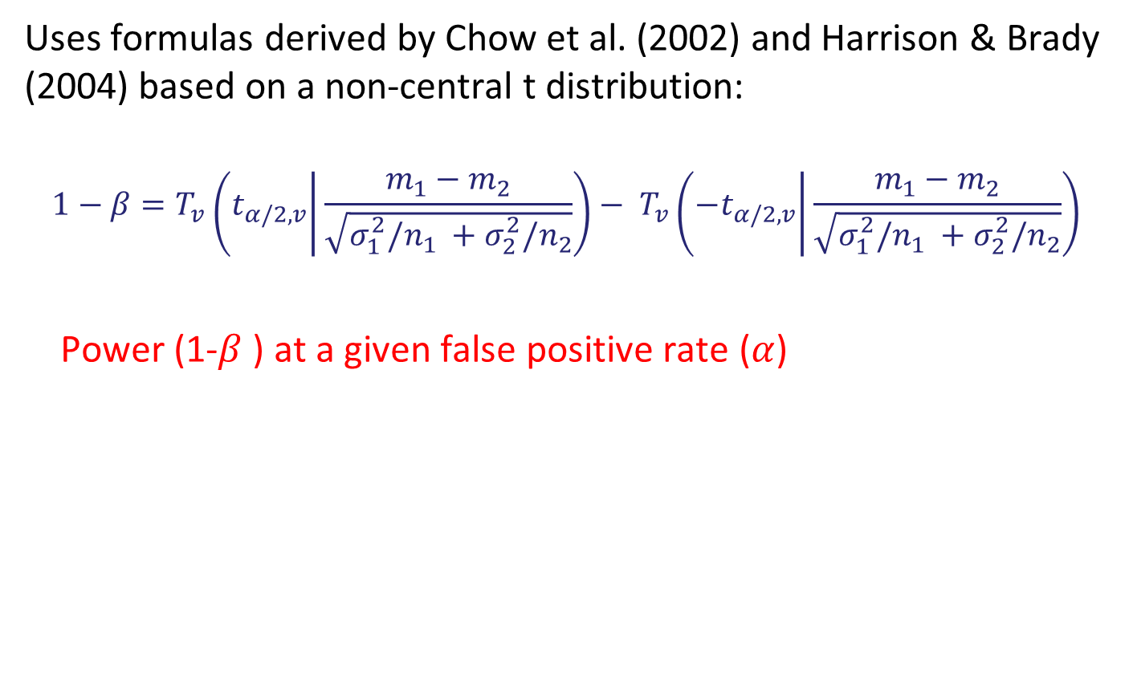
Power Calculation
Uses formulas derived by Chow et al. (2002) and Harrison & Brady (2004) based on a non-central t distribution:
$$1−β=T_{v}\left(t_{α/2,v} | \frac{m_{1}−m_{2}}{\sqrt{σ_{1}^{2}/n_{1} +σ_{2}^{2}/n_{2}}}\right)− T_{v}\left({−t}_{α/2,v} | \frac{m_{1}−m_{2}}{\sqrt{σ_{1}^{2}/n_{1} +σ_{2}^{2}/n_{2}}}\right)$$
Power (1-$β$) at a given false positive rate ($α$)

Slide 59
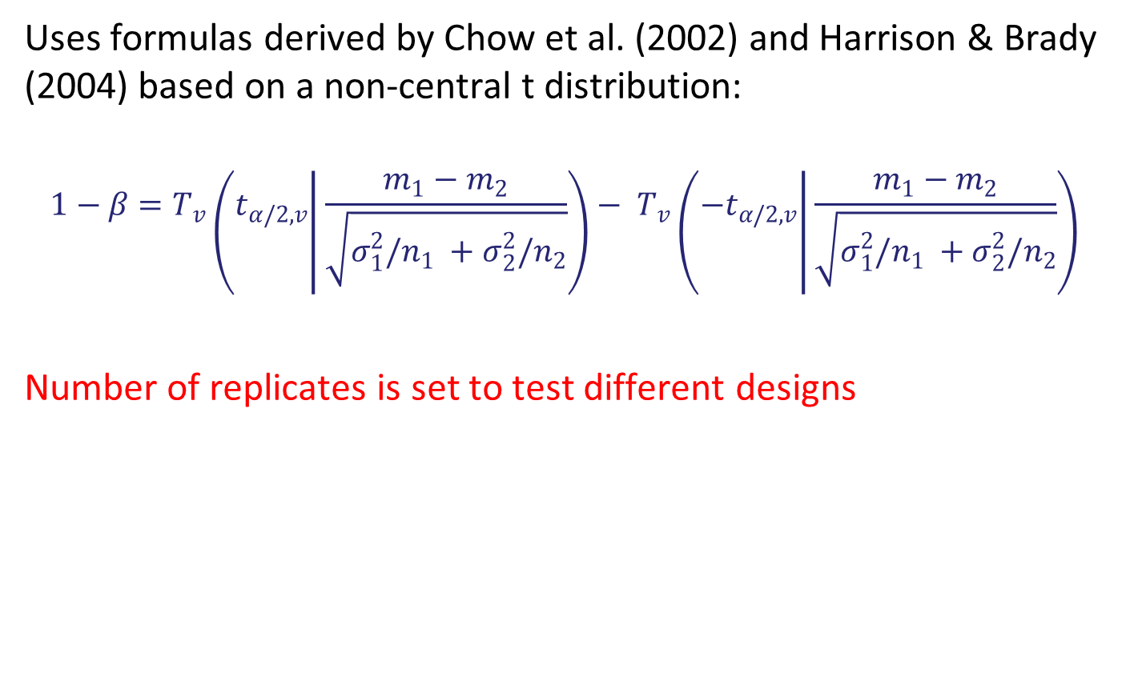
Power Calculation
Uses formulas derived by Chow et al. (2002) and Harrison & Brady (2004) based on a non-central t distribution:
$$1−β=T_{v}\left(t_{α/2,v} | \frac{m_{1}−m_{2}}{\sqrt{σ_{1}^{2}/n_{1} +σ_{2}^{2}/n_{2}}}\right)− T_{v}\left({−t}_{α/2,v} | \frac{m_{1}−m_{2}}{\sqrt{σ_{1}^{2}/n_{1} +σ_{2}^{2}/n_{2}}}\right)$$
Number of replicates is set to test different designs

Slide 60
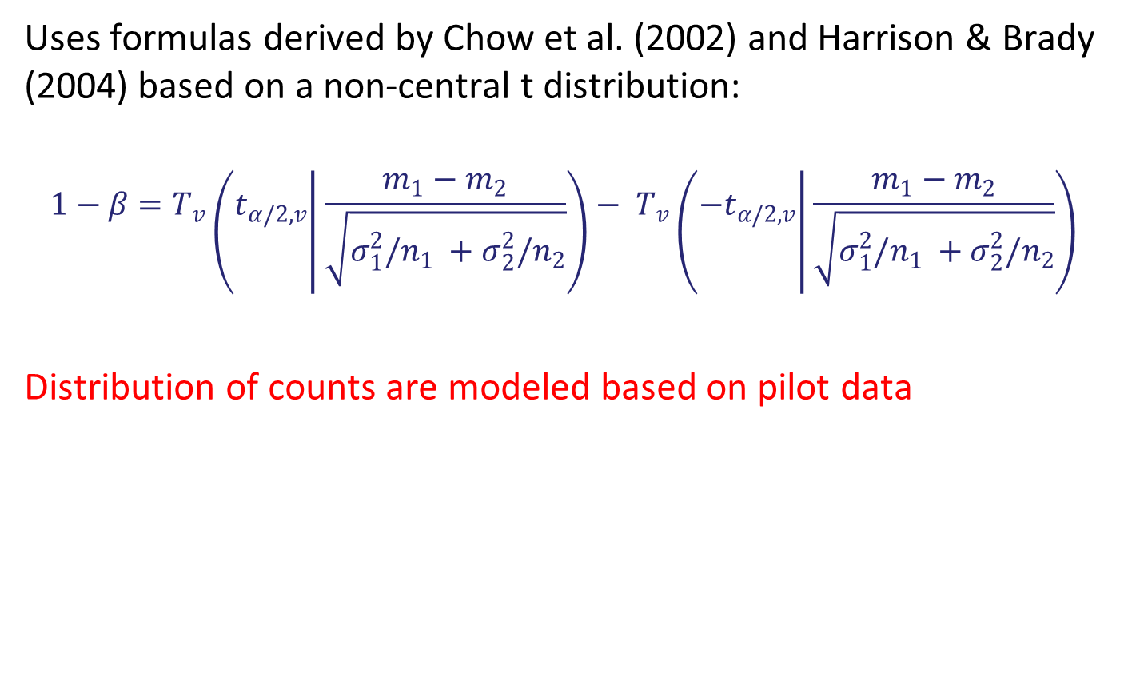
Power Calculation
Uses formulas derived by Chow et al. (2002) and Harrison & Brady (2004) based on a non-central t distribution:
$$1−β=T_{v}\left(t_{α/2,v} | \frac{m_{1}−m_{2}}{\sqrt{σ_{1}^{2}/n_{1} +σ_{2}^{2}/n_{2}}}\right)− T_{v}\left({−t}_{α/2,v} | \frac{m_{1}−m_{2}}{\sqrt{σ_{1}^{2}/n_{1} +σ_{2}^{2}/n_{2}}}\right)$$
Distribution of counts are modeled based on pilot data

Slide 61
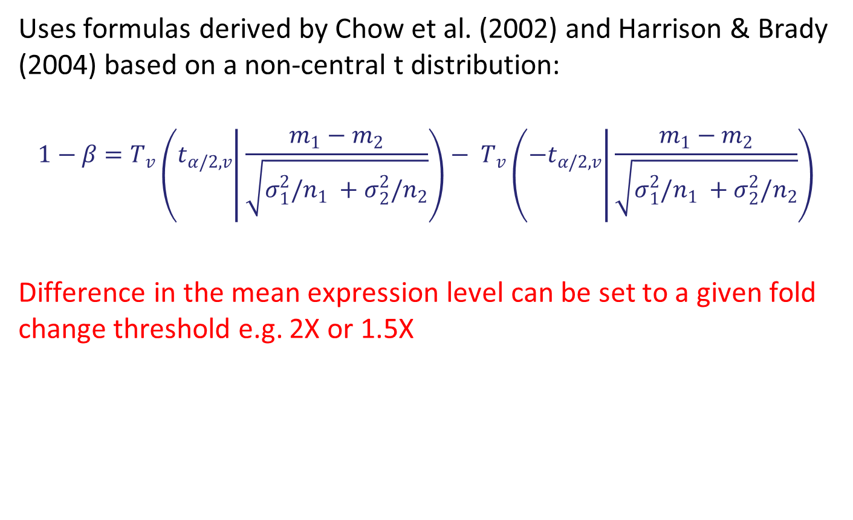
Power Calculation
Uses formulas derived by Chow et al. (2002) and Harrison & Brady (2004) based on a non-central t distribution:
$$1−β=T_{v}\left(t_{α/2,v} | \frac{m_{1}−m_{2}}{\sqrt{σ_{1}^{2}/n_{1} +σ_{2}^{2}/n_{2}}}\right)− T_{v}\left({−t}_{α/2,v} | \frac{m_{1}−m_{2}}{\sqrt{σ_{1}^{2}/n_{1} +σ_{2}^{2}/n_{2}}}\right)$$
Difference in the mean expression level can be set to a given fold change threshold e.g. 2X or 1.5X

Slide 62
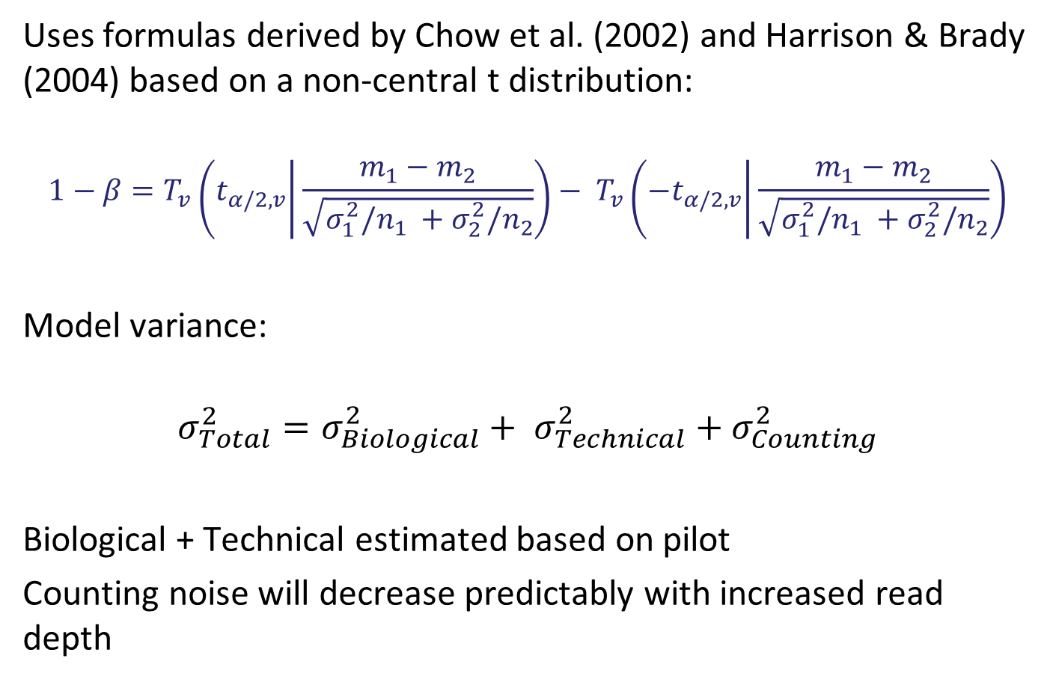
Power Calculation
Uses formulas derived by Chow et al. (2002) and Harrison & Brady (2004) based on a non-central t distribution:
$$1−β=T_{v}\left(t_{α/2,v} | \frac{m_{1}−m_{2}}{\sqrt{σ_{1}^{2}/n_{1} +σ_{2}^{2}/n_{2}}}\right)− T_{v}\left({−t}_{α/2,v} | \frac{m_{1}−m_{2}}{\sqrt{σ_{1}^{2}/n_{1} +σ_{2}^{2}/n_{2}}}\right)$$
Model variance:
$$σ_{Total}^{2}=σ_{Biological}^{2}+ σ_{Technical}^{2}{+ σ}_{Counting}^{2}$$
Biological + Technical estimated based on pilot
Counting noise will decrease predictably with increased read depth

Slide 63
Results

Slide 64
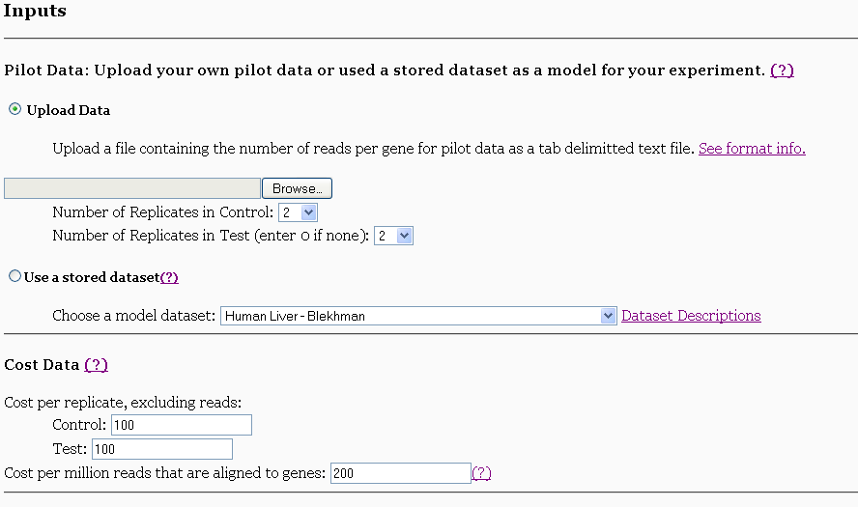
Scotty http://euler.bc.edu/marthlab/scotty/scotty.php

Slide 65
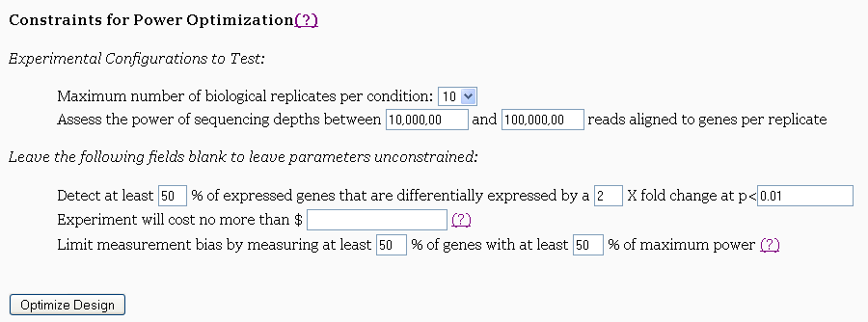
Scotty

Slide 66
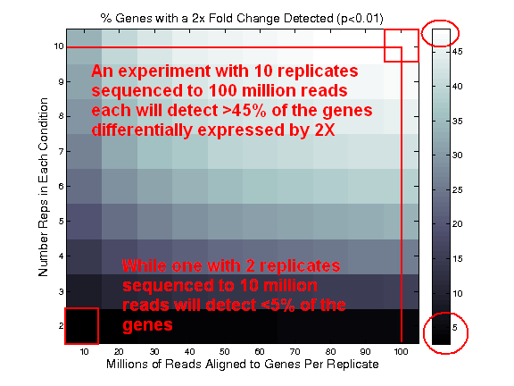
Scotty

Slide 67
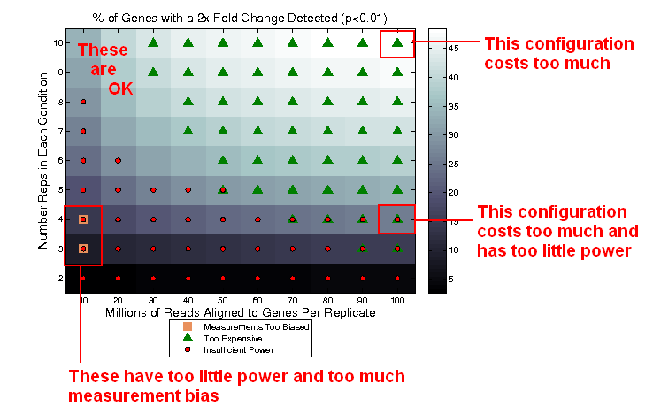
Scotty

Slide 68
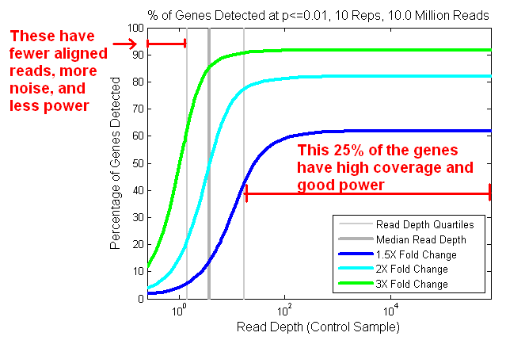
Scotty

Slide 69
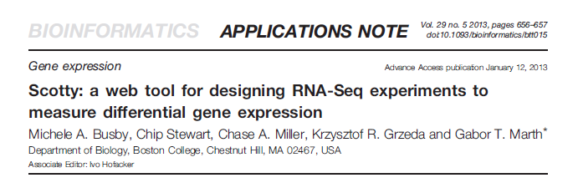
Scotty
Published in Bioinformatics
Since release in January
160 users
250 visits

Slide 70
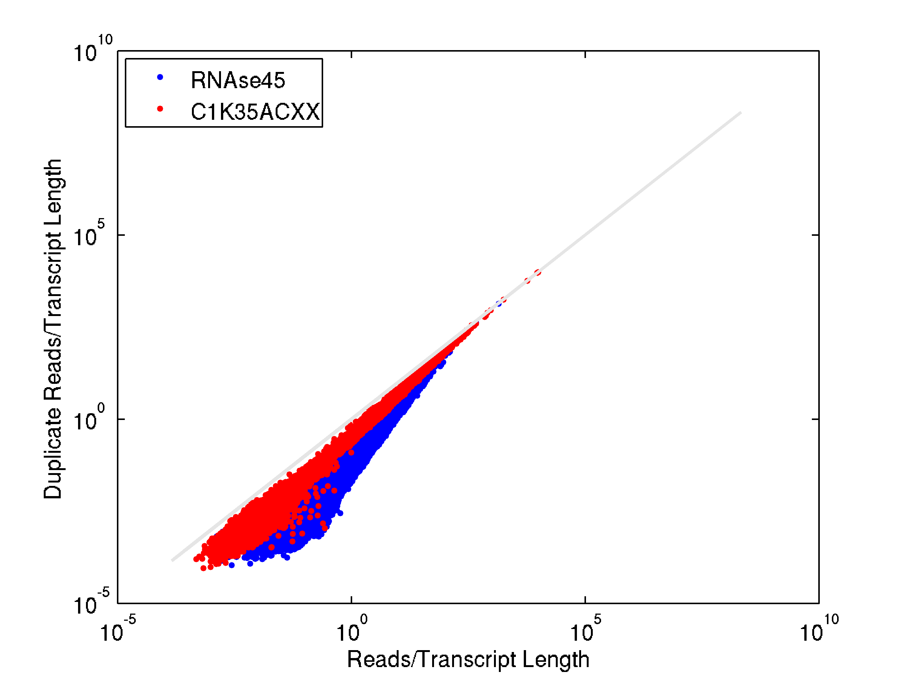
Current and Future Work
Bioinformatics support for
RNA-Seq methods development at the Broad to establish what protocols are the most efficient
Early barcoding strategies to make it cheaper and easier to run multiple replicates
ATGCCC
RNA

Slide 71
Acknowledgments
Boston College
Gabor Marth
Chip Stewart
Krzysztof R. Grzeda
Chase Miller
Derek Barnett
Tony Schreiner
Kourosh Zarringhalam
Broad Institute
Joshua Levin
Xian Adiconis
Christian Matranga
Diego Borges-Rivera
Georgia Giannoukos
Chip Stewart
Aviv Regev

