Slide 1
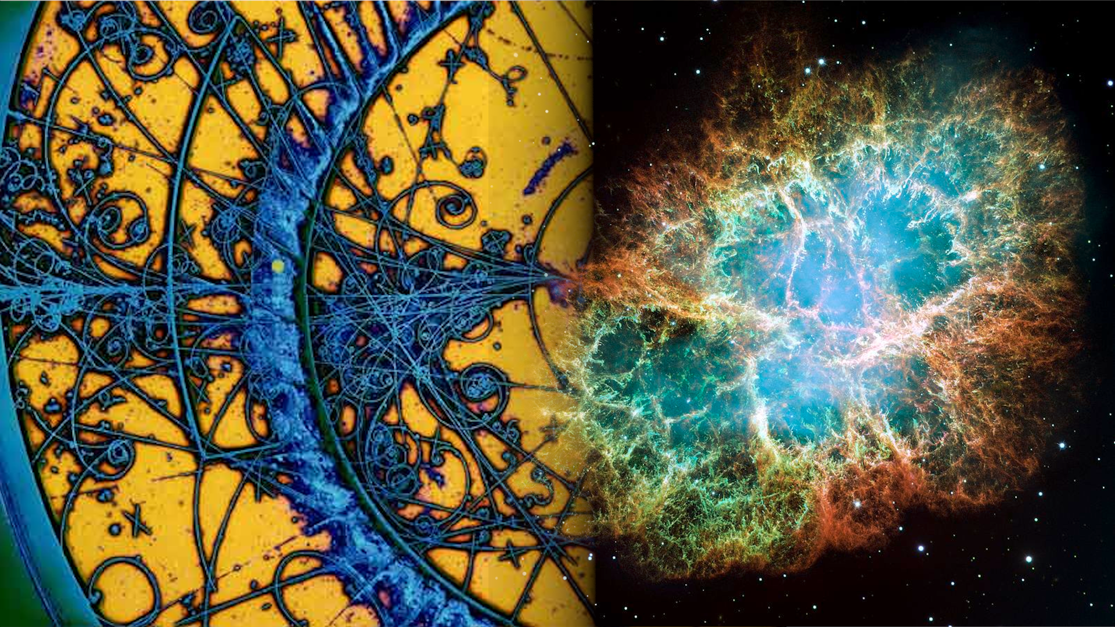


New forces on high-energy
cosmic neutrinos: progress
Mauricio Bustamante
Niels Bohr Institute, University of Copenhagen
Progress report
October 31, 2026
Notes:
Where the analysis stands: the models, the full propagation, the data, first results,
and what is left before the final plots.

Slide 2
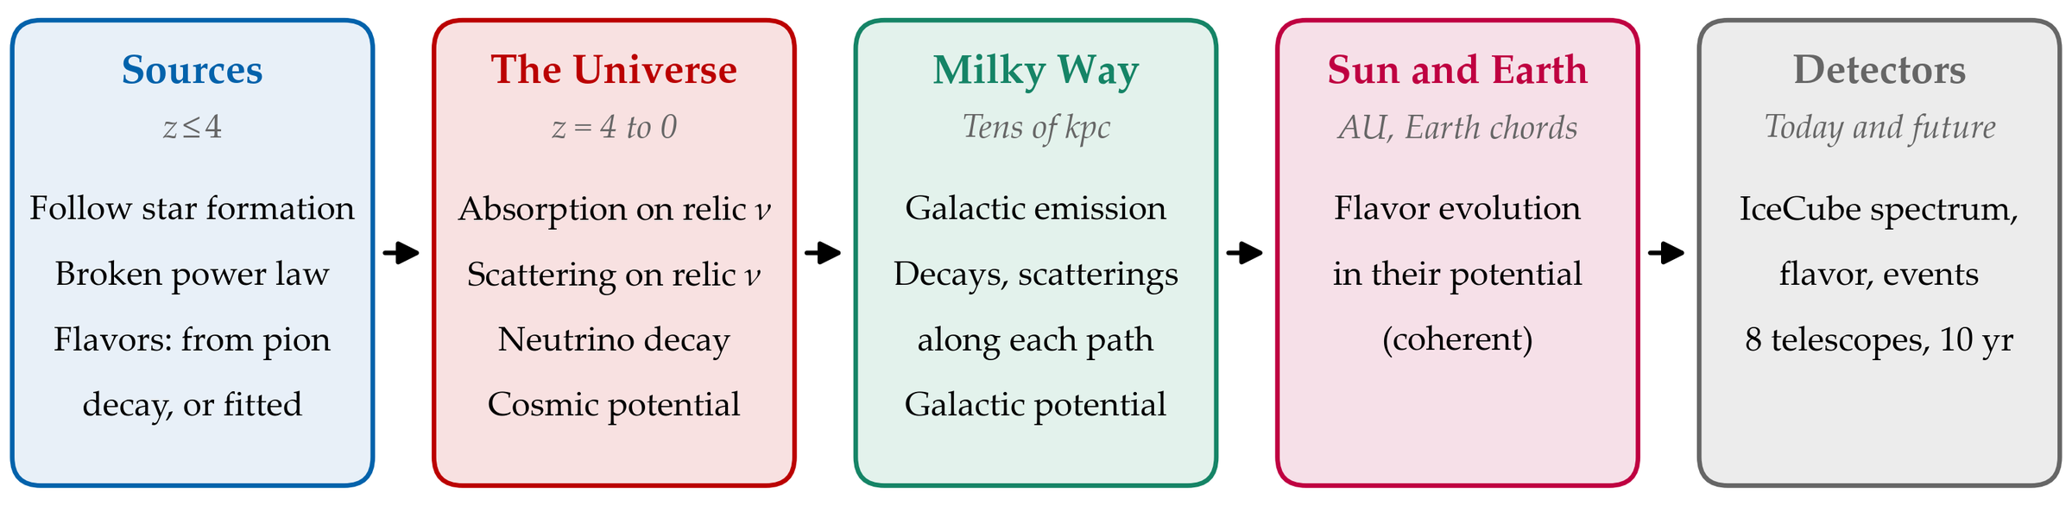
The idea: a new force acts on neutrinos on their way to us
IceCube sees cosmic neutrinos of 10 TeV to tens of PeV, from sources out to redshift ~4. On the way they cross the sea of relic neutrinos, the Milky Way, the Sun and the Earth.
A new, light mediator can absorb them, scatter them, make them decay, or change how their flavors mix, and so mark the energy spectrum or the flavor composition.
We compute all of these together, from the sources to the detector, and fit them to IceCube’s data.
notes/notes.tex, Sec. “The transport equation in full”
2
Notes:
The one-line pitch: a light mediator changes the flux on the way; we model every step.

Slide 3
Three families of models
Model
The mediator couples to
Matter potential from
Mediator masses
Dark portal (νe, νμ or ντ)
Neutrinos, through their mixing with a heavy neutrino: coupling gD |Uα4|²
None in these planes
10⁻³⁰ eV – 1 GeV
Le − Lμ, Le − Lτ
Lepton-number differences: neutrinos and electrons, coupling g′
Electrons: cosmic, Galaxy, Sun, Earth
10⁻³⁰ eV – 1 GeV
Secret interactions: scalar or vector; Majorana or Dirac neutrinos
Neutrinos only: νe, νμ, ντ, or all flavors equally
None
10⁻³⁰ eV – 1 GeV
Each plane is one exclusion region, mediator mass against coupling. Every choice below is its own plane:
• Dark portal and lepton number: 5 models × 2 choices of source flavors (pion decay, or fitted) × 3 data sets = 30 planes below 10 keV, and 30 above.
• Secret interactions: 2 mediators (scalar, vector) × 2 kinds of neutrino (Majorana, Dirac) × 4 flavor choices × 2 mass ranges (below and above 1 keV) × 2 choices of source flavors × 3 data sets = 192 planes.
analysis/configs/campaign_ml, campaign_si · lepton-number models as in Agarwalla, Bustamante, Das, Narang, JHEP 08 (2023) 113
3
Notes:
The coupling axes: g_D times the heavy-neutrino mixing for the dark portal; g' for lepton number.

Slide 4
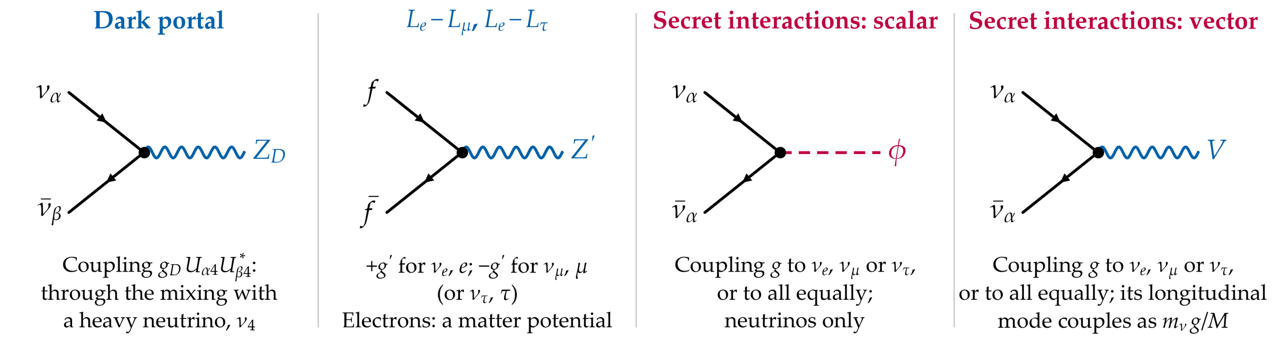
How the mediator couples
The dark portal reaches the light neutrinos only through their mixing with a heavy neutrino, ν4: its planes are drawn in the product gD |Uα4|². The lepton-number boson also couples to electrons, which makes the matter potential. The scalar and the vector secret interactions are separate models, with planes of their own.
notes/notes.tex, Sec. “Matter charges and textures” (benchmark table)
4
Notes:
f stands for any fermion carrying the lepton number: nu_e and e with +g', nu_mu and mu with -g'.

Slide 5
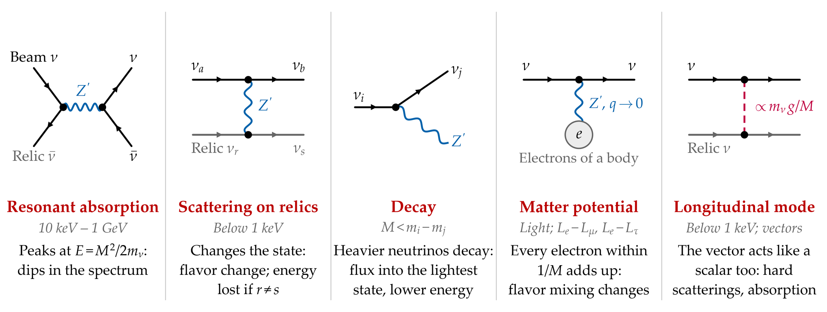
What the mediator does, by its mass
All of these act together, in one equation (next slide). Grey lines: relic neutrinos, 56 per cm³ per state today.
notes/notes.tex, Sec. “The transport equation in full”
5
Notes:
Absorption: s channel on a relic. Scattering: t channel, forward-peaked below 1 keV.
Decay: open when the mediator is lighter than a mass difference. Potential: forward scattering
on matter, coherent. Longitudinal mode: the vector's q q / M^2 part, couplings ~ m_nu g / M.

Slide 6
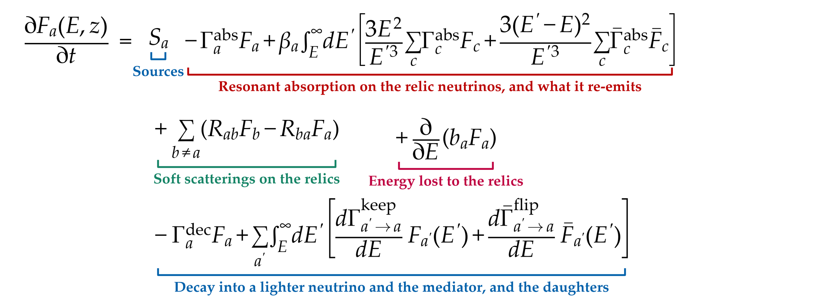
The propagation equation, term by term
Fa(E, z): neutrinos per unit energy in state a, an eigenstate of H = UM²U†/2E(1 + z) + V; E is the energy observed today. The same for antineutrinos. Solved from z = 4 to today: 439 energy bins, 200 redshift steps (400 where decays act), each bin’s processes together and exactly.
notes/notes.tex, Eq. (transport_cosmo) · code: src/dp_sweep.py, src/dp_medium.py
6
Notes:
Sources: star formation up to z = 4, a power law, flavors split over the eigenstates.
Absorption: Breit-Wigner on each relic mass state, thermal average; two secondaries.
Soft scatterings: conversions between states, damped where states decay fast.
Energy loss: scatterings that change the relic's mass state.
Decay: between eigenstates of the medium; daughters keep or flip helicity.

Slide 7
After the Universe: the Galaxy, the Sun and the Earth
Galactic neutrinos (CRINGE template) are emitted along each line of sight and carried to the Sun with the same processes:
Extragalactic neutrinos crossing the Galaxy: there, the lightest neutrino and antineutrino states can decay into each other, which they cannot do between galaxies. So we follow them along every line of sight too.
Sun and Earth: no collisions or decays there, only coherent flavor evolution in the new potential, chord by chord through the Earth:
At the detector: the flux of each flavor, per band of declination or for the whole sky.
notes/notes.tex, Eq. (transport_gal) and Sec. “From the Sun to the detector” · standard matter effects left out (negligible at these energies)
7
Notes:
The Galactic relic column is ~1e-5 of the cosmological one, so no resonant absorption there.
The crossing matters for g/M >~ 1e-2 eV^-1.

Slide 8
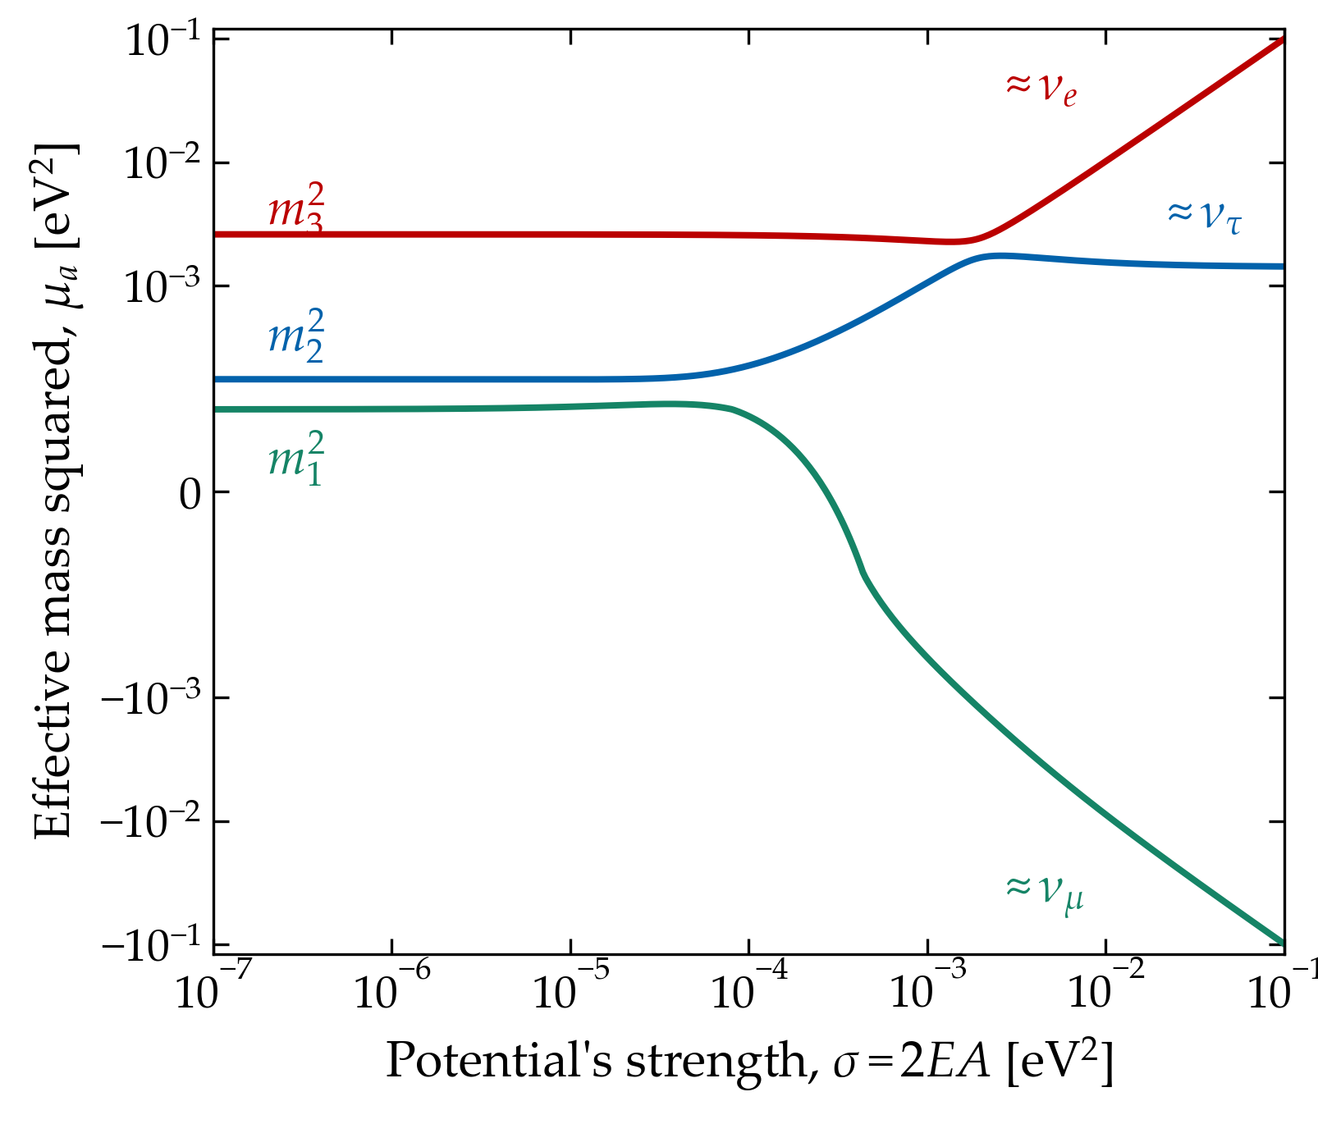
In a potential, the states that travel change
The new potential is V = AS: A sets its size, S its flavor structure. For Le − Lμ, S = diag(1, −1, 0).
The states that travel are the eigenstates of UM²U† + σS, with σ = 2E(1 + z)A. Their effective masses squared are on the right.
Weak potential: they are the mass states, ν1, ν2, ν3.
Strong potential: they become flavor states; νe and νμ get effective masses squared of about +σ and −σ.
A decay a → b is open only where the effective masses allow it: the parent heavier than the daughter, with room for the mediator.
The old code decayed each state with vacuum masses, which let the most stable state decay into itself. Now each state decays with its own effective mass.
Le − Lμ, lightest mass 0.01 eV, NuFIT 6.1 · notes/notes.tex, “What is followed” and “Decay in a medium”
8
Notes:
Eigenvalues of U M^2 U^dagger + sigma S; antineutrinos have -sigma.

Slide 9
Three new effects
New effect
What it is
How much it matters
Decay inside a potential
In a potential, the states that travel are not mass states. Decays now go between these states, each with its own effective mass. The old treatment let a state decay into itself.
Galactic flux at 100 TeV, Le − Lμ at M = 10⁻¹⁶ eV: 3% of the standard one before, 57% now
Extragalactic neutrinos crossing the Galaxy
Inside the Galaxy, the lightest neutrino and antineutrino states can decay into each other. Between galaxies they cannot. We now follow these decays.
Lowers the flux at the top of the band by 13–41%, at g/M = 0.1 eV⁻¹
The vector’s longitudinal mode
With massive neutrinos, the vector also scatters as a scalar would, with couplings ∝ mν g/M
Flux at 10 TeV × 0.95 (lightest mass 10⁻⁶ eV) or × 0.03 (0.1 eV), at g/M = 0.1 eV⁻¹
Also: each step is now solved exactly per energy bin, which cut the time per point from 600–750 s to 4–8 s.
notes/notes.tex, Sec. “Decay in a medium” · docs/dev/DECAY_IN_MEDIUM_2026-10-25.md
9
Notes:
The first one was a physics error, not a numerical one: the old model let the most stable
state decay into itself and slid the flux down in energy.

Slide 10
The data we fit
Data set
What it is
Role
IceCube spectrum + flavor
IceCube’s 2026 combined fit of the astrophysical spectrum, in 1/3-decade segments from 4.6 TeV to 1 PeV; its 2025 flavor-composition measurement with medium-energy starting events (11.4 yr)
Main present-day result
IceCube events
HESE: 7.5 years of high-energy starting events. DR2: through-going muon tracks, IC79 + IC86, above 3 TeV. We fold our fluxes with IceCube’s public detector responses.
Present-day, event by event, in energy and direction
Future telescopes
IceCube, IceCube-Gen2, KM3NeT/ARCA, Baikal-GVD, P-ONE, TRIDENT, NEON, HUNT: 10 years each; tracks, showers, double cascades
Projection, taking today’s best fit as the truth
Atmospheric backgrounds: MCEq, Barr et al. uncertainties. The event set drops the flavor measurement, whose events overlap HESE’s.
IceCube 2026: arXiv:2607.25966 · analysis/spectra.py, config.py · detectors as in NuFlavorSingleSource
10
Notes:
The spectrum's segment correlations are not published; we take them as independent.

Slide 11
Free parameters
Free parameter
Range or prior
Fitted in
Mediator mass M and coupling
On a grid; each mass read on its own
All fits
Astrophysical flux: normalization
0.01–1000 × IceCube’s best fit; no prior
All fits
Spectral indices p, plow, above and below the break at 25 TeV
2–3 and 0.5–2.5; no prior
All fits
Flavors at the sources, extragalactic and Galactic
Pion decay, (1/3, 2/3, 0); or (x, 1 − x, 0), x fitted
Half the planes
Galactic emission: normalization of the CRINGE template
Gaussian prior, 0.91 ± 0.18
All fits
Lightest neutrino mass (normal ordering)
10⁻⁶–0.1 eV; sum of masses < 0.12 eV (95%)
All fits
Event fits only: atmospheric flux (12 Barr parameters, cosmic-ray index, prompt flux); HESE: two normalizations, three detector systematics; DR2: one normalization per configuration
Gaussian priors: the releases’ for HESE, 10% for DR2
Events
Fixed: mixing angles and CP phase at the NuFIT 6.1 central values; sources follow the star-formation rate up to z = 4; as many neutrinos as antineutrinos.
analysis/configs/campaign_ml · analysis/events.py · NuFIT 6.1 · CRINGE: Schwefer, Mertsch, Wiebusch (2023)
11
Notes:
The mixing is held fixed in the likelihood; its effect is estimated outside it.
The lightest mass is profiled exactly (a scan of 11 values, then refined), only where the model holds.

Slide 12
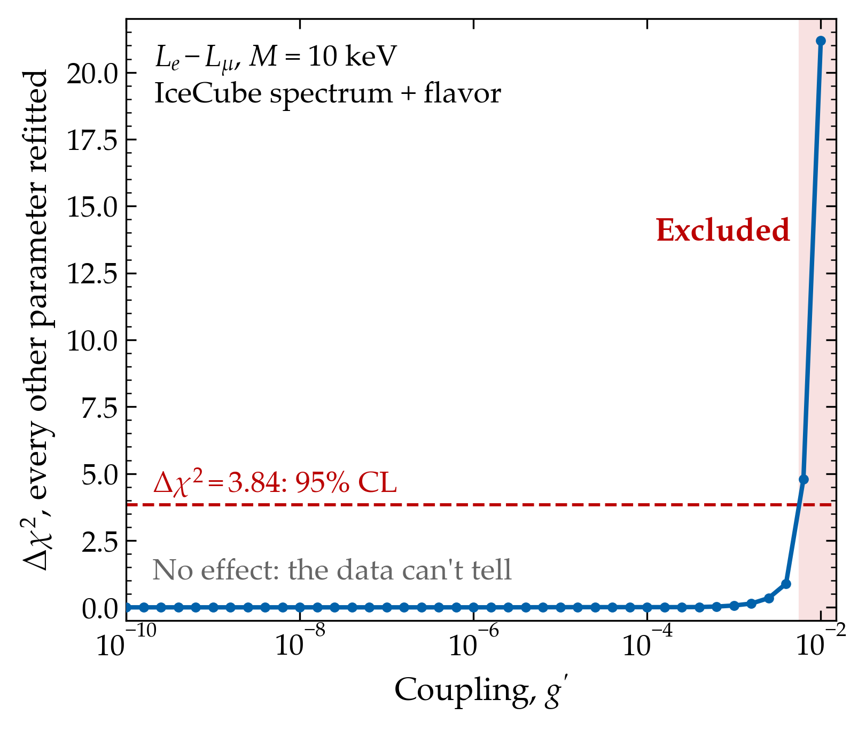
How a limit is read
Frequentist: profile likelihood, χ² = −2 ln L.
For each mediator mass, we scan the coupling; at each coupling, we refit every other parameter.
Excluded at 95% CL: Δχ² > 3.84 above the best fit (or above the no-new-physics fit, where lower).
Small couplings change nothing: Δχ² is flat. The limit is where it crosses 3.84.
In the likelihood: the data, plus the priors of the previous slide as Gaussian penalties. No other corrections. 3.84 is the two-sided value (one-sided: 2.71, tighter).
Planned: coverage tests with pseudo-experiments; Feldman–Cousins if the limits under-cover.
Right: Le − Lμ, M = 10 keV, IceCube spectrum + flavor, pion-decay flavors (the plane’s own grid)
12
Notes:
Here the limit is g' = 5.7e-3 on the grid; with the refinements, 5.9e-3.
HESE's finite simulation statistics are not corrected for (PyFC's L_Eff would do it).

Slide 13
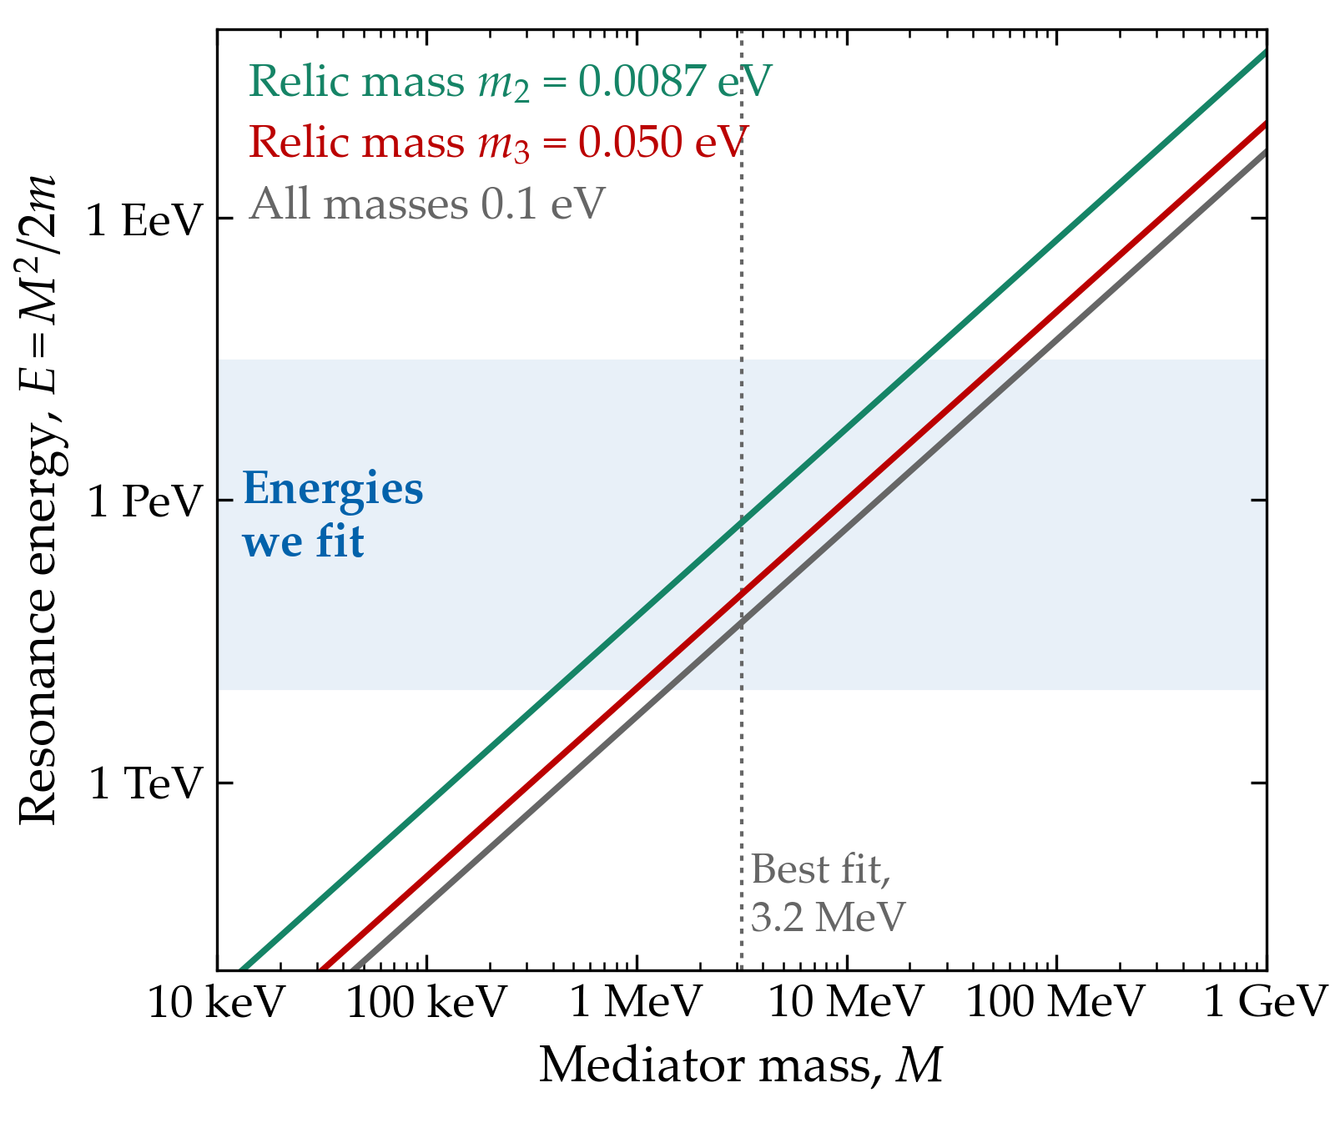
Why MeV mediators: where the resonance falls
A beam neutrino meets a relic neutrino of mass m, almost at rest. They make the mediator when E = M²/2m.
For relics of m2 ≈ 0.009 eV to 0.1 eV and IceCube’s energies, 10 TeV – 30 PeV, this needs M ≈ 0.4–80 MeV.
There the absorption carves a dip in the spectrum, and the products pile up below it.
The data’s best fit, M ≈ 3.2 MeV, puts the resonance at ~100 TeV on m3 and ~0.6 PeV on m2.
Normal ordering, lightest mass ≈ 0 (NuFIT 6.1 splittings), or all masses 0.1 eV · notes, “Thermal absorption rates”
13
Notes:
The lightest relic, nearly massless, is not at rest: its resonance is smeared by the relics'
thermal momenta (included in the rates through the thermal average).

Slide 14
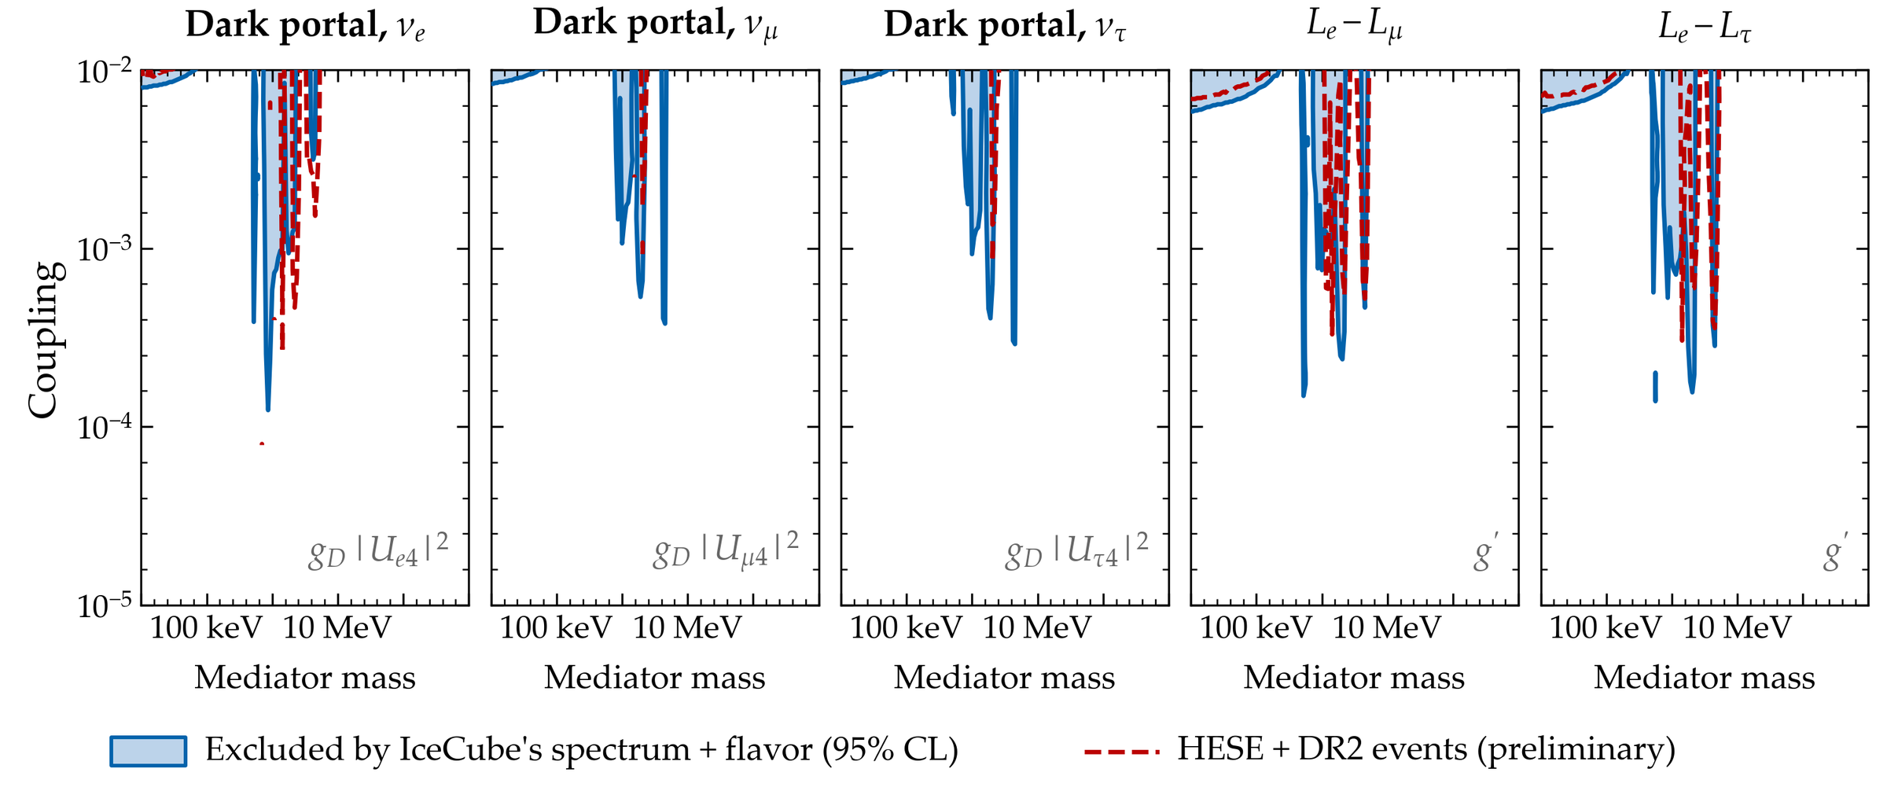
MeV mediators: what IceCube excludes today
Excluded: narrow windows near 0.5–5 MeV, where the resonance is in IceCube’s band, down to couplings of 1.2–3.8 × 10⁻⁴. IceCube’s spectrum mildly prefers a resonance at M ≈ 3 MeV (Δχ² = 5.7–7.0 against no new physics).
Pion-decay flavors at the sources · unchanged by the October code
14
Notes:
Below ~300 keV only couplings above 6-9e-3 are excluded.
Final for IceCube's spectrum + flavor. HESE + DR2 fits are to be re-evaluated with a warm-started
profile before they are final.

Slide 15
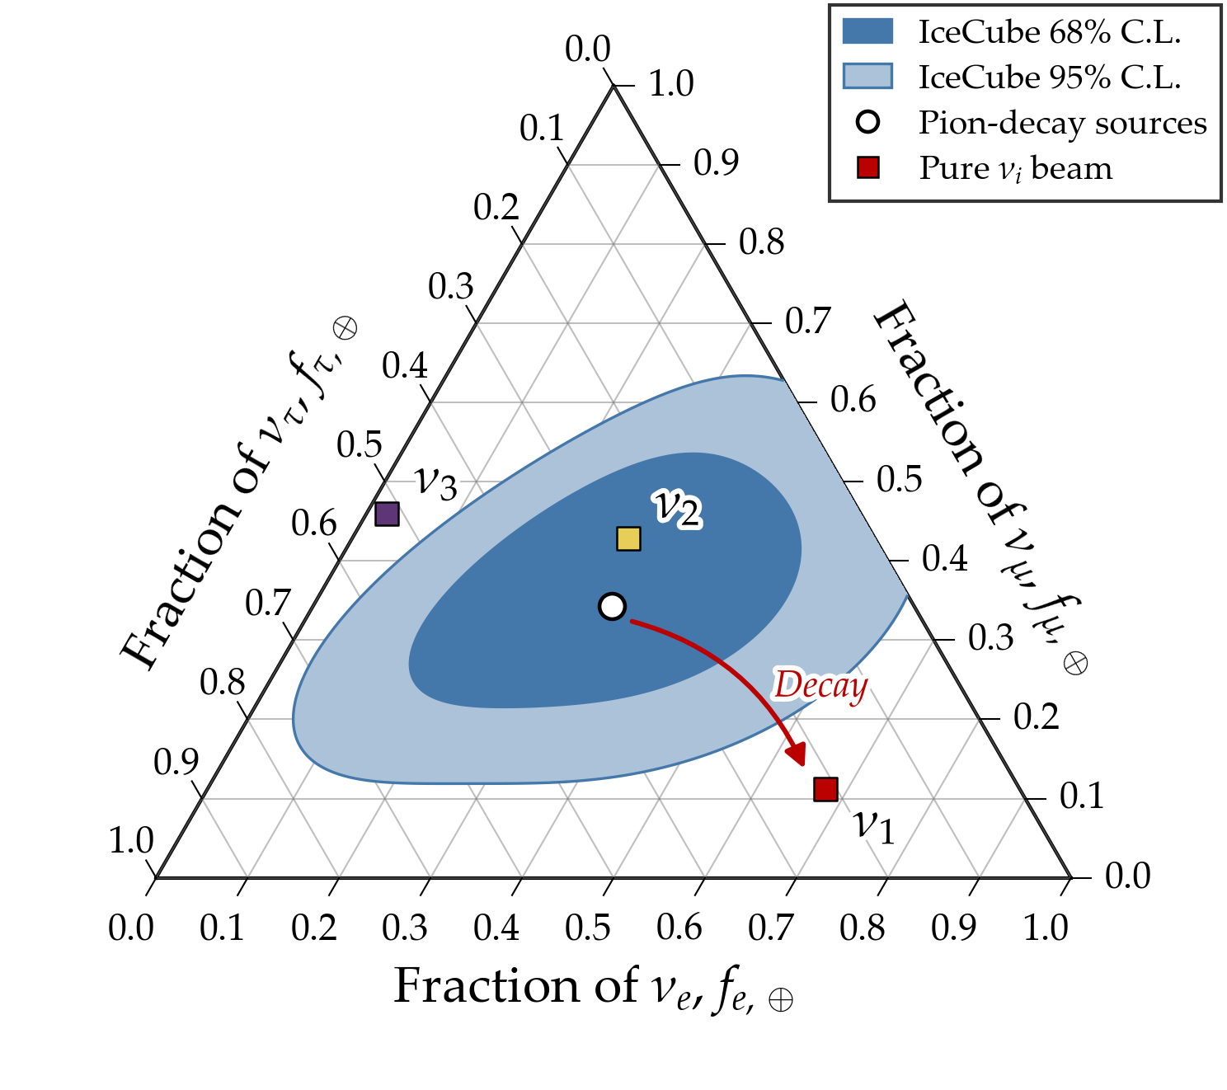
Ultralight mediators: first results (preliminary)
Dark portal, νμ, from IceCube’s spectrum + flavor:
Mediator mass
Excluded gD |Uμ4|²
≤ 10⁻¹⁰ eV
Outside the model’s validity
10⁻⁸, 10⁻⁶ eV
Every coupling ≥ 10⁻⁸
10⁻⁴ eV
≥ 1.8 × 10⁻⁸
10⁻² eV
≥ 1.8 × 10⁻⁵
≥ 1 eV
≥ 10⁻²
At light masses, every coupling in the plane makes the heavier neutrinos decay: the beam arrives as ν1, mostly νe. IceCube’s flavors disfavor that (right): Δχ² = 10–11.
Le − Lμ, a first test at M = 10⁻¹² eV: Δχ² = 2.3 at g/M = 0.03 eV⁻¹, 31 at 0.3 eV⁻¹.
Preliminary: one plane of the final run, limits not yet refined · flavors: IceCube’s medium-energy starting events (2025)
15
Notes:
Preliminary: one plane merged, refinements not done yet.
Triangle: pure nu_1 at Earth is (0.68, 0.11, 0.21); the MESE 2025 surface alone gives 11.5.

Slide 16
Status and next steps
Step
Status
Dark portal + lepton number, MeV (30 planes)
Done · HESE + DR2 fits to be re-evaluated
Dark portal + lepton number, below 10 keV (30 planes)
Running: about half done at the last check (26 Oct); the cluster is offline now
Refine the limits, final plots
Next, when the cluster is back
Checks: mediator decaying back into neutrinos; relic population after decays; every vector point with g/M ≥ 10⁻² eV⁻¹ excluded
To do
Coverage tests with pseudo-experiments
Planned
Secret interactions (192 planes, 10⁻³⁰ eV – 1 GeV)
Configured; runs after the ultralight run
One discovery case; then the paper
Last
Fits take 19–47 min per point with every process on (test of 2026-10-25)
16
Notes:
One final run per family: every physics choice is settled before it starts.

Slide 17
Summary
One transport equation for everything a light mediator does to cosmic neutrinos: absorption, scattering, energy loss, decay, potentials. From the sources, through the Universe, the Galaxy, the Sun and the Earth, to the detector.
Three families of models, mediator masses 10⁻³⁰ eV – 1 GeV, three data sets: today’s IceCube spectrum + flavor, today’s IceCube events, eight future telescopes.
MeV mediators: limits from IceCube’s spectrum + flavor are done.
Ultralight mediators: the final run is more than half done. Where neutrinos decay, IceCube’s flavors exclude even tiny couplings.
Next: finish the run, final plots, secret interactions, one discovery case, the paper.
17

Slide 18
Backup

Slide 19
Where we trust the models, and what we shade
Vector mediators below 1 keV: the vector’s longitudinal mode couples as mν g/M. At large g/M the theory breaks down (perturbative unitarity fails), and the heavier the neutrinos, the sooner. So at each point we fit only the lightest-neutrino masses where the theory holds. Where none does, we shade the point as not allowed.
Scalar secret interactions below 1 keV: the relic neutrinos themselves create a scalar field that shifts every neutrino mass. We do not model this. It matters above g/M ≈ 30 to 10⁴ eV⁻¹, depending on the flavor and the lightest mass; we shade that region.
Decays inside a potential: our decay rates assume each decay is slow against the oscillations between the states that travel. Every run records how well this holds. The correction is at most 1.5% at our test points; it reaches 10–50% only for g/M ≈ 10–30 eV⁻¹, near where unitarity fails.
docs/SIMPLIFICATIONS_AND_ASSUMPTIONS.md, items 22–24 · docs/dev/REVIEW_2026-10-25.md · notes/notes.tex
19
Notes:
The vector's relic background cancels between neutrinos and antineutrinos; the scalar's does not.

Slide 20
Validation
Steps in redshift: where the potential sets the states, 200 steps converge to ≤ 1.3 × 10⁻⁴ in spectral shape; where decays and scatterings cycle, 400 steps to ≤ 1.7 × 10⁻³.
Coarse sky for the Galactic paths (Nside = 4 vs 8): the crossing flux moves by 3 × 10⁻⁴, the Galactic emission by 5.5% (its prior is 18%), the χ² by 0.1–0.3 at Δχ² ≈ 30.
Conservation: each decay keeps one neutrino. Without a potential, the vacuum decay rates come back exactly.
Nothing else moved: the MeV and secret-interaction planes above 1 keV are unchanged by the October code (952 test units, identical to 10⁻¹⁴).
Review: an independent review of all October changes; the full test suite passes on the cluster and in continuous integration.
docs/dev/DECAY_IN_MEDIUM_2026-10-25.md · docs/dev/REVIEW_2026-10-25.md · notes/notes.tex
20
Notes:
Shape = ratio to a 3184-step reference with its median divided out, over 10 TeV - 10 PeV.

Slide 21
Backup: the terms in more detail
Sources: star-formation rate R(z) up to z = 4, spectrum E^{−p}, flavors fα split over the states at the source:
The states followed are the eigenstates of
Absorption: a Breit–Wigner on each relic mass state, averaged over the relics’ thermal momenta; each absorption re-emits a neutrino and an antineutrino.
Soft scatterings: the conversion rate between states is damped where they decay fast (the decay widths enter the damping).
Decay in a medium, a → b: allowed where (1 − x)[x μa(σ) − μ′b(xσ)] − x M² ≥ 0, with μ the effective masses squared and x = E/E′.
notes/notes.tex, Eqs. (sources), (transport_cosmo), (medium_window)
21

