Slide 1
Base Model Overview

Slide 2
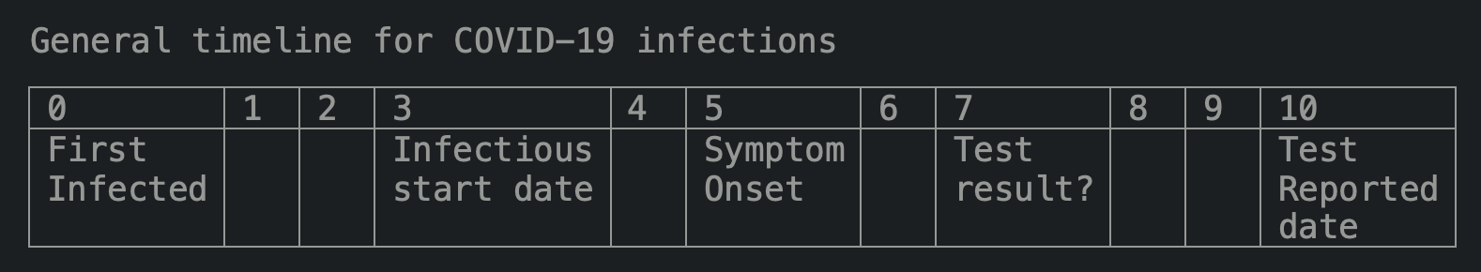
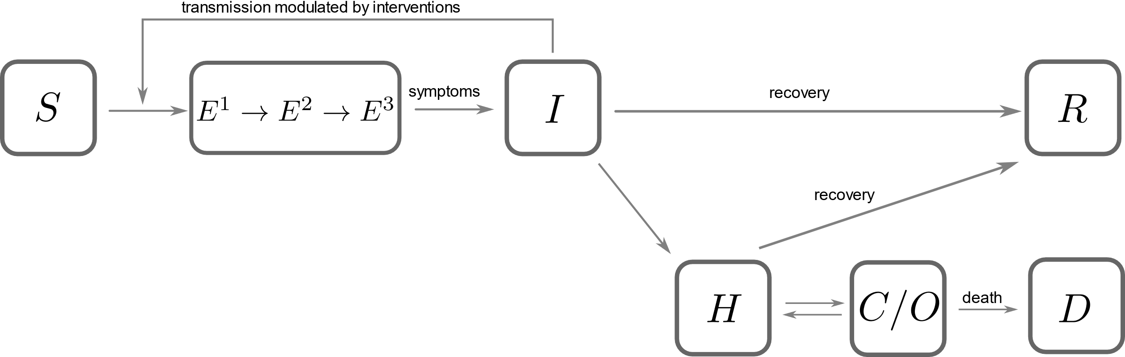
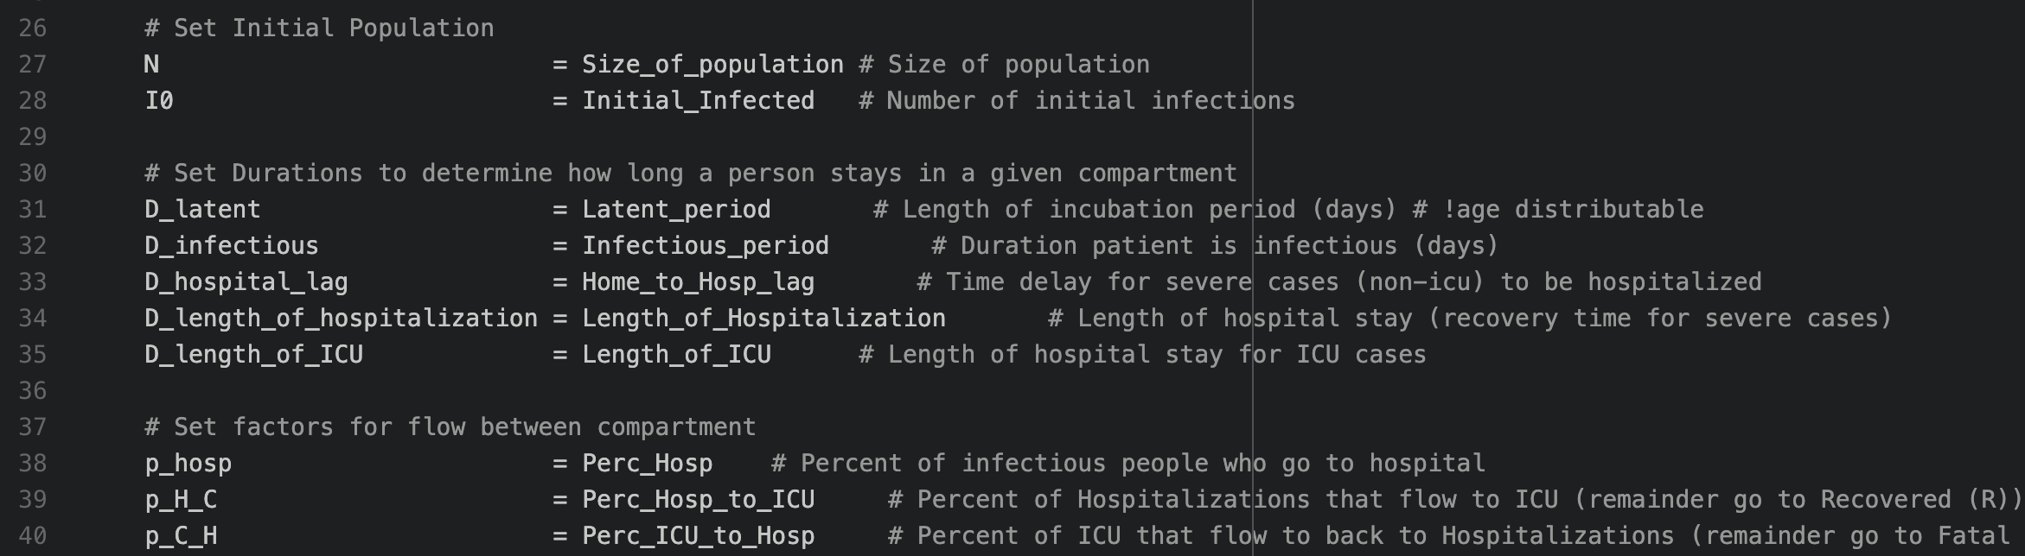
Epi Parameters
./dd_model/model.py
D

Slide 3
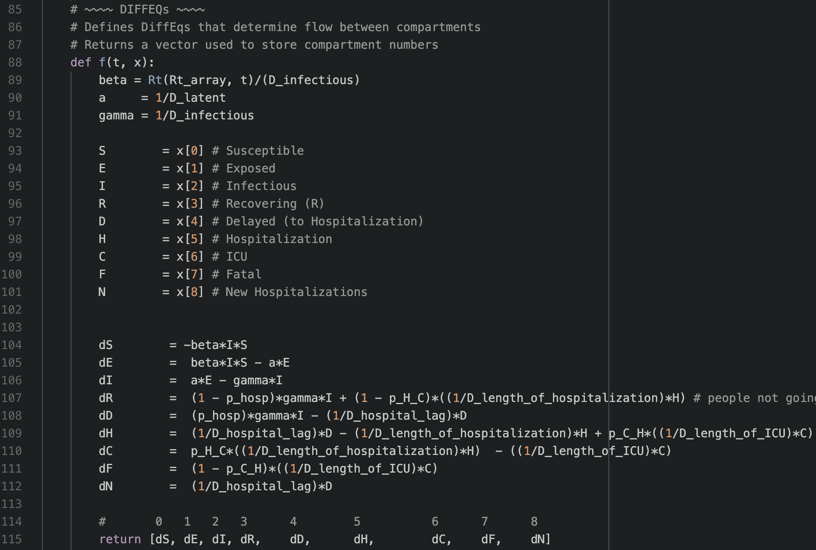


Set Differential Equations
./dd_model/model.py

Slide 4
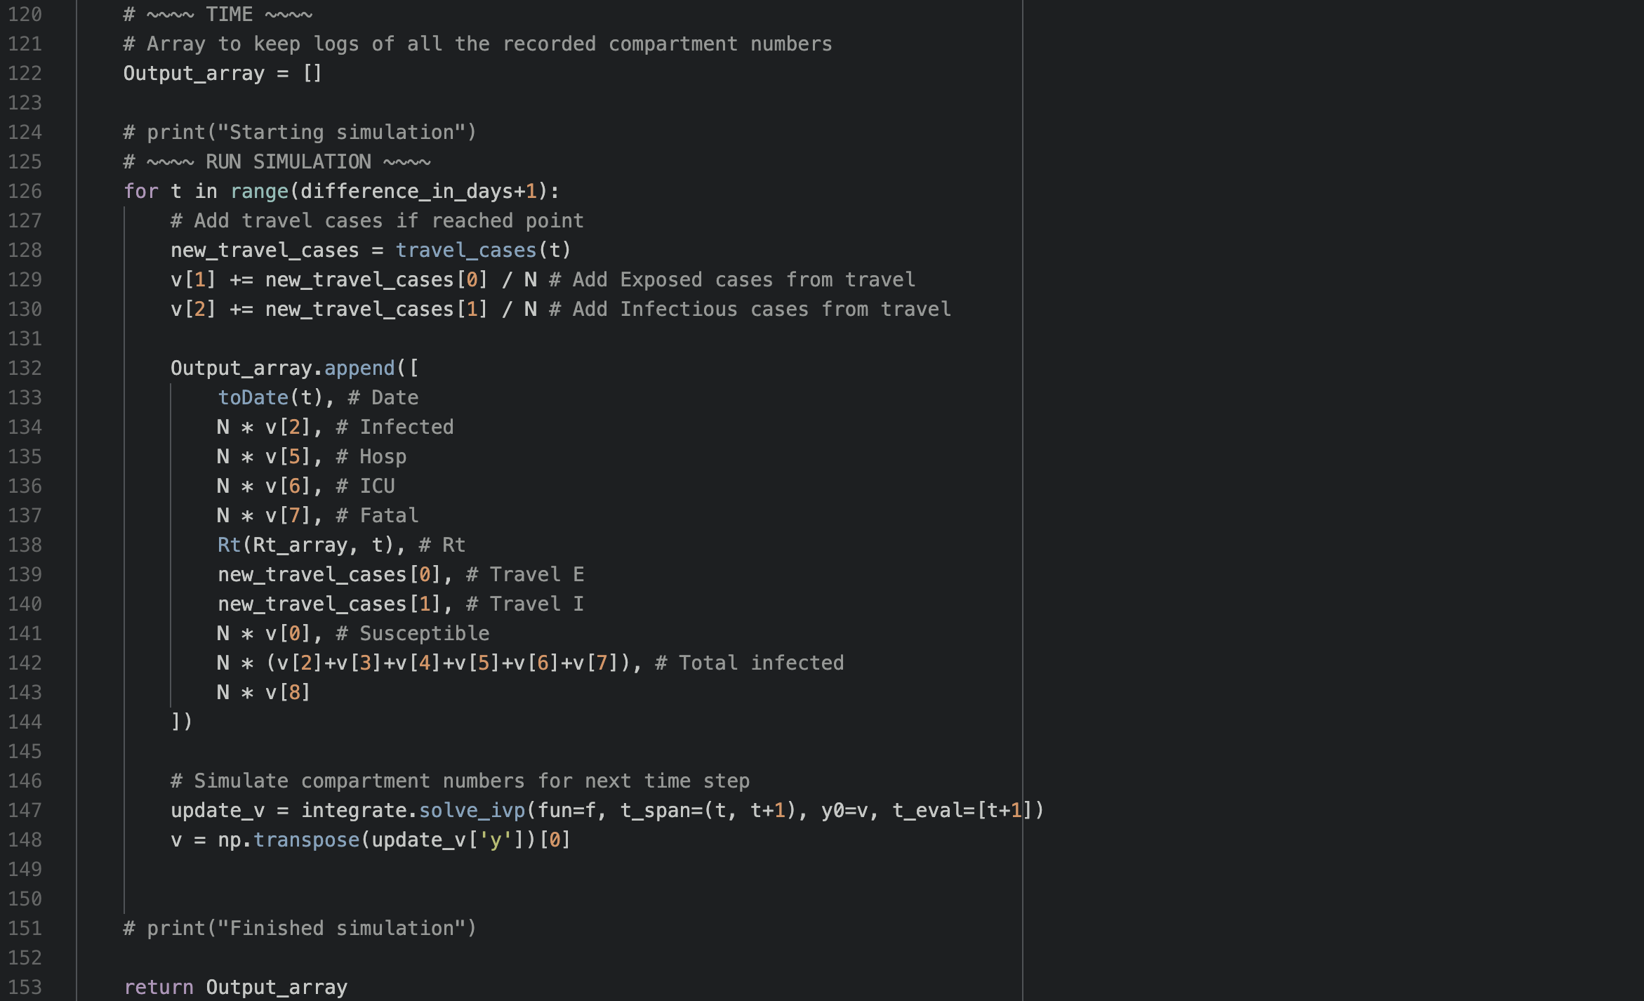
Resolve Differential Equations
./dd_model/model.py

Slide 5
Run Model Overview

Slide 6
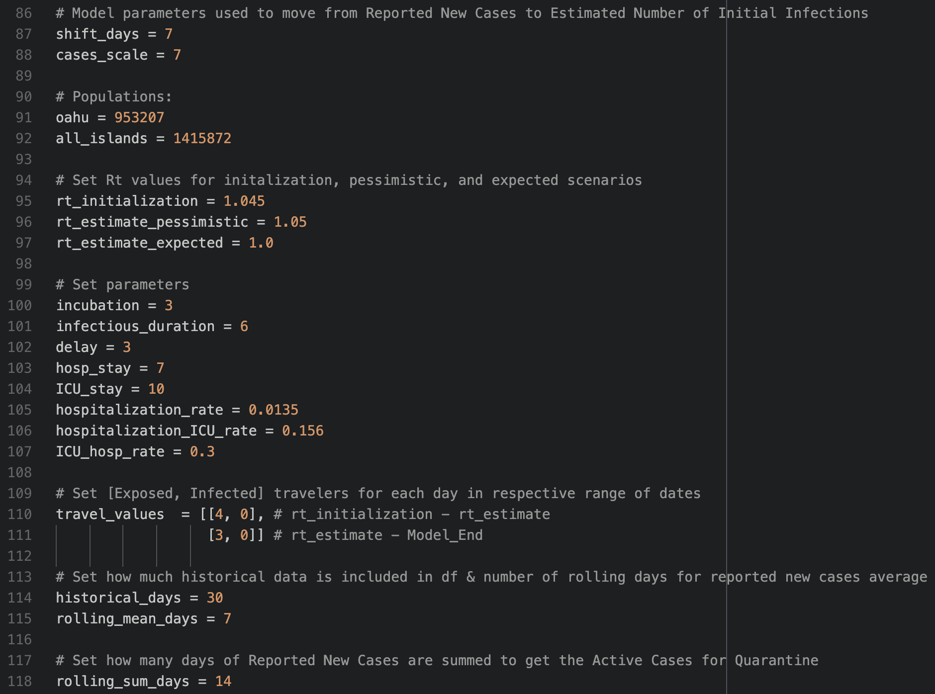
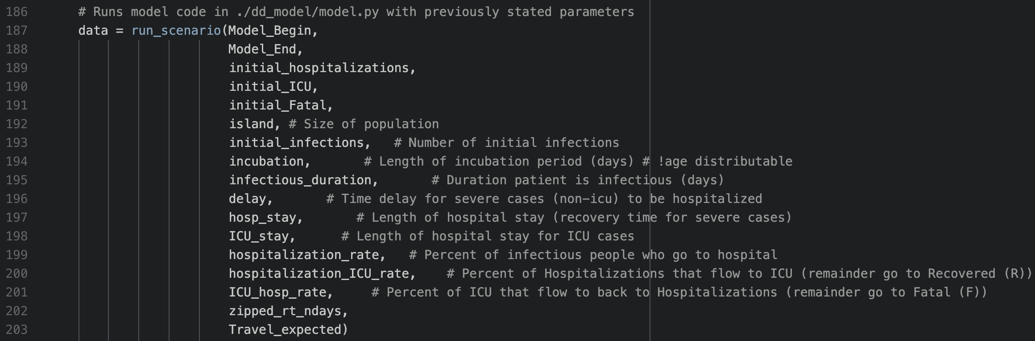
Set Epi Parameters
./dd_model.py

Slide 7
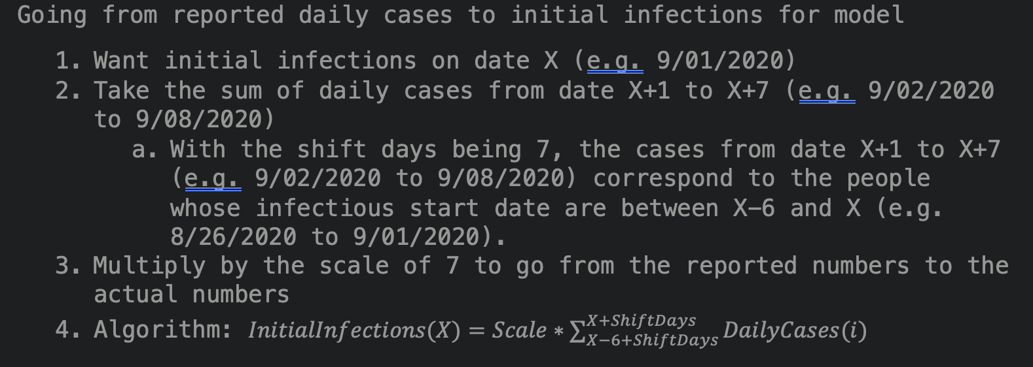
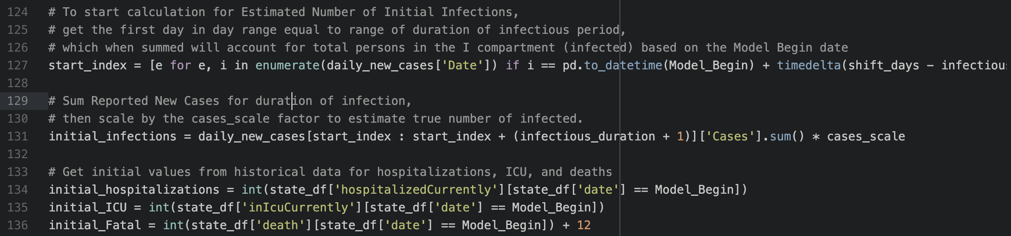
Set Values for Initial Vector
./dd_model.py

