Slide 1
Putting Theory Into Practice
Apache DataFusion & Apache DataFusion Comet
This talk was prepared by Matt Butrovich in his personal capacity. The opinions expressed in this talk are the author's own and do not reflect the views of The Apache Software Foundation, Carnegie Mellon University, or Apple Inc.
Matthew Butrovich | February 18, 2025
Notes:
Highlight this symbiotic relationship between academia and open source through the lens of systems that I contribute to
I get excited and start talking very quickly
We have a broad audience with wonderfully diverse backgrounds, so if I use a term that’s new to you please stop me, ask me to define it.
Why is this topic near and dear to me?
Databricks just raised a $15bn Series J a few weeks ago, so maybe you don’t need convincing that this is real.

Slide 2
Academic and open-source communities push the state-of-the-art in database management systems (DBMSs), and present accessible ways to learn about and contribute to DBMS internals.
Notes:
What I hope to convince you of in this talk
Why is this topic near and dear to me?

Slide 3


About Me
https://mattbutrovi.ch

Notes:
I love database systems! At the bottom of every important application is a DBMS. I think they’re an awesome of intersection of a lot of different areas of computer science: interesting algorithmic and ML problems in query optimization, PL problems with code generation and debugging, low-level systems and hardware knowledge with query execution and storage design.
PhD from CMU. I researched DBMS and OS co-design using eBPF
I now work at Apple as a Distributed Database Engineer primarily working on open-source Apache projects like DataFusion Comet, DataFusion, Spark, Arrow.
, so any of that sounds interesting let’s chat.

Slide 4
Apache DataFusion
Notes:
This isn’t about me, so let’s dive right in
What does that mean in practice? If you’re building an application

Slide 5

Embedded Analytic Query Engine
Apache DataFusion
User Queries (SQL, DataFrames, …)
My Super Cool Application
Query Results
(Apache Arrow)
User Data (Parquet, CSV, …)

Slide 6
Embedded Analytic Query Engine
Apache DataFusion
User Queries (SQL, DataFrames, …)
Front-end
Query processing
Query Results
(Apache Arrow)
SQL Parser
Async I/O
User Data (Parquet, CSV, …)
Logical Optimizer
Vectorized Operators
Physical Optimizer
In-process Execution
Notes:
Andrew Lamb described DataFusion as the LLVM of databases. A framework around which to build composable database management systems

Slide 7
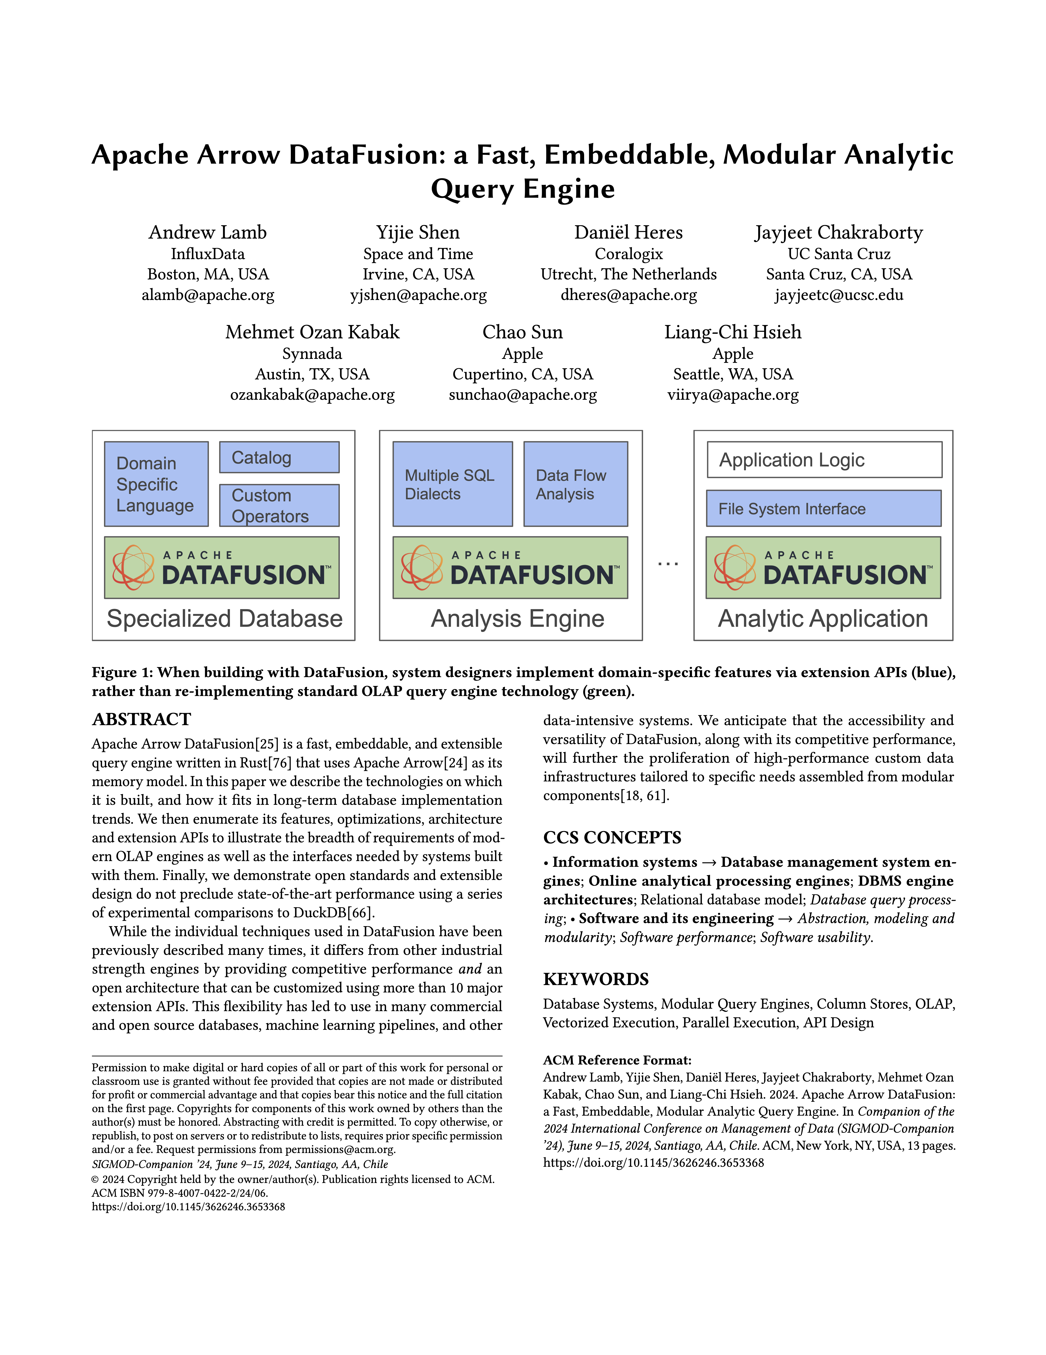
History
Apache DataFusion
Began as open-source
Created by Andy Grove
Donated as an Apache Arrow subproject, now a top-level ASF project
GitHub repository:
729 contributors
Almost 10,000 commits
Notes:
SIGMOD paper in 2024 providing an overview
A couple of Apple authors from my team

Slide 8
Applications
Apache DataFusion
Query engine for building new DBMSs
InfluxDB, ParadeDB, GreptimeDB, …
Query accelerator for existing DBMSs
DataFusion Comet, Blaze, …
Scriptable CLI for batch data lake jobs
Data formats: Parquet, Vortex, LanceDB, Iceberg, Delta
Python bindings for Jupyter notebooks
Notes:
Object stores
If you just want to query some local CSV or Parquet files

Slide 9
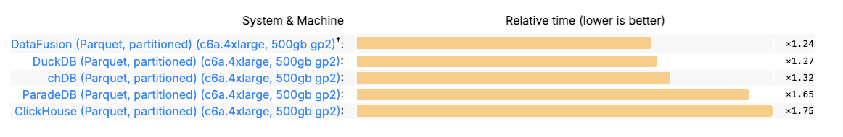
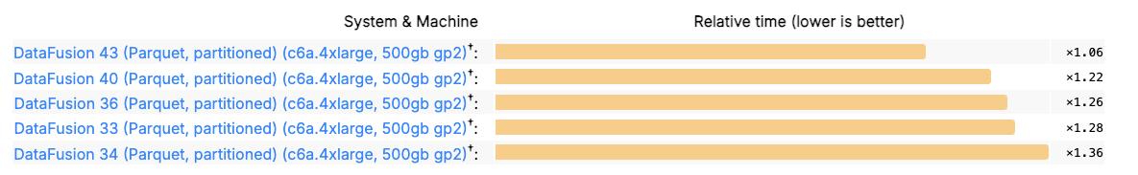
Performance
Apache DataFusion
ClickBench, single-node, partitioned Parquet files:
Performance over time:
Source: Apache DataFusion is now the fastest single node engine for querying Apache Parquet files
Notes:
This if from November, DuckDB has since jumped again, but DataFusion folks are working on it
One of the ideas that contributed to these performance improvements is German-style strings.

Slide 10
German-Style Strings
Apache DataFusion
Data representations impact performance!
Implemented in DataFusion as StringView
Benefits:
Faster loading from Parquet files
Faster filtering of values
Notes:
Takeaways

Slide 11
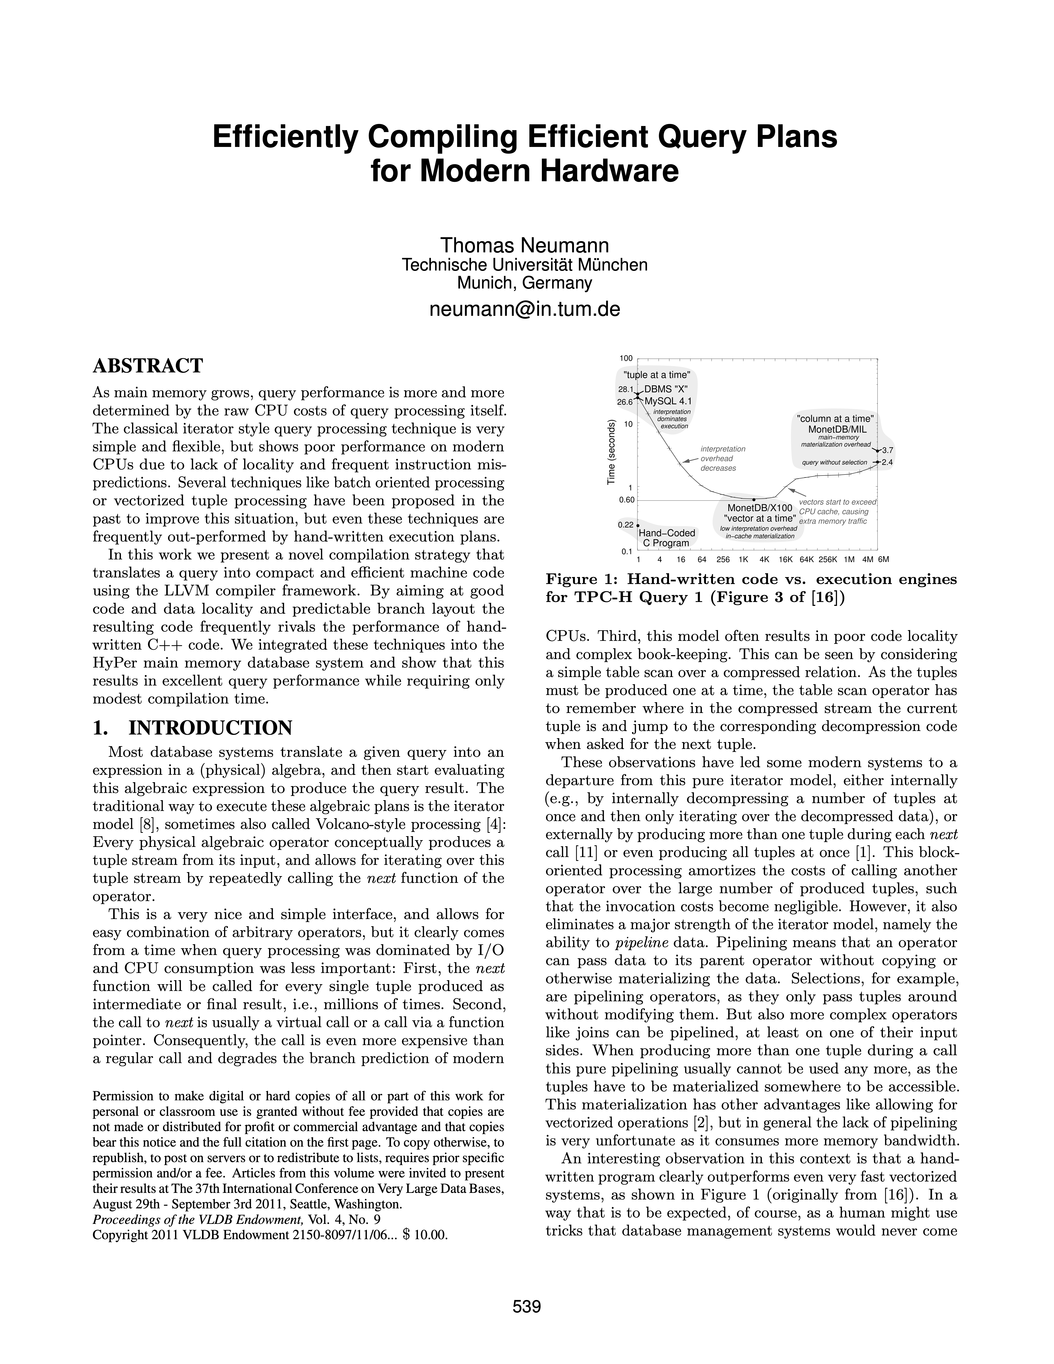
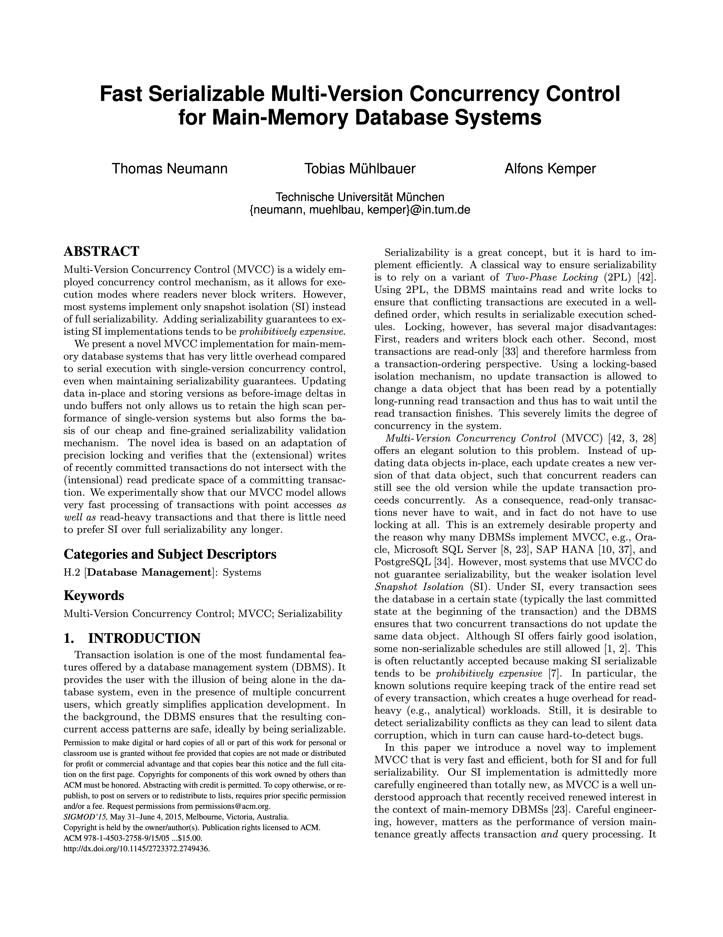
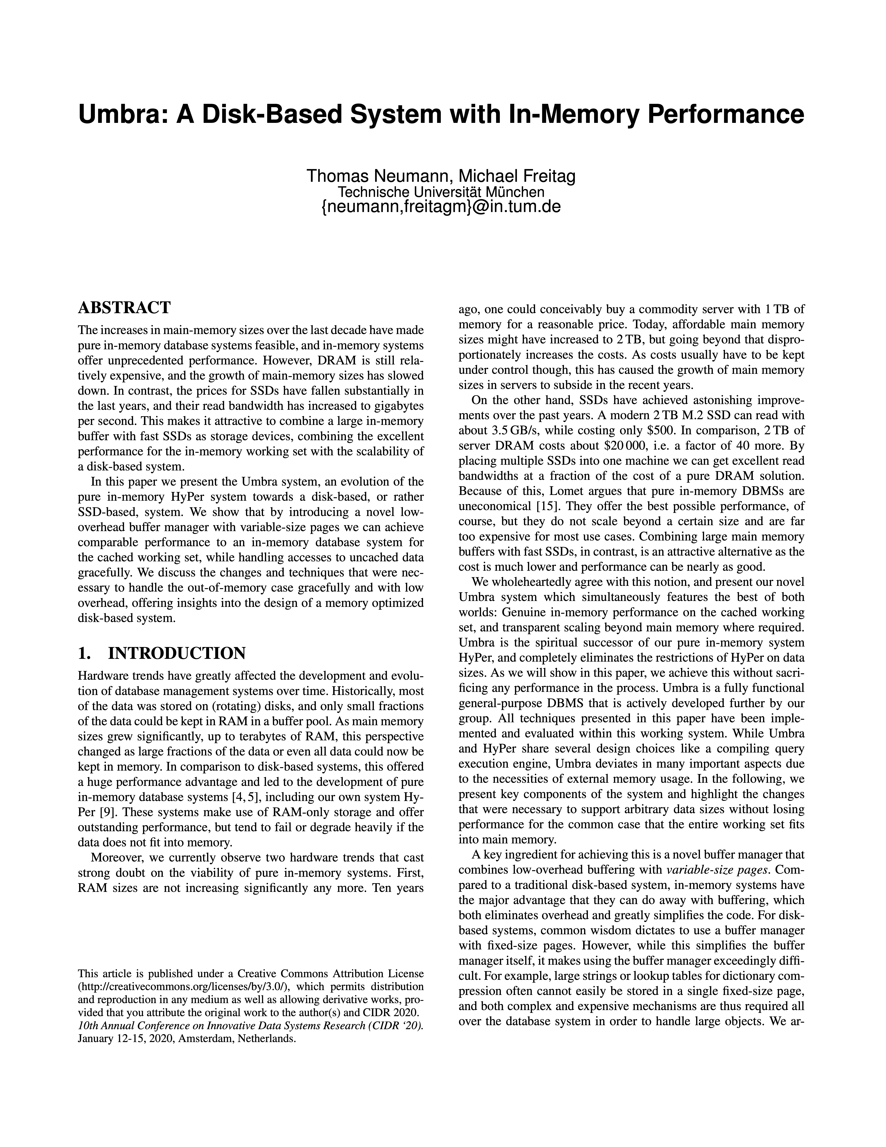
German-Style Strings
Apache DataFusion
TU Munich DBMSs:
HyPer, acquired by Tableau, later acquired by Salesforce
Umbra, commercialized as CedarDB
Notes:
HyPer was a ground-breaking in-memory system that helped popularize JIT compilation, MVCC over columnar data, ART indexes

Slide 12
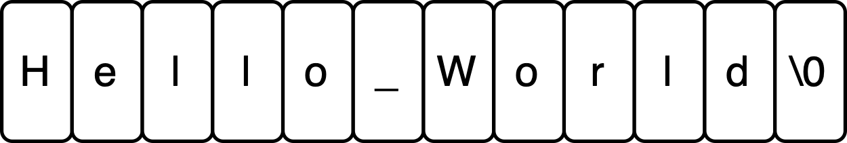
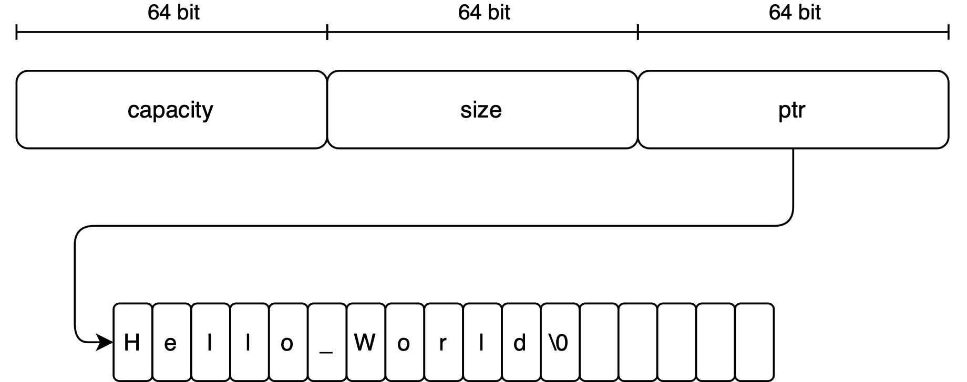
German-Style Strings
Apache DataFusion
C
C++
Source: Why German Strings are Everywhere
Notes:
Strings are generally going to reside on the heap instead of the stack
If we can keep it in stack, we can keep it in CPU registers

Slide 13
German-Style Strings
Apache DataFusion
Observations:
Most strings are short
Strings are not changed often
We usually only look at a subset of the string
Source: Why German Strings are Everywhere
Notes:
Based on common workloads, how can we do better?

Slide 14
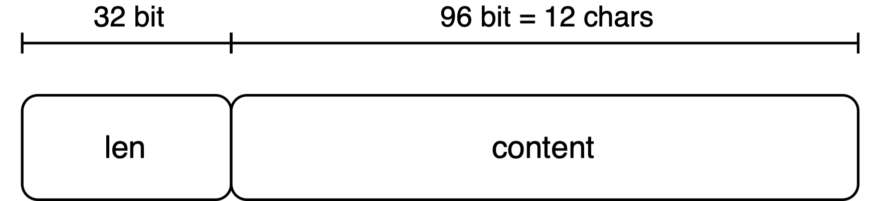
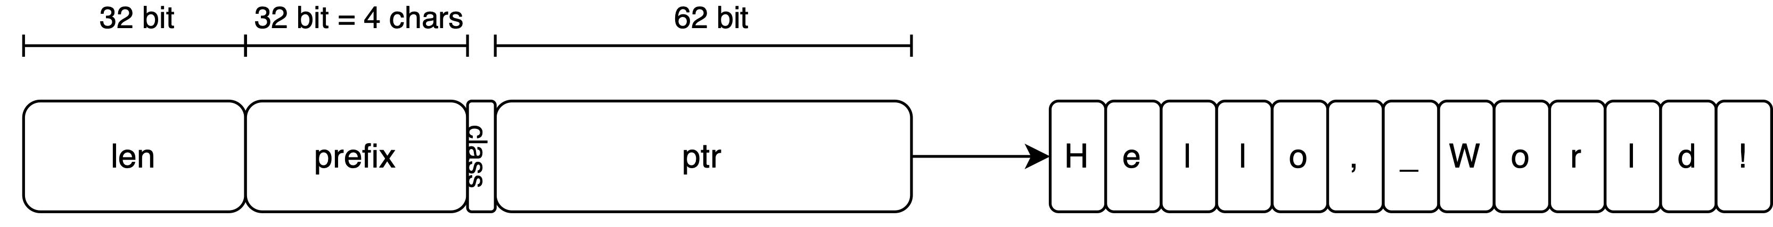
German-Style Strings
Apache DataFusion
Short string
Long string
Source: Why German Strings are Everywhere
Notes:
Every string starts as a 128-bit object
4 level paging: 48 bits, 5 level paging 57 bits
Prefix enables faster equality and ordering operations
Pointer can reference original parquet data, deduplicate data
Downsides: every string takes 128 bits

Slide 15
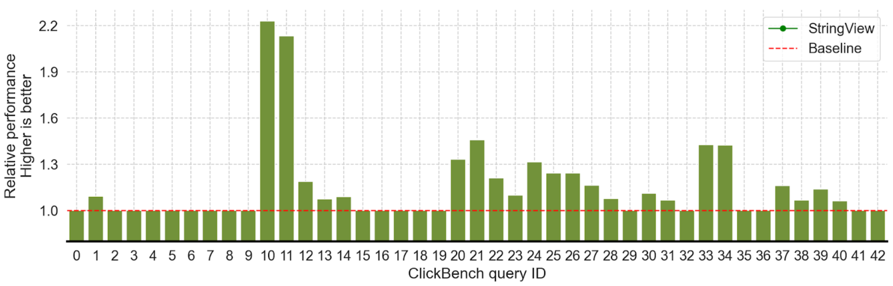
German-Style String Performance
Apache DataFusion
Source: Faster DataFusion with StringView
Notes:
Click bench, overall 8%

Slide 16
Apache DataFusion Comet

Slide 17
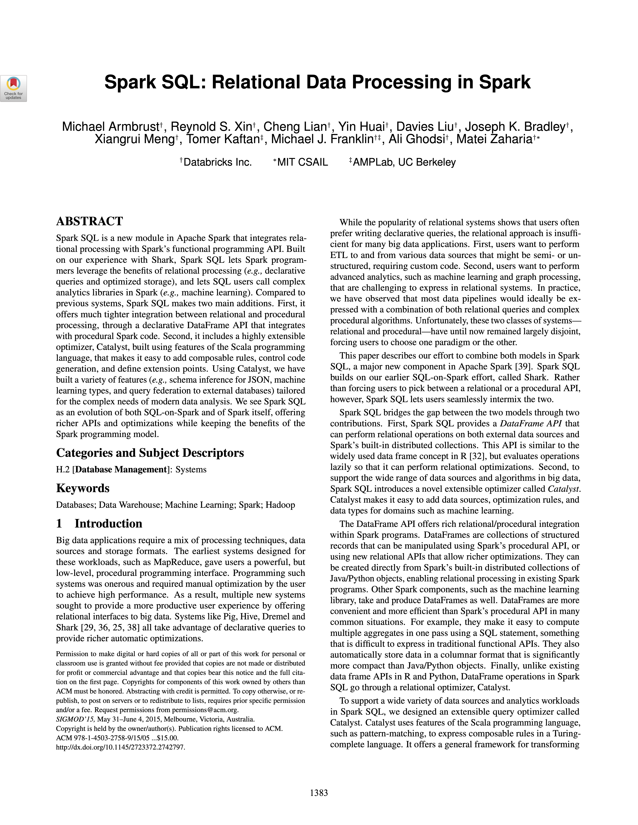
Apache Spark
Apache DataFusion Comet
Large scale distributed query processing
Originated at UC Berkeley’s AMPLab
Downsides:
Row-based query processing
JVM execution not as fast as native code
JVM garbage collection adds unpredictable latency
Notes:
Response to MapReduce processing
Thousands of machines, petabyte-scale operations
Columns A, B, C

Slide 18

Apache Spark
Apache DataFusion Comet
Scheduler
Worker
Executor
Application
Executor
Driver
Worker
Executor
Executor
Notes:
Response to MapReduce processing
Thousands of machines, petabyte-scale operations

Slide 19
Overview
Apache DataFusion Comet
Apache Spark accelerator based on Apache DataFusion
Accelerate shuffle, data loading, operators, expressions, and functions
Fall back to Spark for unsupported operations
Compatible with Spark 3.3, 3.4, 3.5. Experimental support for 4.0
Donated to The Apache Software Foundation in February 2024

Slide 20

Apache Spark
Apache DataFusion Comet
Scheduler
Worker
Executor
Application
Executor
Driver
Worker
Executor
Executor
Notes:
Response to MapReduce processing
Thousands of machines, petabyte-scale operations
This is not a completely new idea

Slide 21
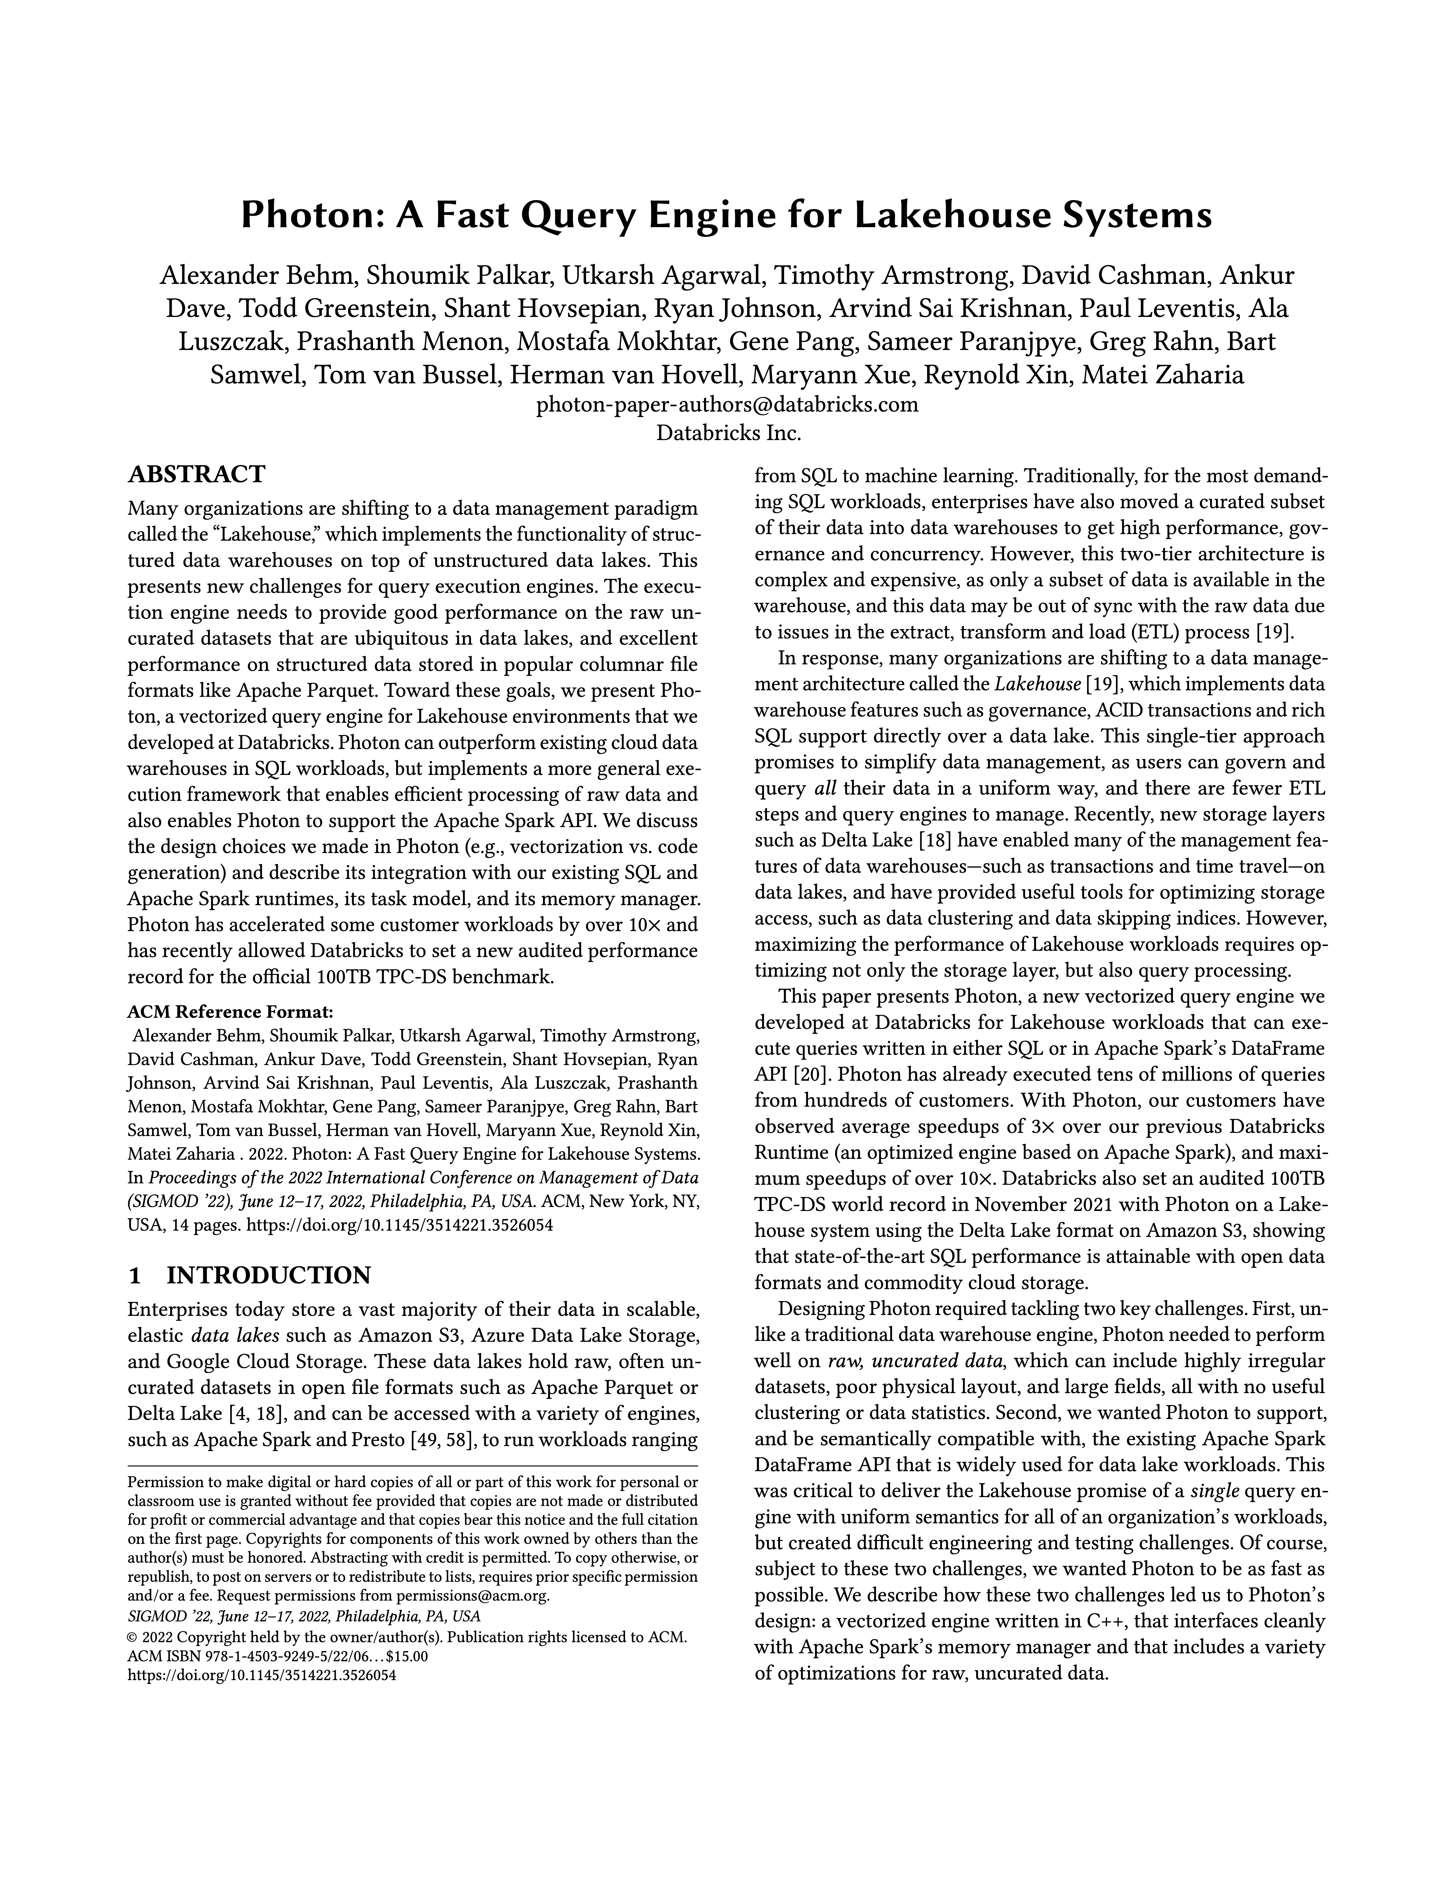
Databricks Photon
Apache DataFusion Comet
Apache Spark accelerator for Databricks
Vectorized C++ engine
Discusses design trade-offs:
JIT compilation vs. interpretation
Validity bitmaps vs. position vectors
Notes:
SIGMOD 2022
Rare in an industry paper

Slide 22
Challenges
Apache DataFusion Comet
Spark is a moving target:
Behavior differences between Spark releases
Configurations change casting behavior
ANSI SQL enforced in Spark 4.0
Data representation differences:
Spark uses Java’s BigDecimal, Arrow uses Decimal128
Spark converts unsigned types to the next size signed type

Slide 23
TPC-H, single-node, partitioned Parquet
Apache DataFusion Comet
Source: Apache DataFusion Comet 0.5.0 Release
Notes:
tpc-h ~2x speedup

Slide 24
Roadmap
Apache DataFusion Comet
Add fuzz testing to CI
Complex Type Support
e.g., arrays, maps, structs
Use DataFusion’s Parquet scan instead of Comet Scan
Support more native functions and expressions
Explore StringView performance benefits

Slide 25
How to Get Involved

Slide 26
Online Open-Source Communities
How to Get Involved
GitHub:
https://github.com/apache/datafusion
https://github.com/apache/datafusion-comet
https://github.com/apache/arrow-rs
Apache DataFusion Community Meeting
Wednesdays @ 11am ET
ASF Slack: https://infra.apache.org/slack.html
Notes:
Beginner issues, we’ve had fantastic new contributors the last few months

Slide 27

Online DBMS Resources
How to Get Involved
Andy Pavlo @ CMU:
Intro to DBMSs (15-445)
Advanced DBMSs (15-721)
Special Topics (15-799):
Optimizers, self-driving DBMSs
CMU-DB YouTube
Lectures, seminars
Notes:
Playlists for introduction to database systems course, graduated courses (special topics, advanced DBMSs), seminar series

Slide 28
Online Systems Communities
How to Get Involved
Discord:
Software Internals: https://discord.gg/243d8pfGB9
DataFusion / Arrow Rust: https://discord.gg/geUyQt6DXJ
DC Systems: https://discord.gg/W6gvyDy8wP
Please share more!
Notes:
#dbs, #papers channels in Software Internals
If these don’t work, email me or something
ASF Slack needs an invite, if it’s important to you let me know.

Slide 29
Takeaways
Putting Theory Into Practice
Database management systems (DBMSs), their academic communities, and their open-source communities are awesome!
Apache DataFusion is a high-performance, embeddable analytics engine
Apache DataFusion Comet uses DataFusion to accelerate Apache Spark
Reach out if you want to chat: https://mattbutrovi.ch
Thank you to Andy Grove and Andrew Lamb for their support in creating this talk.
Notes:
I will put the slides on the Discord

