Slide 1

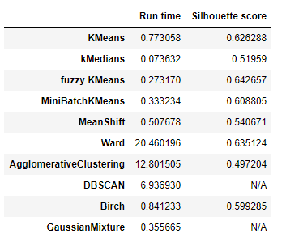
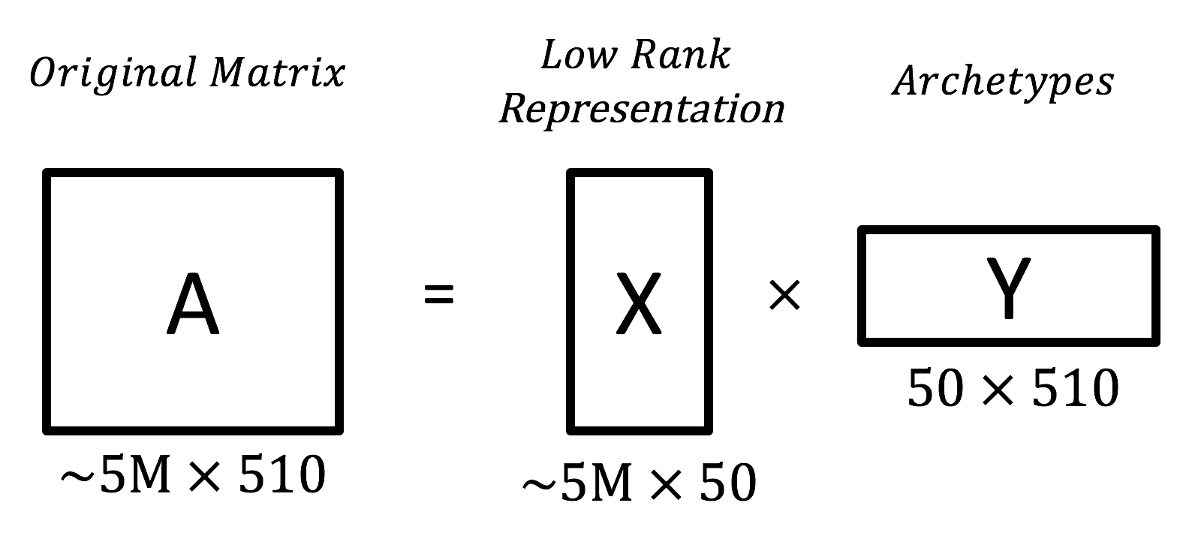
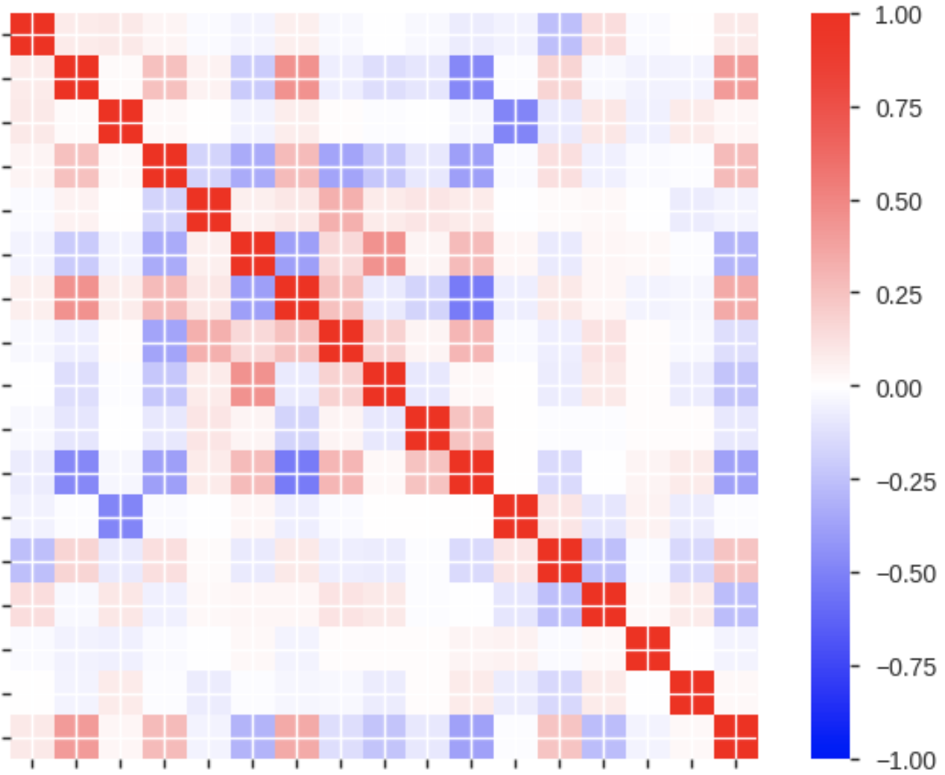
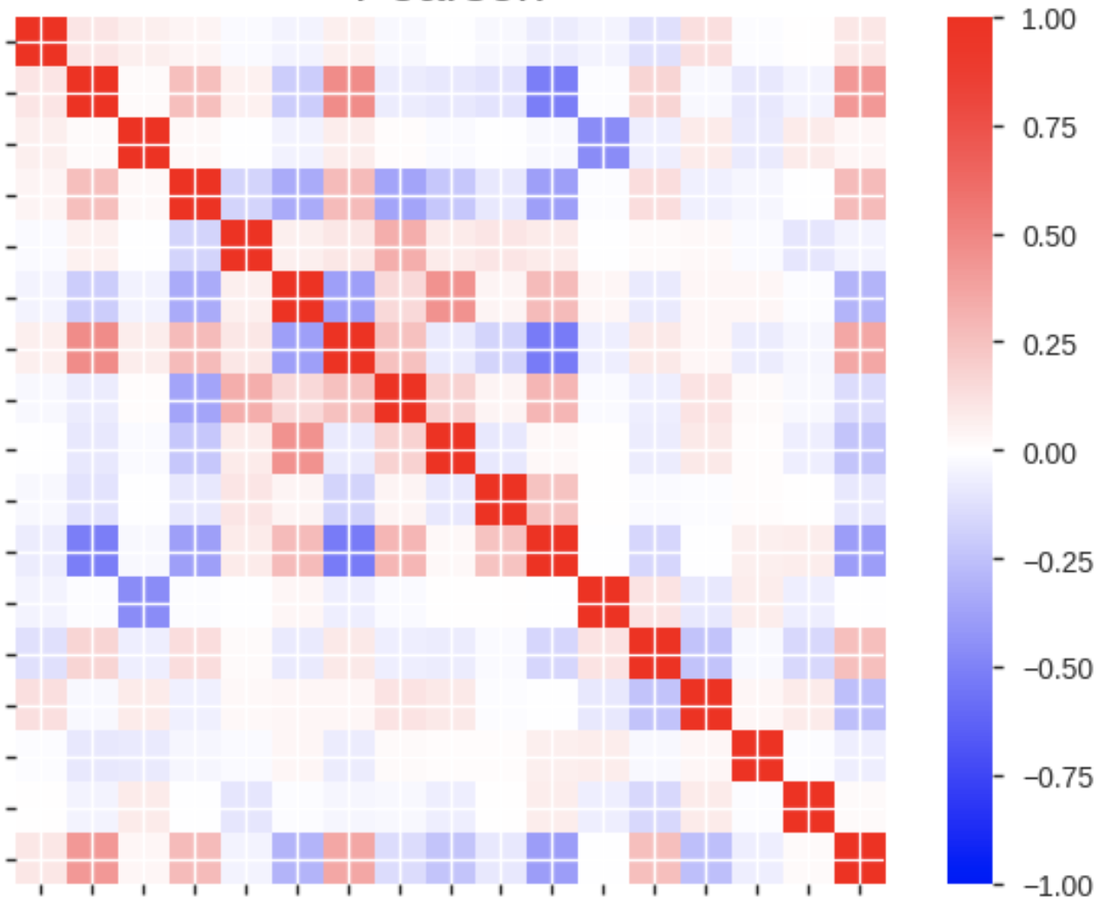
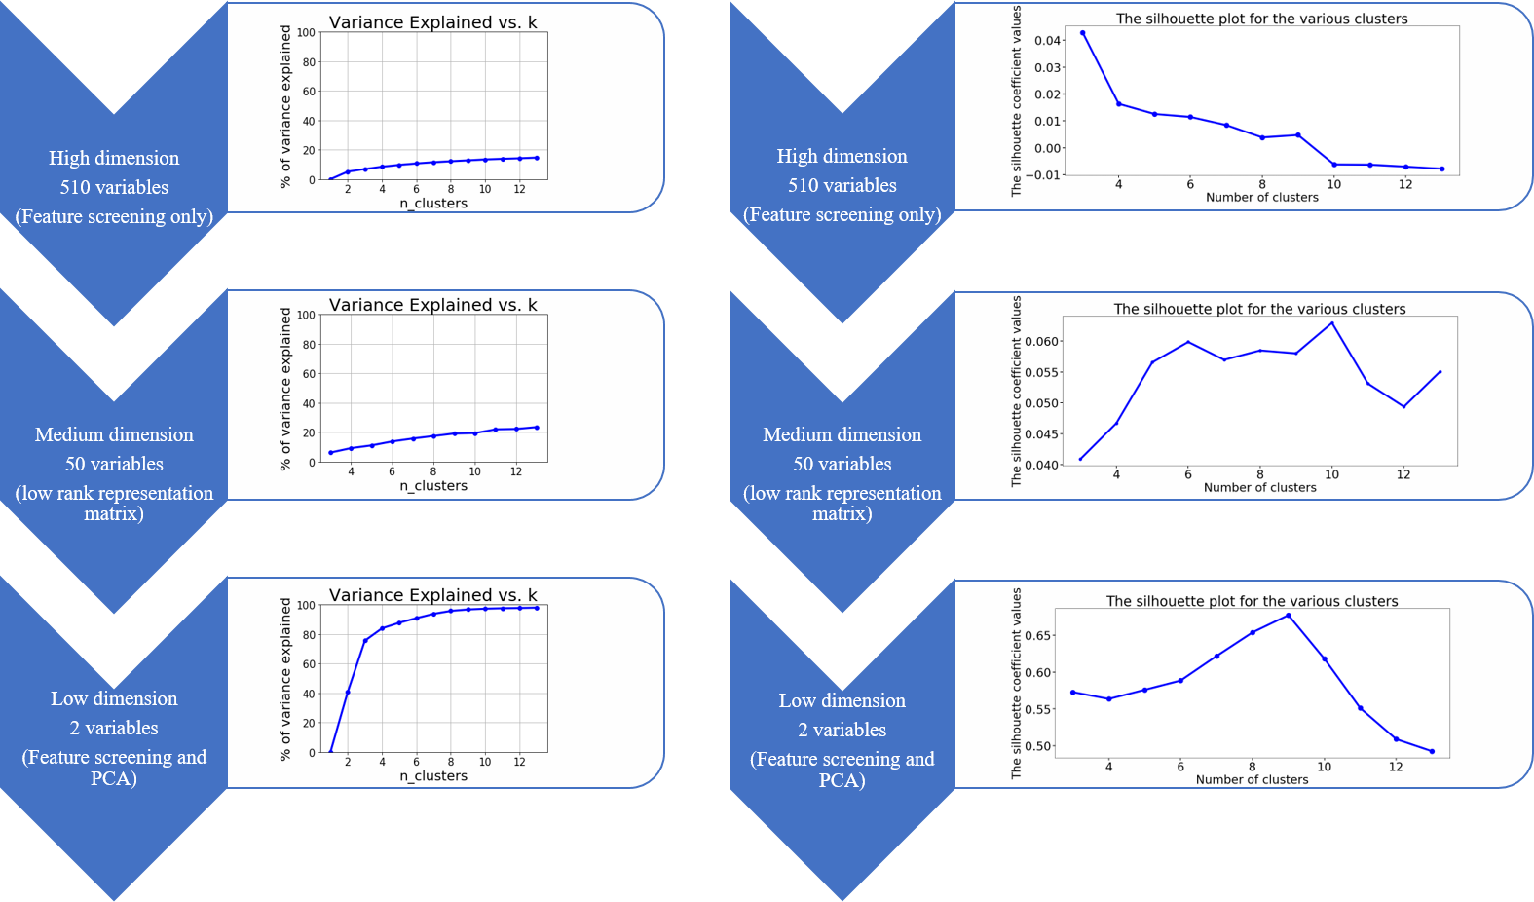
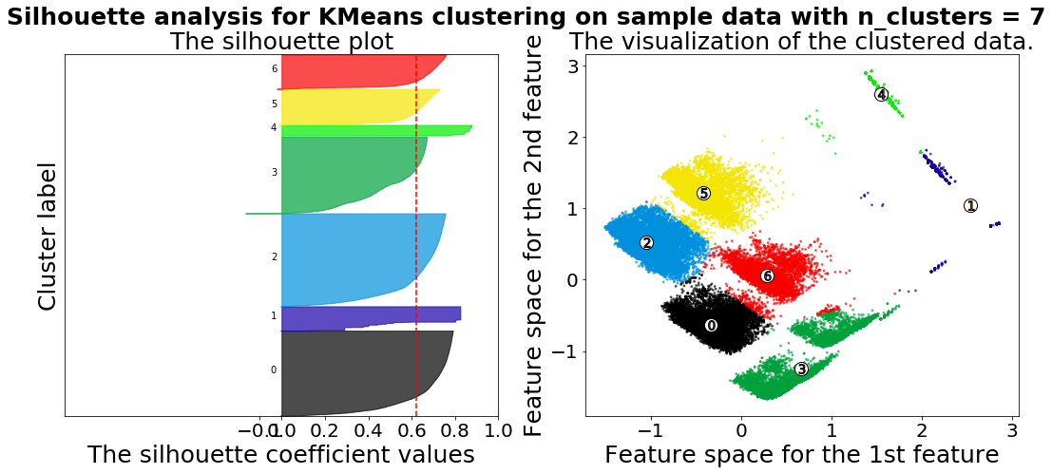
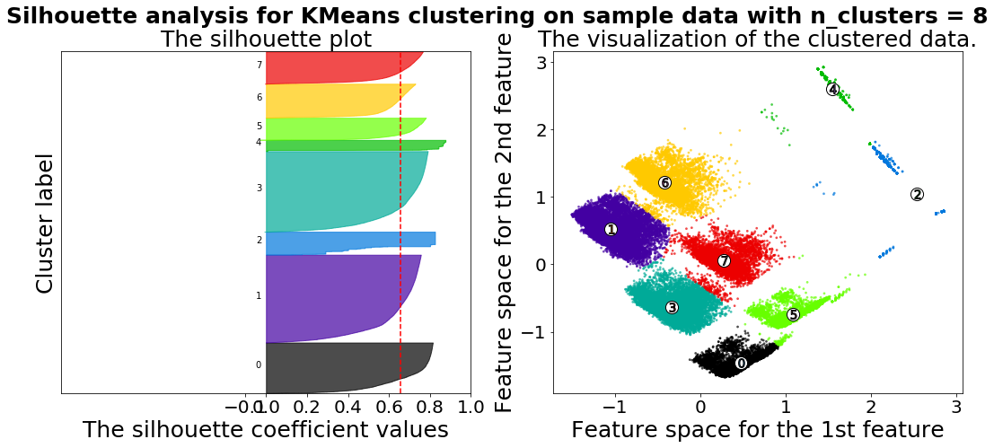
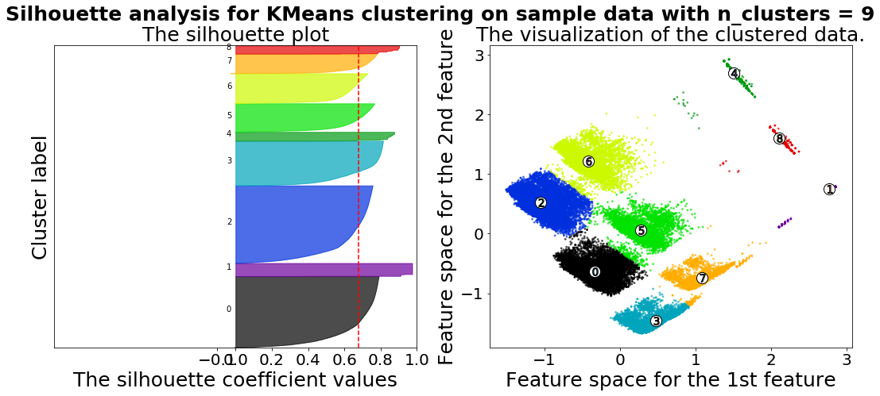
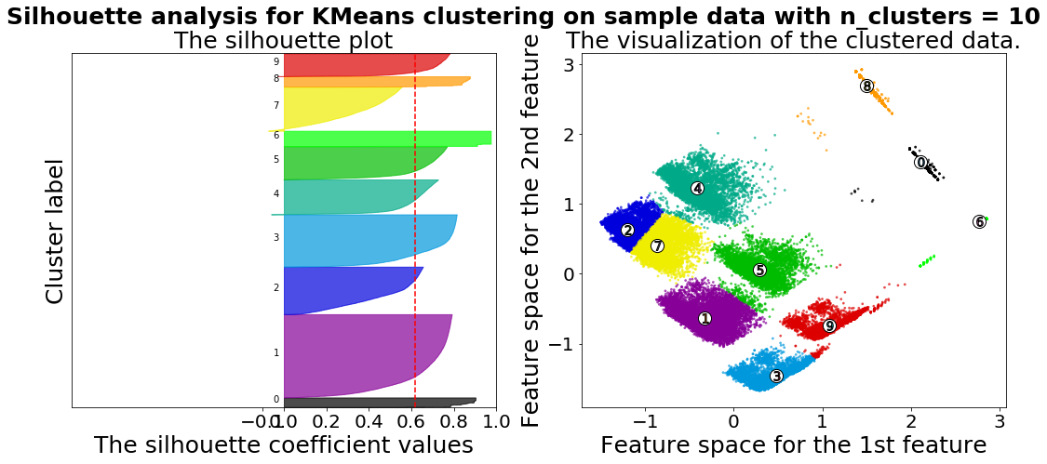
Customer Segmentation for Variable Annuity Products
Mobing Zhuang, Sha Li, Yawen Li
Interdisciplinary Data Science Master Program
Introduction
Results
Conclusions
A variable annuity (VA) is a contract between a customer and an insurance company. With a VA, the insurance company agrees to make periodic payments to the customer in the future. As total sales of VA in U.S. market grows, insurance companies face big challenges in terms of pricing their products due to the great uncertainties of policyholders’ behaviors. This project offers predictive analysis of policyholders’ behaviors to our project sponsor, Milliman. Milliman is one of the world’s largest providers of actuarial and related products and services. We here provide the sponsor reasonable customer segmentation suggestions to differentiate profitability of policyholders for their client insurers. The results will guide insurers’ product design and marketing, and make better estimation on the cost to provide a current product.
Feature Selection
The missing value imputation and feature selection methods were successful for subsequent clustering.
When comparing different clustering algorithms in low dimension, fuzzy K-Means, Ward, and regular K-Means are the top three algorithms in terms of silhouette score. Ward, being an hierarchical clustering algorithm, has much longer runtime and is difficult to scale to a large data set.
Our study showed that K-Means algorithm did not perform as well on high dimensionality. This is probably because euclidean distance is problematic with high dimensionality. We introduced an subspace clustering algorithm, Entropy weighting K-Means (EWKM) to handle high dimensionality.
We applied two methods based on internal metrics to determine optimal K, elbow and average silhouette score methods. Our clustering results on high and medium dimension suggest that optimal K could be 6-10, specifically, our study on the first two principal components suggest K to be 9.
Most clustering algorithms only handle numerical data, we introduced K-Prototype algorithm to handle both numerical and categorical data. however, it is not necessary after our feature selection, which ended up with all numerical variables.
Step 1: Go through all features and remove irrelevant ones.
Step 2: Remove correlated features.
Step 3: LASSO, select features that can predict policyholders’ behaviors.
Step 4: Group features and PCA transformation.
Selected Features
LASSO Models
We constructed two logistic regression models with LASSO regularization to find the features that can predict policyholder behavior, which is represented by two variables:
Surrender Indicator: binary, 1 or 0
Efficiency Group: 8 levels,
I : "I" incomplete withdrawal record,
O1- O3: Light, Medium, Extreme Over Utilizer,
E: Efficient Utilizer,
U1 - U3: Light, Medium, Extreme Under Utilizer
Specifically, the models were constructed using these two variables as response variable respectively and using third party variables as predictors.
Feature Category | # | Feature Description or Representatives | PCA Transformation
Delinquency | 19 | Delinquency number, amount, credit change, etc. | reduced to 10 dimensions
Finance | 9 | Close to limit mortgage, Length of finance history, etc. | reduced to 4 dimensions
Housing | 8 | Market value, lot size, mortgage, residence length, etc. | -
Neighborhood | 13 | Neighborhood income, occupation, education, housing | reduced to 7 dimensions
Trade | 21 | Number, balance, and utilization of trades | reduced to 9 dimensions
Auto Score | 1 | Auto score | -
Credit Score | 1 | Credit score | -
Health | 1 | Health Score* | -
Income | 1 | Bucketed Income Group | -
Life Status | 2 | Age, etc. | -
* Health Score: relative health score based on prescriptions - greater values imply greater mortality risk
Objectives
Study the impact of high dimension on clustering performance.
Customer segmentation to distinguish their profitability.
Deliverable 1
Enriched datasets with missing value imputation and reduced datasets dimensions with feature selection.
Deliverable 2
Method of determining optimal number of clusters (optimal K) based on internal metric.
Future Work
Deliverable 3
Developed and performed different clustering algorithms, compared their clustering performance and running time.
Clustering Algorithm Comparison
In this study, the quality of clusters is measured by internal metric, the compactness and separation of clusters (silhouette and elbow method). External metric, associated with profitability projection, is recommended to be included in the evaluation of clustering algorithm as well.
Clustering algorithms that are based on distance metric is favorable because of its interpretability. There are clear limitations for applying such models to high dimensional data. Entropy based subspace clustering is recommended to use for future work.
Besides application to high dimensional data, scalability to large data sets is also found to be crucial for a clustering algorithm to perform well in this study. Future work is recommended to study the scalability to large data sets of clustering algorithms.
Deliverable 4
Clustering results based on two methods: K-Means and subspace entropy weighting K-Means.
Algorithm | Pros | Cons | Scalability
K-Means | Running Time; Better for high dimensional data; Easy to interpret and Implement. | Assumes the clusters as spherical, so does not work efficiently with complex geometrical shaped data (Mostly Non-Linear); Hard Assignment might lead to mis grouping. | Very large n, medium K
K-Medians | Calculates the median for each cluster as opposed to calculating the mean of the cluster. More robust to outliers compared to K-Means. | Hard Assignment might lead to miscategorization. | Very large n, medium K
Fuzzy K-Means | Allow one piece of data to belong to two or more clusters. | A fixed number of cluster K. | Very large n, medium K
Minibatch K-Means | Reduce the convergence time of K-Means. | Slightly worse performance compared to standard. | Not scalable with n
MeanShift | Simplicity, only one parameter—the kernel bandwidth value is needed, does not require number of clusters to be specified. | N-squared algorithm, slow. However, it’s parallelizable. | Not scalable with n
Ward hierarchical clustering | When spherical multivariate normal distributions are used, Ward’s method is excellent. | Ward’s method only performs well if an equal number of objects is drawn from each population and that it has difficulties with clusters of unequal diameters. | Large n and K
Agglomerative clustering | Any valid measure of distance can be used. | Time complexity O(n3) and requires O(n2) memory. | Large n and K
DBSCAN(Density-based spatial clustering of applications with noise) | Clusters can be any shape, and no need to specify number of clusters. As opposed to K-Means which assumes that clusters are convex shaped. | DBSCAN is not entirely deterministic and cannot cluster data sets well with large differences in densities. | Very large n and medium K
BIRCH (Blanced Iterative reducing and clustering using hierarchies） | Reduced the I/O costs given the limited amount of memory. Robust to outliers and more easily parallelized. | Handles only numeric data. | Very large n and medium K
Gaussian mixtures | Does not assume clusters to be of any geometry. Works well with non-linear geometric distributions as well. Does not bias the cluster sizes to have specific structures as does by K-Means (Circular). | Uses all the components it has access to, so initialization of clusters will be difficult when dimensionality of data is high; Difficult to interpret. | Not scalable
Run time and clustering performance compare
Data
More than 4 million rows and 1063 variables, which are from:
Insurance Company
Vendor Data
Consumer Data
Credit Data
Mortgage Data
Census Data
Health Score
Methods
References
Feature Selection
Feature Screening, remove irrelevant and correlated features
LASSO, select features having predicting power
PCA (filter model), dimension reduction
Wrapper model, order features based on their cluster differentiability.
Data Preparation
Apply Generalized Low Rank Model on High-dimensional Data to reduce dimensionality and impute missing values.
The silhouette value is a measure of how similar an object is to its own cluster compared to other clusters. Ranges from -1 to +1, where a high value indicated that the object is well matched to its own cluster and poorly matched to neighboring clusters.
The comparison was run on a 1.25% random sample from the original size data, with reduced dimension to 2.
Aggarwal, C. C., & Reddy, C. K. (2014). Data clustering: algorithms and applications. Boca Raton: Chapman and Hall/CRC.
Jiang, H., Yi, S., Li, J., Yang, F., Hu, X.(2010). Ant clustering algorithm with K-harmonic means clustering. Expert Systems with Applications 37, 8679-8684.
Madeleine Udell, .Corinne Horn, Reza. Zadeh, and Stephen. Boyd. (2016) Generalized Low Rank Models. Foundations and Trends in Machine Learning.
L. P. Jing, M. K. Ng, Z. X. Huang. (2007). An Entropy Weighting K-Means algorithm for subspace clustering of high-dimensional sparse data. IEEE Transactions on Knowledge and Data Engineering, 19(8): 1026-1041.
Get Low Rank Representation
Pearson Correlation Patterns, original vs. imputed data
Optimal Number of Clusters
Get Low Rank Representation
Elbow Method Average silhouette score analysis
Silhouette analysis on low dimension of various cluster numbers
Generalized Low Rank Model (GLRM) Illustration
Original Data Imputed Data
17 variables 17 variables
Acknowledgement
Model Selection
Applied 10 different clustering algorithms range from basic K-Means, K-Means extensions to hierarchical clustering, kernel-based clustering, density-based clustering and probabilistic model using existing packages.
Self-implemented K-Means, K-Medians, K-Harmonic Means and K-Prototype clustering algorithms from scratch.
Determination of Optimal K
Elbow Method
To define clusters such that the explained variance (between-cluster sum of squares/total sum of squares) is maximized.
Average Silhouette Score Analysis
Silhouette coefficient is calculated using the mean intra-cluster distance and the mean nearest-cluster distance for each sample. Average silhouette measures how close each point in one cluster is to points in the neighboring clusters and thus provides a way to assess clustering performance.
Our team would like to show our appreciation to Megan Hazen, course instructor, for giving us a good guideline throughout the last two quarters. We would also like to express our deepest gratitude to Guy Yollin, Manikant Prasad, Matthias Kullowatz, Talex Diede, and Peggy Brinkmann, people from the project sponsor Milliman, for their continued help and support to make the project a success.
Contact Information
Left column: silhouette plot for various clusters; Right column: clustered data visualization on the first two principal components.
Mobing Zhuang, mbzhuang@uw.edu
Sha Li, shali@uw.edu
Yawen Li, liy44@uw.edu

