Slide 1
Customer Segmentation for
Variable Annuity Products
The Data Pipeline
Mobing Zhuang
Sha Li
Yawen Li
Interdisciplinary Data Science Masters Program, University of Washington

Slide 2
Statement of Problem
Variable annuities have become a part of the retirement and investment plans of many Americans.
Customers purchase a variable annuity contract by making either a single purchase payment or a series of purchase payments. Under the contract, the insurer agrees to make periodic payments to customer, beginning either immediately or at some future date.
In the U.S., there are $2 trillion in assets in variable annuity (VA) market under management.
Policyholder behaviors have an enormous impact on how much it will cost insurers to provide a product. Nevertheless, the enormous uncertainty in the VA space around policyholder’s behavior poses risk towards insurance companies, and such risk is not hedgeable.
The big challenge for insurers: relatively little ability to distinguish between policyholders that will behave in different ways.
This project sponsor Milliman has been a leader in actuarial consulting since 1947.

Slide 3
Design Objectives
Perform customer segmentation analysis, thus provide accurate estimation of policyholder’s behavior:
Improve the current clustering technique, K-means Convergence and initial partition: reasonable initial partition, fast convergence, and a global search of optimum. The number of K: implement algorithms to find optimum number of clusters. Robustness: implement algorithms to be resilient to outliers and noise. Extension of definition of means: replace means with other metrics in the algorithm
Explore and compare K-means with other nonlinear clustering method We will use perform nonlinear transformation on the data matrix and compare the clustering.

Slide 4
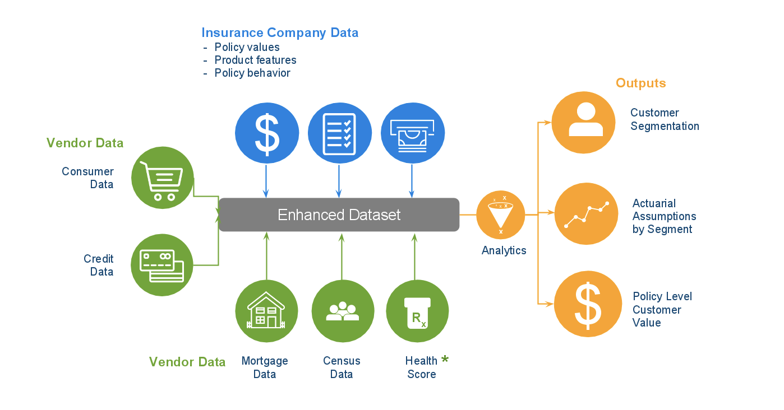
Data Pipeline
Data Sources
Consumer Data: Epsilon, Credit Data: Transunion, Mortgage Data: Black Knight
Health Score data not used in this study

Slide 5
Data Pipeline
Data Sources - Census Data
Census tract and block group level
Geocode the addresses associated with each VA contract to identify the corresponding census tract and block group.
Focus on the following variables:
Population density
Demographic - distribution by gender, age, education, and household type
Income - distribution and percentiles, per capita average, distribution by type(wage, self-employment, social security, etc.), percent below poverty level
Housing - percent owner occupied, distribution by value of owner occupied units, mortgage status, and mortgage amounts by age
Workforce - distribution and by occupation and industry

Slide 6
Data Pipeline
Data Sources - Credit Data, Black Knight
Black Knight provides data and analytics for the mortgage and real estate industries. The data is compiled from county property tax and deed records, as well as mortgage lenders.
Milliman provided addresses to Black Knight and receive the matching property data.
Focus on the following variables:
Loans - the number of active loans, loan types, loan terms, loan ages, amount borrowed, estimated payments and outstanding loan amounts, estimated loan to value
Property - estimated value, change in value, value per square foot, age of home, years owned, lot size
Neighborhood - average loan to value, property value, year built, etc. for the ZIP code

Slide 7
Data Pipeline
Data Sources - Consumer Data, Epsilon
Epsilon is a major vendor of transactional, survey, and consumer data, and also provides various marketing scores and household lifestyle/lifestage clusters.
Epsilon used names and addresses from the policy data to match data from their database.
Focus on the following variables:
Lifestyle - health conditions (e.g. anxiety, arthritis), interests (e.g. golf, travel, fitness)
Financial - estimated income, net worth, liabilities, types of credit cards and loans
Property - dwelling type, mortgage amount, home sale price, home equity,home market value, refinance activity, loan to value
Marketing scores - general, automotive finance, credit card
Census - percent owner occupied, percent families, median school years completed, percent single family homes, median home value

Slide 8
Data Pipeline
Data Sources - Credit Data, Transunion
Transunion is one of the three major consumer credit reporting agencies. Data is compiled from lenders such as credit card issuers, auto finance companies, and mortgage lenders as well as collection agencies and courts.
Transunion used policyholder name, addresses, date of birth, and last 4 digit of SSN to match on the credit records.
Focus on the following variables:
Length of credit history - number, age, types of accounts
Recent credit seeking - number of inquiries, number of recent opened accounts
Utilization - balance of limits, changes in balances
Payment history - number of times past due, number of charge-offs, number of collections
Public records - bankruptcies, liens
Scores

Slide 9
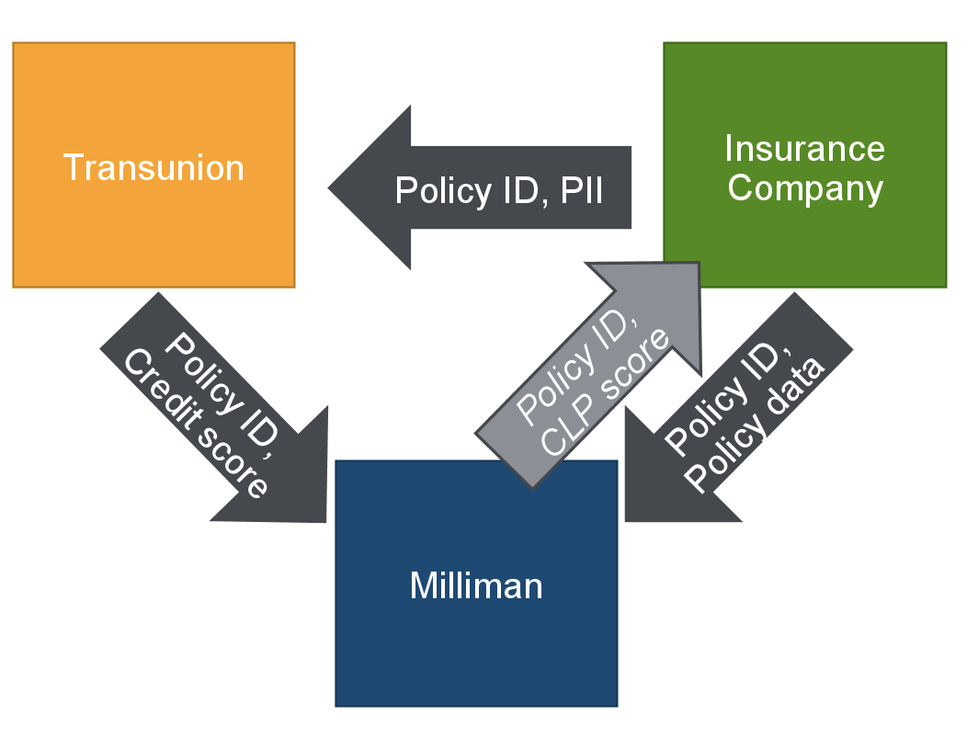
Data Pipeline
No Personal Identifiable Information (PII) Received

Slide 10
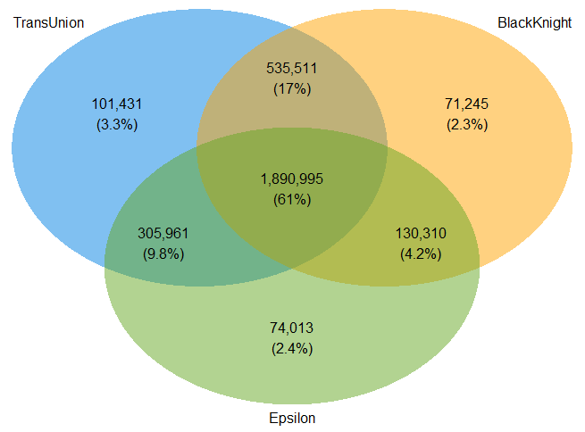
Data Pipeline
Data Sources
No data match 2%

Slide 11
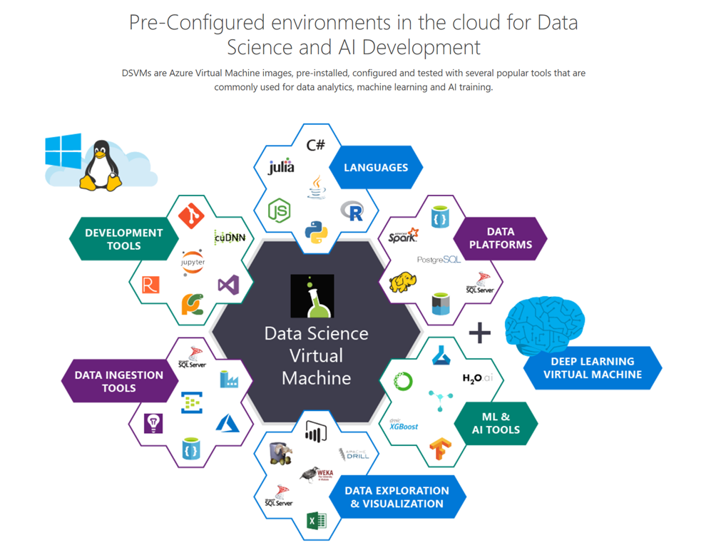
Data Pipeline
Computation Platform - Azure, Data Science Virtual Machine (DSVM)
The raw datasets will be copied to DSVM by data engineers at Milliman.
We will perform the following data processing and analysis on this great platform, a pre-configured environment in the cloud for data science. The plentiful options of languages, tools of development, data ingestion, data visualization, and machine learning will provide great flexibility for the project.

Slide 12
The end!

