Slide 1
DOM Manipulation in JS
Adam gavel

Slide 2

Definition and Purpose
DOM Manipulation (or, Document Object Model) is how JavaScript changes and alters both HTML, and CSS.
It allows developers to quickly change large segments of HTML or CSS, depending on user input, or the user’s device.

Slide 3

Key Terms
The most important methods are –
getElementById() – gets an element based on it’s assigned ID
Element.textContent – allows a developer to see/change text content in an element
Element.classList.add(‘new-style’); - allows a developer to assign a new class to an element
Notes:
Element, in these examples, is a stand-in for any element you want to change.

Slide 4
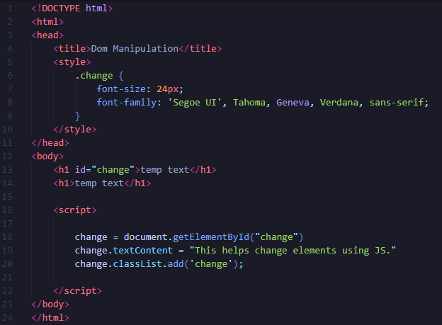
Examples
Notice that there are two h1 elements, with the only difference being the assigned ID.
The script is placed BEFORE the elements. It is important to state elements before attempting to change them.

Slide 5
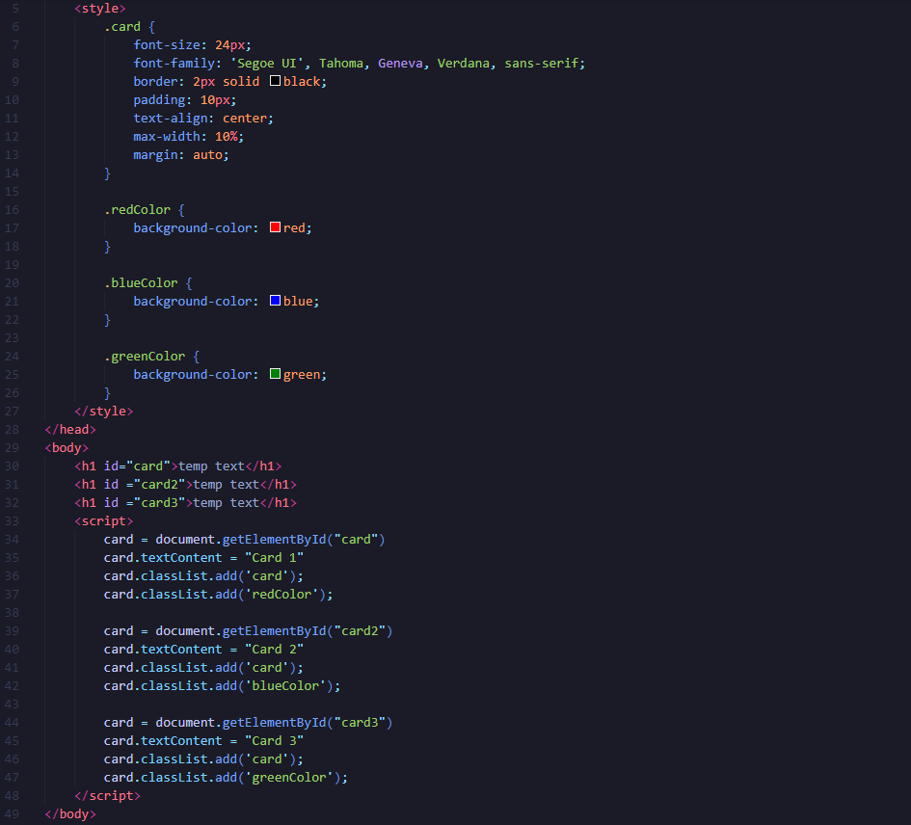
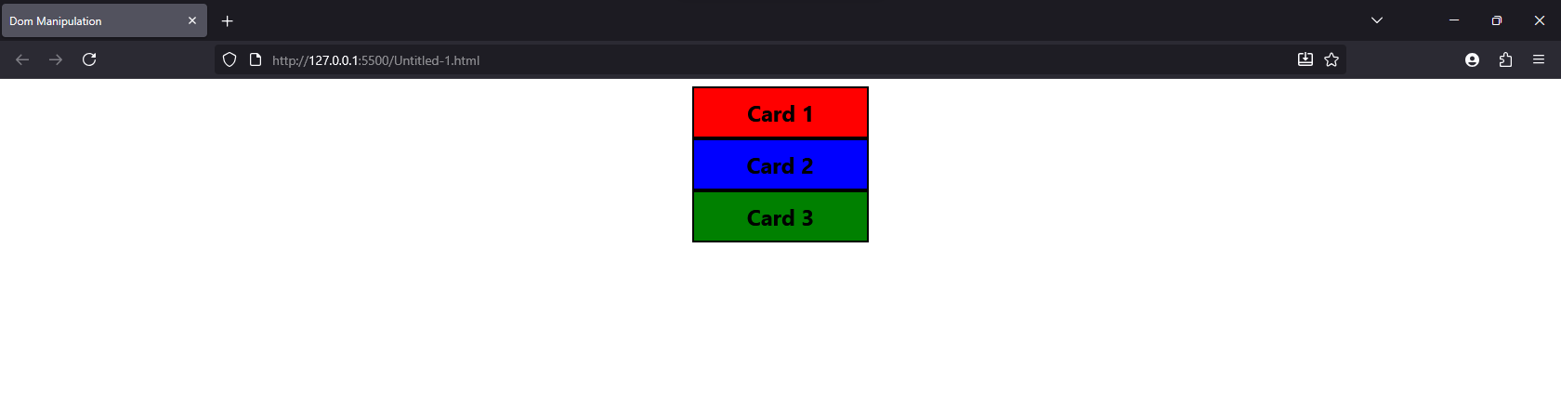
Applied Example
Notes:
There are three different assigned cards. While similar, they are different in both element, and assigned color class.

Slide 6
Common Mistakes / Tips
Style
Element
Script
Always put scripts after elements.
Assigning variables to elements before changing them.
Assigning one ID to multiple elements.
Notes:
It is important to put your style before and element, and an element before a script in your code.

Slide 7

Importance
DOM Manipulation helps developers make large changes quickly, and helps create template for future use.

Slide 8
References
Classwork GitHub Repository (js04)

