Slide 1
JSX
Overview of JSX
JSX syntax
JSX gotchas

Slide 2
Section 1: Overview of JSX
The story so far…
Introducing JSX
Transpiling JSX

Slide 3


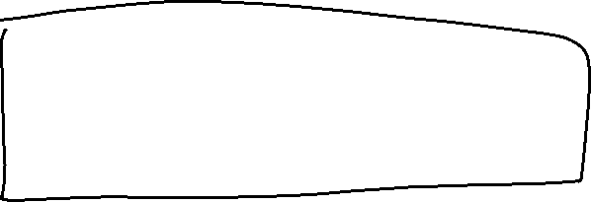




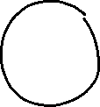
The Story So Far…
In all the examples so far, we've created elements programmatically using React.createElement()
This is very verbose!
const prodList = React.createElement('ul', null,
React.createElement('li', null, 'Swansea City shirt'),
React.createElement('li', null, 'Cardiff City shirt'),
React.createElement('li', null, 'Bugatti Divo'),
React.createElement('li', null, '55in OLED HD TV'),
React.createElement('li', null, 'Carving skis'),
React.createElement('li', null, 'Ski boots')
);

Slide 4





Introducing JSX
React supports a lightweight syntax called JSX
Create React elements concisely and directly
Use XML to specify the elements you want to create
const prodList =
<ul>
<li>Swansea City shirt</li>
<li>Cardiff City shirt</li>
<li>Bugatti Divo</li>
<li>55in OLED HD TV</li>
<li>Carving skis</li>
<li>Ski boots</li>
</ul>

Slide 5
Transpiling JSX
Browsers don't understand JSX syntax
JSX syntax must be transpiled into "pure" React
You can use the Babel transpiler to do this
Add a <script> to download the Babel transpiler
Embed JSX inside <script type="text/babel">
<script src="…URL for Babel on unpkg.com…"></script>
<script type="text/babel">
… Put your JSX code here …
</script>

Slide 6
Section 2: JSX Syntax
JSX content
Using JSX for components
Simple example of JSX
Evaluating JavaScript expressions in JSX
Data-driven JSX
Passing properties to a component in JSX
Complete example

Slide 7
JSX Content
JSX elements can contain plain text
JSX elements can contain JS expressions in {} braces
const productsList =
<ul>
<li>Swansea City shirt</li>
<li>Cardiff City shirt</li>
</ul>
const data = ["Swansea City shirt", "Cardiff City shirt"]
const summaryElem = <div>There are {data.length} items</div>

Slide 8
Using JSX for Components
JSX can be used in a component:
example1.html
function ItemsList() {
return (
<div>
<h1>JSX Example 1</h1>
<ul>
<li>Swansea shirt</li>
<li>Cardiff shirt</li>
<li>Lamborghini</li>
</ul>
</div>
)
}
const root = ReactDOM.createRoot(document.getElementById('root'))
root.render(<ItemsList/>)

Slide 9
Evaluating JavaScript Expressions in JSX
JSX can contain JavaScript expressions:
example2.html
function ItemsList() {
const timestamp = new Date().toLocaleTimeString()
return (
<div>
<h1>JSX Example 2</h1>
<ul>
<li>Swansea shirt</li>
<li>Cardiff shirt</li>
<li>Lamborghini</li>
</ul>
<small>Page generated at {timestamp}</small>
</div>
)
}
const root = ReactDOM.createRoot(document.getElementById('root'))
root.render(<ItemsList/>)

Slide 10
Data-Driven JSX
JSX can contain data-driven content:
const data = ["Swansea shirt", … … … ]
function ItemsList() {
const timestamp = new Date().toLocaleTimeString()
return (
<div>
<h1>JSX Example 3</h1>
<ul>
{ data.map((item, i) => <li key={i}>{item}</li>) }
</ul>
<hr/>
<small>Page generated at {timestamp}</small>
</div>
)
}
const root = ReactDOM.createRoot(document.getElementById('root'))
root.render(<ItemsList/>)
example3.html

Slide 11

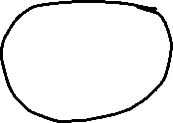
Passing Properties to a Component in JSX
example4.html
function ItemsList(props) {
return (
<div>
<h1>{props.heading}</h1>
<ul>
{props.items.map((item, i) => <li key={i}>{item}</li>)}
</ul>
<hr/>
<small>Page generated at {props.timestamp}</small>
</div>
)
}
const root = ReactDOM.createRoot(document.getElementById('root'))
root.render(
<ItemsList
heading={'JSX Example 4'}
items={data}
timestamp={new Date().toLocaleTimeString()}
/>
)

Slide 12
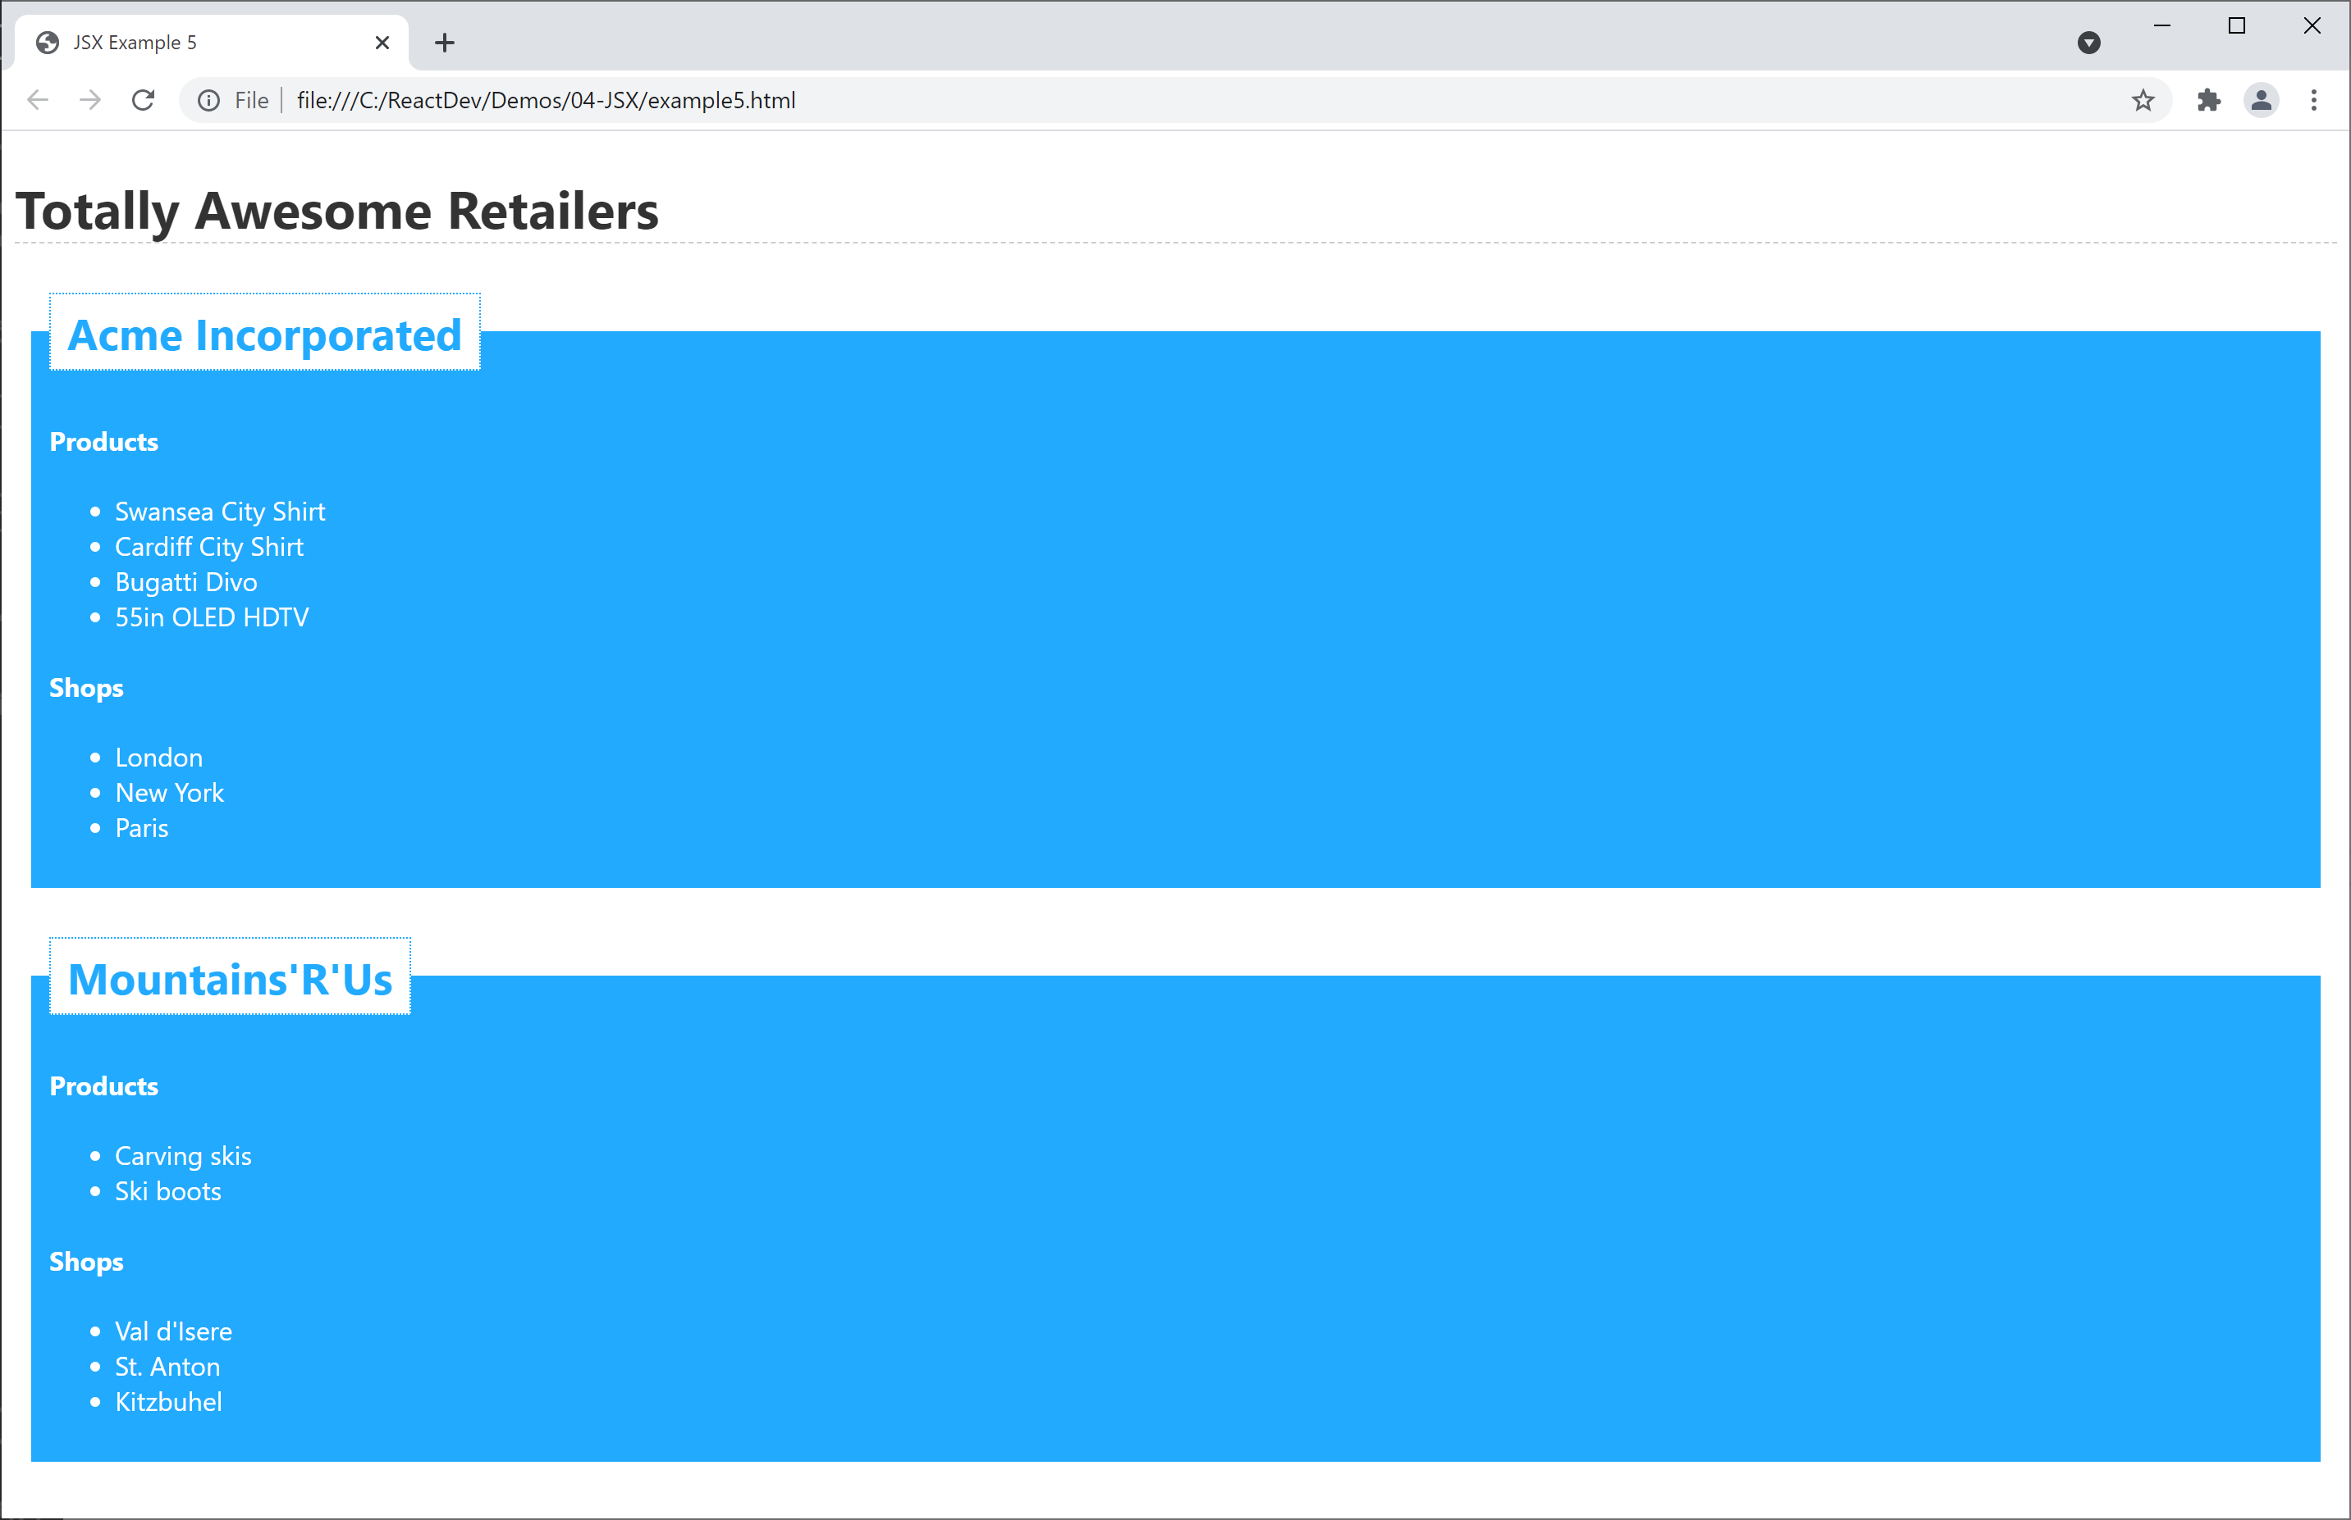
Complete Example
See complete example in example5.html

Slide 13
Section 3: JSX Gotchas
JSX gotchas - 1
JSX gotchas - 2

Slide 14
JSX Gotchas - 1
JSX is case-sensitive
JSX tags must be closed
const badElem1 = <DIV>oops</div>
const badElem2 = <input type="text">

Slide 15
JSX Gotchas - 2
Adjacent JSX elements must be wrapped inside an enclosing tag
To assign a CSS class, use className (not class)
const badElem3 =
<h1>Greetings</h1>
<div>This won't work. Sorry!</div>
const badElem4 =
<div class="emphasis">Won't work!</div>

Slide 16
Summary
Overview of JSX
JSX syntax
JSX gotchas

