Slide 1
Railway Sign Detection in Night Images
Gunho Sohn, Jungwon Kang, Kang Zhao
Feb 20 2018

Slide 2
Contents
Overview
Thales Train System
(Raw) Thales Night Railway Image Set
Task 0: Dataset Generation
Task 1: Sign Detection
Task 2: Sign Detection with Subsequent Deblurring
Reference List

Slide 3
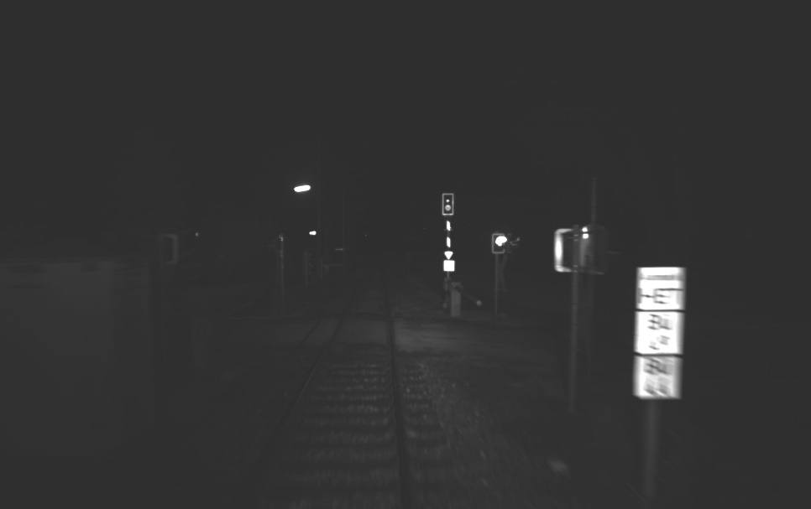
Overview
Objective
Detecting two types (QR & HBB) of signs in night images, and deblurring the detected signs (in real time) * Recognition of the detailed sign contents is not included.
Image
Scope of
this project
Detected
bounding box
QR
HBB
Bu oo
Bu oo
Bu xx
Bu xx
*HBB: HET-B-B

Slide 4
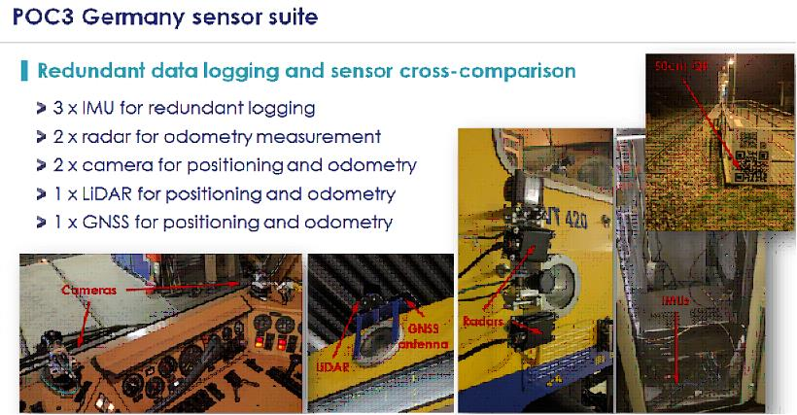
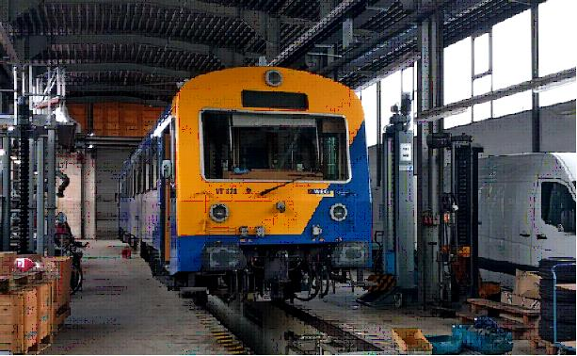
Thales Train System

Slide 5
(Raw) Thales Night Railway Image Set
Image Set 'germany_2017-11-21'
Raw images without annotation
Image set name | Number of Images | Status | Suitability for making training images
img_germany1/mono1 [germany_2017-11-21-16-26-44.bag] | 1779 | Calibration images | Not suitable
img_germany2/mono1 [germany_2017-11-21-16-34-23.bag] | 1160 | Just stationary | Not suitable
img_germany3/mono1 [germany_2017-11-21-16-36-39.bag] | 389 | Just stationary | Not suitable
img_germany4/mono1 [germany_2017-11-21-16-37-28.bag] | 10309 | Just stationary | Not suitable
img_germany5/mono1 [germany_2017-11-21-21-32-33.bag] | 20570 | Train normally moving | Suitable
img_germany6/mono1 [germany_2017-11-21-22-14-05.bag] | 40180 | Train normally moving | Suitable
img_germany7/mono1 [germany_2017-11-21-23-32-27.bag] | 239 | No sign included | Not suitable
img_germany8/mono1 [germany_2017-11-21-23-32-58.bag] | 5206 | Train slowly moving | Suitable
img_germany9/mono1 [germany_2017-11-21-23-43-01.bag] | 4701 | Train slowly moving | Suitable

Slide 6
(Raw) Thales Night Railway Image Set
Signs in Image Set 'img_germany5/mono1'
QR sign (Total 390 images)
Starting frame | Ending frame | Number of images
510 | 680 | 171
785 | 887 | 103
19851 | 19966 | 116
HBB sign (Total 497 images)
2675 | 2700 | 26
2850 | 2866 | 17
3130 | 3150 | 21
3535 | 3550 | 16
3670 | 3692 | 23
3755 | 3773 | 19
3955 | 3978 | 24
4205 | 4235 | 31
6490 | 6510 | 21
11810 | 11823 | 14
11975 | 11995 | 21
13344 | 13368 | 25
13448 | 13477 | 30
13943 | 13968 | 26
14731 | 14758 | 28
14904 | 14916 | 13
14994 | 15009 | 16
15214 | 15227 | 14
15416 | 15429 | 14
15497 | 15507 | 11
15626 | 15637 | 12
16056 | 16075 | 20
16440 | 16460 | 21
16707 | 16740 | 34
*HBB: HET-B-B

Slide 7
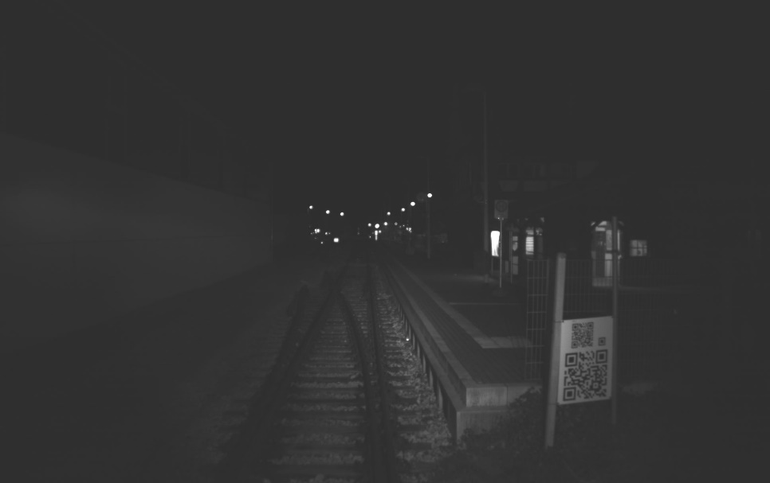
(Raw) Thales Night Railway Image Set
Characteristics of Signs in Images
Having severe scale change
Having extremely illumination-dependent appearance
Showing substantial blur (when a sign is near to fast moving train)
Notes:
E:\dir_yorku\project_deep_railway_sign2_2018\thales_night_image\img_germany5_bu3_3955_3978 의 img_ger5_mono1_3971.jpg
E:\dir_yorku\project_deep_railway_sign2_2018\thales_night_image\img_germany5_qr_510_680 의 img_ger5_mono1_665.jpg

Slide 8
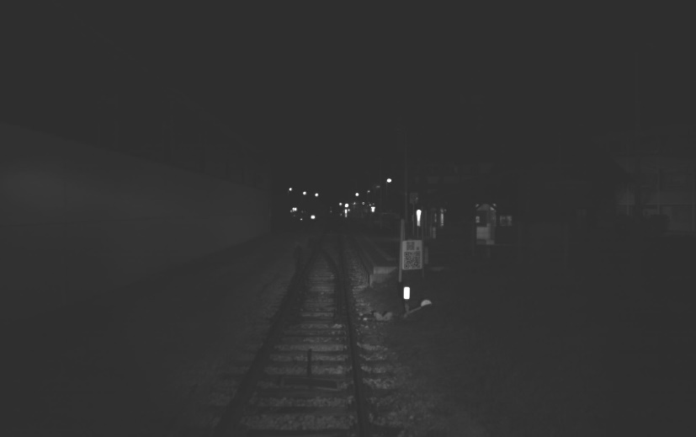

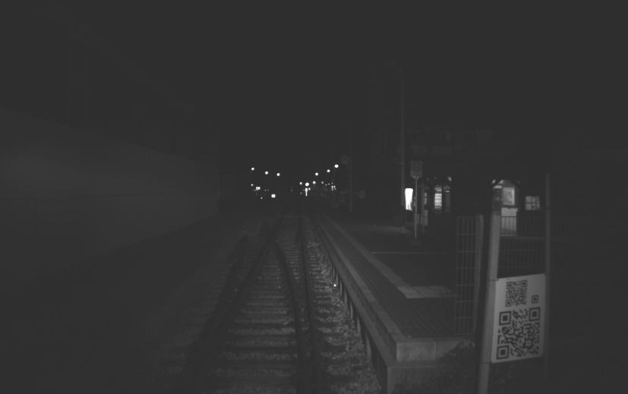

(Raw) Thales Night Railway Image Set
Example of QR Sign
Notes:
E:\dir_yorku\project_deep_railway_sign2_2018\img_thales\img_germany5_qr_510_680
img_ger5_mono1_620.jpg
img_ger5_mono1_670.jpg

Slide 9
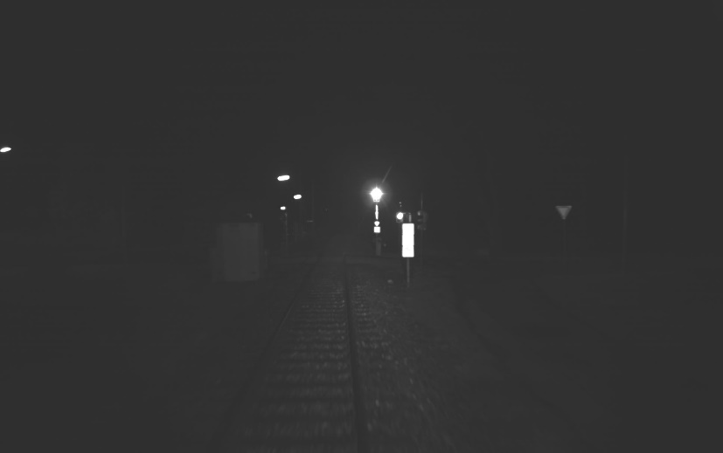


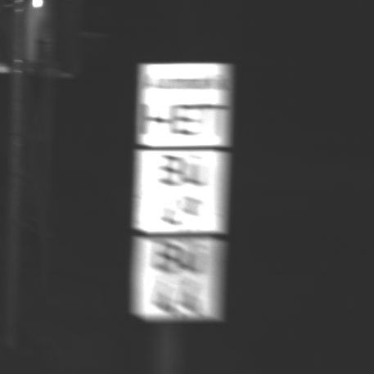
(Raw) Thales Night Railway Image Set
Example of HBB Sign
Notes:
E:\dir_yorku\project_deep_railway_sign2_2018\img_thales\img_germany5_bu3_3955_3978
img_ger5_mono1_3965.jpg
img_ger5_mono1_3971.jpg

Slide 10
Our Approach
Severe Scale Change
→ Treating one object as multiple classes according to the scale
Illumination-dependent appearance
→ Using preprocessing for illumination invariant transformation of images
Not many real images for training
→ Generating virtual dataset and using both real and virtual dataset for training
Substantial blur
→ Deblurring detected signs (for subsequent classification)

Slide 11
List of Tasks
Task 0: Dataset Generation
Task 0a: From real images
Task 0b: From virtual environments
Task 1: Sign Detection
Task 2: Sign Detection with Subsequent Deblurring

Slide 12
Task 0a: Dataset Gen. from Real Images
Bounding box annotation
Alp’s Labeling Tool (ALT)
https://alpslabel.wordpress.com/2017/01/26/alt/
Setting classes for QR & HBB signs
QR near / QR far / HBB near / HBB far, instead of QR / HBB

Slide 13
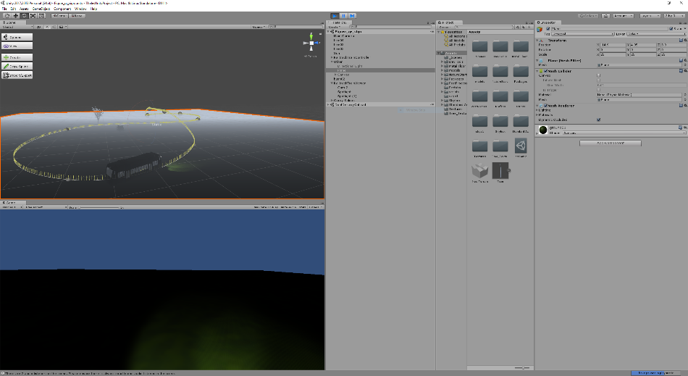
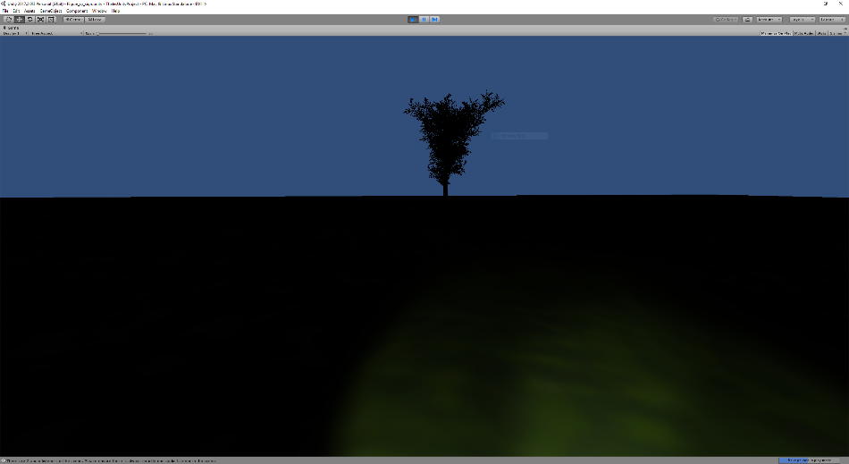
Task 0b: Dataset Gen. from Virtual Env.
Parameters
Position and size of signs in 3D world
Camera intrinsic and extrinsic parameters
Background
Illumination
Train speed
Blur effect in images
Screenshot of the unity program provided by Thales on Feb 7 2018

Slide 14

Task 1: Sign Detection
Detecting Signs from Preprocessed Images
Just training YOLO-v2 with preprocessed images
Preprocess-ing
YOLO-v2
Detected
bounding boxes
Notes:
img_ger5_mono1_3971.jpg

Slide 15
Task 2: Sign Detection with Subsequent Deblurring
Detecting Signs and its Deblurring
Having 'Bounding box + GAN' framework, as in [J. Li, CVPR 2017]
Preprocess-ing
YOLO-v2
Network from Task 1
GAN
(for deblurring)
Detected
bounding boxes
Deblurred
bounding boxes

Slide 16
Reference List
Traffic sign detection in night time
M. A. Garcıa-Garrido, "Fast Traffic Sign Detection and Recognition Under Changing Lighting Conditions", ITSC, 2006
K. Lim K, et al, "Real-time traffic sign recognition based on a general purpose GPU and deep-learning", PLoS ONE 12(3): e0173317. doi:10.1371/journal. pone.0173317, 2017
Use of mixture of real & virtual images
Y. Tian, "Training and Testing Object Detectors with Virtual Images", arXiv:1712.08470v1 [cs.CV] 22 Dec 2017
S. Huang, "Expecting the Unexpected: Training Detectors for Unusual Pedestrians with Adversarial Imposters", CVPR 2017
Object detection + GAN
J. Li, "Perceptual Generative Adversarial Networks for Small Object Detection", CVPR 2017
Illumination-invariant image transform
W. Maddern, "Illumination Invariant Imaging: Applications in Robust Vision-based Localisation, Mapping and Classification for Autonomous Vehicles", ICRA 2014
Deep learning-based deblurring
O. Kupyn, "DeblurGAN: Blind Motion Deblurring Using Conditional Adversarial Networks", arXiv:1711.07064 [cs.CV], Nov 2017
S. Nah, "Deep Multi-scale Convolutional Neural Network for Dynamic Scene Deblurring", arXiv:1612.02177 [cs.CV], Dec 2016
*HBB: HET-B-B
*HBB: HET-B-B

