Slide 1


Software Engineering – 25.10.2018 – Lea Wegner – Natalie Busam
Notes:
Good morning, today we're going to talk about Jira and hope that you will lern something new.
First off all we will show you our presentation, after that we'll show you the basics live in Jira and at the end we'll have a task for you.

Slide 2
Table of contents
About JIRA
Alternatives
Advantages from JIRA (in comparison to the alternatives)
Basics
Create Board, Issue, Epic, Story, Task, Bug
Create Sprint
Log Work
Complete an Issue
Add users
Other features
Our conclusion
Software Engineering – 25.10.2018 – Lea Wegner – Natalie Busam
Notes:
Here you can see our table of contents.
I'll begin with some information about Jira, after that I'll list some alternatives and advantages of it.
Followed by some basics, like creating a board, issue, epic, story, task and bug.
After that Lea will continue with creating a sprint, how to log your working time, complete an issue and add users.
The next points are about some features and at the end our conclusion.

Slide 3

About Jira
Tool for managing projects
Agile software development and monitoring
Supports Scrum (PM method)
No freeware, pricelist:
Some clients:
Software Engineering – 25.10.2018 – Lea Wegner – Natalie Busam
Notes:
First of all some information about Jira.
It is a tool for managing projects and ensures agile software development and monitoring.
Also it supports scrum and Kanban, which are a project-management methods.
Jira isn’t a freeware, here you can see the pricelist for the server and cloud version of it.
As you can see, even very large and well-known companies are trusting in this tool.

Slide 4
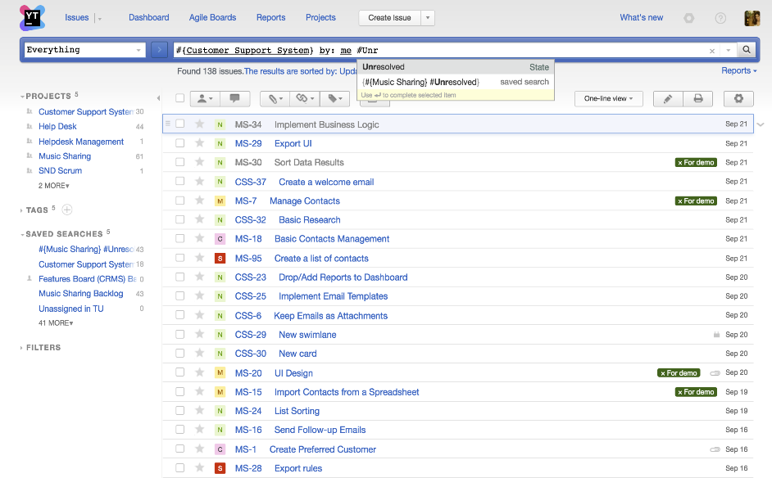
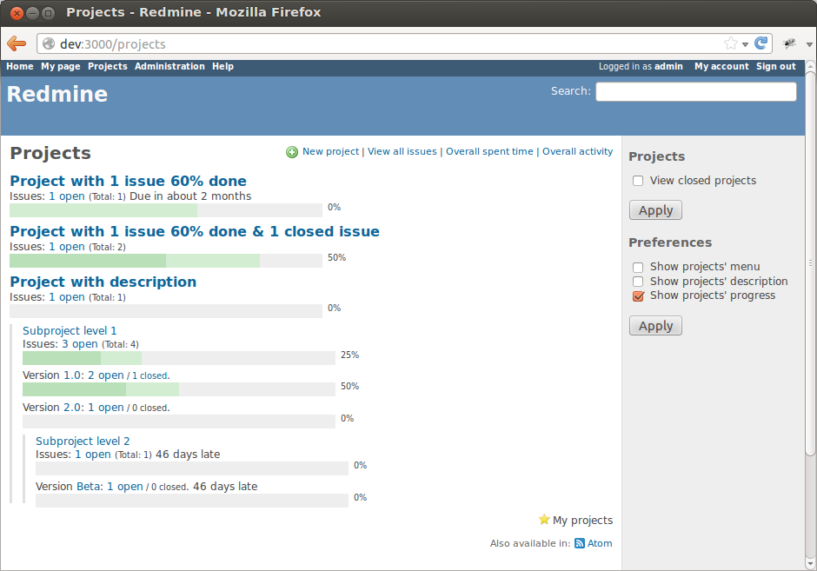
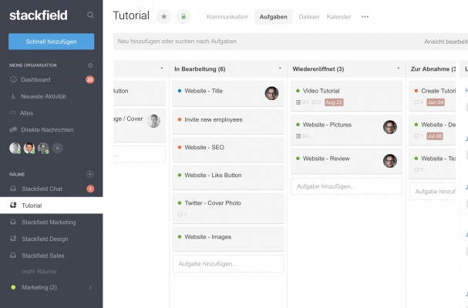
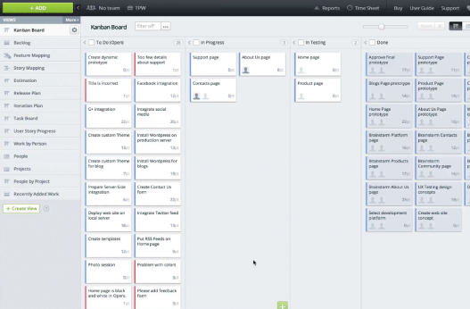
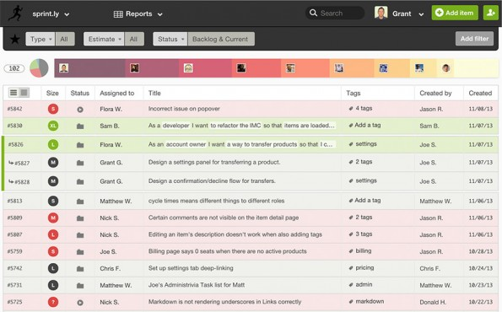
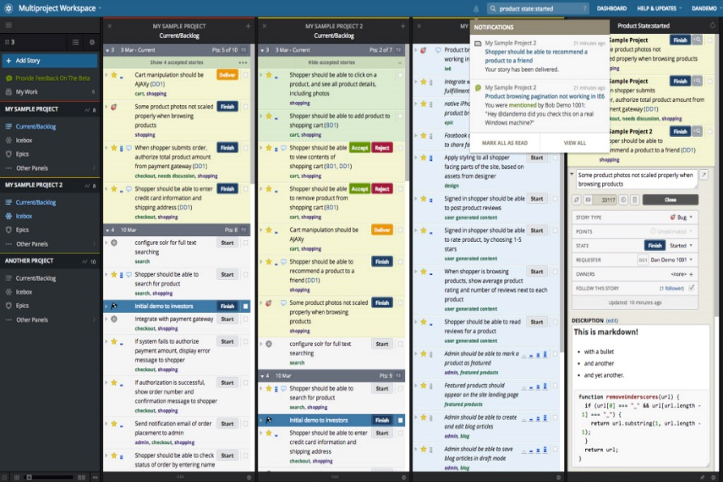
Alternatives
1. YouTrack
2. Redmine
3. Stackfield
4. Target Process
5. Sprintly
6. Pivotal Tracker
Software Engineering – 25.10.2018 – Lea Wegner – Natalie Busam
Notes:
Youtrack is a free browser-based bug tracker, issue tracking system and project management software, developed by JetBrains. Marcel is telling us more about it later.
Redmine is a free and open source, web-based project management and issue tracking tool. It allows users to manage multiple projects. You can also create wikis and open forums, use time tracking within a calendar and Gantt charts for visual representation of projects and their deadlines. → All other tools are also required to have a license like Jira.
Stackfield has its focus on team chat and discussions including tasks, time tracking, documents and many more possibilities.
TargetProcess is primarily aimed at professionals who want to systematically plan and implement their software projects. Also you can use well implemented mobile apps.
Sprintly is the only tool on the market that gives you a single, large board showing every card from every project.
Pivotal Tracker is for developers around the world for real-time collaboration around a shared, prioritized backlog.

Slide 5
Advantages
Amount of rules reduced to a minimum
Time required for administration reduced to a minimum
Easy to understand
Flexible planning
Transparent execution
Drag & Drop system
Very fast adding/ editing/ tracking and deleting issues
Lot of tutorials available
Large and helpful documentation
Helpful shortcuts (e.g. i → assign to me, c → create an issue)
Reduce time
Software Engineering – 25.10.2018 – Lea Wegner – Natalie Busam
Notes:
Now some advantages in comparison to the alternatives:
It reduces amounts of rules and the required time for administration to a minimum
It is easy to understand by its clear representation with many explanations and aids
Flexible planning, transparent execution and easy drag & drop
Very fast adding/ editing/ tracking and deleting issues
Due to its popularity there are lots of tutorials available, including a large documentation
It also has some helpful shortcuts (e.g. i → assign to me, c → create an issue)
The best thing about using such a tool is the time, saved by the transparency of the projects.

Slide 6
Basics
Project: including boards
Board: shows issues
Issue: mostly a "user-story" with some subtasks
Sprints: period in which a milestone is getting completed
Workflow: graphical representation of the process
Software Engineering – 25.10.2018 – Lea Wegner – Natalie Busam
Notes:
Now to the basic terms of the tool.
A project contains boards, which in turn displays the issues.
An issue is mostly a user-story with some subtasks.
A Sprint is a period in which milestones have to be completed.
The last term is workflow, which is a graphical representation of the process.

Slide 7
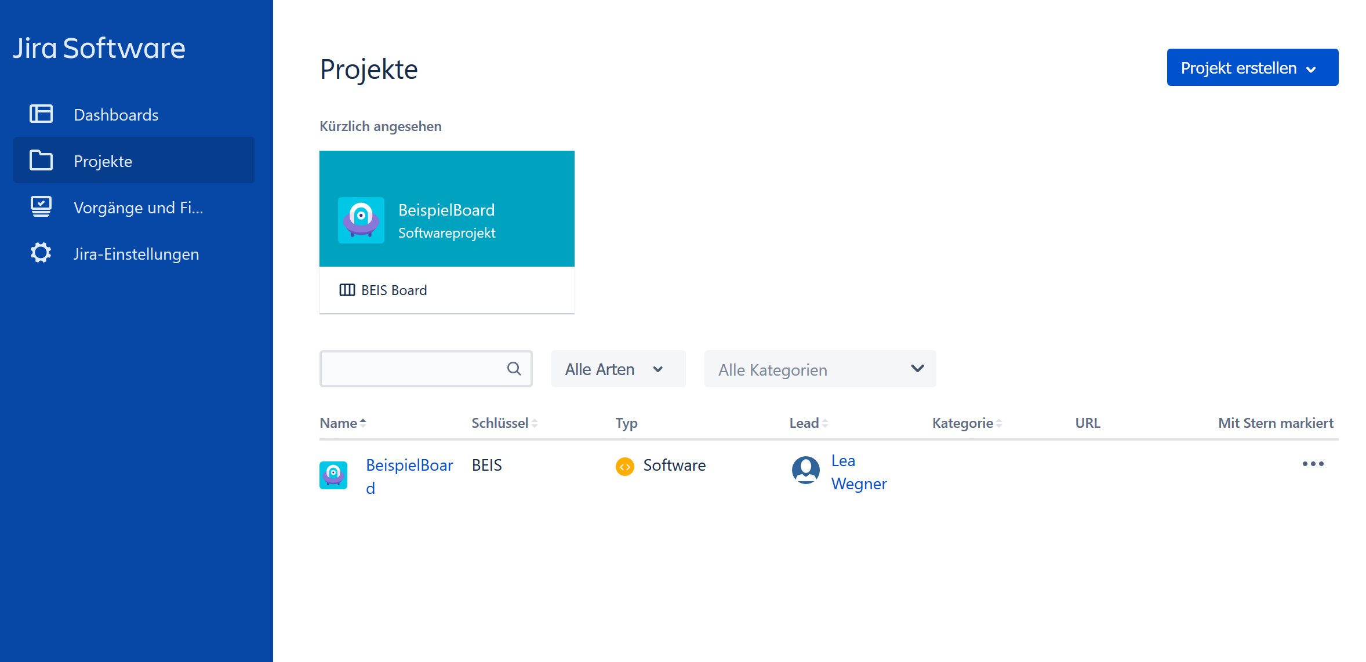
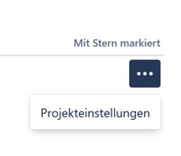
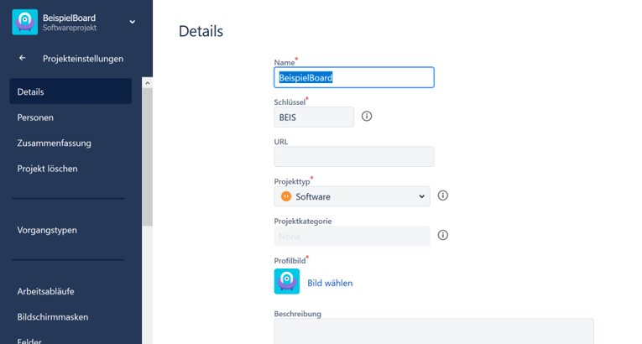
Basic Settings
1. Open the project overview:
2. Open settings:
Name
Key
Project-type
Project-category
Description
Software Engineering – 25.10.2018 – Lea Wegner – Natalie Busam
Notes:
Now to the basic settings.
First of all you have to open the project overview.
All created projects are displayed here.
If you click on the three dots at the end of the line, you get to the respective project settings.
Here you can enter the name, key, project type, category and a description.

Slide 8
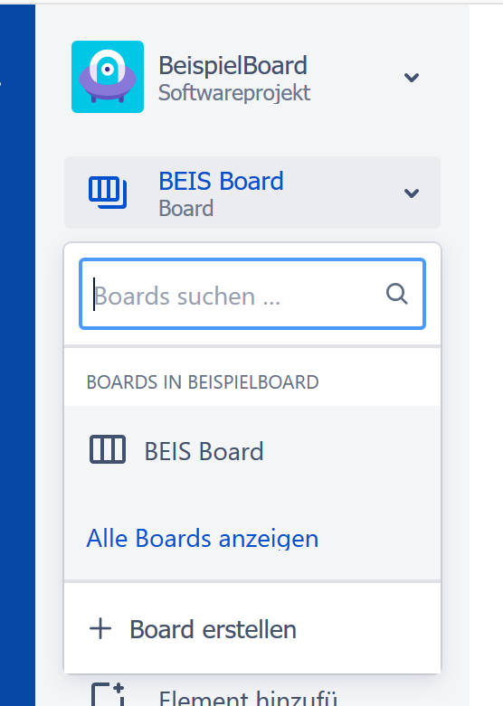
Create Board
Opend board
Searching boards
Show all existing boards
Create a new board
Software Engineering – 25.10.2018 – Lea Wegner – Natalie Busam
Notes:
The next step is to create a board.
To do this, open the created project and use the drop-down menu to create a new board.
Also there are some other possibilities, like searching boards or showing all existing boards.

Slide 9
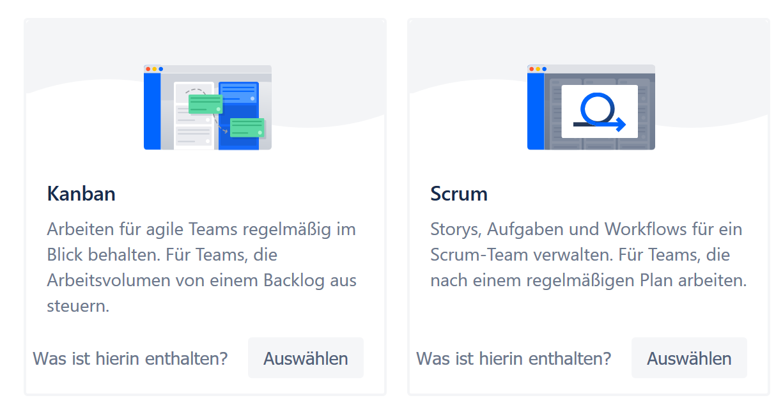
Choose between „Scrum“ and „Kanban“
Kanban: more workflow visualisation, useful when making changes to an existing project
Scrum: for software engineering with sprints
Software Engineering – 25.10.2018 – Lea Wegner – Natalie Busam
Notes:
If you have created a board, you have the choice between Scrum and Kanban.
Kanban is more a workflow visualization and useful when you're making changes to an existing project or when you have a fixed goal.
Scrum in turn is more used for software engineering because of the possibility of creating sprints or for projects whose goals have not yet been defined.

Slide 10
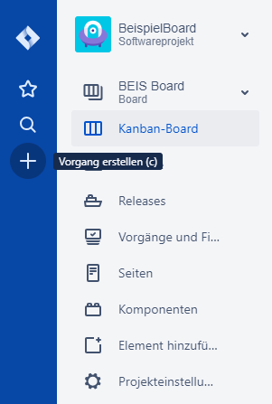
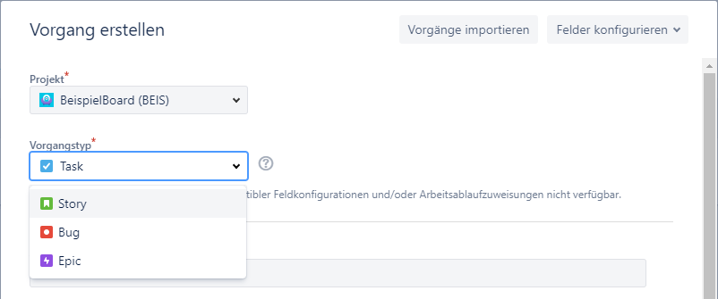
Create Issue
Choose between those process types:
Epic: Task type for a large user story that needs to be split.
Story: Contains a number of tasks that fit together.
Task: A task that needs to be done.
Bug: For solving problems.
Software Engineering – 25.10.2018 – Lea Wegner – Natalie Busam
Notes:
To create a new issue, click on the plus sign on the left side.
A window will open with some sections to fill in, for example the assignment to a project and the selection between four different task types.
The first one is called Epic and will be chosen for larger amount of work with more than a single Use-Case or stories.
A Story contains a number of tasks that fit together and the progress-type is often choosen as a use-case.
A Task is just a task that needs to be done and a Bug for Bug-fixing.
Also there are some more sections, like the description, etc.

Slide 11
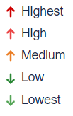
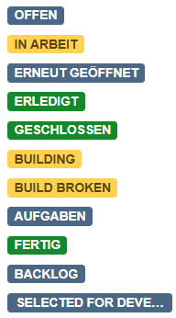
Issue Information
Priorities:
This problem will block progress.
Serious problem that could block progress
Has the potential to affect progress.
Minor problem or easily worked around.
Trivial problem with little or no impact on progress.
Process status:
Building: Source code has been committed, and JIRA is waiting for the code to be built before moving to the next status.
Build Broken: The source code committed for this issue has possibly broken the build.
Software Engineering – 25.10.2018 – Lea Wegner – Natalie Busam
Notes:
Two other important sections are the assignment of a priority and the status.
When you set your issue as highest priority it means that the issue can cause problems because it will block other progresses.
High is also a serious problem and could block progresses too, so those are the issues in sprints, that you have to do first.
Medium has the potential to affect progress.
Low is a minor problem or easily worked around and lowest is a trivial problem with little or no impact on progress.
Also you have the information about its status.
The most of them are self-speaking, like “open” or “in work”.
Building means that the source code has been committed and Jira is waiting for the code to be built before moving to the next status.
And Build Broken means that the source code committed for this issue has possibly broken the build.

Slide 12
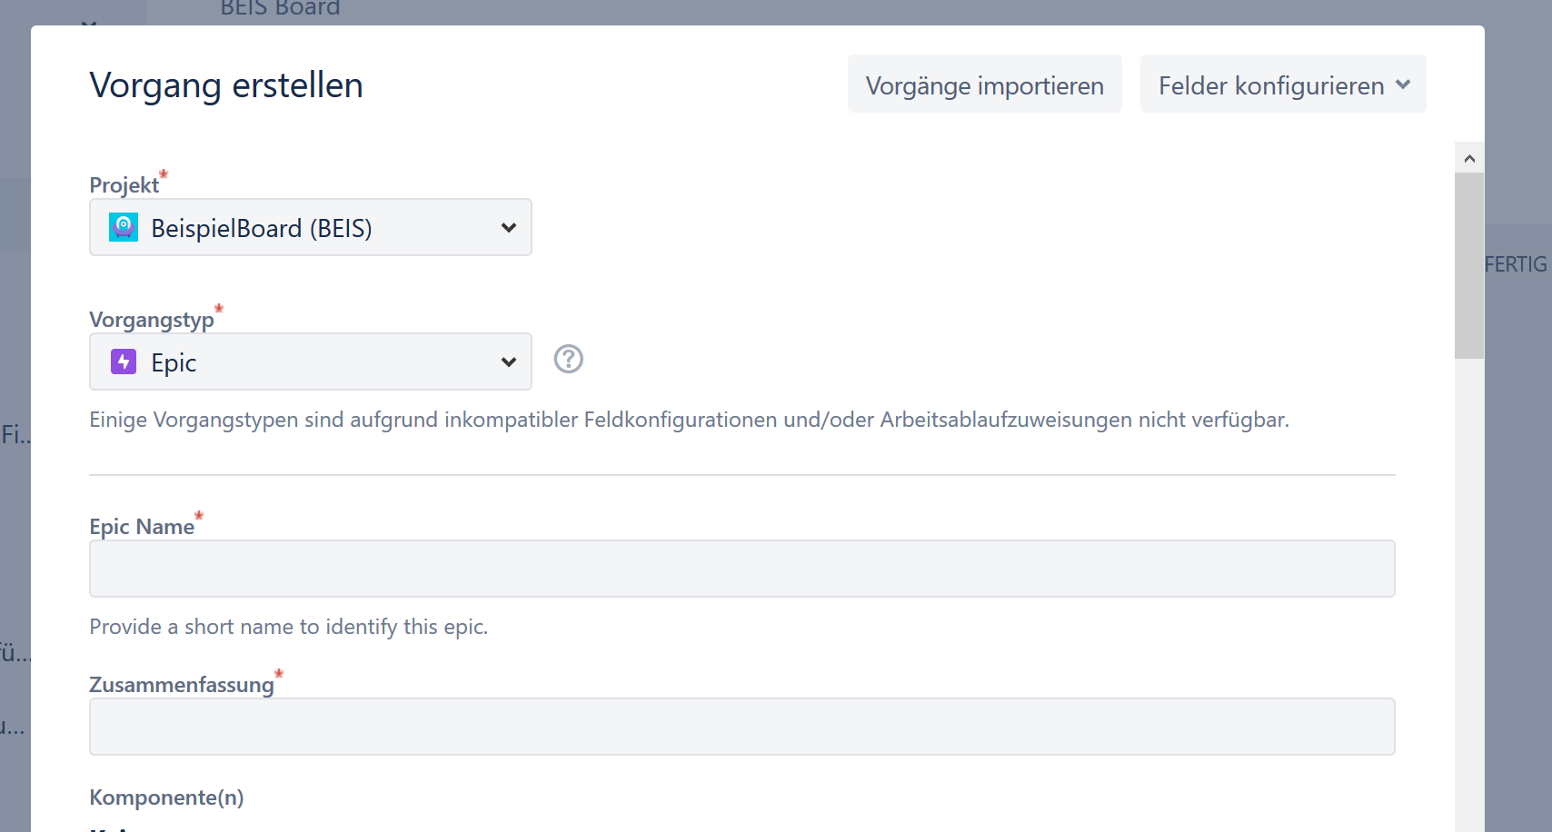
Create Epic
Contains a larger amount of work
Larger than a single use-case
May include several use-cases / stories
Software Engineering – 25.10.2018 – Lea Wegner – Natalie Busam
Notes:
Now to the first process-type „Epic“. Like I said before, Epic will be chosen for larger amount of work with more than a single Use-Case or stories.

Slide 13
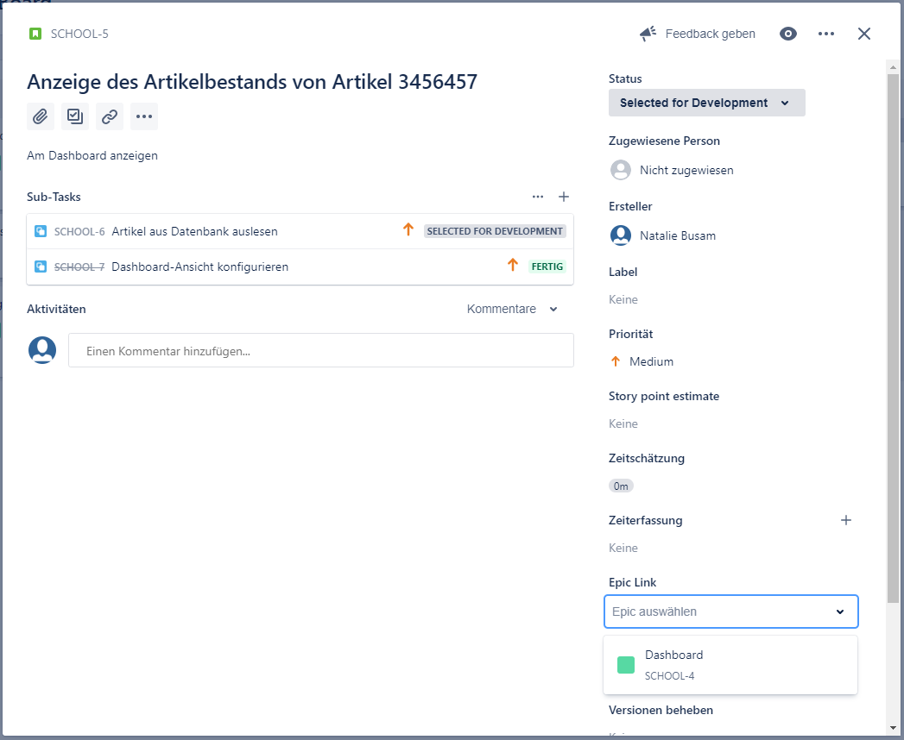
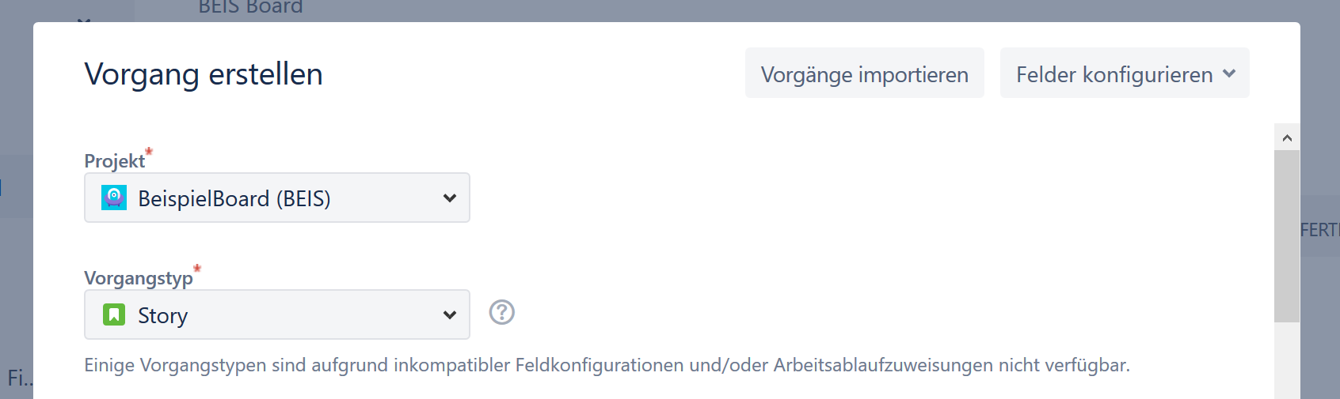
Create Story
Contains a number of tasks that fit together
Often Use-Cases as Stories
Within a created Story, you could define an Epic
Software Engineering – 25.10.2018 – Lea Wegner – Natalie Busam
Notes:
A Story contains a number of tasks that fit together.
The progress-type is often choosen as a use-case.
Within a created Story, you could define an Epic.

Slide 14
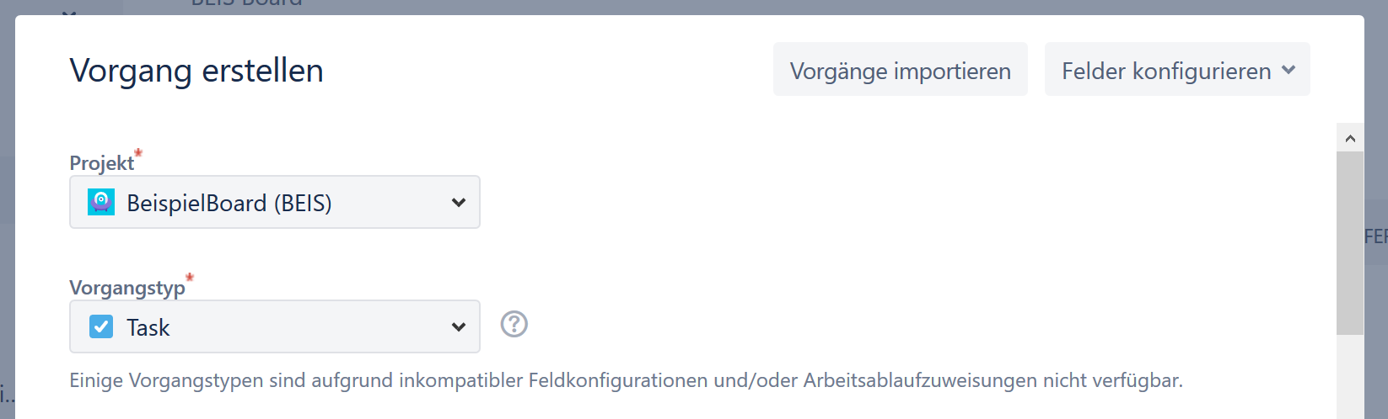
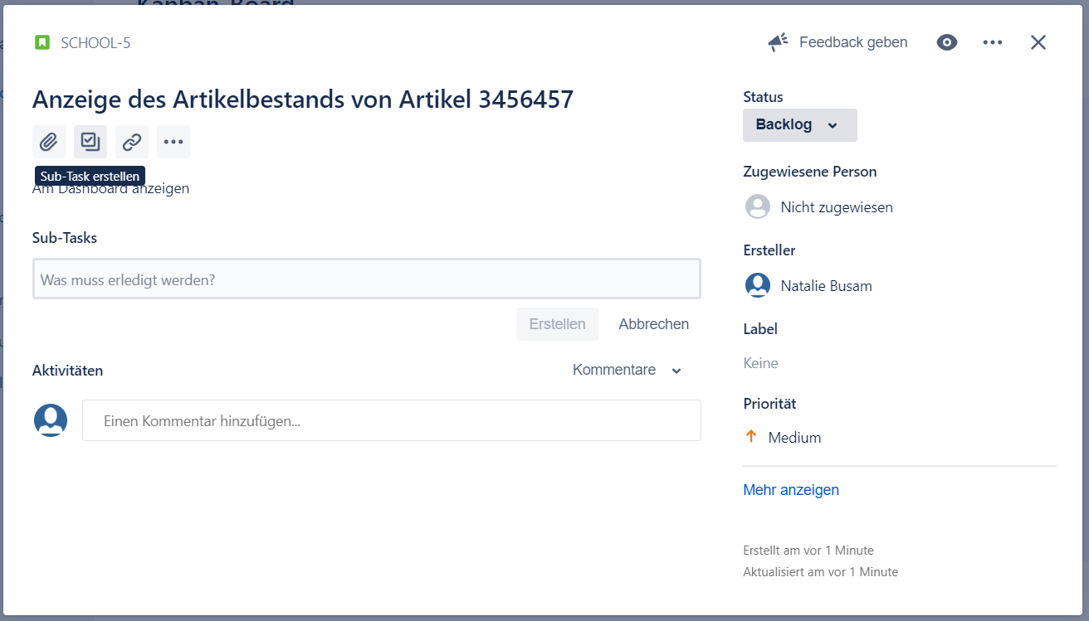
Create tasks and Subtasks
Task: A task that needs to be done.
Subtask: An act that must be completed as an element of a larger/ more complex task.
Possible for all process-types
Software Engineering – 25.10.2018 – Lea Wegner – Natalie Busam
Notes:
Also you can choose „Task“, which is like a „normal“ task and needs to be done.
In Jira you also can create subtasks for every process type.
Just open the issue and click on the symbol.

Slide 15
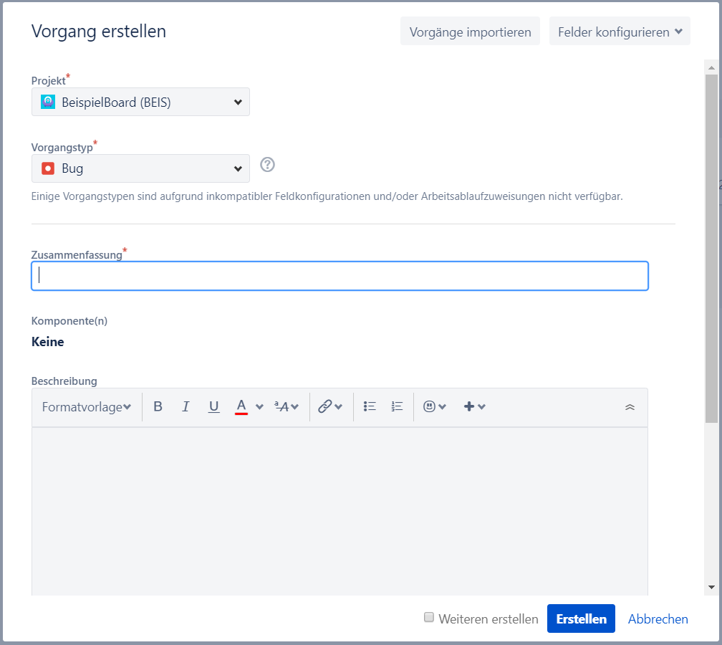
Create Bug
→ Bug-fixing
Software Engineering – 25.10.2018 – Lea Wegner – Natalie Busam
Notes:
The last progress-type is „bug“. This is used for bug-fixing.

Slide 16
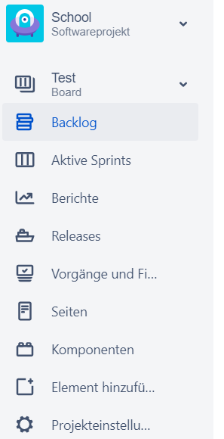
Sprint
Short period of time, ideally 2-4 weeks
Contains an amount of tasks that are meant to be completed until the Sprint‘s deadline
Easy coordination of the team
The project‘s progress can easily be supervised
How to create it
Create a new board
Choose scrum
Open Backlog
Project-name
Displays Sprints, Epics, Stories etc.
Agile Board
Burndown Chart
All Issues
Software Engineering – 25.10.2018 – Lea Wegner – Natalie Busam
Notes:
A Sprint is a process within the projekt management methode scrum
It's a periode of time with selected tickets which are to be done until the sprint ends.
It can be more or less time (then 2-4 weeks)

Slide 17
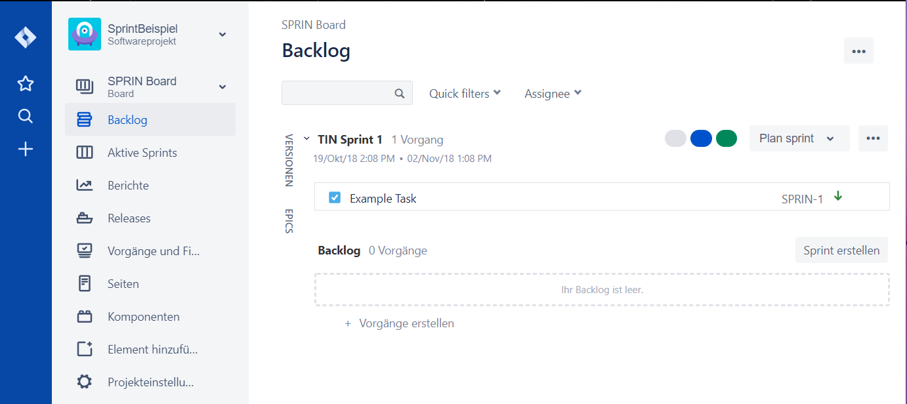
Work with a Sprint
Backlog
Overview of “Features”
Contains: User Stories and Epics (also contains Stories)
Sprint management
Create an Issue
Summary
Description
Reporter
Tags
Estimation
Some Fields might be hidden → click on Configure Fields
Software Engineering – 25.10.2018 – Lea Wegner – Natalie Busam
Notes:
The issues you created will be placed at the bottom of the page.
By clicking on an issue you can see its details.
Here you can set different fields e.g. “Issue Links” there can be set links between different issues.
Jira will not however check if you do these issues in the right order.

Slide 18
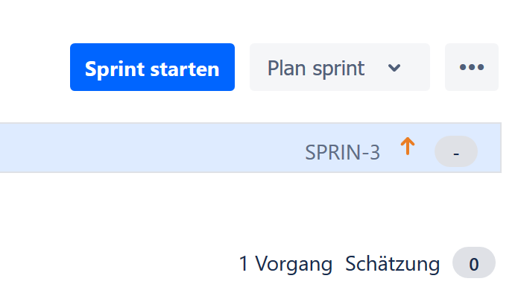
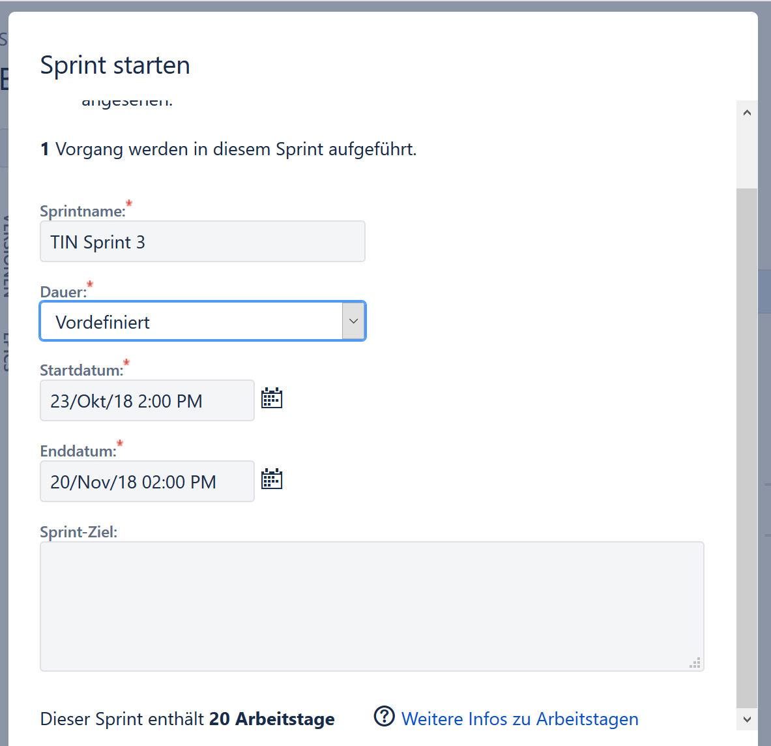
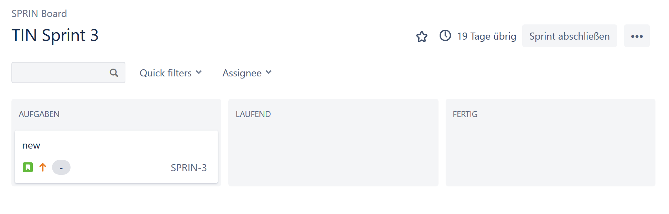
SPRINT SETTINGS
Start a Sprint
Set the time
Automatically calculated workdays are shown
Active Sprints:
Software Engineering – 25.10.2018 – Lea Wegner – Natalie Busam
Notes:
With the Create Sprint button you can create a sprint.
Now you can drag and drop the different issues you want to work on in the particular sprints.
Issues can be added even after the sprint is started so this is decision is not final, but should be close to final.
Press start sprint.
After that should you can set the time and name for it.
It will automatically show you how many workdays are in this periode of time
Depending on how long you Sprint is going e.g.the letters of the alphabet.
If you go to active sprints look like this
3 Columns: To Do, In Progress, Done.
You can add ColumnsChoose.
The Status from the left, drag it and drop it.

Slide 19
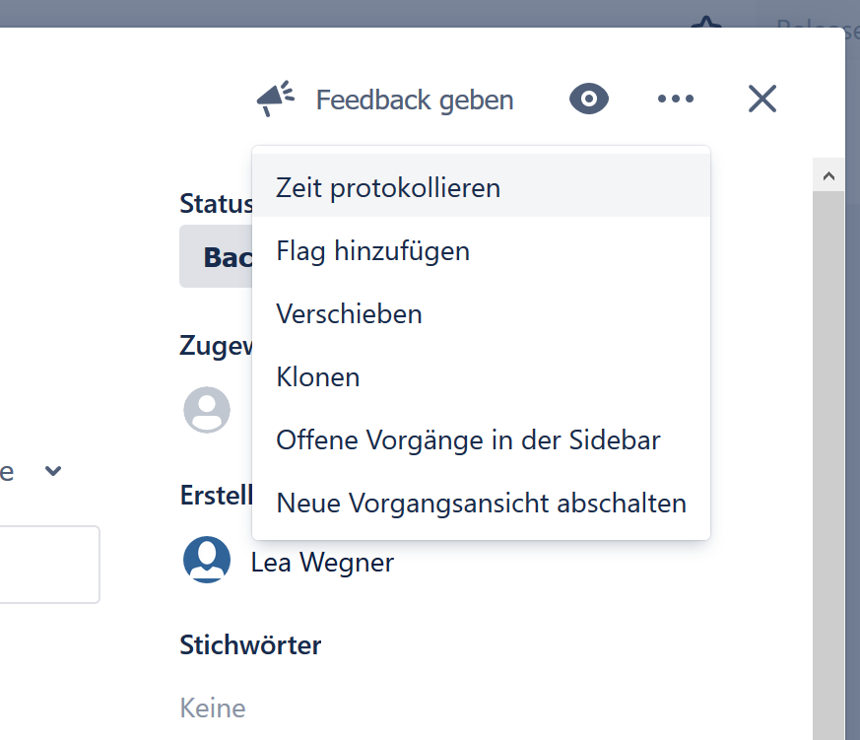
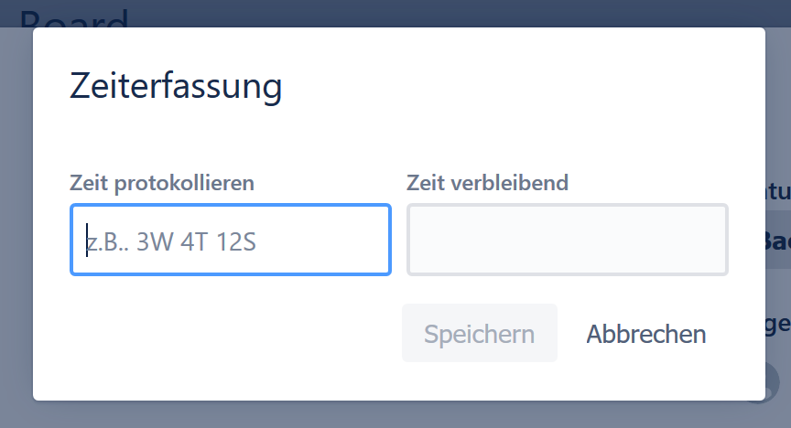
Log work
“Remaining” shows the remaining time for this issue, not lower than 0h
(Estimated time − Logged time = Remaining time)
How?
You can either log work at the 3 dots → log work
Or change estimation in the board configuration
Software Engineering – 25.10.2018 – Lea Wegner – Natalie Busam
Notes:
While you create an issue you can estimate how long this issue will take.
If you worked on that issue you can log the time you needed on it.
This is a very useful tool to keep track of the time you needed.
And it will help you to illustrate your workflow in charts, which will be mentioned a little later.

Slide 20
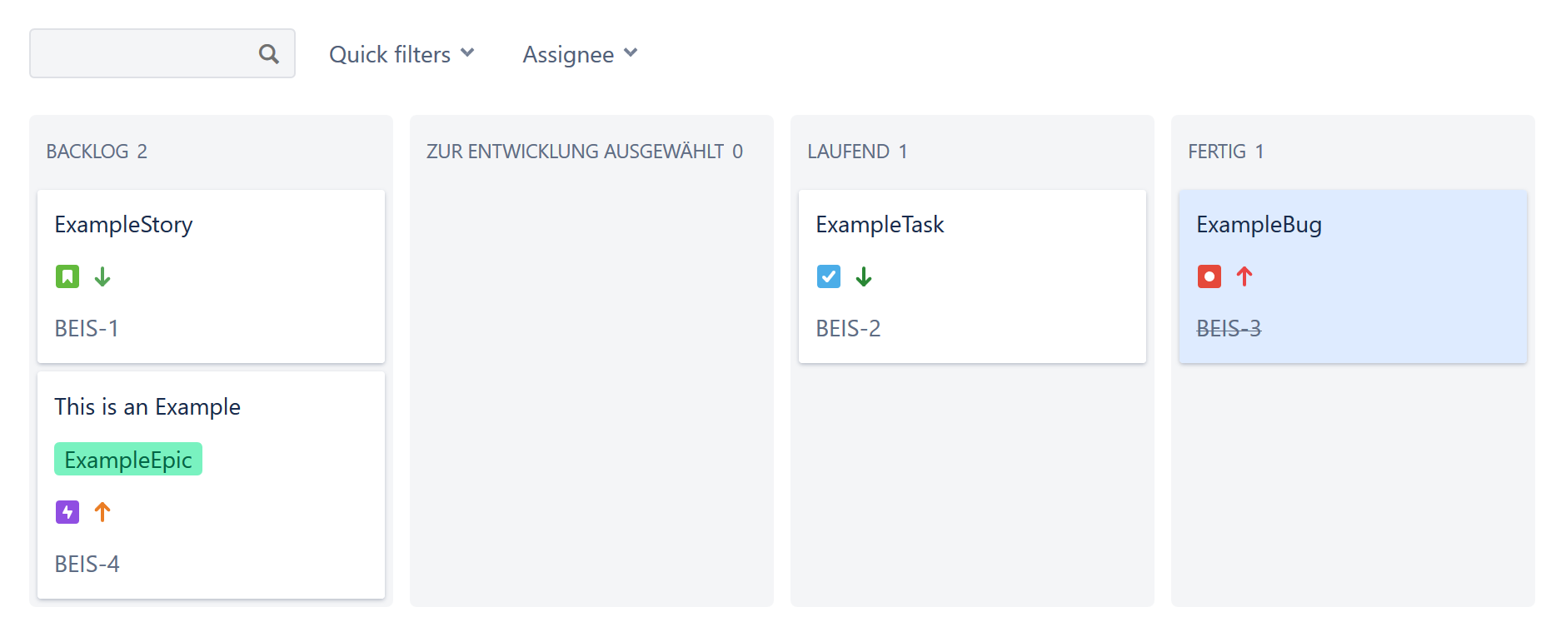
Complete a Issue
Complete a task by dragging and dropping it into “Done” section
If all tasks of a Story are being completed, JIRA will ask you automatically to resolve the parent issue as well
Software Engineering – 25.10.2018 – Lea Wegner – Natalie Busam
Notes:
As mentioned before there is drag and drop system...
Where the tickets is depending on its status.
At the end of a Sprint all Tickets should be in the “done” section, if possible.

Slide 21
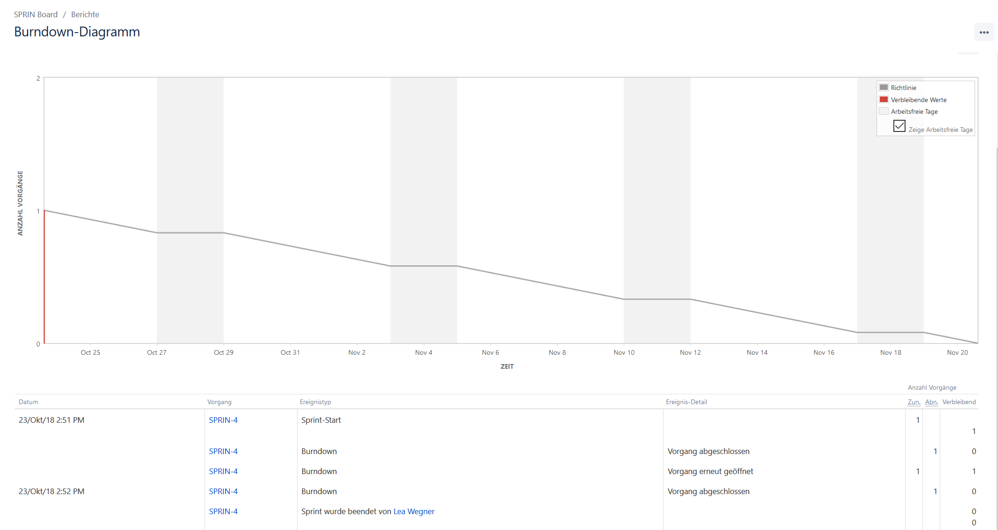
Scrum Tools: Burndown Chart
Click on Reports
This Page displays the Burndown Chart for the current Sprint
Requires: Story Estimation and the Original Time Estimation
Software Engineering – 25.10.2018 – Lea Wegner – Natalie Busam
Notes:
In this section (reports) you will see different charts for your project.
The most important being is the Burndown Chart.
You can use it with story points or only the estimated time vers. The time needed.

Slide 22
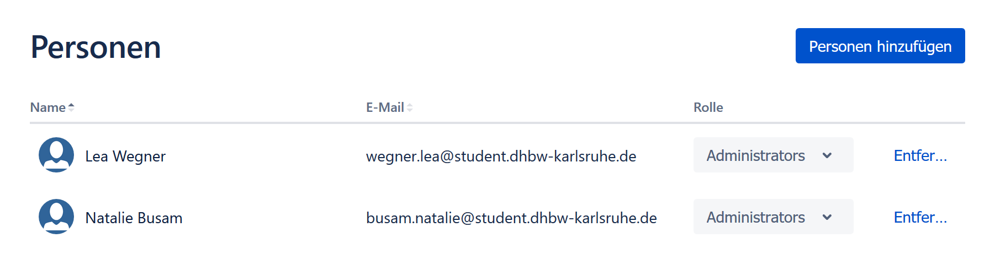
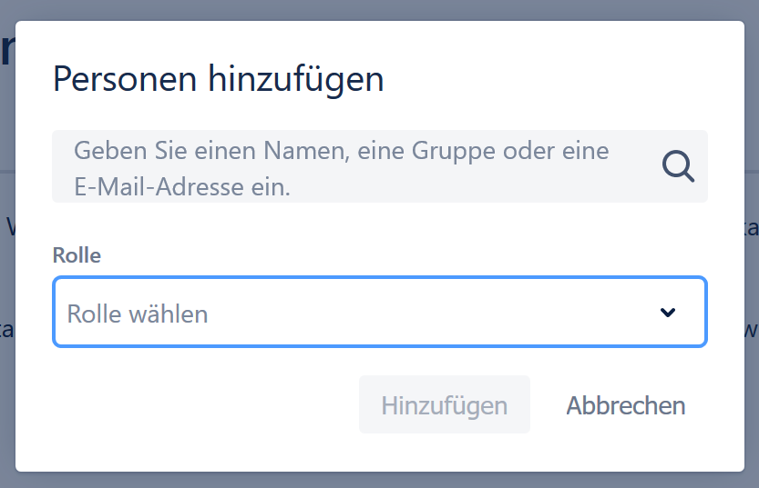
UserS
Overview of users for this project
Add new user
Software Engineering – 25.10.2018 – Lea Wegner – Natalie Busam
Notes:
Because you mostly wouldn’t do a project alone
Its important to add people.
So that they can use the boards and the issues as well.
All you need is the e-mail used during registration.

Slide 23
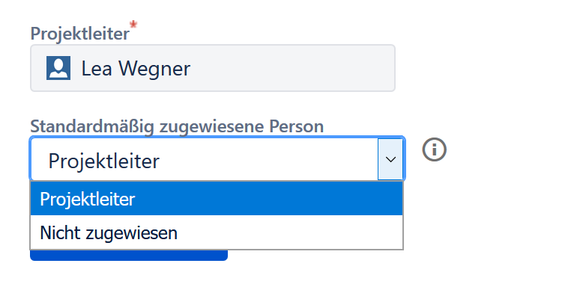
project leader
Choose the project leader
Choose if he should be assigned automatically when creating issues (as default)
Software Engineering – 25.10.2018 – Lea Wegner – Natalie Busam
Notes:
You can choose who the project leader is
And if he should be assigned automatically when creating issues.

Slide 24
Other Features
Connect with GitHub
Connect with Android Studio
Notes:
Because of the popularity of Jira there are many other features, like connecting it with other popular tools like Github and Tools from JetBrain.

Slide 25
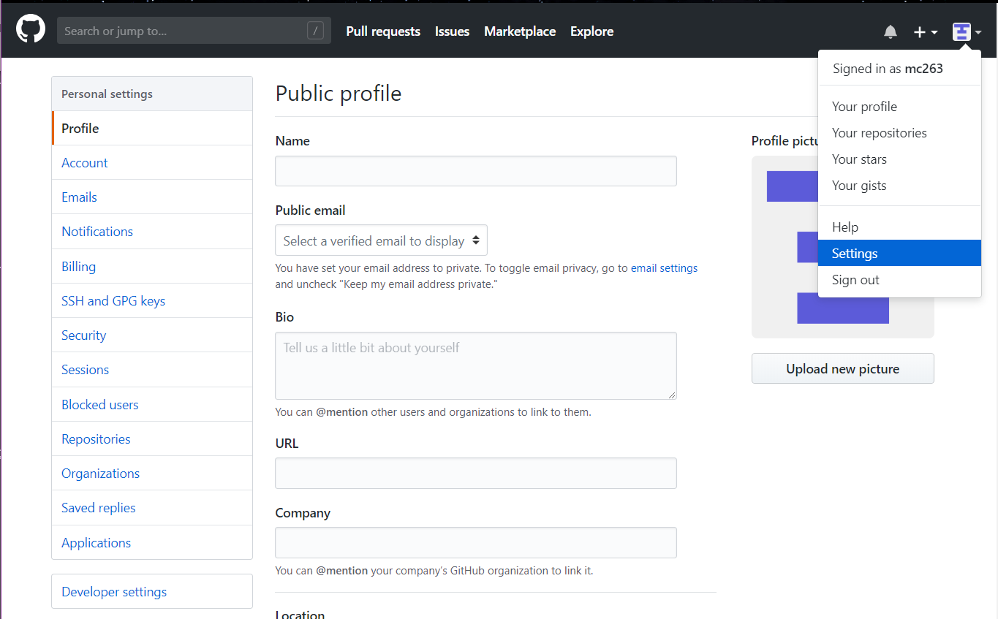
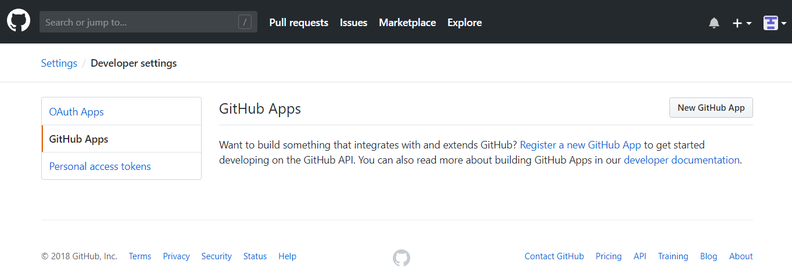
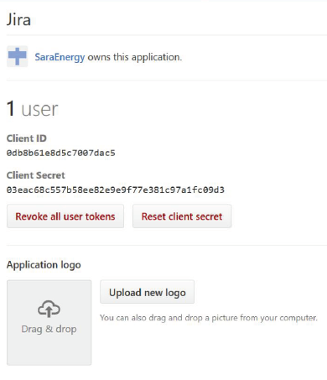
Connect with Github
More informations:
https://confluence.atlassian.com/adminjiracloud/connect-jira-cloud-to-github-814188429.html
Software Engineering – 25.10.2018 – Lea Wegner – Natalie Busam
Notes:
Here is a short tutorial how to connect your GitHub-profile with Jira.
Open settings in Github
Go to Developer settings
Open the Tab „GitHub Apps“ and follow their introductions
If you need some more infos, use the following URL: https://confluence.atlassian.com/adminjiracloud/connect-jira-cloud-to-github-814188429.html

Slide 26
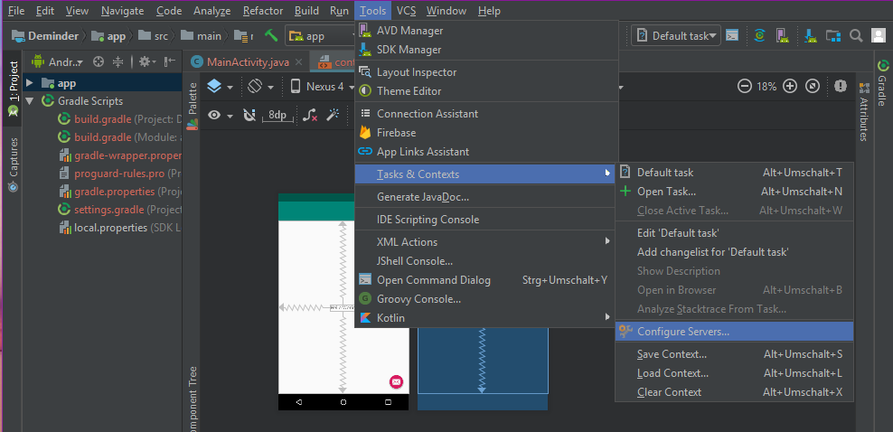
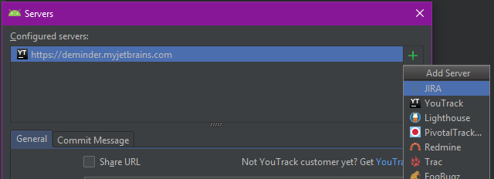
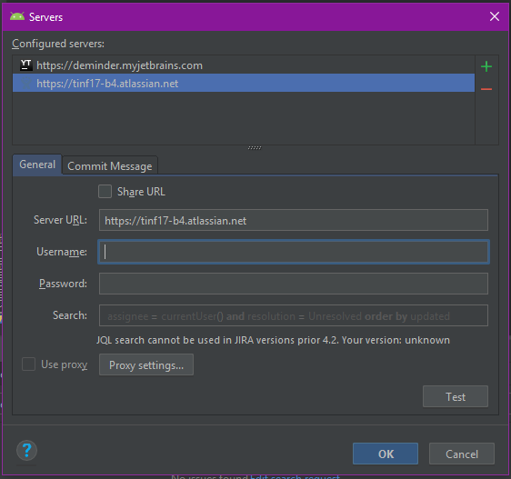
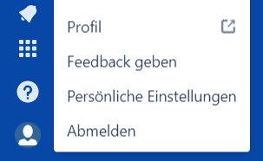
Connect with Android Studio
Open a project in Android Studio
Go to Configure Servers… (Tools → Tools & Context)
Add a new server connection, choose Jira
Fill in your server URL, username and password
Test the connection
→ More Information: https://josiassena.com/android-studio-jira-and-other-bug-tracking-tools/
Software Engineering – 25.10.2018 – Lea Wegner – Natalie Busam
Notes:
We thought that many of you are creating an app as SE project, so we also added a short tutorial how to connect jira with android studio.
….
Marcel showed you how to do it exactly.
For more information follow the URL.

Slide 27
OUR Conclusion
Disadvantage
JIRA has less functionalities then some alternatives
Requires license
Advantage
it is user-friendly, less time is needed
changes are possible, for example if a user logged his time wrong
Shortcuts
Modern design
Software Engineering – 25.10.2018 – Lea Wegner – Natalie Busam

Slide 28
Thank you for your attention!
Software Engineering – 25.10.2018 – Lea Wegner – Natalie Busam

