Slide 1
TV Script Generation
-using RNN to produce script for new Simpsons episode
Mengchen Yang
my1489

Slide 2
Robot Scriptwriter?
YES and NO
YES! we could have script written by robot
NO! It could be the worst script ever
In the case of music, since the data is not so complicated (pitch, rhythm, ...), it can be learnt and generated by AI easily
AI could make poem, or even more, scientific paper (Publishers withdraw more than 120 gibberish papers ), but if you read it through, you can easily see that they are all meaningless-auto-generated texts
The same thing could happen in the case of script.
IT WOULD BE FUN TO WATCH!

Slide 3
Project Introduction
In this project, I’m going to generate a Simpsons script
First, I’ll create a recurrent neural network(RNN)
Second, I’ll train the network on existing scripts from The Simpsons (https://www.kaggle.com/wcukierski/the-simpsons-by-the-data)
Finally, I’ll use it to generate a piece of original writing
The generated episode doesn’t need to make any sense (cause it won’t)
As long as the script has the right format, and doesn’t have grammar mistakes, we could say the project works, since after the training, machine understands the syntax and grammar

Slide 4


Why RNN?
In the basic feedforward network, there’s a single direction in which the information flows: from input to output.
In a recurrent neural network, this direction constraint does not exist, we could use this feature to generate text with sequence.
In RNN, we can take the output of each hidden layer, and feed it back to itself as an additional input. Each node of the hidden layer receives both the list of inputs from the previous layer and the list of outputs of the current layer in the last time step.

Slide 5
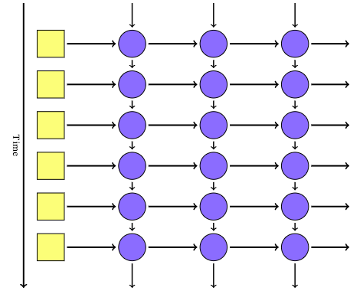
Why RNN?
RNN enables the network to have a simple version of memory, with very minimal overhead
RNN opens up the possibility of variable-length input and output: we can feed in inputs one-at-a-time, and let the network combine them using the state passed from each time step

Slide 6
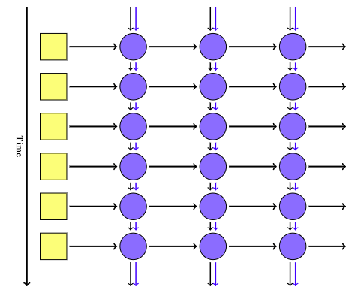
LSTM
In RNN, any value that is output in one time step becomes input in the next, but unless that same value is output again, it is lost at the next tick
We can use a Long Short-Term Memory (LSTM) node instead of a normal node.
LSTM introduces a “memory cell” value that is passed down for multiple time steps, and can be added to or subtracted from at each tick.

Slide 7
Project Overview
Process the data
Lookup table: create vocab_to_int and int_to_vocab to ease the training of RNN (using int instead of vocabs)
Tokenize punctuation: separate token and word to ease the training
Build the neural network
Implement the get_inputs() function to create TF Placeholders for the Neural Network.
Stack one or more BasicLSTMCells in a MultiRNNCell
Apply embedding to input_data using TensorFlow
Build the RNN Cell based on LSTM and apply a fully connected layer
Batch the input and train the RNN
Generate TV script

Slide 8
Project in detail: Build the Network
We are going to learn the dependencies between characters and the conditional probabilities of characters in sequences so that we can in turn generate new and original sequences of characters.
We’re going to use LSTM for its ability to deal with long sequences, and stack up multiple LSTM layers, for deep learning. This approach potentially allows the hidden state at each level to operate at different timescale
With this, we pass in a list of cells and it will send the output of one cell into the next cell.

Slide 9
Project in detail: Word Embedding
The first thing we have to take care of is how we define the input to our language modeling function.
It is clear that the input is a sequence of T−1words, but, how each of these words should be represented? (one-hot-encoding).
In an embedding, words are represented by dense vectors where a vector represents the projection of the word into a continuous vector space.
The position of a word within the vector space is learned from text and is based on the words that surround the word when it is used.
The position of a word in the learned vector space is referred to as its embedding.

Slide 10
Project in detail: Batches
We drop the last batch, since we can't fill the last batch with enough data

Slide 11
Problems and solution
I should’ve run the project on GPU using Google Cloud Platform, however I ran into some problems with tensorFlow. So, I set number of epochs to a relatively small value. Even in this way, it took me about 2 hours to run the program.
The generated script, as mentioned before, is not human-readable, that the script does not make any sense. But from the result, we can see the style of generated scripts are quite similar to Simpsons style.

Slide 12
Review
For this project, I use RNN to generate a new episode’s script for Simpsons, and the train loss is around 0.31.
While the generated script doesn’t make any sense, the format is consistent with the original one.

Slide 13
Reference
https://github.com/udacity/deep-learning/tree/master/tv-script-generation
http://www.hexahedria.com/2015/08/03/composing-music-with-recurrent-neural-networks/

