Slide 1
Lecture 3: Emerging Versus Mature Markets
The Concepts And Theories Behind The Numbers

Slide 2
Equity Market Drivers
Commodity/resource Prices
Collapse of communism.
Trade liberalization.
Deregulation and privatization.
Monetary policies in developed economies.
Capital flows.
Hype and Buzz.

Slide 3
Commodity Prices
Most emerging markets are commodity/resource exporters
Their fortunes rise and fall with commodity prices
Saudi Arabia is a case in point
The performance of its equity markets matches the performance of oil prices (see chart)
Brazil is another case, though its economy is diverse.

Slide 4
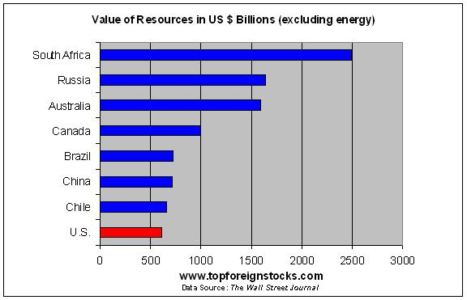
Major Commodity Producers
http://topforeignstocks.com/2010/05/04/the-top-eight-resource-rich-countries/

Slide 5
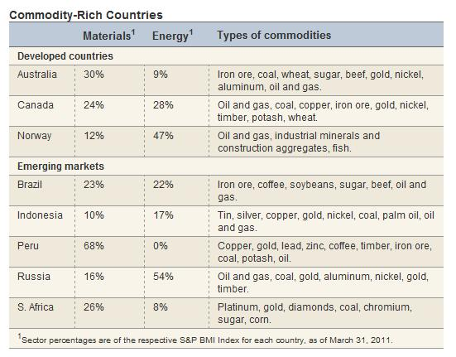
Resource Rich Countries: Minerals And Energy
http://topforeignstocks.com/wp-content/uploads/2011/07/Resource-Rich-Countries-Best.jpg

Slide 6
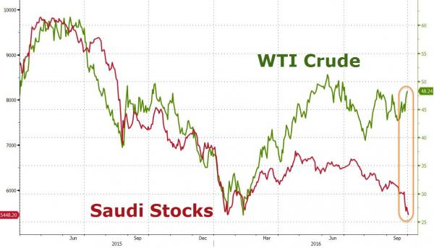
Saudi Stocks versus Crude Oil Prices

Slide 7
But There Are Exceptions To The Rule
Some EM economies are dependent on energy and material imports
Like India, which are affected negatively when the price of energy spikes.

Slide 8
Collapse Of Communism
For eastern European GEM, equity markets began with the collapse of the Berlin Wall.
China’s equity markets began with Den Xiaoping’s injection of capitalism into communism.
The collapse of communism paved the way for market friendly regimes (e.g., Argentina, Chile, Mexico, Brazil), which proceeded with trade liberalization and financial deregulation.

Slide 9
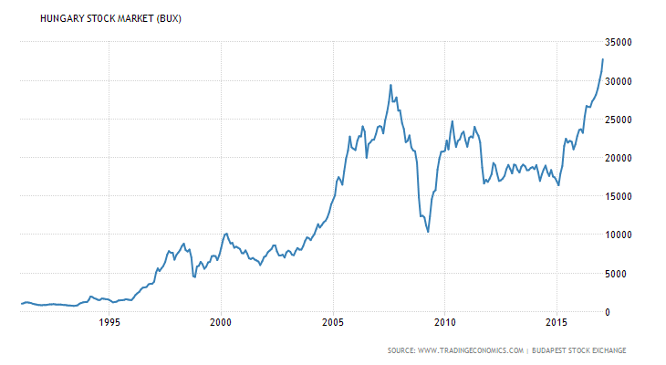
Hungarian Stocks 1980s to Now

Slide 10
Brazilian Stock Market 1977-2018

Slide 11
Trade Liberalization
End of GATT rounds and creation of WTO
Broadening of EU.
Creation of NAFTA.
Strengthening of APEC.
Ease of commodity and capital flows across national borders.
Regional agreements have been supporting WTO rather than running against it.

Slide 12
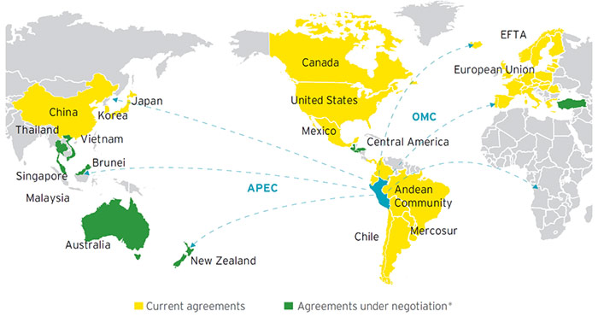
Regional Trade Agreements
http://www.limaeasy.com/business-guide/free-trade-agreements-ftas-with-peru

Slide 13
Deregulation and Privatization
Financial markets are opening up to the masses (“democratization of finance”).
Development of new financial products like ETFs make low-cost index investing available to individual investors.
Equity markets become the mechanisms for privatization, the selling of government assets to investors.

Slide 14
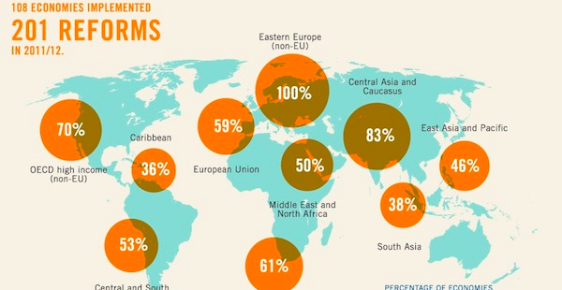
Domestic Reforms And To Trade Liberalization
http://brechtforum.org/economywatch/world-bank-vs-labor

Slide 15
Monetary Policies In Developed Countries
Ultra low interest rates in Japan back in the 1990s unleash a tsunami of liquidity heading for GEM, where interest rates are higher (“the yen carry trade”)
Ultra-low interest rates in the US and Europe send more capital to GEMs (“the dollar and the euro carry trades”)

Slide 16
Capital Flows
GEM booms and busts usually coincide with capital inflows and outflows.
The 2000-2007 boom, for instance, coincided with large capital inflows.
GEM capital inflows increased by 92% between 2000 and 2005 and by 478% between 2005-10
A small “float” magnifies capital moves.

Slide 17
Emerging Market Capital Flows

Slide 18
Hype and Buzz
Investors have been hyped about the potential of EMs like China’s and India’s potential consumer market and Brazil’s commodity riches.
Hype has turned into buzz, as investors’ rush to participate in thinly traded markets sends domestic shares soaring.

Slide 19
Development Theories Behind The Rise And Fall Of GEMs
Rostow’s Five Stages Of Economic Growth
The Unequal Exchange Theory
The Lack of Rule of Law Theory
The Cultural Theory
The Social Agency Problem Theory

Slide 20
The Five Stages Of Economic Growth (Rostow)
Traditional Society
Preparation for take-off
The Take-off
Drive to maturity
Age of high mass consumption

Slide 21
Traditional Society
Subsistent agriculture based economy
Little trade
Low specialization
Excess labor trapped in agriculture
Little technological progress
Low productivity

Slide 22
Preparing for Take-off
Trade is rising
Capital accumulation
Technological progress
Rise of manufacturing
Excess labor persists in agriculture
Rise in productivity and per capita income

Slide 23
The Take-off
Rapid industrialization
Growth in trade
Rapid rise in productivity and per capita income
Urbanization
Infrastructure development

Slide 24
Drive to Maturity
Industrialization continues at a slower pace
The rise of the service sector
Standards of living improve
Shift from quantity to quality of life
Economic growth tapers off

Slide 25
Age of Mass Consumption
Development of new technologies lead to mass production
Rising incomes and use of credit lead to mass consumption.

Slide 26
Behind The Rostow Development Theory: Constraints Of Growth
The numbers constraint
The market frontier constraint
The middle income trap—economic growth stalls when Ems reach a middle income level
The Lewis Turning point—the drying up of the pool of excess labor, and soaring wages

Slide 27
The numbers constraint
The “rule of 72”
High growth rates come harder as numbers get bigger
To grow per capita income by 10%, a country with $1000 income, needs $100, while a country with $10,000 needs $1000, assuming a zero population growth
Things become more difficult with countries with rapidly growing populations.

Slide 28
The Market Frontier Constraint
When emerging markets begin to export to the world, their market share is negligible, so they are price-takers
Domestic exporters can export all they can at world prices, maintaining profitability.
As they grow bigger they become market makers, e.g., China
That’s a drag to profitability of the listed exporting companies (e.g., Korea)

Slide 29
The Middle-Income Trap
In early growth stages, emerging economies can narrow the gap with developed countries by imitation—the copying of foreign technologies.
But they are limits to copying new technologies.
Eventually imitation must be replaced by innovation, and that takes time—growth stalls, and GEM countries stuck in a “middle income” state for years or decades.

Slide 30
Global Innovation Index (2017)
Country | Global Innovation Ranking
Switzerland | 1
USA | 4
China | 22
India | 60
Brazil | 69

Slide 31
The “Lewis Point”
That’s when the excess labor trapped in agriculture is exhausted
There are no more unskilled workers to migrate from agriculture to manufacturing
Labor shortages follow, pushing wages sharply higher
That slows manufacturing and economic growth.

Slide 32
The “Lewis Point”(conntinued)
Can be exacerbated by demographic issues, as is the case currently in China.
China reached the Lewis Point in 2013, according to some estimates, or it will reach it in 2020, according to others—see module readings .

Slide 33
International Labor Cost Comparison
https://www.conference-board.org/ilcprogram/index.cfm?id=23453
In 2016, labor costs in Vietnam were half of those in China
http://www.aseanbriefing.com/news/2015/05/26/the-cost-of-business-in-vietnam-compared-with-china.html

Slide 34
The “Dutch Disease”
The paradoxically harmful effects on a country from a sudden influx of wealth.
Coined after the discovery by the Dutch of massive natural gas reserves in the Northern Sea in the 1960s.
Large export revenues are followed by a currency appreciation that makes everything else the country produce uncompetitive.

Slide 35
Drivers Of Growth
Y=C+I+G+X-M
In most emerging markets, early growth is driven by exports and infrastructure spending (China is a typical example)
Later growth is driven by a pick up in consumer spending, the largest driver of growth in developed economies.
Globalization and Deregulation

Slide 36
Not All Emerging Economies Follow These Stages
Only Six EME followed these stages to achieve sustainable growth for four decades—Taiwan, South Korea, Malaysia, Singapore, Thailand and HK.
Only two GEM, China and India, managed to sustain growth above 5 percent in the last decade.
Most EME stack in the middle stages or regressed to their previous stage.

Slide 37
Not All Emerging Economies Follow These Stages (continued)
Back in the 1960s Burma, Philippines, and Sri Lanka expected to be the next East Asian tigers, but it never happened.
Since the early 19th century, resource rich Latin American countries have gone through several stages of rapid growth, and then regress back to economic stagnation and decline (Argentina is the best example). The country was recently demoted to “Frontier from “Emerging

Slide 38
There are several theories for it:
The Unequal Exchange Theory
The Lack of Rule of Law Theory
The Cultural Theory
The Social Agency Problem Theory

Slide 39
The Unequal Exchange Theory
Held by Marxist, the unequal exchange theory argues that Emerging Economies and mature economies are engaged in an unequal exchange, whereby value is transferred from Emerging Economies back to Developed economies
That’s a form of neocolonialism, which leads into the economic stagnation of Emerging Economies

Slide 40
The Lack Of Rule Of Law
The Rule of Law is about the definition of property rights, and the enforcement of contracts.
That’s important for starting and growing a business (entrepreneurship).
And for leveraging wealth to boost consumption and investments.
Some countries have well-defined property rights, e.g., US, England, Germany.
Other countries don’t have well defined property rights, e.g., Peru and Philippines

Slide 41
World Bank Doing Business Ranking
http://www.doingbusiness.org/en/rankings

Slide 42
Rule of Law (continued)
In these countries, people hold their assets in defective forms.
Houses built on land, whose ownership rights aren’t transparently recorded.
Unincorporated business, as it takes too much red tape to incorporate them.
Because of poor documentation these assets cannot be turned into investment.
That’s what Hernando de Soto calls “Mystery of Capital.”
Without investment, there’s no growth.
Lack of rule of law breeds crony capitalism, which makes maters worse for growth.

Slide 43
Rule of Law (continued)
Mexico failed to sustain growth because it is controlled by monopolies and oligopolies.
Brazil and the Philippines are similar cases.

Slide 44
The Anthropologist Theory: High Context versus Low Context Societies
Developed by anthropologist Edward Hall this theory explains why it is hard to apply the rule of law in high context societies
High context societies are societies like India and Brazil, where strong personal connections make hard to enforce the law.
Low context societies are societies like US, England, and Germany, where personal connections have little impact on the enforcement of the law.

Slide 45
The Social Agency Problem Theory
Developed by Acemoglu and Robinson
In most GEM, the “state,” the political institutions that set up the rules of the economic game, represents a few economic elites rather than the masses.
Governments come and go and this situation perpetuates itself.

Slide 46
Nogales Arizona: The Right And The Wrong Cocktail Of Business And Government
https://www.forbes.com/sites/panosmourdoukoutas/2017/07/02/what-makes-life-in-america-mexico-india-and-china-so-different-the-right-mix-of-institutions/#3846fe8f2675

Slide 47
All These Factors Can Contribute To The Rise Of Crony Capitalism And Corruption
Cozy relations between business and government can create oligopolies and cartels, which restrict competition.
Chaebol in SK
Semibankirschina (Rule of Seven Bankers) China
Mexico and Brazil have their own cartels.

Slide 48
Corruption And Cronyism
Lead to the rise of inflation, corruption and revolution
The three killers of emerging market growth

