Slide 1


Software Owner and Administrator: Bastian Ritter · bastian.ritter@senvion.in
CSCM Tool
Controller Status Code Management Tool
Management overview
Version 4.16.0
2026-10-26
Main Controllers and Hub Controllers of wind turbines
CSCM Tool v4.16.0 · Management overview
1 / 11
Notes:
Version 4.16.0, 2026-10-26. All screens in this deck are screenshots of the real application with fictitious data.

Slide 2
One governed source of truth for every status code
Before
With the tool
The result
Codes lived in documents. A change was hard to trace and hard to reuse.
A code is created, reviewed, approved, versioned and released in one place.
Manuals, specifications and SCADA lists are produced from approved codes only.
CSCM Tool v4.16.0 · Management overview
2 / 11
Notes:
The core idea in one slide: a code is created, reviewed, approved, versioned and released in one place, and everything else is derived from it.

Slide 3
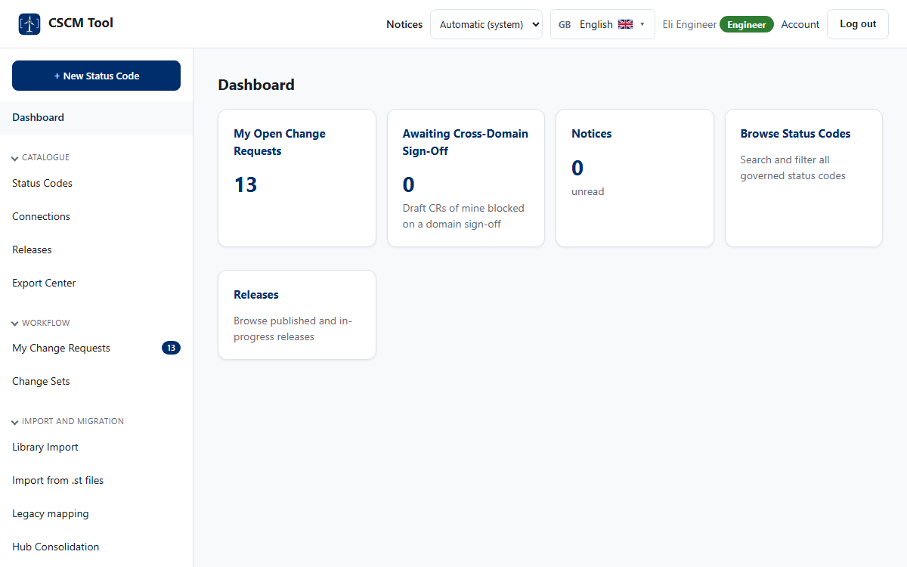
Everything people need, in one place
1
A menu for the role
Each person sees only what their role may do.
2
Work that waits
Counters and links lead straight to reviews, approvals and drafts.
3
Colour with meaning
Roles and lifecycle states have fixed colours, never decoration.
CSCM Tool v4.16.0 · Management overview
3 / 11
Notes:
The dashboard of an engineer. The menu on the left follows the role; the badge next to the name shows the role by colour.

Slide 4
Three independent decisions before a release
Draft
Review
Pending
Approved
Released
1
Reviewer
2
Administrator
3
Chief Engineer
Checks content and wording, and signs off.
Confirms audience access and signs off.
Approves. Nobody can approve their own work.
Before the review, the engineering domains concerned sign off the content (cross-domain sign-off). Every step is recorded in an audit log that cannot be changed.
CSCM Tool v4.16.0 · Management overview
4 / 11
Notes:
No single person can release a code: the author, a reviewer, an administrator and the Chief Engineer all take part, and a domain engineer signs off first.

Slide 5
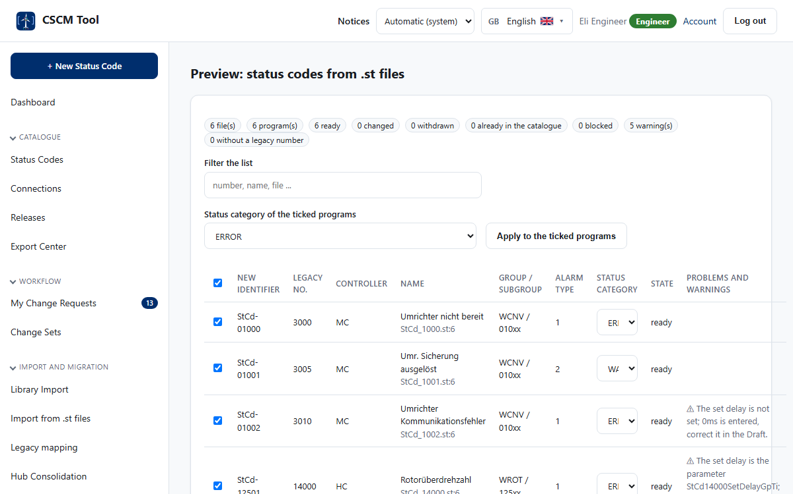
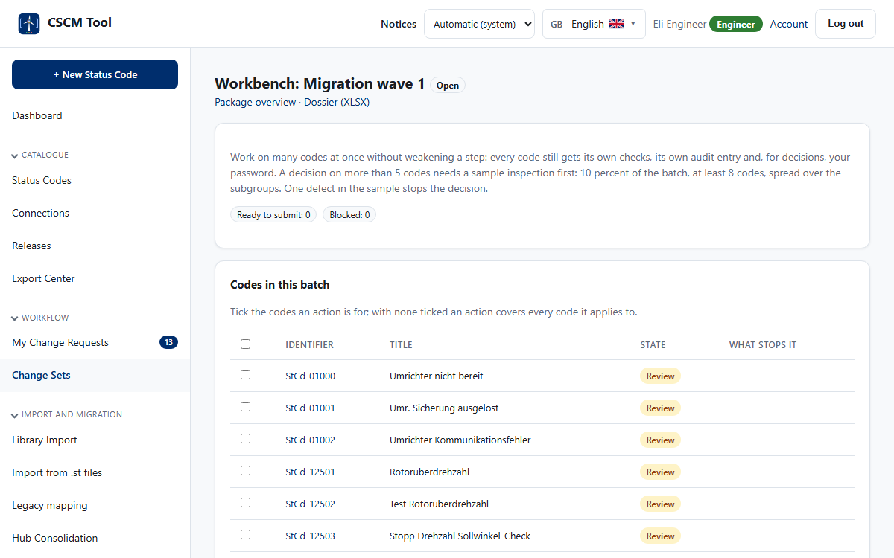
The first migration: about 1,250 codes
Programs are read from the controller files and previewed. Nothing is created until a person has looked.
The workbench lets each step work on the whole batch, with a sample inspection that one defect can stop.
CSCM Tool v4.16.0 · Management overview
5 / 11
Notes:
Roughly 900 Main Controller and 350 Hub Controller codes pass the same governance as a single code. The sample inspection keeps bulk decisions honest.

Slide 6
Built to be trusted
1,019
93 %
215
19
automated tests, all passing
of the application code covered
requirements, each traced to tests
languages, including right to left
The REST API has 161 operations, the database 61 tables. Every change of a code is kept with who, when and why.
CSCM Tool v4.16.0 · Management overview
6 / 11
Notes:
The numbers come from the latest test report and the requirement documents of this version.

Slide 7
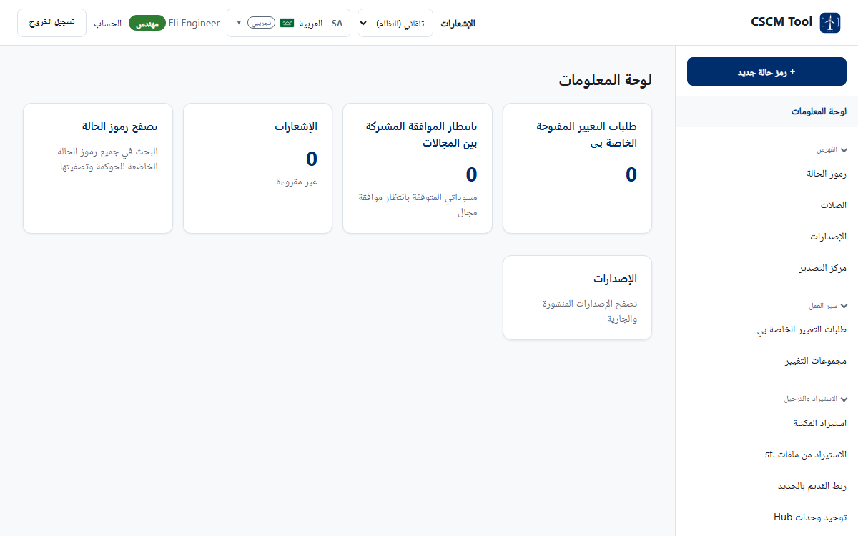

Looks right in every language and light
Right to left for Arabic
Dark theme, set by the system or by choice
And on a phone
CSCM Tool v4.16.0 · Management overview
7 / 11
Notes:
The interface follows the user's language, can switch between light and dark, and works on a phone.

Slide 8
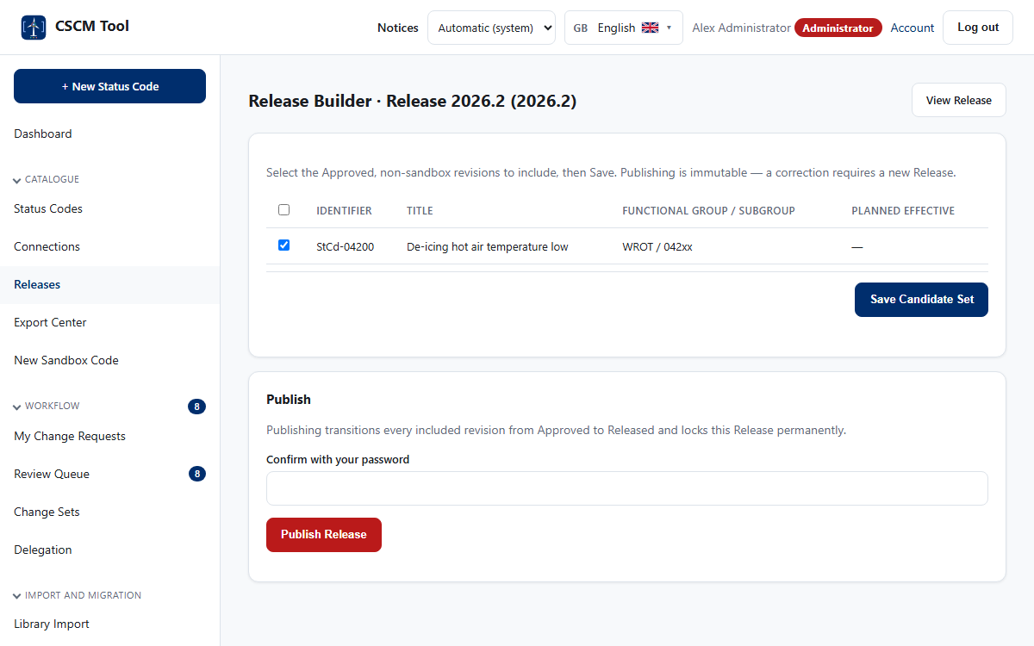
Releases people can rely on
1
A fixed baseline
A release holds the latest published revision of every code.
2
A package for every audience
All languages, access levels and formats in one download.
3
A clear download rule
Everyone downloads what is released; the working set stays internal.
CSCM Tool v4.16.0 · Management overview
8 / 11
Notes:
Releases are immutable once published. The package is built in the background.

Slide 9


Insight for engineering
Catalogue health: how full each number range is, and what stalls.
Connections: which code suppresses, requires or escalates to which.
CSCM Tool v4.16.0 · Management overview
9 / 11
Notes:
The connections are read from the controller programs themselves, never invented.

Slide 10
Recently delivered
v4.13.0
Bulk workflow for the migration — I-70 with I-61 and I-62
FR-180
v4.13.1 / v4.13.2
Select-all on every list with tick boxes
FR-181, FR-182
v4.14.0
Dark mode
FR-183
v4.14.1
Visible version
FR-184
v4.15.0
Release documents as PDF
FR-185
v4.16.0
Design showcase decks
FR-186, FR-187
CSCM Tool v4.16.0 · Management overview
10 / 11
Notes:
Taken from the improvement list of this version. Newest last.

Slide 11

Governed, traceable, ready for the first migration
Every code created, reviewed, approved and released in one tool
Bulk work for the migration, kept honest by a sample inspection
Languages, accessibility and a dark theme from the start
CSCM Tool v4.16.0 · Management overview
11 / 11
Notes:
Questions and next steps.

