Slide 1


Software Owner and Administrator: Bastian Ritter · bastian.ritter@senvion.in
CSCM Tool
Controller Status Code Management Tool
Design walkthrough for the team
Version 4.16.1
2026-10-27
Main Controllers and Hub Controllers of wind turbines
CSCM Tool v4.16.1 · Design walkthrough
1 / 23
Notes:
Version 4.16.1, 2026-10-27. All screens in this deck are screenshots of the real application with fictitious data.

Slide 2
Design principles
1
Same shell everywhere
2
Colour means something
Top bar, role-based menu and tokens of the OneTool design system. No CDN, no framework.
Roles, lifecycle states and confidence have fixed colours. Every pair is checked for contrast.
3
Everyone can use it
4
Nothing is lost
Keyboard operable, labelled controls, 19 languages, right to left, dark theme.
A rejected form keeps what was typed. Every action is audited.
CSCM Tool v4.16.1 · Design walkthrough
2 / 23
Notes:
The rules behind every screen. They are written down in docs/10-ui-ux-specification.md.

Slide 3
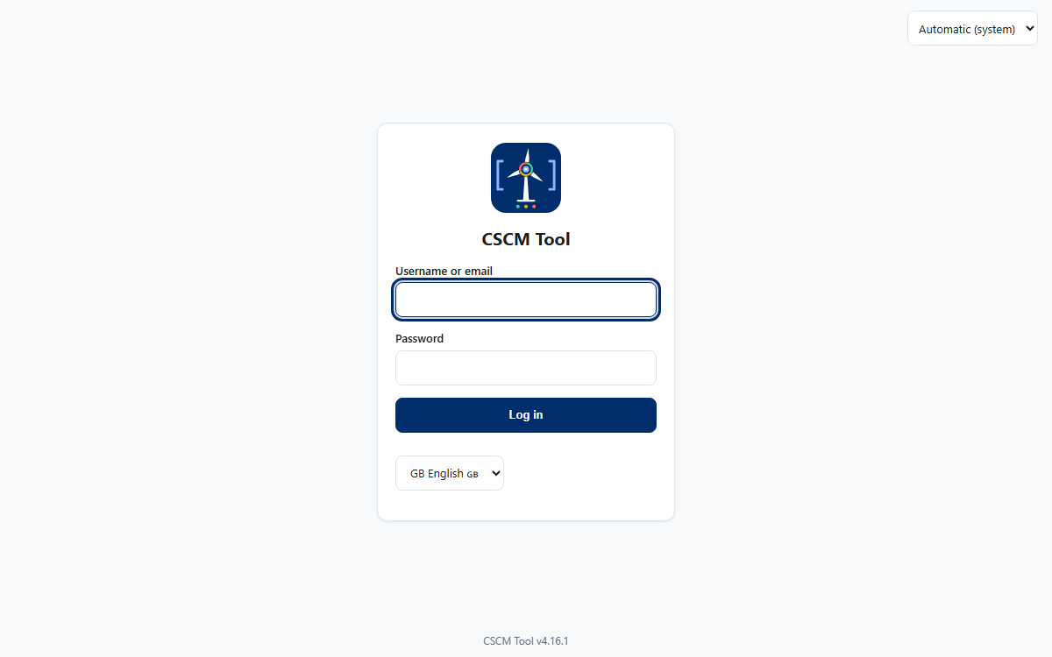
Login
Password sign-in, with the language choice and the theme choice before anybody is signed in.
Where the organisation uses Windows accounts, one button signs in with the Windows identity.
CSCM Tool v4.16.1 · Design walkthrough
3 / 23
Notes:
In a deployment people sign in with their Windows account; the password form can be switched off.

Slide 4
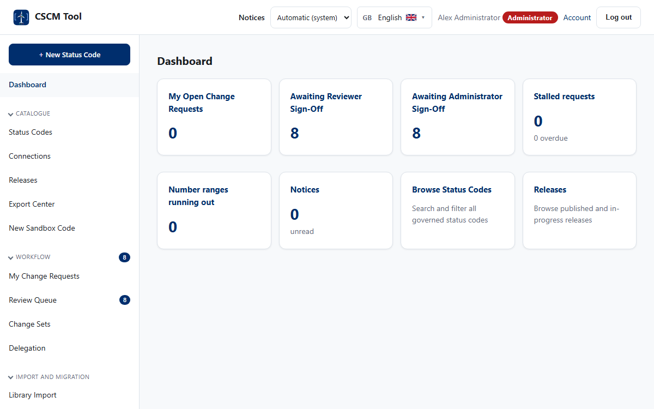
The shell: top bar and menu
1
Top bar
Notices, theme, language, the person and their role badge, account and log out.
2
Menu
Groups open and close; the count beside a link is the work waiting there.
3
Role colours
Red is the highest role. The colours repeat in lists and reports.
CSCM Tool v4.16.1 · Design walkthrough
4 / 23

Slide 5
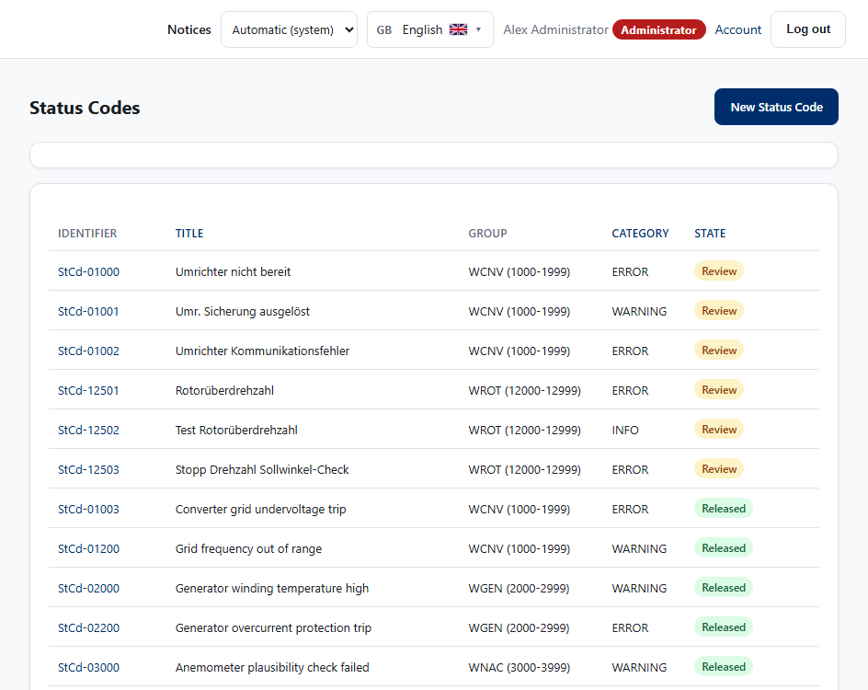
Status Codes: find, filter, share
1
Filters
Search tolerates typos; group, subgroup, platform, lifecycle and category narrow the list.
2
Columns and saved searches
Choose the columns, save a view and share its link.
3
State badges
Draft to Archived, always in the same colours and always with words.
CSCM Tool v4.16.1 · Design walkthrough
5 / 23

Slide 6
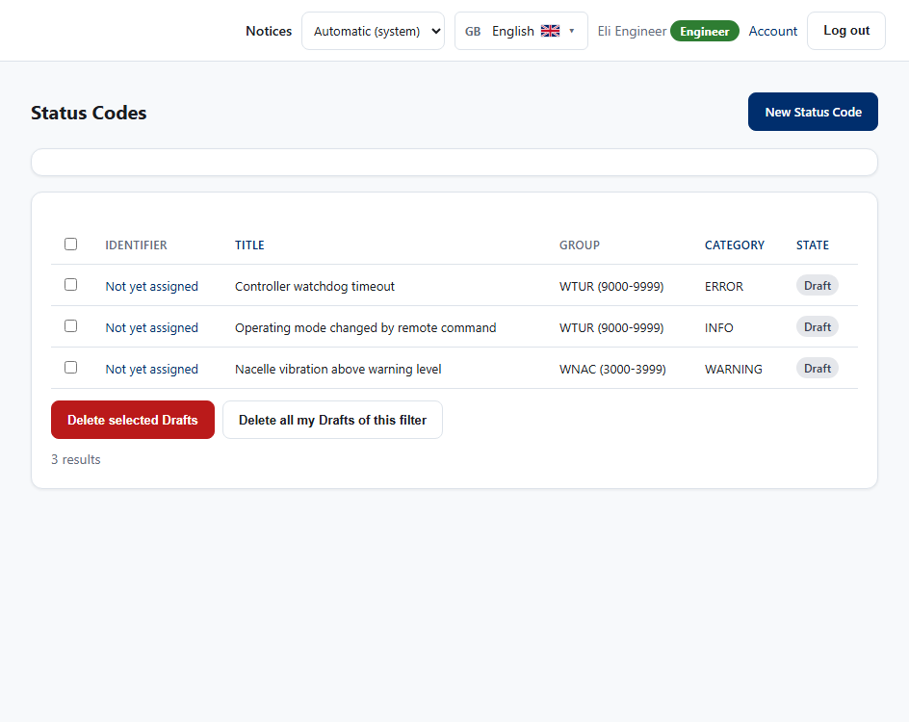
Select, select all, delete Drafts
1
Tick boxes for your own Drafts
Only the author can delete a Draft, so only these rows have a box.
2
Select all
The box in the header ticks every Draft on the page.
3
All Drafts of a filter
When filtered to Draft, one button deletes your Drafts on every page.
CSCM Tool v4.16.1 · Design walkthrough
6 / 23

Slide 7
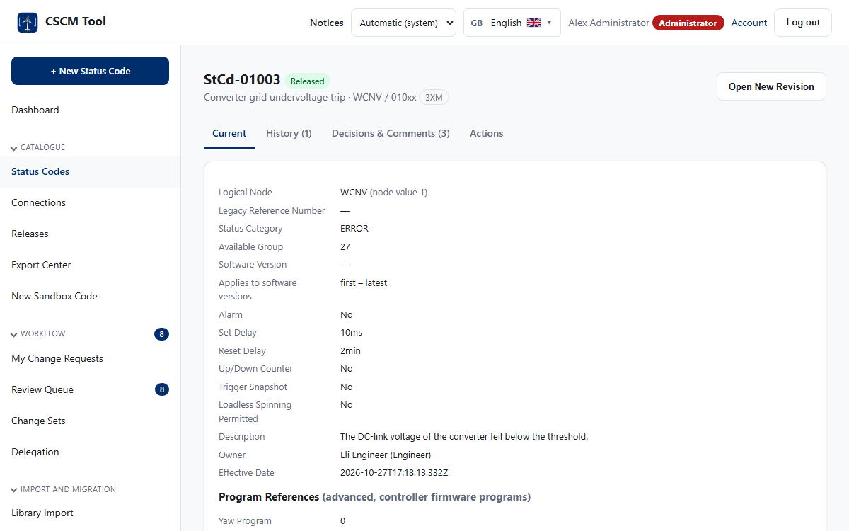
A status code
1
Identity and state
The number, the state badge and the sign-offs at a glance.
2
Tabs
Details, history, comparison, where used, translations.
3
One number, forever
A number is issued once, at submit, and never reused.
CSCM Tool v4.16.1 · Design walkthrough
7 / 23

Slide 8
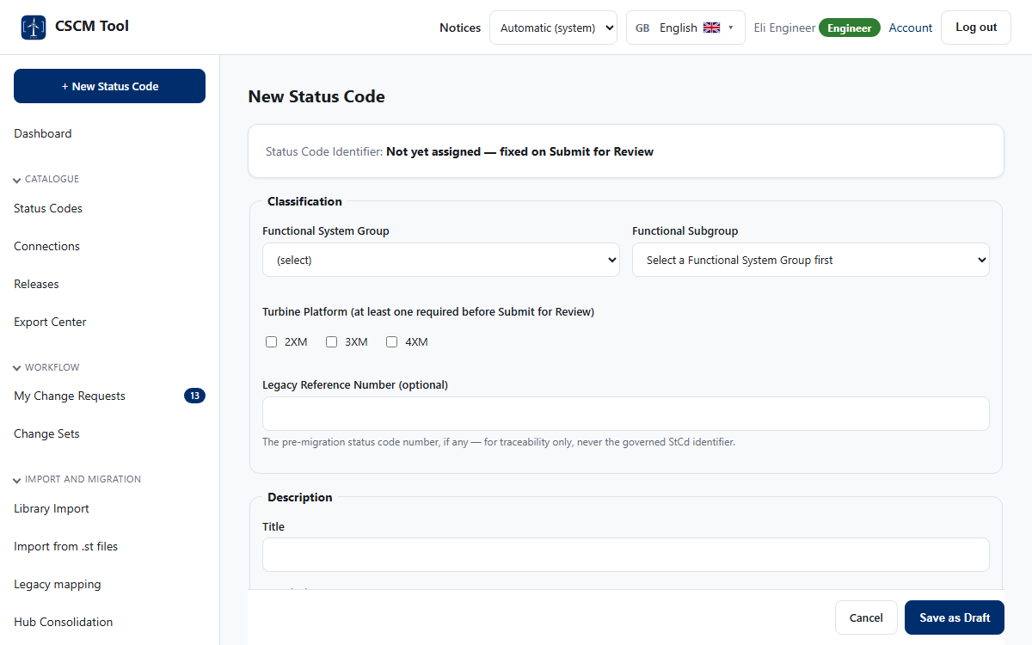
Writing a code
1
Help beside every field
Each choice explains itself; subgroups follow the group chosen.
2
Soft checks
Duplicates, similar titles and range capacity are shown while typing.
3
Nothing is lost
A rejected save keeps every entry and says what to correct.
CSCM Tool v4.16.1 · Design walkthrough
8 / 23

Slide 9
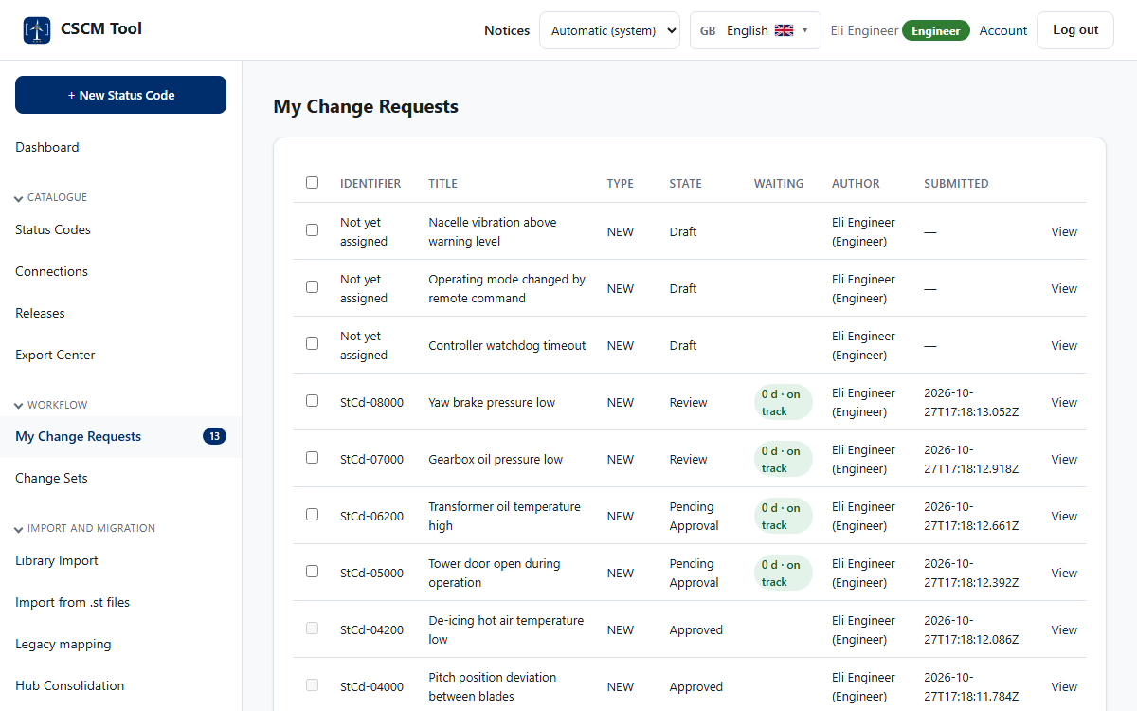
My work and the queues
1
My Change Requests
Your own requests, their state, and who they wait for.
2
Select and withdraw
Tick several and withdraw them at once; each is reported.
3
Queues for the roles
Review and approval queues show the age of every request.
CSCM Tool v4.16.1 · Design walkthrough
9 / 23

Slide 10
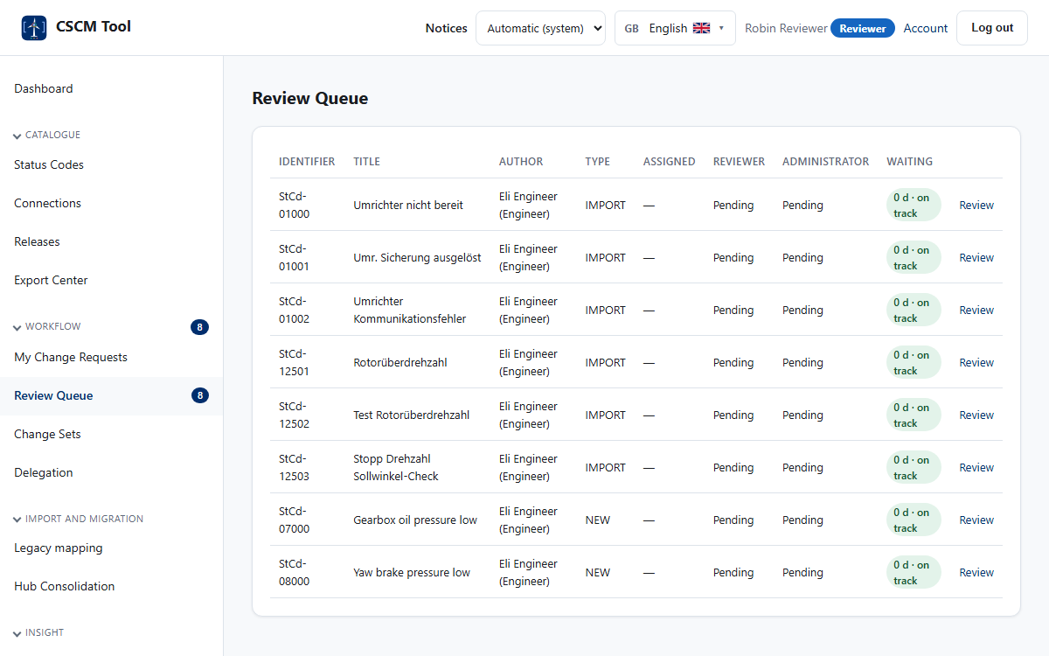
Review queue
1
Waiting time as a pill
Green, amber and red follow the service level of the step.
2
Open and decide
One click to the request with its full history.
3
Separation of duties
You cannot review your own work.
CSCM Tool v4.16.1 · Design walkthrough
10 / 23

Slide 11
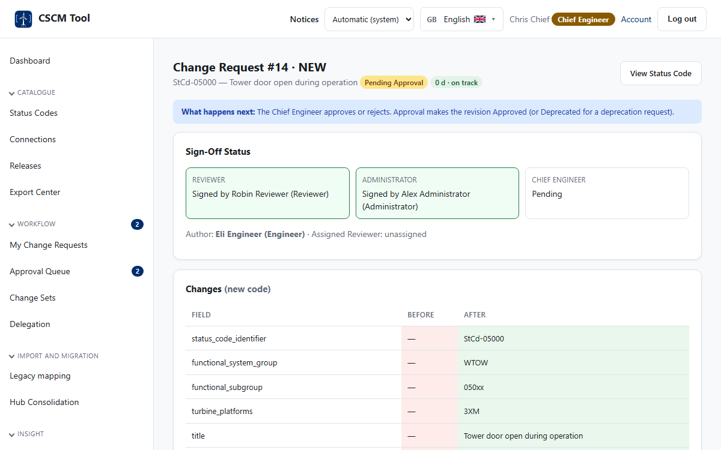
Sign-off and approval
1
The strip of sign-offs
Domain, Reviewer, Administrator and Chief Engineer, each with name and time.
2
Comments and field notes
Decisions, comments and notes on single fields stay with the request.
3
Password for decisions
Sensitive steps ask for the password again.
CSCM Tool v4.16.1 · Design walkthrough
11 / 23

Slide 12
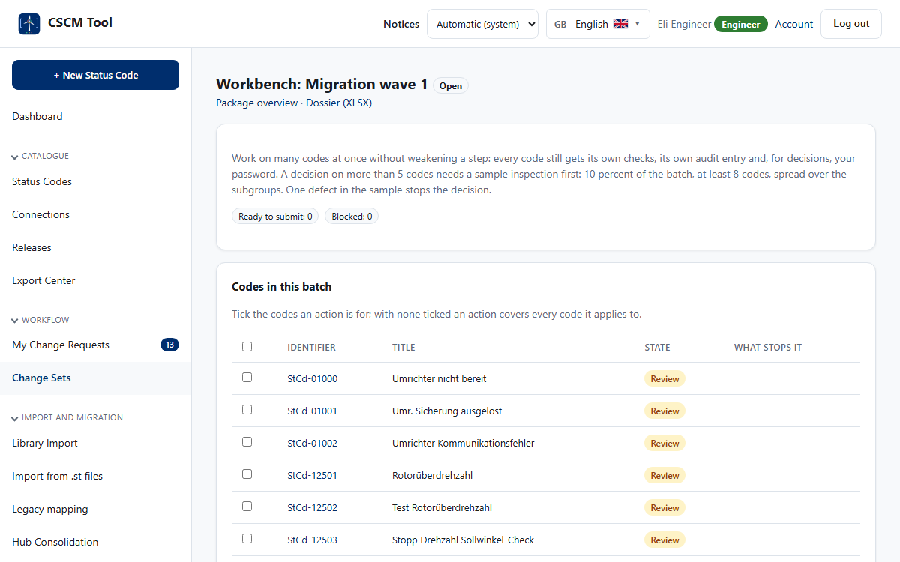
Change sets and the workbench
1
Readiness
What still stops each Draft from being submitted.
2
Bulk edit and bulk steps
Set one value, submit, sign off or decide for the whole batch.
3
Sample inspection
Draw a sample, mark each code, and one defect stops the batch.
CSCM Tool v4.16.1 · Design walkthrough
12 / 23

Slide 13
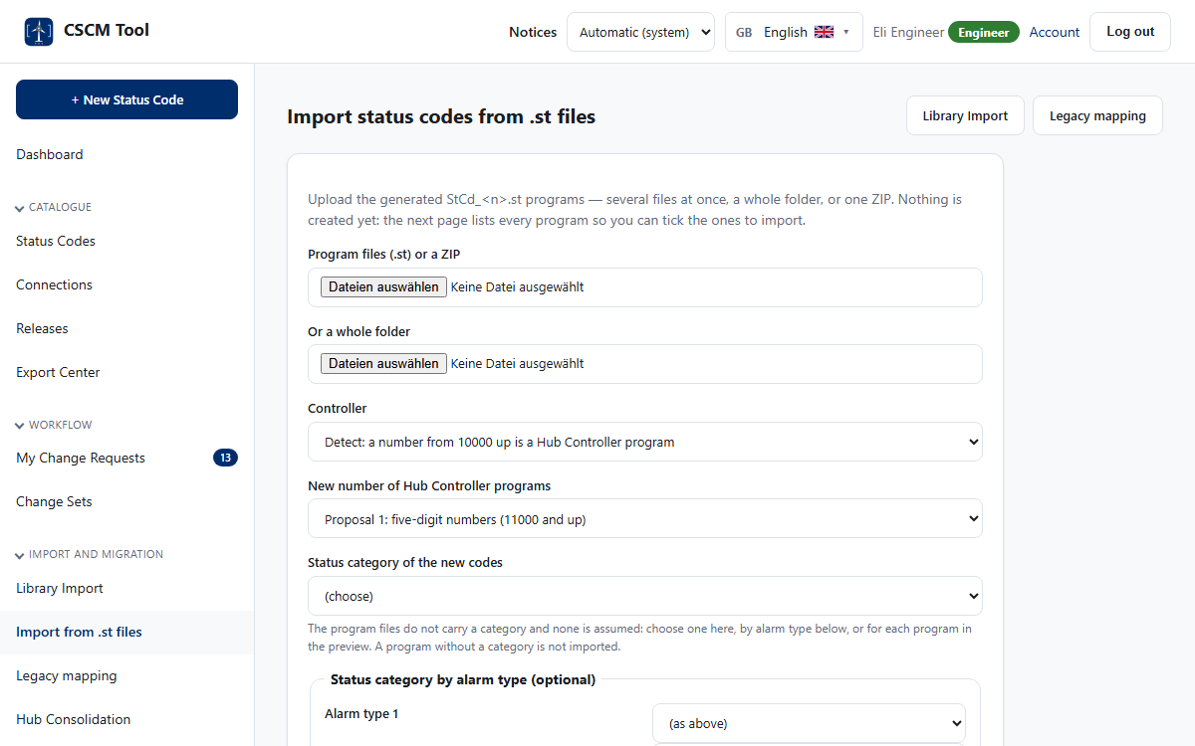
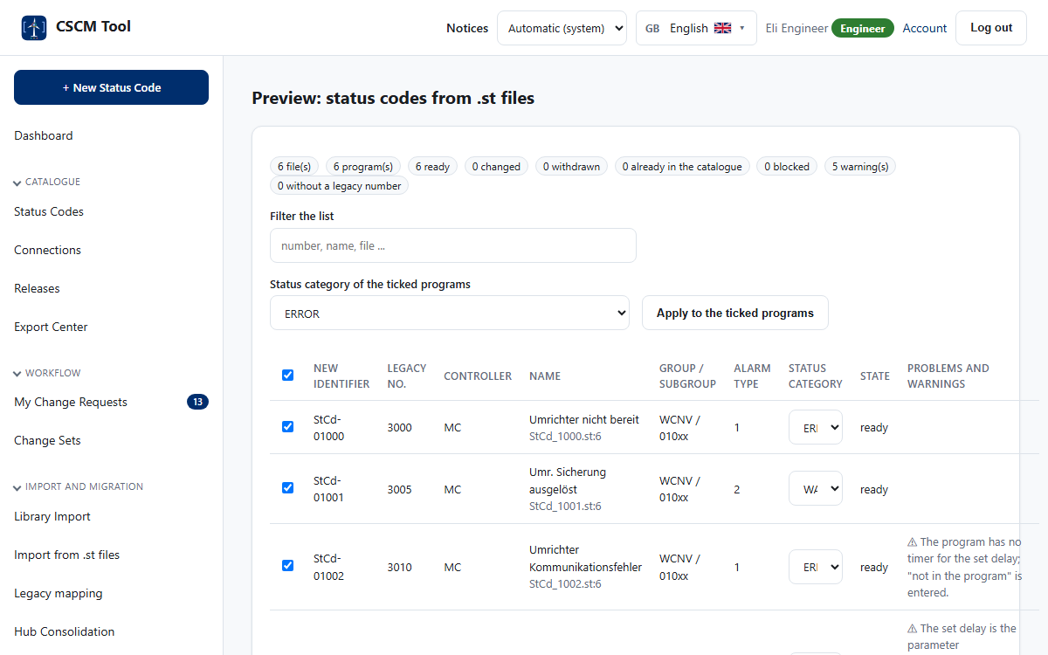
Importing from controller programs
Upload files, a folder or a ZIP. Choose a category for each alarm type.
Every program is a row with its new number, alarm type and a category you can change.
CSCM Tool v4.16.1 · Design walkthrough
13 / 23
Notes:
The import creates Drafts only. They still need every decision before release.

Slide 14

Connections
1
Suppressed by
A code that is silenced while its cause is active.
2
Escalates to
Where a repeating code is replaced by its repeat code.
3
Read, not guessed
Taken from the programs; loops and missing codes are named.
CSCM Tool v4.16.1 · Design walkthrough
14 / 23

Slide 15
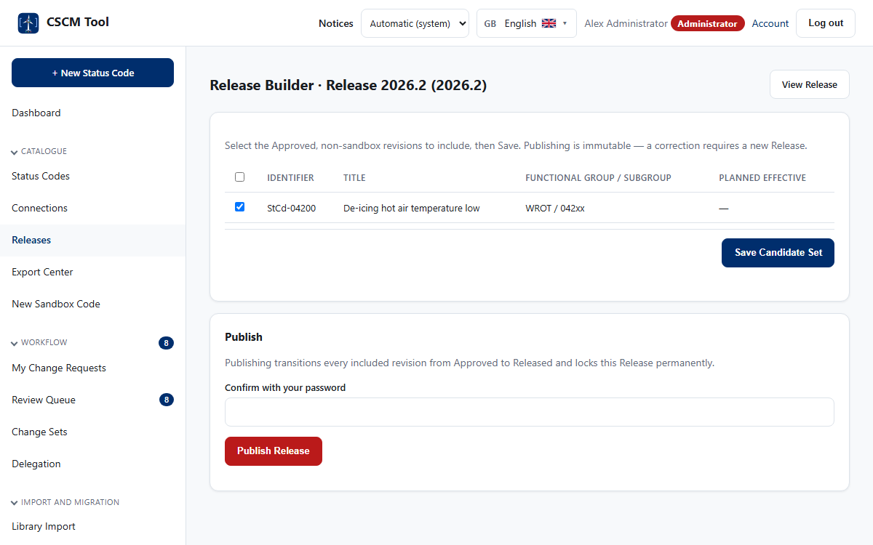
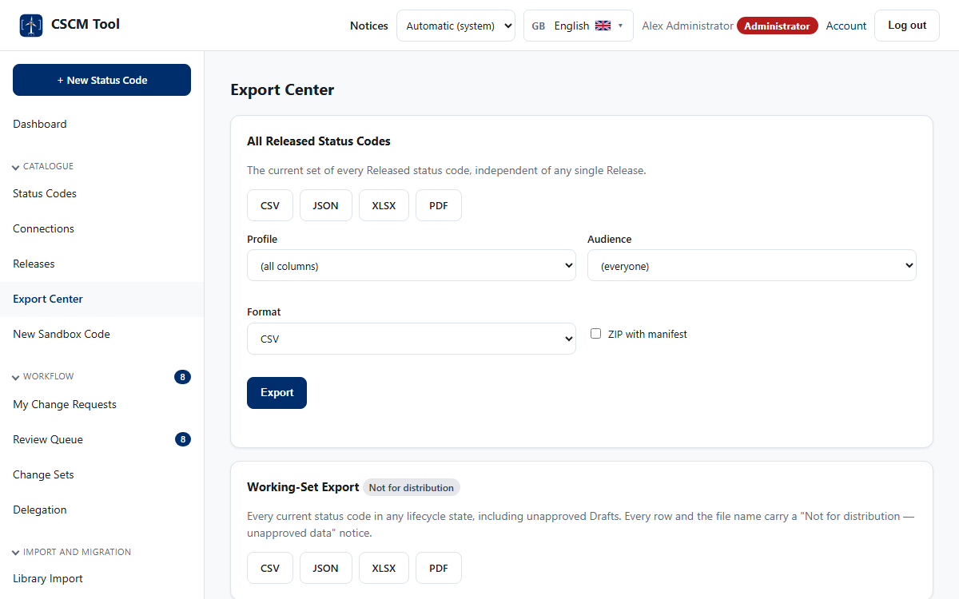
Releases and exports
The builder collects approved codes into an immutable release.
Exports and the package, with the download rule applied.
CSCM Tool v4.16.1 · Design walkthrough
15 / 23
Notes:
A package holds every language and access level in the formats chosen.

Slide 16

Catalogue health
1
Capacity of the ranges
How full each number range is, and when it will run out.
2
Colour for the controller
Main Controller rows blue, Hub Controller rows light blue.
3
Stalled work
Requests that wait too long are listed for the administrator.
CSCM Tool v4.16.1 · Design walkthrough
16 / 23

Slide 17
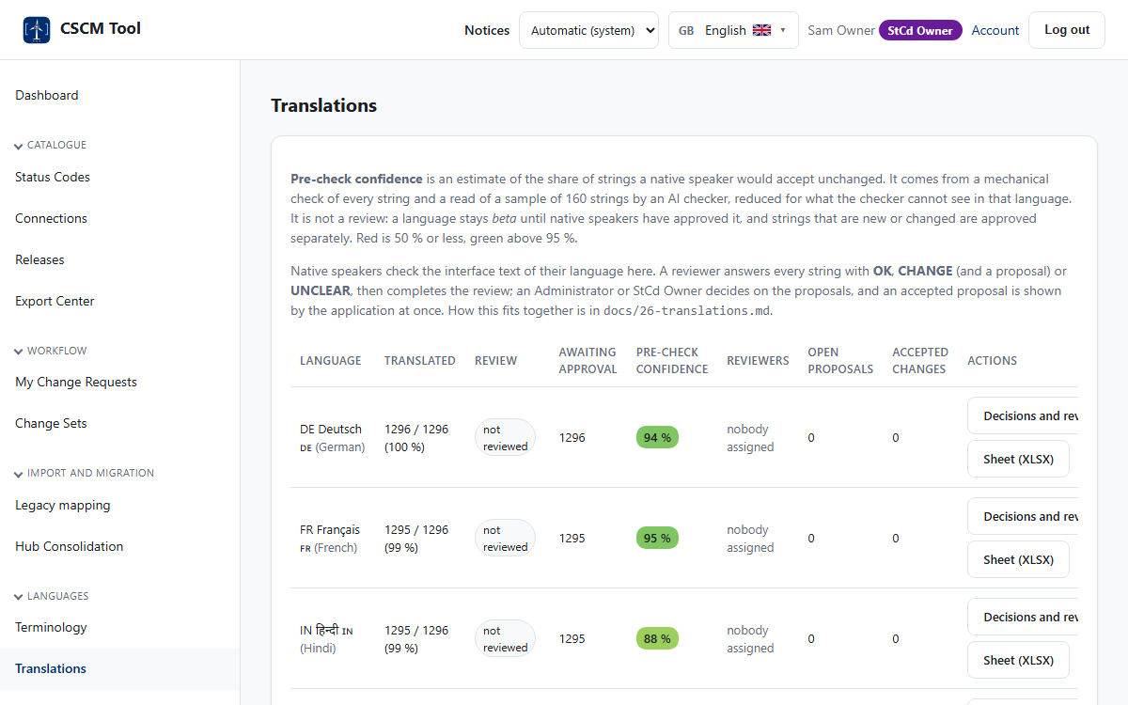
Translations and confidence
1
One row per language
Coverage, native-speaker review and the confidence of the pre-check.
2
Confidence colours
Red up to 50 %, green above 95 %.
3
New words are checked
Changed or new texts are checked and approved separately.
CSCM Tool v4.16.1 · Design walkthrough
17 / 23

Slide 18
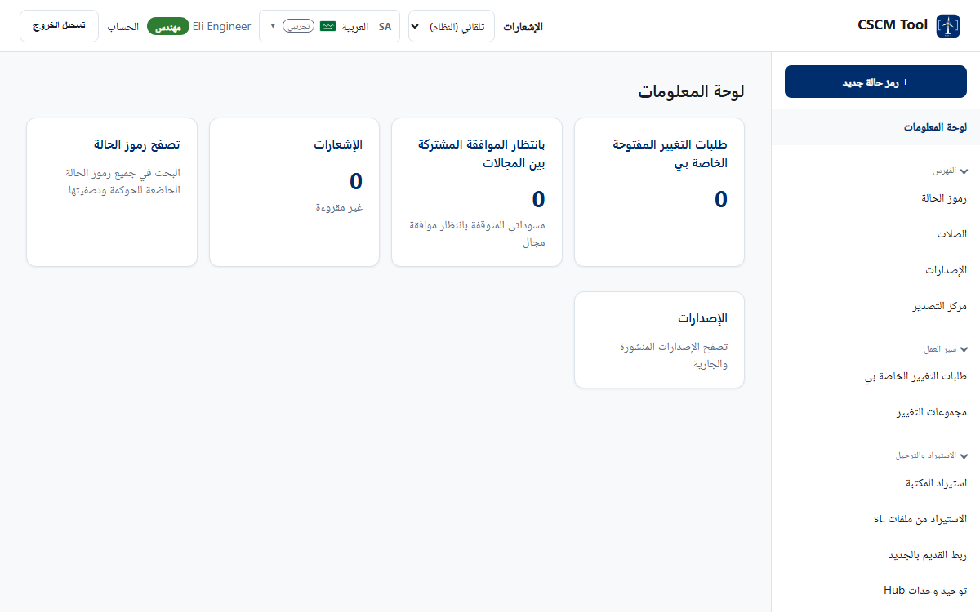
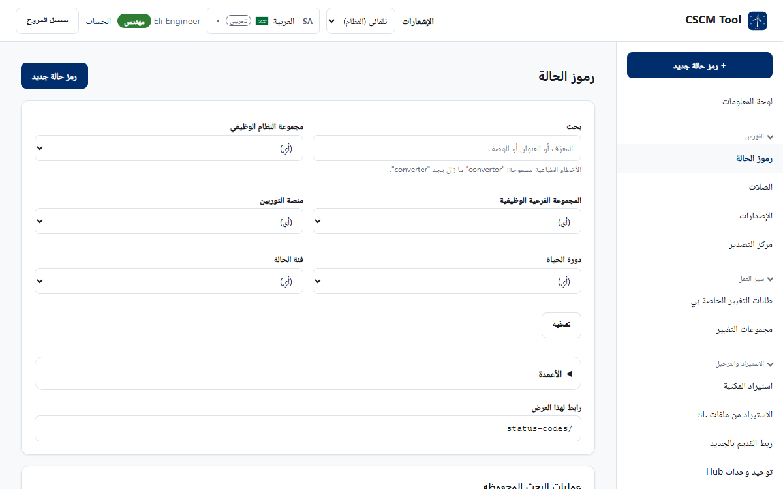
Languages and right to left
Arabic mirrors the whole layout: menu on the right, tables read from the right.
Identifiers and numbers stay left to right inside the text.
CSCM Tool v4.16.1 · Design walkthrough
18 / 23
Notes:
19 languages; the language list shows the country letters and the flag.

Slide 19
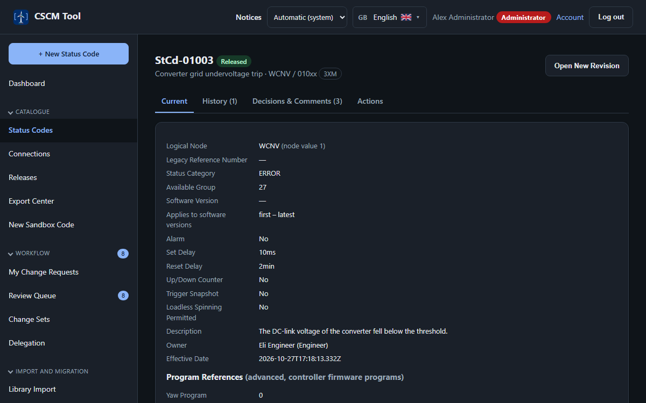
Light and dark
Light: ink on paper, for the office and for print.
Dark: the same page, with every colour pair checked for contrast.
CSCM Tool v4.16.1 · Design walkthrough
19 / 23
Notes:
The choice is Automatic (system), Light or Dark and is kept on the device. Printouts and exports stay light.

Slide 20
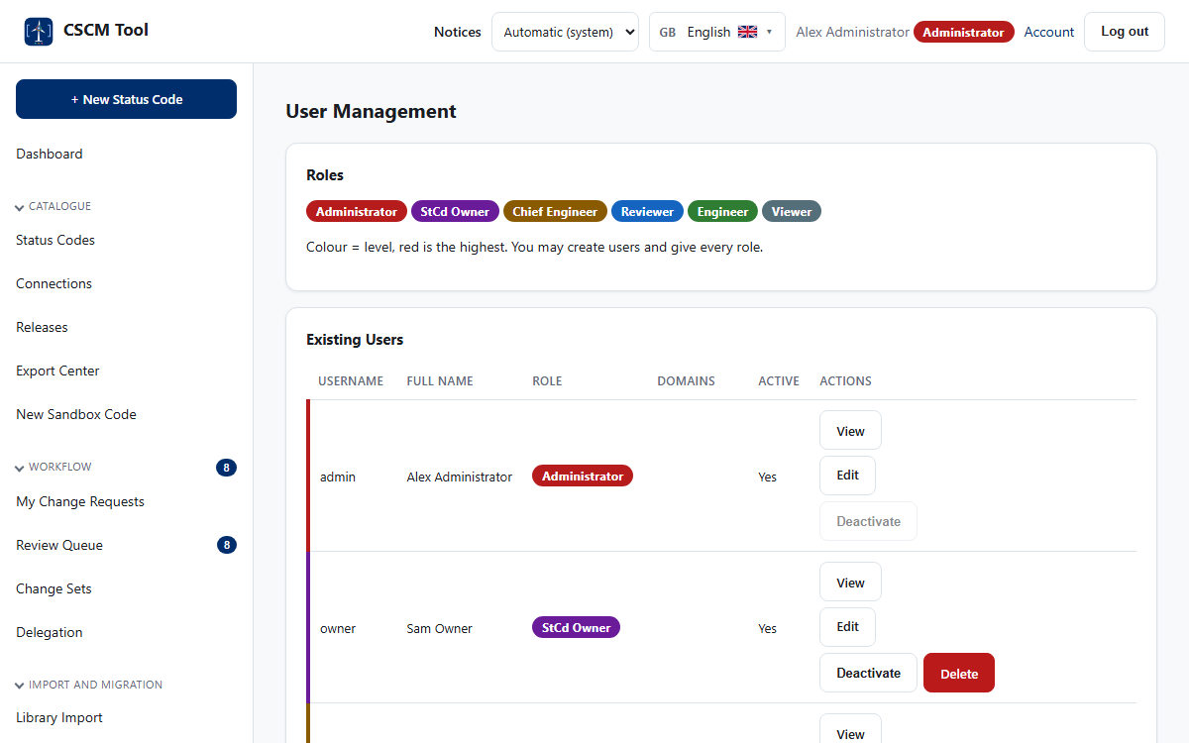
People and roles
1
Six roles
Viewer, Engineer, Reviewer, Chief Engineer, Administrator, StCd Owner.
2
Colour is the level
The role badge colour is the same everywhere it appears.
3
Accounts by e-mail
The e-mail address is fixed and links the Windows identity.
CSCM Tool v4.16.1 · Design walkthrough
20 / 23

Slide 21

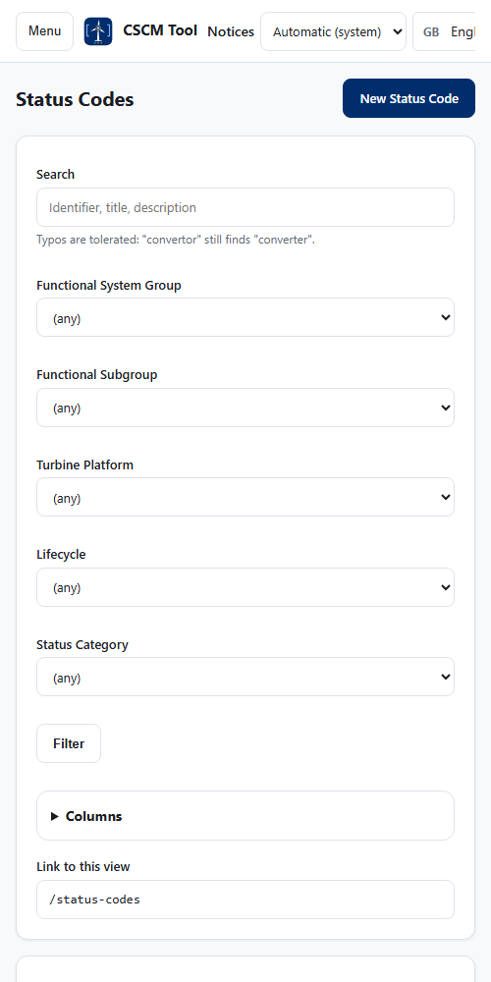
On a phone
1
Menu on demand
A button opens the menu; Esc closes it.
2
Touch-sized targets
Buttons and links are at least 44 by 44 pixels.
3
No horizontal page scroll
Wide tables scroll inside their card.
Dashboard
Status codes
CSCM Tool v4.16.1 · Design walkthrough
21 / 23
Notes:
The menu folds away below 768 px and tables scroll inside their card.

Slide 22
Rules for every new screen
1
Use tokens, never colours
var(--color-surface), var(--tint-warn-bg) ... A test fails on a hex colour outside the tokens.
2
Give a dark twin to a new token
A light token without a dark value would stay light on a dark page.
3
Label every control
A visible label or an accessible name; tables use scope on their headers.
4
Words for states, not only colour
Badges carry the state as text.
5
Translate every text
New words go through the confidence check and a separate approval.
CSCM Tool v4.16.1 · Design walkthrough
22 / 23
Notes:
From docs/10-ui-ux-specification.md section 13 and the accessibility tests.

Slide 23

The same rules, from login to release
One shell, tokens for every colour, both themes
Governance visible in every screen
Version 4.16.1: 1,035 tests, 19 languages
CSCM Tool v4.16.1 · Design walkthrough
23 / 23

