Slide 1


Software Owner and Administrator: Bastian Ritter · bastian.ritter@senvion.in
CSCM Tool
Controller Status Code Management Tool
Design walkthrough for the team
Version 4.18.0
2026-10-28
Main Controllers and Hub Controllers of wind turbines
CSCM Tool v4.18.0 · Design walkthrough
1 / 24
Notes:
Version 4.18.0, 2026-10-28. All screens in this deck are screenshots of the real application with fictitious data.

Slide 2
Design principles
1
Same shell everywhere
2
Colour means something
Top bar, role-based menu and tokens of the OneTool design system. No CDN, no framework.
Roles, lifecycle states and confidence have fixed colours. Every pair is checked for contrast.
3
Everyone can use it
4
Nothing is lost
Keyboard operable, labelled controls, 19 languages, right to left, dark theme.
A rejected form keeps what was typed. Every action is audited.
CSCM Tool v4.18.0 · Design walkthrough
2 / 24
Notes:
The rules behind every screen. They are written down in docs/10-ui-ux-specification.md.

Slide 3
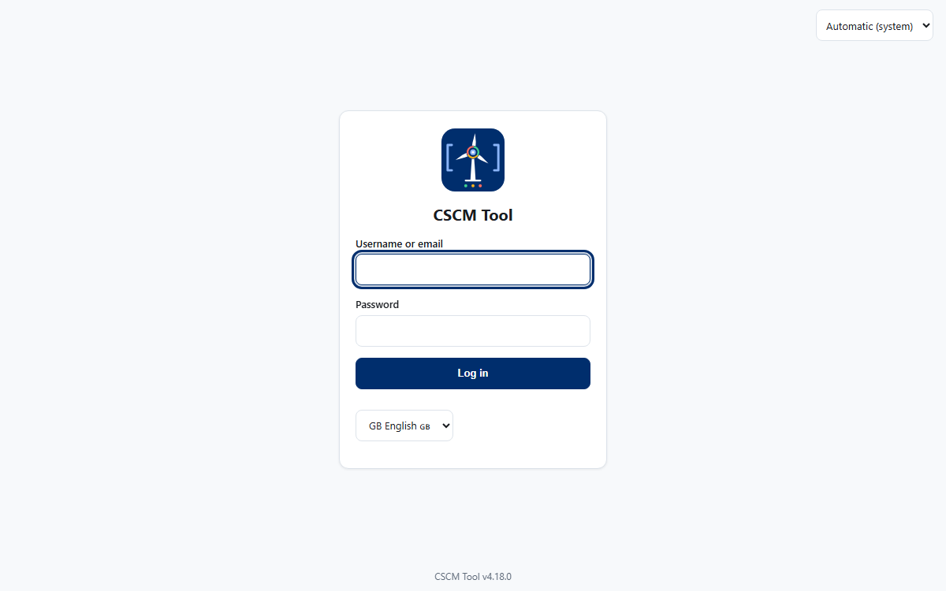
Login
Password sign-in, with the language choice and the theme choice before anybody is signed in.
Where the organisation uses Windows accounts, one button signs in with the Windows identity.
CSCM Tool v4.18.0 · Design walkthrough
3 / 24
Notes:
In a deployment people sign in with their Windows account; the password form can be switched off.

Slide 4
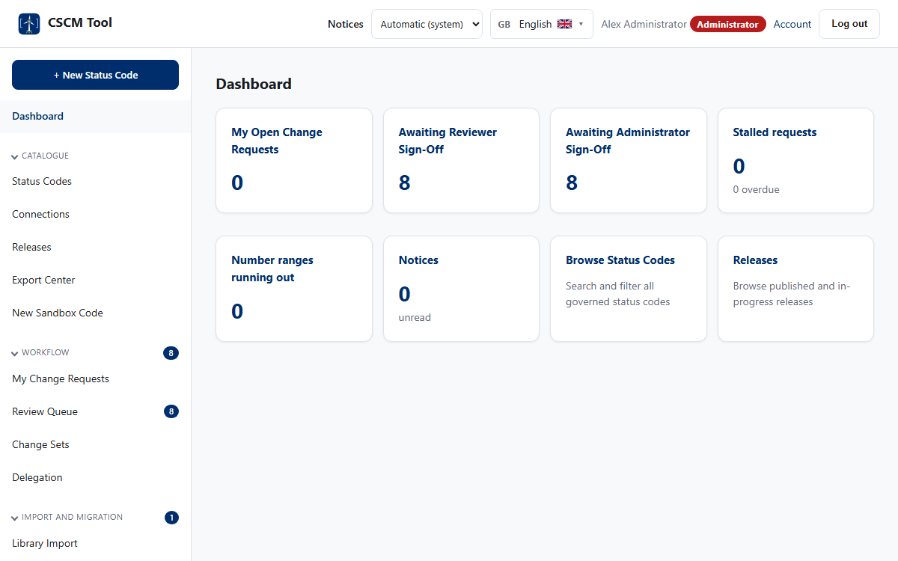
The shell: top bar and menu
1
Top bar
Notices, theme, language, the person and their role badge, account and log out.
2
Menu
Groups open and close; the count beside a link is the work waiting there.
3
Role colours
Red is the highest role. The colours repeat in lists and reports.
CSCM Tool v4.18.0 · Design walkthrough
4 / 24

Slide 5
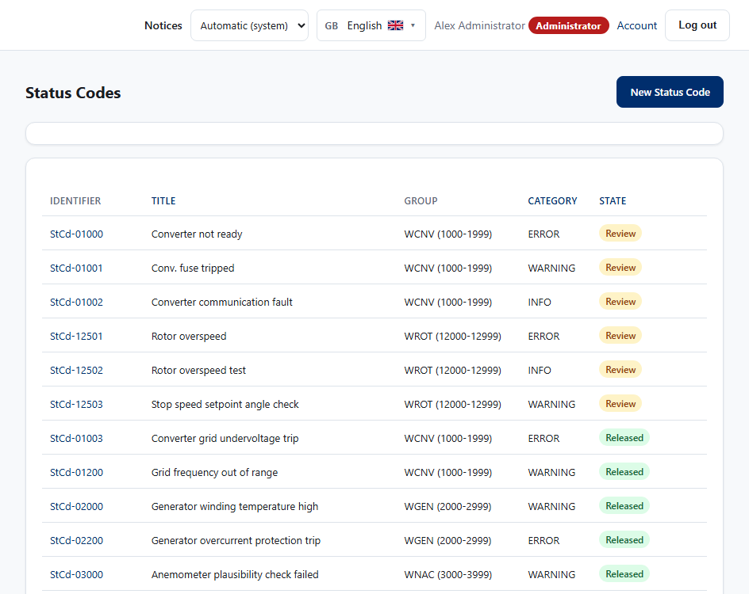
Status Codes: find, filter, share
1
Filters
Search tolerates typos; group, subgroup, platform, lifecycle and category narrow the list.
2
Columns and saved searches
Choose the columns, save a view and share its link.
3
State badges
Draft to Archived, always in the same colours and always with words.
CSCM Tool v4.18.0 · Design walkthrough
5 / 24

Slide 6
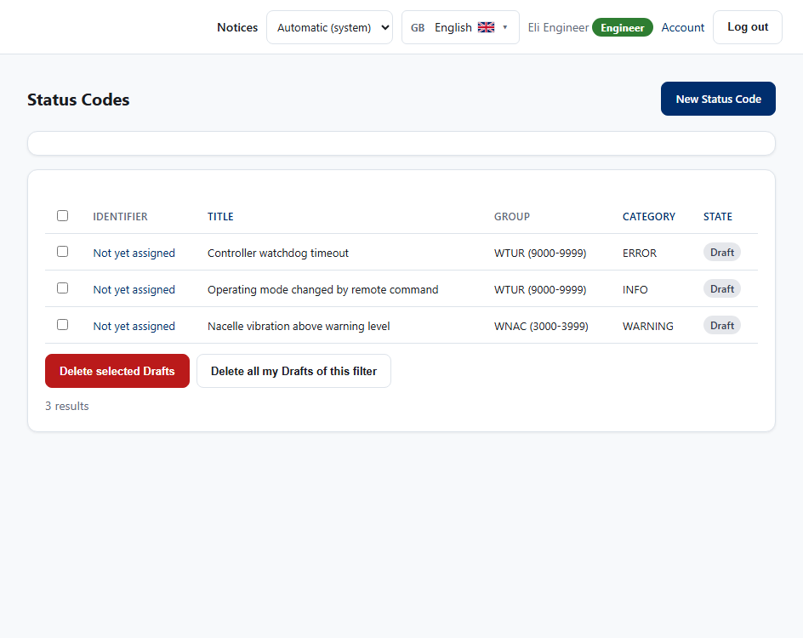
Select, select all, delete Drafts
1
Tick boxes for your own Drafts
Only the author can delete a Draft, so only these rows have a box.
2
Select all
The box in the header ticks every Draft on the page.
3
All Drafts of a filter
When filtered to Draft, one button deletes your Drafts on every page.
CSCM Tool v4.18.0 · Design walkthrough
6 / 24

Slide 7
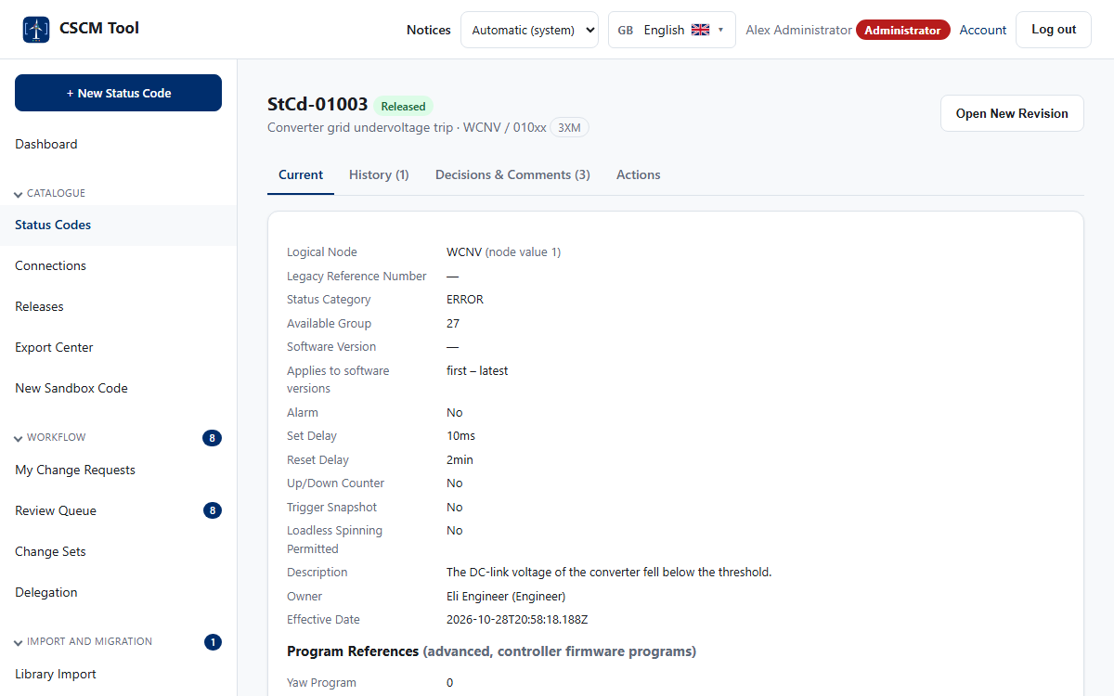
A status code
1
Identity and state
The number, the state badge and the sign-offs at a glance.
2
Tabs
Details, history, comparison, where used, translations.
3
One number, forever
A number is issued once, at submit, and never reused.
CSCM Tool v4.18.0 · Design walkthrough
7 / 24

Slide 8
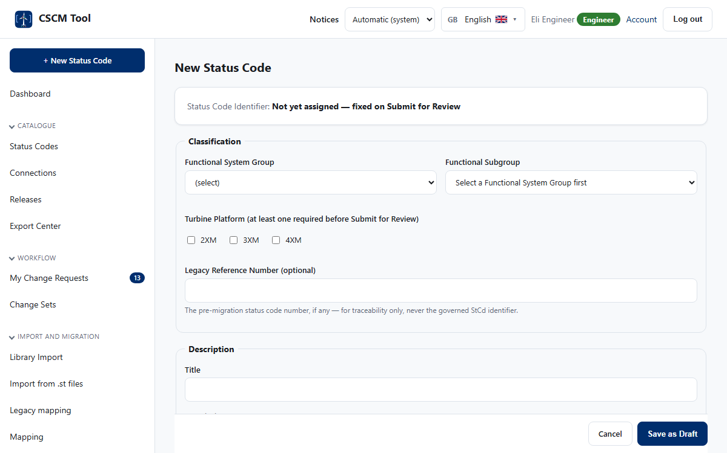
Writing a code
1
Help beside every field
Each choice explains itself; subgroups follow the group chosen.
2
Soft checks
Duplicates, similar titles and range capacity are shown while typing.
3
Nothing is lost
A rejected save keeps every entry and says what to correct.
CSCM Tool v4.18.0 · Design walkthrough
8 / 24

Slide 9
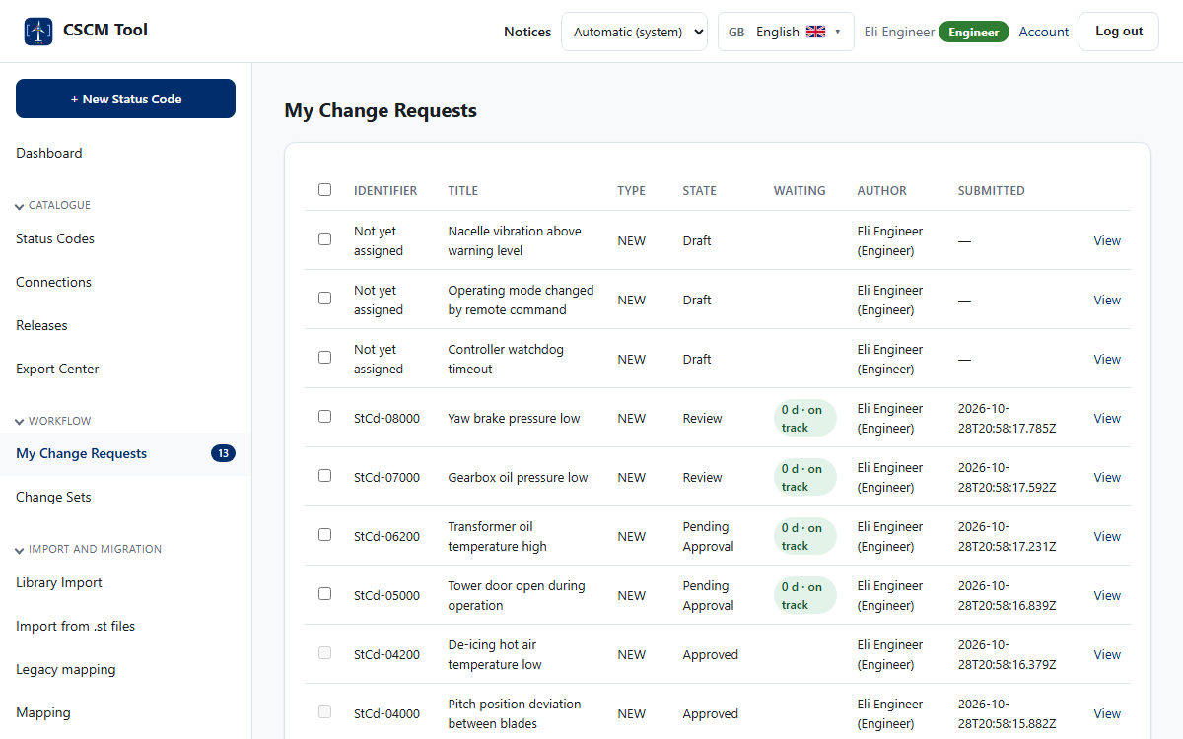
My work and the queues
1
My Change Requests
Your own requests, their state, and who they wait for.
2
Select and withdraw
Tick several and withdraw them at once; each is reported.
3
Queues for the roles
Review and approval queues show the age of every request.
CSCM Tool v4.18.0 · Design walkthrough
9 / 24

Slide 10
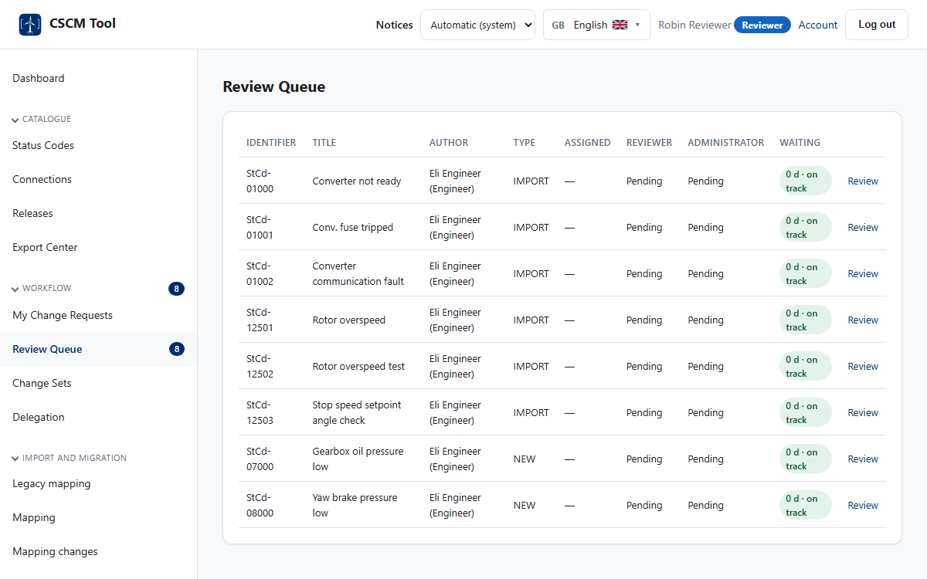
Review queue
1
Waiting time as a pill
Green, amber and red follow the service level of the step.
2
Open and decide
One click to the request with its full history.
3
Separation of duties
You cannot review your own work.
CSCM Tool v4.18.0 · Design walkthrough
10 / 24

Slide 11
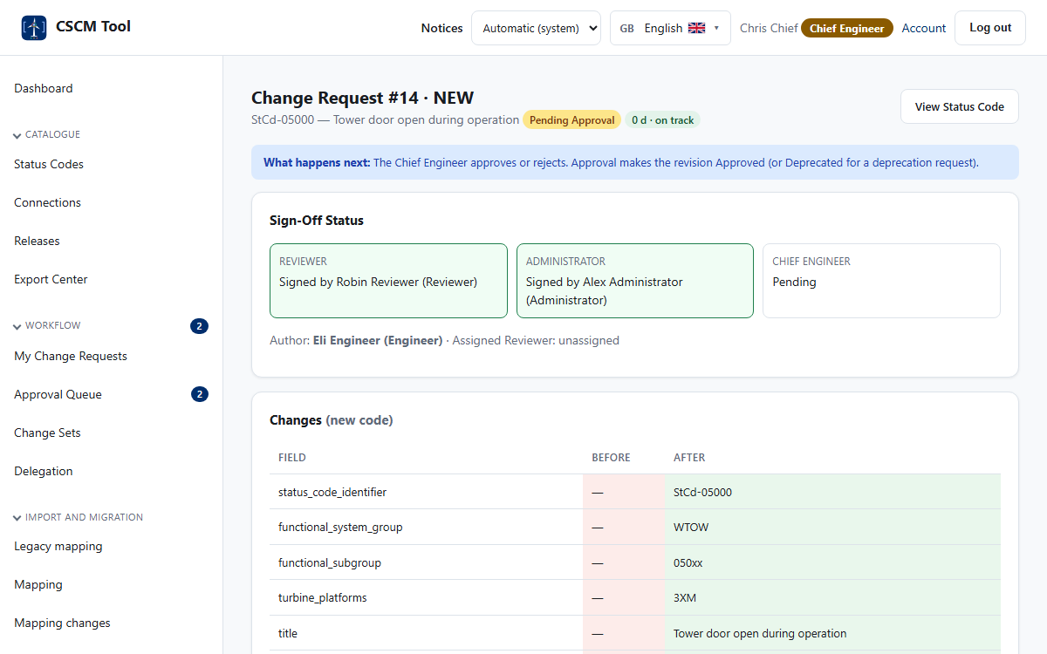
Sign-off and approval
1
The strip of sign-offs
Domain, Reviewer, Administrator and Chief Engineer, each with name and time.
2
Comments and field notes
Decisions, comments and notes on single fields stay with the request.
3
Password for decisions
Sensitive steps ask for the password again.
CSCM Tool v4.18.0 · Design walkthrough
11 / 24

Slide 12

Change sets and the workbench
1
Readiness
What still stops each Draft from being submitted.
2
Bulk edit and bulk steps
Set one value, submit, sign off or decide for the whole batch.
3
Sample inspection
Draw a sample, mark each code, and one defect stops the batch.
CSCM Tool v4.18.0 · Design walkthrough
12 / 24

Slide 13
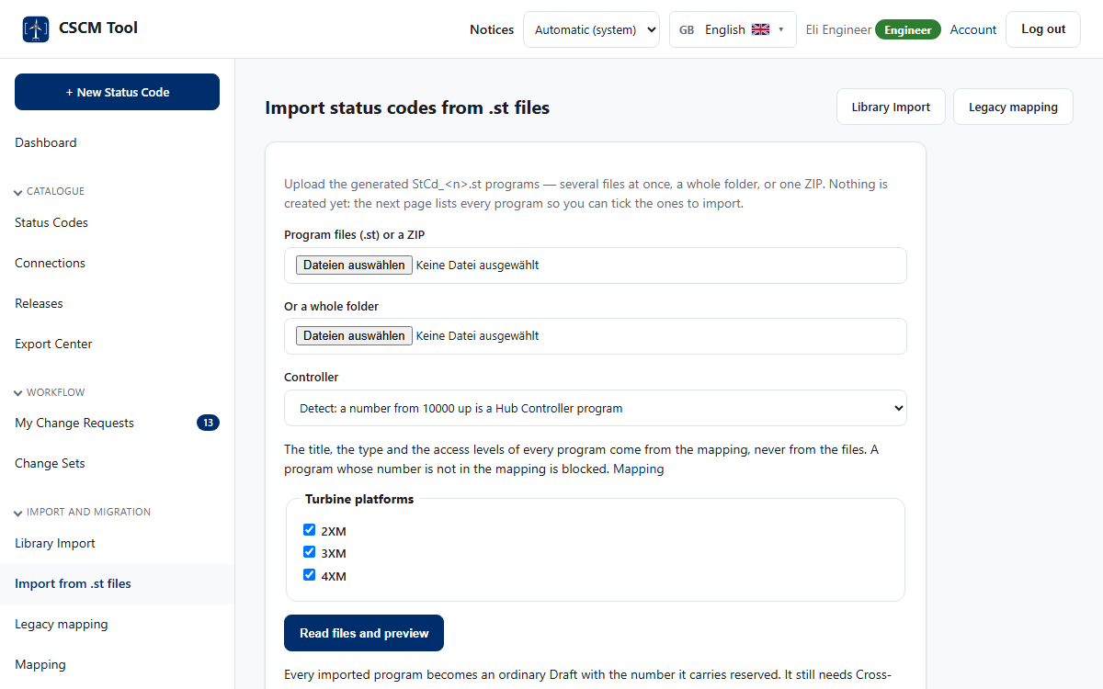

Importing from controller programs
Upload files, a folder or a ZIP. The title, type and access levels come from the mapping.
Every program is a row with its new number, its type from the mapping, and what is wrong with it.
CSCM Tool v4.18.0 · Design walkthrough
13 / 24
Notes:
The import creates Drafts only. They still need every decision before release.

Slide 14
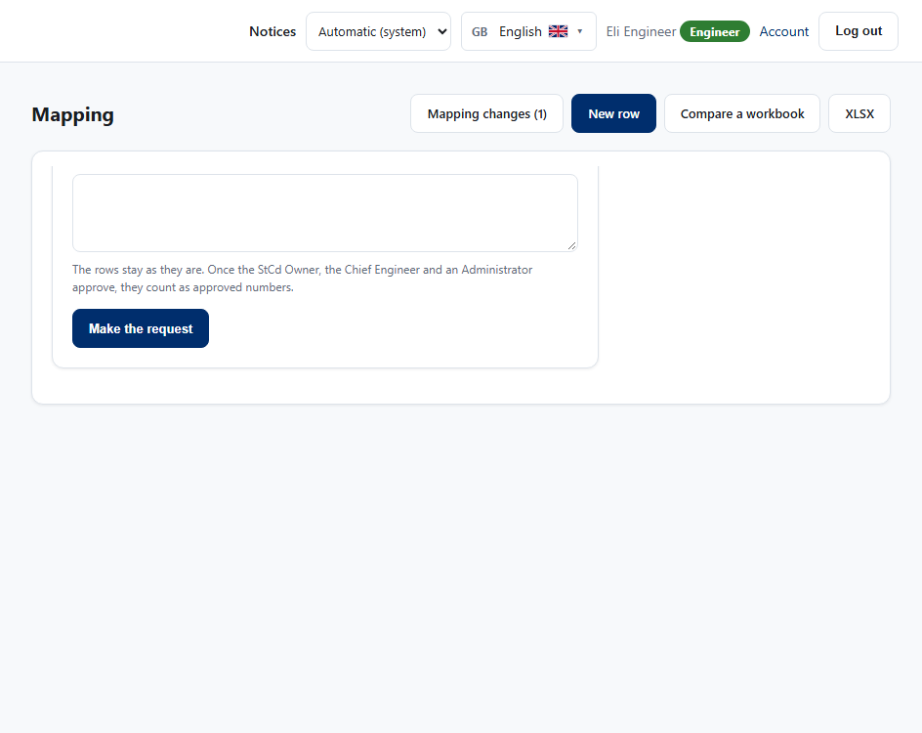
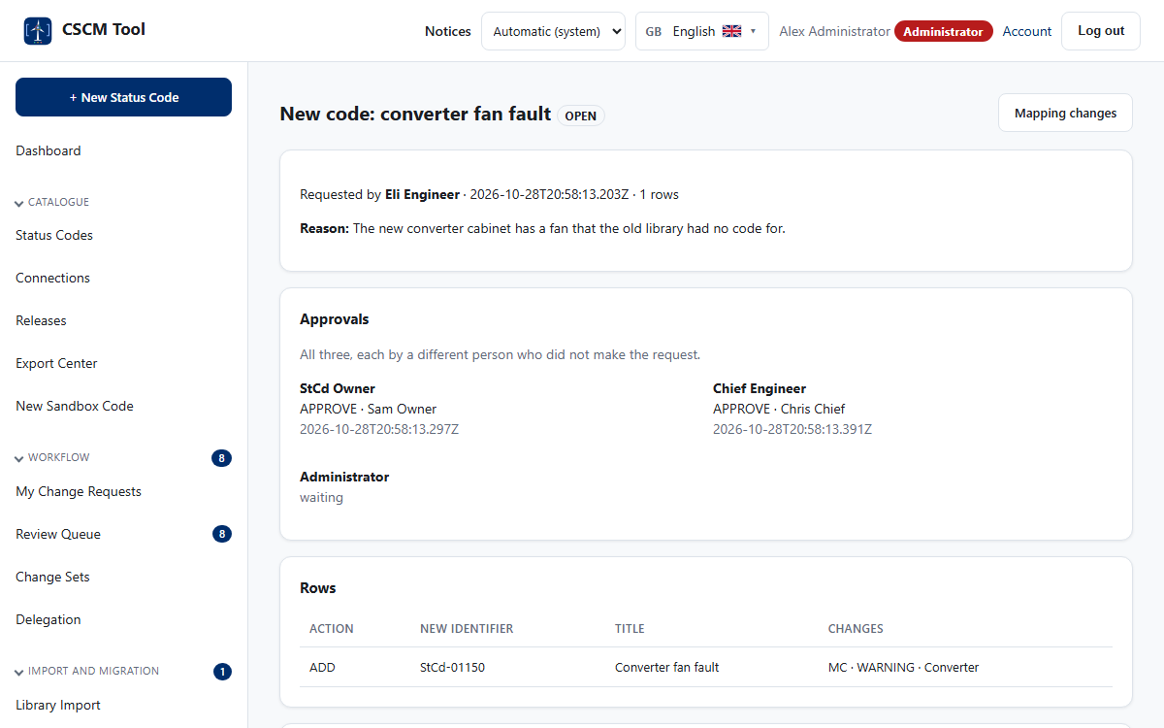
The mapping and its three approvals
Which legacy code becomes which new one, with the title, type and access levels the programs do not carry.
A change takes effect only when the StCd Owner, the Chief Engineer and an Administrator have approved it.
CSCM Tool v4.18.0 · Design walkthrough
14 / 24
Notes:
Nothing in the mapping changes by itself: a request, a reason, three different people, and every step in the audit log.

Slide 15

Connections
1
Suppressed by
A code that is silenced while its cause is active.
2
Escalates to
Where a repeating code is replaced by its repeat code.
3
Read, not guessed
Taken from the programs; loops and missing codes are named.
CSCM Tool v4.18.0 · Design walkthrough
15 / 24

Slide 16

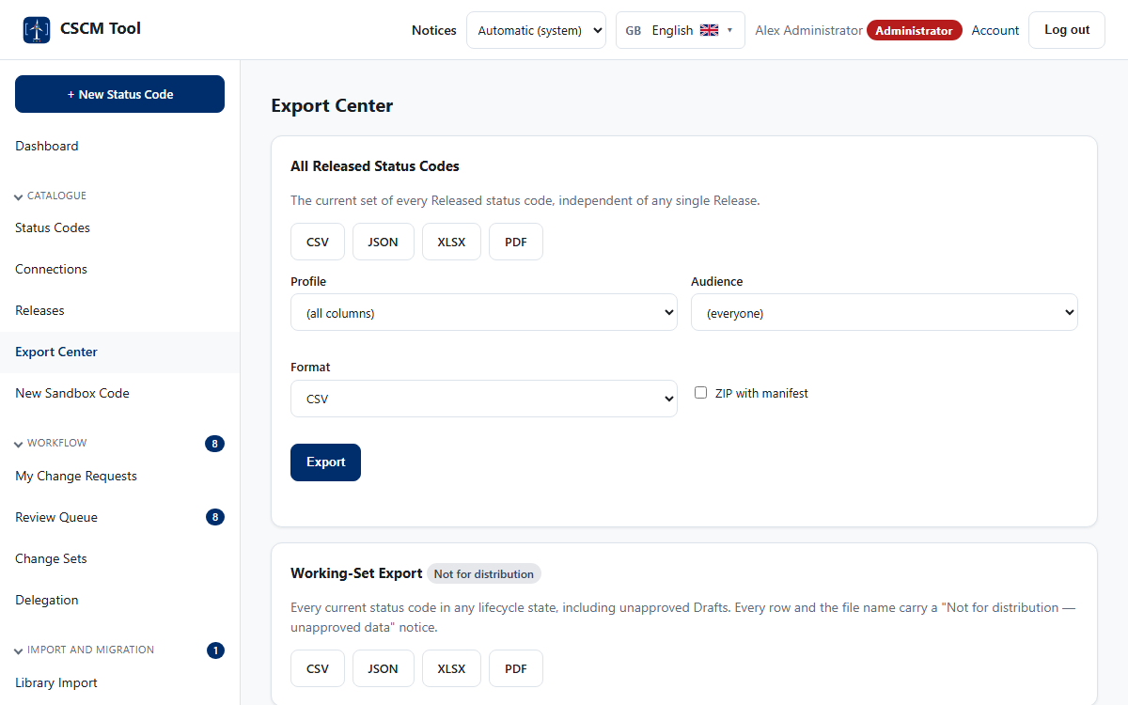
Releases and exports
The builder collects approved codes into an immutable release.
Exports and the package, with the download rule applied.
CSCM Tool v4.18.0 · Design walkthrough
16 / 24
Notes:
A package holds every language and access level in the formats chosen.

Slide 17

Catalogue health
1
Capacity of the ranges
How full each number range is, and when it will run out.
2
Colour for the controller
Main Controller rows blue, Hub Controller rows light blue.
3
Stalled work
Requests that wait too long are listed for the administrator.
CSCM Tool v4.18.0 · Design walkthrough
17 / 24

Slide 18
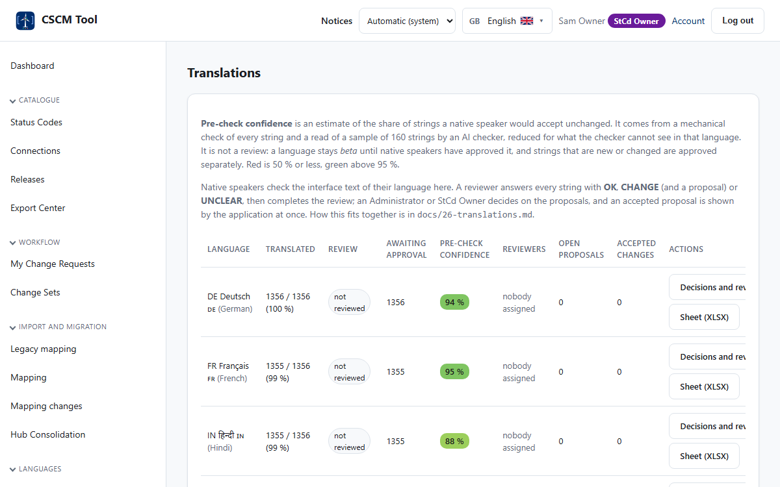
Translations and confidence
1
One row per language
Coverage, native-speaker review and the confidence of the pre-check.
2
Confidence colours
Red up to 50 %, green above 95 %.
3
New words are checked
Changed or new texts are checked and approved separately.
CSCM Tool v4.18.0 · Design walkthrough
18 / 24

Slide 19

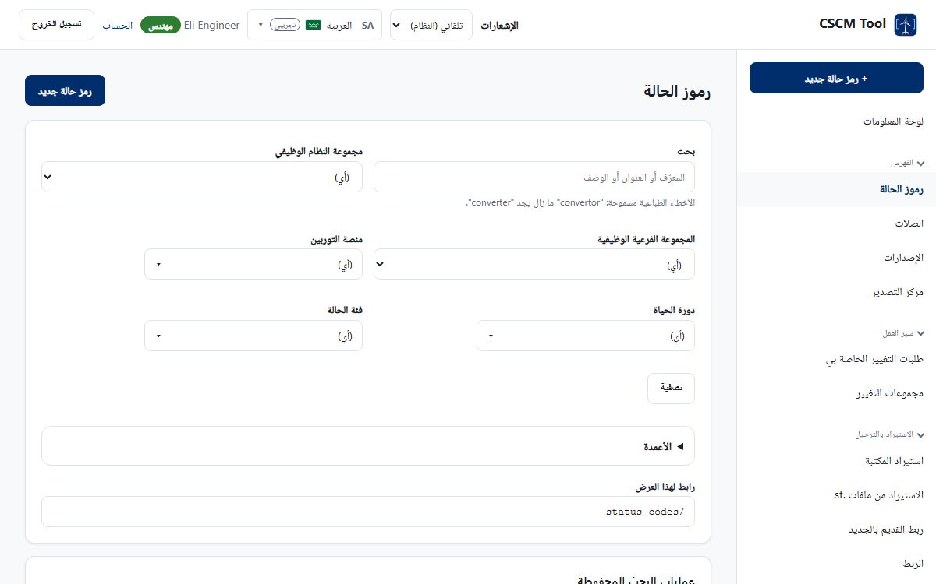
Languages and right to left
Arabic mirrors the whole layout: menu on the right, tables read from the right.
Identifiers and numbers stay left to right inside the text.
CSCM Tool v4.18.0 · Design walkthrough
19 / 24
Notes:
19 languages; the language list shows the country letters and the flag.

Slide 20
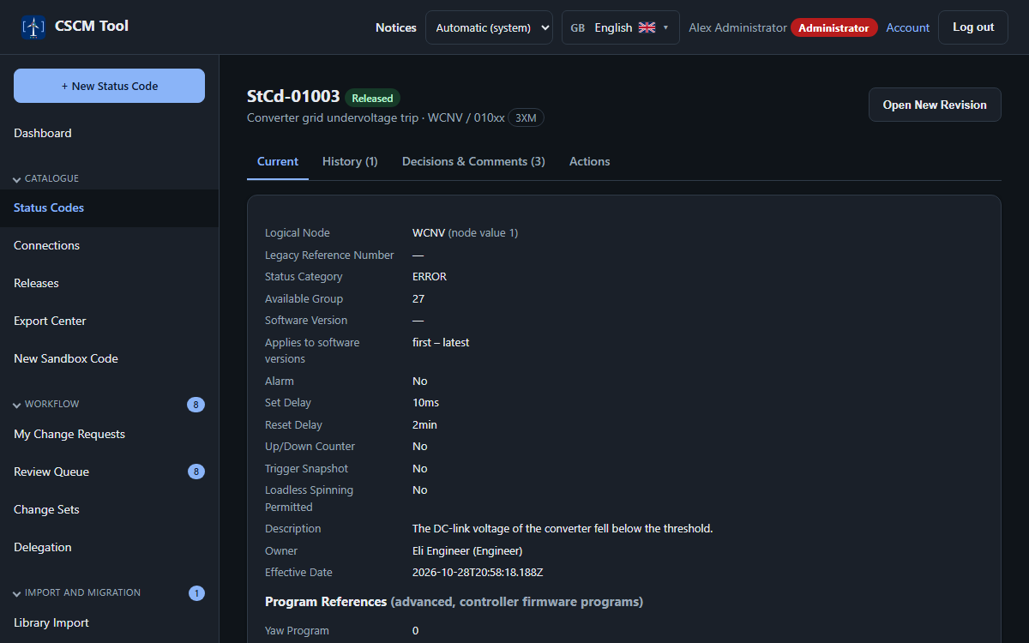
Light and dark
Light: ink on paper, for the office and for print.
Dark: the same page, with every colour pair checked for contrast.
CSCM Tool v4.18.0 · Design walkthrough
20 / 24
Notes:
The choice is Automatic (system), Light or Dark and is kept on the device. Printouts and exports stay light.

Slide 21
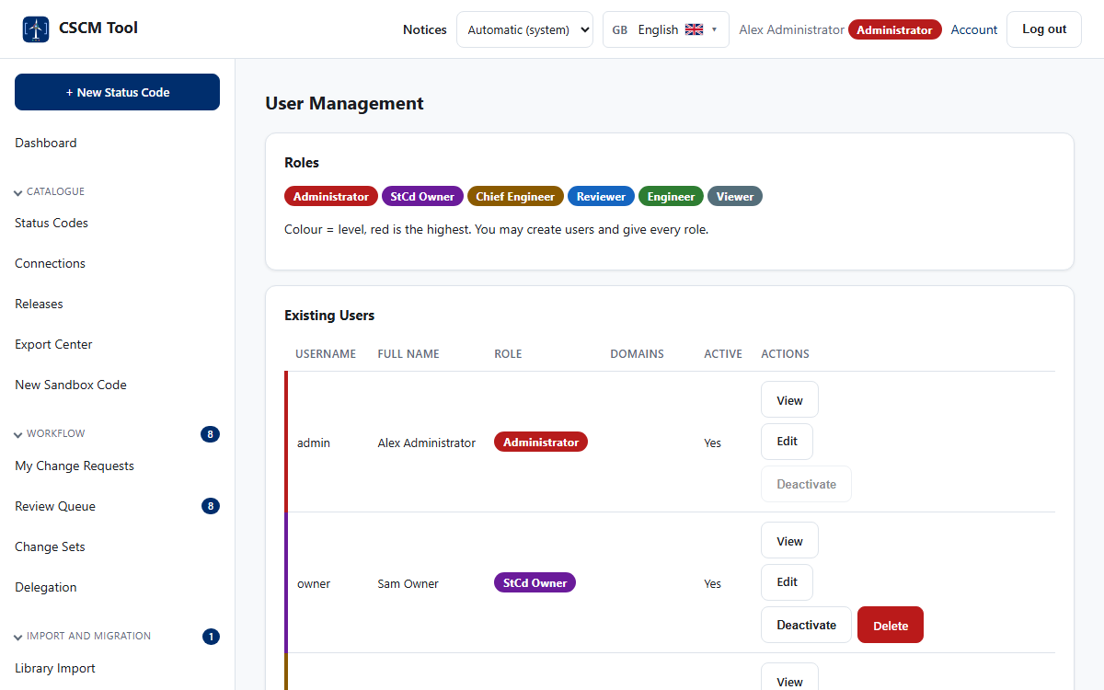
People and roles
1
Six roles
Viewer, Engineer, Reviewer, Chief Engineer, Administrator, StCd Owner.
2
Colour is the level
The role badge colour is the same everywhere it appears.
3
Accounts by e-mail
The e-mail address is fixed and links the Windows identity.
CSCM Tool v4.18.0 · Design walkthrough
21 / 24

Slide 22

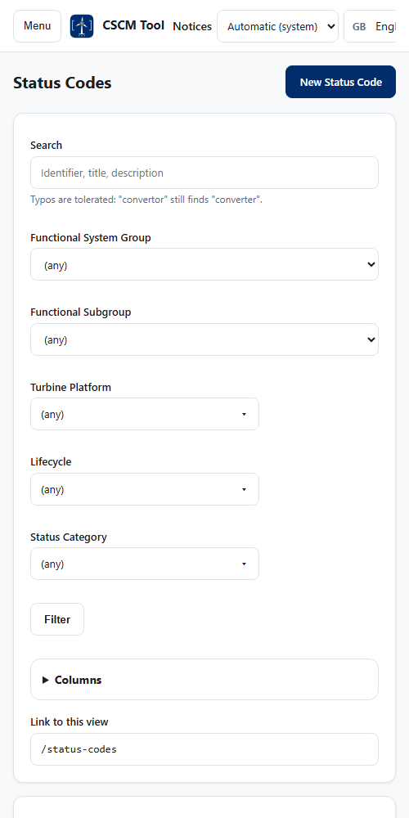
On a phone
1
Menu on demand
A button opens the menu; Esc closes it.
2
Touch-sized targets
Buttons and links are at least 44 by 44 pixels.
3
No horizontal page scroll
Wide tables scroll inside their card.
Dashboard
Status codes
CSCM Tool v4.18.0 · Design walkthrough
22 / 24
Notes:
The menu folds away below 768 px and tables scroll inside their card.

Slide 23
Rules for every new screen
1
Use tokens, never colours
var(--color-surface), var(--tint-warn-bg) ... A test fails on a hex colour outside the tokens.
2
Give a dark twin to a new token
A light token without a dark value would stay light on a dark page.
3
Label every control
A visible label or an accessible name; tables use scope on their headers.
4
Words for states, not only colour
Badges carry the state as text.
5
Translate every text
New words go through the confidence check and a separate approval.
CSCM Tool v4.18.0 · Design walkthrough
23 / 24
Notes:
From docs/10-ui-ux-specification.md section 13 and the accessibility tests.

Slide 24

The same rules, from login to release
One shell, tokens for every colour, both themes
Governance visible in every screen
Version 4.18.0: 1,089 tests, 19 languages
CSCM Tool v4.18.0 · Design walkthrough
24 / 24

