Slide 1
Use of R for Visual Display of Public Health Data
Michael Samuel, DrPH
Senior Epidemiologist/Data Scientist
California Department of Public Health

Slide 2
Data
Action
Program
New program
Revised program priorities
New guidelines
New policy
New hypothesis (may lead to new action)
More (or less) money!

Slide 3
HIV and Hepatitis among Injection Drug Users New Mexico, 1997
 | N tested |  | % Positive | 95% C.I.
HIV | 1002 |  | 0.5 | .16-1.6
Hep A | 696 |  | 66.1 | 62.4-69.6
Hep B | 950 |  | 61.1 | 57.9-64.2
Hep C | 945 |  | 82.2 | 79.6-84.6

Slide 4
HIV and Hepatitis Among Injection Drug Users New Mexico, 1997

Slide 7

Data
Action

Slide 8
Guidelines for Effective Visual Display
Complexity is good, and…
Keep it simple, stupid
Know your audience
Data integrity
Clear labels and annotations
Use appropriate scale(s)
Use appropriate type of chart
Pay attention to details
Less is more
Avoid extraneous “Chart Junk”

Slide 9
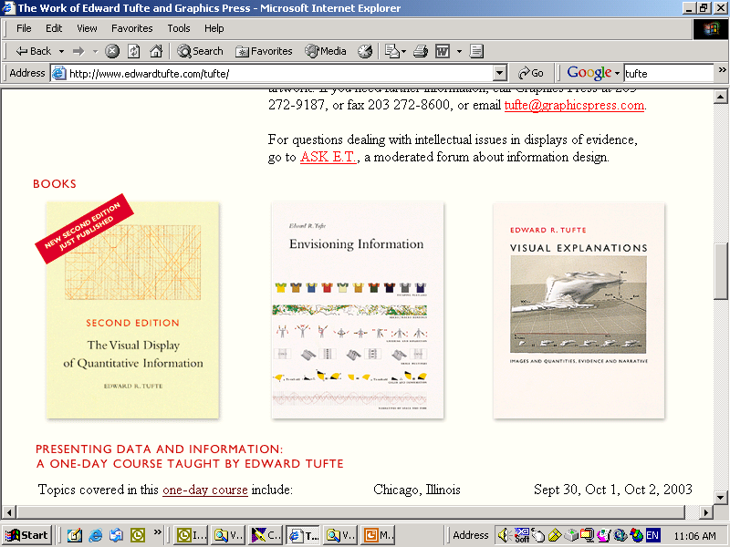


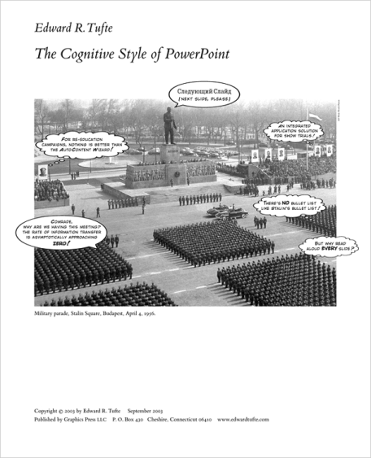

Slide 10
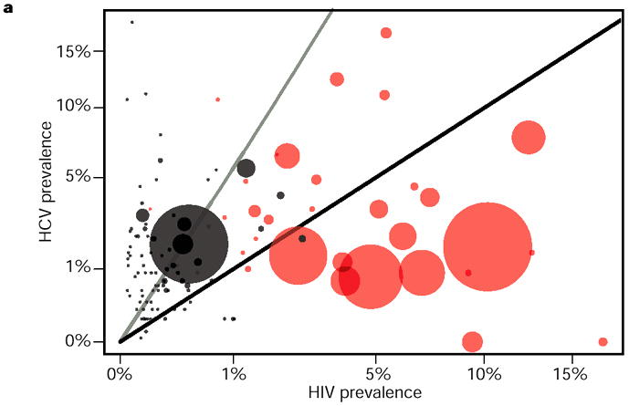

Slide 11

Nature 422, 679 (17 April 2003)
Epidemiology: Sexual transmission of HIV in Africa
Polly R. Walker, Michael Worobey, Andrew Rambaut, Edward C. Holmes and Oliver G. Pybus
Figure 1 Comparison of epidemic histories of human immunodeficiency virus (HIV) and hepatitis C virus (HCV) in different countries, and in South Africa during the 1990s. a, HCV and HIV prevalence in the general population (including children) of every country for which data are available. The arcsine square-root transformation for proportions was used because the original distribution of points was strongly L-shaped. Sub-Saharan African countries are represented by red circles; other countries are represented by black circles; the radius of each circle is proportional to the number of HIV infected individuals in that country. Countries below the black line have a higher prevalence of HIV than HCV; the opposite is true for countries above the black line. The grey line represents an HCV:HIV prevalence ratio of 6, which indicates the relative parenteral transmissibility of the two pathogens 3. All prevalence figures apart from five HCV values were obtained from World Health Organization sources. b, HIV and HCV prevalence in South African adults from 1990 to 2000 (estimates for HIV from ref. 6; estimates for HCV from sources listed in supplementary information).
NATURE | VOL 422 | 17 APRIL 2003 | www.nature.com

Slide 12
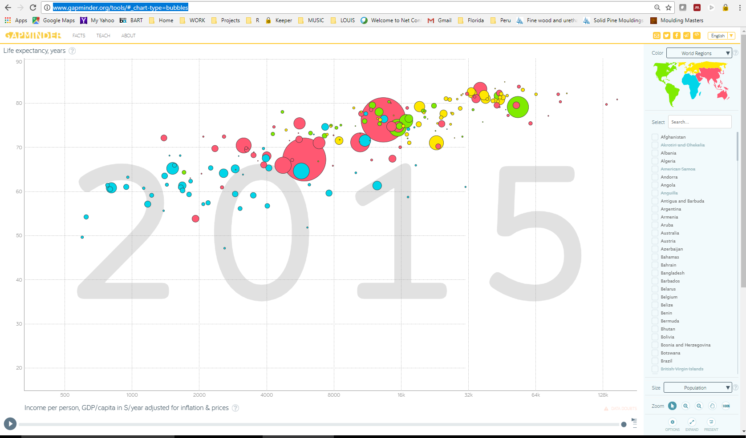
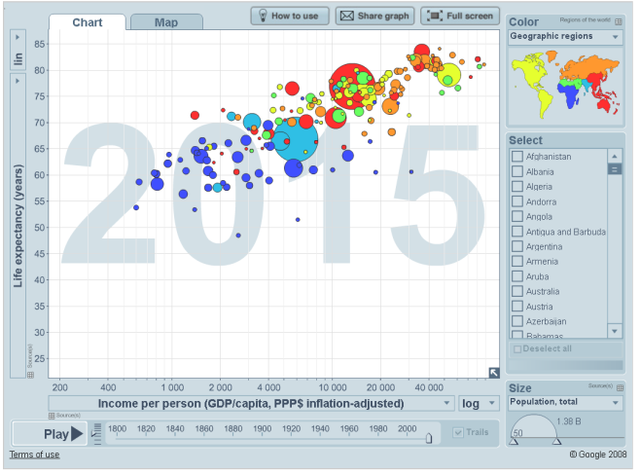

http://www.gapminder.org/tools/

Slide 13
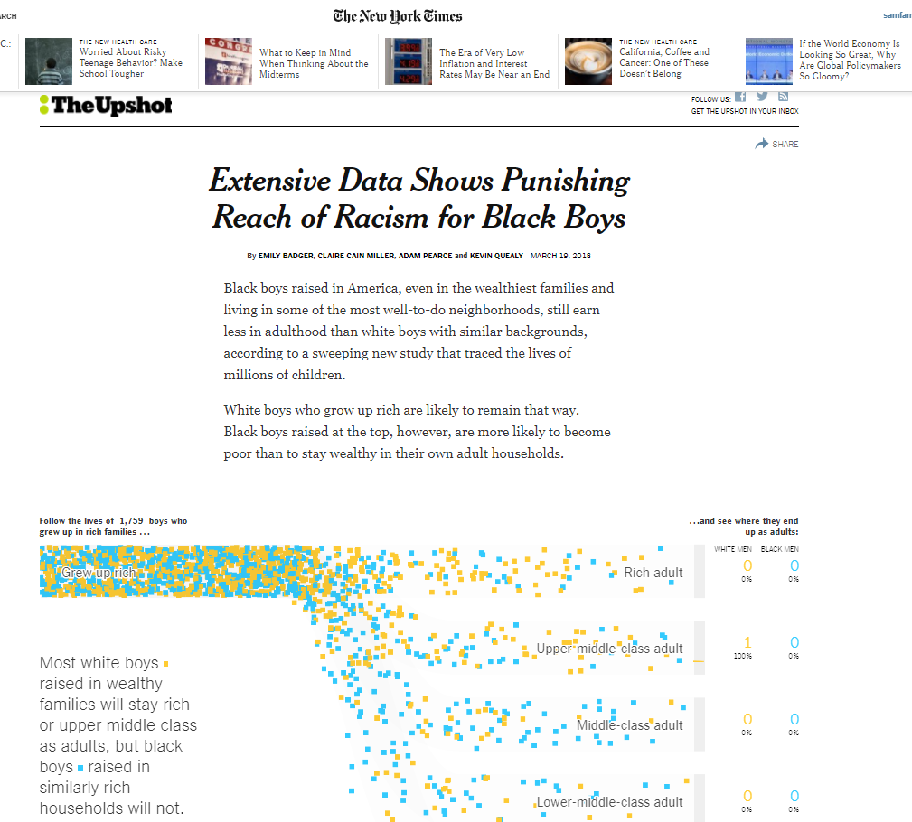
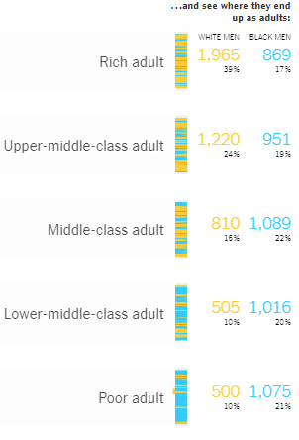
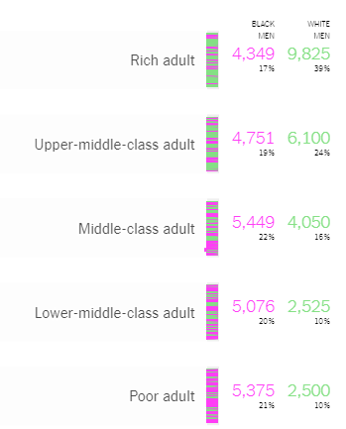
https://www.nytimes.com/interactive/2018/03/19/upshot/race-class-white-and-black-men.html
https://www.nytimes.com/interactive/2018/03/27/upshot/make-your-own-mobility-animation.html

Slide 14
Display Types
Tables
Charts
Line (simple, multiple)
Bar (simple, clustered, stacked, 100%; vertical, horizontal)
Pie
Plots
Histograms
Box
Scatter
Regression-related
Maps
And many others including combinations the above

Slide 15
“Nut and Bolts”
Scale and Proportion
Labels and Legends
Grid Lines
Color
Animation/”PowerPoint”
Font
3D
Production/Reproduction
Chart Junk
Software

Slide 16
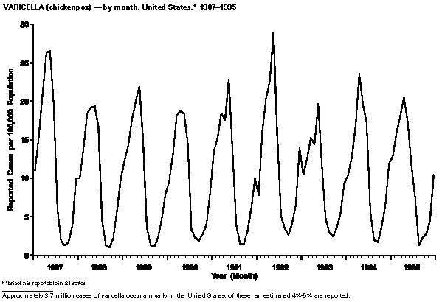

Slide 18
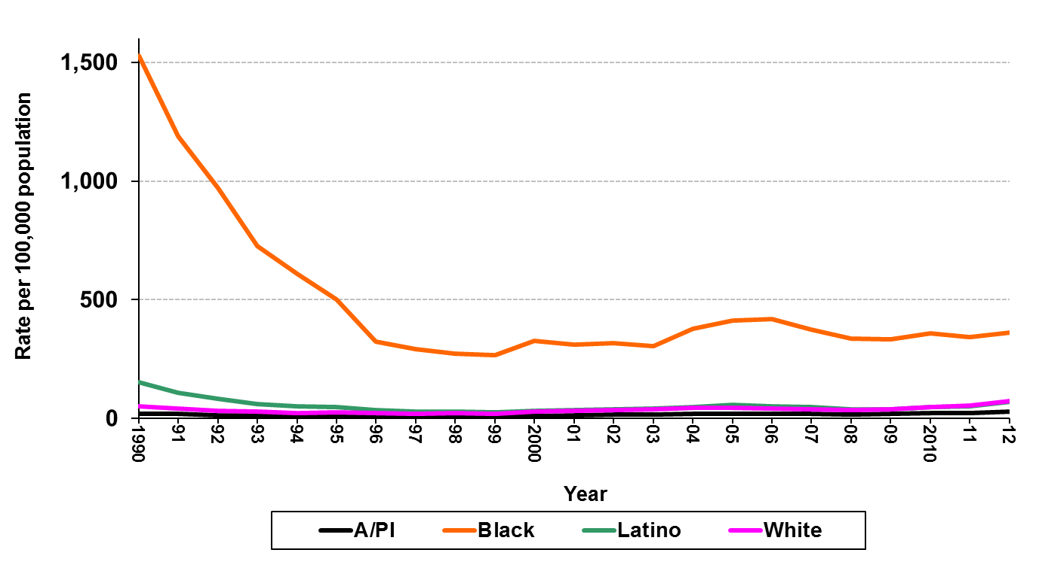
Gonorrhea, Rates for Males by Race/Ethnicity California, 1990–2012
Note: NA/AN = Native American/Alaskan Native, A/PI = Asian/Pacific Islander.
Race/ethnicity “Not Specified” ranged from 21.1% to 36.1% of cases for males in any given year.

Slide 19
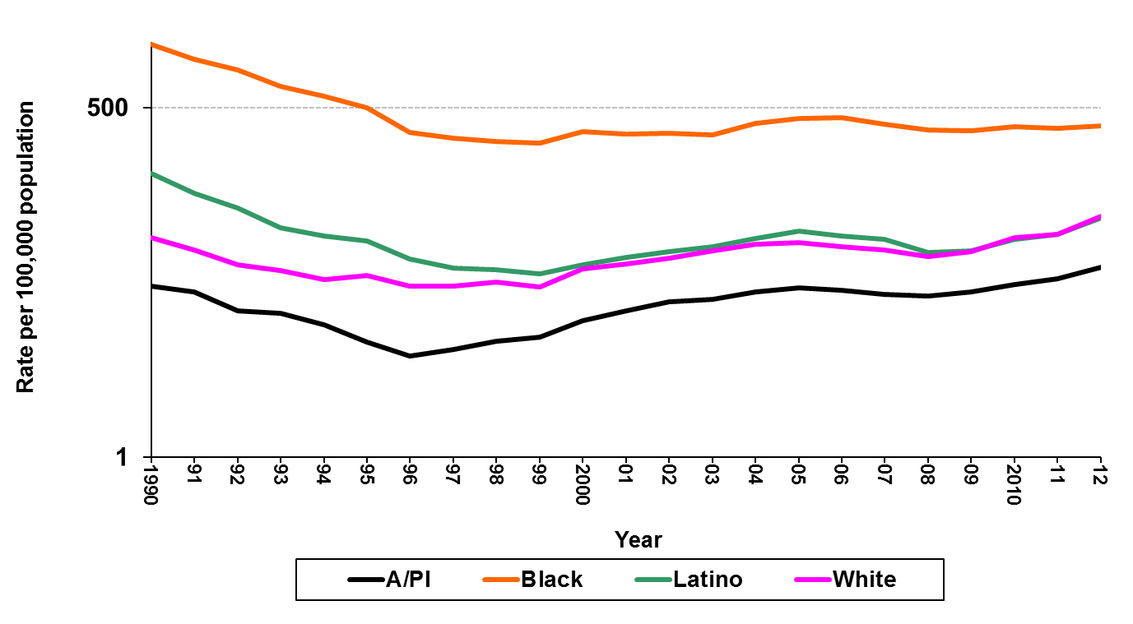
Gonorrhea, Rates for Males by Race/Ethnicity California, 1990–2012
Note: NA/AN = Native American/Alaskan Native, A/PI = Asian/Pacific Islander.
Race/ethnicity “Not Specified” ranged from 21.1% to 36.1% of cases for males in any given year.

Slide 20

For More Information:
Part 1 “General Concepts”
Part 1a: http://youtu.be/1c41eMOjt_U
Part 1b: http://youtu.be/XlKA2hgg-rY
Part 2 “Nuts and Bolts”
Part 2a: http://youtu.be/pUDcGlulfW8
Part 2b: http://youtu.be/YCRyVPpz-yk

Slide 21
Why Use R for Visual Display
Data, calculations/statistics, text and any other information can be placed with code anywhere on any type of visual display
Mind-blowing array of plotting functionality from core program and contributed packages
Flexible system for getting data “in”
Powerful system for organizing, processing, formatting and analyzing data
Flexible system for getting visual displays out

Slide 22
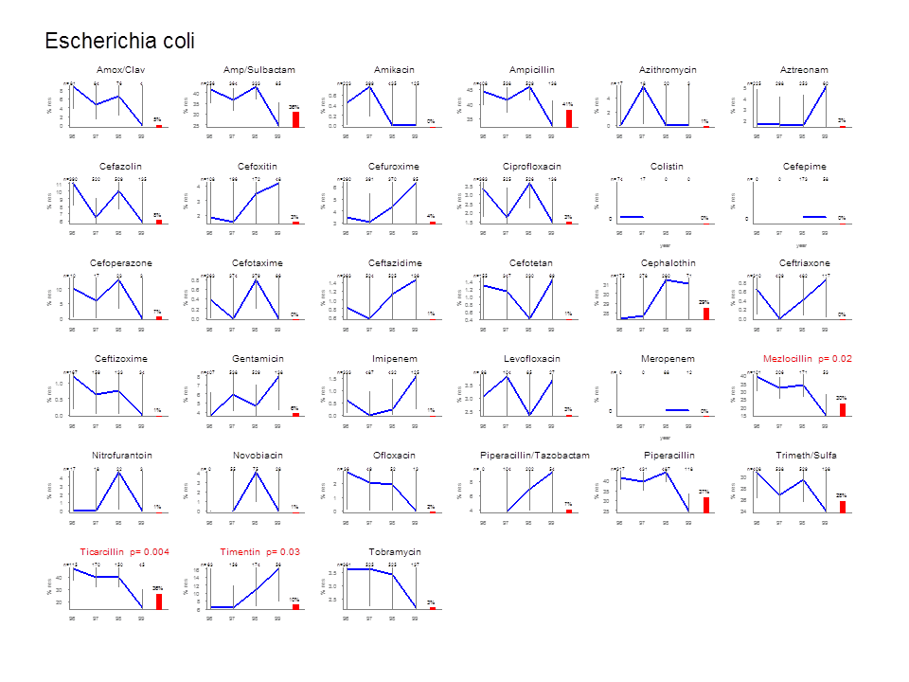
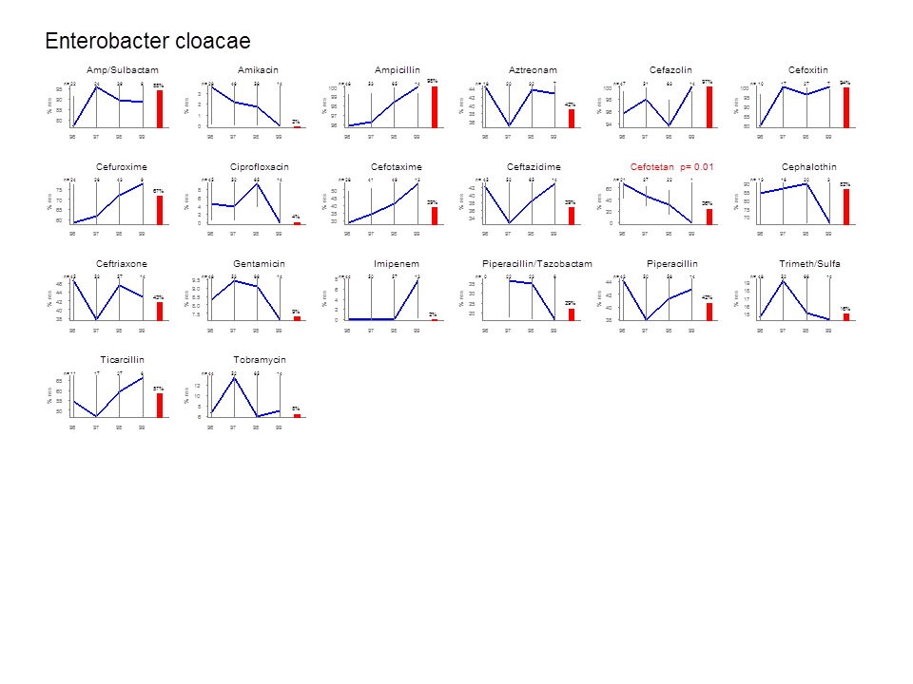
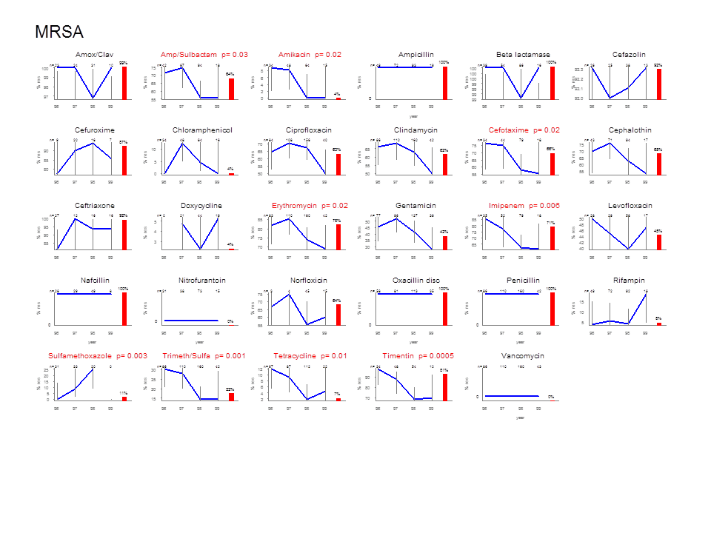
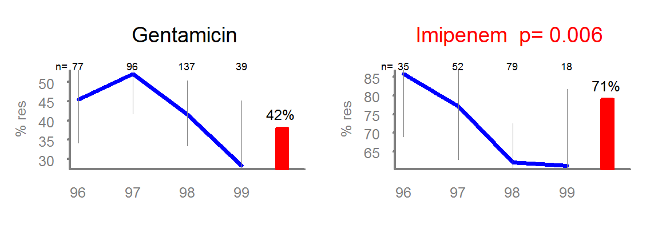

Slide 23
Rates:
By category
By single age
0 1 2 3 4 5 6 7 8 9 10 11 12 13 14 15 16 17 18 19 20 21 22 23 24 25 26 27 28 29 30 31 32 33 34 35 36 37 38 39 40 41 42 43 44 45 46 47 48 49 50 51 52 53 54 55 56 57 58 59 60 61 62 63 64 65
Note: The rate for the last category is calculated for persons aged 45 to 100 years.

Slide 24
R Shiny Files
server.R
generates the output based on selected input
Data
(e.g. .csv files)
ui.R
sets up the structure/layout of the input and output panels
Global.R
everything else, especially functions

Slide 25
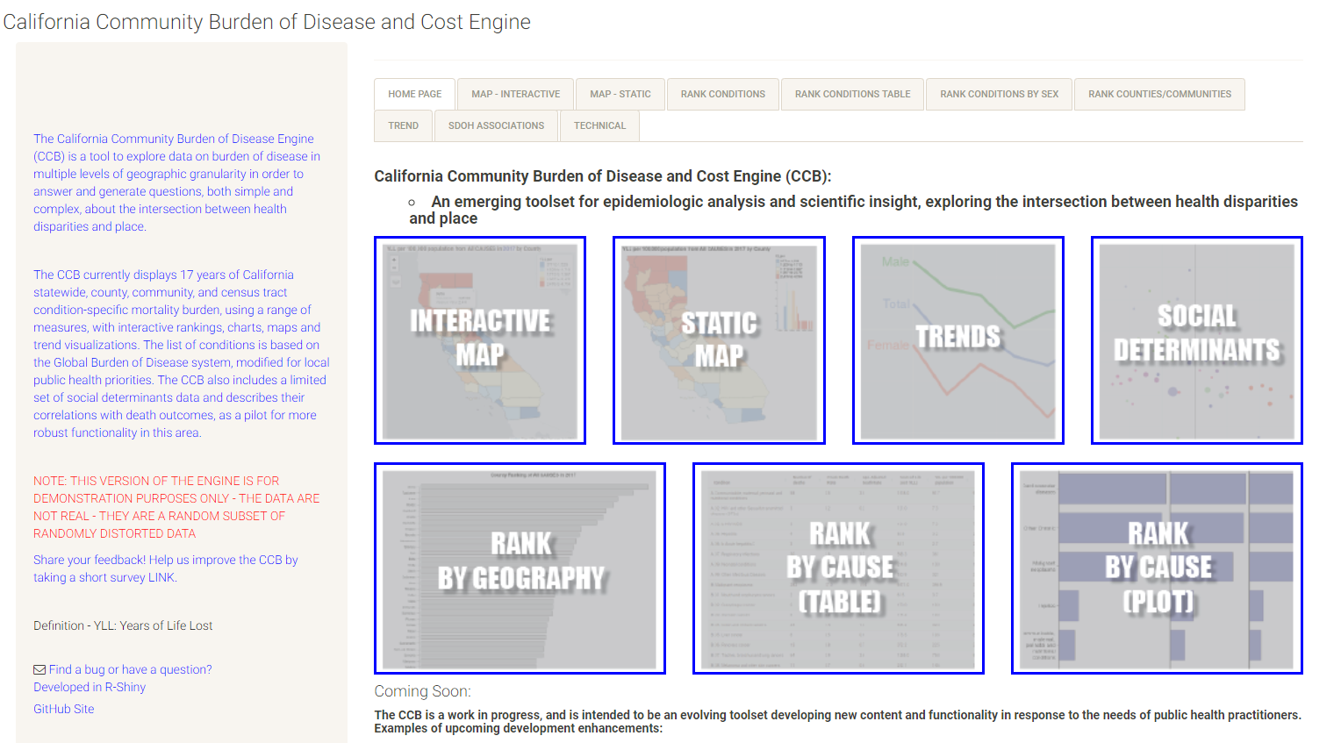
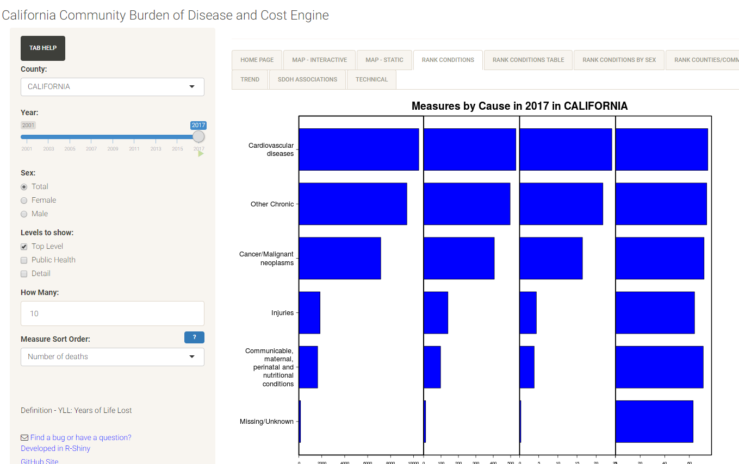
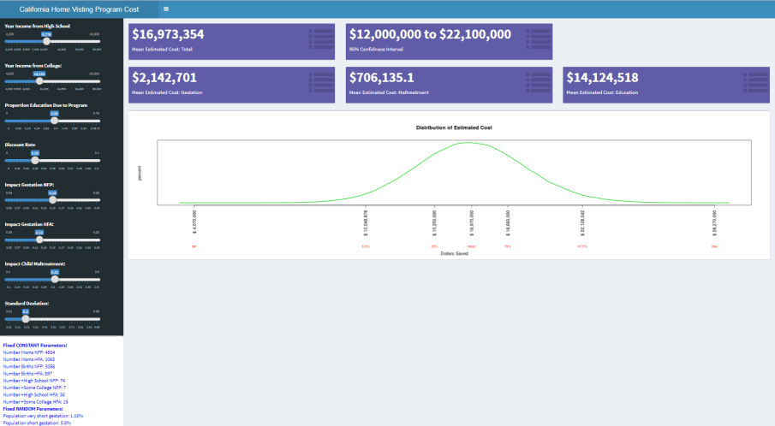
https://phdataviz.shinyapps.io/myCBD/
https://phdataviz.shinyapps.io/chvpecon/

