Slide 1
COLOR BALANCE AND FUSION FOR UNDERWATER IMAGE ENHANCEMENT
GUIDE
PROF.NATHEERA BEEVI.M
THASLIMA LATIF
S6 MCA

Slide 2
INTRODUCTION
Introducing an effective technique to enhance the images captured underwater and degraded due to the medium scattering and absorption. It builds on the blending of two images that are directly derived from a color compensated and white-balanced version of the original degraded image. The two images to fusion, as well as their associated weight maps, are defined to promote the transfer of edges and color contrast to the output image.

Slide 3
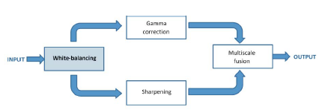
PHASES

Slide 4
TECHNIQUES USED
WHITE BALANCING
IMAGE FUSION

Slide 5
WHITE BALANCING
White-balancing aims at improving the image aspect, primarily by removing the undesired color castings due to various illumination or medium attenuation properties.
Achieved by using Color correction and Gray World Algorithm

Slide 6
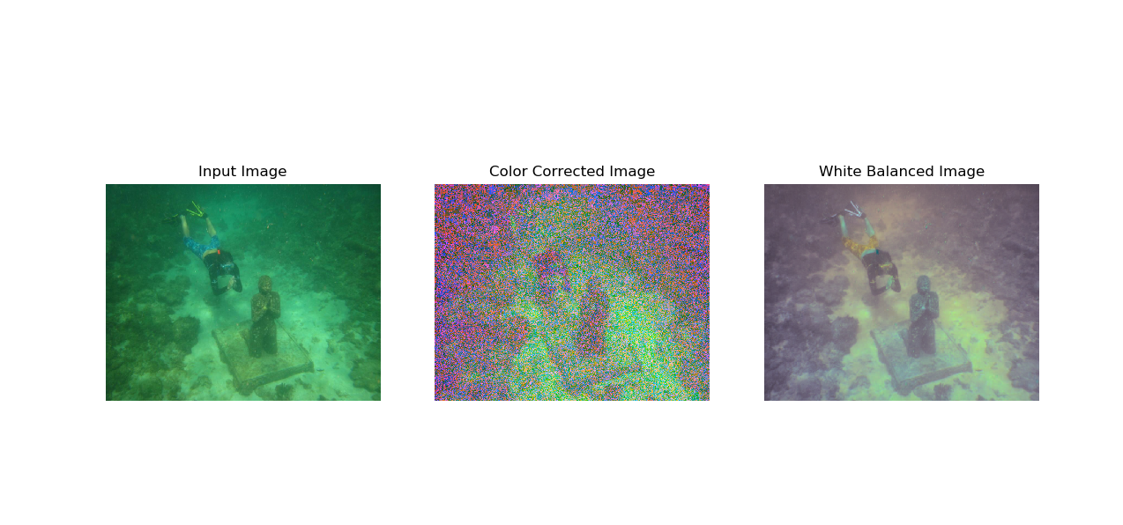
WHITE BALANCING OUTPUT

Slide 7
TOOLS
Language : Python
IDE : PyCharm

Slide 8
THANK YOU

