Slide 1
IMPLEMENTING MERKLE TREE USING RANK BALANCED TREE
MUHAMMED RISHAL P.K.

Slide 2
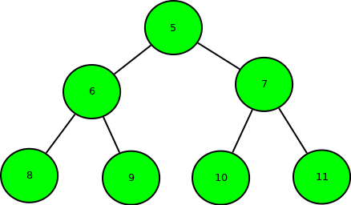
Introduction
Binary Search Tree
Binary Search Tree is a node-based binary tree data structure which has the following properties:
The left subtree of a node contains only nodes with keys lesser than the node’s key.
The right subtree of a node contains only nodes with keys greater than the node’s key.
The left and right subtree each must also be a binary search tree.

Slide 3
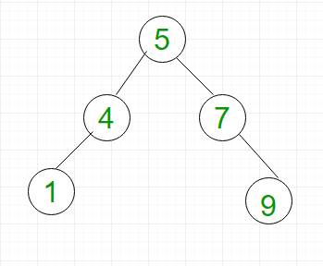
AVL TREE
AVL tree is a self-balancing Binary Search Tree (BST) where the difference between heights of left and right subtrees cannot be more than one for all nodes.
Complexity
insertion, and deletion all take O(log n) time in both the average and worst cases

Slide 4
Proposed system
MERKLE TREE
Merkle tree also known as hash tree is a data structure used for data verification and synchronization.
It is a tree data structure where each non-leaf node is a hash of it’s child nodes.
All the leaf nodes are at the same depth and are as far left as possible.
It maintains data integrity and uses hash functions for this purpose.
A hash function maps an input to a fixed output and this output is called hash. The output is unique for every input and this enables fingerprinting of data. So, huge amounts of data can be easily identified through their hash.

Slide 5
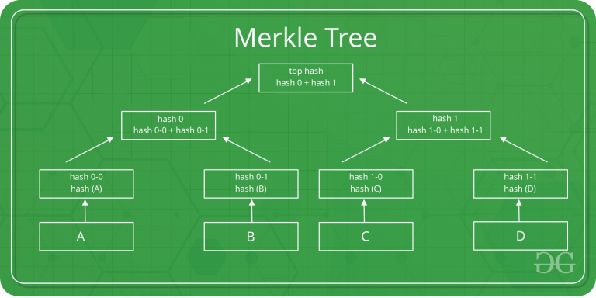

Slide 6
This structure of the tree allows efficient mapping of huge data and small changes made to the data can be easily identified.
If we want to know where data change has occurred then we can check if data is consistent with root hash and we will not have to traverse the whole structure but only a small part of the structure.
The root hash is used as the fingerprint for the entire data.

Slide 7
COMPLEXITY
Space | O(n)
Searching | O(logn)
Traversal | O(n)
Insertion | O(logn)
Deletion | O(logn)
Synchronization | O(logn)

Slide 8
Applications
Merkle trees are useful in distributed systems where same data should exist in multiple places.
Merkle trees can be used to check inconsistencies.
Apache Cassandra uses Merkle trees to detect inconsistencies between replicas of entire databases.
It is used in bitcoin and blockchain.

Slide 9
CONCLUSION
Using a Merkle tree can significantly reduce the amount of data that a trusted authority has to maintain for verification purposes. It separates the validation of the data from the data itself. A Merkle tree can reside locally, or on a distributed system
1. They provide a means to prove the integrity and validity of data
2. They require little memory or disk space as the proofs are computationally easy and fast
3. Their proofs and management only require tiny amounts of information to be transmitted across networks

Slide 10
Thank You

