Slide 1
ERP
Vishnu prakasam
S6 mca
Roll NO : 634

Slide 2
Overview
Introduction
Technologies
Work Assigned
Screenshots
Conclusion

Slide 3
Introduction
The new project undertaken by IKM known as LSGD-ERP is aiming for “This is not computerisation, this is e-governance”.
This project is to integrate the services developed in different timeframes provided by the IKM into a single environment and enables the user to access e-government facilities from a single place and by maintain transparency and also the law is fully followed.

Slide 4
Technologies
Angular CLI: 1.7.3
Angular: 5.2.8
Editors : Visual Studio Code , Netbeans.
Laravel version 5.6
Node: 9.3.0
OS: linux x64
Pgadmin III
PHP version 7.2.7
Processor – i5 >
Ubuntu : 16.0.4

Slide 5
Work Assigned
Complete settings services in workflow module
State level Admin Settings
District level Admin Settings
Unit level Admin Settings
Seat Settings

Slide 6
Screenshots

Slide 7
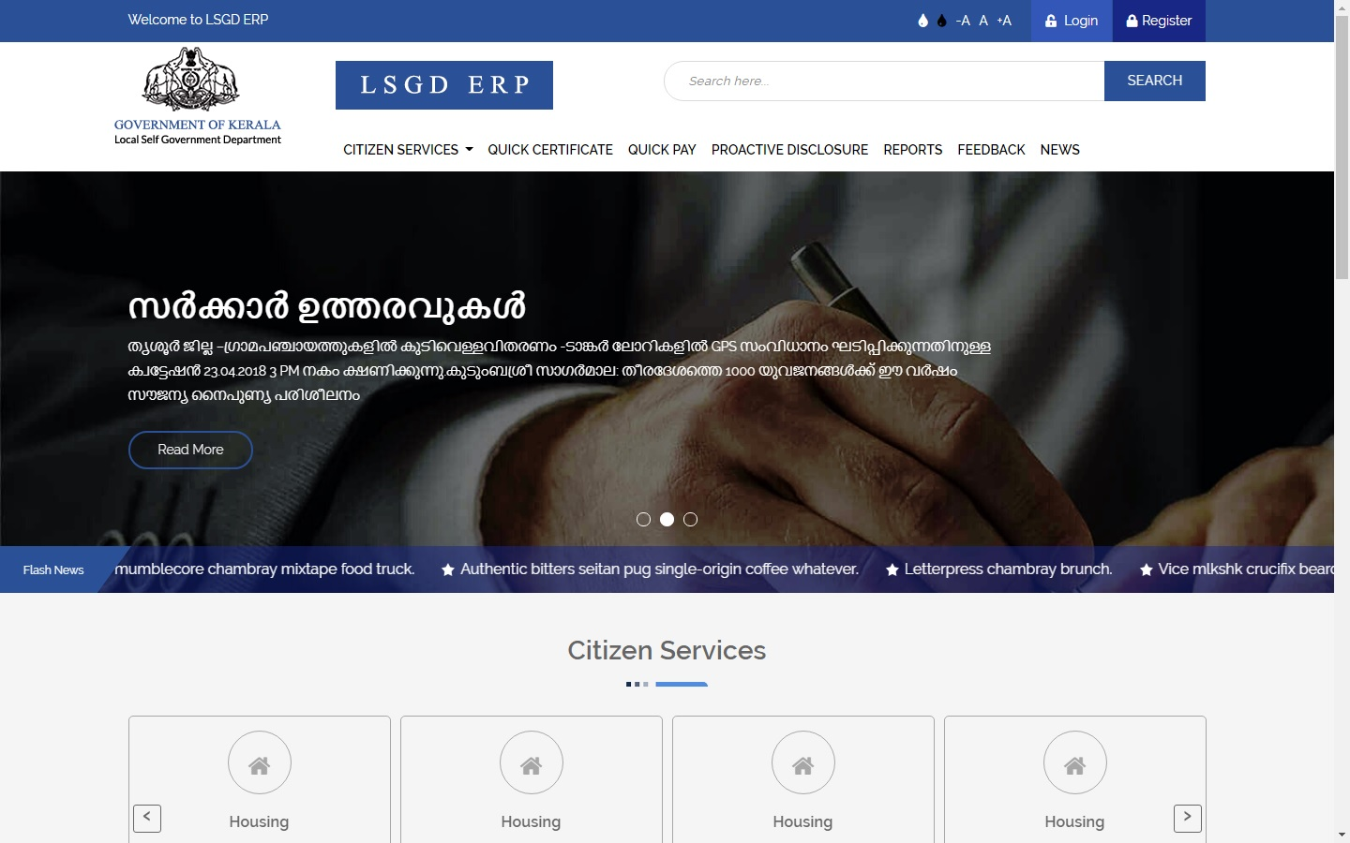

Slide 8
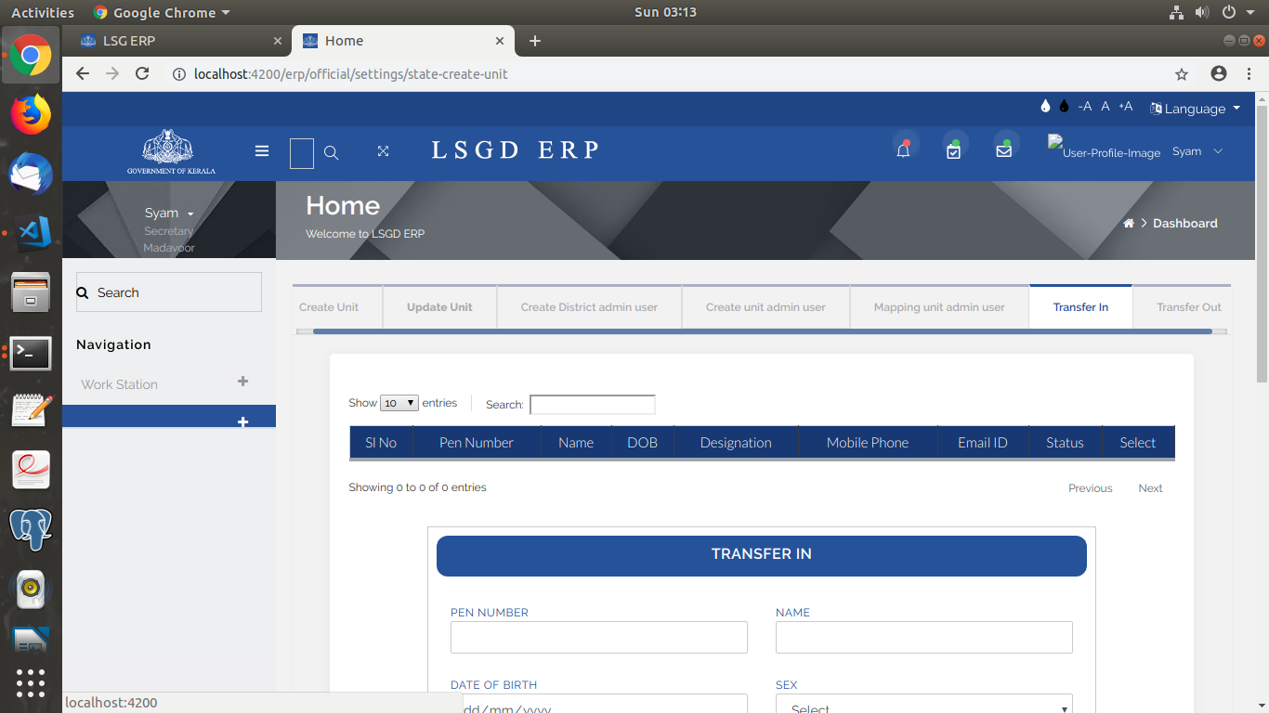

Slide 9
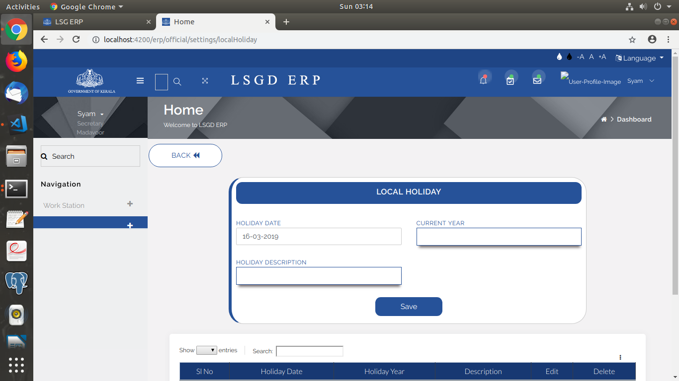

Slide 10
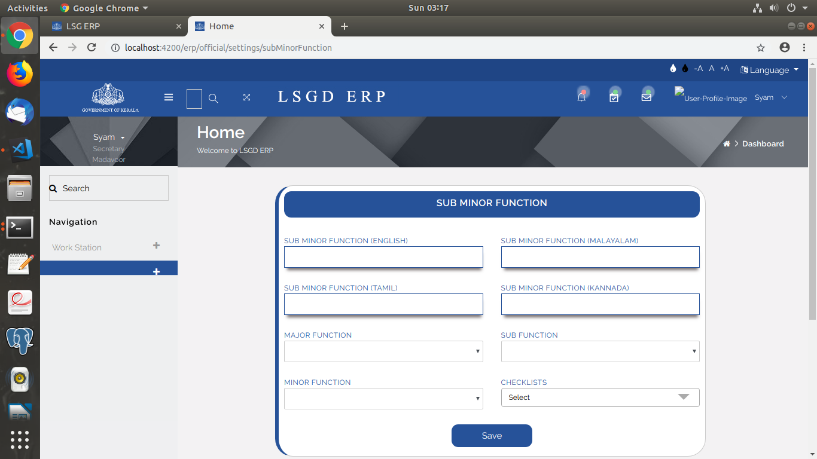

Slide 11
Conclusion
This project aims to provide an e-governance platform.
It makes file management and other office related tasks easier.

Slide 12
Thank You !

