Slide 1
MULTIPLE WATERMARKING TECHNIQUE FOR SECURING SOCIAL NETWORK CONTENTS.
Guided By,
Rahulnath H A
Assistant Professor
Dept.of .MCA
Submitted by,
JULIE.T ALEX
ROLLNO :11

Slide 2
CONTENTS
INTRODUCTON
METHODOLOGY
process
Work completed
PROPOSED SYSTEM
CONCLUSION
REFERENCES

Slide 3
INTRODUCTION
Large volume of multimedia documents/contents are transmitted online.
Often open access is available.
Prone to copyright violation, authenticity, confidentiality and ownership identity theft.

Slide 4

Digital Watermarking
“It is the act of hiding a message related to a digital signal (i.e. an image, song, video) within the signal itself.”

Slide 5
The major benchmark parameters of a digital watermark are
Imperceptibility
robustness
data payload
computational complexity
Image watermarking is a value added/security tool for hiding digital information into multimedia documents.
The hidden watermark can be later extracted or detected.

Slide 6
METHODOLOGY
Multiple watermarking method .
Embeds two watermarks in the form of image and text simultaneously.
Improves performance and enhances the security.

Slide 7
Cont…
Host image is initially decomposed to third level DWT.
Text watermark is embedded to low frequency band (LL3) at the third level.
Image watermark is embedded to vertical frequency band (LH2) at second level DWT.
Find the DCT of the watermark image.

Slide 8
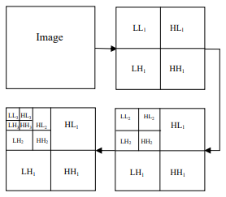

Slide 9


Work completed

Slide 10
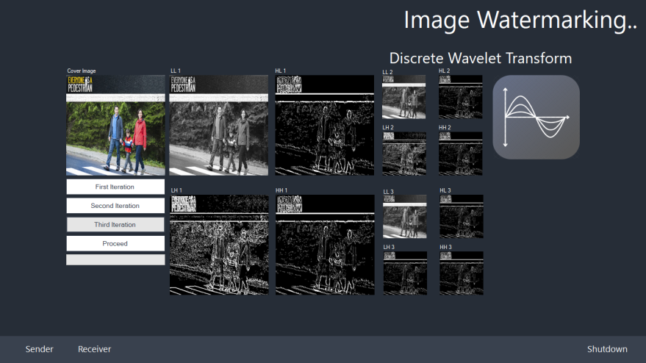

Slide 11
CONCLUSION
Provides the extra level of security and reduce storage/bandwidth requirements.
Addresses the issue of channel noise distortions leading to faulty watermark in different applications.

Slide 12
REFERENCES
A.K.Singh,et al., Multiple watermarking technique for securing online social network contents using Back Propagation Neural Network, Future Generation Computer Systems(2016),http://dx.doi.org/10.1016/j.Future.2016.11.023.
Q. Su, B. Chen, A novel blind color image watermarking using upper Hessenberg matrix, International Journal of Electronics and Communications (2017), doi: http://dx.doi.org/10.1016/j.aeue.2017.05.025
S. Iftikhar, M. Kamran, E.U. Munir, S.U. Khan, A reversible watermarking technique for social network data sets for enabling data trust in cyber, physical, and social computing, IEEE Syst. J. (2015)

Slide 13
Y. Xing, J. Tan, A color image watermarking scheme resistant against geometrical attacks, Radioengineering 19 (1) (2010) 62–67.
A. Ghafoor, M. Imran, A non-blind color image watermarking scheme resistent against geometric attacks, Radioengineering 21 (4) (2012) 1246–1251.
V. Santhi, A. Thangavelu, DC coefficients based watermarking technique for color images using singular value decomposition, Int. J. Comput. Electr. Eng. 3(1) (2011) 8–16.
M. Zhao, Y. Dang, Color image copyright protection digital watermarking algorithm based on DWT & DCT, in: 4th International Conference on Wireless Communications, Networking and Mobile Computing, Dalian, 12-14 Oct. 2008,pp. 1–4.

Slide 14
M.C. Wolak, Digital watermarking, Preliminary Proposal, Nova Southeastern University, United States, 2000.N.
Nikolaidis, I. Pitas, Digital image watermarking: An overview, in: IEEE International Conference on Multimedia Computing and Systems, Florence, Italy, Vol. 1, 1999, pp. 1–6.

Slide 15
THANK YOU!

