Slide 1
Online airlines ticket fraud detection using data mining
Project Guide –
Dr. Nadera Beevi. S
By
Rejo R Varghese

Slide 2
About the paper
It is a paper in which the fraud on airlines tickets is detected using crimes script
Every day, hundreds of people fly on airline tickets that have been obtained fraudulently. This crime script analysis provides an overview of the trade in these tickets, drawing on interviews with industry and law enforcement, and an analysis of an online black market.
The acts to be played are written and roles are played and then the choke points are found where the fraud can be caught
Scope of this paper is limited to airlines tickets obtained fraudulently

Slide 3
what is crime script?
It is the descriptive analysis of a situation where in the role player or actor plays the role and performs the task for fraud to occur
The role plays are analysed and played by each actor
The situation are made in such a that fraud happens and we try to find ways to handle it.

Slide 4
Proposed system
Creation of data for analysis.
Selecting the best algorithm for analysis.
Pre-processing of data before analysis
Performing datamining using python.

Slide 5
primary objective
TO PREVENT AND FIND FRAUD ON AIRLINES TICKETS USING DATA MINING

Slide 6
Platform and steps done till now
The IDE used for this is Python Spyder for data mining
Process done till now is
Data preprocessing that is
Importing of data set
Missing data changing
Categorization of data
Feature scaling
Splitting of Dataset into Test Dataset and Training Dataset

Slide 7
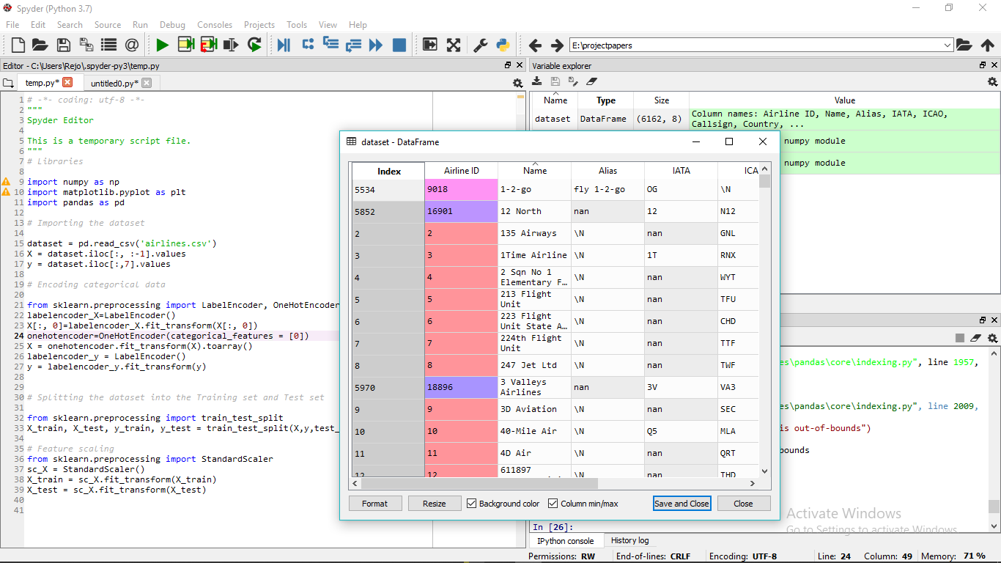
Screenshots

Slide 8
Literature review
Data Mining: An Improved Approach for Fraud Detection
BY Gogu.Sandeep1 ,Sachin Malviya2 , Dheeraj Sapkale2 1 Department of Computer Science, 2 Department of Information Technology Medicaps Institute of Science & Tech, Indore, India
Data Mining Techniques for Fraud Detection
BY Rekha Bhowmik Department of Computer Science, Sam Houston State University, Huntsville, Texas, rbb002@shsu.edu
https://precognitive.io/2017/09/20/airlines-need-fraud-protection-more-than-ever-right-now/
Why Airlines industry needs fraud protection more now.

Slide 9
Literature review
https://www.ravelin.com/blog/fighting-fraud-in-the-airline-industry
The Different types of Frauds faced by airlines industry and causes of such frauds to occur.
https://www.tripadvisor.in/ShowTopic-g1-i10702-k11245746-Flight_Ticket_Fraud_Alert-Air_Travel.html
The Frauds in major sites.
https://www.springboard.com/blog/data-mining-python-tutorial/
The Datamining Methods for python.
https://bigdata-madesimple.com/step-by-step-approach-to-perform-data-analysis-using-python/
To learn about how to perform datamining using python.

Slide 10
references
Leaving on a jet plane: the trade in fraudulently obtained airline tickets
Alice Hutchings
Data Mining: An Improved Approach for Fraud Detection
BY Gogu.Sandeep1 ,Sachin Malviya2 , Dheeraj Sapkale2 1 Department of Computer Science, 2 Department of Information Technology Medicaps Institute of Science & Tech, Indore, India
Data Mining Techniques for Fraud Detection
BY Rekha Bhowmik Department of Computer Science, Sam Houston State University, Huntsville, Texas, rbb002@shsu.edu

Slide 11
System Requirements
4 GB Ram
Windows 7 or above
i5 Processor

Slide 12


