Slide 1
RADIATION DETECTION USING ROBOT
Guide: Prof.RahulNath
Viji Krishna

Slide 2
CONTENTS
INTRODUCTION
REVIEW OF LITERATURE
METHODOLOGIES
PROPOSED SYSTEM
CONCLUSION
REFERENCES

Slide 3
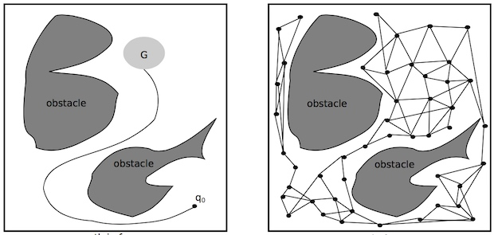
INTRODUCTION
Robot Motion planning
Input
geometric descriptions of obstacles and robot
Output
continuous sequence of collision free configuration

Slide 4
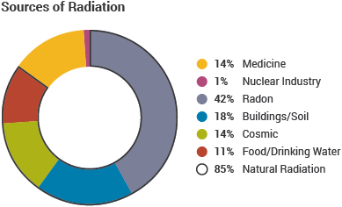
Nuclear Radiation
Nuclear radiation refers to the particles and photons emitted during reactions that involve the nucleus of an atom

Slide 5
LITERATURE REVIEW
Ab. HafizZakaria Yasir MandEt al…1
The development of a spatial radiation map by an autonomous mobile robot that is equipped with Geiger Muller sensor. Mapping of gamma radiation autonomously using robot as agents will help to prevent harm to human especially when radiation related disaster occur.
Mohammed I Alfraheed and Et al….2
Radiation is measured by detecting the levels of alpha,beta and gamma
rays

Slide 6
PROPOSED SYSTEM
To detect nuclear radiations using robot

Slide 7
CONCLUSION
An algorithm is designed to automatically detect obstacles
Project helps to detect nuclear radiations using robots that can protect us from many disasters

Slide 8
REFERENCES
1.Development of autonomous radiation mapping robot
2.A robot for real time detection of nuclear radiation levels

