Slide 1


Slide 2
OPTIKEY???
Opti Key is an assistive on-screen keyboard developed by Julius Sweetland
It is designed to help Motor Neuron Disease (MND) patients interact with Windows computers.
it is a great alternative to often expensive and complicated AAC (alternative and augmentative communication) products.

Slide 3
Features
Allows selections via dwell selection, physical buttons and assistive devices
Can be used with eye-tracking devices
Can be used as alternative to physical keyboard or mouse
Automatically inserts spaces between words and capitalizes letters to increase typing rate

Slide 4
Types whole words and phrases in a single selection by "swiping" or "auto-complete“.
A large mouse cursor will be displayed to show where Opti Key is pointing
'Speak' key converts everything typed into speech
Can be used to type into any application

Slide 5
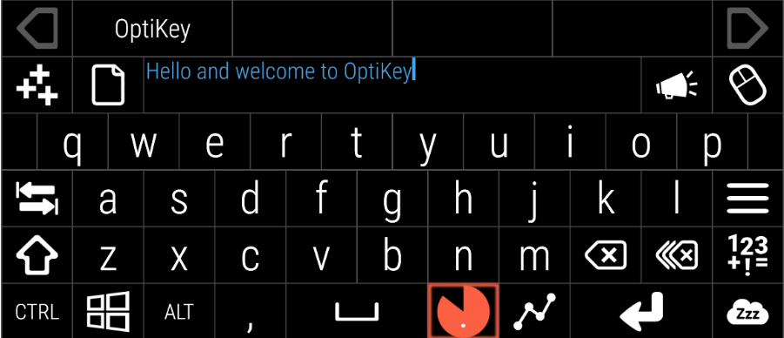

Slide 6
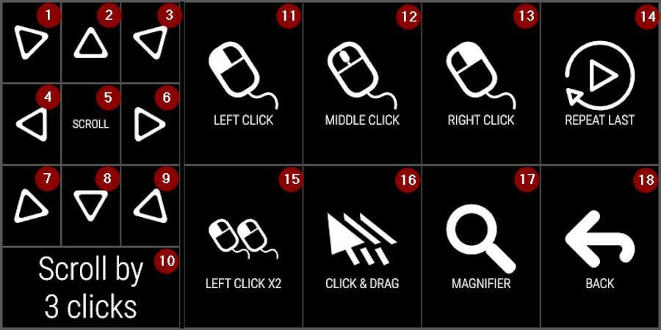

Slide 7
To do….
Change keyboard color,set an option to change color
Setup both male and female voices.

Slide 8
References
https://www.disabled-world.com/assistivedevices/computer/optikey.php
www.optikey.org
https://sourceforge.net/projects/optikey.mirror/
https://www.youtube.com/watch?v=03NFUMlXrf8
https://github.com/OptiKey/OptiKey
https://www.youtube.com/watch?v=HLkyORh7vKk

