Slide 1
SIMULATION AND ANALYSIS OF DEEP LEARNING NETWORK FOR PARALLEL HARDWARE IMPLEMENTATION
RAHUL SATHEESH S
Guide:
Prof.Sheera
Dr.Biju Simon (Intel) S6 MCA

Slide 2
ABSTRACT
In this project we describe the implementation of a complete deep learning algorithm for speech recognition. This project also compare the speed-up obtained and communication statistics implementing the training procedure only taking advantage of the multi-thread capabilities of multi-core processors.

Slide 3
Parallel Processing
A mode of operation in which a process is split into parts, which are executed simultaneously on different processors attached to the same computer.
processing of program instructions by dividing them among multiple processors with the objective of running a program in less time.

Slide 4
Systolic Architectures
Replace single processor with an array of regular processing elements
Orchestrate data flow for high throughput with less memory access
Different from pi
Nonlinear array structure, multidirection data flow, each PE may have (small) local instruction and data memory
Different from SIMD: each PE may do something different
Initial motivation: VLSI enables inexpensive special-purpose chips
Represent algorithms directly by chips connected in regular pattern

Slide 5
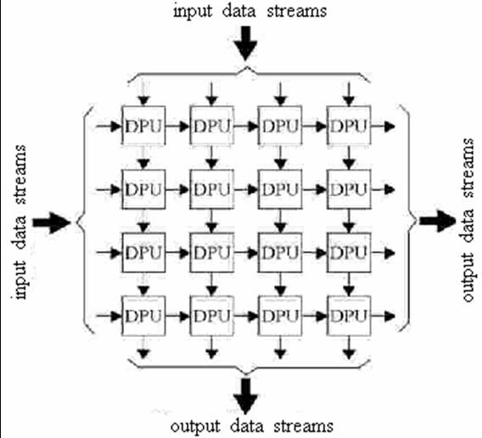

Slide 6
Deep Learning
also known as deep structured learning or hierarchical learning
Deep Learning is a subfield of machine learning concerned with algorithms inspired by the structure and function of the brain called artificial neural networks.

Slide 7
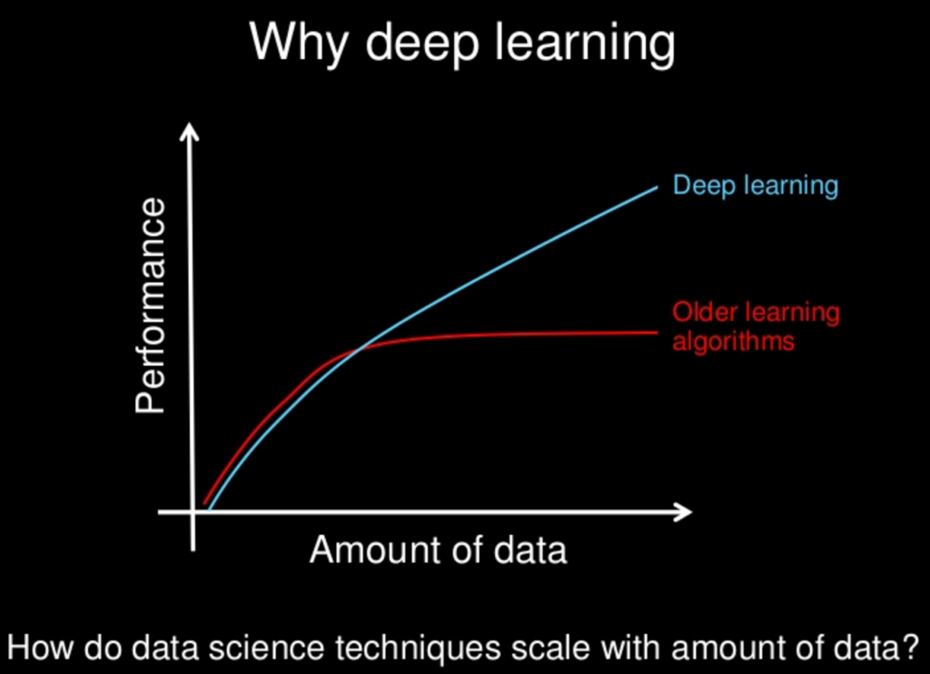

Slide 8
ANN-HMM MODEL
The training databases usually include utterances of sentences or words collected from many different speakers, transcribed in terms of their corresponding phonetic units.
requires these two alternate steps:
1) Find the best alignment of the utterance frames to the states of the corresponding phonetic units.
2) Find the weights of the network that better discriminate among the states, by producing for each state an estimate of the posterior probability P(state|x), where x is the input pattern.

Slide 9
THANK YOU

