Slide 1
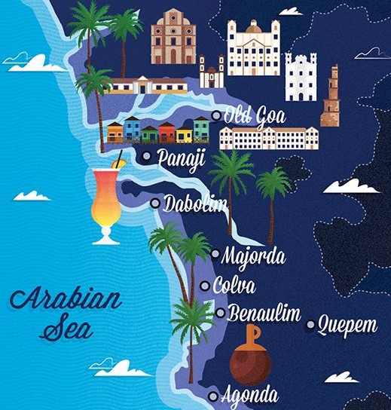
OBJECT-ORIENTED TECHNOLOGY· MINI PROJECT
CleanGoa
Together, Let’s Keep Goa Clean
Anish Rohidas Naik Mamlekar
MCA-2609
Atharv Yeshwant Naik Rasaikar
MCA-2612

Slide 2
INTRODUCTION
A website that helps people report cleanliness issues and take part in community cleaning activities.
CleanGoa is a platform developed to improve cleanliness and protect the environment in Goa by connecting citizens, volunteers, and local administrators. The main aim of this project is to provide a simple and effective way for people to report cleanliness issues and participate in activities that help maintain clean and healthy surroundings.
Report an issue
Review and manage
See public updates
Citizens upload a photograph, describe the problem and provide its location.
Administrators review reports and organize volunteer missions.
Approved reports appear on a public map with their current status.
Main goal: make cleanliness problems easier to report, review and track.

Slide 3
Competitor Analysis
Feature | Swachhata-MoHUA | Goa Public Grievances / CM Helpline | CleanUp India | CleanGoa
Report cleanliness issues | Yes | General grievances | Not its main focus | Yes
Upload photos and location | Yes | Depends on grievance channel | Not its main focus | Yes
Organize volunteer cleanup drives | Not its main focus | Not its main focus | Yes | Yes
Register for volunteer missions | Not its main focus | Not its main focus | Yes, through volunteer communities | Yes
Reporting and volunteering in one website | Not its main focus | Not its main focus | Focuses on cleanup communities | Core proposed feature
Goa-focused cleanliness platform | No, broader urban coverage | Goa-focused grievance service | Supports cleanup communities across India | Yes
CleanGoa's proposed distinction: combine cleanliness reporting, administrator review, an approved-issue public map and volunteer mission registration in one Goa-focused website.

Slide 4
Market Analysis
Key Stakeholders
Citizens and residents
Submit reports and track their status.
Volunteers and students
Register for missions and participate in drives.
NGOs and community groups
Help coordinate local cleanup activities.
Tourism-related businesses
May support cleaner public and visitor areas.
Easy issue reporting
Status visibility
Volunteer coordination
Users can submit a photo, description and location instead of relying only on informal messages.
A public map can help people view approved reports and understand their current status.
Mission details and registration can help interested people join organized cleanup activities.

Slide 5
Proposed Revenue Model
Revenue source | Priority | Revenue type
CSR project funding | High | Funding for eligible environmental projects
Government service contracts | High | Contract income for agreed services
Grants and NGO partnerships | Medium | Project-based funding
Local business sponsorships | Medium | Campaign or event sponsorship
Advertising Revenue | Medium | Sponsored advertisements from eco-friendly businesses, hotels, and tourism operators
CleanGoa can generate revenue through CSR funding, government contracts, sponsorships, and advertisements while keeping citizen reporting and volunteer participation free.

Slide 6
Three main components
1. User section
2. Admin section
3. Public map
• Report garbage and other cleanliness issues
• View reports on a map
• Join cleanliness drives
• Review submitted reports
• Approve or reject reports
• Organize volunteer missions
• Display approved cleanliness issues
• Show their current status
• Help users understand local issues
What each role can do
Citizen / User
Administrator
Report a cleanliness issue with a photo, description and location.
Check approved reports on the public map.
Register for a volunteer mission and participate.
Review submitted reports.
Approve or reject a report.
Organize a cleanliness mission and provide its details.

Slide 7
How a user reports an issue
Example: a user visits a place in Goa and finds garbage scattered around.
1
Log in
2
Add a photo
3
Describe it
The user signs in to CleanGoa.
The user photographs the garbage.
The user enters a short description.
4
Add location
5
Submit
Select a point on the map or enter the location manually.
The report is sent for administrator review.
The report contains the information needed for the administrator to review the issue.

Slide 8
Reviewing a cleanliness report
Reports are checked before they are displayed on the public map.
Submitted
Under review
Decision
The user sends a report with a photo, description and location.
The administrator checks the submitted information.
The administrator approves or rejects the report.
Approved report
Shown on the public map

Slide 9
Viewing and tracking reports
The map helps users see approved issues and follow their status.
Approved reports
Visible on the public map.
Current status
Users can track the status of their reports.

Slide 10
Organizing a cleanliness drive
Administrators can organize missions for volunteers to join.
1. Create a mission
2. Share details
3. Participate
Example: a Sunday morning beach-cleaning drive at Baga Beach.
Users can view the mission details before registering.
Users register for the mission and take part in the drive.
The mission module connects people who want to help keep Goa clean.

Slide 11
Two connected modules
CleanGoa brings cleanliness reporting and volunteer mission management together.
Citizen
Administrator
Public map
Volunteers
→
→
→
Reports an issue
Reviews the report
Shows approved issue
Join a mission
Reporting makes an issue visible for review. Volunteer missions provide a way for people to take part in cleanliness activities.

Slide 12
CONCLUSION
A cleaner Goa, together.
CleanGoa connects citizens, administrators and volunteers through a simple process for reporting cleanliness issues, reviewing reports, viewing approved issues on a map and joining cleanliness drives.
Thank you

