Slide 1
Goan Konkani Dialect Identification Using Speech Audio
8
An AI system that listens to a person speaking Konkani and tells which part of Goa their dialect comes from
Goan Konkani dialects
recognised from voice alone
DONE BY
Ravi Chauhan -2637
Samidha Mote- 2643
Olivia Fernandes -2632
Notes:
Introduce the project. In simple words: we taught a computer to listen to someone speaking Konkani and tell which part of Goa their dialect comes from. Most important point: the system never converts speech into text; it listens to the sound itself.

Slide 2

Problem Statement
Konkani is written in four scripts
Spelling is not standardised
Devanagari, Roman, Kannada and Malayalam are all in use, so a text-based tool has to pick one and leaves part of the community out.
"How are you?" is written Koxem asa, Koso asa, Kosso asa and more, so text classifiers learn typing habits instead of dialects.
Writing erases the dialect
No labelled dataset exists
Dialects differ in pitch, rhythm and nasality. All of this is lost the moment speech is turned into text.
No public dataset tells us which Goan dialect a recording belongs to, so the data had to be built from scratch.
GOAL: Identify a speaker's Goan Konkani dialect directly from their voice.
Notes:
Walk through the four problems. Each one explains why the usual approach of turning speech into text does not work for Konkani. End on the goal.

Slide 3
Proposed System
Listen, do not transcribe
Built on a pre-trained speech model
The system works on the raw audio waveform, so pitch, vowel length and nasal sound stay in the signal. Script and spelling no longer matter.
We start from Meta's MMS-300M, which already knows speech from 1,400+ languages, and fine-tune only its top 4 of 24 layers.
Eight Goan dialects
Easy to use
Antruz, Bardez, Sashti Christian, Sashti Hindu, Canacona, Sattarkar, Pednekar and Gawda Kudali, with a probability for each.
Upload a file or speak into the microphone. A 6-second clip is classified in about 48 ms, with a web, desktop and command-line interface.
Notes:
Describe the four parts of the proposal: acoustic-first, a pre-trained model, eight dialects, and an easy-to-use application.

Slide 4
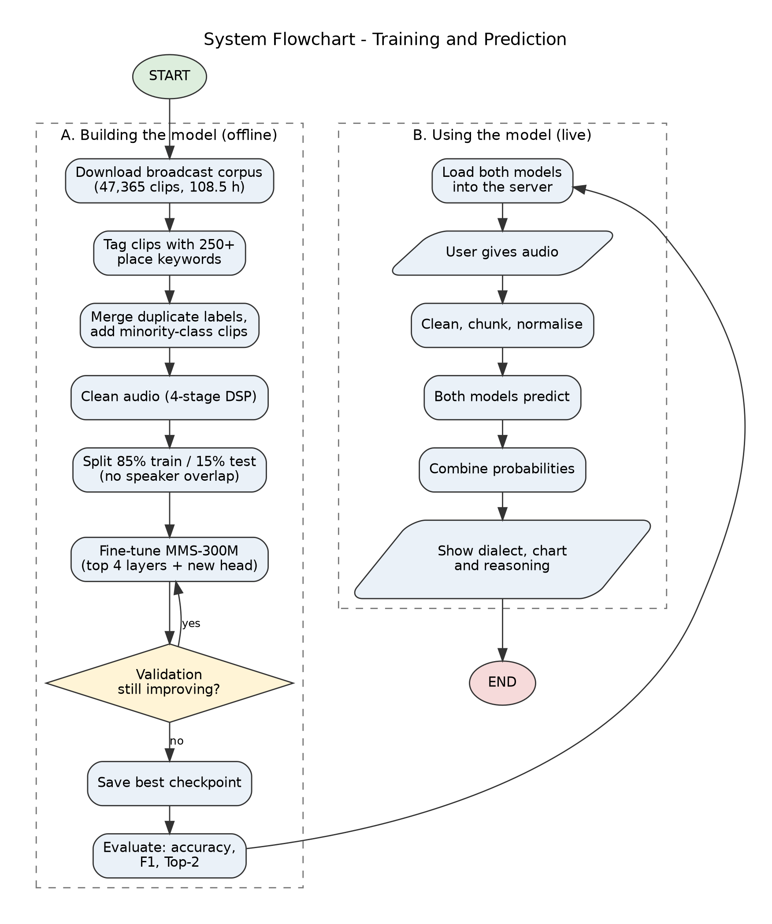
Flowchart: From Raw Audio to Dialect
Collect 108.5 hours of Goan TV speech and tag each clip using 250+ place names.
Clean the audio with a four-stage filter and split it 85% / 15% for training and testing.
Fine-tune MMS-300M (top 4 layers plus a new classification head) and keep the best checkpoint.
Live use: the user gives audio, which is cleaned and cut into 6-second windows.
Two models predict, the probabilities are combined, and the app shows the dialect, a chart and reasoning.
Notes:
Explain the flowchart in two parts. Part A is the offline work: building the dataset and training. Part B is what happens every time a user gives audio.

Slide 5
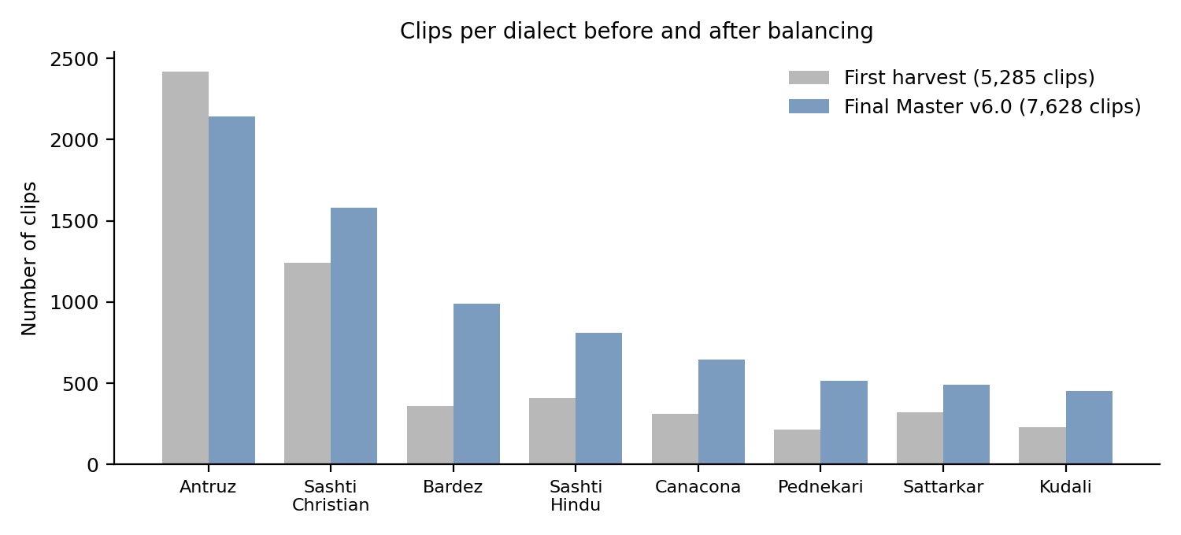
Building the Dataset
108.5 h
250+
of Goan TV audio, 47,365 clips, no dialect labels
place names used to tag clips automatically
7,628
4.7 : 1
validated clips, about 59.5 hours
imbalance, down from 10.5 : 1
A harvester with 20 worker threads reads each clip's description and matches village, taluka and parish names. A clip about Calangute is tagged Bardez, and one from Margao is tagged Sashti Christian. Only matches with a confidence of 0.90 or higher were kept.
Notes:
Explain that the dataset did not exist, so we built it. We tagged clips automatically using place names, then balanced the small dialects by collecting more clips.

Slide 6
Cleaning the Audio
Stage | Setting | What it does
1 High-pass | 80 Hz | Removes mains hum, desk thumps and rumble
2 Low-pass | 7.6 kHz | Removes hiss and avoids aliasing
3 Noise reduction | Up to 10 dB | Adaptive removal of steady background noise
4 Trim the start | Below -45 dB for 0.1 s | Cuts leading silence only
A mistake that taught us something
Our first filter also trimmed silence at the end of each clip. Accuracy for Bardez and Sashti Christian dropped by about 14 points. These speakers end sentences with a long, soft vowel or a nasal murmur, which sounds like silence but carries the dialect. We removed end-trimming and kept only start trimming.
Notes:
Each clip goes through four filters. The story about end trimming is important: it shows that something that looks like silence to an engineer can be the key clue to a dialect.

Slide 7
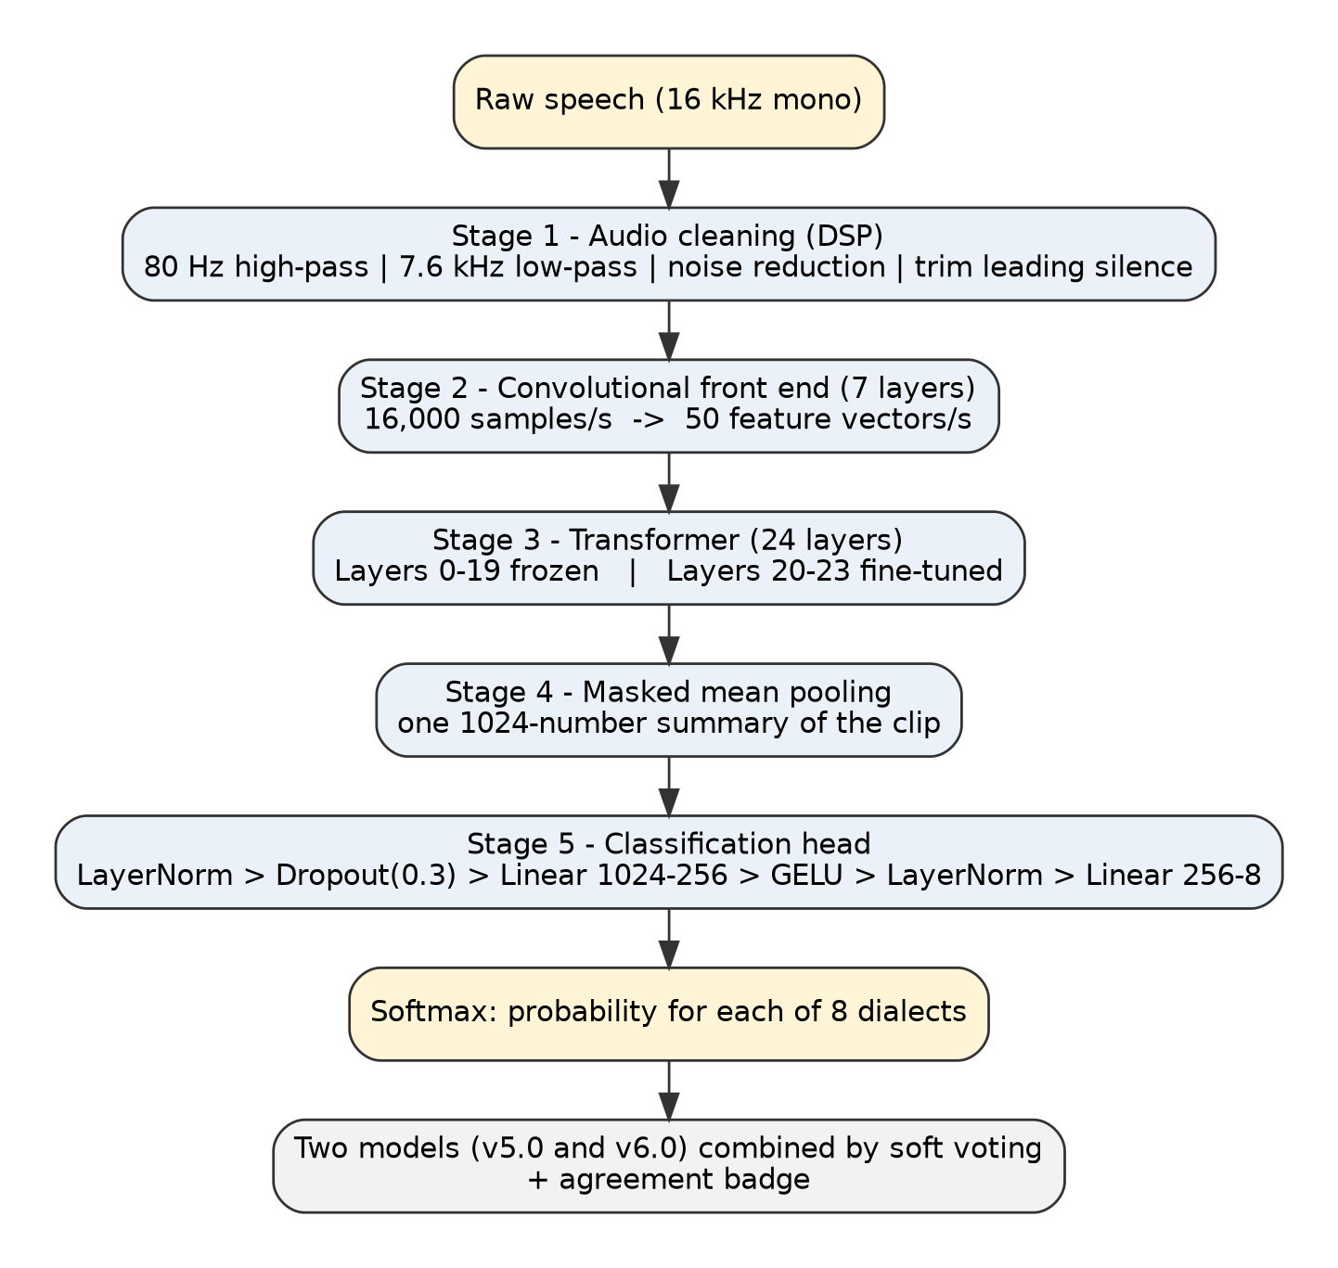
How the Model Works
A convolution front end turns 16,000 audio samples per second into 50 feature vectors per second.
24 transformer layers build context: layers 0 to 19 are frozen and layers 20 to 23 are fine-tuned.
Masked mean pooling summarises the clip into one 1,024-number vector.
A small head (1,024 to 512 to 8) outputs a probability for each dialect.
Focal loss with class weights makes the rare dialects count more.
Long audio is cut into 6-second windows with a 3.5-second step and the results are averaged.
Notes:
Walk through the architecture from top to bottom. The key point: we do not train the whole model, only the top four layers and a small head, which protects what the model already knows.

Slide 8
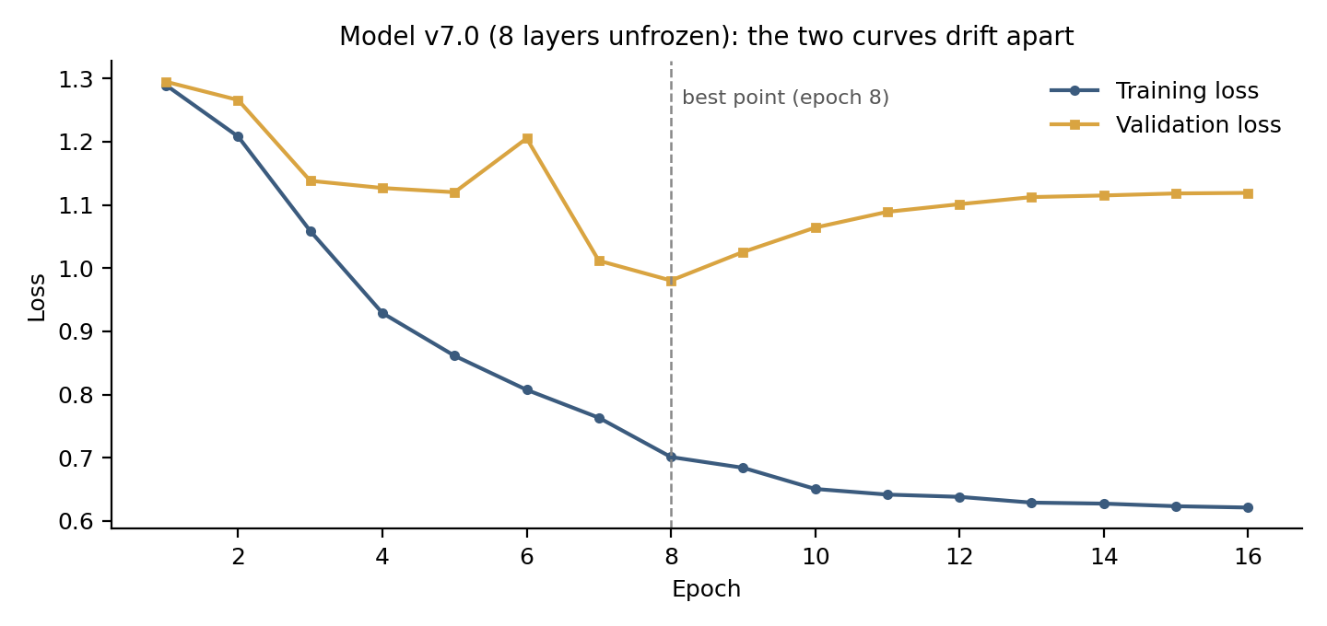
Key Experiment: How Deep to Fine-Tune?
Layers trained | Accuracy | Macro F1
0 (head only) | 35.80% | 30.12%
Top 2 | 43.25% | 38.40%
Top 4 (chosen) | 51.18% | 46.08%
Top 8 | 40.35% | 36.39%
With too few layers the model cannot adapt. With eight layers, training loss kept falling while validation loss rose after epoch 8: the model learned who was speaking instead of how they speak.
Why this matters
The middle layers of a speech model hold speaker identity. Keeping them frozen stops the model from memorising voices.
Notes:
This is the key experiment. Four versions, identical except for how many layers can learn. Four layers is the sweet spot. Eight layers overfit because the model memorised the voices of TV newsreaders.

Slide 9
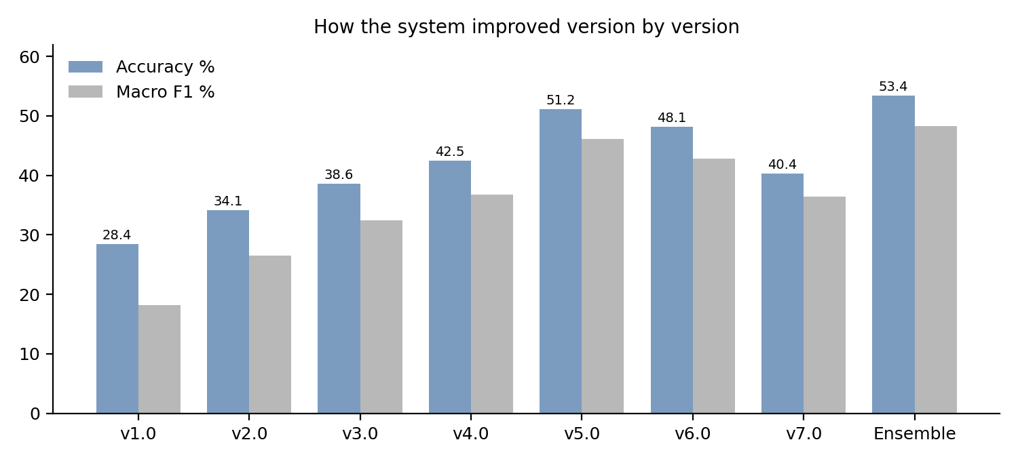
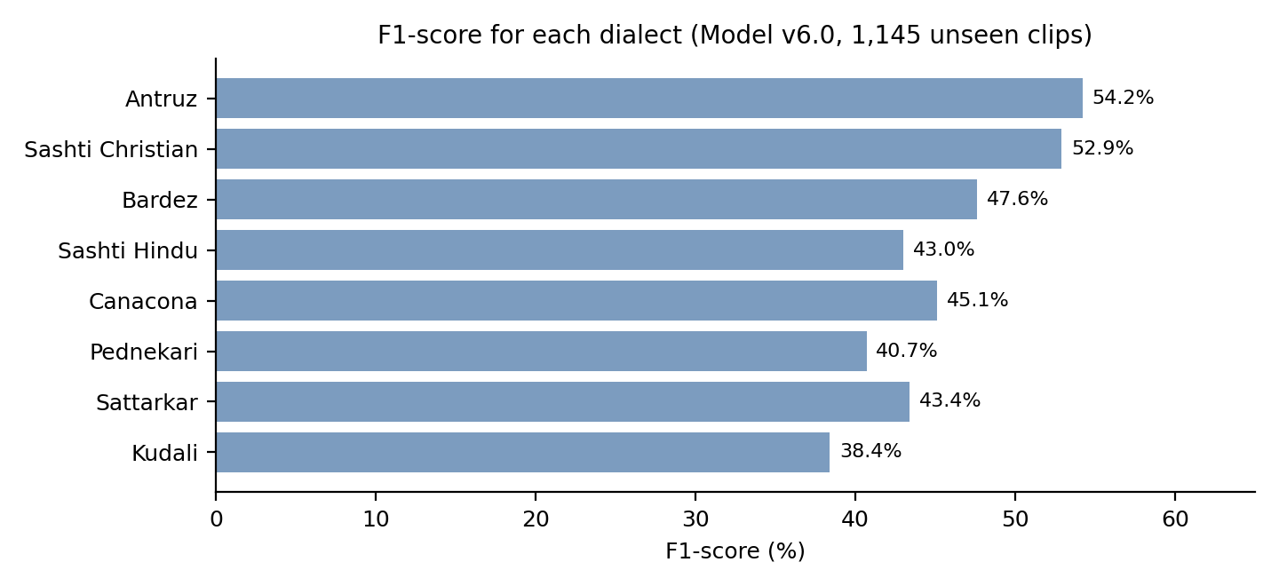
Results
53.4%
84.1%
accuracy over 8 classes (chance 12.5%)
right dialect in the top 2 guesses
48 ms
51.18%
per 6-second clip on Apple M4
best single model (v5.0)
Mistakes follow the map: Antruz is confused with Sashti Hindu, and Bardez with Pednekari. These are neighbours, just as real dialects blend into each other.
Notes:
Show how the system improved version by version and the final numbers. Chance level is 12.5%, so 53.4% is over four times better. The Top-2 score of 84.1% shows that mistakes are between neighbouring dialects.

Slide 10
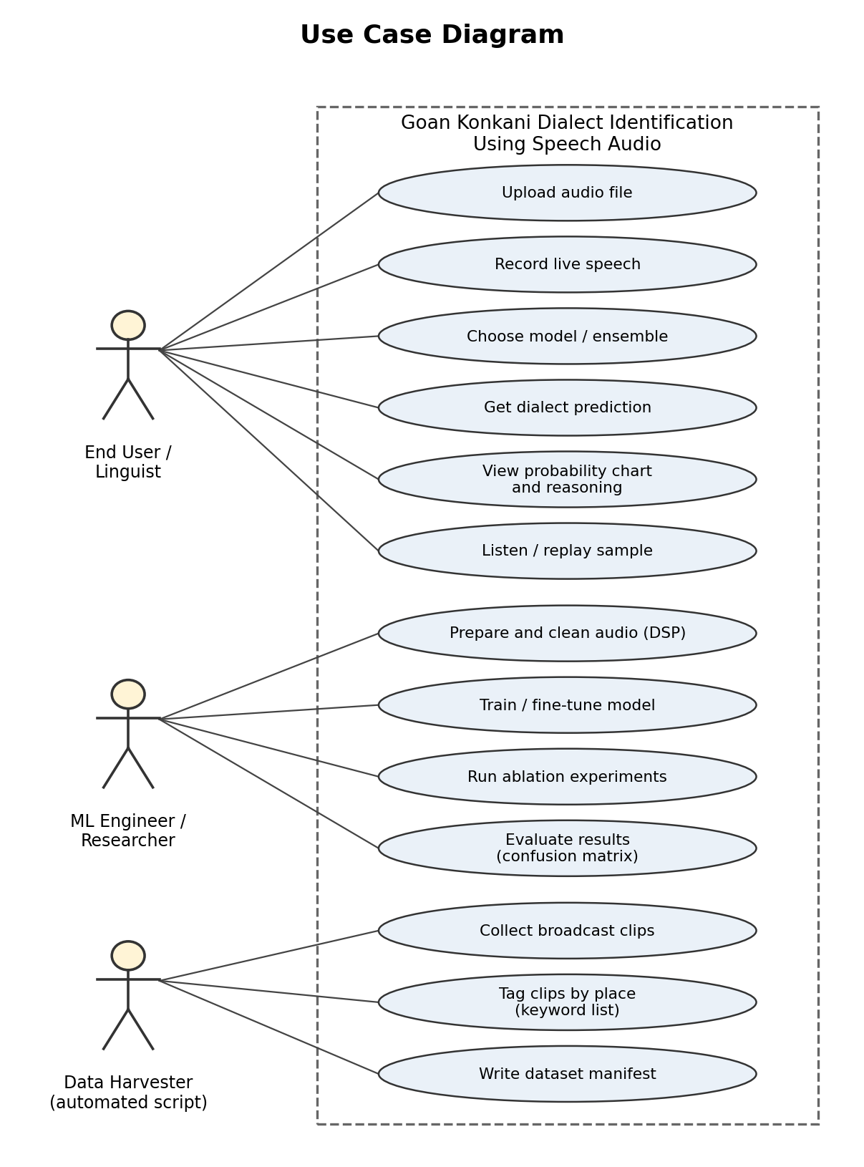
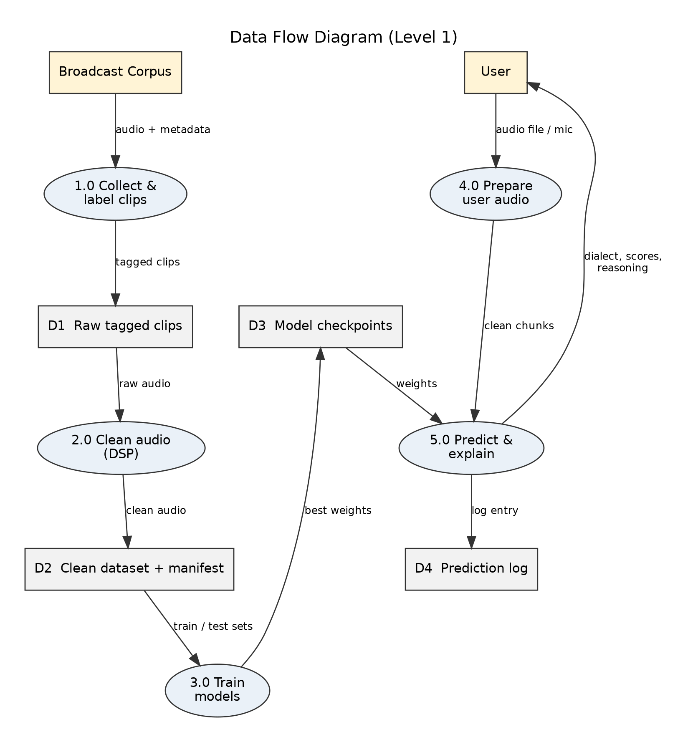
Design: Users and Data Flow
Use case diagram
Data flow diagram
Notes:
Left: the use case diagram with three kinds of users: the end user, the ML engineer and the automated data harvester. Right: the data flow diagram, showing how raw audio becomes a labelled dataset and trained weights, and how a user recording becomes a result.

Slide 11
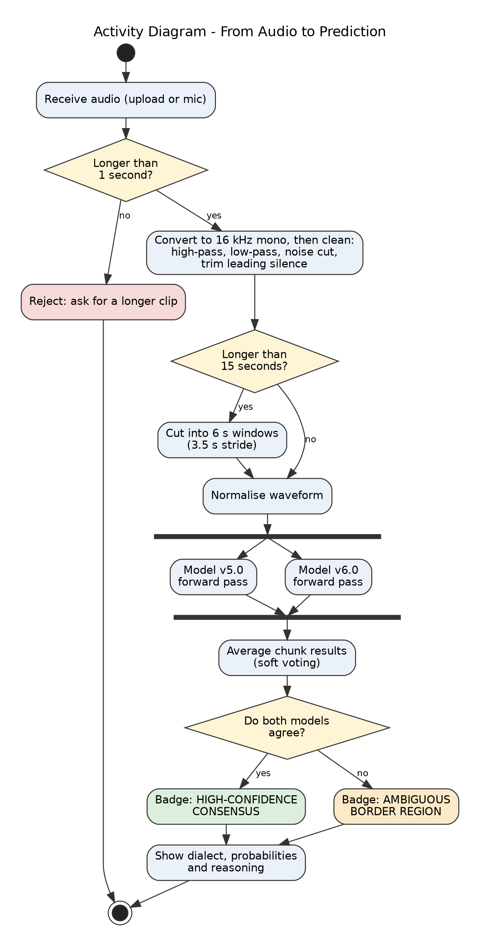
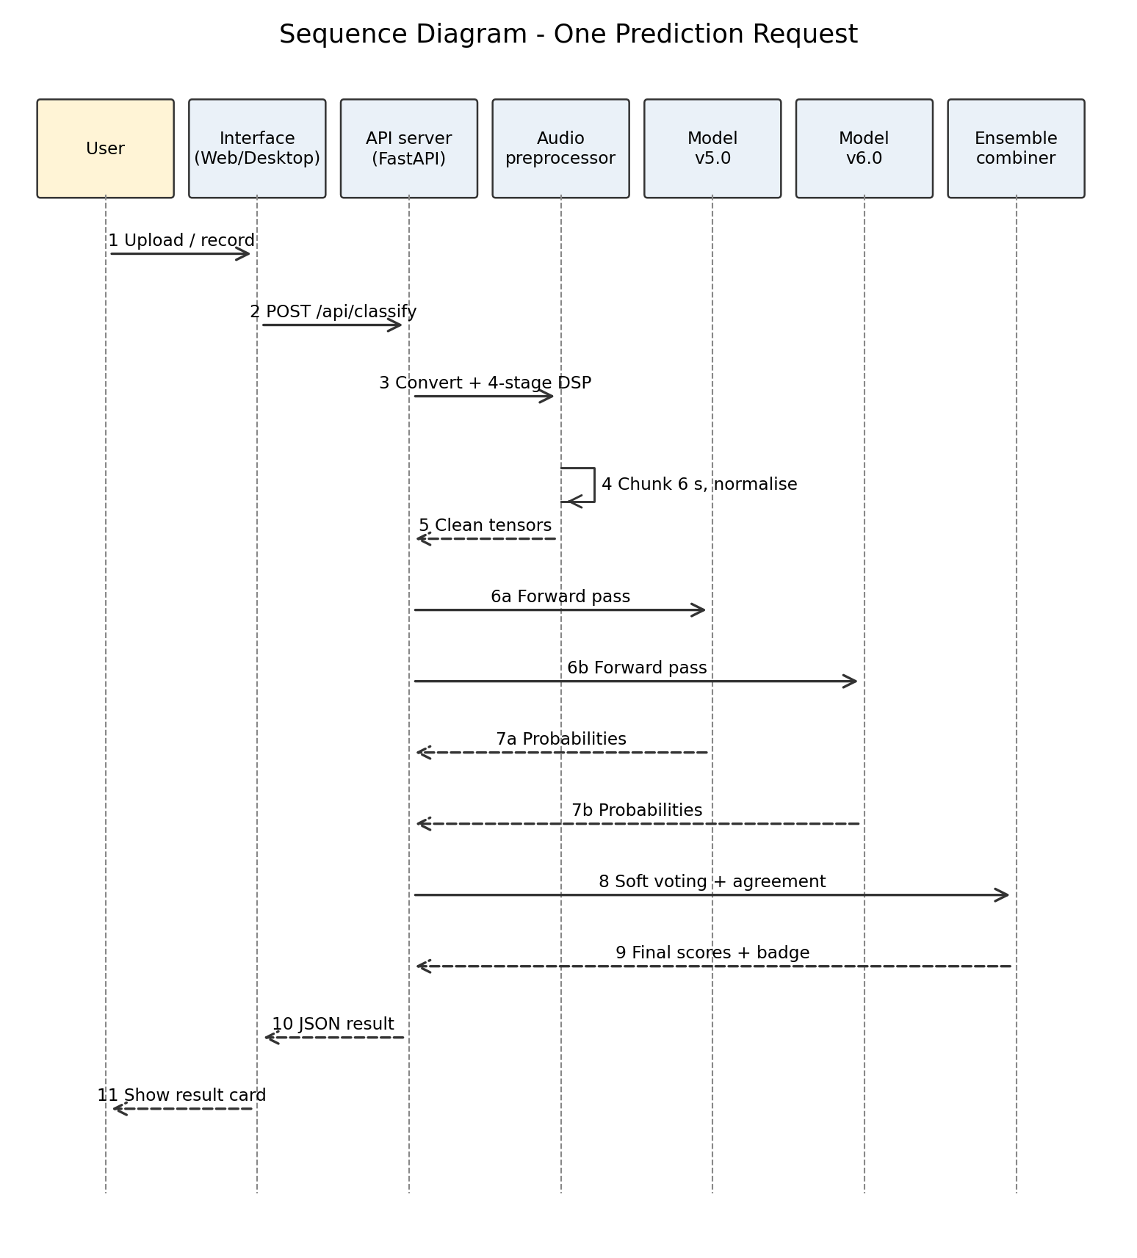
Design: Prediction Step by Step
Activity diagram
Sequence diagram
Notes:
Left: the activity diagram showing the decisions in one prediction, including the check on whether both models agree. Right: the sequence diagram showing which component talks to which, step by step.

Slide 12
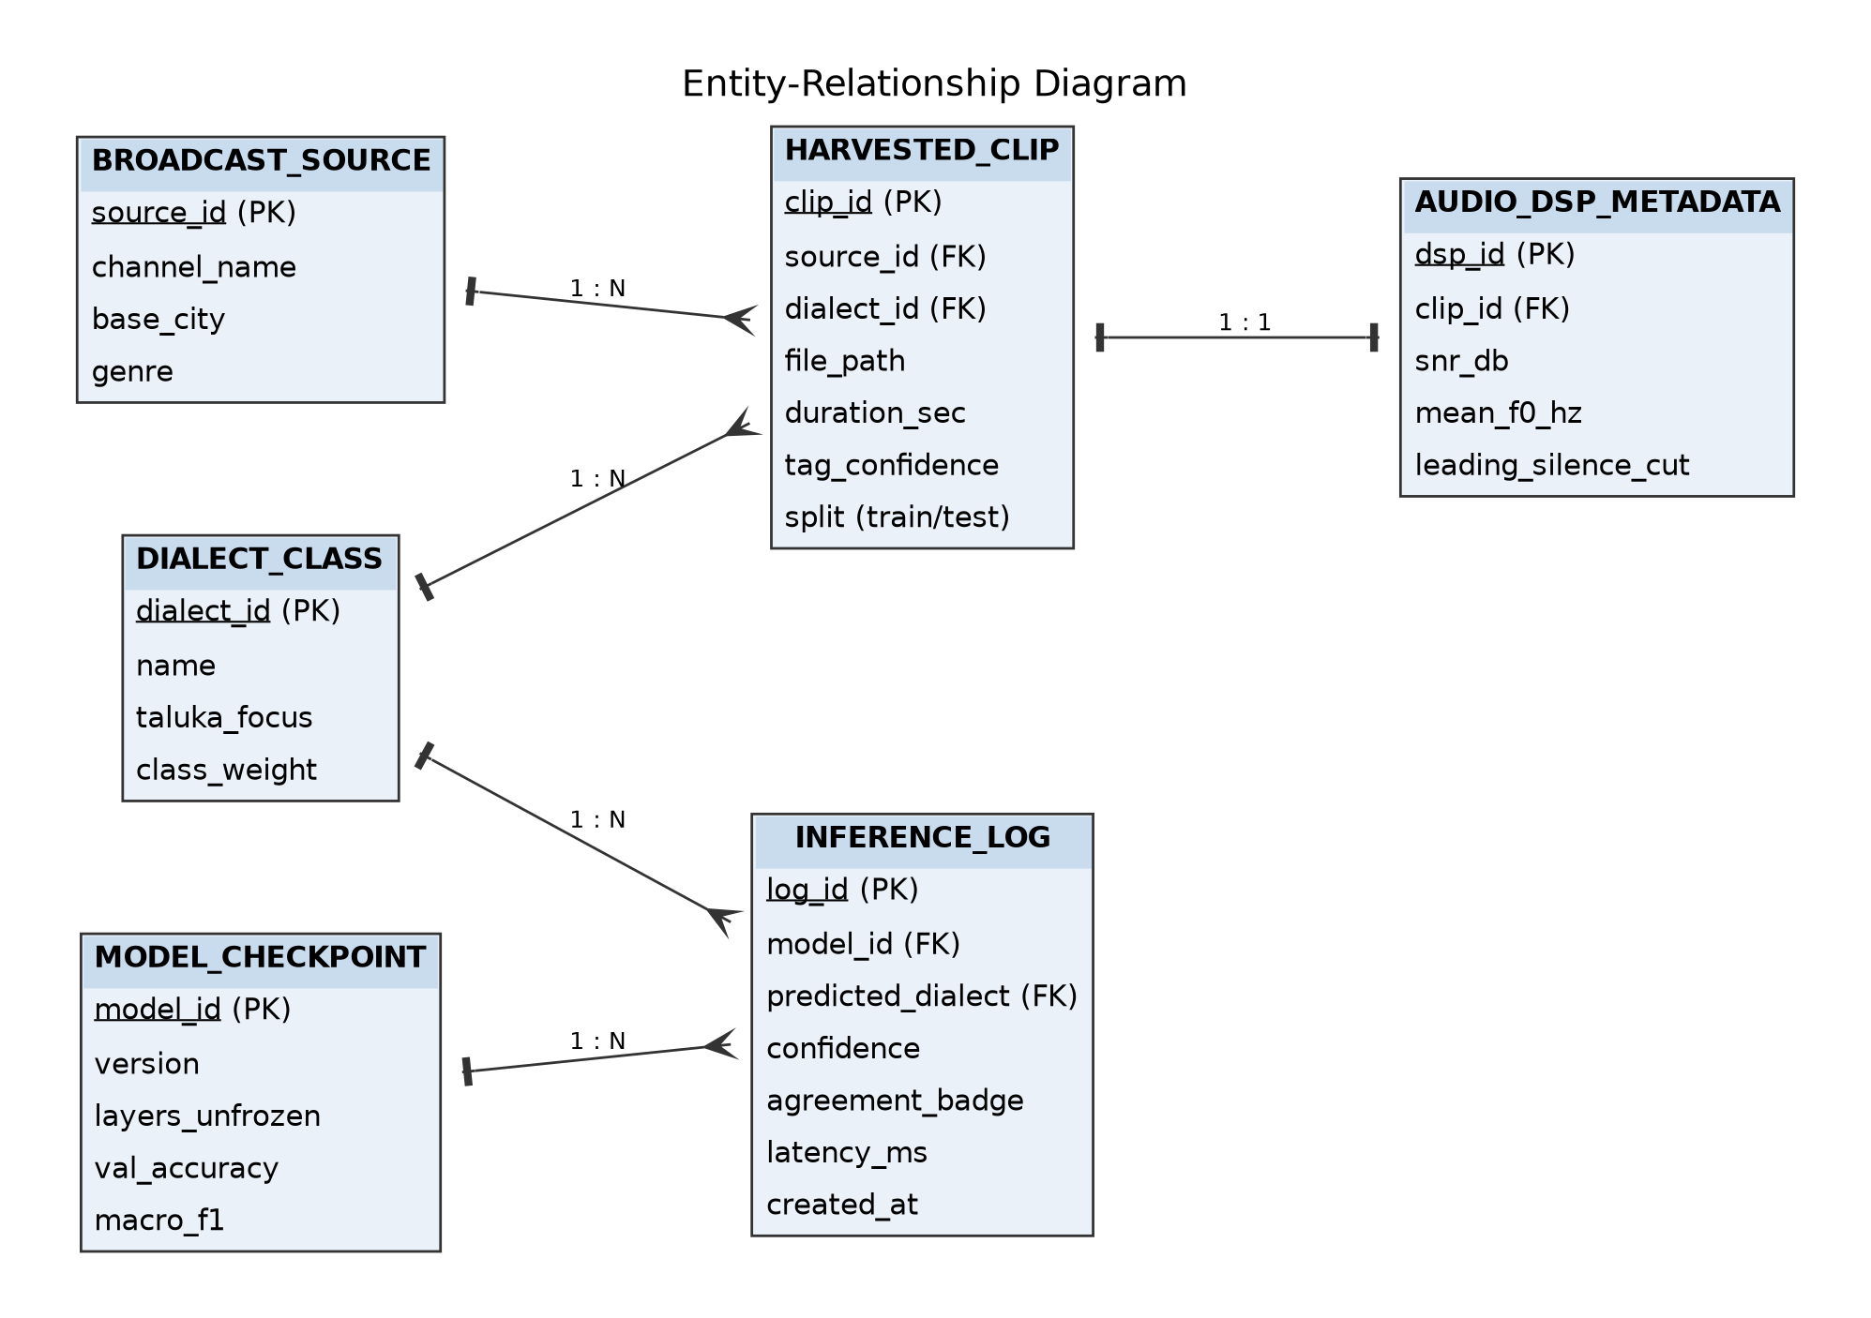
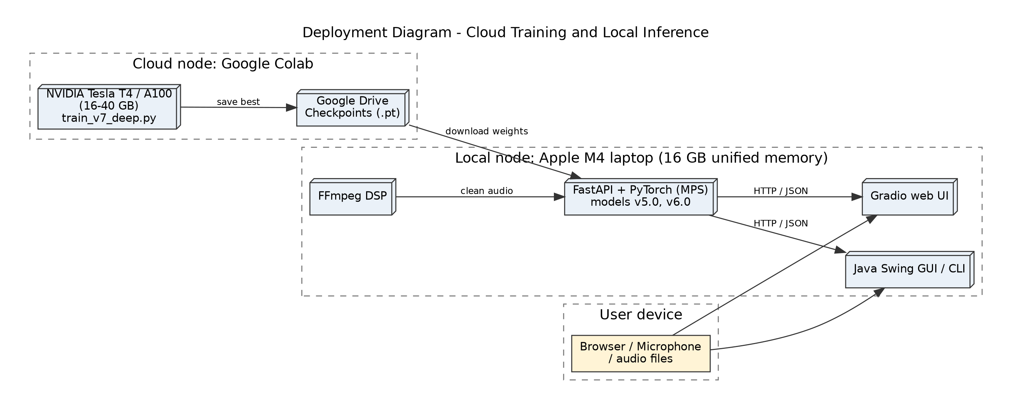
Design: Data Model and Deployment
Entity-relationship diagram
Deployment diagram
Notes:
Left: the entity-relationship diagram of the dataset and prediction logs. Right: the deployment diagram, which shows that training runs on a cloud GPU and prediction runs locally on a laptop.

Slide 13
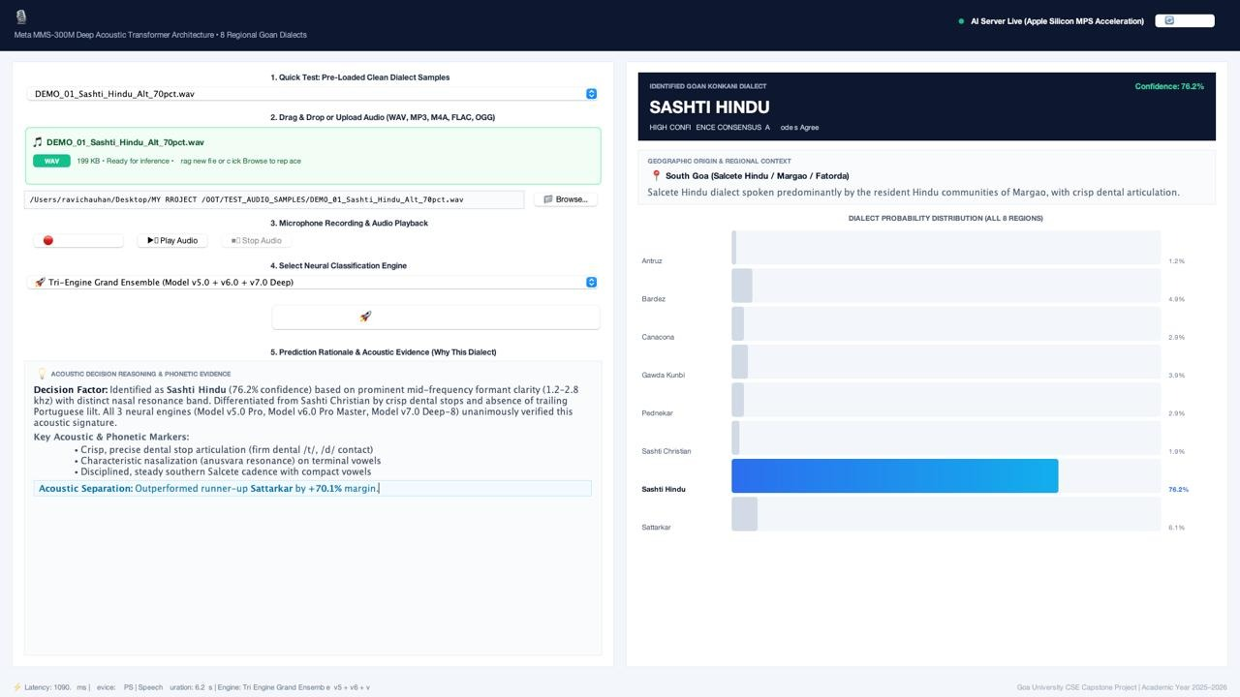
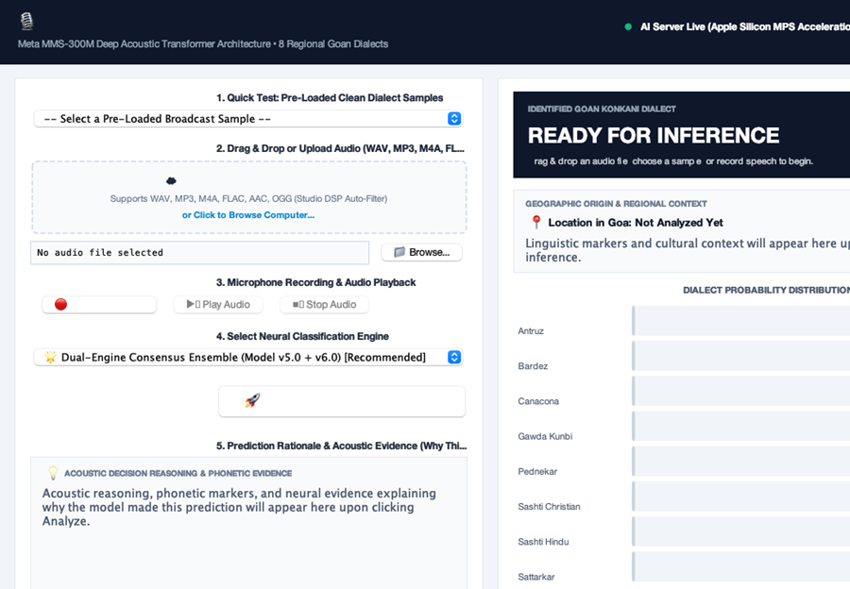
Demonstration
Start the backend and wait until both models are loaded on the GPU
Open the app: the status shows it is connected and ready
Pick a sample, upload a file or record from the microphone
Choose the engine, for example the dual ensemble
Press Analyse and classify
Read the dialect, the eight probabilities, the agreement badge and the reasoning
Try a clip from another dialect to compare
Notes:
Run the live demo in these seven steps. The images on the left are illustrative mock-ups; replace them with real screenshots of your running application.

Slide 14
Limitations
Moderate accuracy
Dialects form a continuum
Labels are inferred
53.4% over eight classes is far above chance, but the system is wrong nearly half the time.
Border speakers sound like two dialects at once, so eight boxes are always an approximation.
Clips were tagged from place names in the metadata, so some labels are noisy.
TV, not village speech
Repeated speakers
Uneven data
Broadcast audio is cleaner than field recordings, so real-world accuracy may be lower.
The same newsreaders appear many times, which the 8-layer experiment showed can mislead a model.
Antruz still has 4.7 times more clips than Kudali, so small dialects score lower.
Notes:
Be open about limits. These are honest and each one has a clear next step on the future scope slide.

Slide 15
Disclaimer and Responsible Use
The system suggests a dialect and shows a probability for each class. It is not a final judgement.
Treat low-confidence or "ambiguous boundary" results with care: the speaker may sit between two dialects.
Dialect is a feature of how someone speaks, not a measure of identity, and should not be used to judge a person.
Results depend on audio quality: clear speech of 5 to 15 seconds works best.
The application runs on the user's own machine, so recordings do not have to be sent to an external server.
Best used as an assistant
Linguists, teachers and archivists can use it to sort and explore recordings, then check the result against their own knowledge.
Not for judging people
Never use a dialect label to make decisions about a person.
Notes:
Explain that the system gives a suggestion with probabilities, not a verdict. It should be used as an assistant for researchers and learners.

Slide 16
Future Scope
Phone-sized model
Compress the model (INT8, ONNX or CoreML) so it runs offline on ordinary phones.
Dialect-aware assistant
Link the classifier to Indic language models so a voice assistant can reply in the user's dialect.
Multi-speaker audio
Add speaker diarisation to label dialects turn by turn in meetings and interviews.
Community corpus
Collect verified recordings from villages across Goa to remove label noise and cover smaller dialects.
Soft labels
Describe a border speaker as, for example, 70% Bardez and 30% Pednekari instead of forcing one label.
Notes:
Five next steps. Each one answers a limitation: better data, smaller models, and more realistic handling of border speakers.

Slide 17
Conclusion
This project shows that a computer can learn to hear where a Goan is from. By working directly on sound, using a pre-trained speech model and a carefully built dataset, the system identifies eight Goan Konkani dialects with 53.4% accuracy and 84.1% Top-2 accuracy, and runs in about 48 milliseconds per clip.
Direct
Careful
Honest
Listening to the audio keeps the pitch, rhythm and nasality that text throws away.
Fine-tuning the top 4 layers and cleaning the audio with dialect clues in mind gave the best results.
Probabilities, a consensus badge and a Top-2 view show that dialects blend into each other.
Notes:
Summarise in three points: we listened instead of transcribed, we built the data and cleaned it carefully, and the system is honest about uncertainty.

Slide 18
THANK YOU
Notes:
Thank the audience and invite questions.

