Slide 1
Buffer Overflow Defenses
Week 3
© Mark Cabanero 2019
Notes:
Hey there!
I hope that these slides can be used for the basis for a whole lot of computer security learning, because UConn didn’t quite have one.
This was presented / discussed in a two hour session about buffer overflow defenses. Prior to this week, we talked about Von Neumann architecture (Computer Architecture, 3666) and how things get placed onto the stack (a buffer that we treat as if it’s one continuous array). This is to show how some of the naive attacks done (overflowing a buffer we read into) were mitigated, and how it might evolve in the future.
I copyrighted these slides for the sake of not wanting them used verbatim. I believe that there’s a lot of information still out there not covered, and it’s really important to smooth out a lot of the discussion that was said here.
With that said, the rest of the slide notes should contain some conversation about what was talked about when, just to better explain what was put down.

Slide 2
Environment
Notes:
I used a DigitalOcean droplet with gdb + GEF [2] installed, because it gave me access to helpful commands to show certain aspects about the binaries.
It’s not necessary, but it makes seeing things like the stack, values in the register, where we are in code, etc. a whole lot easier.

Slide 3
Quick Recap
Buffer overflows
Program stores data about its state in its (stack) frame
Write data past the end of a buffer
Arbitrarily changed to how the program should operate
Notes:
As said before, we talked about buffer overflows the past week.
The way I have it in my head is that a program initially sets up information about its state (arguments passed in, where we currently are, etc.) in the stack. Whenever we call another function or perform a computation, we modify the stack in some sort of way.
Previously, our buffer overflows had no mitigations turned on, so we overwrote the return address of the stack frame so that we could jump to an unintended code path.

Slide 4
Mitigations?
Mentioned before, what about a way to check if the state is the same before we leave the function?
Stop executing the memory we can write to
Just place things “randomly” into memory
Notes:
We had talked two weeks prior of some possible mitigations to buffer overflows.
Some ideas were to not make the stack both writable and executable (only one or the other, but not both), or make the placement of things in memory slightly randomized. This makes it harder to just say, “hey, jump to this return address fixed in our binary at compile time, we’ll be okay!”
I think we had some talk related to just not using the stack architecture as well, but can’t recall.

Slide 5
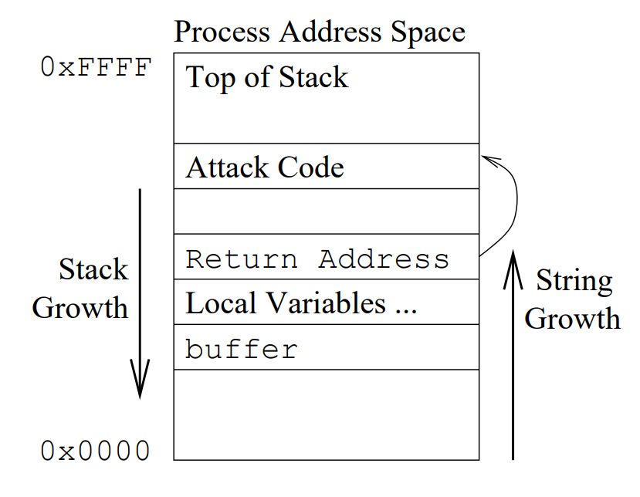
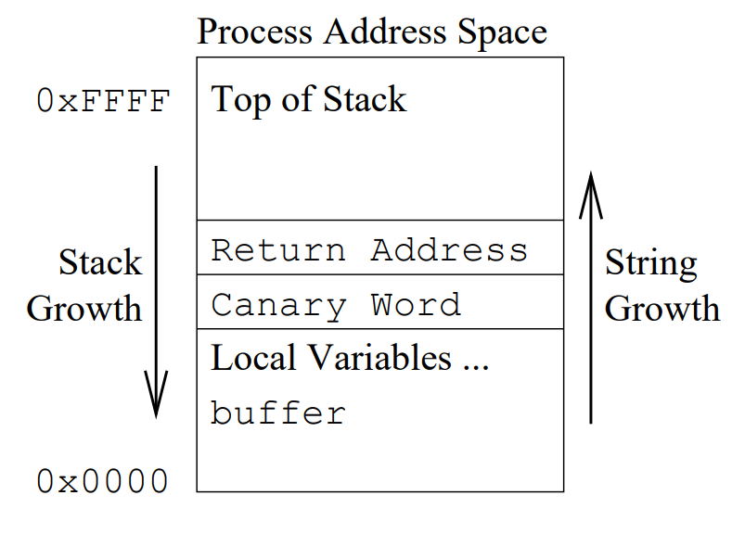
StackGuard (Stack Canaries)
Notes:
Enter in Stack Canaries! This is from a paper called StackGuard [1] that talked about the very first implementation of stack canaries.
On the left, the idea is that the buffer could be overflowed, overwrite the return address, and execute some attack code elsewhere in the stack. On the right, the mitigation comes from the canary word.
In writing to the buffer, you cannot be selective of when you start or stop writing, you would continue writing past the buffer (in the direction of string growth). So, that means that in the case on the right, you would have to overwrite the canary word before you could get to the return address. The problem with that is that the canary word is checked versus some place in the program, to see whether or not the canary word is valid before returning. So, if it so happened to be clobbered from someplace, the program immediately stops execution, and faults.
Note, we came upon this realization when prompted that the canaries are written in at compile-time. It’s hard to say where exactly they are stored, which might be an interesting thing to explore.
Fun fact, they’re called canaries because of Miner's canary. I like the term “stack cookie” because of such.

Slide 6
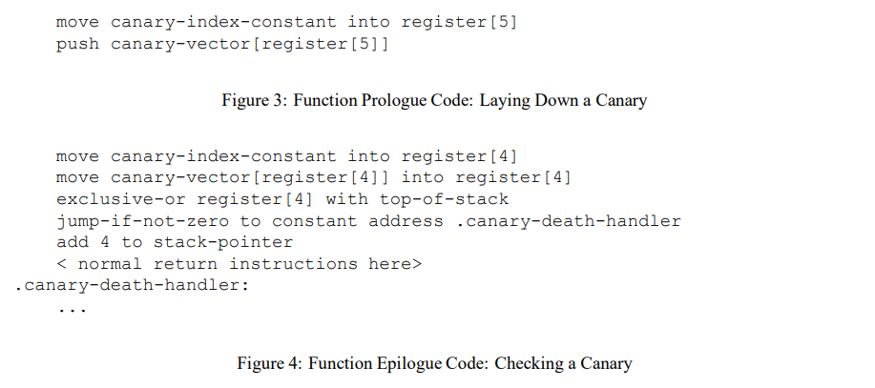
StackGuard (Stack Canaries)
Notes:
This was a demonstration of how the stack canaries were validated in psuedo-CPU language.
At the start, there is a vector of these canaries. A particular one is chosen (from canary-index-constant) and then pushed onto the stack by fetching that particular index from canary-vector.
The function then does it’s thing.
Afterwards, the function gets that same stack canary back from the canary-vector, XOR’s it with the top of the stack (which should be the stack canary), and then checks. If it’s not zero (thus the value on the stack is not the same as the one loaded from canary-vector) then, bail out and handle the death. Otherwise, just return.

Slide 7
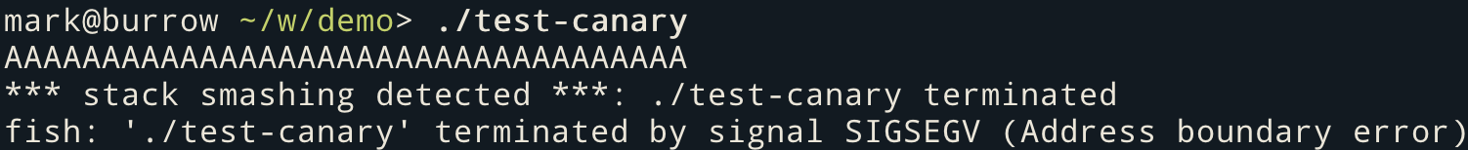
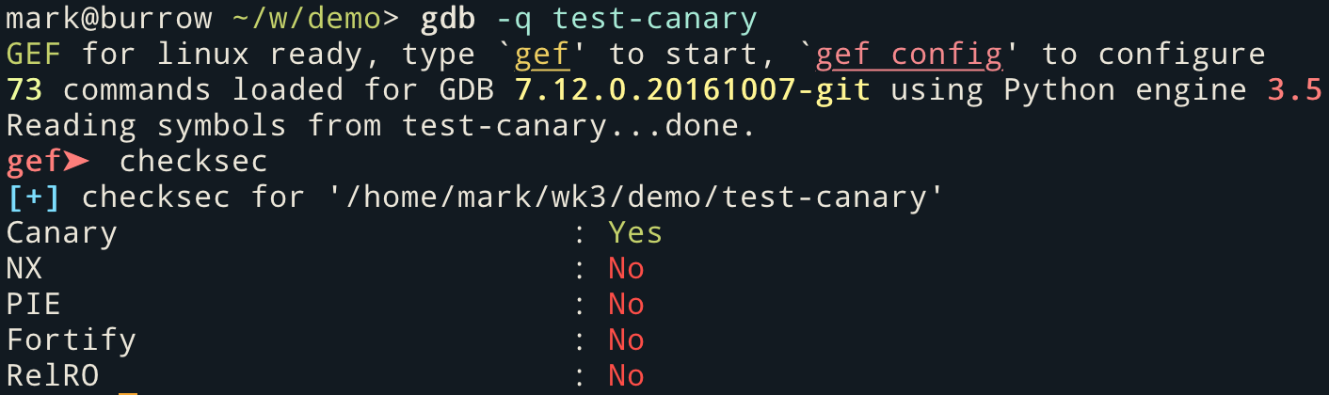
StackGuard Demo
Notes:
Ideally, the demos are done live, so that students can follow along for fun. Breaking stuff together is cool, honestly.
This is where I showed off test-canary. This is a binary compiled specifically with a whole bunch of flags to turn everything off BUT stack canaries. It should be in the Makefile provided, but if not, the flags used for a non-secure binary were:
-g -m32 -mpreferred-stack-boundary=2 -fno-stack-protector -z execstack -D_FORTIFY_SOURCE=0 -no-pie -z norelro
-g: Keeps debug symbols on for the binary, to show where you are in the code.
-m32: Compiles it with x86 in mind, to keep down the size of the memory addresses, and just less conventional overhead.
-mpreferred-stack-boundary=2: I can’t fully recall what this does. I believe it was to make sure how the stack was aligned in memory read nicely, because there were points where values didn’t make sense because of how big things were. Don’t think it’s completely necessary.
-fno-stack-protector: Stack canaries, the things we like.
-z execstack: Allows us to execute things in the stack; i.e., we have the stack +rwx.
-D_FORTIFY_SOURCE=0: One of the later slides. Basically, check the bounds of certain C functions, and only allow for a maximum size if it can infer that it will only be passed a certain size. We turn that off.
-no-pie: One of the later slides. Basically, keep the layout of how the program goes into memory static, instead of changing every time the program is executed.
-z norelro: One of the later slides. Certain lookup tables are made to be read only, or something of the likes.
Now, we wanted to demonstrate the presence of canaries, so basically, turn on stack protectors: -fstack-protector instead.
First, we launch the two programs (test and test-canary) to show how both operated on normal input, and invalid input.
Then, we launch gdb, and then use a command provided by GEF (checksec) to show the protections of that binary.

Slide 8
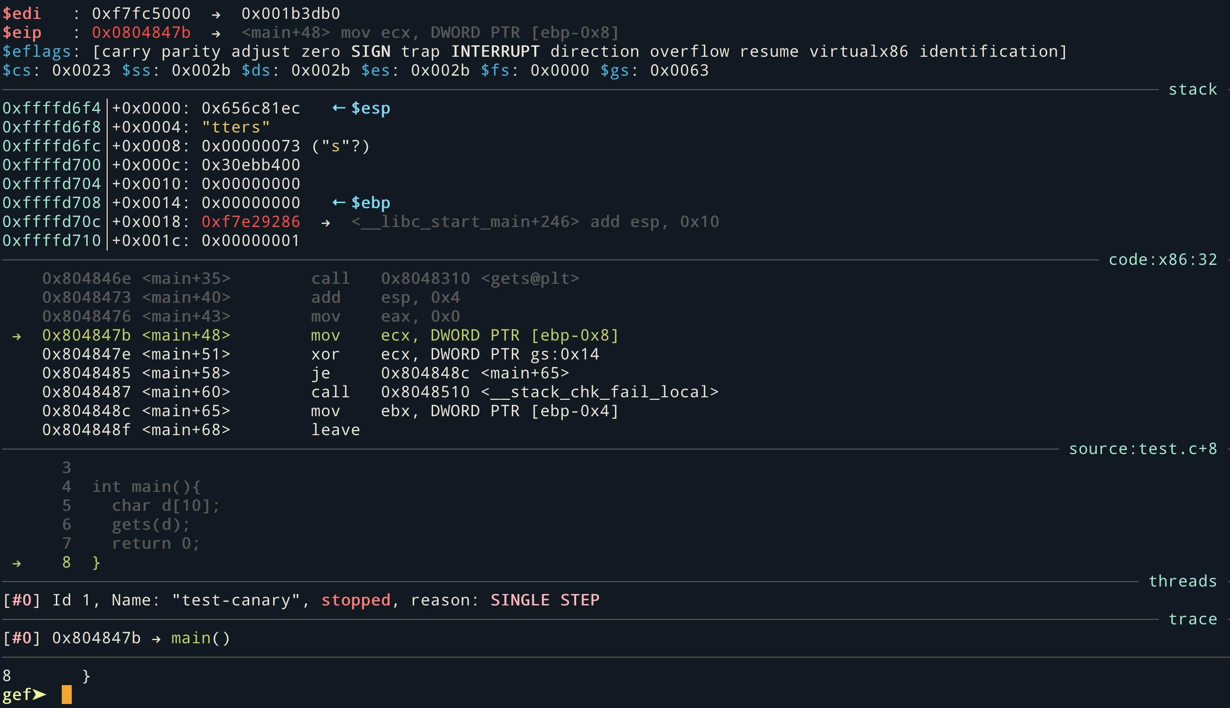
Notes:
After breaking on main, I went through the code with n to go through the source (as seen), without stepping into functions. Just before the code finishes, however, I highlight the call to <__stack_chk_fail_local>, showing that now we have a way to see if the stack canary is valid or not.
This is with a valid input, to show the normal control flow of it not failing.

Slide 9
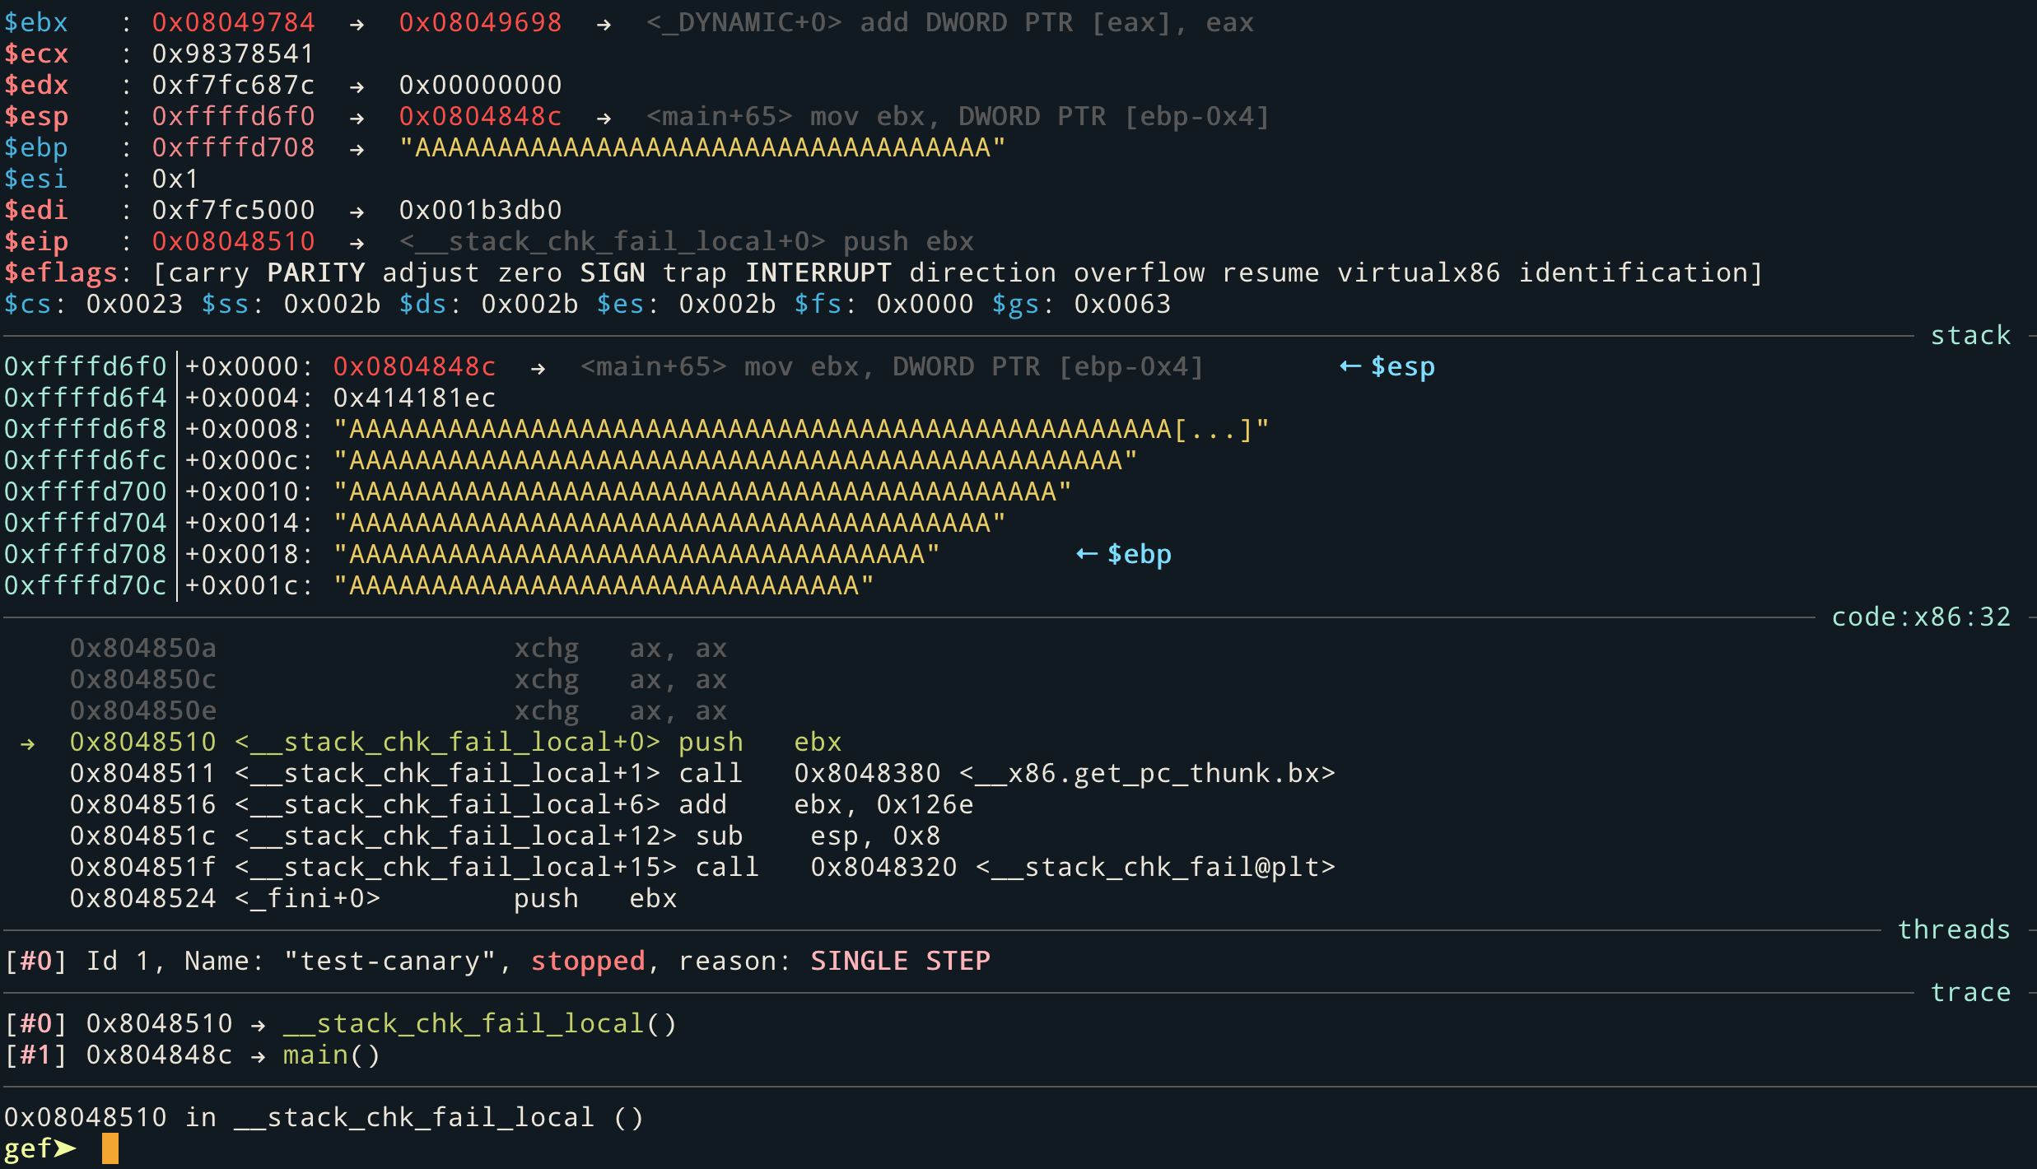
Notes:
I did the exact same test, except running it with a huge input (a lot of As), and then seeing where the code path went. Now, it would to __stack_chk_fail_local(), and how it looks like we’re going to fail out of this program.
I didn’t really emphasize what the code was actually doing, more emphasizing that it’s in line with what the paper had done. It would be nice to see the stack cookie be placed in the stack, but at least we get the comparison at the end.

Slide 10
MemGuard (of the same paper)
Also mentions protecting the return address when a function is called, unprotecting the return address when it returns
That’s costly, probably not best to do that in user memory
Notes:
I brought up another interesting find from the same paper [1] that talked about MemGuard, an alternative to placing a random value on the stack.
Here, the return address of the function is protected in some way by the CPU, and just before the function returns, it unprotects it. I don’t think I have a good explanation beyond that; I believe that the paper originally talked about using CPU traps for it? Basically, highlighted afterwards.

Slide 11
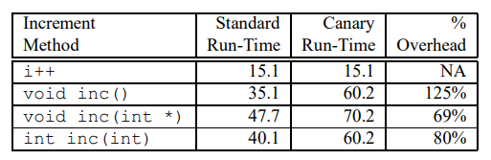
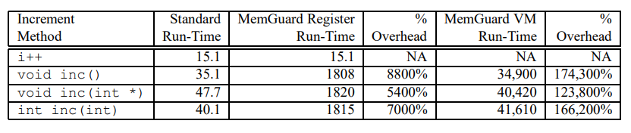
The Cost
Notes:
This is just to demonstrate the overhead cost from StackGuard and MemGuard in an idealized scenario.
The scenario is mentioned in the paper, but, it’s basically incrementing a number millions of times.
One uses direct manipulation of that variable in that function (so, there’s no overhead cost),
One uses a function that must manipulate a global variable, and the overhead from that.
One uses a pointer to the integer in question.
One uses a return type with a pass-by-value.
We can see that the canary run time added a particular overhead, however, if done with MemGuard instead, we can see that the tradeoff is so slight in comparison. I believe that the MemGuard Register vs MemGuard VM depended on the implementation of protecting the return address, but the main point I stressed here was the relative lightweight approach. It was something that could be put in the compiler, and yet everyone could benefit. There are also other charts in the StackGuard paper to look at for more examples of tradeoffs of security vs performance.

Slide 12
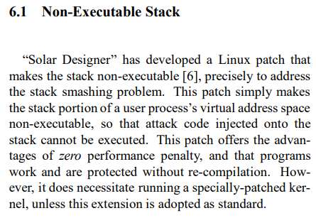
Non-Executable Stack
We’re afraid of writing code into the stack that we execute, so why don’t we just stop that?
Notes:
This was also mentioned in the StackGuard paper [1] of other people doing similar works in trying to secure the stack.
This went into a discussion about how the NX-bit had to be put onto CPUs first in order to better support this feature. Basically, some regions in the stack would be flagged as non-executable (so no +x set) based off of the CPU telling if such a region was or was not.

Slide 13
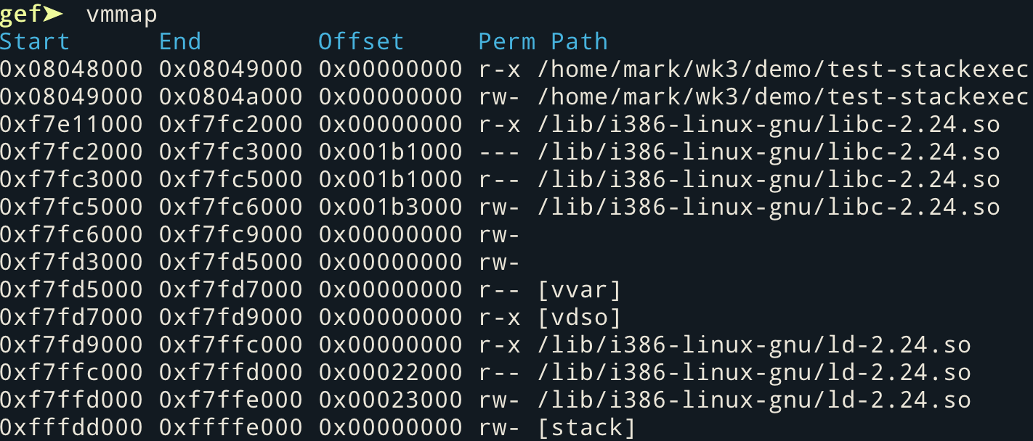
Non-Executable Stack Demo
Notes:
Here, same thing as StackGuard; run checksec, and then break on main().
This time, instead of executing further, run vmmap. Here, the permissions of the stack are now just read and write, not executable. So, if we were able to actually write malicious code onto the stack, we couldn’t just point the return address to it, for it would fail out. I don’t think I had an example of this, just because the buffer was too small + I didn’t want to pop a shell on the running droplet.
This was compared to the non-secured binary, however, just to show the permissions difference.

Slide 14
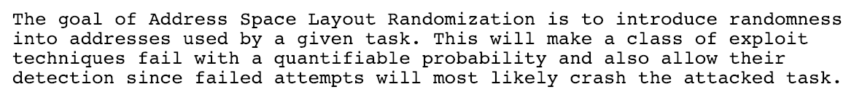
ASLR (Address Space Layout Randomization)
Notes:
Here, we talked about ASLR, and what it meant. Since we were relying on buffer overflows using static locations in memory, we just shift things around and went with it.

Slide 15
ASLR Demo
Notes:
I believe GDB turned off ASLR on my machine, so the demonstration was kind of wonky.
I think I turned off all the flags except debug symbols and x86 compilation, and just demonstrated how vmmap start and end boundaries changed on each execution.
Considering that GDB actually does turn off ASLR (just tested it), it’s kinda hard to show unless you tell GDB not to turn off ASLR.

Slide 16
Comparison Interlude
Notes:
At this point, it was around 70-80 minutes into class, so we took a break to talk about the differences between stack canaries, NX, and ASLR. We talked about:
When they came about
What were they trying to address (breaking the stack, writing to the stack, jumping in the stack, respectively)
How were they implemented so everyone could benefit (at compile-time, needed hardware features, needed hardware features, respectively)
Did that actually fix anything? (Well, yes and no; we moved towards functions and explicit boundaries to try and mitigate these as well)
And probably other things. However, the comparison is very important, because it emphasized that technology was developed in response to things breaking, and how it was approached.

Slide 17
Even more defenses?
Position Independent Executable (PIE) - No PIE means that app will tell the loader which virtual addresses to use, and the memory layout is static
Notes:
These were speedrun. Probably better to consult other sources for this if you really want to go in-depth, but it’s addressing the values seen in checksec that weren’t covered elsewhere in the presentation.

Slide 18
Even more defenses?
FORTIFY_SOURCE - the compiler will try to intelligently read the code it is compiling / building. When it sees a C-library function call against a variable whose size it can deduce (like a fixed-size array - it is more intelligent than this btw) it will replace the call with a FORTIFY'ed function call, passing on the maximum size for the variable. If this special function call notices that the variable is being overwritten beyond its boundaries, it forces the application to quit immediately.
Notes:
Same with this one.

Slide 19
Even more defenses?
Relocation Read-Only - headers in the binary are marked as read-only once the linker is done doing its magic.
Partial RELRO versus Full RELRO - Full RELRO has the Global Offset Table & Procedure Linkage Table (process-specific look up table for symbols) are marked read-only too.
Notes:
As well as this one. The tables were really hard to comprehend, but it was the end of the class, so not enough time dedicated to such. It’s possible to cover these, but there needs to be understanding about the Global Offset Table and the Procedure Linkage Table, which would probably be better explained with a return-to-libc demonstration.

Slide 20
References
[1] StackGuard: Automatic Adaptive Detection and Prevention of Buffer-Overflow Attacks - https://www.usenix.org/legacy/publications/library/proceedings/sec98/full_papers/cowan/cowan.pdf
[2] GDB Exploit Framework: https://github.com/hugsy/gef
[3] PaX paper on ASLR: https://pax.grsecurity.net/docs/aslr.txt
[4] Talk about some security vulnerability mitigations (until 14:32): https://youtu.be/9-uNC4-RbQM?t=382
Notes:
I know that was a lot, and probably more time could be spent explaining the concepts. I showed the effect of each one, but not how the mitigations affected the binary against malicious code. Hopefully, your example might include such!
But anyhow, thanks for taking a look at my research. I really hope that it helps guide you in the right direction, and others can benefit from a few things I learned.

