Slide 1
The Mobile Landscape
Week 11 / © Mark Cabanero 2019
Notes:
Hello again!
This was presented / discussed in a two hour session talking about Mobile Security. Prior to this week, we discussed a lot about isolation technologies (OS, hypervisor, SGX), so this was supposed to discuss the differences in the mobile architecture compared to our current OS architecture. This could be a variety of things: from how the subsystems are integrated on the chip, to sandboxing applications and data in the phone, to how permissions interact in such a way to contribute to security. That’s unfortunately way too much to cover in one presentation, so, this ultimately came out a little bit too wide in scope, while not addressing things too much in depth.
I copyrighted these slides to not having them used verbatim. There is a ton of information out there alongside these slides, and a lot can still be modified to bring it to a coherent point. Also, I’m a big fan of not having the entire presentation laid out, but having key points, and then explained either in talking or in notes.
With that said, the rest of the slide notes should contain conversation about what was talked about when, to better contextualize what we did.

Slide 2
Outline
~15 minutes of history
~1+ hour of reversing
~15 minutes of the future of mobile
Notes:
With any presentation, a good idea of where you’ll be going is appreciated.

Slide 3
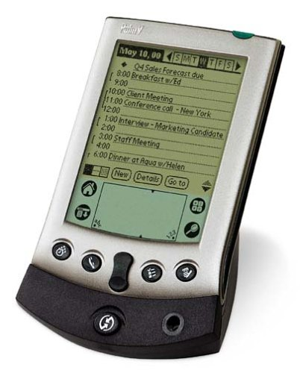
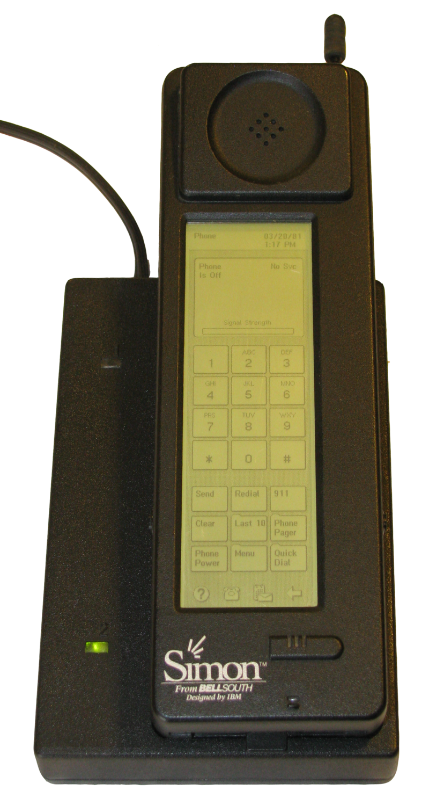
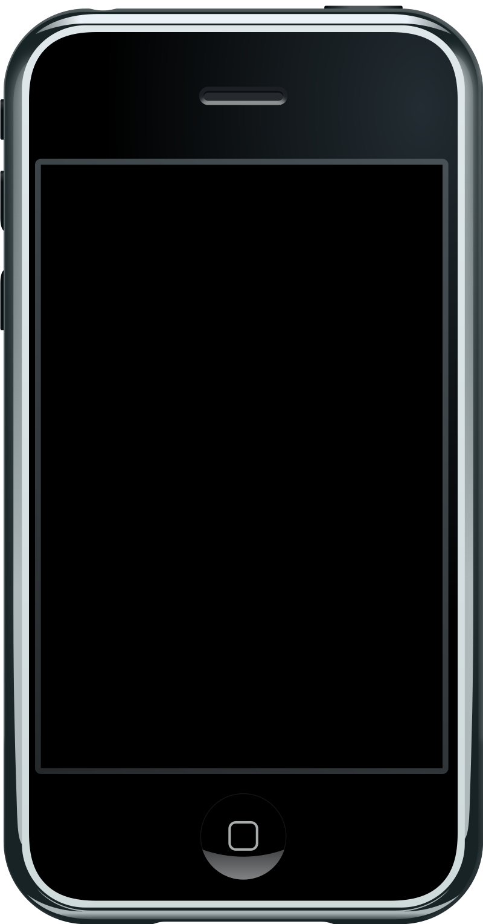
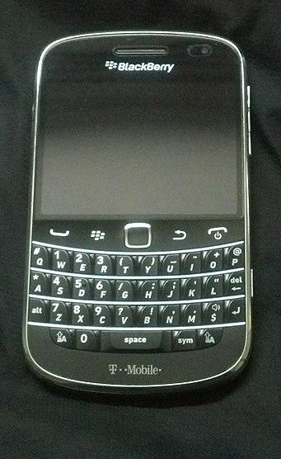
First Smartphone?
PDAs ⇒ phones ⇒ phones w/ keyboards ⇒ screens
Palm V handheld PDA (personal digital assistant)
IBM Simon
BlackBerry
Apple iPhone (2007)
Notes:
If we were to assign an age to smart phones, they wouldn’t be old enough to drive yet. This was to show how the features that each smartphone has (calendar, contacts, organization, etc.) built off of representations from the past. Also, a shoutout to the IBM Simon and the BlackBerry for bringing those concepts along, with the iPhone being the first popular release of a phone with just a screen.
This didn’t even brush upon how the concept of apps (something that the iPhone 1 had only first-party support for) became a main selling point for smart phones, until the release of the iPhone 3G (and the App Store launch).

Slide 4
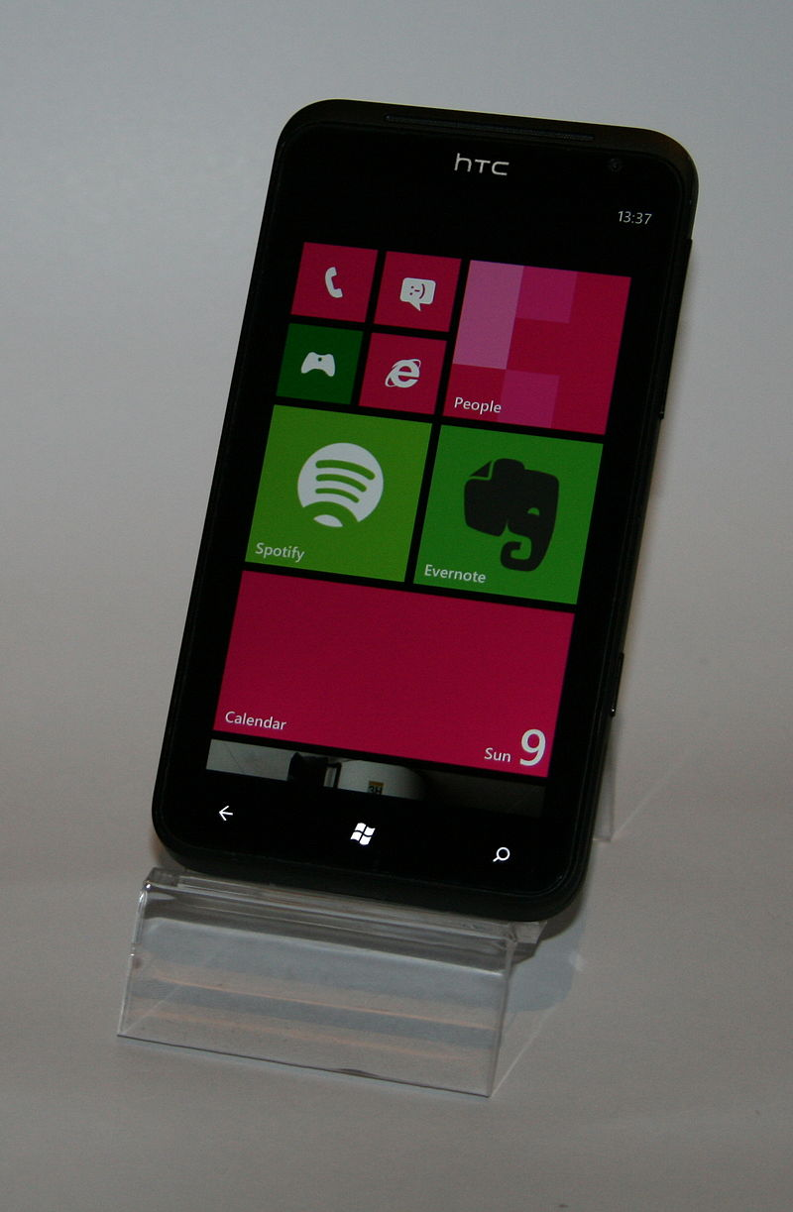
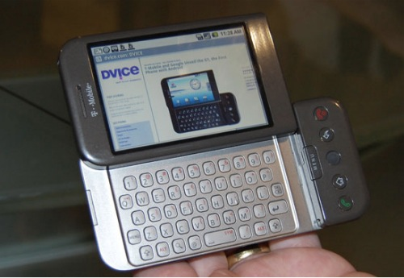
First Smartphones?
Google’s Android (2008), started dev in 2003 Microsoft’s Windows Phone (2010), same
HTC Dream (T-Mobile G1), 2008
HTC Titan (2010)
Notes:
Similarly, to give credit to other companies that were developing the market around this time, there was emphasis that these mobile PCs (which people saw smartphones as) were in development from big players of the time. Notably, these companies started development around 2003, while releasing software for smartphones years later. So, the security concepts and the design language used for these smartphones were influenced by OSes of that time.

Slide 5
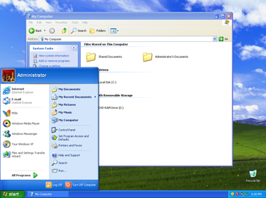
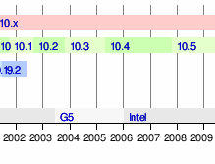
In context
Windows XP, released in 2001; SP3, released in 2008
Apple released Leopard
Notes:
Namely, this was the era of Windows XP and the first versions of Mac OS X 10. This was the era where people had computers connected for the internet. Yes, there was Windows 98 / 2000 / ME and Mac OS 9, but these were developed with the intent that they would end up online. IE 6 was made for this golden era of computing!
That also came with the drawback of realizing, “wait, this isn’t as secure as we thought,” reminding me of viruses and worms that were seemingly coming out every few months (https://en.wikipedia.org/wiki/Timeline_of_computer_viruses_and_worms). Yes, we have APTs and botnets today, but that’s with mitigations and knowledge of what not to do. I can remember that during this era, that there was folklore that “connecting an unpatched system of XP to the internet would have you infected in a short period of time.”
And we wanted to now put that power into phones, everywhere. Were we mad? Hopefully, not.

Slide 6
Main Ideas
“What if your PC, but on the go?”
Had to create ways to distribute programs (apps)
Different ways of approaching the market
Notes:
Basically, the mobile era allowed us the power of the PC, but not needing an actual machine for it. This made us attack challenges (the distribution of software, the licensing and customizability of operating systems, the power you had on your hardware) in varying ways, depending on which company you were talking about.

Slide 7
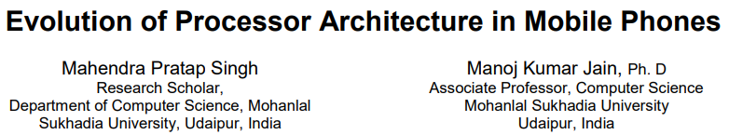
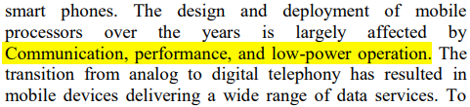
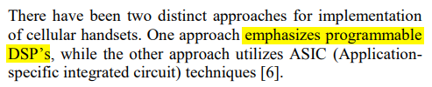
Architectural Shift
We can’t shove a desktop CPU into a phone
https://pdfs.semanticscholar.org/7174/57549f70742352e1116851b39391aa43b0f7.pdf
Notes:
Also, highlighted the idea that even though we wanted a mobile PC, we couldn’t shove PC-level hardware into phones. Imagine a socketed CPU that would have existed during the developing part (Athlons, Pentiums) being put into a mobile form factor. Yes, there are mobile chips, but we didn’t have things equivalent to the watt-sippers of today (Intel’s -U SKU comes to mind).
The paper talks about how a different architecture was employed to use less cycles to perform the same computations, which would overall lead to less power draw. However, that’s not the entire story. Consider that I mentioned x86 CPUs of that time, yet phones aren’t built with the x86 platform in mind. Another consideration is to talk about why a different CPU architecture was chosen in the first place.

Slide 8
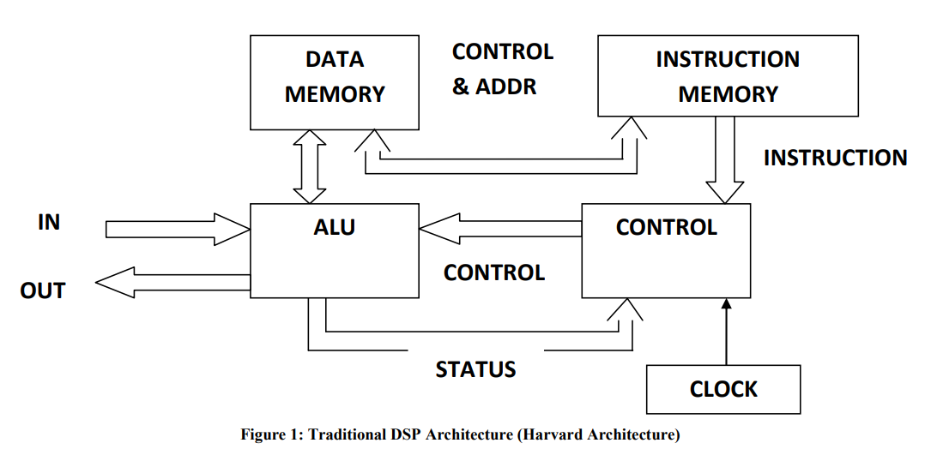
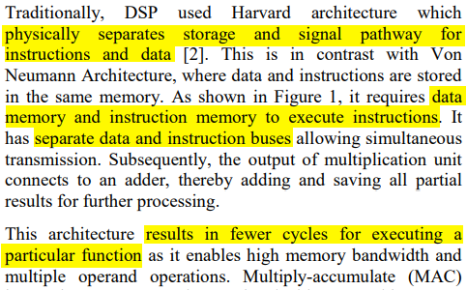
Digital
Signal
Processor
Notes:
This just builds in from the paper on the previous slide, ultimately culminating on how these processors could still run instructions and use less cycles by doing so. This architecture also was different from the Von Neumann architecture we had kept in mind throughout every single week, leading up to this one. Unfortunately, I didn’t get to see too in depth if this still was the base for mobile processors of today, but still, it’s interesting to think that data and instructions were performed separately to save clocks.

Slide 9
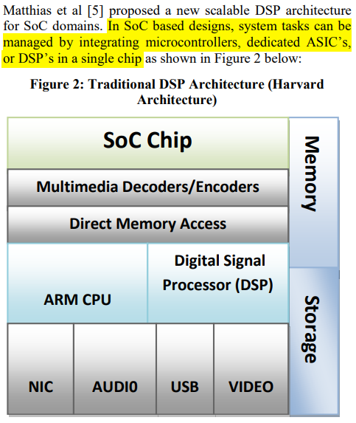
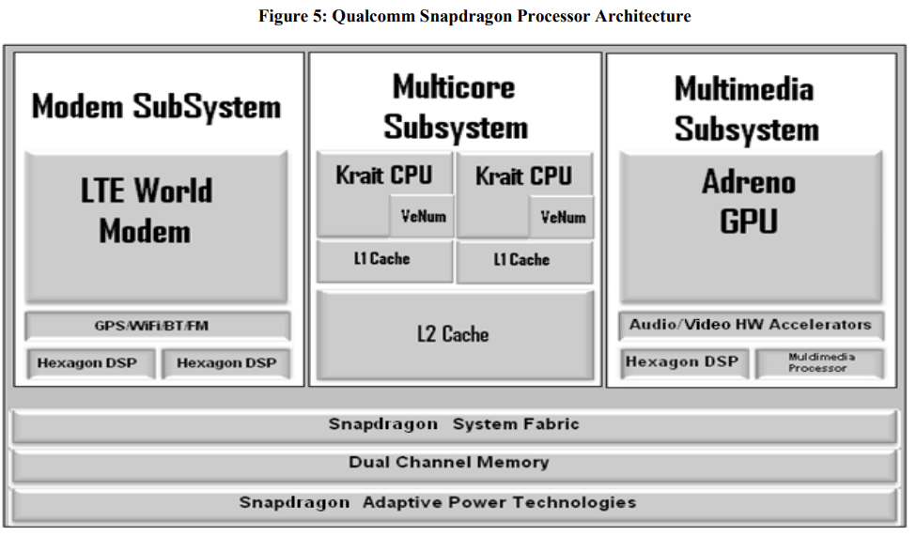
System-on-a-Chip
Notes:
Considering how we had PCs that had a generic motherboard and then components that you could slot on, phone manufacturers had to approach it from a different point of view. If we had that customizability from the get go, writing an operating system to support all of that would be tricky, on top of having to deal with challenges that would crop up with interactions in the small form factor.
This slide was meant to highlight that all of those concerns ended up being bundled down into a System-on-a-Chip (SoC), in order to take certain concerns out of the worries of different software developers. I believe I highlighted how the LTE chip was separate to the entire system, yet the multicore main OS still had to converse with it. Other that simple messages passed through, the separation of concerns should be that the LTE modem deals with only the LTE communications, while the multicore subsystem dealt with the mobile operating system.

Slide 10
Reversing on Android
Notes:
After all that historical context, we hopped into reversing instead.
Probably would have been better with exploring the history of Android and how it’s evolved over the time with those concepts of architecture kept in mind, but that’s insanely vast. I still believe there would be more benefit to exploring the architectural differences of PCs vs phones, but that requires a lot more knowledge on the subject matter to make meaningful comparisons.

Slide 11
Background
Android isn’t just “call main()”
Slides 11 - 22 @ https://mobisec.reyammer.io/slide/3
Like using messaging patterns
Notes:
Here, I utilized a lot of Yanick Fratantonio’s MOBISEC course (https://mobisec.reyammer.io/). If you want to really spend a lot of time understanding how to talk about the Android side of security and programming, refer to him and his slides! It’s truly filled to the brim with content.
The slides refer to “Intro to App Development,” and highlight how Android apps are structured around Users interacting with Activities, as well as how messages are passed around the system to deal with events, sort of like using messaging patterns in software development.
I think that seeing an actual “Hello World!” Android app at this point, with source code + emulator would help out immensely to nail this point home.

Slide 12
Thinking about Architecture
It’s basically like Linux
Slides 3-24 @ https://mobisec.reyammer.io/slide/4
Use a bridge (Binder) to do RPC/IPC to get information that is privileged
Notes:
In this slide, I wanted to talk more about the architecture behind Android itself, and how apps would use a mechanism to get access to data it typically does not. Just like how operating systems have system calls in order to try and get information it normally does not have access to, mobile operating systems (Android in this case) have a bridge (Binder) to make calls to protected information to get what is necessary.
For example, what if our app wants location information to geotag some event? We can’t simply have access to that information in the app itself, otherwise, any app could get the location information without intervention from the user. This is what necessitates a check of permissions, in order to communicate this information from a more privileged source.
I technically skipped this during my presentation, but this is important if you ever touch on permissions and how they work in depth. If you have an example application + emulator to show this, that would be neat.

Slide 13
Tools & Methodology
babyrev & pincode @ https://challs.reyammer.io/
Slides 34 - 46, https://mobisec.reyammer.io/slide/7
Slides 1 - 44, https://mobisec.reyammer.io/slide/8
apktool, https://ibotpeaches.github.io/Apktool/
jadx, https://github.com/skylot/jadx
adb / Android Studio (emulate locally)
Notes:
This is the slide I basically left open as we poked around Android apps.
babyrev and pincode were the two APKs (Android application packages) that I wanted to work together to understand how they run and reverse, but I don’t believe I explained them too well. They’re meant to act like mini-CTFs (https://en.wikipedia.org/wiki/Capture_the_flag#Computer_security), but I think I didn’t spend enough time talking about the concepts to impart the knowledge.
We mainly used jadx-gui to poke around APKs to see how they’re structured and what they contain. I wanted to use APKtool to show how APKs pack away Android’s Java VM bytecode (smali), but that kind of got lost in translation. jadx helped out to translate it roughly back to Java, so we mainly used that (because translating bytecode by hand is a pain).
I was the only one that had adb & Android Studio running (just to emulate the application as we looked through it), but it’s definitely a tool to have if you want to show how the applications work on the Android platform.
We went through what babyrev is trying to do, and unfortunately, did not get time to go through pincode. We talked briefly what larger Android APKs might look like (Facebook), but again, I stress on how simple APKs (“Hello World”, sending events out to the phone to open up a link, communicating over HTTP, accessing permissions on the phone, etc.) would have been immensely helpful to demonstrate the similarities to a PC operating system.
We also brushed on other “vulnerabilities,” namely, Cloak and Dagger (http://cloak-and-dagger.org/) to demonstrate the abuse of accessibility features on the phone to perform malicious actions on it.

Slide 14
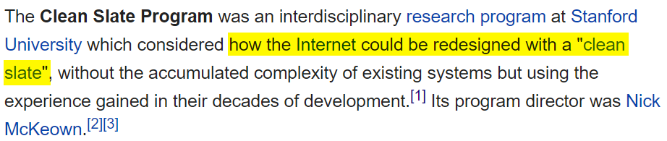
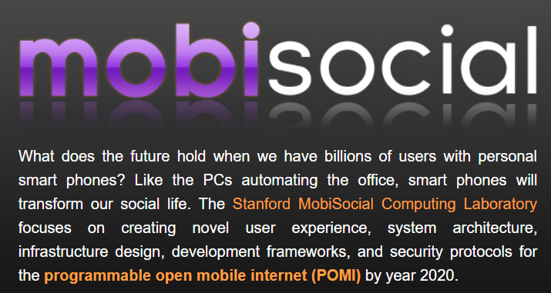
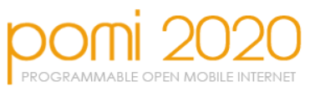
The Future?
http://pomi.stanford.edu/content.php?page=research
Notes:
When writing this presentation, there were three potential subtopics to address:
The mobile landscape: advantages and disadvantages
What the clean slate redesign meant
How did abandoning legacy help?
How does the new interface help/hurt?
“Clean slate redesign” lead me to only hearing about the Clean Slate Program from Stanford University, and how internet infrastructure was going to be redesigned to evolve for a mobile landscape. That’s different from the DARPA program CRASH (https://www.darpa.mil/program/clean-slate-design-of-resilient-adaptive-secure-hosts), which had talk about making systems more resilient to attacks. The mobile landscape was meant to talk about the DARPA initiative more than the Stanford one, but both had goals in mind to better improve infrastructure for these mobile hosts.
Legacy / new interface would probably come from comparing these new architectures, but I wanted to have more time dedicated to showing what reversing Android code was like.
---
All in all, this presentation is really all over the place, in trying to cover a lot while not having a cohesive point. Architectural redesign and reversing would probably have to be separate weeks, but I believe that there’s a lot of knowledge that can be learned if time is taken to split the two, with examples to demonstrate both concepts. I know Yanick plans to have different kinds of challenges too (App development, exploitation), but that was not released during the time of the presentation. Hopefully, they have, so that you can have more inspiration for teaching this topic. All I can say is, best of luck!

